Slide 1
INTRODUCTION TO DATA NORMALISATION
It is possible that the data structure resulting from the ERD data model and its mapping is correct.
However it should be checked according to certain principles.
Normalisation is the process by which you determine the best way to form tables and relationships.

Slide 2
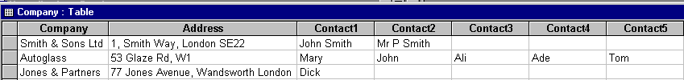
Poor Data Structure – Example 1
Address not split into components - how to search postcodes?
Limited number of contacts can be stored - what if more wanted?
[Repeating items]
Format of Contact data different
Lots of empty [null] data
No identifying primary key

Slide 3
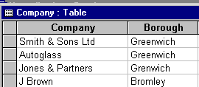
Poor Data Structure – Example 2
Notice the error
Another form of ‘repeating items’ demonstrated in the Borough field.

Slide 4
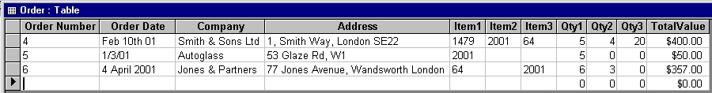
Poor Data Structure – Example 3
Duplication of data already in Company table
Order date in wrong data format [text]
Item and Qty are repeating items
Problem with sequencing items in Order Number 6
TotalValue could be calculated [derived] from other data

Slide 5
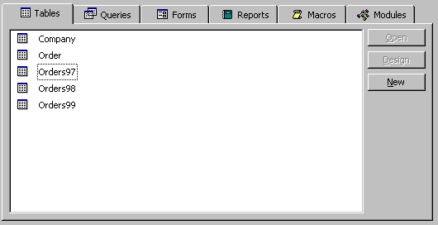
Poor Data Structure – Example 4
Data separated into different tables with the same structure
How would you get statistics on all orders?

Slide 6
Normalisation ‘Rules of Thumb’
Put key data (data which exists regardless of other data) in separate tables
Make records uniquely identifiable
Use look-up tables (to prevent entry errors)
Keep all fields in a table in a 1:1 relationship to one another (no repeating items within a record)
Hold each data item in only one place (no duplication across tables)
Make all fields in a table depend on the key

Slide 7
Normalisation ‘Rule of Thumb 1’
Put key data (data which exists regardless of other data) in separate tables
Company
Item
This data will exist regardless of whether there are any Orders or Contacts

Slide 8
Normalisation ‘Rule of Thumb 2’
Make records uniquely identifiable
Unique Primary Keys
Company
Company_Id

Slide 9
Normalisation ‘Rule of Thumb 3’
Use look-up tables (to prevent entry errors)
Borough
Data Entry through a combo box

Slide 10
Normalisation ‘Rule of Thumb 4’
Keep all fields in a table in a 1:1 relationship to one another (no repeating items within a table)
Company
Company_Id
Company Name
Address1
Address2
Address3
Postcode

Slide 11
Normalisation ‘Rule of Thumb 5’
Hold data item in only one place (no duplication across tables)
Set Relationships between tables
Contact
M
1
Company

Slide 12
Normalisation ‘Rule of Thumb 6’
Make all fields in a table depend on the key
Company
Company_Id
Company Name
Address1
Address2
Address3
Postcode
Each of the fields can only have one value, dependant on the Company_Id.

Slide 13
Contact
Name
M
Date
Number
Quantity
Name
1
1
M
1
M
Company
Order
OrderItems
Address
M
M
1
1
Borough
Item
Items
Borough
The complete data structure

