Slide 1
WORKFLOW

Slide 2
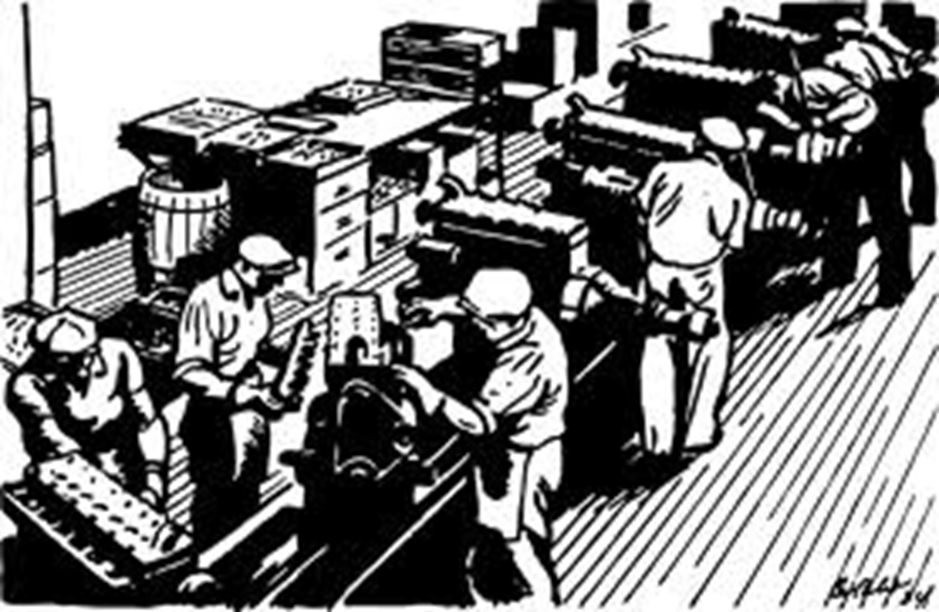
WORKFLOW

Slide 3
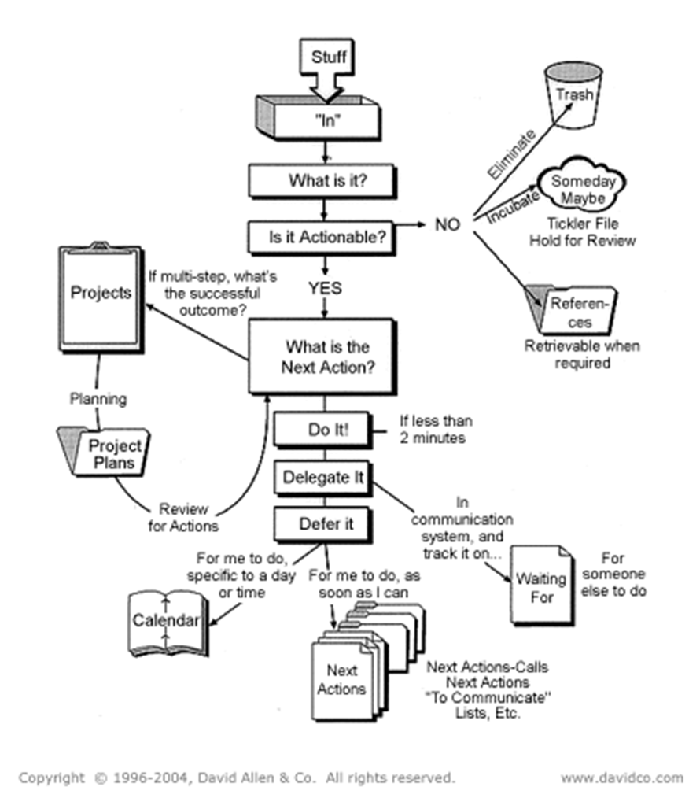
FLOW CHARTS

Slide 4
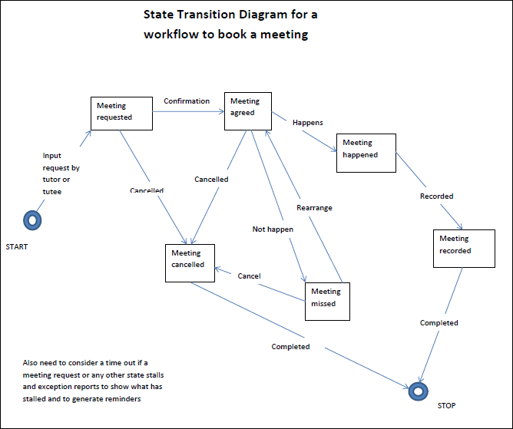

Slide 5
THE OFFICE ANALOGY
The workflow process is traditionally defined in office terms - moving the paper, processing the order, issuing the invoice.
But the same principles and tools apply to
  filling the order from the warehouse
  assembling documents, parts, tools, and people to repair a complex system
  manufacturing a complex device.

Slide 6
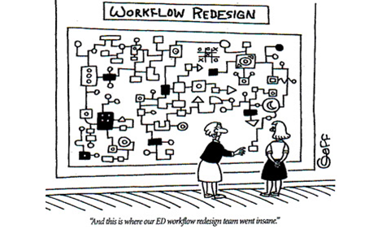
UNDERSTANDING WORKFLOW IS HARD

Slide 7
MONITORING
Reporting tools give
  the total work accomplished, the turn-around time, etc.
  the productivity of the individuals, teams, and groups.
  the number and types of errors that are caught and corrected for each type of process and user.
Exception reports
  Backlog of work throughout the day can be used to schedule staff as required, adjust assignments if necessary to meet deadlines, and in general, manage teams.
  Alarms can highlight problems - for example, "notify me if the total number of items to be processed is greater than 450."

Slide 8
CONTROL
Control can be
  Manually done by supervisors from a dashboard
  Automated using a customized workflow system optimised for the application, at the expense of flexibility for "instant" changes.
In either case
  User profiles - qualifications, experience, training, etc. are stored in the system and used when tasks are assigned.
  Managers need to be able to manually assign work to an individual - perhaps because they made an error and need to fix it, or perhaps because it is a special case that they are uniquely qualified to fix.
  Priorities must be adjusted to move critical work to the head of the list.

Slide 9
SUMMARY
Automated workflow has advantages and disadvantages
Big data and analytics are now being used in Workflow Management Systems

