Slide 1
TEAM 1 – SUPERVET
Duc Vo
Jou Ho
Khanh le
Sam farmer

Slide 2
Problem statement
A poor vet clinic database system:
Slow system
Manual booking
Disparate database
-> Out-of-date information, missed appointments, and wasted staff time
An improved database system:
-> Clients are more active in scheduling
-> Staff can focus on taking care of pets
-> Decrease business costs while improving customer experience
Vets would be able to access pet information, customer information, pet health records, prescriptions, prescription products. Employees would be able to access vet information, customer information, purchases, prescription product price and availabilities. Customers can view their information, their pet information, their appointments, prescriptions, purchases, etc. Admin can view information regarding all users but with limited access to personal information.

Slide 3
Mission statement
To make the tasks of database management easier for a vet clinic so that communications between the clinic (doctors and employees) and customers are transparent and customer needs are delivered efficiently
Our application will return user-requested details relating to vets, employees, customers, products, and prescriptions such as appointment information, health records, revenue of the clinic, etc.

Slide 4
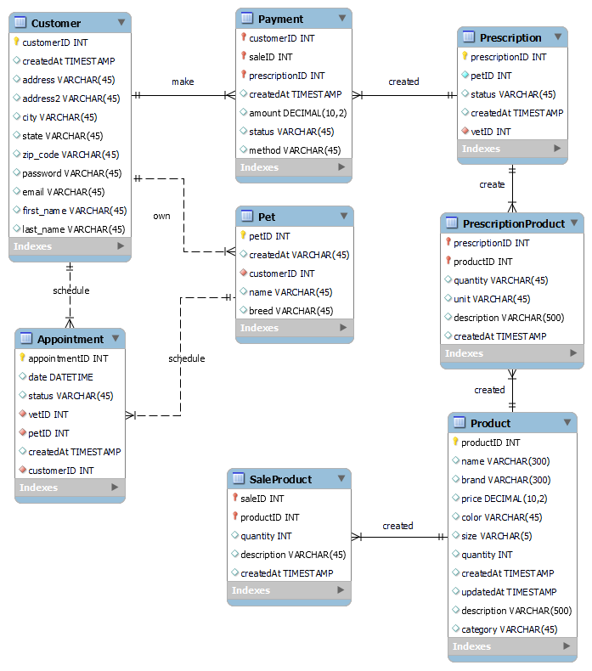
External model: Customer View
Notes:
Customer View:
Able to:
Sign up with personal info
Make appointment with a vet
Register their pets
Make payment

Slide 5
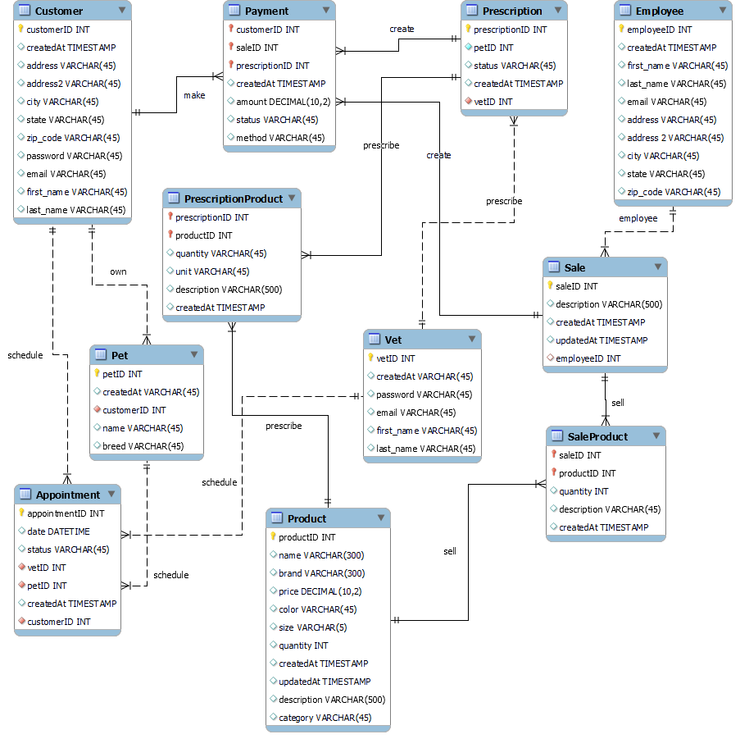
External model: Vet/Employee View
Notes:
Vet/Employe View:
Vets are able to:
Sign up with personal info
Confirm appointment with customer
Prescribe products to pets
Employees are able to:
Sign up
Sell non-pharmaceutical products to customers

Slide 6
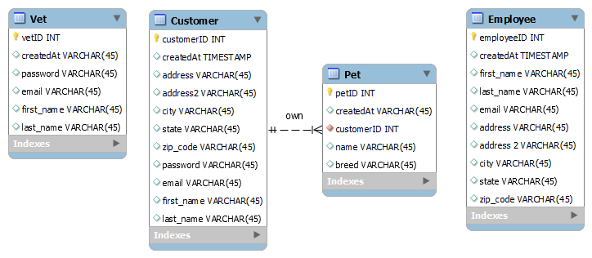
External model: Admin View
Notes:
Admin view provides information regarding all users but with limited access to personal information

Slide 7
Logical model with MySQL

Slide 8
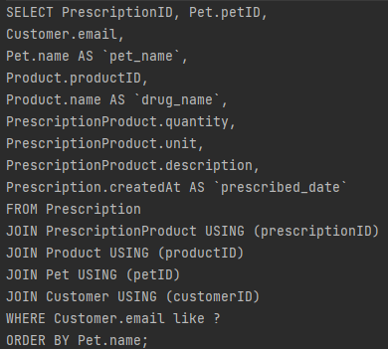
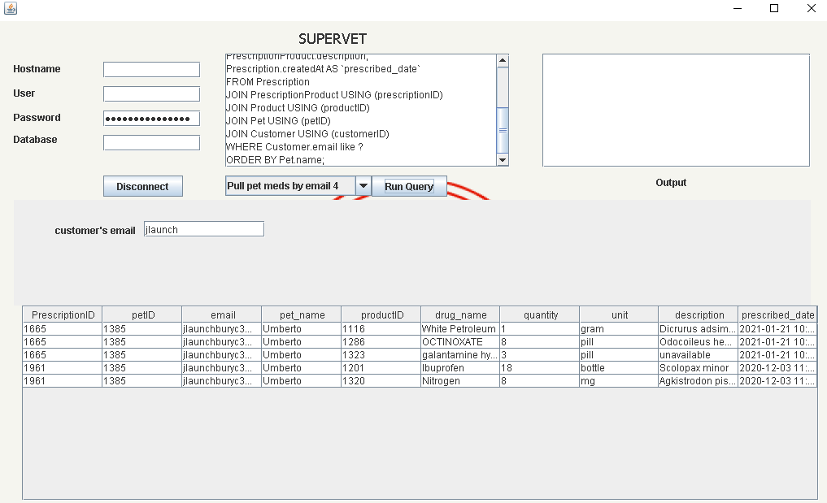
Display customer prescription information
Notes:
Email to feed: dbevanslp@feedburner.com

Slide 9
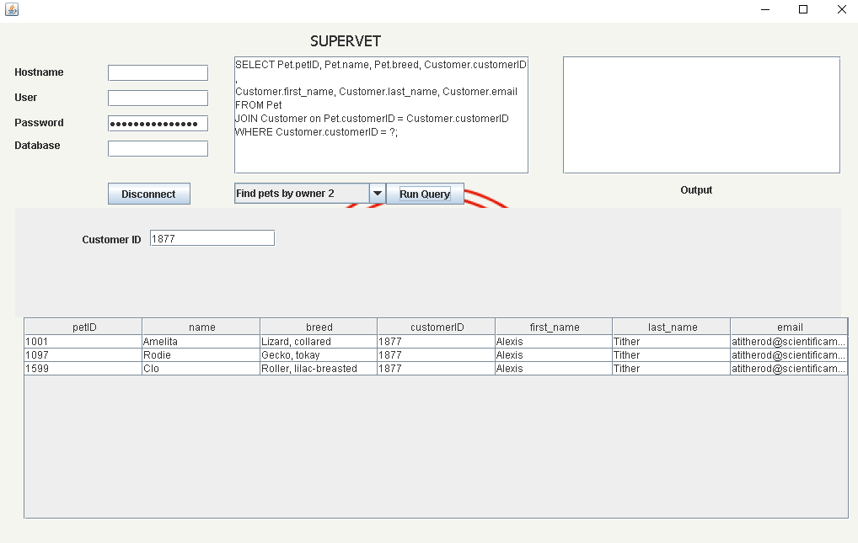
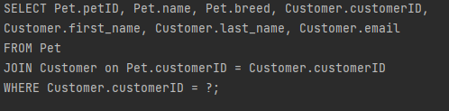
Finding pet by owner
Notes:
1877

Slide 10

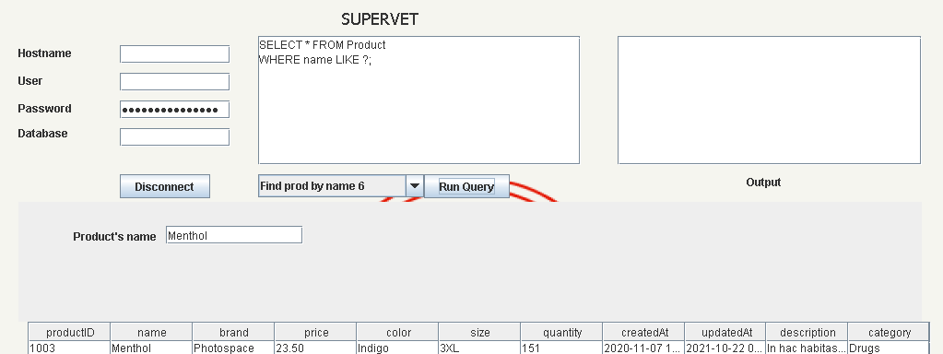
Update product price
QUERY->
Original
Price ->
Notes:
Price = 999.99
productID = 1003

Slide 11
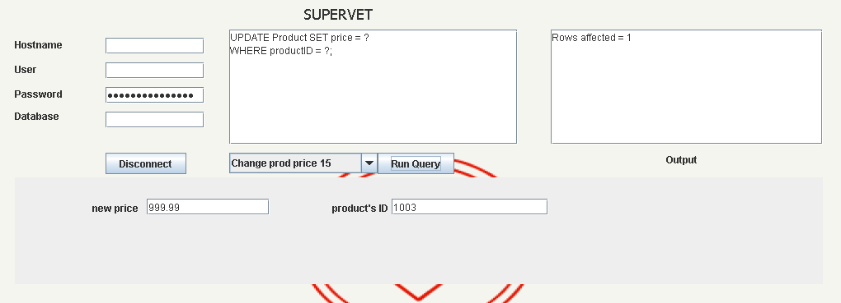
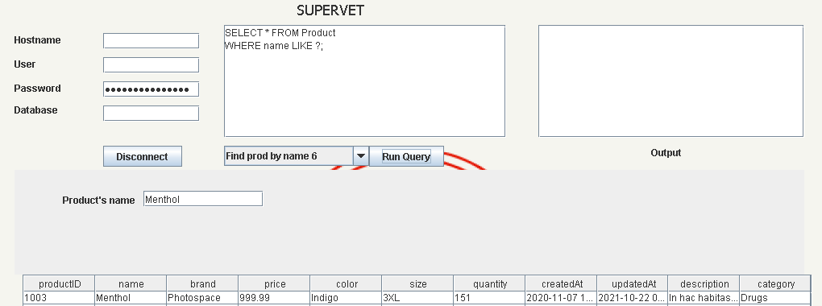
Update price cont.
Update
Price ->
New
Price ->

Slide 12
Demonstration

