Slide 1
DISCRETE MATHEMATICS
GRAPHS

Slide 2
TOPICS
Graphs and Graph Models
Graph Terminology
Special Types of Graphs
Representing Graphs
Connectivity
Euler and Hamilton Paths
Shortest-Path Problems
Notes:
Last week: using graph represent relations
Project planning: Network analysis like CPM
finding the shortest path between two cities in a transportation network

Slide 3
TOPICS
Graphs and Graph Models
Graph Terminology
Special Types of Graphs
Representing Graphs
Connectivity
Euler and Hamilton Paths
Shortest-Path Problems

Slide 4
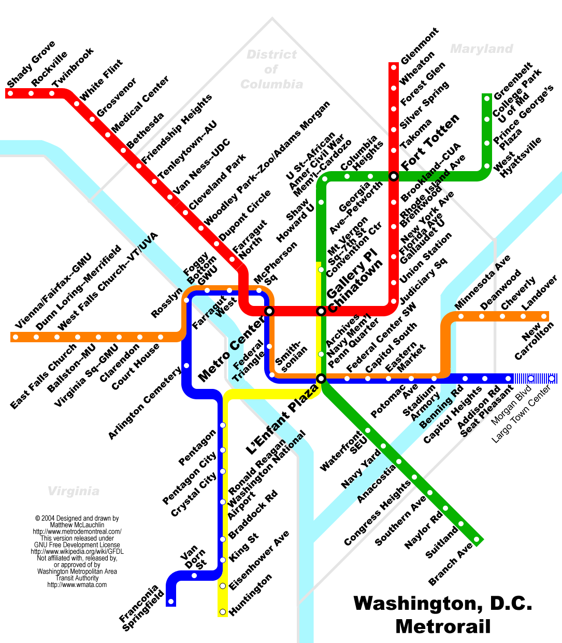

Definition
A graph G = (V,E) consists of V, a nonempty set of vertices (or nodes) and E, a set of edges.
Each edge has either one or two vertices associated with it, called its endpoints. An edge is said to connect its endpoints.
A graph with an infinite vertex set or an infinite number of edges is called an infinite graph
A graph with a finite vertex set and a finite edge set is called a finite graph
Notes:
Airline connections
Metro/bus maps
Computer networks

Slide 5
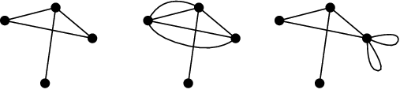
Graph classification
Undirected graph: edges has no direction
Simple graph: no multiple edges, no loops
Multigraph: multiple edges, no loops
Pseudograph: multiple edges, loops
simple graph
multigraph
pseudograph

Slide 6
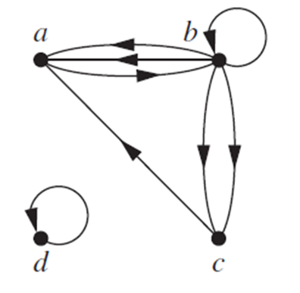
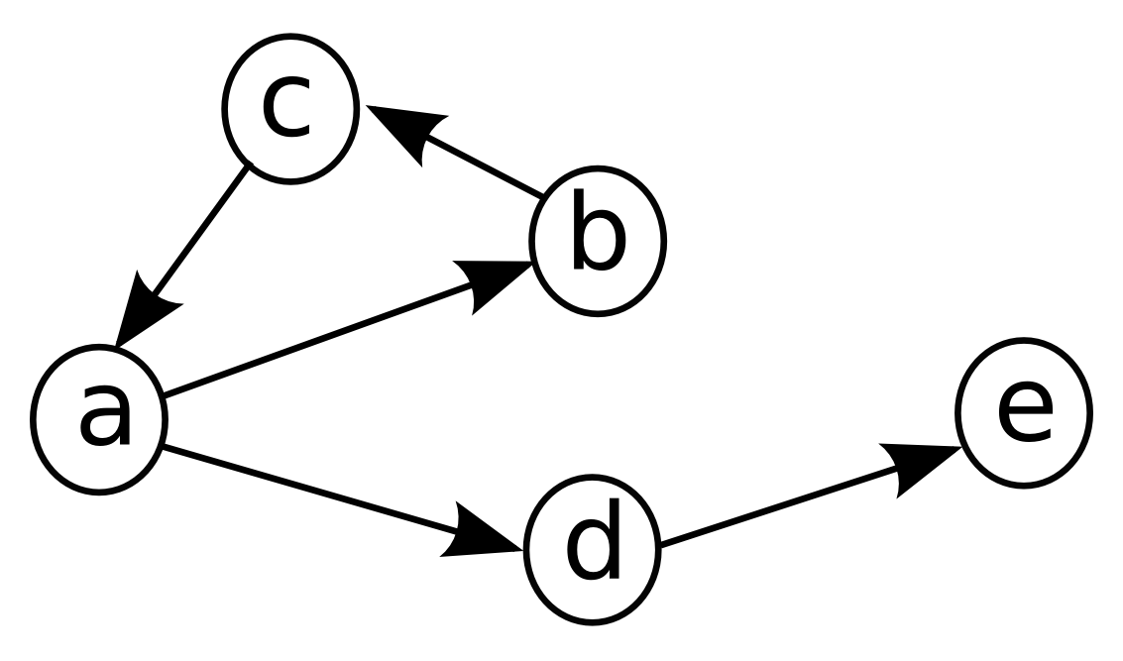
Graph classification
Directed graph: edges have direction between endpoints
Simple directed graph (digraph): no multiple edges, no loops
Directed multigraph: multiple edges, loops
Mixed graph: both undirected & directed
simple directed graph
directed multigraph

Slide 7
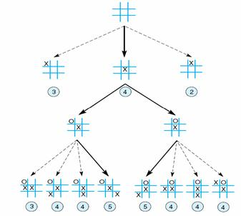
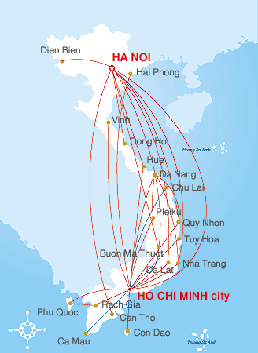
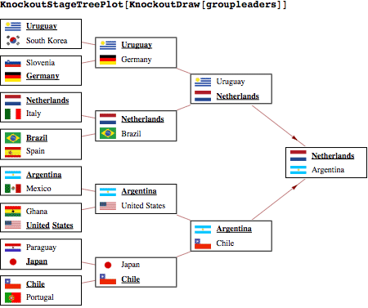
Graph models
Using graph as a model
Social network
Collaboration graphs
Web graph
State space (in AI)
Airline route
Football tournament
…

Slide 8
TOPICS
Graphs and Graph Models
Graph Terminology
Special Types of Graphs
Representing Graphs
Connectivity
Euler and Hamilton Paths
Shortest-Path Problems

Slide 9
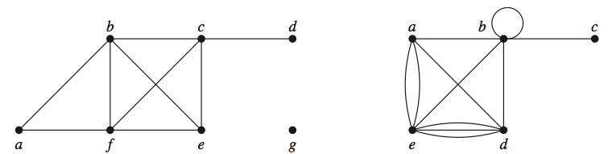
Basic terminologies for undirected graph
If G is undirected, two vertices u and v are called adjacent if they are endpoints of an edge e, and e is called incident with u and v.
The degree of a vertex in an undirected graph is the number of edges incident with it (a loop at a vertex contributes twice)
A vertex of degree zero is called isolated. A vertex of degree one is called pendant.
g is isolated
c is pendant
deg(a) = 4
deg(b) = 6
Notes:
Hinh 2: deg(b) = 6

Slide 10
The Handshaking theorem for undirected graph
Let G = (V , E) be an undirected graph with m edges. Then
An undirected graph has an even number of vertices of odd degree.
Example: Can we have a simple graph with 5 vertices of degrees: 1, 2, 3, 3, 4?
Notes:
Proof: Each edge contributes two to the sum of the degrees of the vertices because an edge is incident with exactly two (possibly equal) vertices. This means that the sum of the degrees of the vertices is twice the number of edges.
Proof: Let V1 and V2 be the set of vertices of even degree and the set of vertices of odd degree, respectively. Because deg(v) is even for v ∈ V1, the first term in the right-hand side of the last equality is even. Furthermore, the sum of the two terms on the right-hand side of the last equality is even, because this sum is 2m. Hence, the second term in the sum is also even. Because all the terms in this sum are odd, there must be an even number of such terms. Thus, there are an even number of vertices of odd degree.

Slide 11
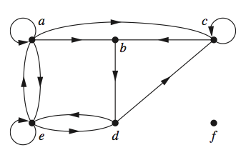
Basic terminologies for directed graph
If e = (u,v) is an edge of a directed graph, u is said to be adjacent to v and v is adjacent from u. The vertex u is called the initial and v is called the terminal or end vertex of e.
The in-degree of a vertex v in a directed graph, denoted by deg⁻(v), is the number of edges with v as their terminal vertex. The out-degree of u, denoted by deg⁺(v), is the number of edges with v as their initial vertex.
a is adjacent to c
d is adjancent from b
deg⁻(c) = 3
deg⁺(c) = 2
deg⁻(f) = deg⁺(f) = 0

Slide 12
The Handshaking theorem for directed graph
Let G = (V , E) be a graph with directed edges. Then
Notes:
Because each edge has an initial vertex and a terminal vertex, the sum of the in-degrees and the sum of the out-degrees of all vertices in a graph with directed edges are the same. Both of these sums are the number of edges in the graph

Slide 13
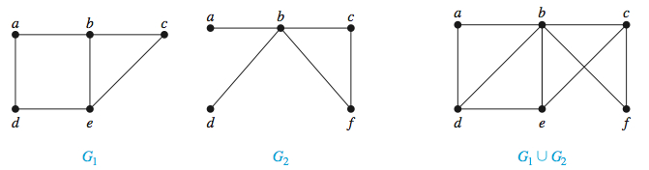
Graph Union
The union of 2 graphs G and H is a new graph whose vertex set consists of vertices of G and H, and whose edge set consists of edges of G and H

Slide 14
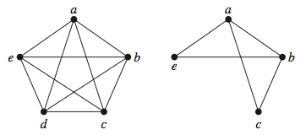
Subgraph
A subgraph of a graph G = (V,E) is a graph H = (W,F), where W ⊆ V and F ⊆ E. A subgraph H of G is a proper subgraph of G if H ≠ G.

Slide 15
TOPICS
Graphs and Graph Models
Graph Terminology
Special Types of Graphs
Representing Graphs
Connectivity
Euler and Hamilton Paths
Shortest-Path Problems
Notes:
Last week: using graph represent relations
Project planning: Network analysis like CPM
finding the shortest path between two cities in a transportation network

Slide 16
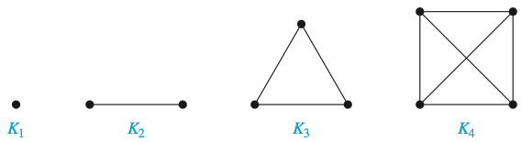
Complete graph
A complete graph on n vertices, denoted by K_{n}, is a simple graph that contains exactly one edge between each pair of distinct vertices.
Notes:
|Kn| = n(n-1) / 2

Slide 17
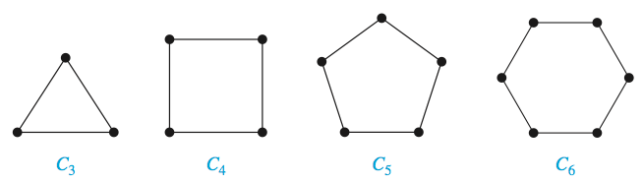
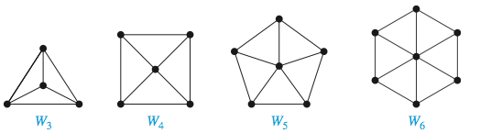
Cycle graph & Wheel graph
A cycle C_{n}, n ≥ 3, consists of n vertices v₁, v₂, . . . , v_{n} and edges {v₁, v₂}, {v₂, v₃}, . . . , {v_{n−1}, v_{n}}, and {v_{n}, v₁}.
We obtain a wheel W_{n} when we add an additional vertex to a cycle C_{n}, for n ≥ 3, and connect this new vertex to each of the n vertices in C_{n}, by new edges.
Notes:
|Cn| = n
|Wn| = 2n

Slide 18
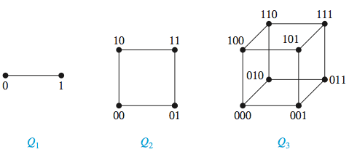
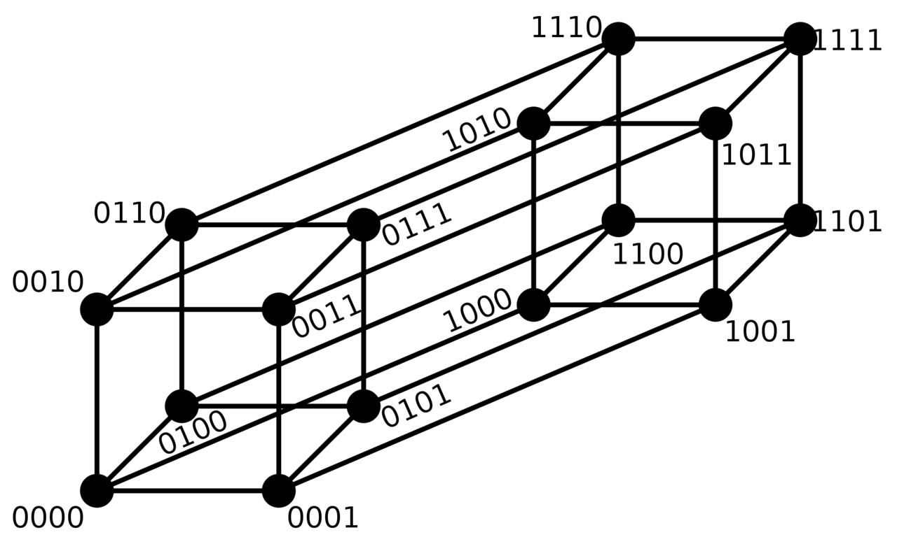
n-cube graph
An n-dimensional hypercube, or n-cube, denoted by Q_{n}, is a graph that has vertices representing the bit strings of length n. Two vertices are adjacent if and only if the bit strings that they represent differ in exactly one bit position.
Q₄
Notes:
|Qn| = nx2^{n-1}
sdf

Slide 19
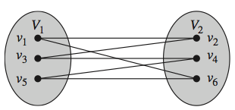
Bipartite graph
A simple graph G is called bipartite if the vertex set can be divided in two disjoint subsets such that each edge connects one vertex from one of these two subsets to another vertex of the other subset.
Notes:
Graph G is bipartite because its vertex set is the union of two disjoint sets, {a, b, d} and {c, e, f, g}
Graph H is not bipartite because its contains triangles (a, b, f)

Slide 20
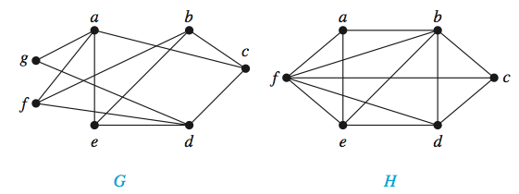
Bipartite graph
A simple graph G is called bipartite if the vertex set can be divided in two disjoint subsets such that each edge connects one vertex from one of these two subsets to another vertex of the other subset.
Notes:
Graph G is bipartite because its vertex set is the union of two disjoint sets, {a, b, d} and {c, e, f, g}
Graph H is not bipartite because its contains triangles (a, b, f)

Slide 21
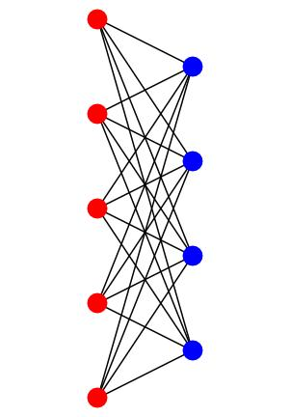

Bipartite graph
A simple graph is bipartite if and only if it is possible to assign 1 of 2 different colors to each vertex of the graph so that no two adjacent vertices are assigned the same color.
A complete bipartite graph Km,n is a graph that has its vertex set partitioned into two subsets of m and n vertices, respectively with an edge between two vertices if and only if one vertex is in the first subset and the other vertex is in the second subset.
K_{3,5}
Notes:
Which graphs Kn,Cn,Wn,Qn are bipartite?
In 2009 Netflix gave a $1Million prize to the group that was best able to predict how much someone would enjoy a movie based on their preferences. This can be viewed, and in the submissions often was, as a bipartite graph problem. The viewers are the vertices U and the movies the vertices V and there is an edge from u to v if u viewed v.

Slide 22
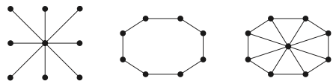
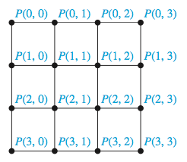
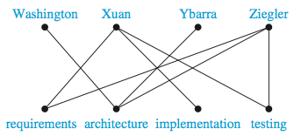
Applications of special types of graph
Network topologies
Network interconnection in parallel computing
Matching problems

Slide 23
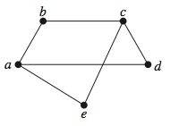
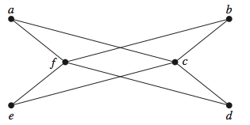
Exercises
Which of these graphs is bipartite?
Draw these graphs.
K₇
K_{1,8}
K_{4,4}
C₇
W₇

Slide 24
TOPICS
Graphs and Graph Models
Graph Terminology
Special Types of Graphs
Representing Graphs
Connectivity
Euler and Hamilton Paths
Shortest-Path Problems

Slide 25
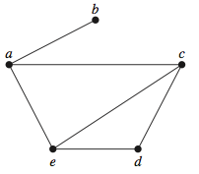
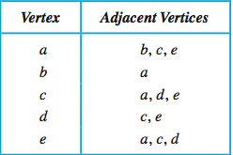
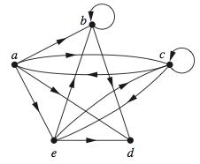
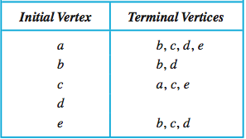
Using adjacency list
Specify vertices that are adjacent to each vertex of the graph
Example:

Slide 26
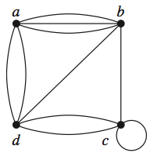
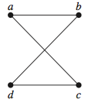
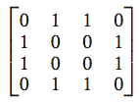
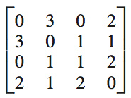
Using adjacency matrix
Let G be a pseudograph with vertices v₁, v₂, . . . , v_{n}. We can represent G by a square matrix [a_{ij} ] of order n, whose entries are determined as follows: a_{ij} = the number of edges in G connecting v_{i} and v_{j}
Notes:
n! matrices
symmetric
----- Meeting Notes (11/12/14 19:34) -----
Câu hỏi thi: Cho đồ thị vô hướng, vẽ các ma trận không đối xứng, có 1 đáp án đối xứng

Slide 27
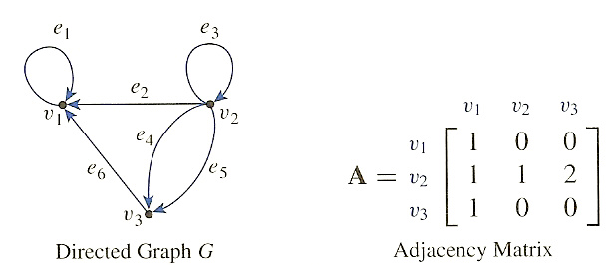
Using adjacency matrix
Let G be a directed graph with vertices v₁, v₂, . . . , v_{n}. We can represent G by a square matrix [a_{ij}] of order n, whose entries are determined as follows: a_{ij} = the number of edges in G whose initial vertex is v_{i} and whose end vertex is v_{j}
Notes:
n! matrices
not symmetric

Slide 28
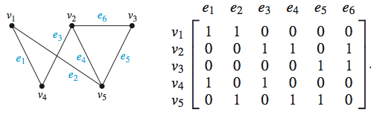
Using incidence matrix
Let G be a pseudograph with vertices v₁, v₂, . . . , v_{n} and edges e₁, e₂, . . . , e_{m}. We can represent G by an incident matrix [a_{ij}] of size n × m, whose entries are determined as follows:
a_{ij} =1 if e_{j} is incident to v_{i},
and a_{ij} = 0 otherwise.

Slide 29
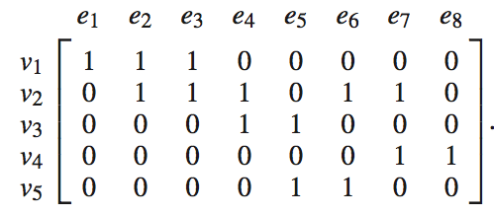
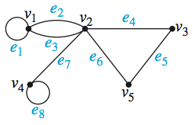
Using incidence matrix
Multiple edges: two identical columns
Loop: exactly one entry is 1

Slide 30

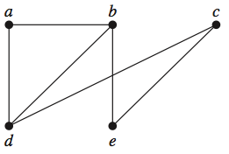
Exercises
Use adjacency list, adjacency matrix and incidence matrix to represent the given graph
Draw an undirected graph with the given adjacency matrix then represent it again by adjacency list and incidence matrix
Notes:
----- Meeting Notes (5/14/15 21:10) -----
Câu hỏi thi: When representing graph by incidence matrix, Which is true:
A row that all values is 0
A column that all values is 0
A column that has 3 number 1
None of them

Slide 31
TOPICS
Graphs and Graph Models
Graph Terminology
Special Types of Graphs
Representing Graphs
Connectivity
Euler and Hamilton Paths
Shortest-Path Problems
Notes:
Last week: using graph represent relations
Project planning: Network analysis like CPM
finding the shortest path between two cities in a transportation network

Slide 32
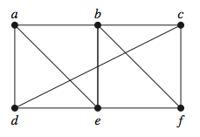
Path
Let G be an undirected graph. A path of length n from u to v is a sequence of edges e₀ = x₀x₁, e₁ = x₁x₂, ..., e_{n} = x_{n−1}x_{n}, where x₀ = u, x_{n} = v.
If u = v and n > 0, a path is called a circuit
A path / circuit is called simple if it doesn’t contain the same edge more than once.
Same definition for directed graph
Path of length 4: a, b, e, f, c
Not a path: a, d, c, e
Circuit of length 4: b, c, d, e, b
Not a simple path: a, b, f, c, d, a, b, f
Notes:
Chú ý với graph có loops
Example: Acquaintanceship Graphs : Photocopie girl (Chloe) -> Her colleague (Isaac)-> Phoebe friends’ (jasmine?) -> Jasmine’s roommates -> Gunther -> Rachel
Always think about the trail
path = walk
circuit = closed walk
simple path = trail

Slide 33
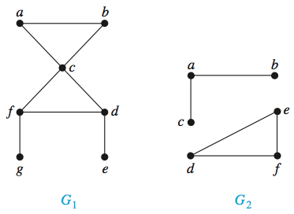
Connectedness in undirected graph
An undirected graph is connected if there is a path between any pair of distinct vertices.
An undirected graph that is not connected is called disconnected
G₁ is connected
G₂ is disconnected

Slide 34
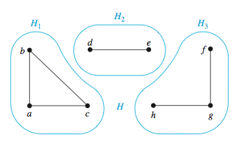
Connectedness in undirected graph
A connected component of an undirected graph is a maximal subgraph that is connected.
A cut vertex, or an articulation point, is a vertex that if we remove it and all the edges incident with it we will obtain a subgraph having more connected components than the original graph

Slide 35
Connectedness in undirected graph
A subset V’ of the vertex set V of G = (V, E) is a vertex cut, or separating set, if G − V’ is disconnected.
Vertex connectivity of a graph G, denoted by κ(G), is the minimum number of vertices in a vertex cut.
0 ≤ κ(G) ≤ n − 1
A graph is k-connected (or k-vertex-connected), if κ(G) ≥ k
a
e
c
d
vertex cut examples: {c}, {d, e}
κ(G) = 1
G is 1-connected
b
f
Notes:
Khi nào thì k(G) = 0? Khi nào thì k(G) = n – 1
Κ κ kappa /'kæpə/
Λ λ lambda /'læmdə/

Slide 36
Connectedness in undirected graph
A cut edge, or a bridge, is an edge that if we remove it we will obtain a subgraph having more connected components than the original graph
A set of edges E’ is called an edge cut of G if the subgraph G − E’ is disconnected
The edge connectivity of a graph G, denoted by λ(G), is the minimum number of edges in an edge cut of G
0 ≤ λ(G) ≤ n − 1
a
e
cut edge example: cd
edge cut examples: {cd}, {ac, bc}
λ(G) = 1
c
d
b
f
Notes:
Is there a graph without cut edge?
Κ κ kappa /'kæpə/
Λ λ lambda /'læmdə/

Slide 37
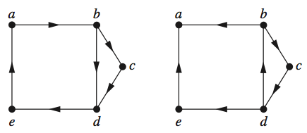
Connectedness in directed graph
A directed graph is strongly connected if for all pairs of vertices u and v there is a path from u to v and vice versa.
A directed graph is weakly connected if there is a path between every two vertices in the underlying undirected graph.
A strongly connected component of a directed graph G is a maximal subgraph of G that is strongly connected.
strongly
connected
weakly
connected

Slide 38
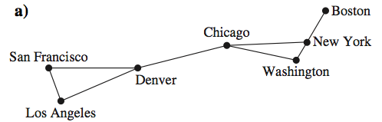
Exercises
Find some cut vertices, vertex cuts, cut edges, edge cuts. Then what is κ(G) andλ(G)?
Notes:
Κ κ kappa /'kæpə/
Λ λ lambda /'læmdə/

Slide 39
TOPICS
Graphs and Graph Models
Graph Terminology
Special Types of Graphs
Representing Graphs
Connectivity
Euler and Hamilton Paths
Shortest-Path Problems
Notes:
Last week: using graph represent relations
Project planning: Network analysis like CPM
finding the shortest path between two cities in a transportation network

Slide 40
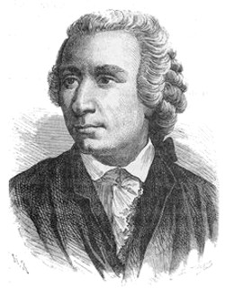
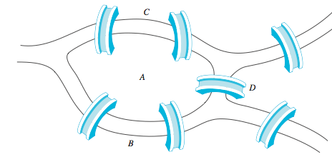
Euler problem
Is this possible to start at some location, travel across all bridges without crossing any bridge twice, then return to the starting point?

Slide 41
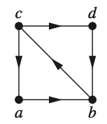
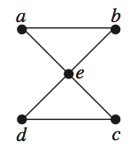
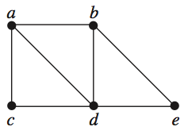
Definitions
A simple circuit containing all edges of a graph is called Euler circuit.
A simple path containing all edges of a graph is called Euler path.
Euler circuit: a, e, c, d, e, b, a
Euler path: a, c, d, e, b, d, a, b
Euler path or circuit?
Notes:
c, a, b, c, d, b
Are there conditions for existence of euler path / circuit?

Slide 42
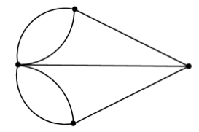
Conditions for existence of Euler path and circuit
A connected multigraph G has Euler circuits if and only if every vertex has even degree.
If G does not have Euler circuits, then it has Euler paths if and only if it has exactly two vertices of odd degrees
C
7 bridges as
a graph
A
D
B
Notes:
Answer is no
Euler paths and circuits can be used to solve many practical problems. For example, many applications ask for a path or circuit that traverses each street in a neighborhood, each road in a transportation network

Slide 43
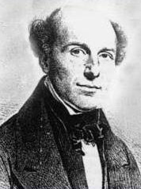
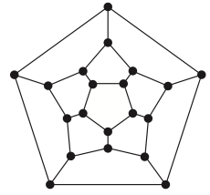
Hamilton problem
Given a map of cities where two cities are connected if we can travel between them. Start at one city, can we travel all the cities, visiting each city exactly once the back to the first city?

Slide 44

Definitions
A simple path that passes through all vertices exactly once is called Hamilton path.
A simple circuit that passes through all vertices exactly once is called Hamilton circuit.
Hamilton circuit:
a, b, c, d, e, a
Hamilton path:
a, b, c, d
Notes:
Is there a simple way to determine whether a graph has a Hamilton circuit or path? At first, it might seem that there should be an easy way to determine this, because there is a simple way to answer the similar question of whether a graph has an Euler circuit. Surprisingly, there are no known simple necessary and sufficient criteria for the existence of Hamilton circuits.

Slide 45


Conditions for existence of Hamilton path and circuit
A graph with a vertex of degree one cannot have a Hamilton circuit
Dirac’s theorem: If G is a simple graph with n vertices with n ≥ 3 such that the degree of every vertex in G is at least n/2, then G has a Hamilton circuit.
Ore’s theorem: If G is a simple graph with n vertices with n ≥ 3 such that deg(u) + deg(v) ≥ n for every pair of nonadjacent vertices u and v in G, then G has a Hamilton circuit.

Slide 46



Exercises
Determine whether the following graphs has an Euler circuit or path? If yes, construct these circuits / paths
Notes:
Can someone cross all the bridges shown in this map ex- actly once and return to the starting point?

Slide 47



Exercises
Determine whether the given graph has a Hamilton circuit / path?

Slide 48
TOPICS
Graphs and Graph Models
Graph Terminology
Special Types of Graphs
Representing Graphs
Connectivity
Euler and Hamilton Paths
Shortest-Path Problems

Slide 49

Weighted graph
A graph that has a number assigned to each edge is called a weighted graph. The length of a path in a weighted graph is the sum of all weights of the edges of this path.
Notes:
Find the path of shortest length between two vertices in a weighted graph.

Slide 50

Dijkstra’s Algorithm
Let G be a weighted graph. To find the shortest path between A and Z in G:
Finds the length of the shortest path from A to the first vertex.
Finds the length of the shortest path from A to the second vertex.
Finds the length of the shortest path from A to the third vertex.
...
Continue the process until Z is reached.

Slide 51
Dijkstra’s Algorithm
procedure Dijkstra(G: weighted connected simple graph, with all weights positive)
{G has vertices a = v₀,v₁,...,v_{n} = z and lengths w(v_{i},v_{j}) where w(v_{i},v_{j}) = ∞ if {v_{i},v_{j}} is not an edge in G}
for i := 1 to n L(v_{i} ) := ∞
L(a) := 0 C := ∅ {the labels are now initialized so that the label of a is 0 and all
other labels are ∞, and C is the empty set}
while z ∈ C
u := a vertex not in C with L(u) minimal
C := C ∪ {u} for all vertices v not in C
if L(u) + w(u, v) < L(v) then L(v) := L(u) + w(u, v)
{this adds a vertex to C with minimal label and updates the labels of vertices not in C}
return L(z) {L(z) = length of a shortest path from a to z}

Slide 52
Dijkstra’s Algorithm
Example: find shortest-path from vertex 1 to other vertices
2
24
3
9
1
18
14
6
6
2
30
4
19
5
11
15
5
6
20
16
7
8
44

Slide 53
Dijkstra’s Algorithm
Initiate all distance from (1) to others = infinity
∞
∞
2
24
3
0
9
1
∞
18
14
6
6
2
∞
30
∞
4
19
5
11
15
5
6
20
16
7
8
44
∞
∞

Slide 54
Dijkstra’s Algorithm
(0) is confirmed, put (0) into C
∞
∞
2
24
3
0
9
1
∞
18
14
6
6
2
∞
C
30
∞
4
19
5
11
15
5
6
20
16
7
8
44
∞
∞

Slide 55
Dijkstra’s Algorithm
Update distance from (0) to (2), (6) and (7)
9
∞
2
24
3
0
9
1
14
18
14
6
6
2
∞
30
∞
4
19
5
11
15
5
6
20
16
7
8
44
∞
15

Slide 56
Dijkstra’s Algorithm
(2) is confirmed, update distances for adjacent vertices of (2)
9
33
2
24
3
0
9
1
14
18
14
6
6
2
∞
30
∞
4
19
5
11
15
5
6
20
16
7
8
44
∞
15

Slide 57
Dijkstra’s Algorithm
(6) is confirmed, update distances for adjacent vertices of (6)
9
32
2
24
3
0
9
1
14
18
14
6
6
2
∞
30
44
4
19
5
11
15
5
6
20
16
7
8
44
∞
15

Slide 58
Dijkstra’s Algorithm
(7) is confirmed, update distances for adjacent vertices of (7)
9
32
2
24
3
0
9
1
14
18
14
6
6
2
∞
30
35
4
19
5
11
15
5
6
20
16
7
8
44
59
15

Slide 59
Dijkstra’s Algorithm
(3) is confirmed, update distances for adjacent vertices of (3)
9
32
2
24
3
0
9
1
14
18
14
6
6
2
∞
30
34
4
19
5
11
15
5
6
20
16
7
8
44
51
15

Slide 60
Dijkstra’s Algorithm
(5) is confirmed, update distances for adjacent vertices of (5)
9
32
2
24
3
0
9
1
14
18
14
6
6
2
45
30
34
4
19
5
11
15
5
6
20
16
7
8
44
50
15

Slide 61
Dijkstra’s Algorithm
(4) is confirmed, update distances for adjacent vertices of (4)
9
32
2
24
3
0
9
1
14
18
14
6
6
2
45
30
34
4
19
5
11
15
5
6
20
16
7
8
44
50
15

Slide 62
Dijkstra’s Algorithm
(8) is confirmed, all shortest distance from (1) are calculated
9
32
2
24
3
0
9
1
14
18
14
6
6
2
45
30
34
4
19
5
11
15
5
6
20
16
7
8
44
50
15

Slide 63


Exercises
Find the length of a shortest path between a and z
Find the length of a shortest path between a and g, b and z

Slide 64
Graph traversal: BFS
Problem: How to travel all vertices of a connected component of a graph?
Breadth-First-Search: Start at one vertex, visit all of its ‘neighbors’, then for each neighbor, recursively do the same process.
BFS can be implemented by:
Queue

Slide 65
BFS using queue
BFS(Graph G, start)
{
all vertices of G are first painted white
start vertex is painted grey and put in a queue
while the queue is not empty
{
a vertex u is removed from the queue
for all white successors v of u
{
v is painted grey
v is added to the queue
}
u is painted black
}
}

Slide 66
BFS using queue
1
0
6
4
2
3
5
0
1
2
3
5
6
4

Slide 67
Graph traversal: DFS
Problem: How to travel all vertices of a connected component of a graph?
Depth-First-Search: start at one vertex, visit one of its ‘neighbors’. Then from this neighbor, recursively reach to as deep as possible other vertices through the graph. When all neighbors of a vertex are visited, go back to previous vertex and do it again.
DFS can be implemented by:
Recursion
Stack

Slide 68
DFS using Stack
DFS(Graph G, start)
{
all vertices of G are first painted white
paint start grey then push start into stack
while stack is not empty
{
a vertex u is popped out from the stack
visit u and painted u black
for all white successors v of u
{
paint v grey
push v into stack
}
}
}

Slide 69
DFS using stack
1
0
6
4
2
3
5
4
5
2
6
3
3
3
3
0
1
1
1
1
1
1
1
1
1

