Slide 1
data_tructures(&algorithms, lecture02)
Doan Trung Tung, PhD – University of Greenwich (Vietnam)

Slide 2
Plan
Algorithm Analysis
01
Measuring algorithms by time, big-O analysis
Array popular algorithms
02
Searching, counting, accumulating, copying, …
Linked List
Definition, presentation, popular operations
03
Advanced Linked List
Doubly Linked List, Circular Linked List
04

Slide 3
Algorithms Analysis
Count execution, big-O, recursion analysis, ..

Slide 4
Algorithmic Performance
There are two aspects of algorithmic performance:
Time
Instructions take time.
How fast does the algorithm perform?
What affects its runtime?
Space
Data structures take space
What kind of data structures can be used?
How does choice of data structure affect the runtime?

Slide 5
Analysis of Algorithms
When we analyze algorithms, we should employ mathematical techniques that analyze algorithms independently of specific implementations, computers, or data.
To analyze algorithms:
First, we start to count the number of significant operations in a particular solution to assess its efficiency.
Then, we will express the efficiency of algorithms using growth functions.

Slide 6
Execution Time of Algorithms
Each operation in an algorithm (or a program) has a cost.
Each operation takes a certain of time.
Sequence of operations
count = count + 1; ➔ take a certain amount of time, but it is constant
count = count + 1; Cost: c₁
sum = sum + count; Cost: c₂
➔ Total Cost = c₁ + c₂

Slide 7
Execution Time of Algorithms
Simple If-Statement
Cost Times
if (n < 0) c1 1
absval = -n c2 1
else
absval = n; c3 1
Total Cost <= c1 + max(c2,c3)

Slide 8
Execution Time of Algorithms
Simple Loop
Cost Times
i = 1; c1 1
sum = 0; c2 1
while (i <= n) { c3 n+1
i = i + 1; c4 n
sum = sum + i; c5 n
}
Total Cost = c1 + c2 + (n+1)*c3 + n*c4 + n*c5
➔ The time required for this algorithm is proportional to n

Slide 9
Execution Time of Algorithms
Nested Loop
Cost Times
i=1; c1 1
sum = 0; c2 1
while (i <= n) { c3 n+1
j=1; c4 n
while (j <= n) { c5 n*(n+1)
sum = sum + i; c6 n*n
j = j + 1; c7 n*n
}
i = i +1; c8 n
}
Total Cost = c1 + c2 + (n+1)*c3 + n*c4 + n*(n+1)*c5+n*n*c6+n*n*c7+n*c8
➔ The time required for this algorithm is proportional to n²

Slide 10
General rules for estimation
Loops: The running time of a loop is at most the running time of the statements inside of that loop times the number of iterations.
Nested Loops: Running time of a nested loop containing a statement in the inner most loop is the running time of statement multiplied by the product of the sized of all loops.
Consecutive Statements: Just add the running times of those consecutive statements.
If/Else: Never more than the running time of the test plus the larger of running times of S1 and S2.

Slide 11
Algorithm Growth Rates
We measure an algorithm’s time requirement as a function of the problem size n.
Algorithm A requires 5*n² time units to solve a problem of size n.
Algorithm B requires 7*n time units to solve a problem of size n.
The most important thing to learn is how quickly the algorithm’s time requirement grows as a function of the problem size.
Algorithm A requires time proportional to n².
Algorithm B requires time proportional to n.
An algorithm’s proportional time requirement is known as growth rate.

Slide 12
Common Growth Rates
Function | Growth Rate Name
c | Constant
log N | Logarithmic
log²N | Log-squared
N | Linear
N log N
N² | Quadratic
N³ | Cubic
2^{N} | Exponential

Slide 13
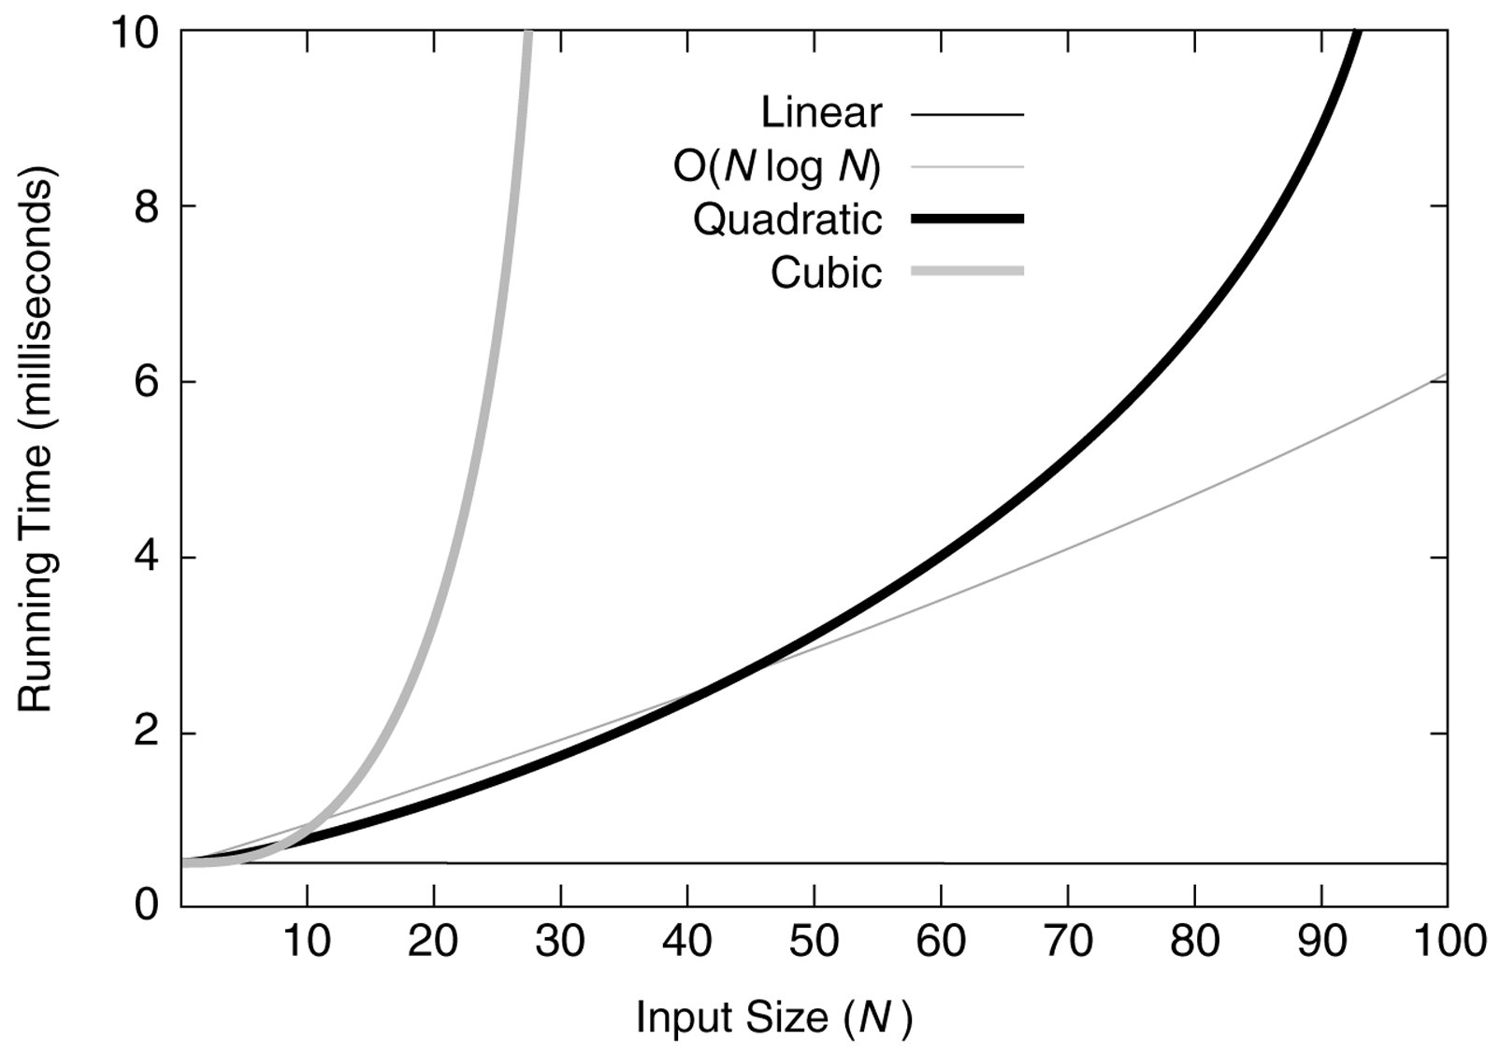
Common Growth Rates

Slide 14
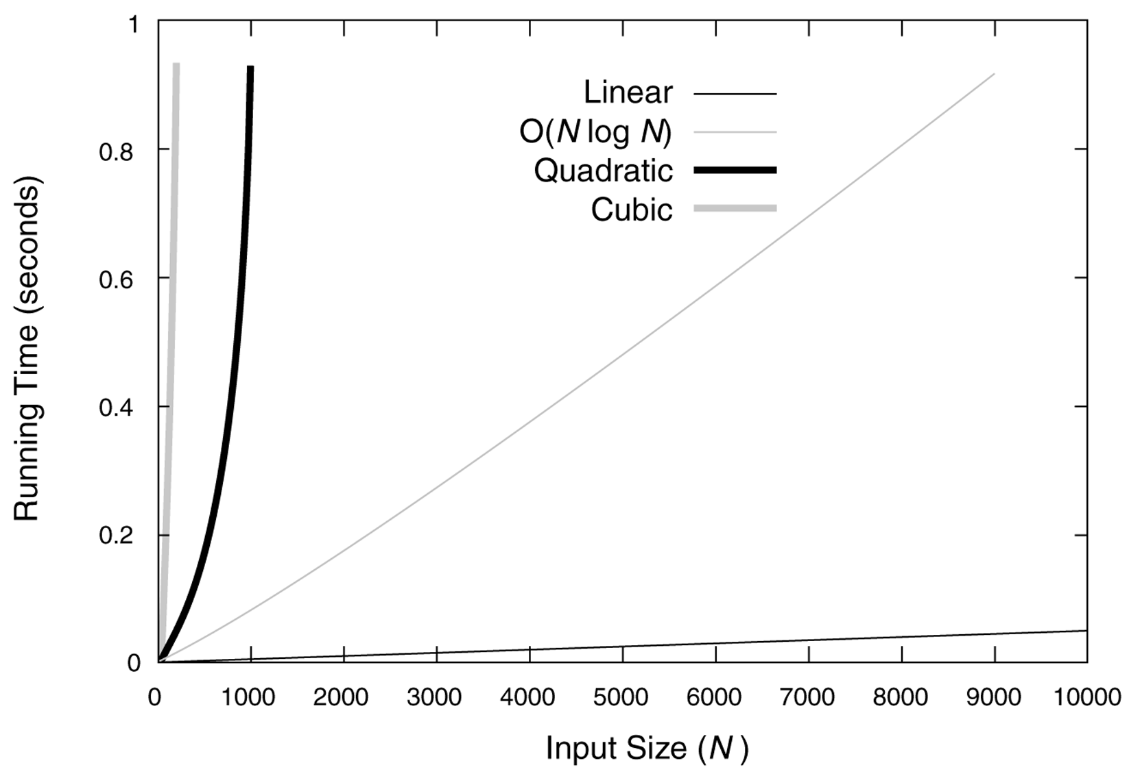
Common Growth Rates

Slide 15
Big-O Notation
If Algorithm A requires time proportional to f(n), Algorithm A is said to be order f(n), and it is denoted as O(f(n)).
The function f(n) is called the algorithm’s growth-rate function.
If Algorithm A requires time proportional to n², it is O(n2).
If Algorithm A requires time proportional to n, it is O(n).

Slide 16
Big-O Notation
Definition:
Algorithm A is order f(n) – denoted as O(f(n)) –
if constants k and n₀ exist such that A requires
no more than k*f(n) time units to solve a problem
of size n ≥ n₀.
The requirement of n ≥ n₀ in the definition of O(f(n)) formalizes the notion of sufficiently large problems.
In general, many values of k and n can satisfy this definition.

Slide 17
Big-O Notation
If an algorithm requires n²–3*n+10 seconds to solve a problem size n. If constants k and n₀ exist such that
k*n² > n²–3*n+10 for all n ≥ n₀ .
the algorithm is order n²
(In fact, k is 3 and n₀ is 2, maybe more)
3*n² > n²–3*n+10 for all n ≥ 2 .
Thus, the algorithm requires no more than k*n² time units for n ≥ n₀ so it is O(n²)

Slide 18
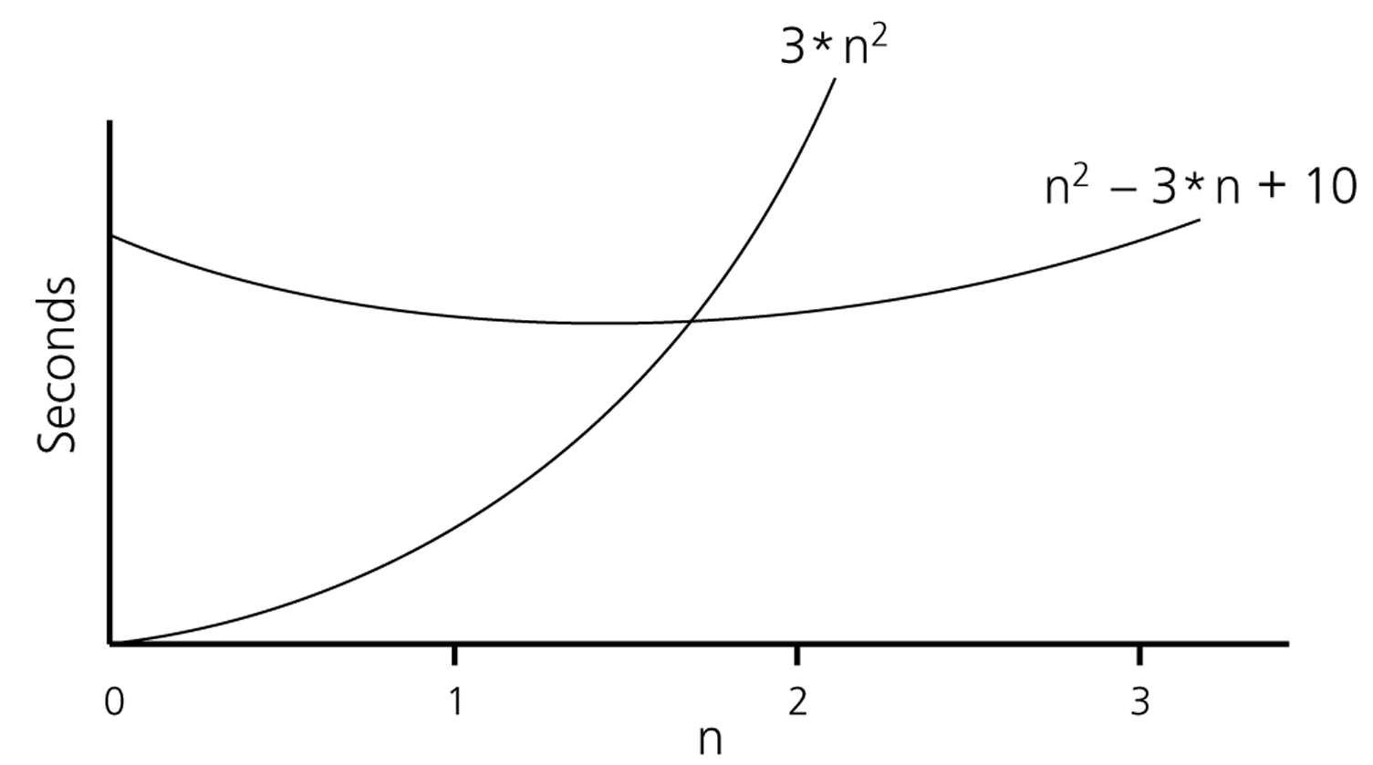
Big-O Notation

Slide 19
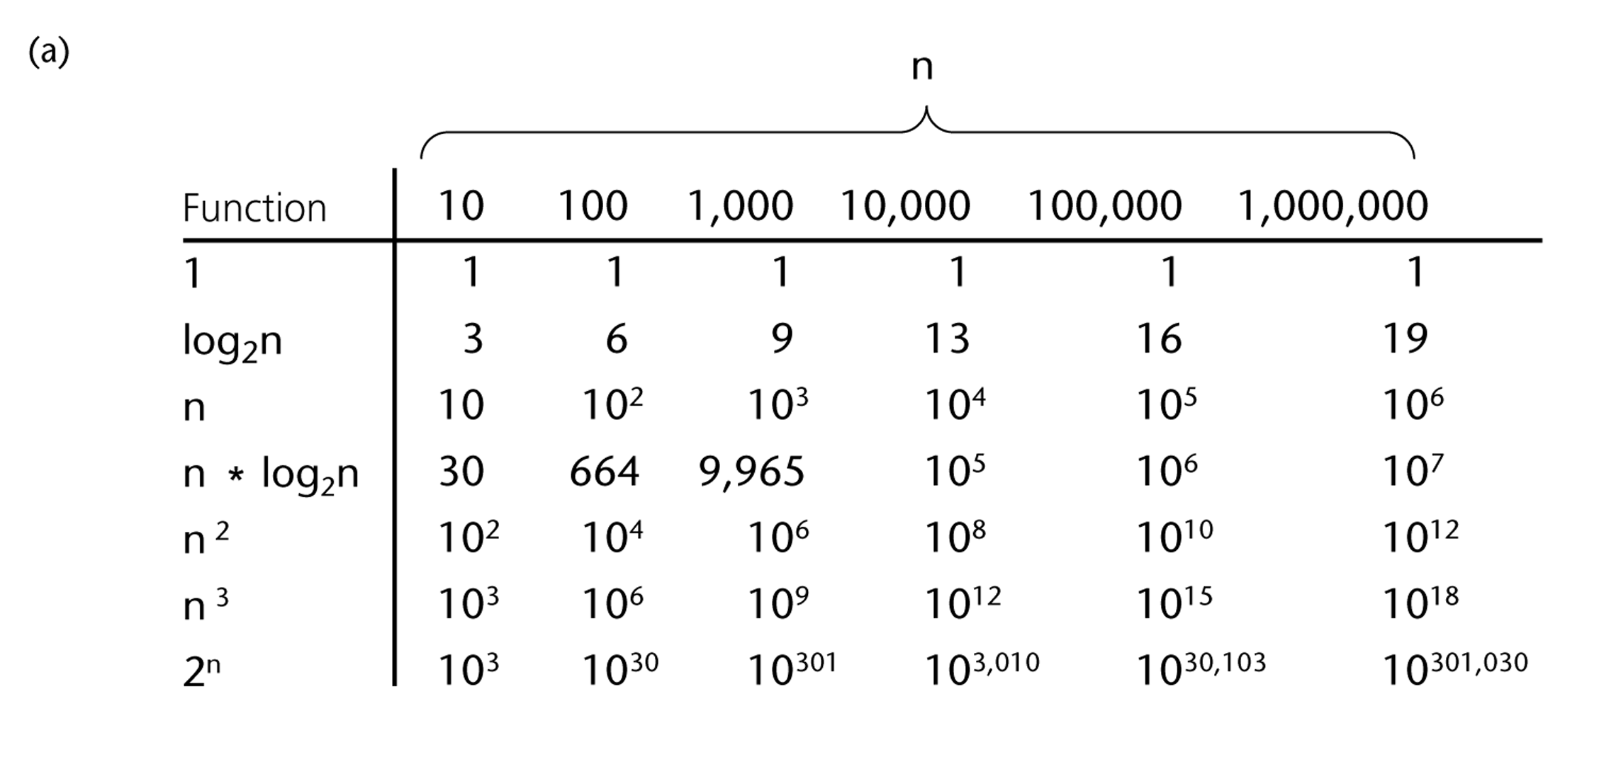
Popular Growth-Rate Functions

Slide 20
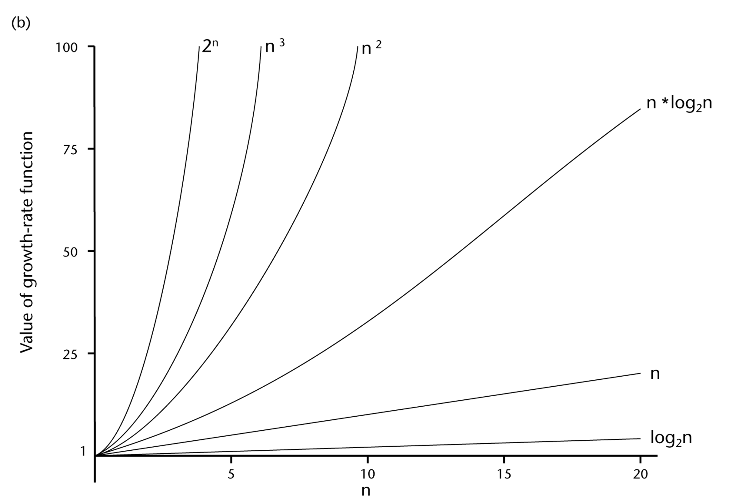
Popular Growth-Rate Functions

Slide 21
Popular Growth-Rate Functions
O(1) Time requirement is constant, and it is independent of the problem’s size.
O(log₂n) Time requirement for a logarithmic algorithm increases slowly as the
problem size increases.
O(n) Time requirement for a linear algorithm increases directly with the size
of the problem.
O(n*log₂n) Time requirement for a n*log₂n algorithm increases more rapidly than
a linear algorithm.
O(n²) Time requirement for a quadratic algorithm increases rapidly with the
size of the problem.
O(n³) Time requirement for a cubic algorithm increases more rapidly with the
size of the problem than the time requirement for a quadratic algorithm.
O(2^{n}) As the size of the problem increases, the time requirement for an
exponential algorithm increases too rapidly to be practical.

Slide 22
Properties of Growth-Rate Functions
We can ignore low-order terms in an algorithm’s growth-rate function.
If an algorithm is O(n³+4n²+3n), it is also O(n³).
We can ignore a multiplicative constant in the higher-order term of an algorithm’s growth-rate function.
If an algorithm is O(5n³), it is also O(n³).
O(f(n)) + O(g(n)) = O(f(n)+g(n))
If an algorithm is O(n³) + O(4n²), it is also O(n³ +4n²) ➔ So, it is O(n³).

Slide 23
Counting & Growth-Rate Functions
Cost Times
i = 1; c1 1
sum = 0; c2 1
while (i <= n) { c3 n+1
i = i + 1; c4 n
sum = sum + i; c5 n
}
T(n) = c1 + c2 + (n+1)*c3 + n*c4 + n*c5
= (c3+c4+c5)*n + (c1+c2+c3)
= a*n + b
➔ So, the growth-rate function for this algorithm is O(n)

Slide 24
Counting & Growth-Rate Functions
Cost Times
i=1; c1 1
sum = 0; c2 1
while (i <= n) { c3 n+1
j=1; c4 n
while (j <= n) { c5 n*(n+1)
sum = sum + i; c6 n*n
j = j + 1; c7 n*n
}
i = i +1; c8 n
}
T(n) = c1 + c2 + (n+1)*c3 + n*c4 + n*(n+1)*c5+n*n*c6+n*n*c7+n*c8
= (c5+c6+c7)*n² + (c3+c4+c5+c8)*n + (c1+c2+c3)
= a*n² + b*n + c
➔ So, the growth-rate function for this algorithm is O(n²)

Slide 25
Counting recursive function
Algorithm BINARY-SEARCH (A, lo, hi, x)
if (lo > hi)
return FALSE
mid ← ⎣(lo+hi)/2⎦
if x = A[mid]
return TRUE
if ( x < A[mid] )
BINARY-SEARCH (A, lo, mid-1, x)
if ( x > A[mid] )
BINARY-SEARCH (A, mid+1, hi, x)
T(n) = c + T(n/2)
= c + c + T(n/4)
= c + c + c + T(n/8)
Replace n = 2^{k}
T(n) = c + c + … + c + T(1)
= clogn + T(1)
So we have T(n) = O(logn)
c1
c2
T(n/2)
T(n/2)
=> T(n) = c + T(n/2)

Slide 26
Analyze recursive function
T(0) = c
T(n) = b + T(n - 1)
= b + b + T(n - 2)
= b +b +b + T(n - 3)
…
= kb + T(n - k)
Replace k = n, we have:
T(n) = nb + T(n - n)
= bn + T(0)
= bn + c.
So T(n) = O(n).
Function factorial(n)
Begin
if n = 0 then return 1
else return n*factorial(n-1);
End.

Slide 27
Array algorithms
Popular & advanced array algorithms

Slide 28
Popular array algorithms
Sum of all elements
Search for an element
Count number of appearances
Delete one element
Insert one element
Find min/max element
Reverse elements
Sort elements ascending / descending

Slide 29
Advanced array algorithms
Re-arrange elements based on condition
Rotate an array left / right by k elements
Find duplicate numbers
Remove duplicate numbers
Check if an array is a subset of another array

Slide 30
Linked List
Single Linked List, Double Linked List, Circular Linked List

Slide 31
Drawbacks of Arrays
Array is very useful data structure in many situations.
However, it has some limitations
Fixed size
Need size information for creation
Inserting an element in the middle of an array leads to moving other elements around
Deleting an element from the middle of an array leads to moving other elements around
Other data structures are more efficient for these cases

Slide 32
Self-referential structures
Many dynamic data structures are implemented through the use of a self-referential structure
A self-referential structure is an object, one of this object member is a reference to another object of its own type.
With this arrangement, it’s possible to create ‘chains’ of data of varying form
Linked List
Tree

Slide 33
Linked List
A collection of nodes storing data and links to other nodes
A linear data structure composed of nodes
Each node holds some info and reference to another node in the list
Types of linked lists
Single linked list
Double linked list
Circular linked list

Slide 34
Single linked lists
Its node contains two data fields: info and next.
Info stores information which is usable by user
Next links it to its successor in the sequence
List operations: add (to head, to tail), remove (at head, at tail), find, insert, check empty, etc.
12
99
37
NULL
head
tail

Slide 35
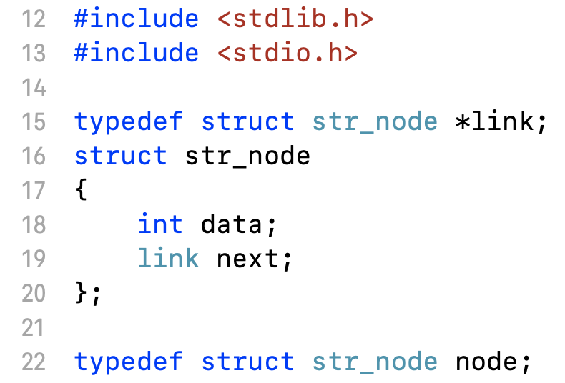
Declaration of list data structure
Declare node structure

Slide 36
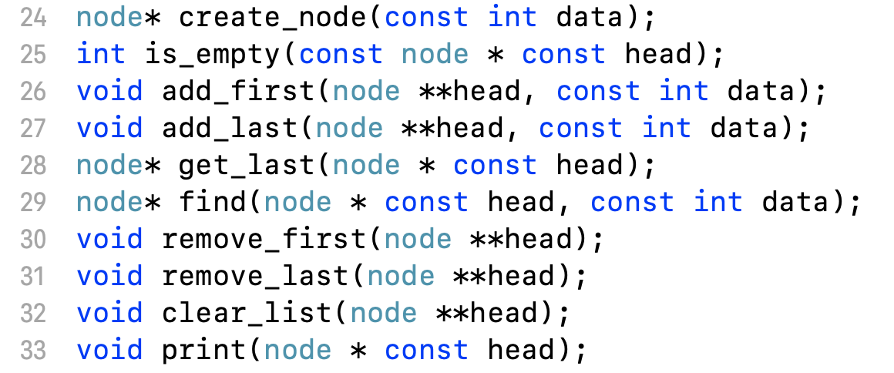
Declaration of list data structure
Declare list operations

Slide 37
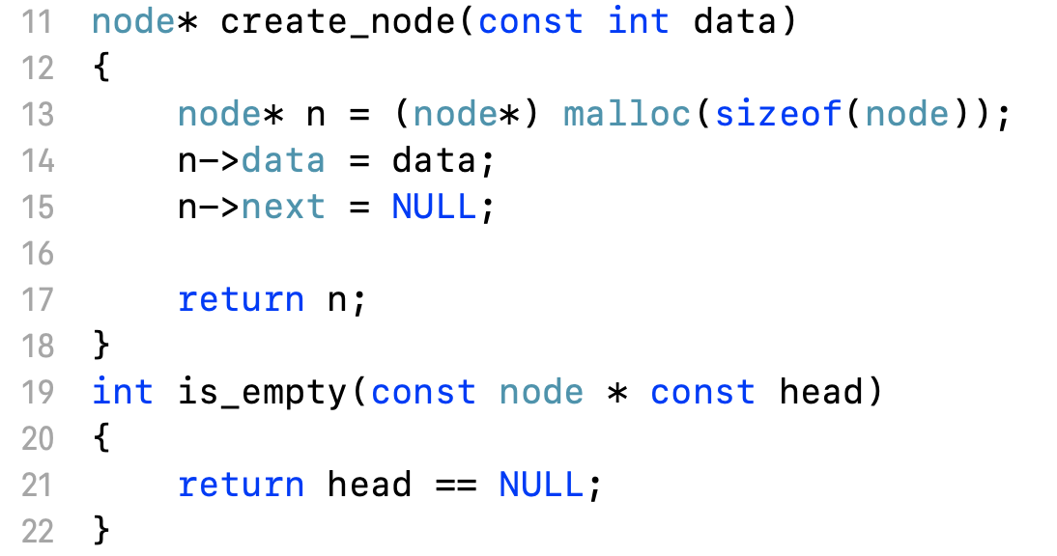
Implementation of list operations

Slide 38
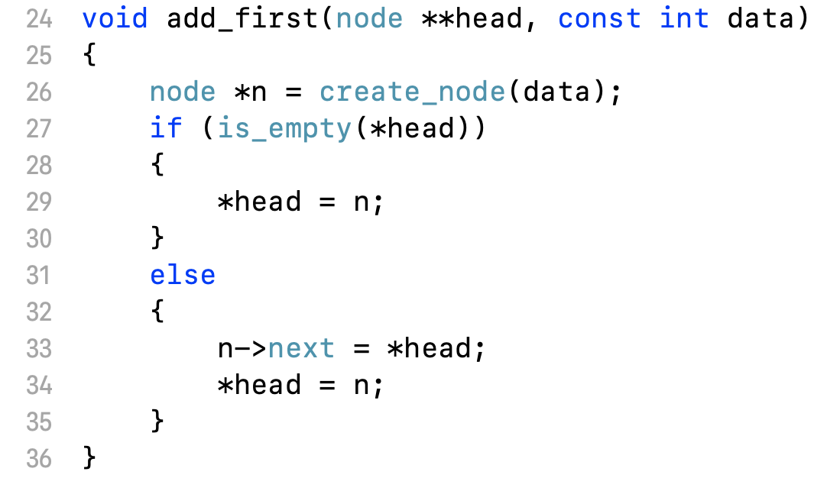
Implementation of list operations

Slide 39
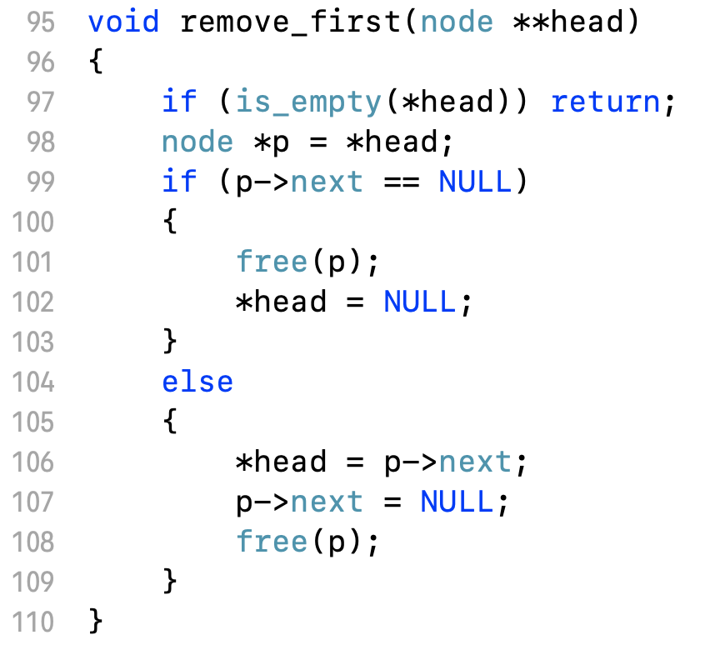
Implementation of list operations

Slide 40
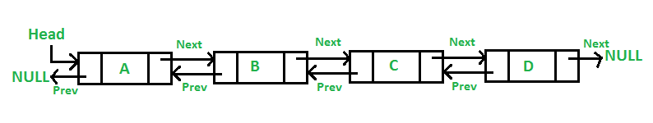
Double Linked List
In doubly linked list, each node has two reference fields
one to the successor and
one to the predecessor

Slide 41
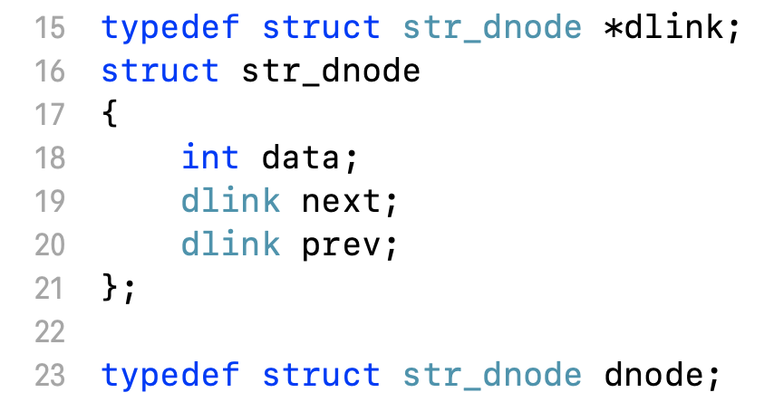
Declaration of Double Linked List
Declare struct node

Slide 42
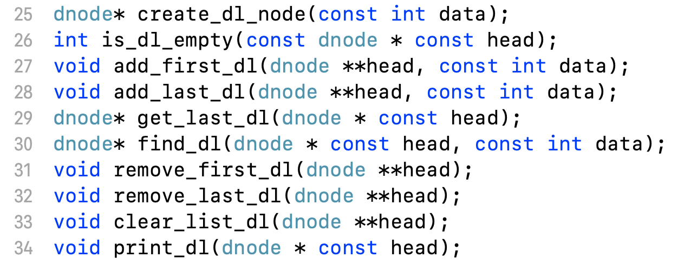
Declaration of Double Linked List
Declare list operators

Slide 43
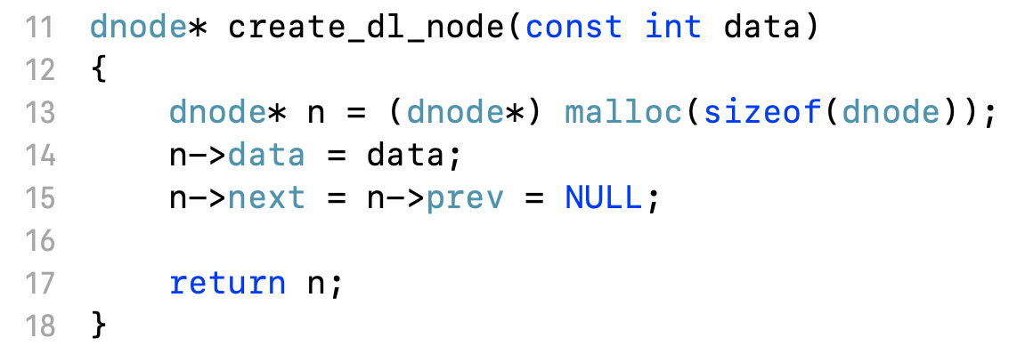
Implementation of Double Linked List

Slide 44
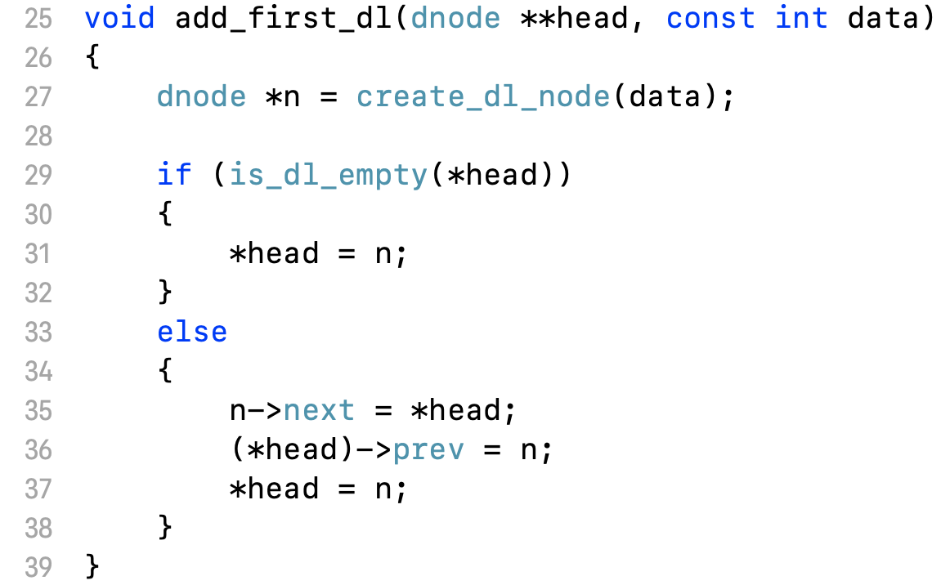
Implementation of Double Linked List

Slide 45
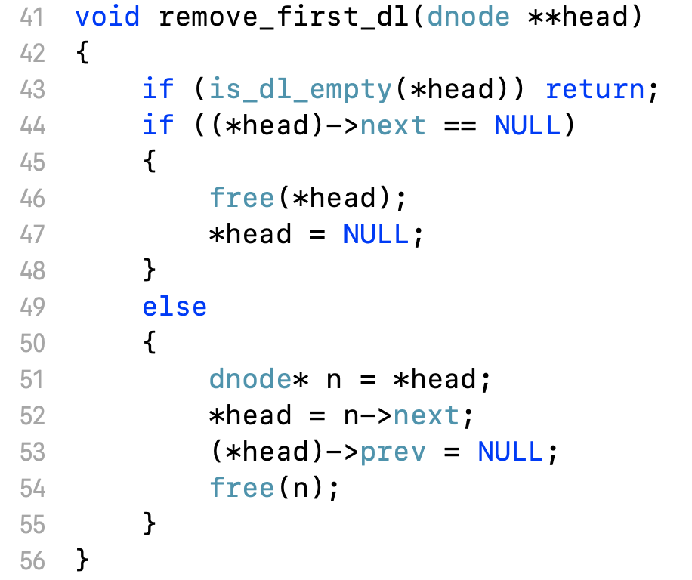
Implementation of Double Linked List

Slide 46
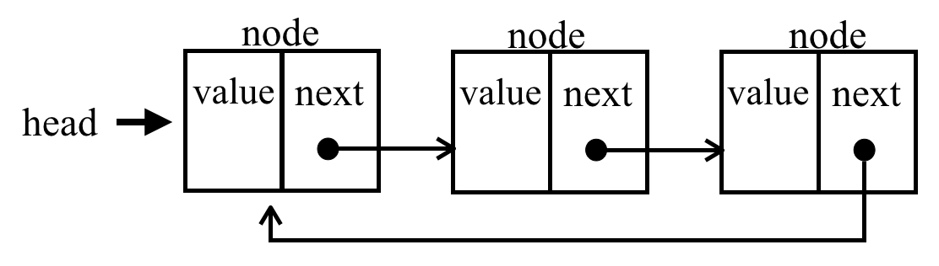
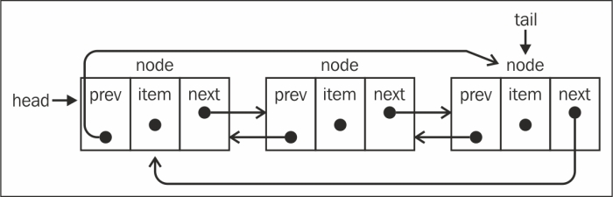
Circular Linked List
Circular Single Linked List
Circular Double Linked List

