Slide 1

Group 2: Library Management System
Group 2:
Đỗ Khánh Nam | 20225988
Trần Anh Khôi | 20225981
Ngô Minh Đức | 20226028

Slide 2
Work Distribution
 | Name | Email | Work distribution
1 | Đỗ Khánh Nam (leader) | nam.dk225988@sis.hust.edu.vn | ERD, queries 21-30, indexes
2 | Trần Anh Khôi | khoi.ta225981@sis.hust.edu.vn | Relational Schema, queries 1- 10 , indexes
3 | Ngô Minh Đức | duc.nm226028@sis.hust.edu.vn | Report, queries 11 – 20, indexes

Slide 3
Table of contents
Description
Entity relationship diagram
Relational schema

Slide 4
Table of contents
Description
Entity relationship diagram
Relational schema

Slide 5
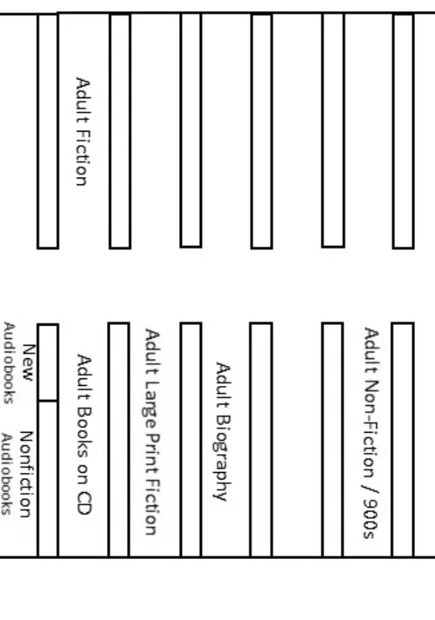
Description
- Library → Book(BookID) → Bookcopy(Book_copyID)
- Bookcopy has 2 status: available and unavailable for borrowing
- Books are grouped by category to put on bookshelves

Slide 6
Description
Staff side
Store information: name, dob, gender,…
2 main tasks:
Add or remove books/bookcopies
Verify the borrowing/returning/compensating process of borrowers
Need to make statistics: know the most borrowed categories, borrower at what age borrow book the most → have more readers

Slide 7
Description
Borrower side
Use library app to
Register for reader card → information: name, dob, age,… → have a barcode
Search for books with different filters: title, author, ….
Receive notifications: when a wanted book is available, when it’s due date of a bookcopy
Borrow books in person

Slide 8
Description
Procedures when going to the library
Borrower:
Scan barcode (store visit history)
Find books
Come to frontdesk, scan each bookcopy (store bookcopyid, employeeid, borrowerid) → borrow/return/compensate

Slide 9
Description
4. Constraints
If the book wanted is unavailable → waitlist
Number of bookcopies borrowing <= 5
Borrowing time = 90 days
Damage a bookcopies (verified by employees) → compensate

Slide 10
Table of contents
Description
Entity relationship diagram
Relational schema

Slide 11
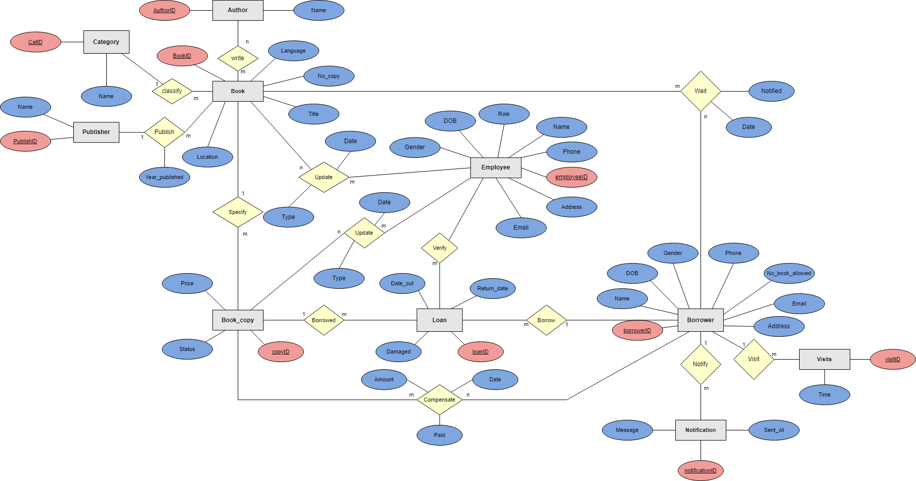
Entity relationship diagram

Slide 12
Table of contents
Description
Entity relationship diagram
Relational schema

Slide 13
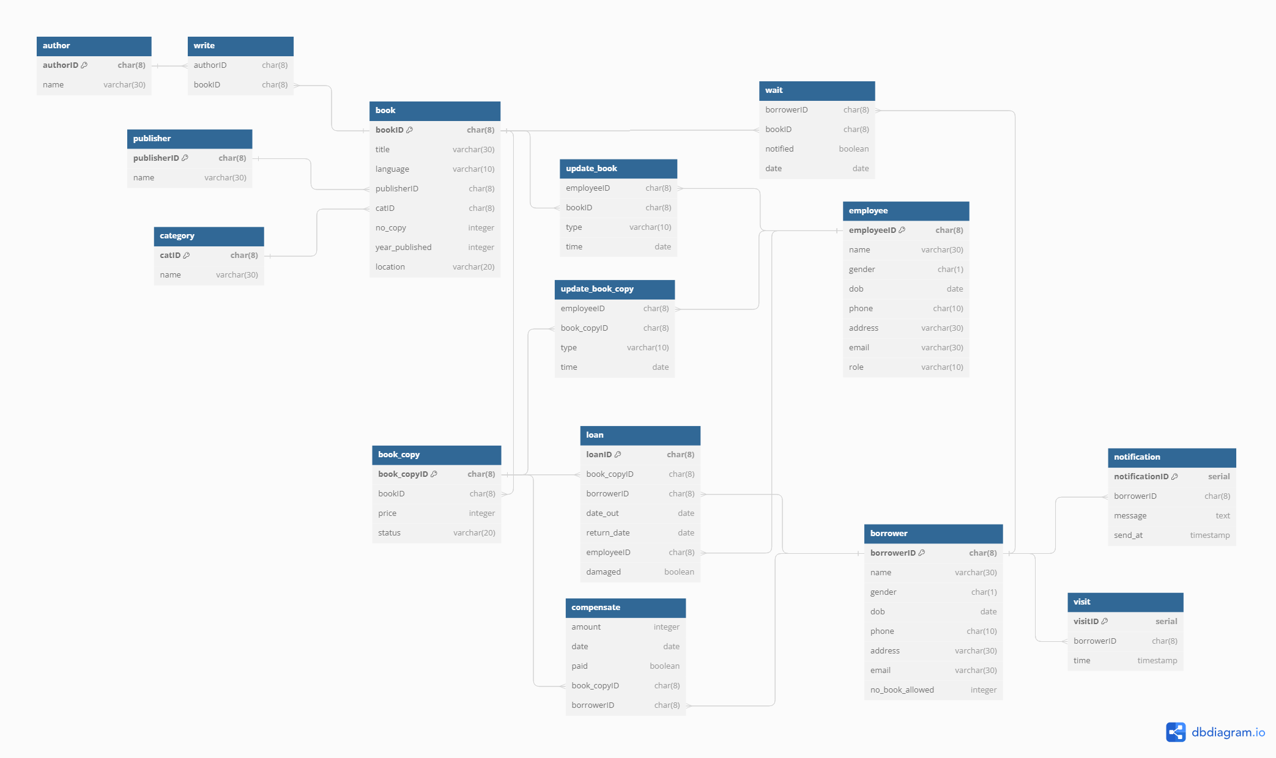
Relational schema

Slide 14
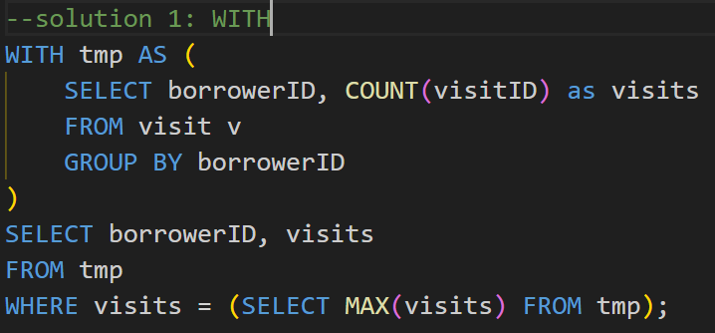
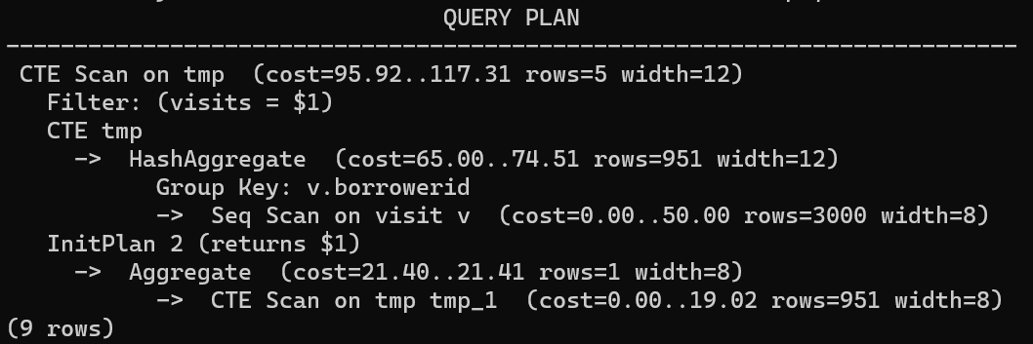
Queries
12. List borrowers that make the most visits

Slide 15
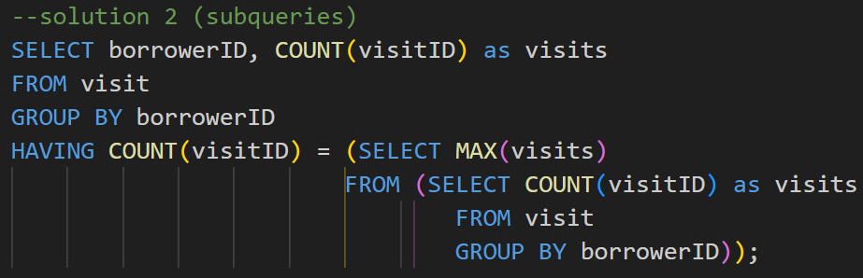
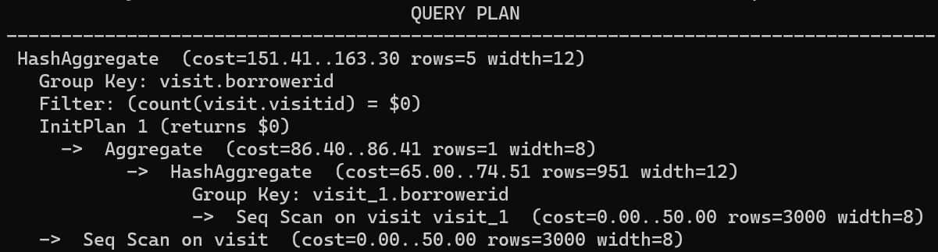
Queries
12. List borrowers that make the most visits

Slide 16
Queries
13 List how many books a borrower borrows in a year

Slide 17
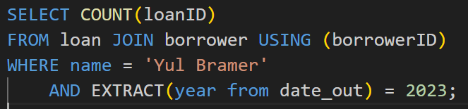
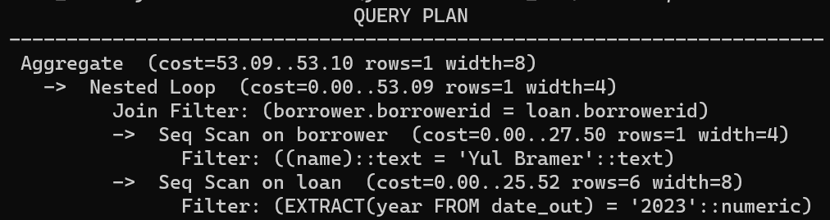
Queries
13 List how many books a borrower borrows in a year

Slide 18
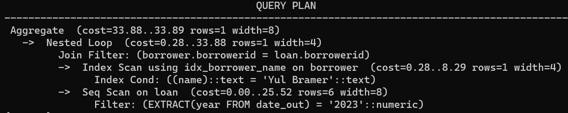
Queries
13 List how many books a borrower borrows in a year

Slide 19
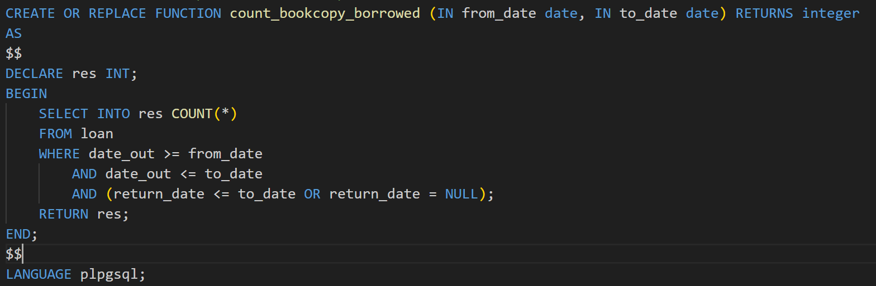
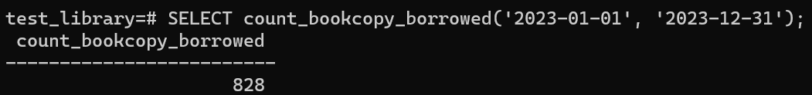
Queries
13 List how many books a borrower borrows in a year

Slide 20
THANK YOU !

