Slide 1
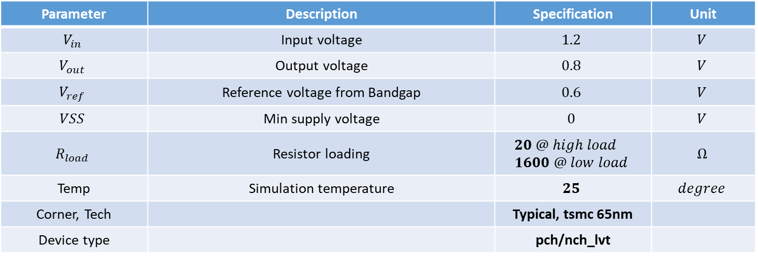
SIMULATION CONDITION
Parameter | Description | Specification | Unit
$$V_{in}$$ | Input voltage | $$1.2$$ | $$V$$
$$V_{out}$$ | Output voltage | $$0.8$$ | $$V$$
$$V_{ref}$$ | Reference voltage from Bandgap | $$0.6$$ | $$V$$
$$VSS$$ | Min supply voltage | $$0$$ | $$V$$
$$R_{load}$$ | Resistor loading | $$20 @ high load \\ 1600 @ low load$$ | $$Ω$$
Temp | Simulation temperature | $$25$$ | $$degree$$
Corner, Tech |  | Typical, tsmc 65nm
Device type |  | pch/nch_lvt

Slide 2
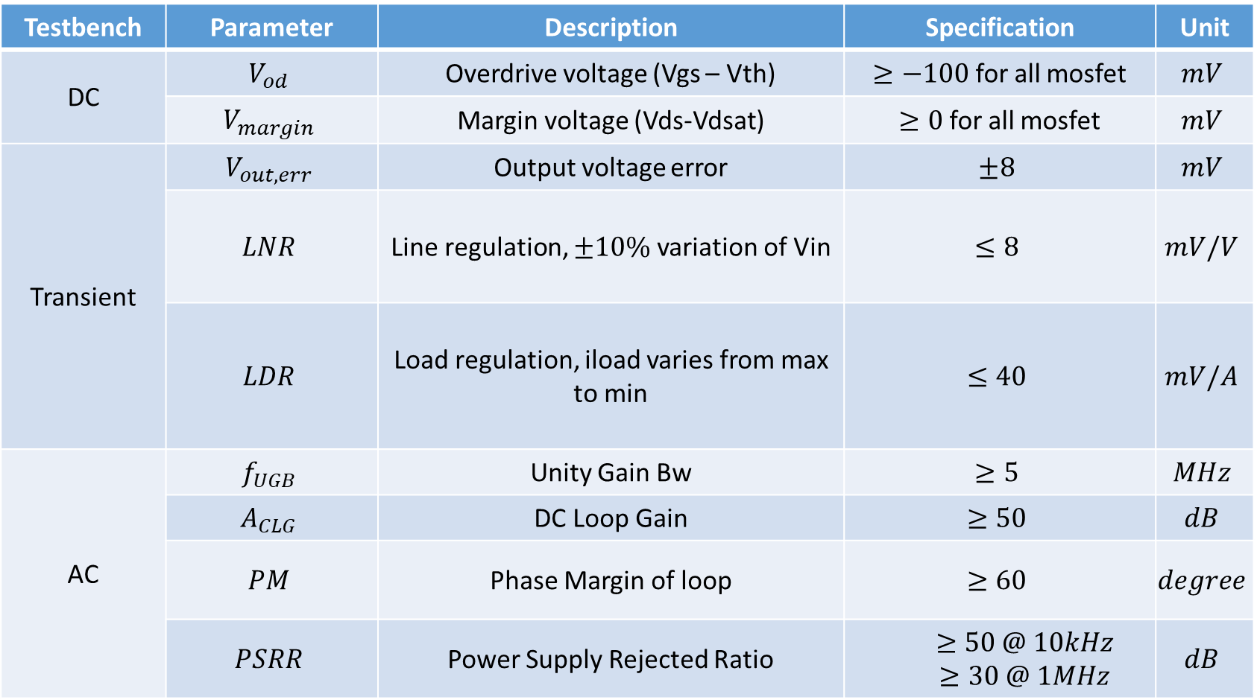
LDO SPECIFICATION
Testbench | Parameter | Description | Specification | Unit
DC | $$V_{od}$$ | Overdrive voltage (Vgs – Vth) | $≥−100$ for all mosfet | $$mV$$
 | $$V_{margin}$$ | Margin voltage (Vds-Vdsat) | $≥0$ for all mosfet | $$mV$$
Transient | $$V_{out,err}$$ | Output voltage error | $$±8$$ | $$mV$$
 | $$LNR$$ | Line regulation, $±10\%$ variation of Vin | $$≤8$$ | $$mV/V$$
 | $$LDR$$ | Load regulation, iload varies from max to min | $$≤40$$ | $$mV/A$$
AC | $$f_{UGB}$$ | Unity Gain Bw | $$≥5$$ | $$MHz$$
 | $$A_{CLG}$$ | DC Loop Gain | $$≥50$$ | $$dB$$
 | $$PM$$ | Phase Margin of loop | $$≥60$$ | $$degree$$
 | $$PSRR$$ | Power Supply Rejected Ratio | $$≥50 @ 10kHz$$ $≥30 @ 1MHz$ | $$dB$$

Slide 3
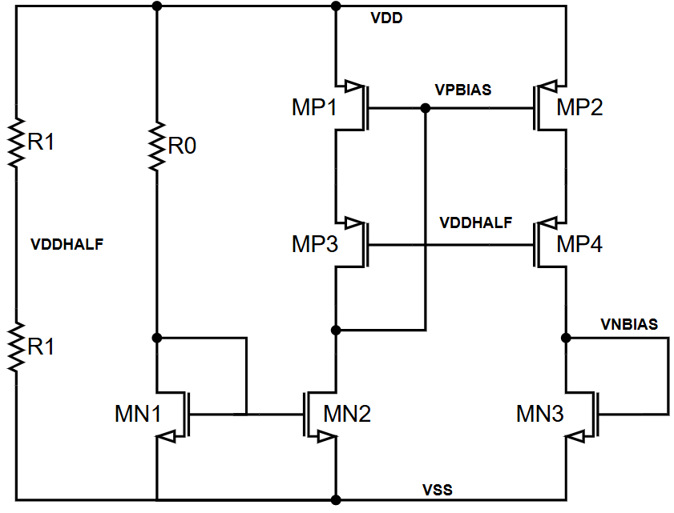
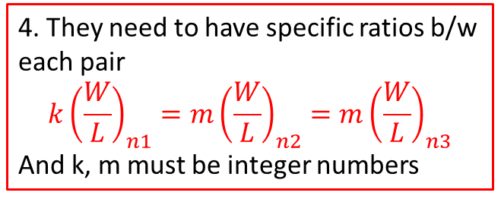
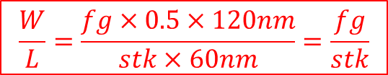
BIAS
1.1 Should choose R1~kOhm to reduce static current as much as possible (recommend: 30kOhm) 1.2 R0 should be chosen around ~kOhm (1-500kOhm)
2. These 2 devices must have the same dimension (fg & stk).
3. These 2 devices must be the same (fg & stk), no need to be as same as (2)
4. They need to have specific ratios b/w each pair $${k\left(\frac{W}{L}\right)}_{n1}=m{\left(\frac{W}{L}\right)}_{n2}=m{\left(\frac{W}{L}\right)}_{n3}$$
And k, m must be integer numbers
$$\frac{W}{L}=\frac{fg×0.5×120nm}{stk×60nm}=\frac{fg}{stk}$$

Slide 4
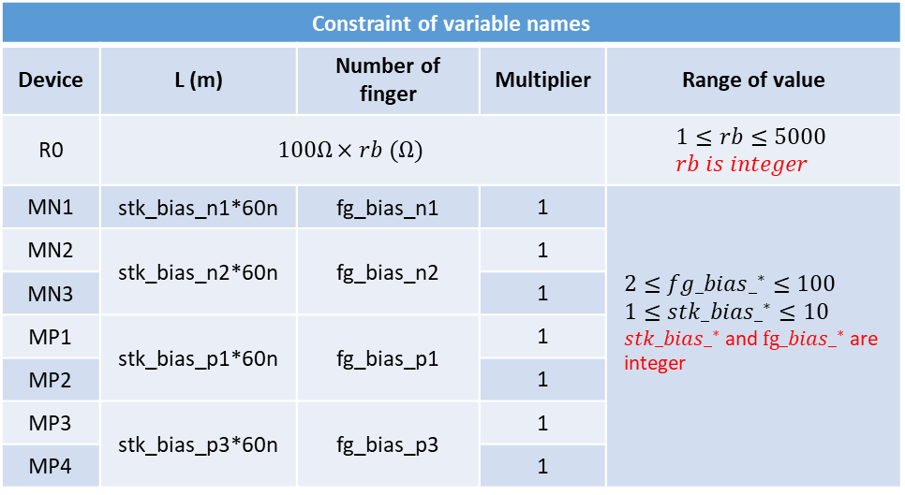
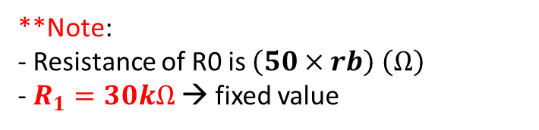
BIAS
1.1 Should choose R1~kOhm to reduce static current as much as possible (recommend: 30kOhm) 1.2 R0 should be chosen around ~kOhm (1-500kOhm)
**Note: - Resistance of R0 is $\left(50×rb\right) \left(Ω\right)$
- $R_{1}=30kΩ$ → fixed value
Constraint of variable names
Device | L (m) | Number of finger | Multiplier | Range of value
R0 | $$100Ω×rb (Ω)$$ |  |  | $$1≤rb≤5000 \\ rb is integer$$
MN1 | stk_bias_n1*60n | fg_bias_n1 | 1 | $$2≤fg_bias{_}^{∗}≤100 \\ 1≤stk_bias{_}^{∗}≤10 \\ stk_bias{_}^{∗} \text{and} fg_bias{_}^{∗} \text{are} \text{integer}$$
MN2 | stk_bias_n2*60n | fg_bias_n2 | 1
MN3 |  |  | 1
MP1 | stk_bias_p1*60n | fg_bias_p1 | 1
MP2 |  |  | 1
MP3 | stk_bias_p3*60n | fg_bias_p3 | 1
MP4 |  |  | 1
UPDATE
** finger width = 200n

Slide 5
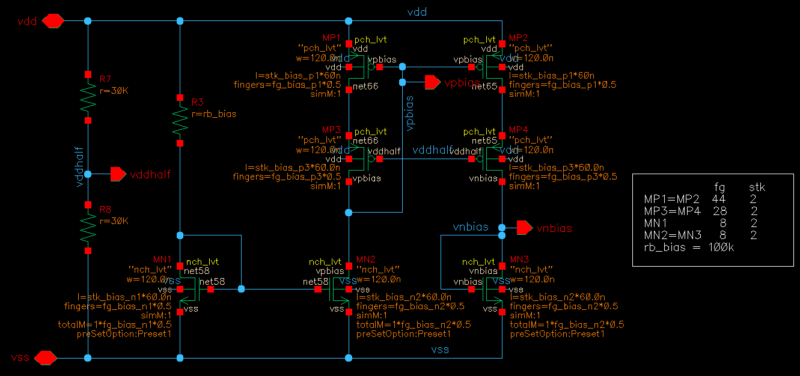
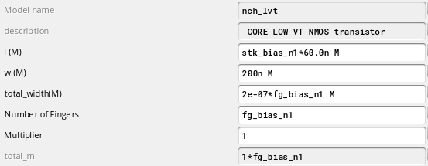
BIAS - example
Total length = stk * 60n (stk is integer number (1, 2, …)
Variable name
stk_core_p1 fp_core_p1
Min finger width
stk_core_p3 fp_core_p3
Automatically adjust
stk_core_n1 fp_core_n1
n.o fingers, *0.5 means we want 60n per step
Keep multi=1
stk_core_n2 fp_core_n2
Reference transistor size
** must follow variable name when applying optimization algorithms

Slide 6
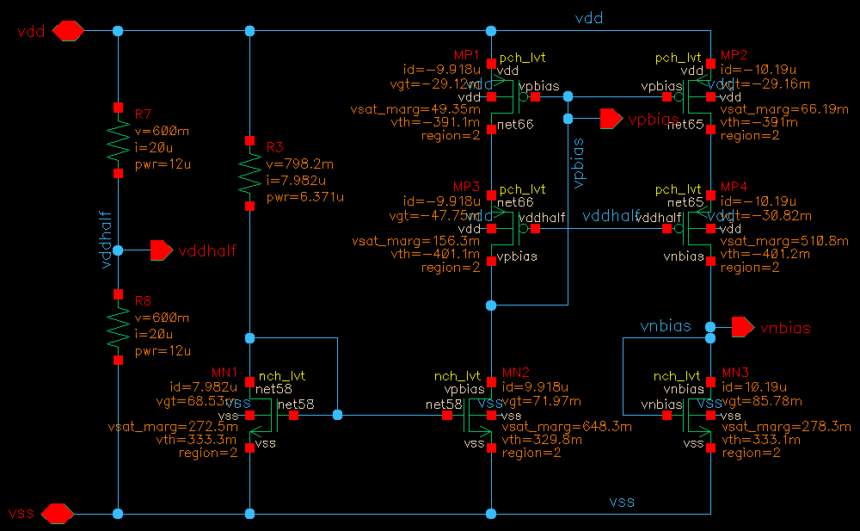
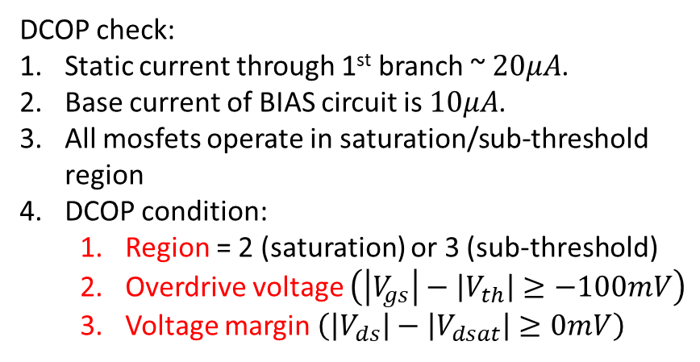
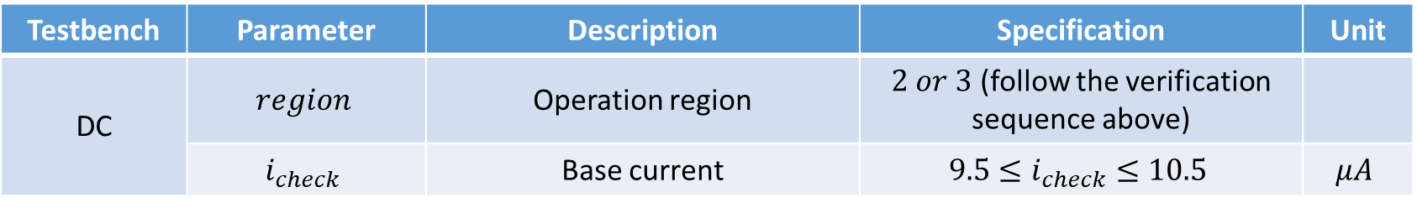
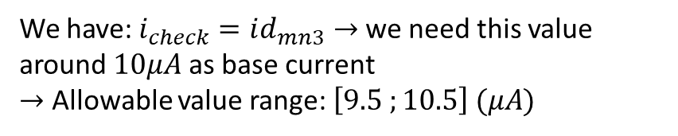
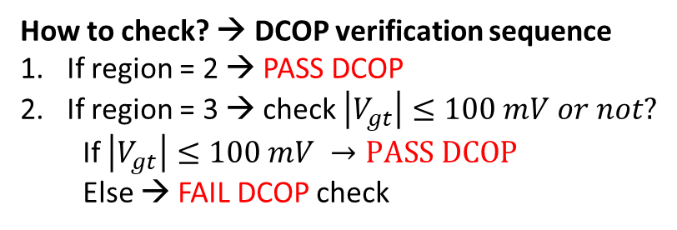
BIAS - example
DCOP check:
Static current through 1st branch ~ $20μA$.
Base current of BIAS circuit is $10μA$.
All mosfets operate in saturation/sub-threshold region
DCOP condition:
Region = 2 (saturation) or 3 (sub-threshold)
Overdrive voltage $\left(\left|V_{gs}\right|−\left|V_{th}\right|≥−100mV\right)$
Voltage margin $\left(\left|V_{ds}\right|−\left|V_{dsat}\right|≥0mV\right)$
How to check? → DCOP verification sequence
If region = 2 → PASS DCOP
If region = 3 → check $\left|V_{gt}\right|≤100 mV or not?$
If $\left|V_{gt}\right|≤100 mV →PASS DCOP$
Else → FAIL DCOP check
i_check
We have: $i_{check}=id_{mn3}→$we need this value around $10μA$ as base current
$→$ Allowable value range: $\left[9.5 ;10.5\right] (μA)$
Testbench | Parameter | Description | Specification | Unit
DC | $$region$$ | Operation region | $2 or 3$ (follow the verification sequence above)
 | $$i_{check}$$ | Base current | $$9.5≤i_{check}≤10.5$$ | $$μA$$

Slide 7
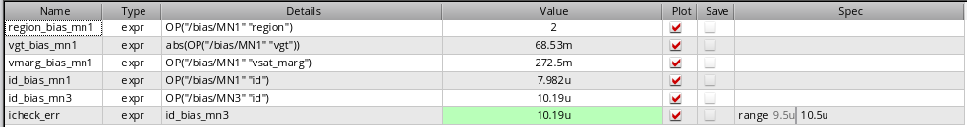
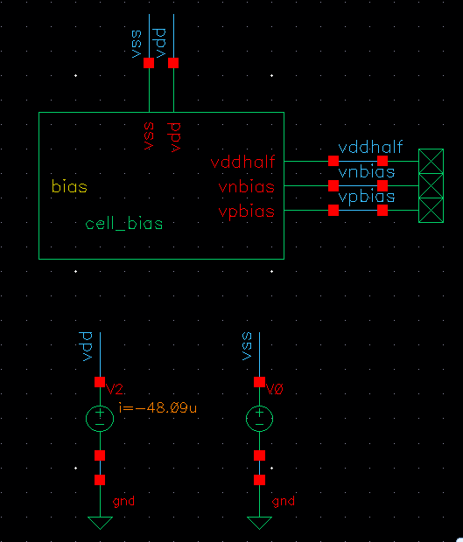
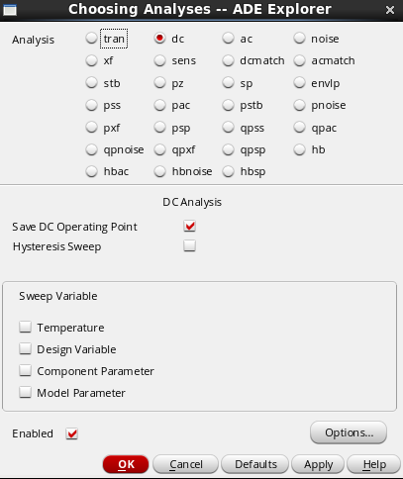
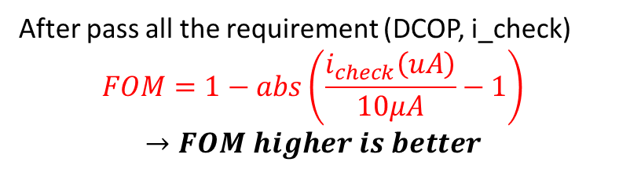

BIAS - example
Example of DCOP check of 1 device → need to check all devices in schematic
Name of parameters
Measurement → can include in OCEAN file to do the simualtion
Cell name
Testbench setup
$i_{check}$ measurement
After pass all the requirement (DCOP, i_check) $$FOM=1−abs\left(\frac{i_{check}\left(uA\right)}{10μA}−1\right)$$
$$→FOM higher is better$$
→ DCOP analysis

Slide 8
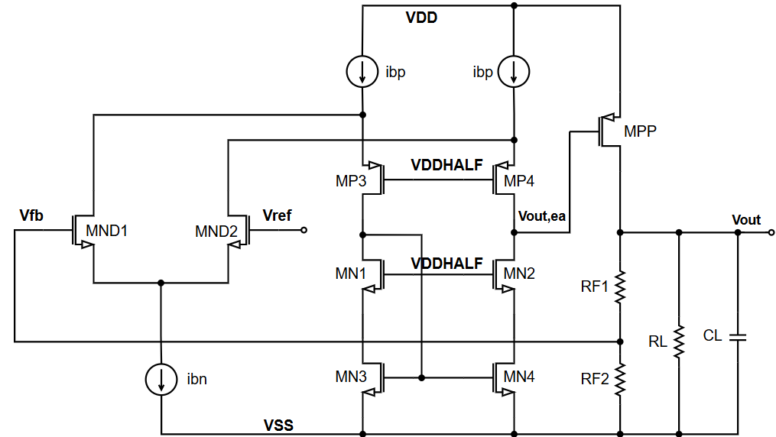

** When we separately design EA, there are no more information about core voltage from core cell → replace core devices by current sources and just need to evaluate the optimized core current
2. Replace 2 identical core PMOS by 2 ideal current source having same current value
Core
3. These 2 devices must be the same (fg & stk), no need to be as same as other pair
1. Must be the same (fg & stk)
Ibp=i0
4. Need to choose (fg, stk & m – multi) to adapt both min & max current consumption from load system
Ibp=i0
i2
i2
i1
i1
5. These 2 devices must be the same (fg & stk), no need to be as same as other pair
Ibn=i3
$$i_{bp}=i_{1}+i_{2} \\ i_{bn}=2×i_{2}$$
6. These 2 devices must be the same (fg & stk), no need to be as same as other pair
7. Replace by current source

Slide 9
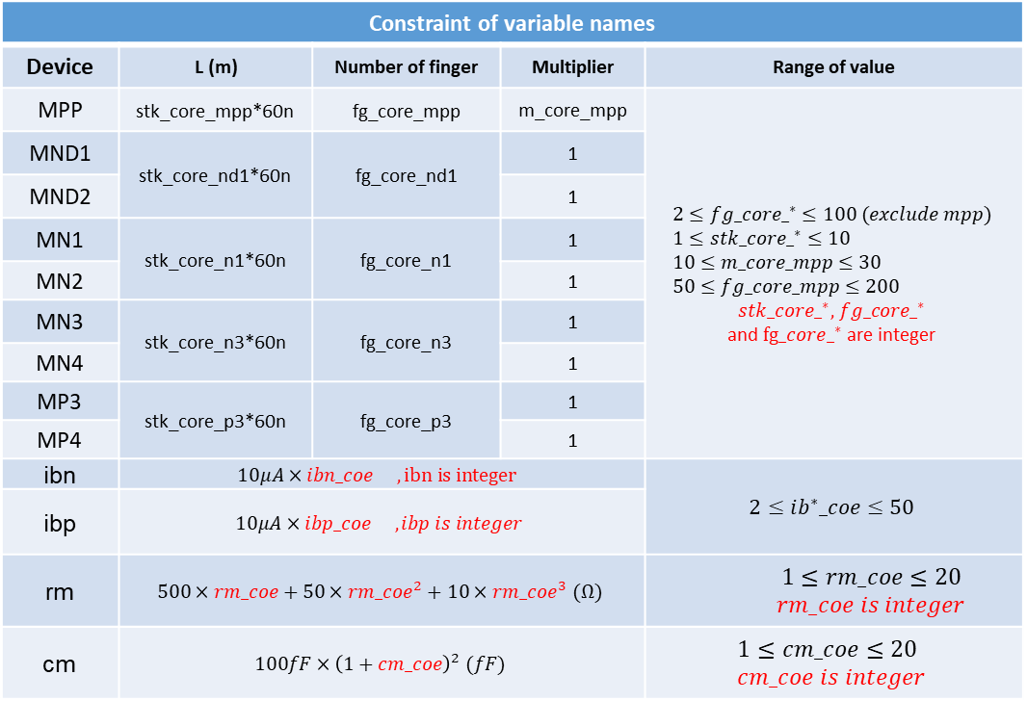
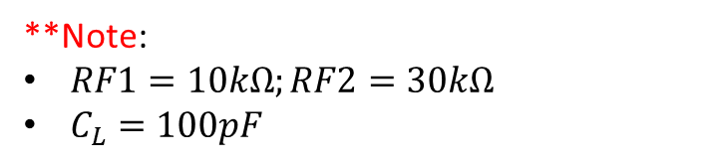
Constraint of variable names
Device | L (m) | Number of finger | Multiplier | Range of value
MPP | stk_core_mpp*60n | fg_core_mpp | m_core_mpp | $$2≤fg_core{_}^{∗}≤100 (exclude mpp) \\ 1≤stk_core{_}^{∗}≤10 \\ 10≤m_core_mpp≤30 \\ 50≤fg_core_mpp≤200$$ $$stk_core{_}^{∗}\text{, }fg_core{_}^{∗}$$ $$\text{and} fg_core{_}^{∗} \text{are} \text{integer}$$
MND1 | stk_core_nd1*60n | fg_core_nd1 | 1
MND2 |  |  | 1
MN1 | stk_core_n1*60n | fg_core_n1 | 1
MN2 |  |  | 1
MN3 | stk_core_n3*60n | fg_core_n3 | 1
MN4 |  |  | 1
MP3 | stk_core_p3*60n | fg_core_p3 | 1
MP4 |  |  | 1
ibn | $$10μA×ibn_coe ,ibn is integer$$ |  |  | $$2≤ib^{∗}_coe≤50$$
ibp | $$10μA×ibp_coe ,ibp is integer$$
rm | $$500×rm_coe+50×rm_coe^{2}+10×rm_coe^{3} (Ω)$$ |  |  | $$1≤rm_coe≤20 \\ rm_coe is integer$$
cm | $$100fF×{\left(1+cm_coe\right)}^{2} (fF)$$ |  |  | $$1≤cm_coe≤20 \\ cm_coe is integer$$
Core
** finger width = 200n
UPDATE
**Note:
$RF1=10kΩ;RF2=30kΩ$
$C_{L}=100pF$

Slide 10
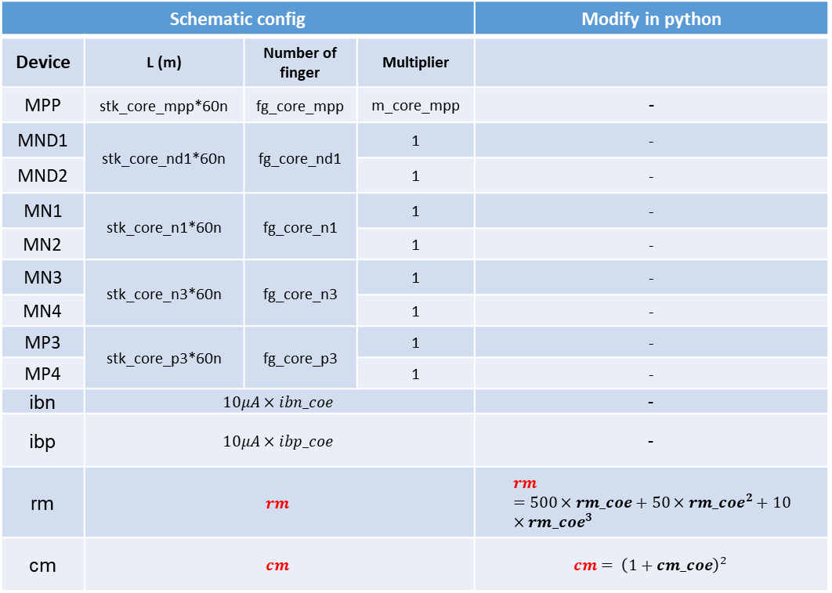
Schematic config |  |  |  | Modify in python
Device | L (m) | Number of finger | Multiplier
MPP | stk_core_mpp*60n | fg_core_mpp | m_core_mpp | -
MND1 | stk_core_nd1*60n | fg_core_nd1 | 1 | -
MND2 |  |  | 1 | -
MN1 | stk_core_n1*60n | fg_core_n1 | 1 | -
MN2 |  |  | 1 | -
MN3 | stk_core_n3*60n | fg_core_n3 | 1 | -
MN4 |  |  | 1 | -
MP3 | stk_core_p3*60n | fg_core_p3 | 1 | -
MP4 |  |  | 1 | -
ibn | $$10μA×ibn_coe$$ |  |  | -
ibp | $$10μA×ibp_coe$$ |  |  | -
rm | $$rm$$ |  |  | $$rm=500×rm_coe+50×rm_coe^{2}+10×rm_coe^{3}$$
cm | $$cm$$ |  |  | $$cm= {\left(1+cm_coe\right)}^{2}$$
Core
UPDATE
**Note:
$RF1=10kΩ;RF2=30kΩ$
$C_{L}=100pF$

Slide 11
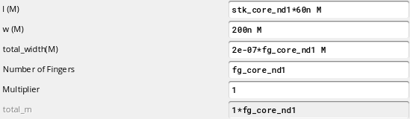
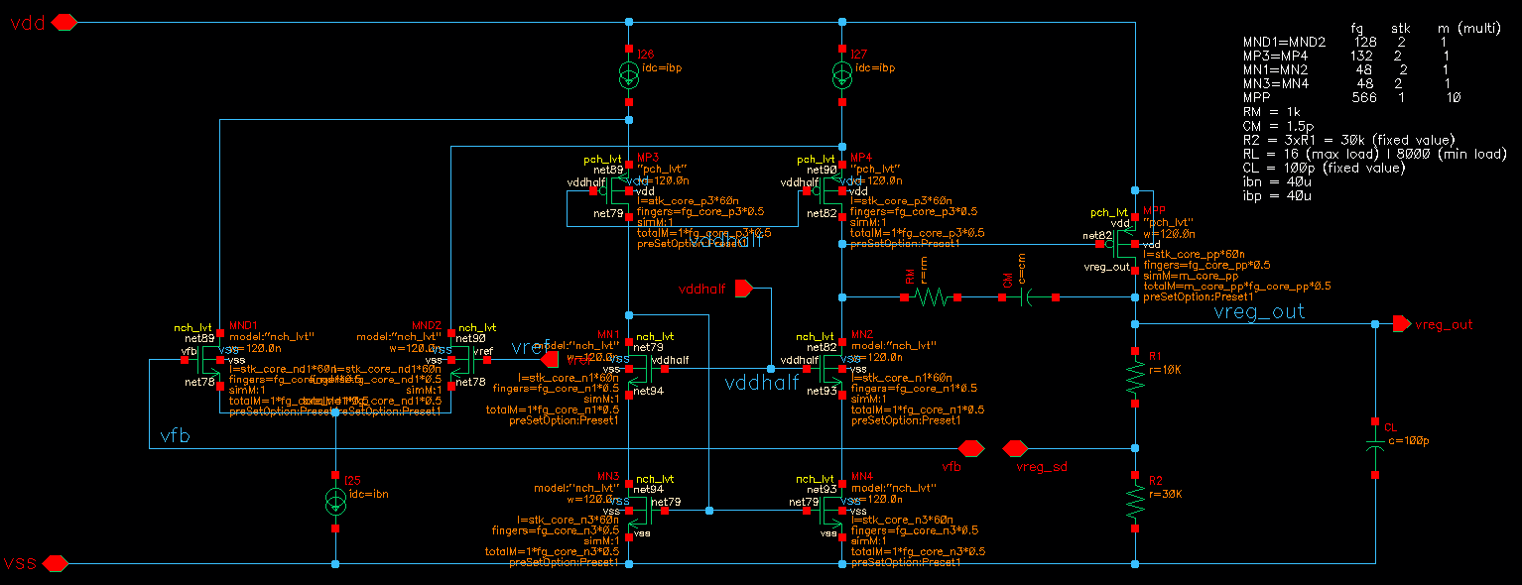
Total length = stk * 60n (stk is integer number (1, 2, …)
Core - example
Min finger width
Automatically adjust
n.o fingers, *0.5 means we want 60n per step
Keep multi=1, except MPP
ibp
stk_core_mpp fp_core_mpp m_core_mpp
stk_core_p3 fp_core_p3
stk_core_nd1 fp_core_nd1
rm
cm
stk_core_n1 fp_core_n1
Fixed value
ibn
stk_core_n3 fp_core_n3

Slide 12
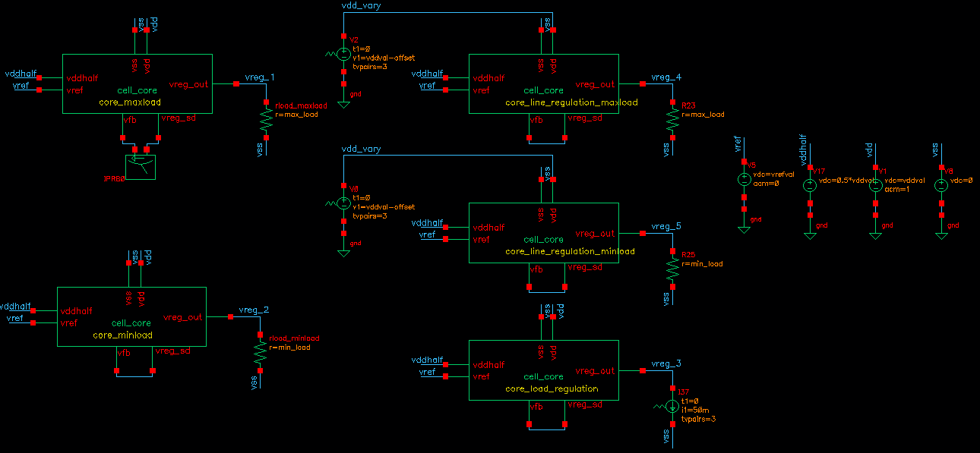

Core - testbench
VDD source: DC=vddval AC=1 VREF source: DC=vrefval AC=0
Should use the same instance name of example
DC source
Offset = 0.1*vddval min_load = 8000 ohm max_load = 16 ohm

Slide 13
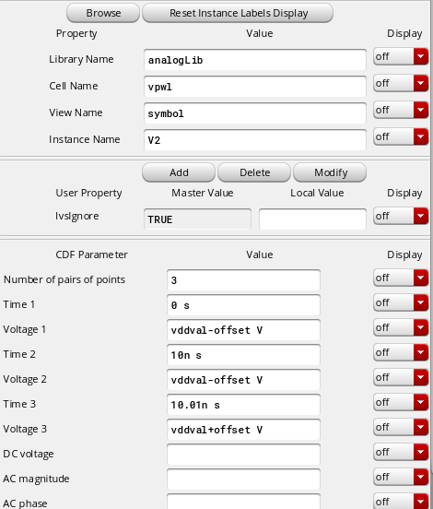
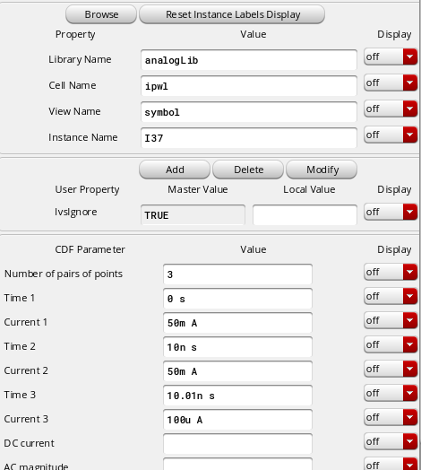
Core - testbench
Should use the same instance name of example
Lib: analigLib cell name: iprobe instance name: IPRB0

Slide 14
Core - testbench
Used to check LINE REGULATION and VOUT_ERR for both min & max load verification
Used to check DCOP and AC of max_load verification
Used to check DCOP and PSR of min_load verification
Used to check LOAD REGULATION & VOUT_ERR

Slide 15
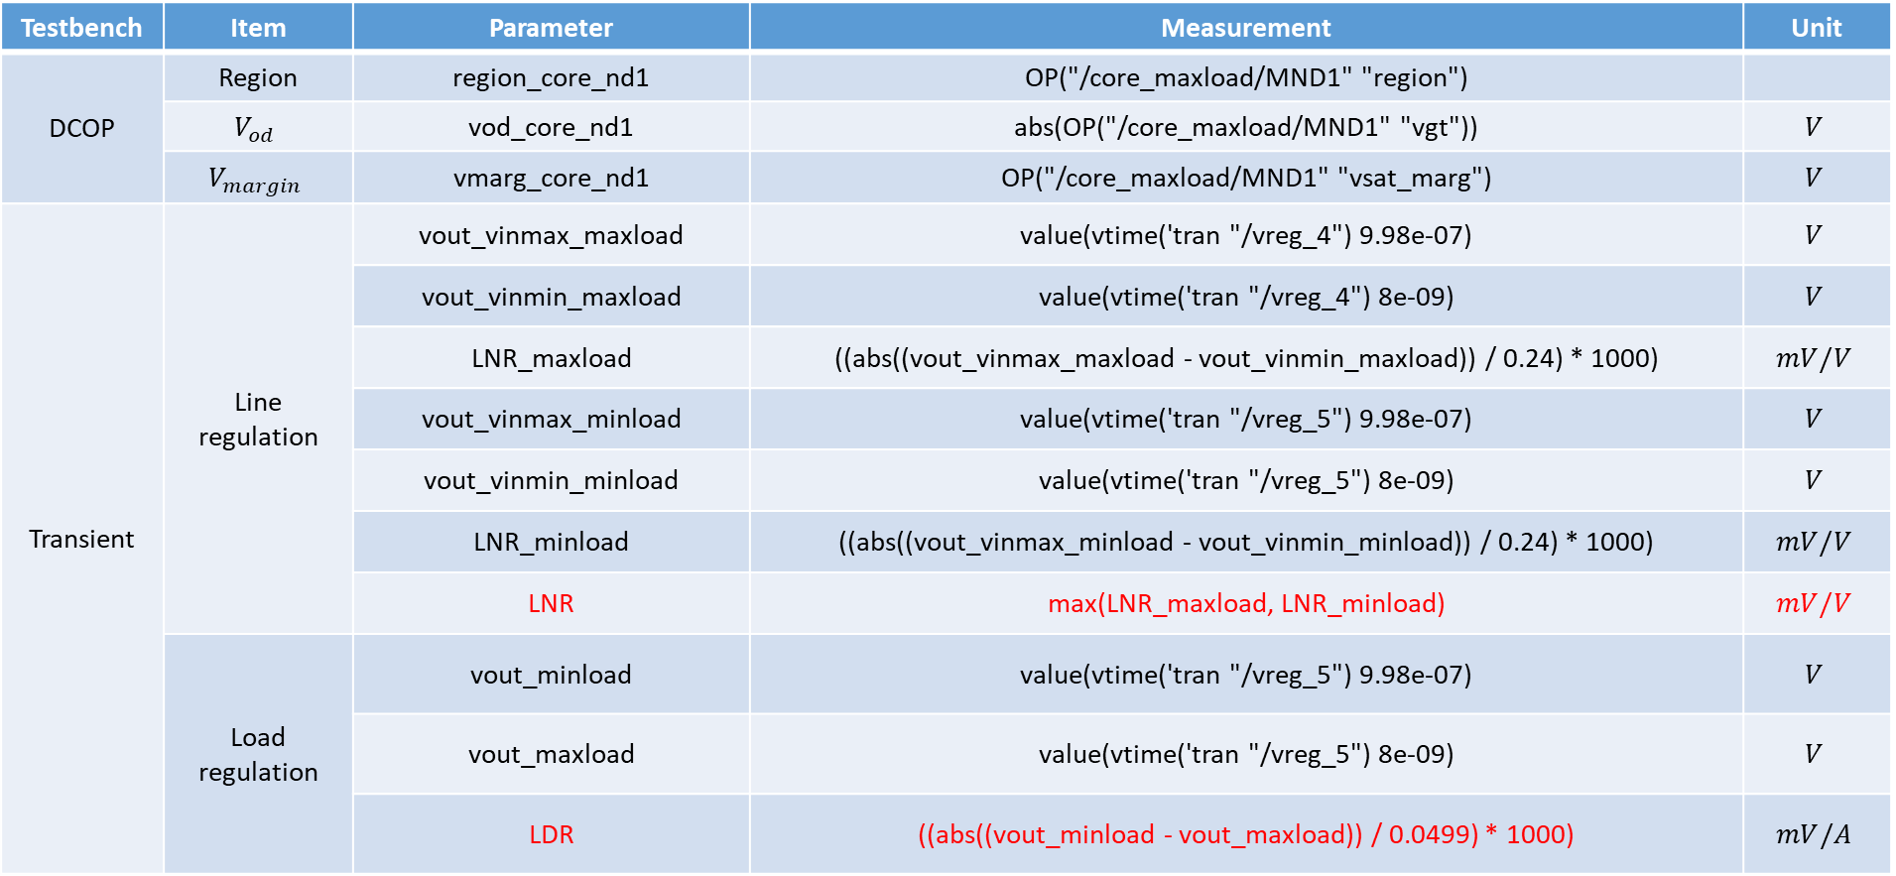
Core - testbench
Testbench | Item | Parameter | Measurement | Unit
DCOP | Region | region_core_nd1 | OP("/core_maxload/MND1" "region")
 | $$V_{od}$$ | vod_core_nd1 | abs(OP("/core_maxload/MND1" "vgt")) | $$V$$
 | $$V_{margin}$$ | vmarg_core_nd1 | OP("/core_maxload/MND1" "vsat_marg") | $$V$$
Transient | Line regulation | vout_vinmax_maxload | value(vtime('tran "/vreg_4") 9.98e-07) | $$V$$
 |  | vout_vinmin_maxload | value(vtime('tran "/vreg_4") 8e-09) | $$V$$
 |  | LNR_maxload | ((abs((vout_vinmax_maxload - vout_vinmin_maxload)) / 0.24) * 1000) | $$mV/V$$
 |  | vout_vinmax_minload | value(vtime('tran "/vreg_5") 9.98e-07) | $$V$$
 |  | vout_vinmin_minload | value(vtime('tran "/vreg_5") 8e-09) | $$V$$
 |  | LNR_minload | ((abs((vout_vinmax_minload - vout_vinmin_minload)) / 0.24) * 1000) | $$mV/V$$
 |  | LNR | max(LNR_maxload, LNR_minload) | $$mV/V$$
 | Load regulation | vout_minload | value(vtime('tran "/vreg_5") 9.98e-07) | $$V$$
 |  | vout_maxload | value(vtime('tran "/vreg_5") 8e-09) | $$V$$
 |  | LDR | ((abs((vout_minload - vout_maxload)) / 0.0499) * 1000) | $$mV/A$$

Slide 16
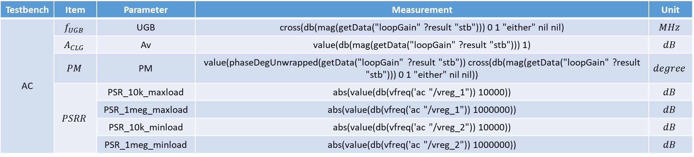
Core - testbench
Testbench | Item | Parameter | Measurement | Unit
AC | $$f_{UGB}$$ | UGB | cross(db(mag(getData("loopGain" ?result "stb"))) 0 1 "either" nil nil) | $$MHz$$
 | $$A_{CLG}$$ | Av | value(db(mag(getData("loopGain" ?result "stb"))) 1) | $$dB$$
 | $$PM$$ | PM | value(phaseDegUnwrapped(getData("loopGain" ?result "stb")) cross(db(mag(getData("loopGain" ?result "stb"))) 0 1 "either" nil nil)) | $$degree$$
 | $$PSRR$$ | PSR_10k_maxload | abs(value(db(vfreq('ac "/vreg_1")) 10000)) | $$dB$$
 |  | PSR_1meg_maxload | abs(value(db(vfreq('ac "/vreg_1")) 1000000)) | $$dB$$
 |  | PSR_10k_minload | abs(value(db(vfreq('ac "/vreg_2")) 10000)) | $$dB$$
 |  | PSR_1meg_minload | abs(value(db(vfreq('ac "/vreg_2")) 1000000)) | $$dB$$
Example:

Slide 17
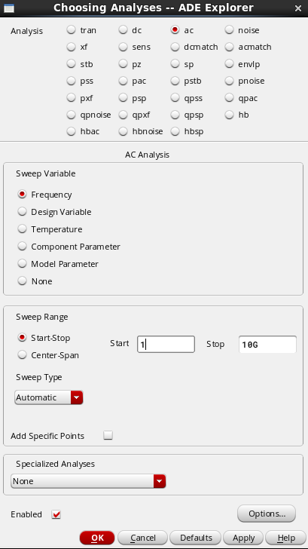
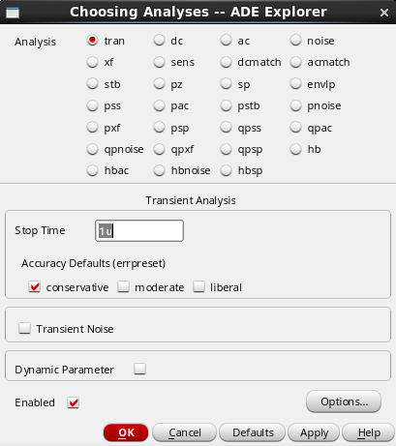
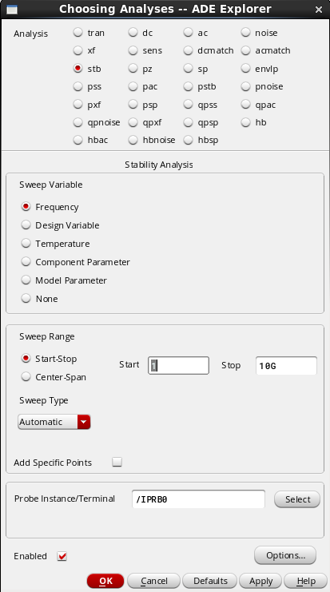
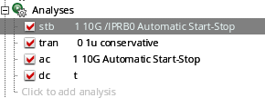
Core - testbench
DCOP analysis
TRANSIENT analysis
AC analysis
STB analysis
→ Execute these analyses in parallel

Slide 18
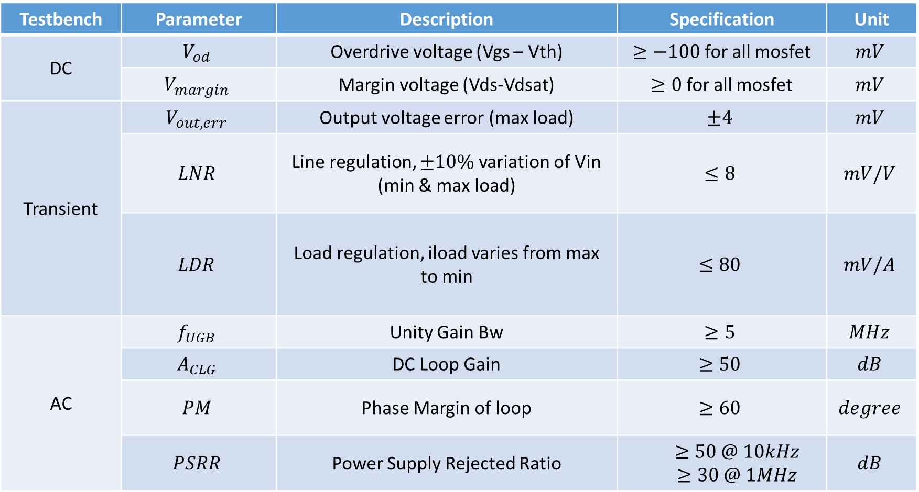
Core Specification
Testbench | Parameter | Description | Specification | Unit
DC | $$V_{od}$$ | Overdrive voltage (Vgs – Vth) | $≥−100$ for all mosfet | $$mV$$
 | $$V_{margin}$$ | Margin voltage (Vds-Vdsat) | $≥0$ for all mosfet | $$mV$$
Transient | $$V_{out,err}$$ | Output voltage error (max load) | $$±4$$ | $$mV$$
 | $$LNR$$ | Line regulation, $±10\%$ variation of Vin (min & max load) | $$≤8$$ | $$mV/V$$
 | $$LDR$$ | Load regulation, iload varies from max to min | $$≤80$$ | $$mV/A$$
AC | $$f_{UGB}$$ | Unity Gain Bw | $$≥5$$ | $$MHz$$
 | $$A_{CLG}$$ | DC Loop Gain | $$≥50$$ | $$dB$$
 | $$PM$$ | Phase Margin of loop | $$≥60$$ | $$degree$$
 | $$PSRR$$ | Power Supply Rejected Ratio | $$≥50 @ 10kHz$$ $≥30 @ 1MHz$ | $$dB$$

Slide 19
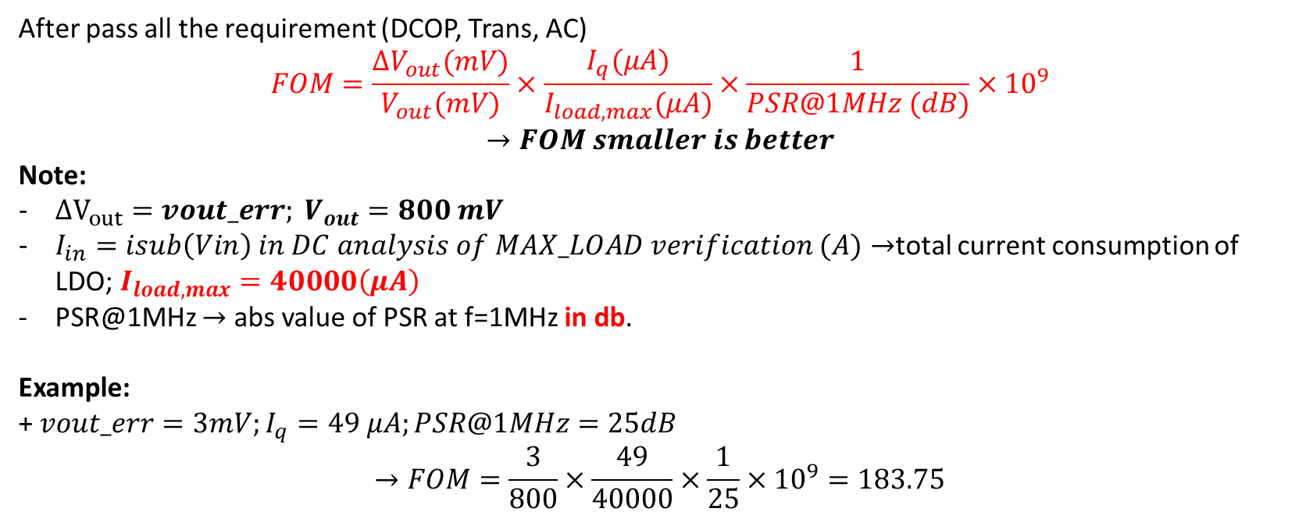
Core Specification
After pass all the requirement (DCOP, Trans, AC) $$FOM=\frac{ΔV_{out}(mV)}{V_{out}(mV)}×\frac{I_{q}(μA)}{I_{load,max}(μA)}×\frac{1}{PSR@1MHz (dB)}×{10}^{9}$$
$$→FOM smaller is better$$
Note:
$ΔV_{out}=vout_err; V_{out}=800 mV$
$I_{in}=isub\left(Vin\right) in DC analysis of MAX_LOAD verification (A)→$total current consumption of LDO; $I_{load,max}=40000\left(μA\right)$
PSR@1MHz $→$ abs value of PSR at f=1MHz in db.
Example:
+ $vout_err=3mV;I_{q}=49 μA;PSR@1MHz=25dB$ $$→FOM=\frac{3}{800}×\frac{49}{40000}×\frac{1}{25}×10^{9}=183.75$$
UPDATE

