Slide 1
Project Work
Dispersing Unit Design
Hieu Nguyen
Duc Nguyen

Slide 2
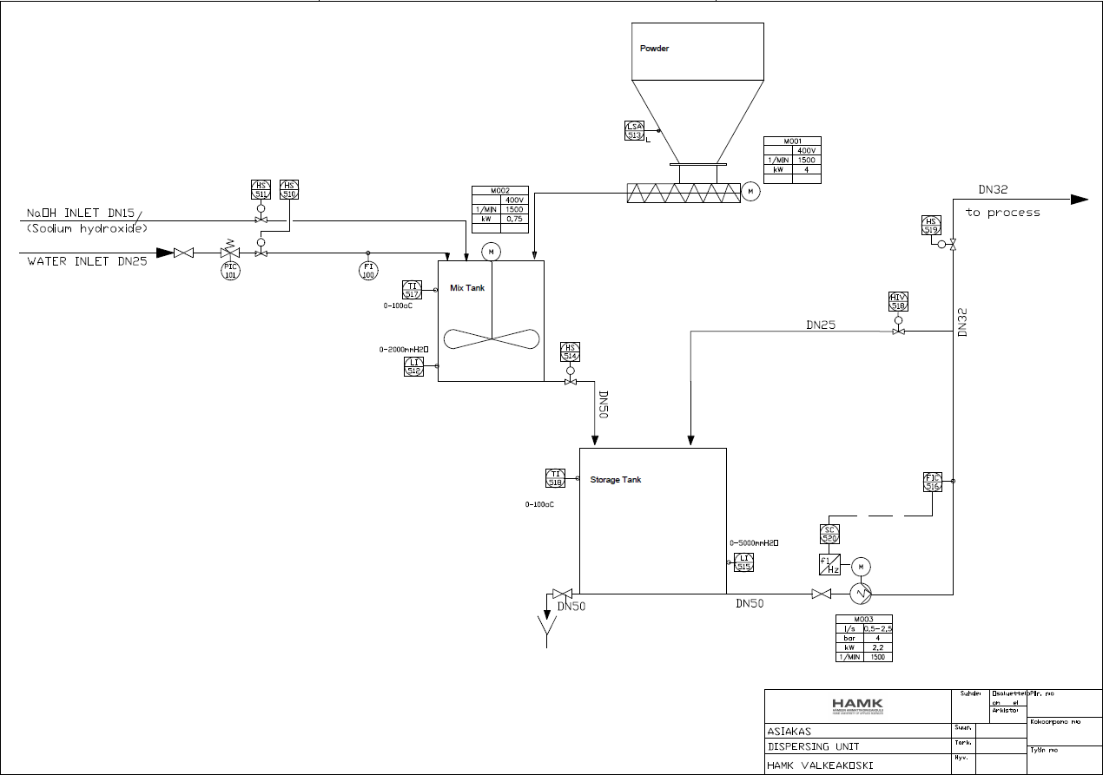
P&I diagram of dispersing unit design

Slide 3
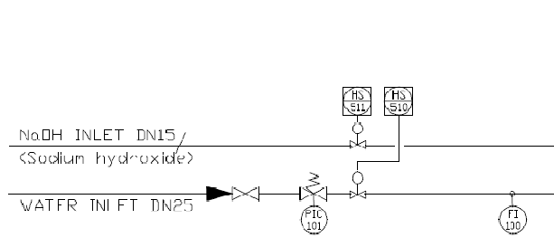
At the beginning, both the NaOH liquid and the water are conducted into the mixing tank simultaneously through the DN15 and DN25 alternately.
To control the flow rate in each pipe, there are two hand valve HS-511 and HS-510 corresponded to DN15 and DN25 which are also managed in the control room.
Besides that, the pressure relief valve with the pressure indicator PIC-101 and flow meter FI-100 are located on the pipe DN25 controlling on the field individually.

Slide 4
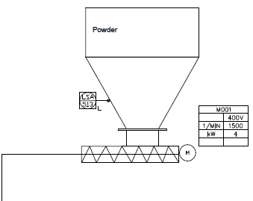
Concurrently the powder from the powder tank is dispatched by the conveyor motor MO-01 with the mixing liquid NaOH and water into the mixing tank. On the side of the power tank, the low-level switch alarm LSA-513 is adjusted for operating the powder level.

Slide 5
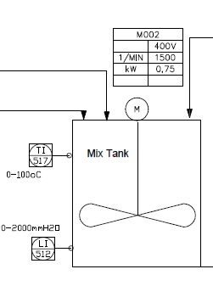
The following stage of the process is all the materials is leaded into the mixing tank and stirred by the stirring motor MO-02.
The temperature transmitter TI-517 for the set point range 0-100℃ and the hydrostatic low-level transmitter LI-512 for the set point range 0-2000mmH2O are merged on the side of the tank indicating the temperature and level of the mixed liquid to the control room.

Slide 6
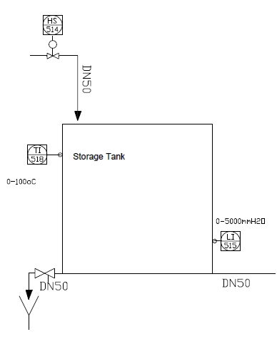
After the mixing stage, the result liquid is released into the storage tank via the pipe DN50 with the control of the hand valve HS-514.
Concerning the storage tank, also the temperature transmitter for the set point range 0-100℃ TI-518 and hydrostatic low-level transmitter LI-515 for the set point range 0-5000mmH2O are attached on the side of the tank indicating the temperature and level of the liquid mixture to the control room.

Slide 7
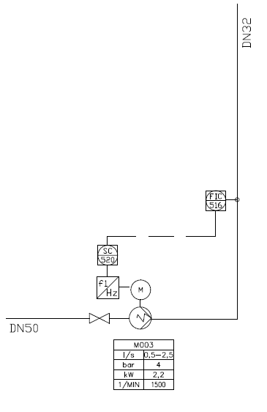
There is the pump motor MO-03 connected with the speed drive SC-520 drains the liquid mixture from the storage tank through the pipe DN50 to the pipe DN32.
Based on the database signal from the FIC-516 flow transmitter measures the flow rate in the pipe DN32 indicating to the control room, the speed drive is adjusted to control the pump motor speed reasonably.

Slide 8
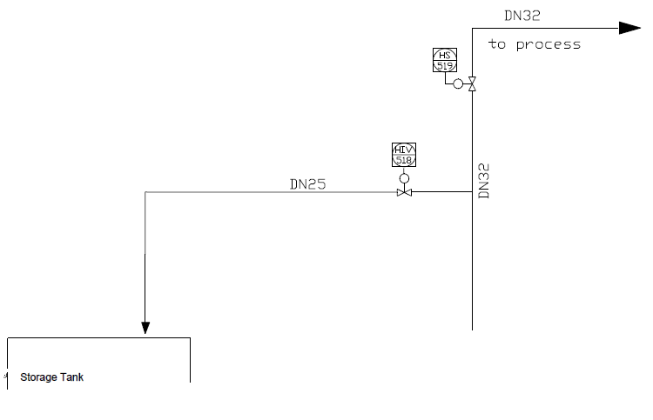
On the pipe DN32 to the next stage, the hand valve HS-519 commanded from the control room is combined. Another direction flow is the displacement of liquid back to the storage tank via the pipe DN25 and operated by the hand valve HIV-518.

Slide 9
Hieu Nguyen:
Motor list
I/O list
Circuit diagrams
Cable list
Description of circuit operation
Definition of control circuit
Cabinet layout
Duc Nguyen:
Instrument list
Loop Programming charts
Description of Process operation
Description of application software
Hook-up drawings
Table of name plates

Slide 10
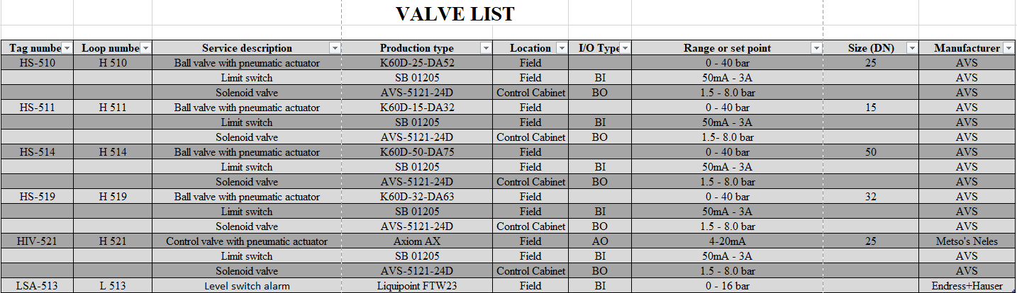

Slide 11
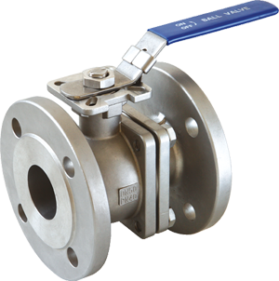
Ball valve with pneumatic actuator type K60D
Manufacturer AVS

Slide 12
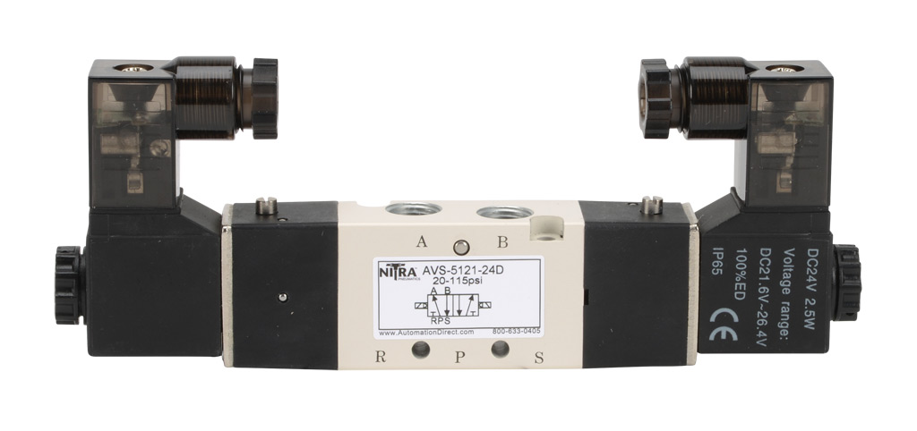
Solenoid valve type AVS-5121-24D
Manufacturer AVS

Slide 13
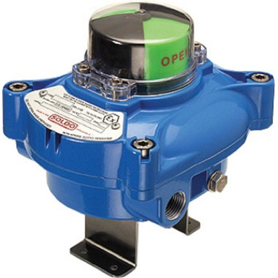
Limit switch type SB01205
Manufacturer AVS

Slide 14
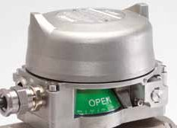
Control valve type Axiom AX
Manufacturer Metso’s Neles

Slide 15
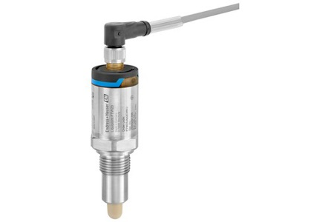
Level switch alarm type Liquipoint FTW23
Manufacturer Endress+Hauser

Slide 16
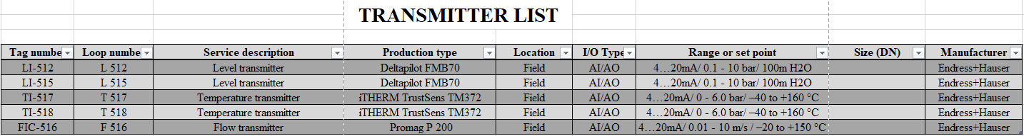

Slide 17
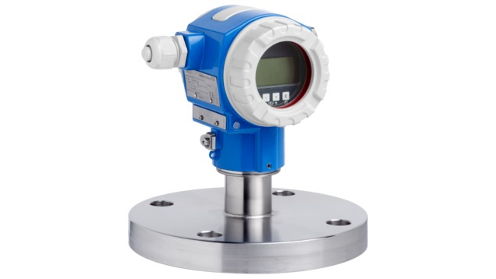
Hydrostatic level transmitter type Deltapilot FMB70
Manufacturer Endress+Hauser

Slide 18
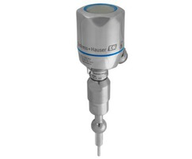
Temperature transmitter type iTHERM TrustSens TM372
Manufacturer Endress+Hauser

Slide 19
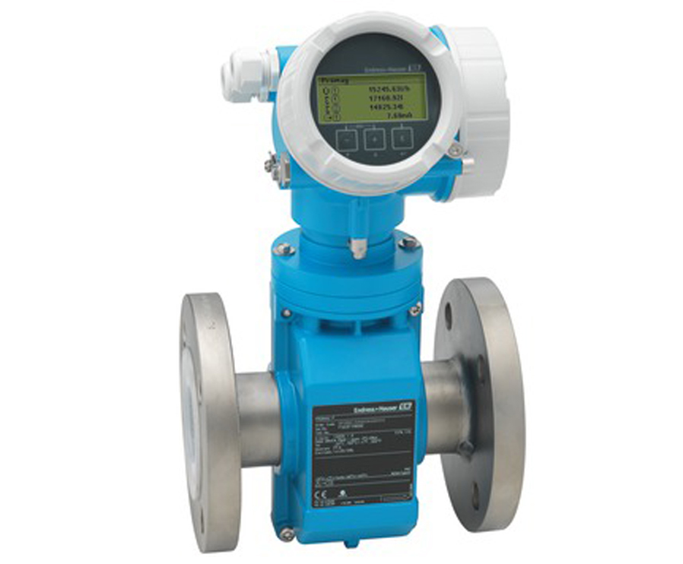
Electro-magnetic flow transmitter type Promag P 200
Manufacturer Endress+Hauser

Slide 20
Motor list

Slide 21
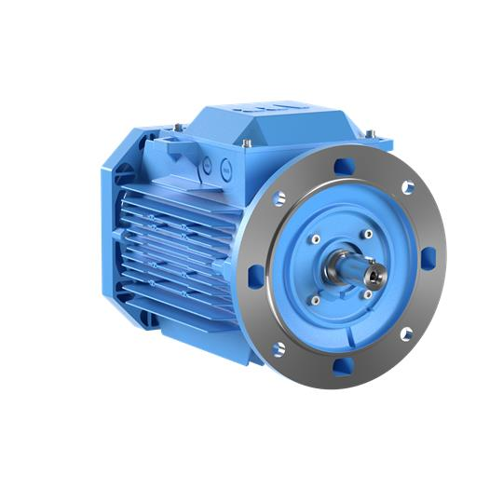
Powder conveyor motor type 3GAA112320-ADJ
Manufacturer ABB

Slide 22
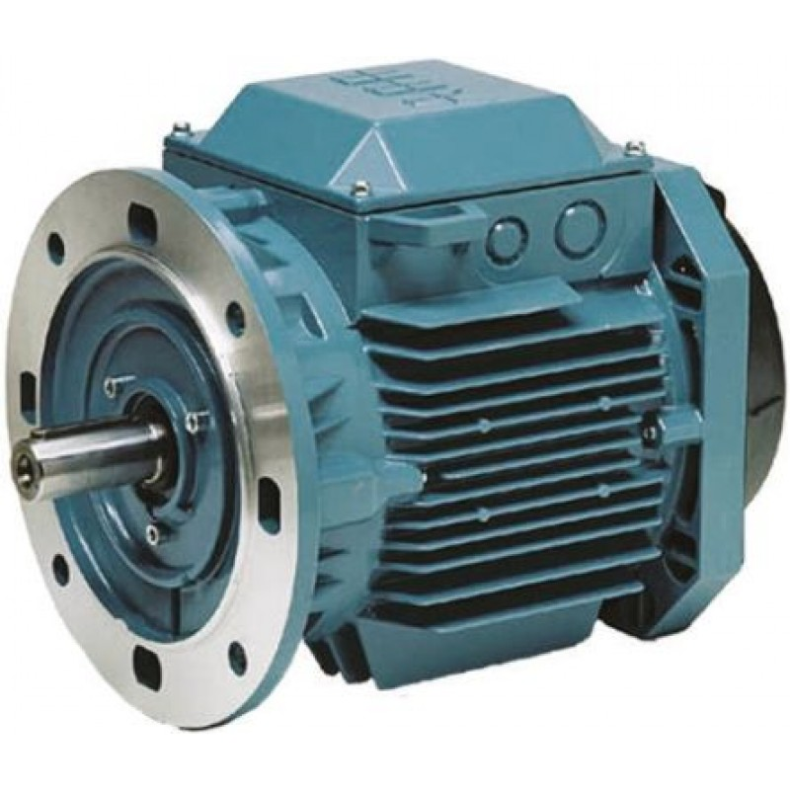
Mixing tank mixer motor type 3GAA082614-BSJ
Manufacturer ABB

Slide 23
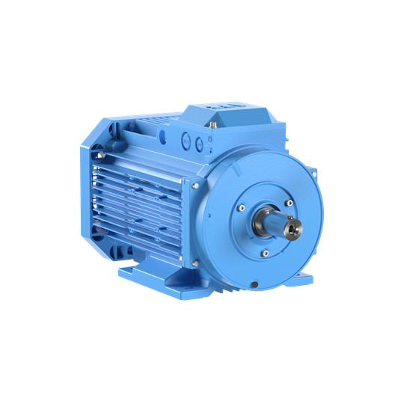
Storage tank feed motor type 3GAA102530-ASJ
Manufacturer ABB

Slide 24
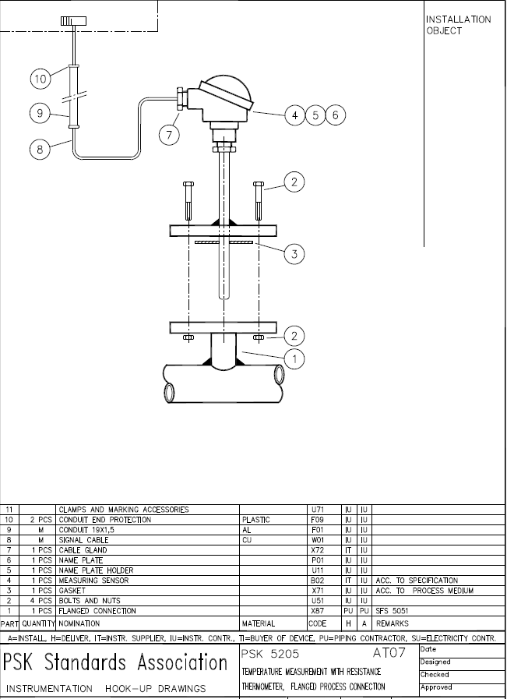

Slide 25
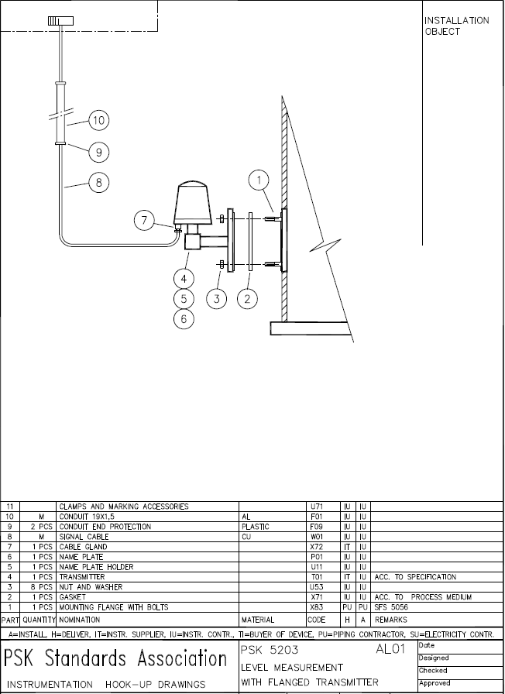

Slide 26
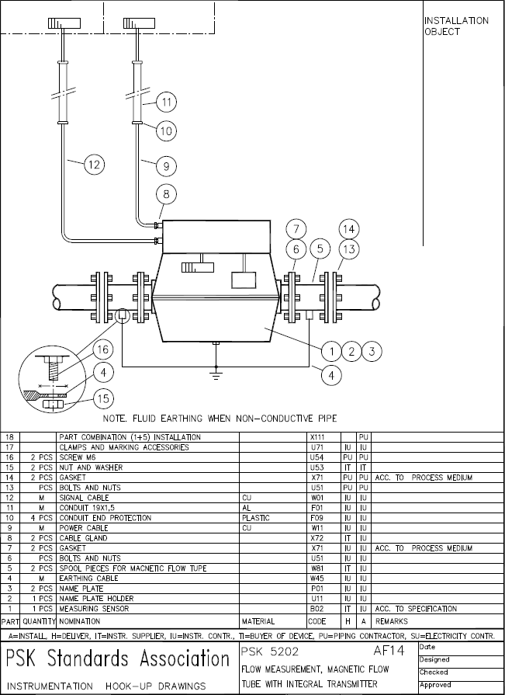

Slide 27
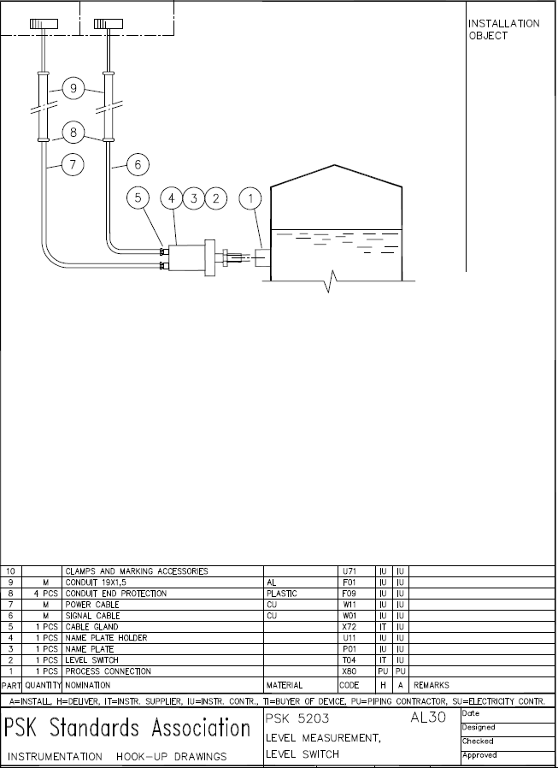

Slide 28
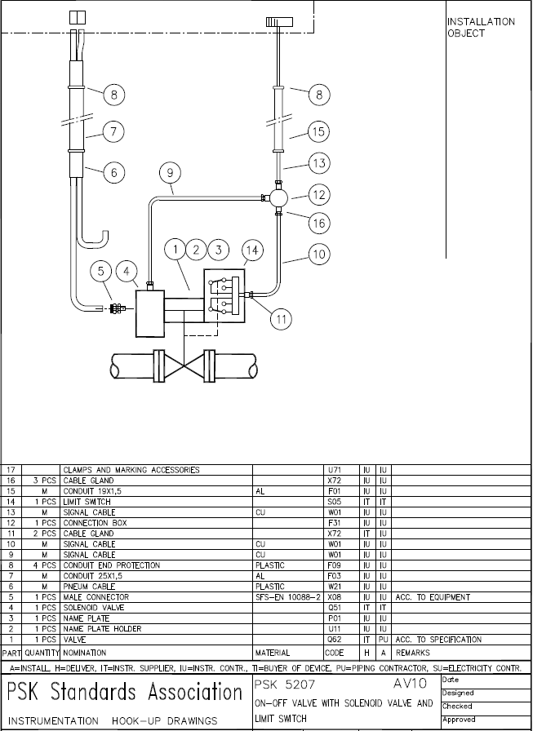

Slide 29
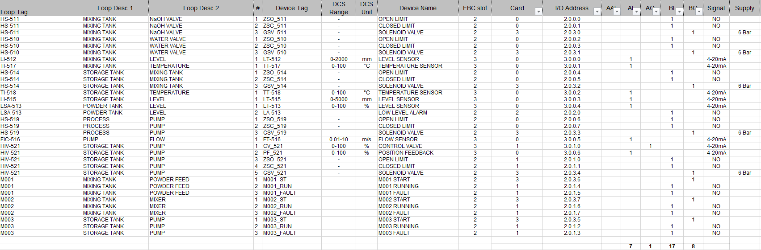
I/O list reservation

Slide 30
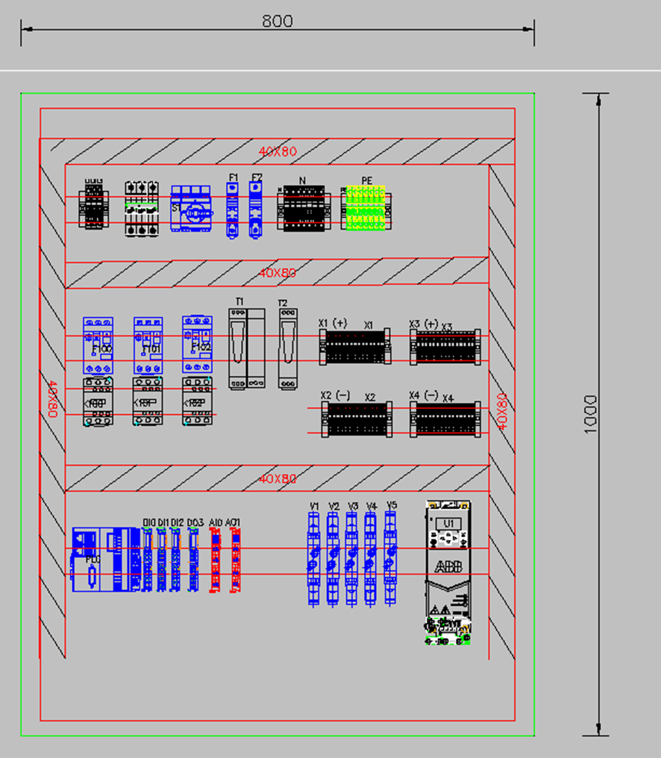
Control cabinet layout

Slide 31
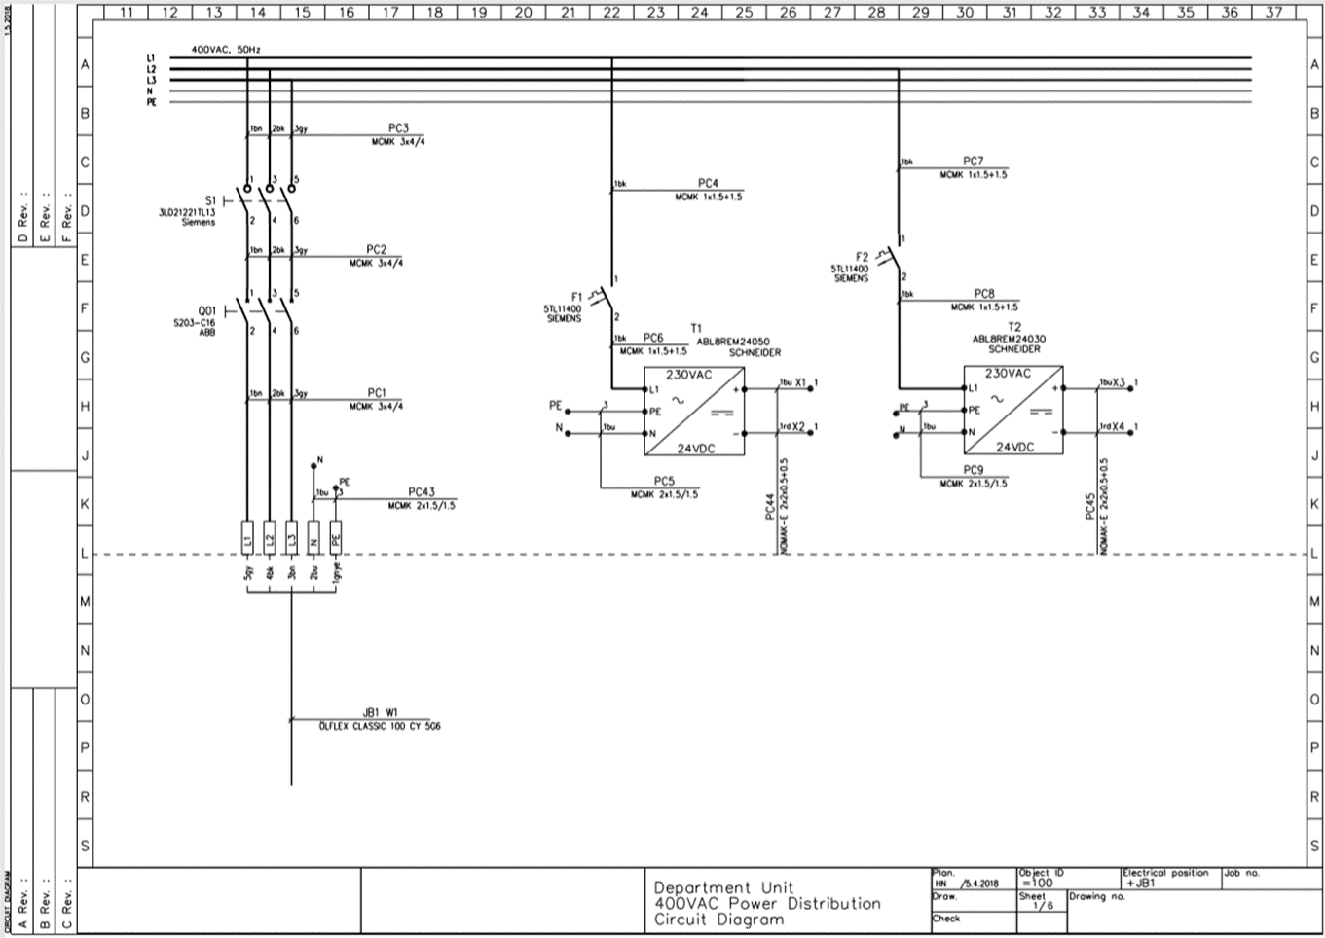
Main power distribution and transformer

Slide 32
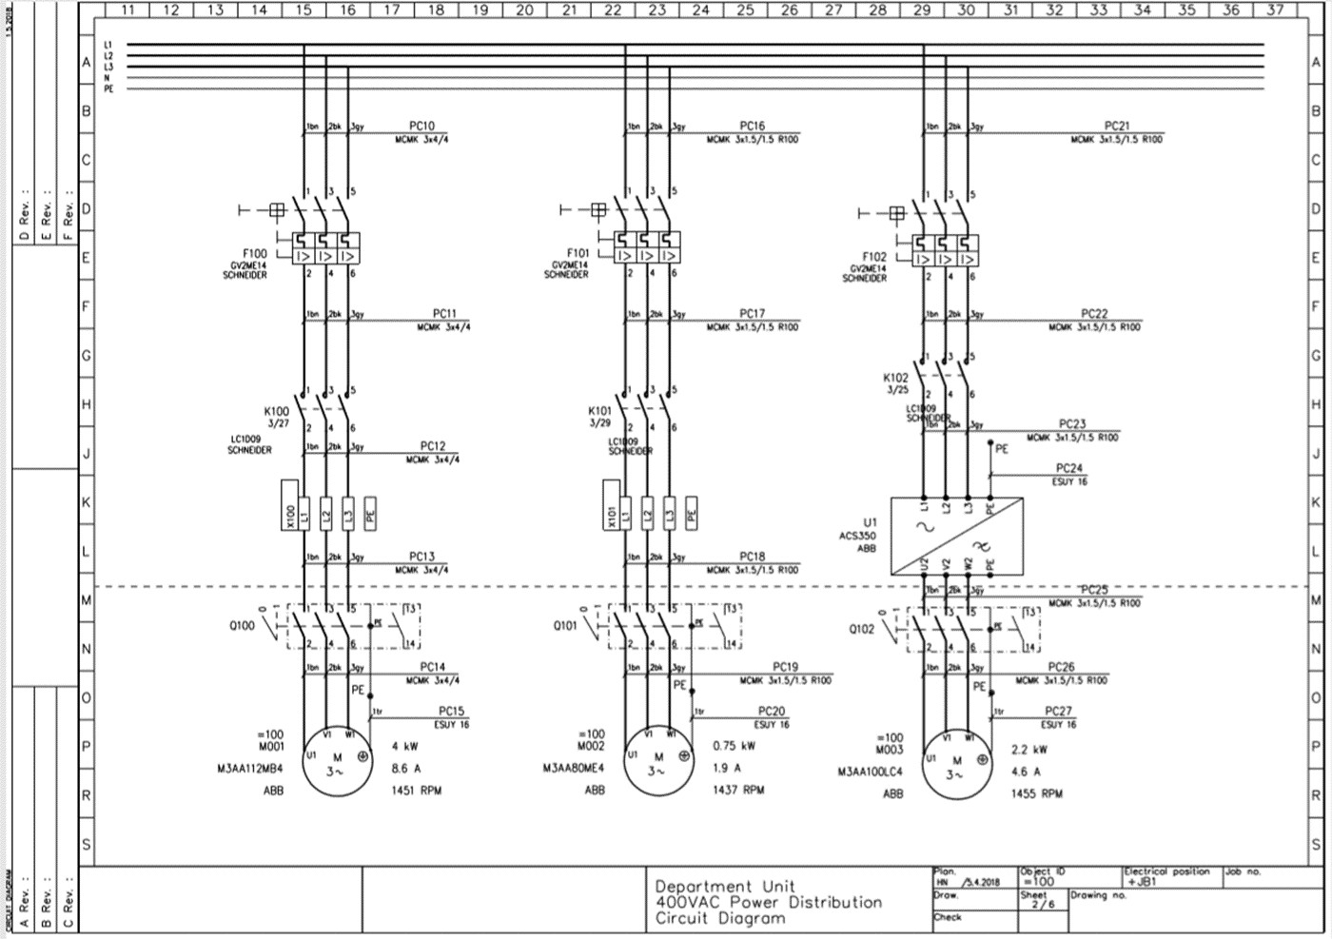
Motors and their protection devices

Slide 33
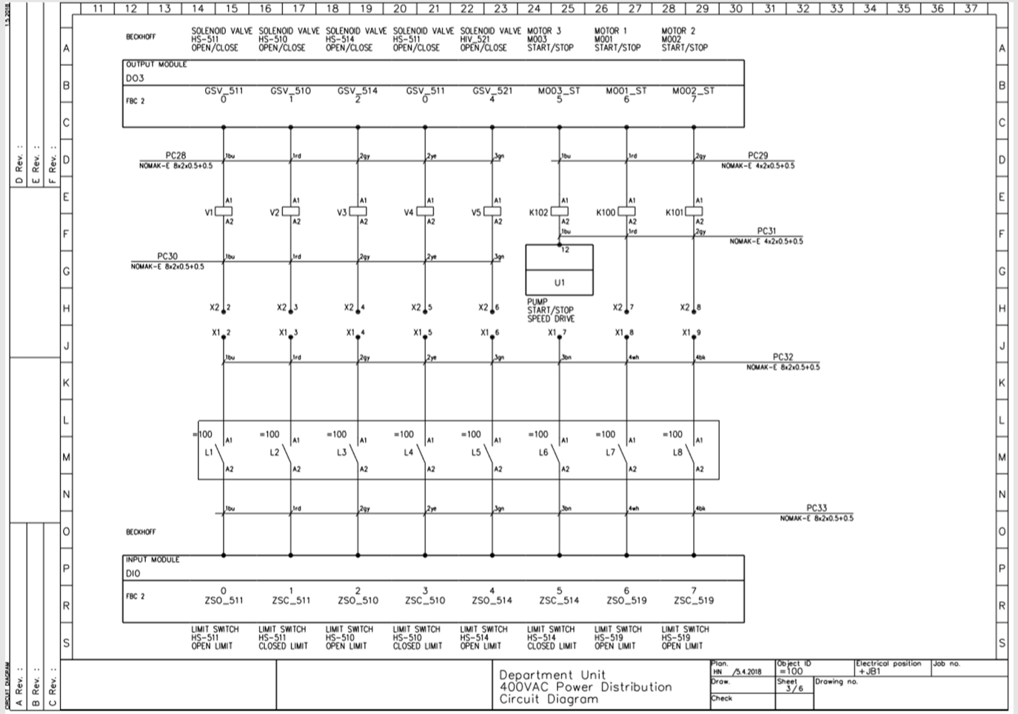
Control system

Slide 34
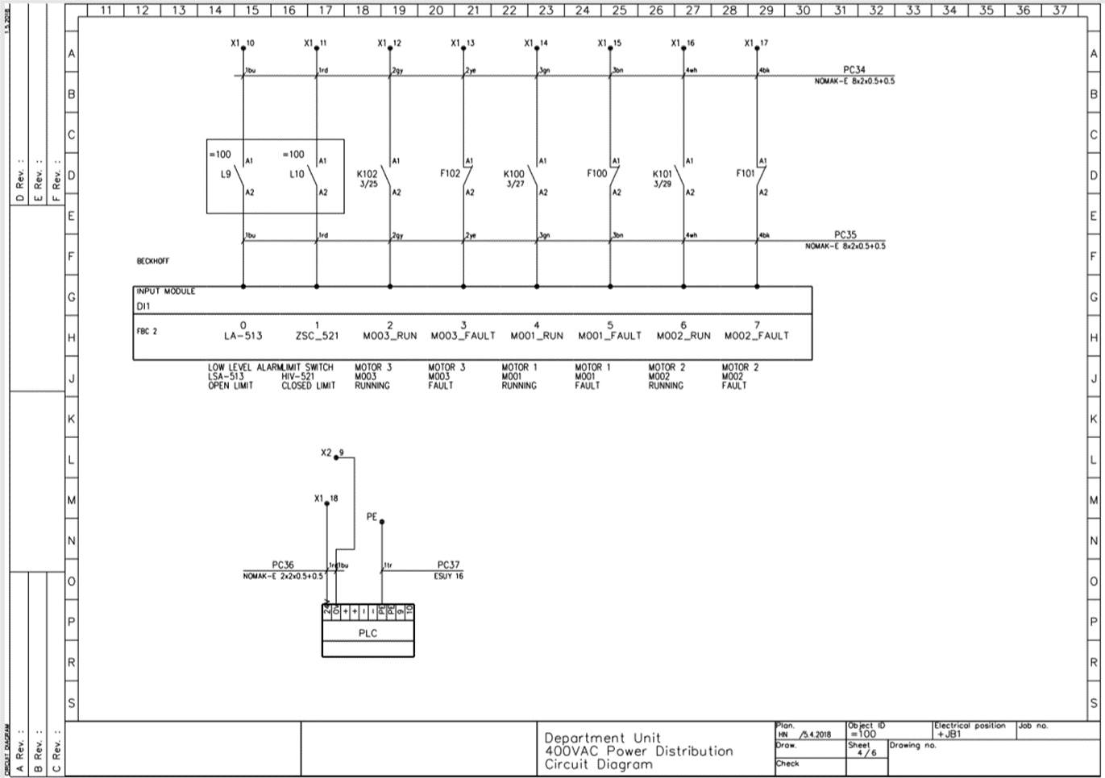
Control system

Slide 35
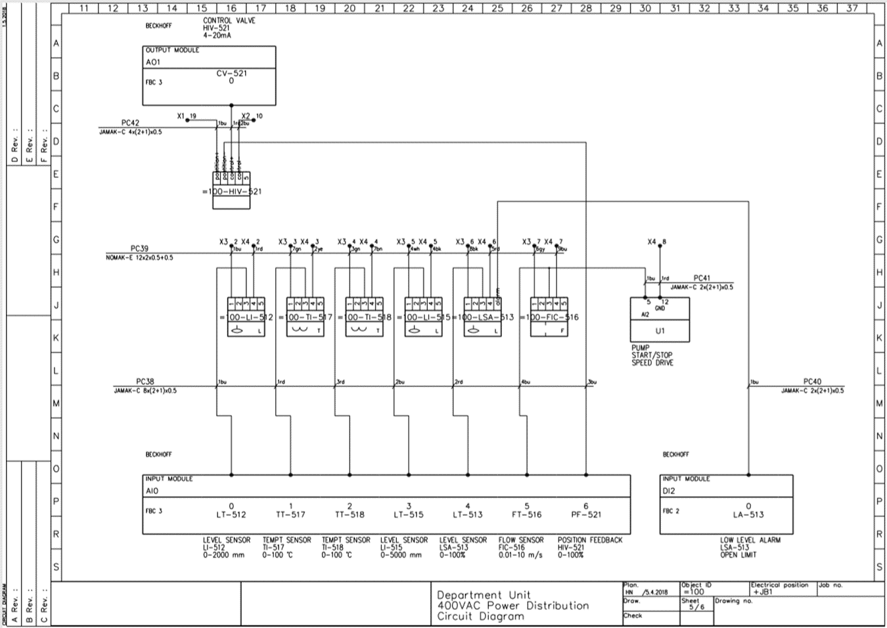
Sensors

Slide 36
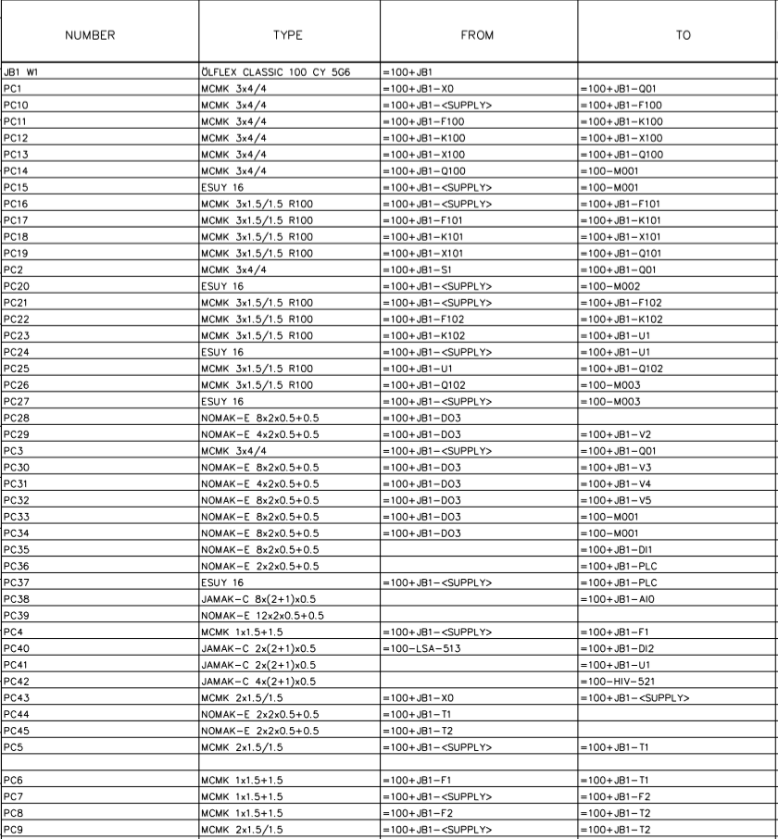
Cable list

Slide 37
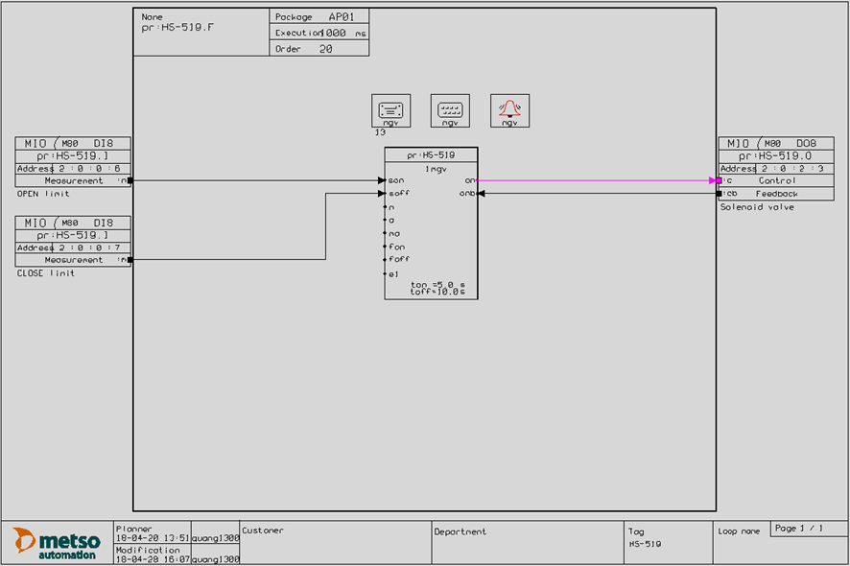
Hand valve control loop

Slide 38
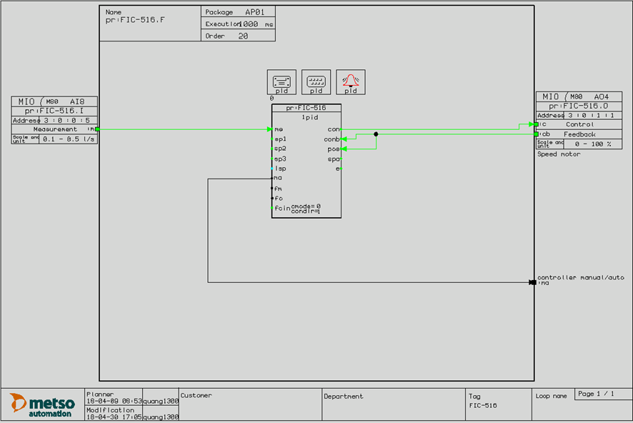
Flow indicating control loop

Slide 39
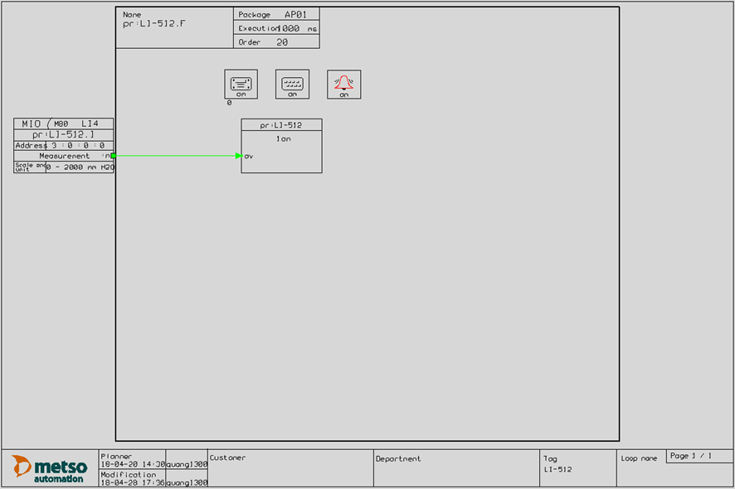
Hydrostatic level measurement loop

Slide 40
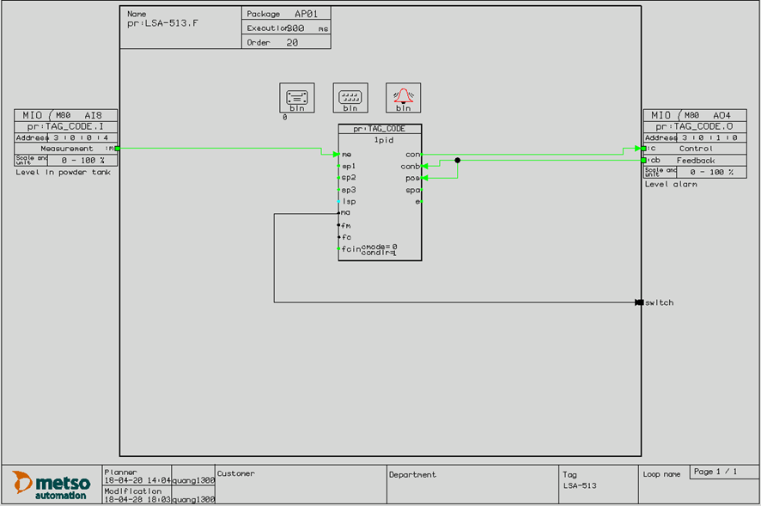
Level switch alarm loop

Slide 41
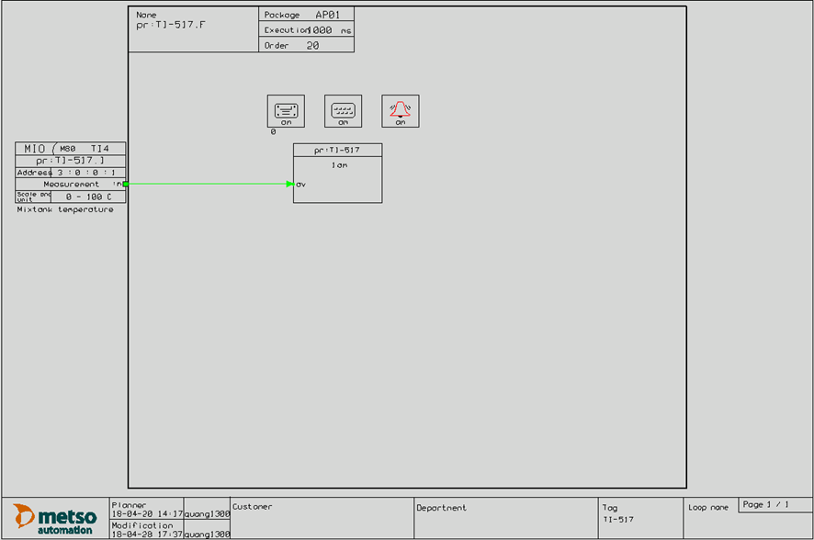
Temperature measurement loop

Slide 42
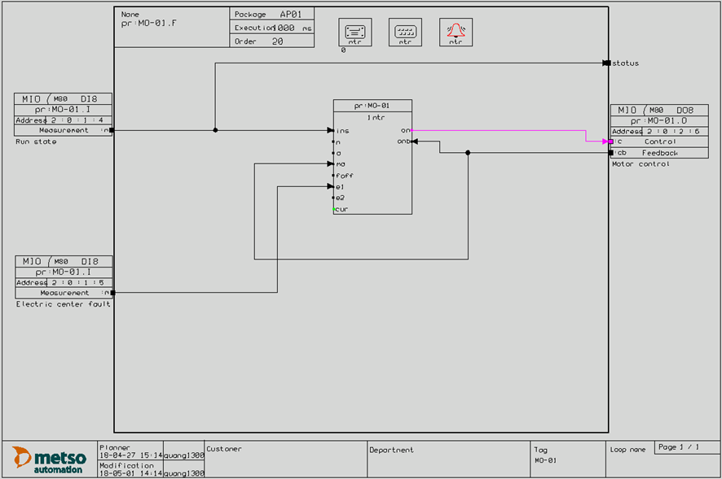
Powder conveyor motor loop

Slide 43

Mixing tank mixer motor loop

Slide 44
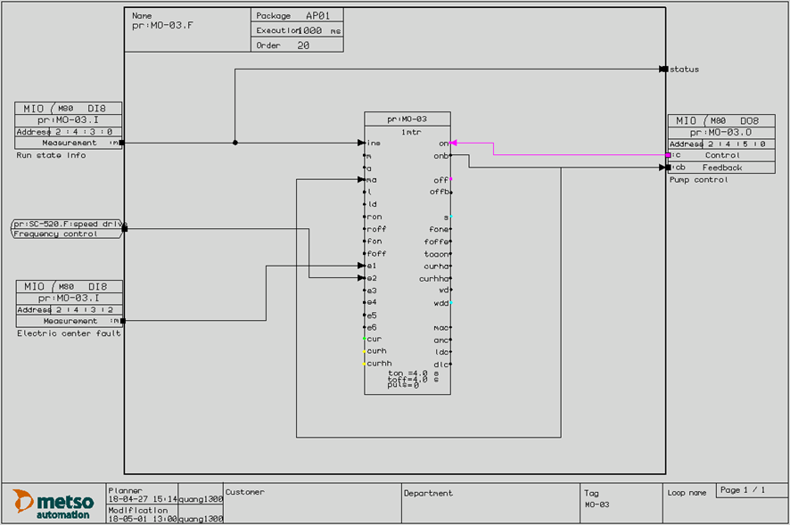
Storage tank feed motor loop

Slide 45
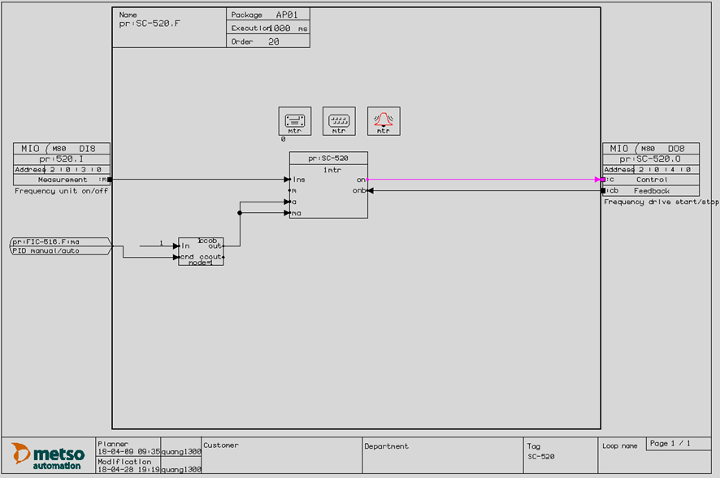
Speed drive loop

Slide 46
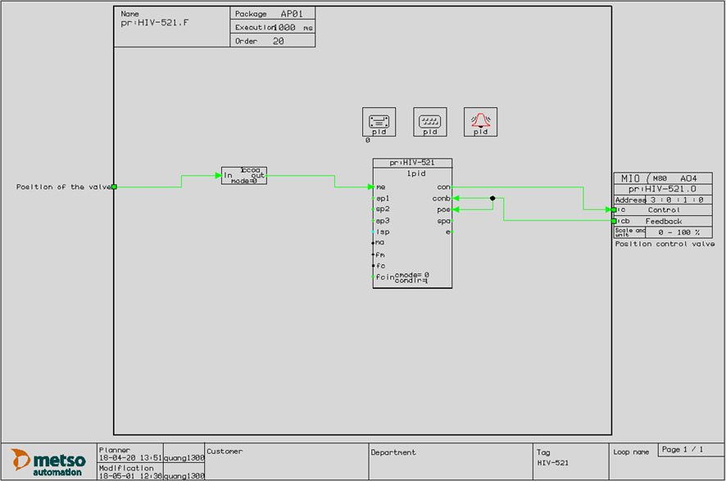
Control valve loop

Slide 47
Hieu Nguyen:
Motor list
I/O list
Circuit diagrams
Cable list
Description of circuit operation
Definition of control circuit
Cabinet layout
Duc Nguyen:
Instrument list
Loop Programming charts
Description of Process operation
Description of application software
Hook-up drawings
Table of name plates

Slide 48
challenges
CAD skill
Devices information and searching the suitable components based on the given requirement
Time management
Determine parts of plan

Slide 49
Application for future
Knowing how to prepare and design the basic automation process.
Perceiving experience in searching components based on the given information.
The fundamental ideas for installing the electrical network and control cabinet.
By accomplishing this process, we are able to apply it into another liquid mixing in industry

Slide 50



