Slide 1
EBILLING AND INVOICE SYSTEM
Group Members:
Nguyen Van Duc, ducnvgc00560@fpt.edu.vn
Mai Duc Muoi, muoimd00568@fpt.edu.vn
Nguyen Gia Quyen, quyenng00466@fpt.edu.vn

Slide 2
problem definition
This project is to be developed for one of the big decorator services in Mumbai, they supply decorating item to film industry for movie shooting. Presently they issue their client handwritten invoice and they enter details in manual register. And maintain MS Excel file for product rate. They want computerization of their manual invoice and bill generation process.
The client uses MS Excel, and maintains their product list, customer list, and prints the invoice, however it is not possible them to share the data from multiple system in multi user environment, there is lot of duplicate work, and chance of mistake. When the product price are changed they need to update each and every excel file. There is no option to find and print previous saved invoice.
There is no security; any body can access any report and sensitive data, also no reports to find out the sales volume, stock list, and summary report. This eBilling and invoicing system is used to overcome the entire problem which they are facing currently, and making complete atomization of manual billing and invoicing system.

Slide 3
user requirements
Manage Orders
Add new order
Add Products to Order
Remove Product from Order
Save Orders
Manage Products
Add Product
Update Product
Delete Product
Manage Customers
Add Customers
Update Customers
Delete Customers
Magage Users
Add Users
Update Users
Delete Users

Slide 4
Architecture
Presentation Tier
Database Tier

Slide 5
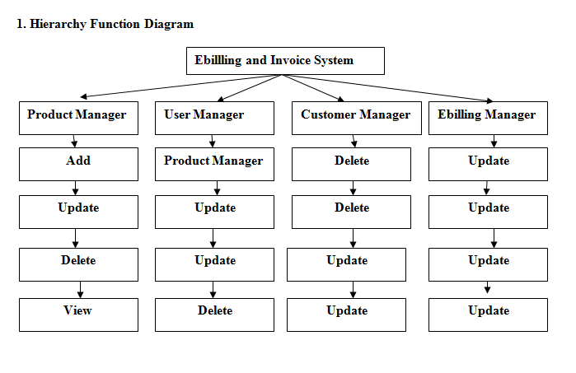

Slide 6
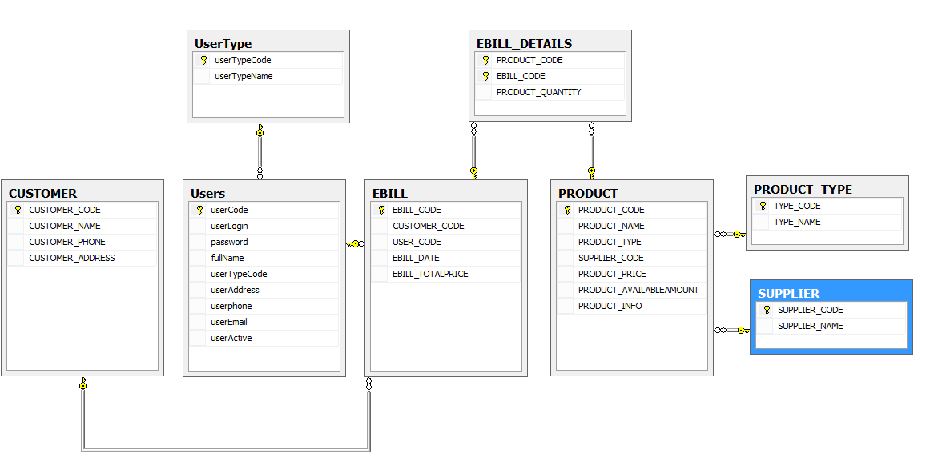
Database design

