Slide 1
iTracking
iOS Fresher Final Project

Slide 2
OUTLINE
Introduction
Key features
Used Techniques
Demo
Q&A

Slide 3
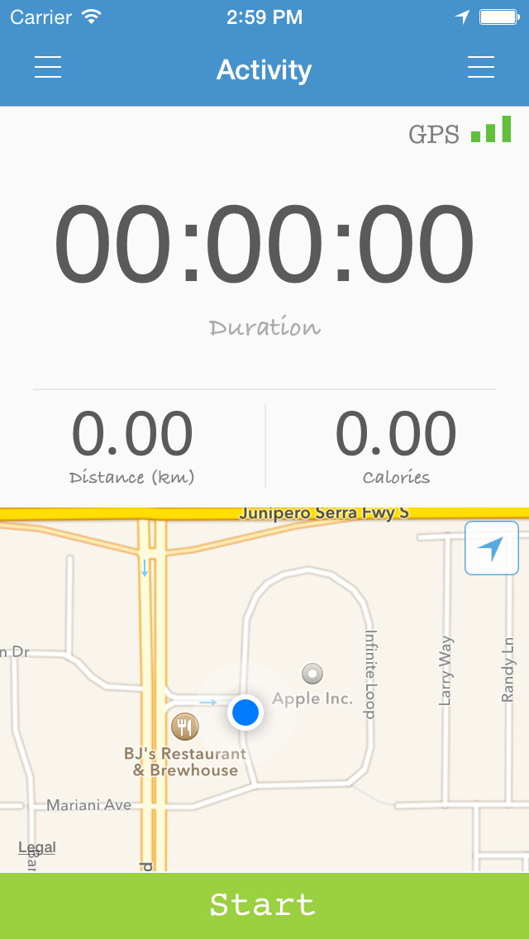
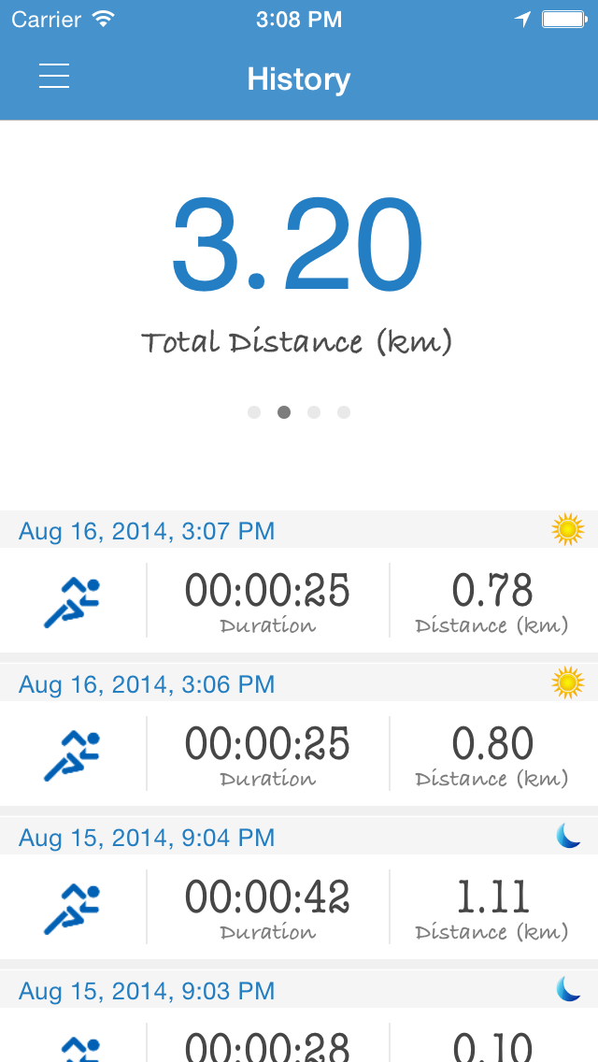
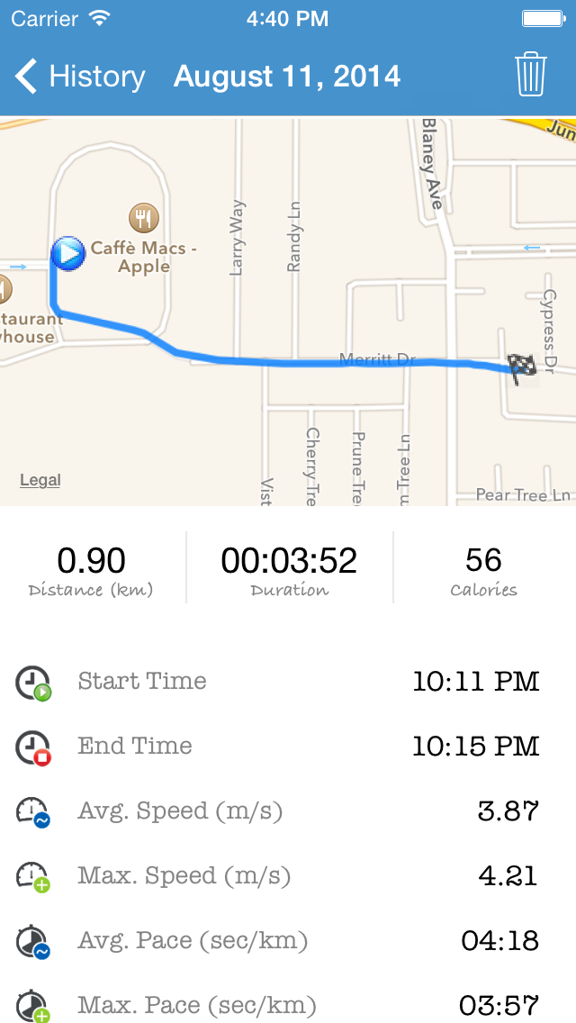
INTRODUCTION
Notes:
Track user’s location -> give real-time feedback during workout
Log activity history and view additional details

Slide 4
KEY FEATURES
Tracking Activities
Track user’s location
Calculate:
GPS Signal strength
Distance traveled
Duration
Speed
Burned Calories
…
GPS Signal Strength
Show User’s Location
Notes:
Custom location manager class, define new delegate
Altitude coordinate (lack of device)

Slide 5
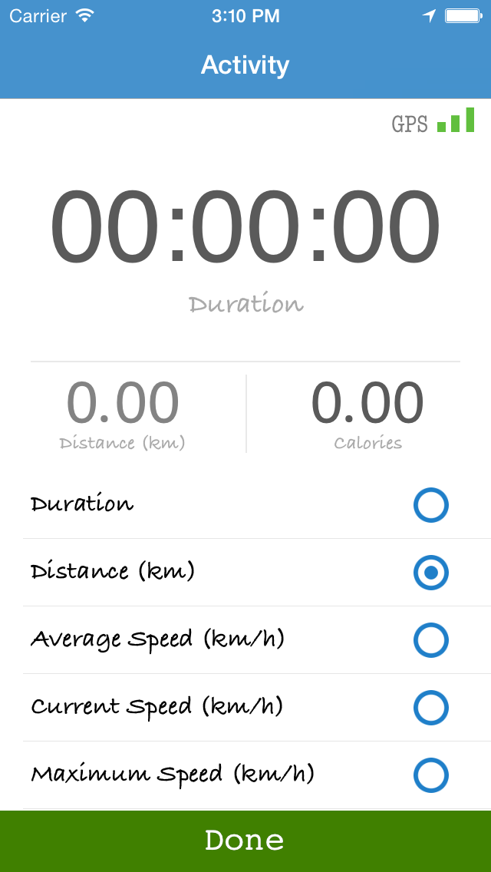
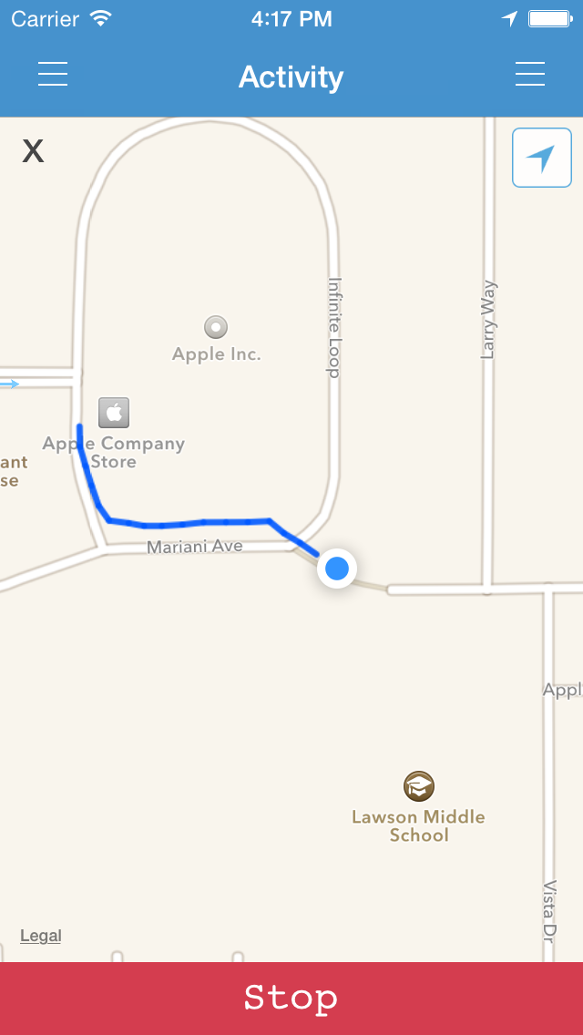
KEY FEATURES
Tracking Activities
Track user’s location
Calculate information
Customize View
Customize Info Label
Maximize Map

Slide 6
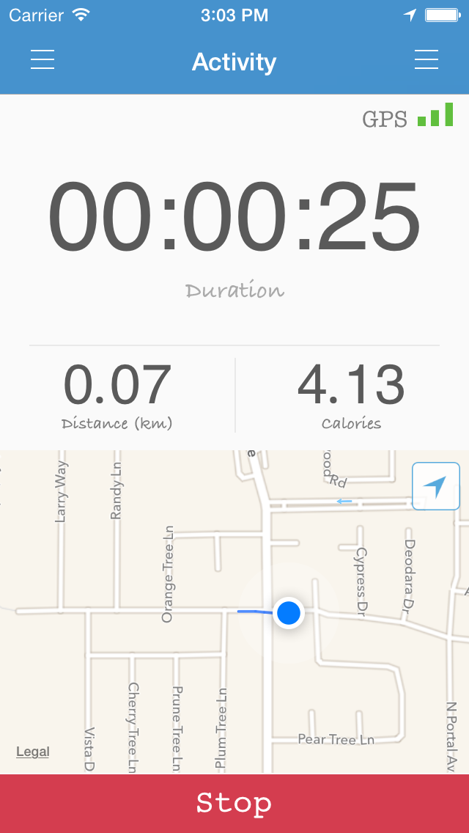
KEY FEATURES
Tracking Activities
Track user’s location
Calculate information
Customize View
Voice notification
Start/Stop tracking
Distance
Duration

Slide 7

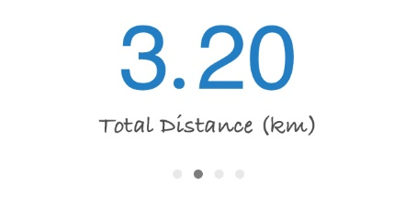
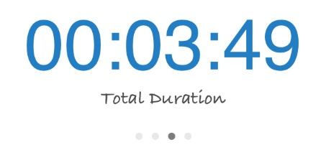
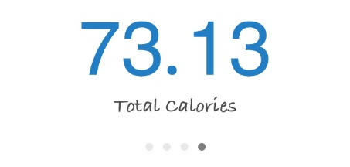
KEY FEATURES
Tracking Activities
History
Statistics

Slide 8
KEY FEATURES
Tracking Activities
History
Statistics
Display activity detail

Slide 9
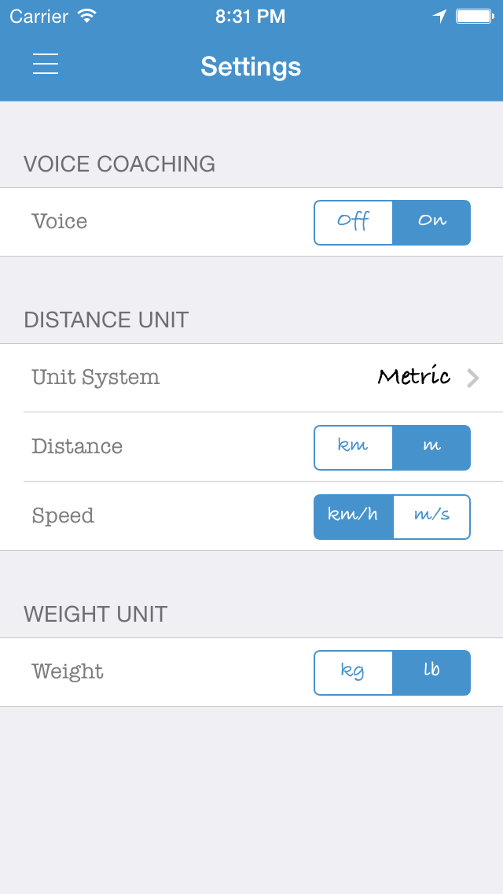
KEY FEATURES
Tracking Activities
History
Preference
Turn on/off voice notification
Change distance/speed/weight unit
Turn on/off voice
Change distance / speed unit
Change weight unit

Slide 10
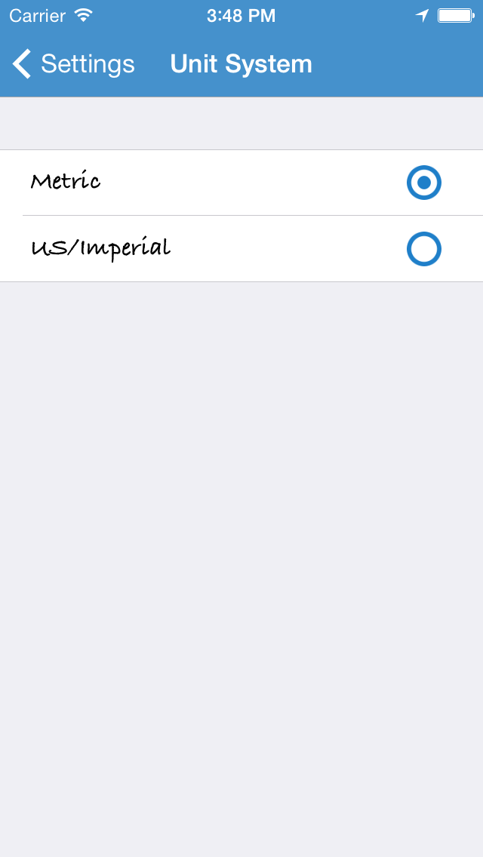
KEY FEATURES
Tracking Activities
History
Preference
Turn on/off voice notification
Change distance/speed/weight unit
Change Unit System
Metric (meters, kilometers…)
US/Imperial (miles, feet…)

Slide 11
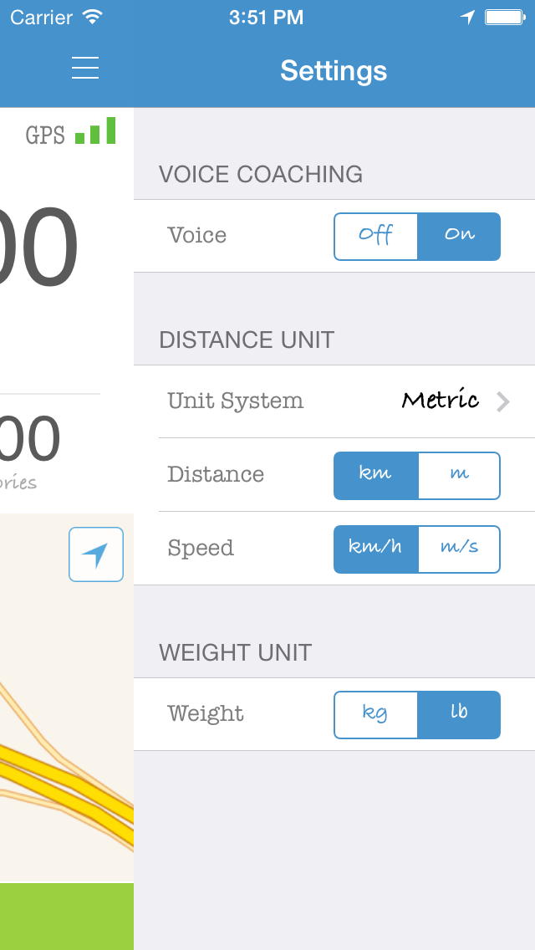
KEY FEATURES
Tracking Activities
History
Preference
Turn on/off voice notification
Change distance/speed/weight unit
Change Unit System
Change Preference in Activity View

Slide 12
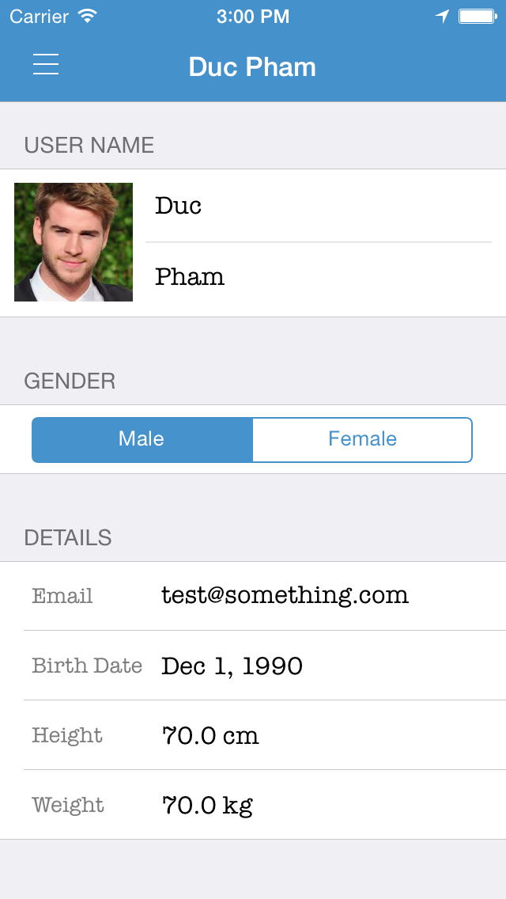
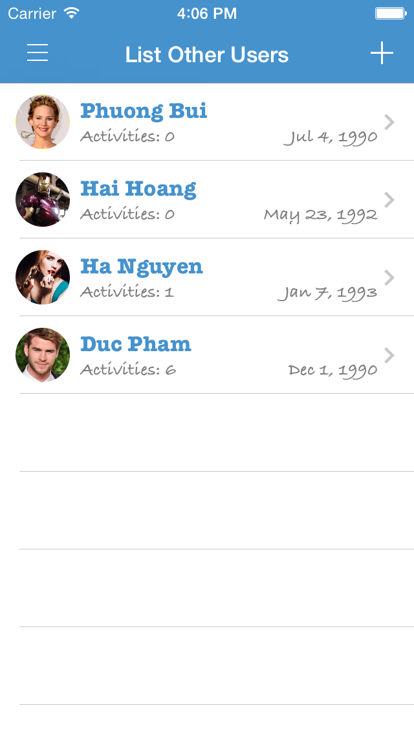
KEY FEATURES
Tracking Activities
History
Preference
User Information
Switch user

Slide 13
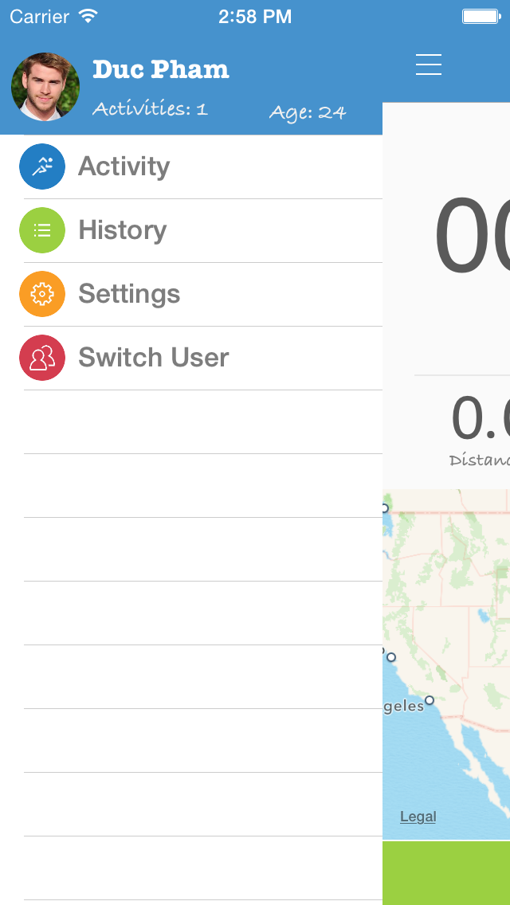
KEY FEATURES
Tracking Activities
History
Preference
User Information
Additional features
Easy-access Menu

Slide 14
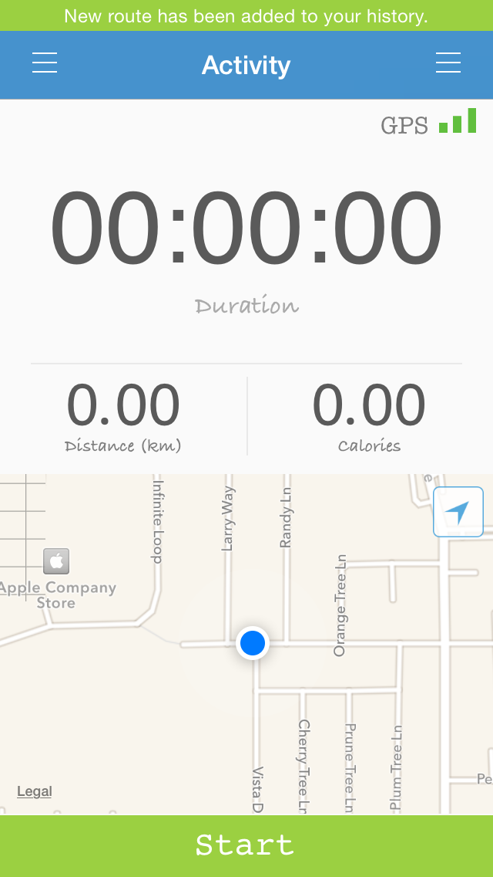


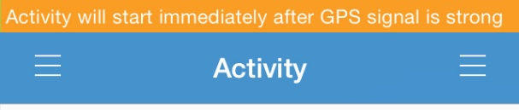

KEY FEATURES
Tracking Activities
History
Preference
User Information
Additional features
Easy-access Menu
Status bar notification

Slide 15
USED TECHNIQUES
Store data:
Core data → User + History Data
NSUserdefault → Preference
PList → METValue (required to calculate Calorie)
Animation
CoreBasicAnimation: blink effect
UIView animation: transition animation
Multithreading:
Load profile picture (Table view)
Display clock and duration
Add time delay to functions
Text-to-Speech:
AVSpeechSynthesizer

Slide 16
DEMO

Slide 17
Q&A

