Slide 1
Vigenere cipher decoder
ICT.01-K61

Slide 2
First table team
Team members:
Pham Le Duc – 20161128
Nguyen Gia Bach - 20160306

Slide 3
Introduction to Vigenere cipher
Definition: given a key with a specific length called “k” and a plain message “p”.
We encrypt by adding each letter of the plain text to the corresponding letter in the key, then use mod for the total of characters in the alphabet to receive a cipher letter.
We decrypt by reversing the process, but this time we minus the cipher letter with the key letter.

Slide 4
Cryptanalysis of the Vigenere Cipher
Because we do not know what the key and its length for encryption is, we use Cryptanalysis of the Vigenere Cipher to DECRYPT a plain text given by its cipher text.
Two main steps:
Step 1: Find possible key lengths of the key used to encrypt the plain text (Index of Coincidence method)
Step 2: Find possible plain texts by finding possible keys using “χ²” (Chi-squared) method

Slide 5
Index of coincidence
Step 1
Step 1
Identify m – the possible length of the key with the starting value m = 1.
Step 2
Step 2
Generate a substring using m as a split point. Meaning that, we pick up the first letter, concat the next one after m indexes, and so on until we reach the end of the cipher text.
Step 3
Step 3
Calculate the IC value for each occurrence of the letters within the substring we have just generated using the IC formula.

Slide 6
Index of coincidence (CONt)
Step 4
Step 4
Calculate the average index of coincidence for each iteration to observe the result.
Step 5
Step 5
Store the average IC values to display and store the values m that its average IC value is roughly 0.065.
Step 6
Step 6
All the m values stored are possible key lengths. These are used for the second phase of the algorithm.

Slide 7
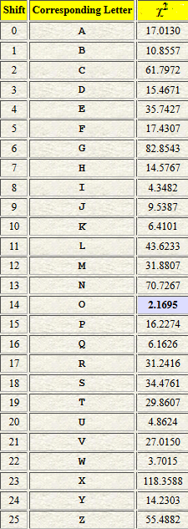

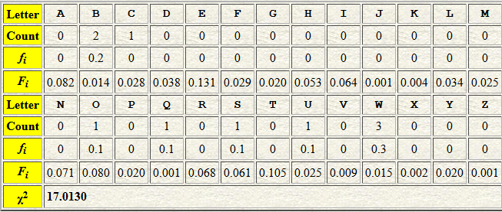

The “χ²” (Chi-squared) method
χ² $=\sum_{i=1}^{n}{\frac{{(f_{i}−F_{i})}^{2}}{F_{i}}}$
E.g: WWBQCUOBSW (Caesar ciphertext) -> Key ?

Slide 8
The “χ²” (Chi-squared) method
Step 1
Step 1
With known key-length, devide ciphertext into cosets -> each coset was encrypted using same key character -> Caesar encryption
Step 2
Step 2
Find key character for each coset -> break Caesar cipher -> Use χ² method -> Combine key characters into full key
Step 3
Step 3
Find plaintext using known ciphertext and derived key:
Pi = (Ei - Ki) mod 26

Slide 9
THANK YOU FOR LISTENING

