Slide 1


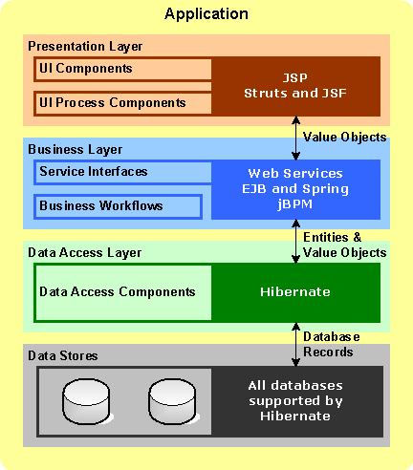
ORM & Hibernate
Kiến trúc ứng dụng Java
[Course title]
Presenter :
Email:
Trainer’s name– Course title

Slide 2
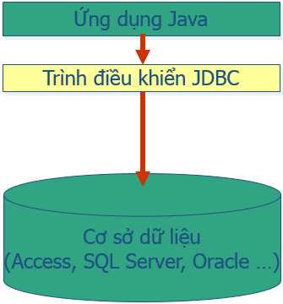
ORM & Hibernate
JDBC
[Course title]
Presenter :
Email:
Trainer’s name– Course title

Slide 3
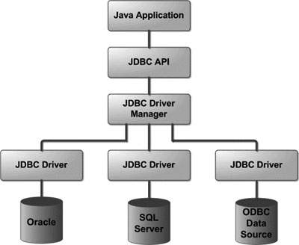
ORM & Hibernate
OMINEXT INTERNAL TRAINING DOCUMENTS (Confidential)
[Course title]
Presenter :
Email:
Trainer’s name– Course title

Slide 4
ORM & Hibernate
Ưu nhược điểm khi dung JDBC
Ưu điểm JDBC | Nhược điểm JDBC
Đơn giản và dễ sử dụng, chỉ cần thành thành SQL. Peformance tốt với data lớn. Dễ tích hợp, phù hợp với các ứng dụng nhỏ. | Phức tạp, phát sinh nhiều code nếu sử dụng trong dự án lớn Phụ thuộc vào một DBMS cụ thể.
Presenter :
Email:
Trainer’s name– Course title

Slide 5
ORM & Hibernate
What is ORM?
ORM stands for Object-Relational Mapping (ORM) is a programming technique for converting data between relational databases and object oriented programming languages such as Java, C#, etc.
Presenter :
Email:
Trainer’s name– Course title

Slide 6
ORM & Hibernate
An ORM system has the following advantages over plain JDBC
Sr.No. | Advantages
1 | Let’s business code access objects rather than DB tables.
2 | Hides details of SQL queries from OO logic.
3 | Based on JDBC 'under the hood.'
4 | No need to deal with the database implementation.
5 | Entities based on business concepts rather than database structure.
6 | Transaction management and automatic key generation.
7 | Fast development of application.
Presenter :
Email:
Trainer’s name– Course title

Slide 7
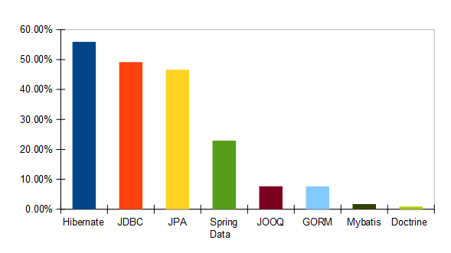
ORM & Hibernate
Java ORM Frameworks
Presenter :
Email:
Trainer’s name– Course title

Slide 8
ORM & Hibernate
Hibernate
Hibernate is an Object-Relational Mapping (ORM) solution for JAVA. It is an open source persistent framework created by Gavin King in 2001. It is a powerful, high performance Object-Relational Persistence and Query service for any Java Application.
Hibernate maps Java classes to database tables and from Java data types to SQL data types and relieves the developer from 95% of common data persistence related programming tasks.
Presenter :
Email:
Trainer’s name– Course title

Slide 9
ORM & Hibernate
Supported Databases
Hibernate supports almost all the major RDBMS. Following is a list of few of the database engines supported by Hibernate
HSQL Database Engine
DB2/NT
MySQL
PostgreSQL
FrontBase
Oracle
Microsoft SQL Server Database
Sybase SQL Server
Informix Dynamic Server
Presenter :
Email:
Trainer’s name– Course title

Slide 10
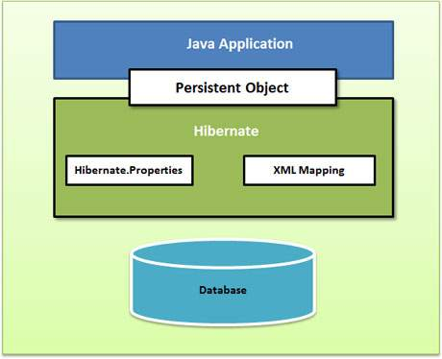
ORM & Hibernate
Hibernate Architecture
Presenter :
Email:
Trainer’s name– Course title

Slide 11
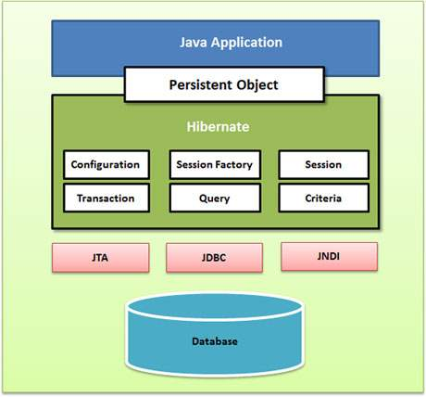
ORM & Hibernate
Hibernate Architecture
Presenter :
Email:
Trainer’s name– Course title

Slide 12
ORM & Hibernate
Configuration Object
The Configuration object is the first Hibernate object you create in any Hibernate application. It is usually created only once during application initialization. It represents a configuration or properties file required by the Hibernate.
The Configuration object provides two keys components −
Database Connection − This is handled through one or more configuration files supported by Hibernate. These files are hibernate.properties and hibernate.cfg.xml.
Class Mapping Setup − This component creates the connection between the Java classes and database tables.
Presenter :
Email:
Trainer’s name– Course title

Slide 13
ORM & Hibernate
SessionFactory Object
Configuration object is used to create a SessionFactory object which in turn configures Hibernate for the application using the supplied configuration file and allows for a Session object to be instantiated. The SessionFactory is a thread safe object and used by all the threads of an application.
The SessionFactory is a heavyweight object; it is usually created during application start up and kept for later use. You would need one SessionFactory object per database using a separate configuration file. So, if you are using multiple databases, then you would have to create multiple SessionFactory objects.
Presenter :
Email:
Trainer’s name– Course title

Slide 14
ORM & Hibernate
Session Object
A Session is used to get a physical connection with a database. The Session object is lightweight and designed to be instantiated each time an interaction is needed with the database. Persistent objects are saved and retrieved through a Session object.
The session objects should not be kept open for a long time because they are not usually thread safe and they should be created and destroyed them as needed.
Presenter :
Email:
Trainer’s name– Course title

Slide 15
ORM & Hibernate
Transaction Object
A Transaction represents a unit of work with the database and most of the RDBMS supports transaction functionality. Transactions in Hibernate are handled by an underlying transaction manager and transaction (from JDBC or JTA).
This is an optional object and Hibernate applications may choose not to use this interface, instead managing transactions in their own application code.
Presenter :
Email:
Trainer’s name– Course title

Slide 16
ORM & Hibernate
Query Object
Query objects use SQL or Hibernate Query Language (HQL) string to retrieve data from the database and create objects. A Query instance is used to bind query parameters, limit the number of results returned by the query, and finally to execute the query.
Presenter :
Email:
Trainer’s name– Course title

Slide 17
ORM & Hibernate
Criteria Object
Criteria objects are used to create and execute object oriented criteria queries to retrieve objects.
Presenter :
Email:
Trainer’s name– Course title

Slide 18
ORM & Hibernate
Hibernate - Configuration
<?xml version = "1.0" encoding = "utf-8"?>
<!DOCTYPE hibernate-configuration SYSTEM
"http://www.hibernate.org/dtd/hibernate-configuration-3.0.dtd">
<hibernate-configuration>
<session-factory>
<property name = "hibernate.dialect">
org.hibernate.dialect.MySQLDialect
</property>
<property name = "hibernate.connection.driver_class">
com.mysql.jdbc.Driver
</property>
<!-- Assume test is the database name -->
<property name = "hibernate.connection.url">
jdbc:mysql://localhost/test
</property>
<property name = "hibernate.connection.username">
root
</property>
<property name = "hibernate.connection.password">
root123
</property>
<!-- List of XML mapping files -->
<mapping resource = "Employee.hbm.xml"/>
</session-factory>
</hibernate-configuration>
Presenter :
Email:
Trainer’s name– Course title

Slide 19
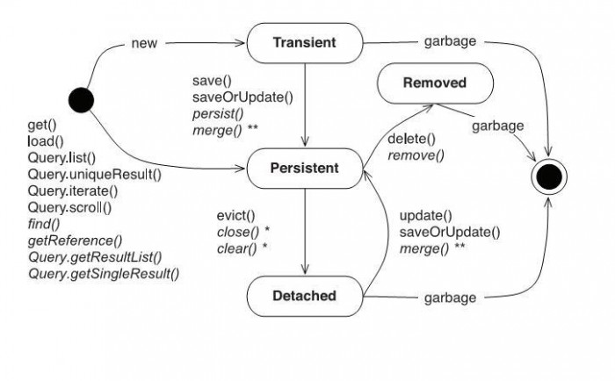
ORM & Hibernate
Hibernate - Sessions
A Session is used to get a physical connection with a database. The Session object is lightweight and designed to be instantiated each time an interaction is needed with the database. Persistent objects are saved and retrieved through a Session object.
transient: Đối tượng không có quan hệ với Session hiện tại của hibernate. persistent: Đối tượng có quan hệ với Session hiện tại của hibernate và trạng thái của nó được đồng bộ với csdl. detached: Đối tượng đã từng có trạng thái persistent nhưng hiện tại đã không còn giữ quan hệ với Session.
Presenter :
Email:
Trainer’s name– Course title

Slide 20
ORM & Hibernate
Hibernate - Mapping Types
Mapping type | Java type | ANSI SQL Type
integer | int or java.lang.Integer | INTEGER
long | long or java.lang.Long | BIGINT
short | short or java.lang.Short | SMALLINT
float | float or java.lang.Float | FLOAT
double | double or java.lang.Double | DOUBLE
big_decimal | java.math.BigDecimal | NUMERIC
character | java.lang.String | CHAR(1)
string | java.lang.String | VARCHAR
byte | byte or java.lang.Byte | TINYINT
boolean | boolean or java.lang.Boolean | BIT
yes/no | boolean or java.lang.Boolean | CHAR(1) ('Y' or 'N')
true/false | boolean or java.lang.Boolean | CHAR(1) ('T' or 'F')
Mapping type | Java type | ANSI SQL Type
date | java.util.Date or java.sql.Date | DATE
time | java.util.Date or java.sql.Time | TIME
timestamp | java.util.Date or java.sql.Timestamp | TIMESTAMP
calendar | java.util.Calendar | TIMESTAMP
calendar_date | java.util.Calendar | DATE
Presenter :
Email:
Trainer’s name– Course title

Slide 21
ORM & Hibernate
Hibernate - Query Language
Hibernate Query Language (HQL) is an object-oriented query language, similar to SQL, but instead of operating on tables and columns, HQL works with persistent objects and their properties. HQL queries are translated by Hibernate into conventional SQL queries, which in turns perform action on database.
Although you can use SQL statements directly with Hibernate using Native SQL, but I would recommend to use HQL whenever possible to avoid database portability hassles, and to take advantage of Hibernate's SQL generation and caching strategies.
String hql = "SELECT count(distinct E.firstName) FROM Employee E";
Query query = session.createQuery(hql);
List results = query.list();
Presenter :
Email:
Trainer’s name– Course title

Slide 22
ORM & Hibernate
Hibernate - Criteria Queries
Hibernate provides alternate ways of manipulating objects and in turn data available in RDBMS tables. One of the methods is Criteria API, which allows you to build up a criteria query object programmatically where you can apply filtration rules and logical conditions.
Criteria cr = session.createCriteria(Employee.class);
cr.add(Restrictions.eq("salary", 2000));
List results = cr.list();
Presenter :
Email:
Trainer’s name– Course title

Slide 23
ORM & Hibernate
Hibernate - Native SQL
You can use native SQL to express database queries if you want to utilize database-specific features such as query hints or the CONNECT keyword in Oracle. Hibernate 3.x allows you to specify handwritten SQL, including stored procedures, for all create, update, delete, and load operations.
String sql = "SELECT * FROM EMPLOYEE";
SQLQuery query = session.createSQLQuery(sql);
query.addEntity(Employee.class);
List results = query.list();
Presenter :
Email:
Trainer’s name– Course title

Slide 24
ORM & Hibernate
Hibernate – Khi nào dùng Native query, HQL, Criteria
Native Query | Criteria | HQL
Phục thuộc vào database, nếu chuyển database có thể phải viết lại. Với các yêu cầu đã có sẵn SQL thì có thể dùng, giảm effort chuyển sang Criteria or HQL | Với các query phức tạp để viết thành criteria thì khá phức tạp. - Phù hợp với các form search khi mà cần pass nhiều tham số - Code clean, IDE suggest code, và nếu có thay đổi entity,… thì sẽ dễ dàng thay đổi các phần liên quan. | Tương tự như SQL nhưng không phụ thuộc vào database.
Presenter :
Email:
Trainer’s name– Course title

Slide 25
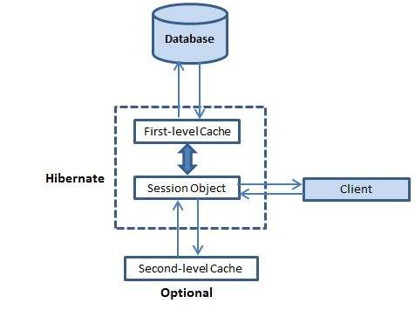
ORM & Hibernate
Hibernate - Caching
Presenter :
Email:
Trainer’s name– Course title

Slide 26
ORM & Hibernate
Hibernate - Caching
First-level Cache: The first-level cache is the Session cache
CÁC ĐẶC ĐIỂM QUAN TRỌNG CẦN CHÚ Ý
First Level Cache là mặc định trong Hibernate và không có cách nào để disable nó cả.
Khi chúng ta truy vấn 1 thực thể (abc) lần đầu tiên, nó sẽ được lấy về từ database và được lữu trữ trong bộ nhớ của first-level cache - cái mà được liên kết với đối tượng hibernate session
Nếu chúng ta truy vấn lại cùng 1 đối tượng (abc) với cùng session, nó sẽ được load từ trong cache thay vì việc thực thi lại câu truy vấn sql
Thực thể (abc) được load có thể bị xóa khỏi session, khỏi bộ nhớ first level cache bằng việc sử dụng phuơng thức evict(entity). Như vậy, vào lần tiếp theo ta truy vấn thực thể đó, nó sẽ được lấy từ database (thay vì bộ nhớ cache).
Toàn bộ bộ nhớ cache cúa session có thể bị làm trống với việc sử dụng phuơng thức clear(). Điều này có nghĩa là các thực thể được lưu trữ trong bộ nhớ cache cũng sẽ bị xóa bỏ.
Presenter :
Email:
Trainer’s name– Course title

