Slide 1
AlphaFold 2:
How domain-science-informed neural architectures
can matter more than big data, through the lens of protein folding
June 2026
Danu Caus

Slide 2
Introduction

Slide 3
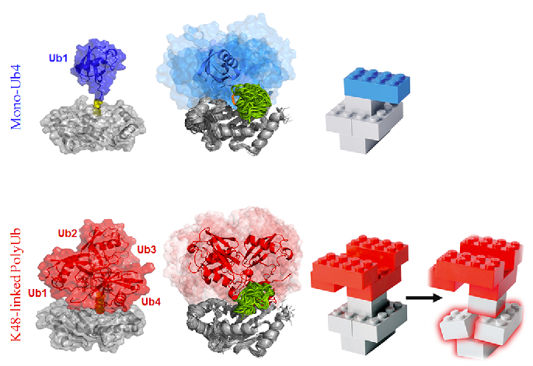
Proteins Are Bio-LEGO-Like Structures
“Protein Assembly and Building Blocks: Beyond the Limits of the LEGO Brick Metaphor.” by Y. Levy
Notes:
https://www.semanticscholar.org/paper/Protein-Assembly-and-Building-Blocks%3A-Beyond-the-of-Levy/86a997321430edf8815f35d5e7254c1b9e7a1dd2/figure/3

Slide 4
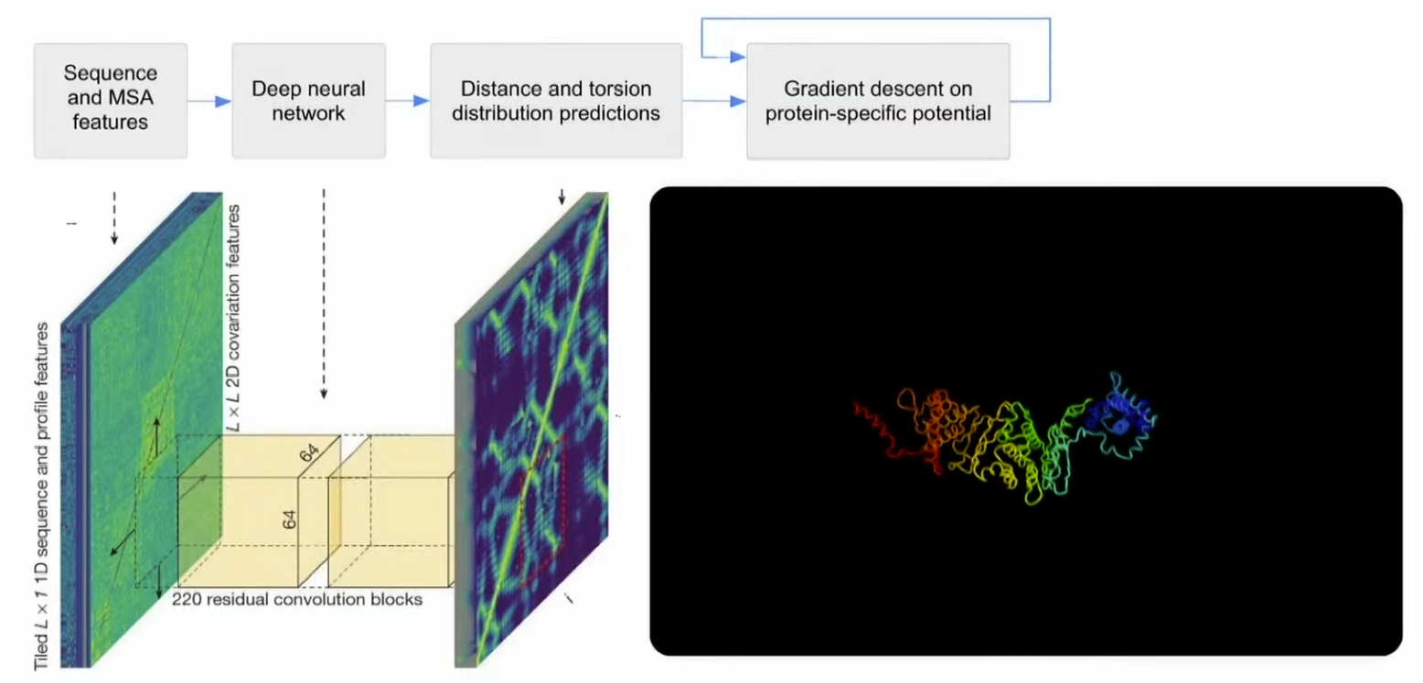
AlphaFold 1 (2018)
AlphaFold 1 was more like a vision network applied to distogram maps.
Notes:
https://www.youtube.com/live/HnT1VWzdFWc?si=UFpn88-tfqoCicw2&t=4472

Slide 5
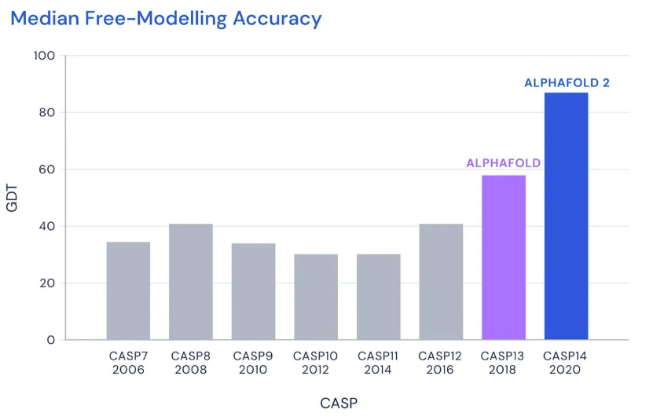
AlphaFold 1 vs AlphaFold 2 Performance
CASP is a biennial international competition that evaluates how well computational methods can predict the 3D structure of proteins from their amino-acid sequence.
Notes:
https://deepmind.google/blog/alphafold-a-solution-to-a-50-year-old-grand-challenge-in-biology/

Slide 6
AlphaFold 2

Slide 7
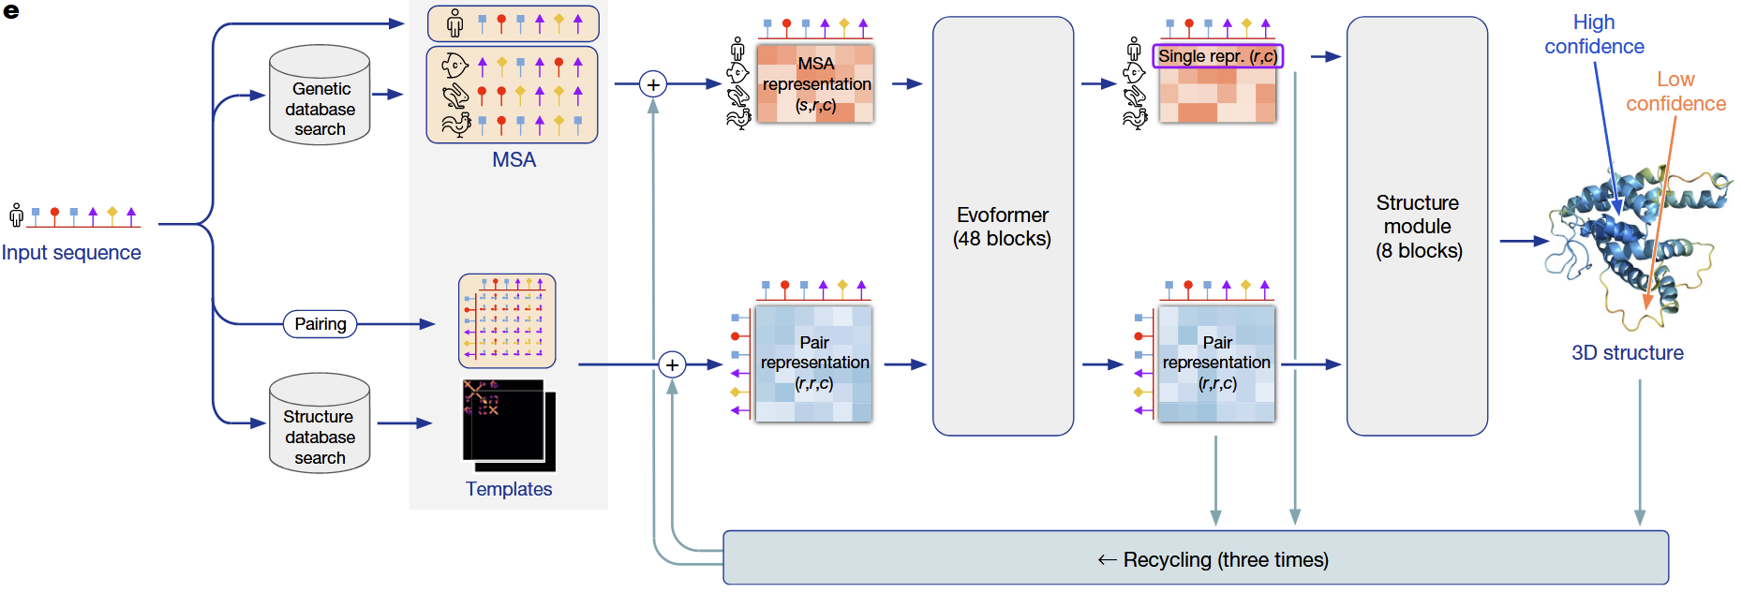
AlphaFold 2 (2020)
“Highly accurate protein structure prediction with AlphaFold”, by John Jumper et al.
Notes:
https://www.nature.com/articles/s41586-021-03819-2/figures/1

Slide 8
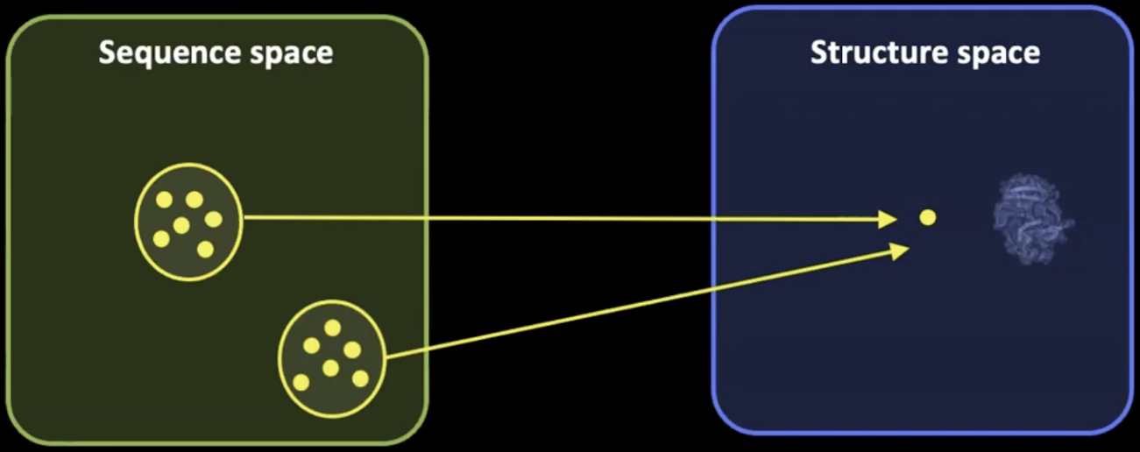
Sequence-Structure Mapping
Many different amino-acid sequences can converge to a similar 3D fold, so sequence space is much larger than structure space.
This many-to-one mapping can actually aid generalization: diverse sequences may share the same overall fold, although predicting fine structural details remains challenging.
Notes:
https://youtu.be/yqeUH4RsJp8?si=HdVgS42s6IYCoQTT&t=2353

Slide 9
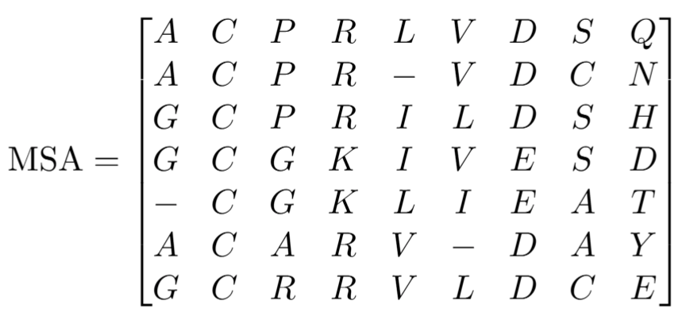
Multiple Sequence Alignments (MSA)
Information across species
Information within sequence
Notes:
https://youtu.be/yqeUH4RsJp8?si=xP8f2NNcNfyTD_ks&t=2555

Slide 10
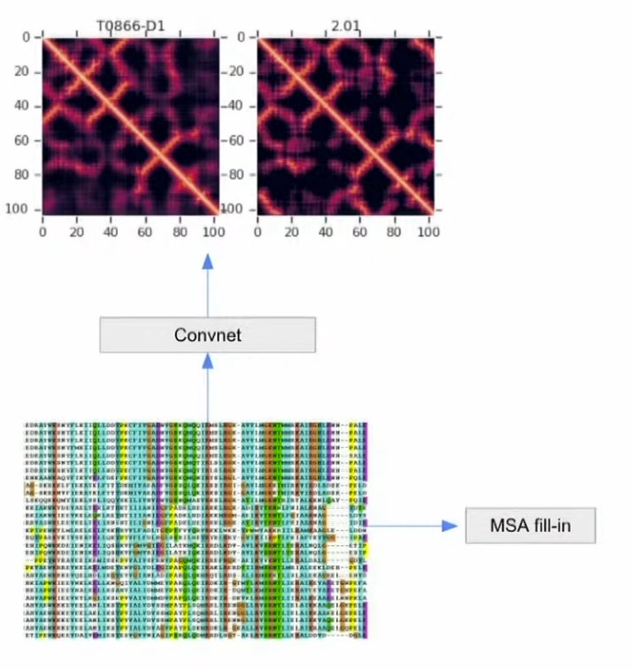
Using Evolutionary Data
BERT-style models on MSAs learned to recover masked evolutionary information
Axial attention alternates between processing within sequences and across sequences
This architectural choice aligned the network operations with the biological structure of the problem
Notes:
https://www.youtube.com/live/HnT1VWzdFWc?si=6ahkv6q_wM41T39C&t=5053

Slide 11
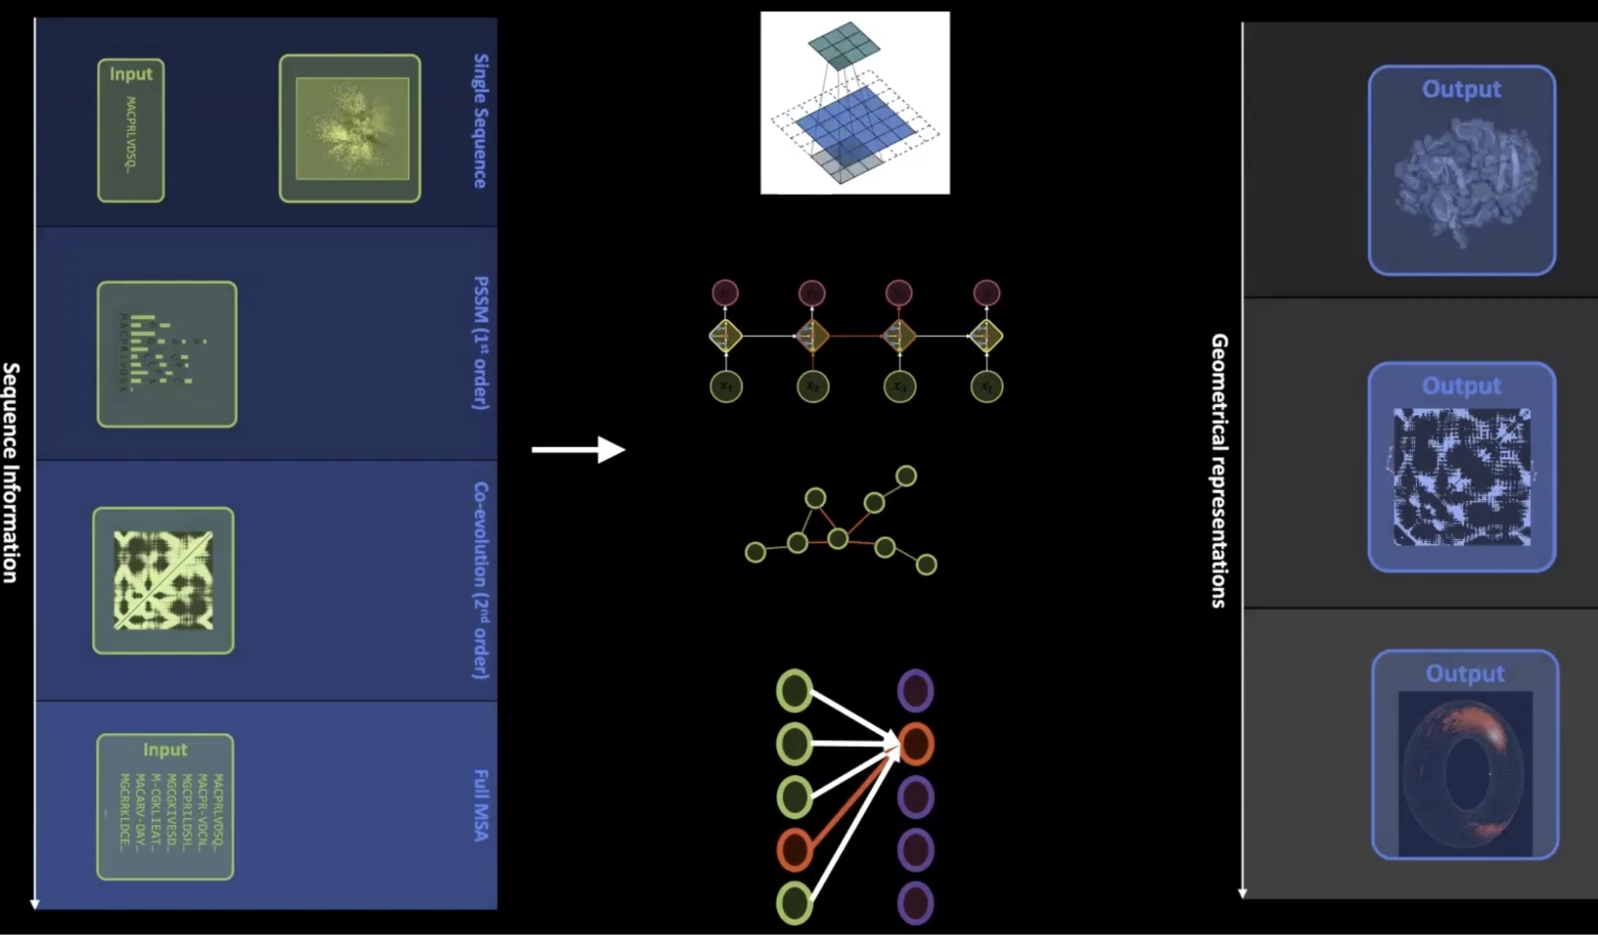
AlphaFold 2 Links 1D, 2D, and 3D Representations
3D Structure
2D Structure
1D Structure
Notes:
https://youtu.be/ri39B0Voujc?si=Xli-4UMtF7sbY0pi&t=128

Slide 12
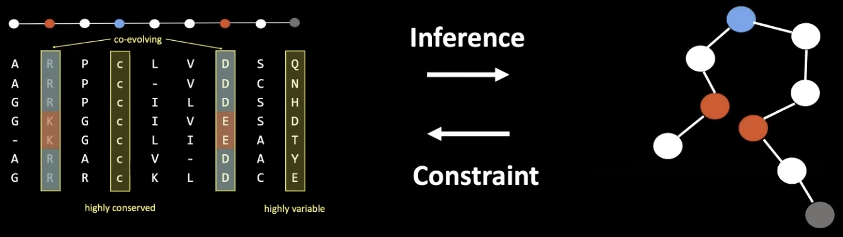
Modelling Co-Evolution
The key inductive bias we want to model is the idea of co-evolution
Note that the red tokens are the residues
(A residue is an amino acid unit within a protein chain)
Notes:
https://youtu.be/ri39B0Voujc?si=VLqUBel55hr8XzY_&t=218

Slide 13
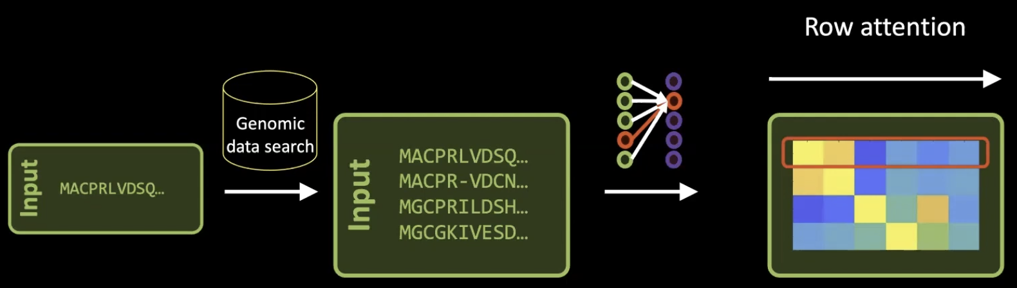
Row Attention Integrates Information Within a Sequence
Notes:
https://youtu.be/ri39B0Voujc?si=olQKoYOxeHCqKBMf&t=787

Slide 14
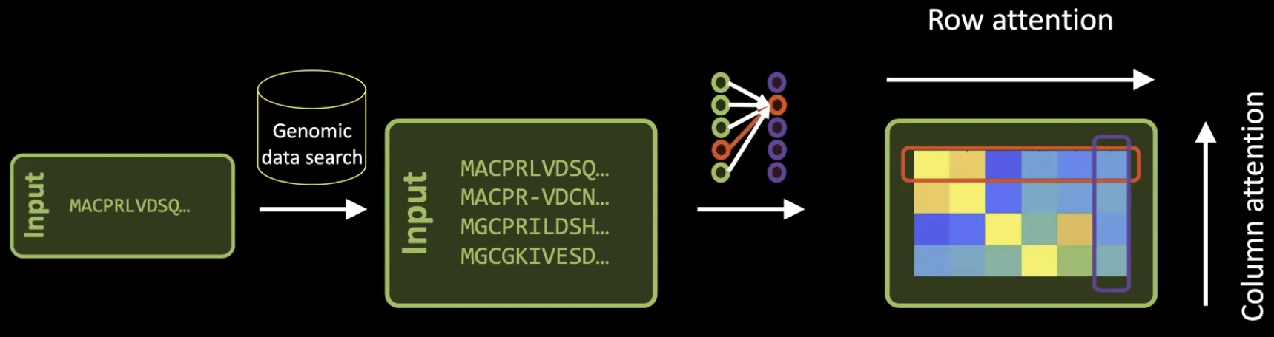
Column Attention Integrates Information Across Sequences
Notes:
https://youtu.be/ri39B0Voujc?si=xAEug8cseT6R5I5c&t=808

Slide 15
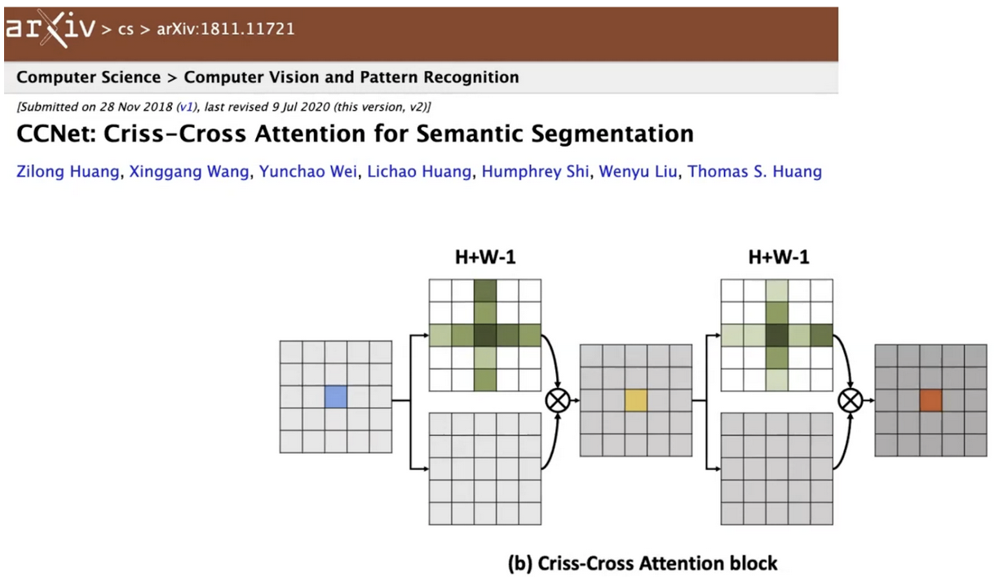
Axial Attention Alternates Between Rows and Columns
Criss-cross attends to the row and column of each position simultaneously. Axial attention alternates: first all rows, then all columns. Both achieve global coverage, but axial is simpler.
AlphaFold 2 uses axial attention by alternating row and column attention
This separates processing across sequences from processing along residue positions
Notes:
https://youtu.be/ri39B0Voujc?si=9Xk8Tmp3fUQxSL9q&t=881

Slide 16
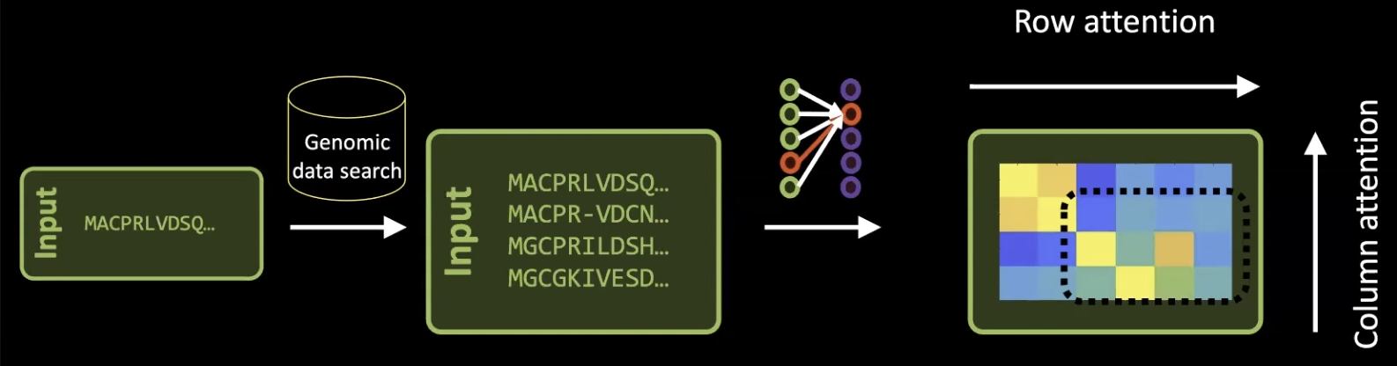
Cropping Makes Training Tractable
AlphaFold uses cropping during training, but not at inference time.
Notes:
https://youtu.be/ri39B0Voujc?si=eEOiopaMBRxOJAQj&t=953

Slide 17
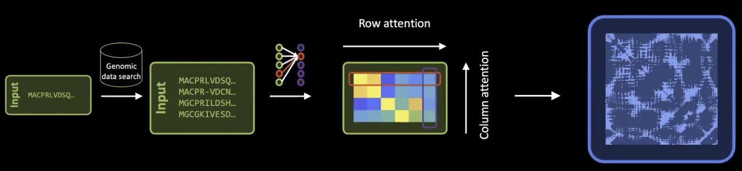
The Evoformer First Predicts Pairwise Distances
First conceptual step is the prediction of a distogram. The distogram may indicate the geometry or fold of the protein.
Note → A distogram is a matrix where entry (i, j) represents the predicted distance between residue i and residue j, specifically between their C^{α} atoms (the central carbon of each residue's backbone). So for a protein with L residues, you get an L × L matrix.
Notes:
https://youtu.be/ri39B0Voujc?si=R9sgcWlrdJpCW31N&t=1015

Slide 18
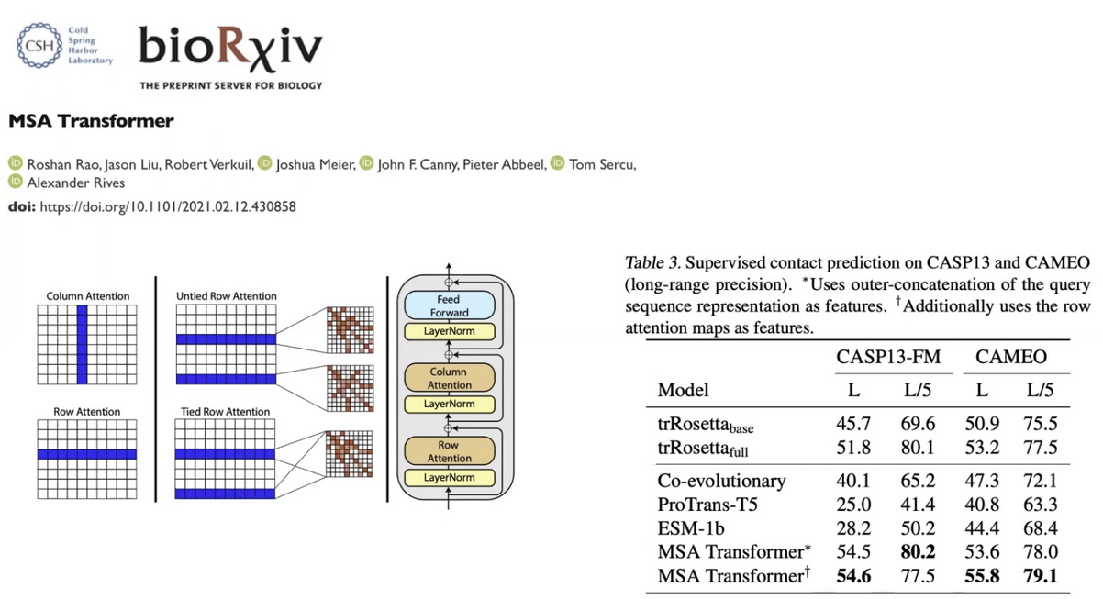
MSA Transformer Helped Establish the Design Direction
Notes:
https://youtu.be/ri39B0Voujc?si=THD4_Am7zqoQ8PbC&t=1066

Slide 19
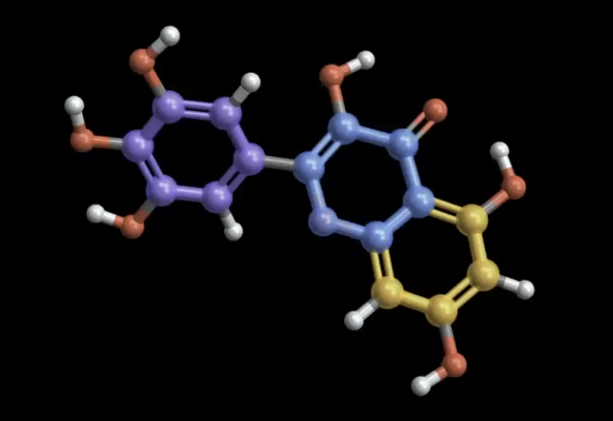
Proteins “are” Graphs
A chemical molecule can be represented as a graph, so we need to encode relational structure
Standard Transformers do not model edge information explicitly
Notes:
Standard transformers are not the right inductive bias for reasoning over graphs → https://youtu.be/ri39B0Voujc?si=HqV11TlXbUqS-CU7&t=1226

Slide 20
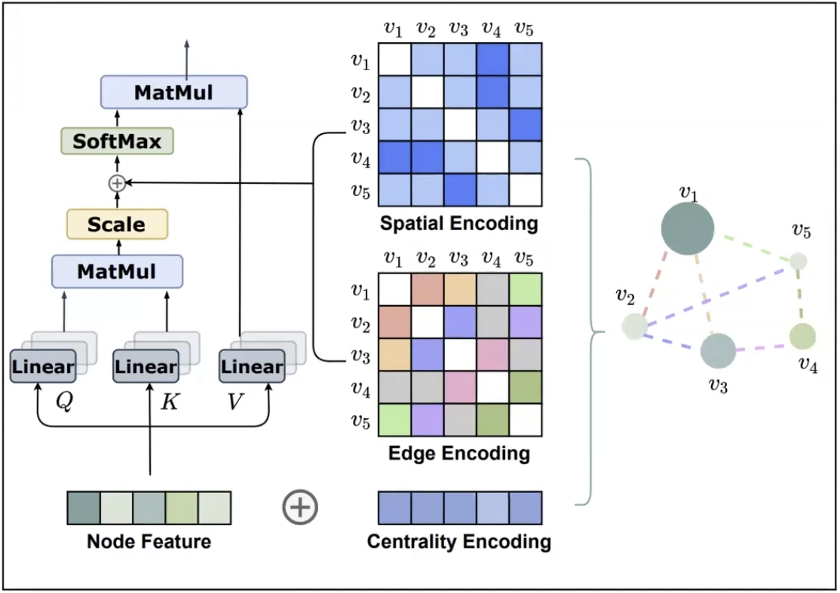
Transformer Graph Representations
Extending Transformers to encode Graph Edges
“Do Transformers Really Perform Bad for Graph Representation?” by C. Ying et al., NeurIPS 2021
Notes:
https://youtu.be/ri39B0Voujc?si=yvpb-gDzFNT7cbUn&t=1352

Slide 21
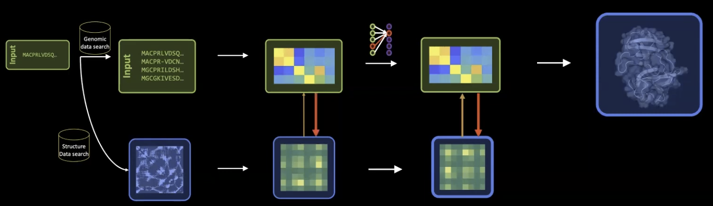
MSA and Pair Representations Exchange Information
Notes:
https://youtu.be/ri39B0Voujc?si=ridfpMhFRH4SjKOY&t=1781

Slide 22
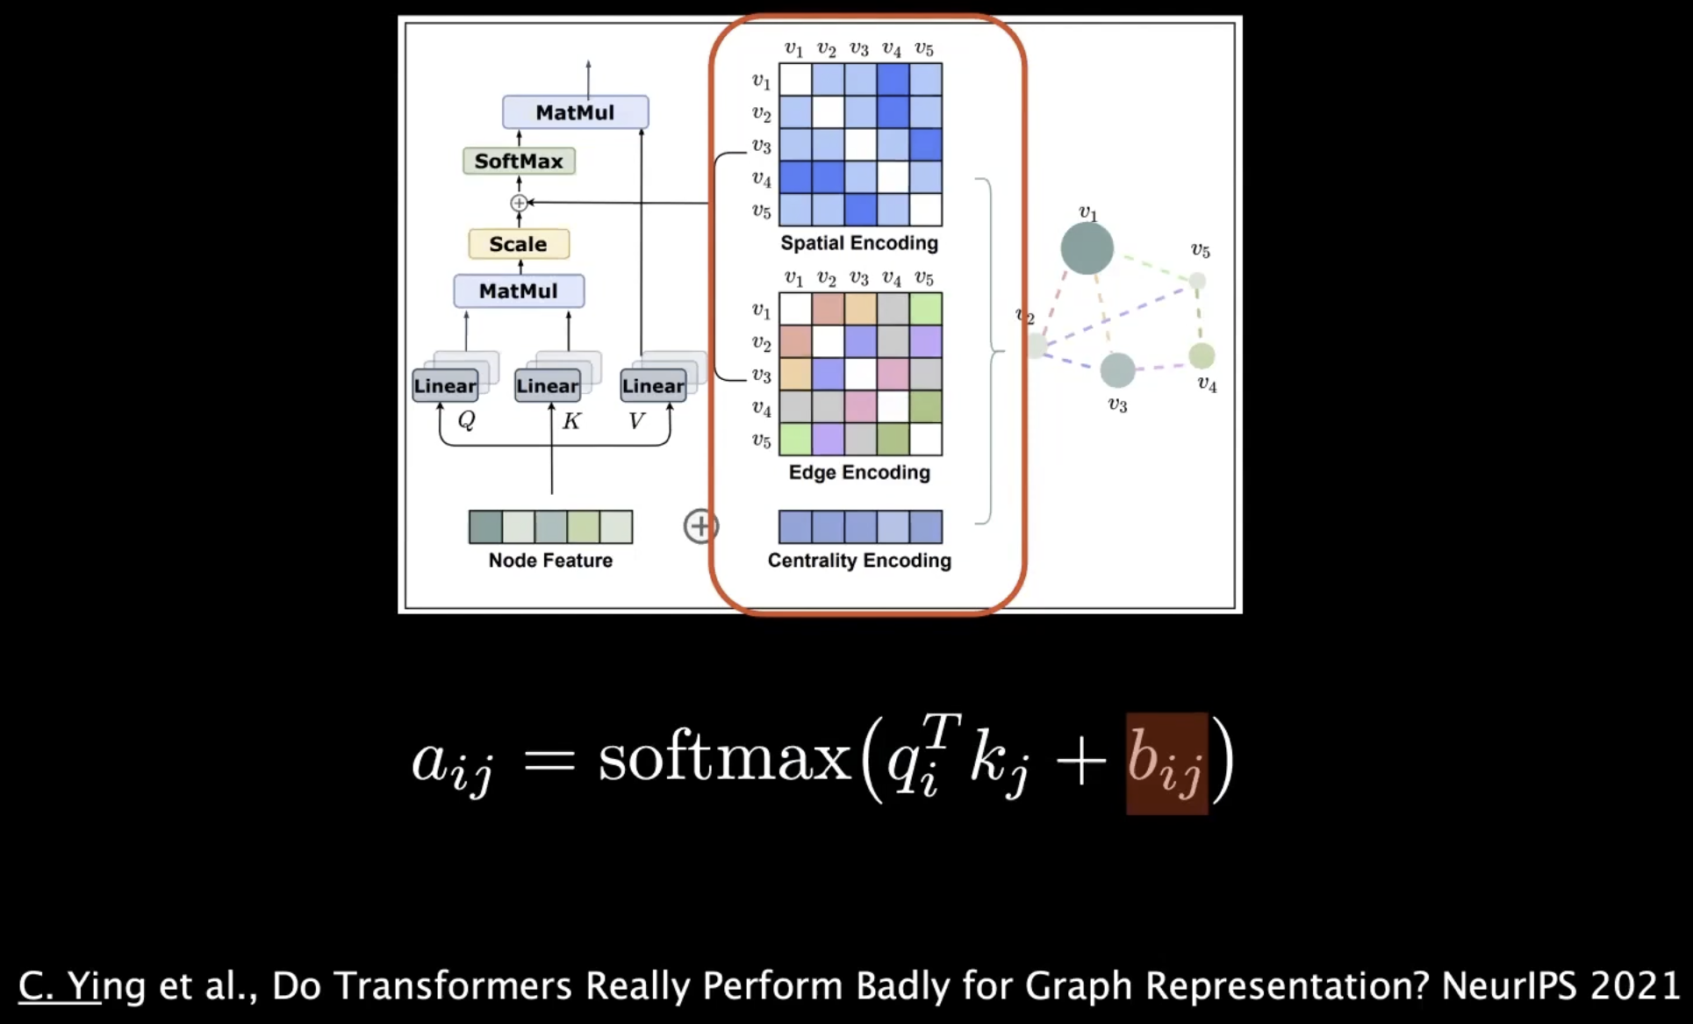
Attention Bias Can Encode Pairwise Edge Information
Bias b == Edge Information
Notes:
https://youtu.be/ri39B0Voujc?si=x9p6lARiM5aXfeRX&t=1384

Slide 23
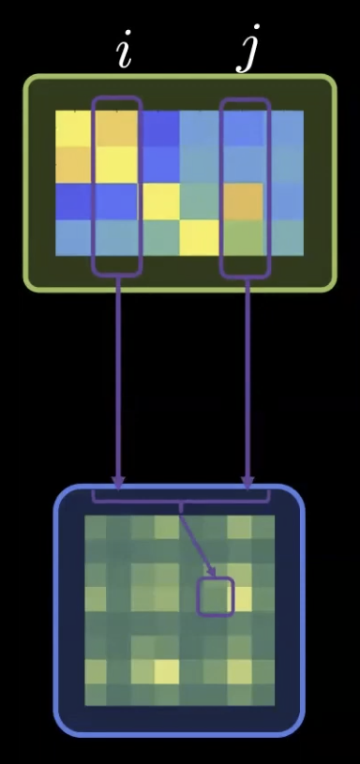
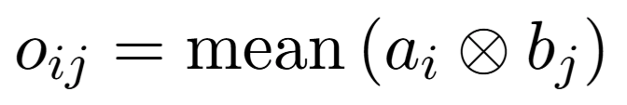
The Pair Representation Is Updated from the MSA
Take the mean of the outer product of 2 columns of the MSA.
Notes:
https://youtu.be/ri39B0Voujc?si=8RzAPoHFJldEq26I&t=1908

Slide 24
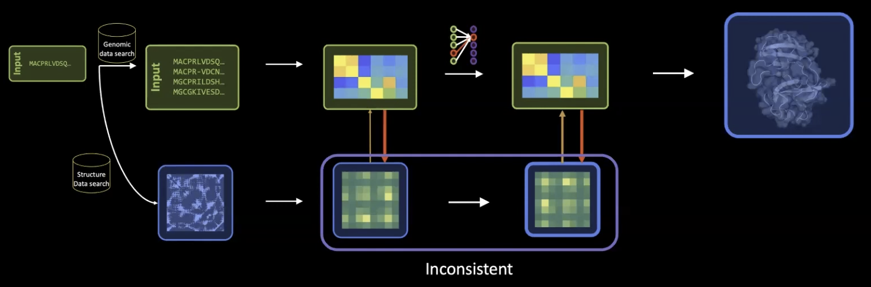
Pairwise Predictions Must Be Geometrically Consistent
Notes:
https://youtu.be/ri39B0Voujc?si=NPHXZPgqI2k11Ifq&t=2035

Slide 25
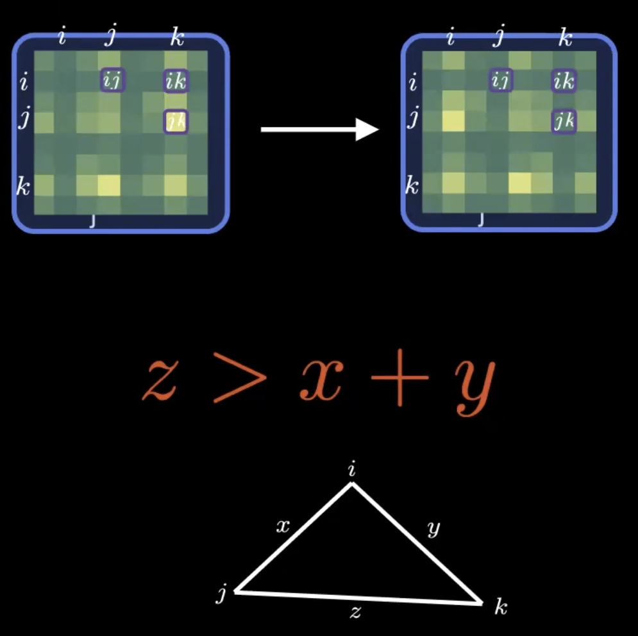

Triangle Constraints Enforce Geometric Consistency
We need to correct this!
We must obey the triangle inequality →
Notes:
https://youtu.be/ri39B0Voujc?si=vcvWHcc_sJC4611G&t=2145

Slide 26
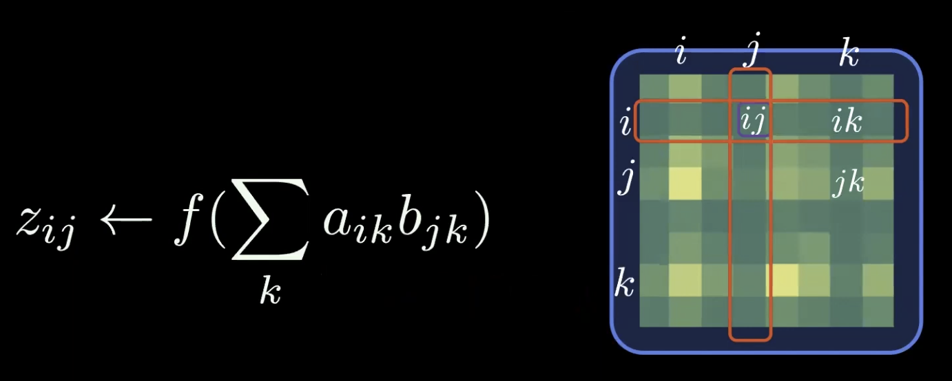
AlphaFold 2 Enforces Triangle Constraints Through Smooth Updates
Expensive!
But worth it.
Triangle consistency is encouraged through smooth updates of the 2D pair representation
Notes:
https://youtu.be/ri39B0Voujc?si=7OSJZVgex2B__EXi&t=2155

Slide 27
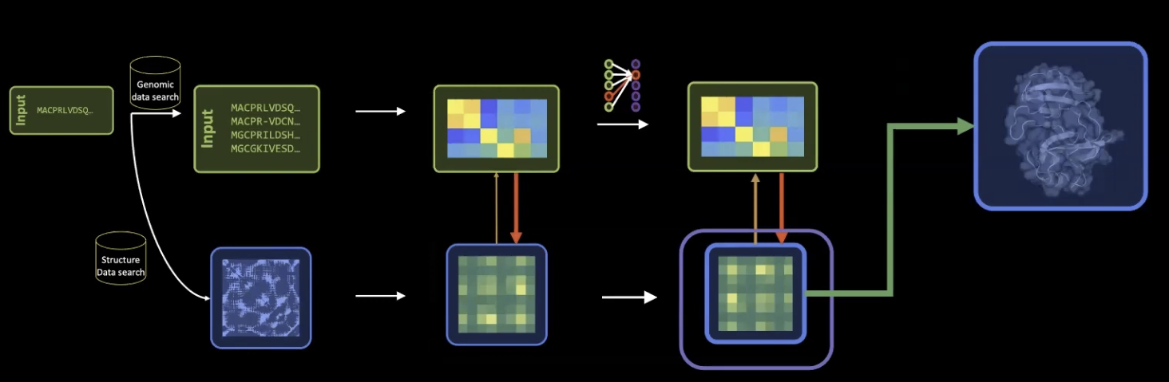
The Structure Module Converts Representations into 3D Coordinates
To produce 3D structure, AlphaFold uses the Pair Representation together with the First Row of the MSA, corresponding to the target sequence.
There are many more pairwise relationships than there are coordinates to find, so the structure is heavily constrained → i.e. the model has more than enough information to pin down the 3D shape.
Notes:
https://youtu.be/ri39B0Voujc?si=6s_PlQVIk17iW9YH&t=2366

Slide 28
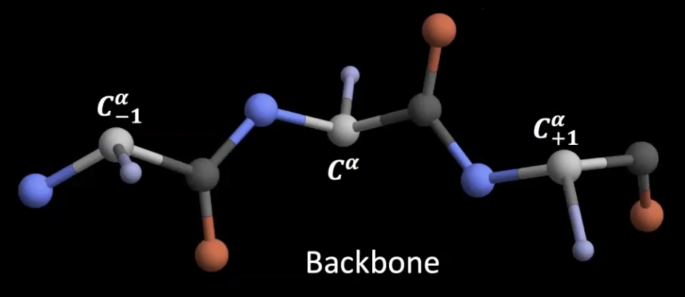
The Protein Backbone Provides the Structural Scaffold
Notes:
https://youtu.be/ri39B0Voujc?si=pTw3hBN7KFLDscy1&t=2505

Slide 29
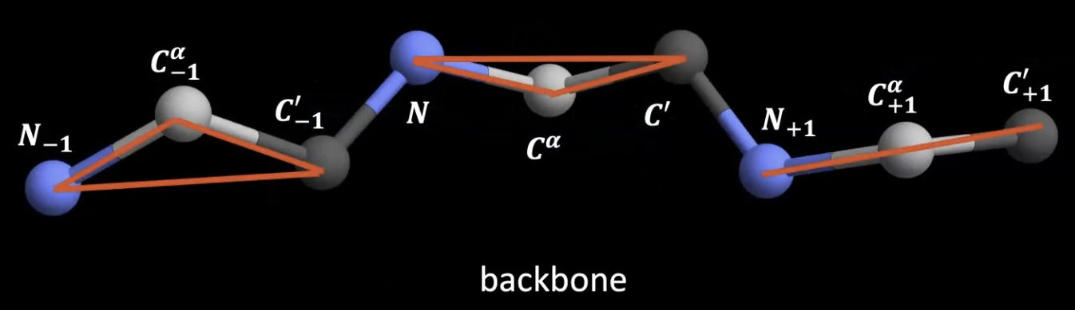
Each Residue Is Represented as a Rigid Local Frame
Each residue is represented by a rigid Local Frame (red triangles).
Structure prediction requires learning the position and orientation of these frames in Euclidean Space.
Notes:
https://youtu.be/ri39B0Voujc?si=C3Y1HCO4zGry1Jh1&t=2590

Slide 30
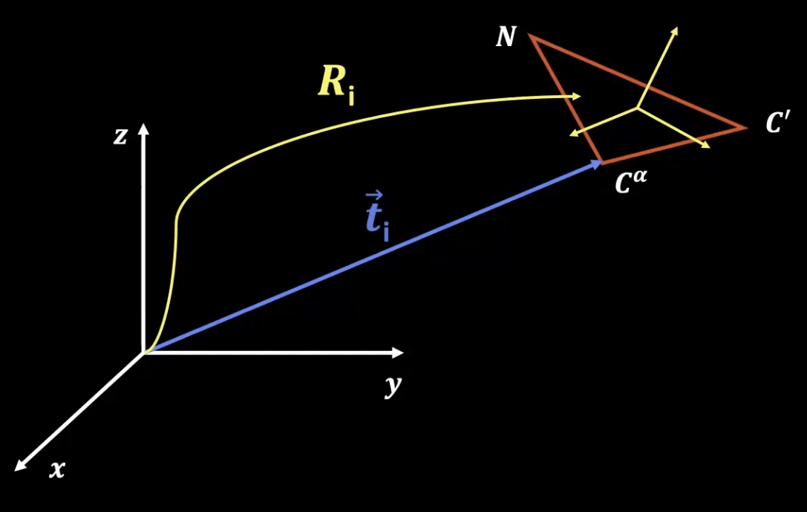
Structure Prediction Becomes Rotation and Translation of Local Frames
Our task is to learn the rotation matrix R and translation vector t for each of the triangles.
There are 2 frames: global coordinates frame (white) and local coordinates frame (yellow).
Notes:
https://youtu.be/ri39B0Voujc?si=-nPHDMZG79afFDwT&t=2687

Slide 31
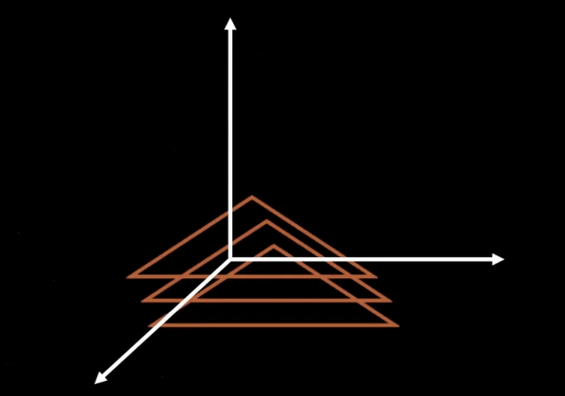
“Black hole” Initial Conditions
Initially Placed
at the Origin
Initial conditions → collapse all the triangles (i.e. bag of words) at the origin, such that the C^{𝞪} atom is sitting at the origin of the global reference frame, and all the local reference frames are oriented in the same direction as the global reference frame.
Notes:
https://youtu.be/ri39B0Voujc?si=V-9oFSwiI8MEuwhg&t=2917

Slide 32
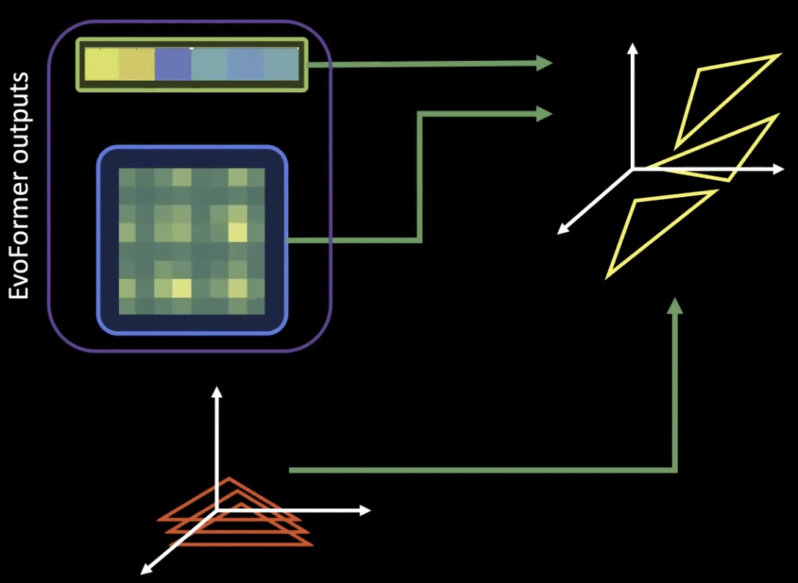
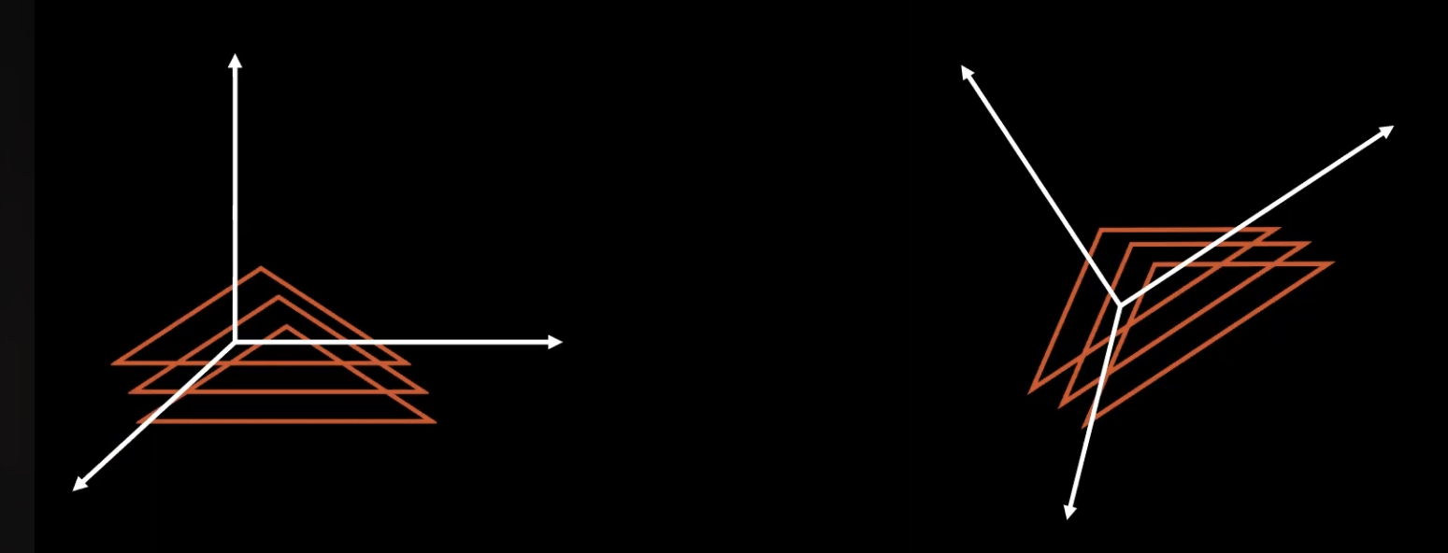
Problem Is: There Is No Meaningful Absolute Coordinate System
Or
Notes:
https://youtu.be/ri39B0Voujc?si=4J-jJRzt1vhNGJHo&t=3019

Slide 33
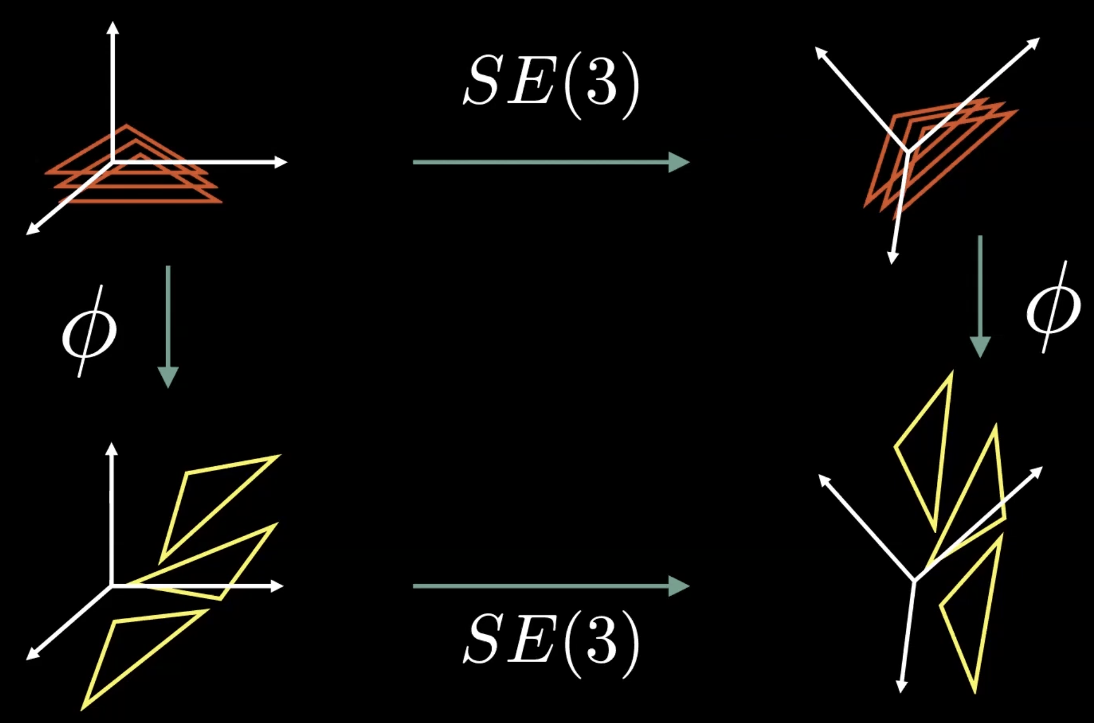
The Structure Module Must Be Rotation-Equivariant
The “Evoformer” operates on abstract feature representations with no geometric meaning. But the “Structure Module” must produce actual 3D coordinates. And since a protein has no preferred orientation in space, the structure module must be SE(3)-equivariant: rotating the input must rotate the output by the same amount. So both paths around the diagram must agree.
Notes:
https://youtu.be/ri39B0Voujc?si=6Hl2hwAyvsqZHTBr&t=3248

Slide 34
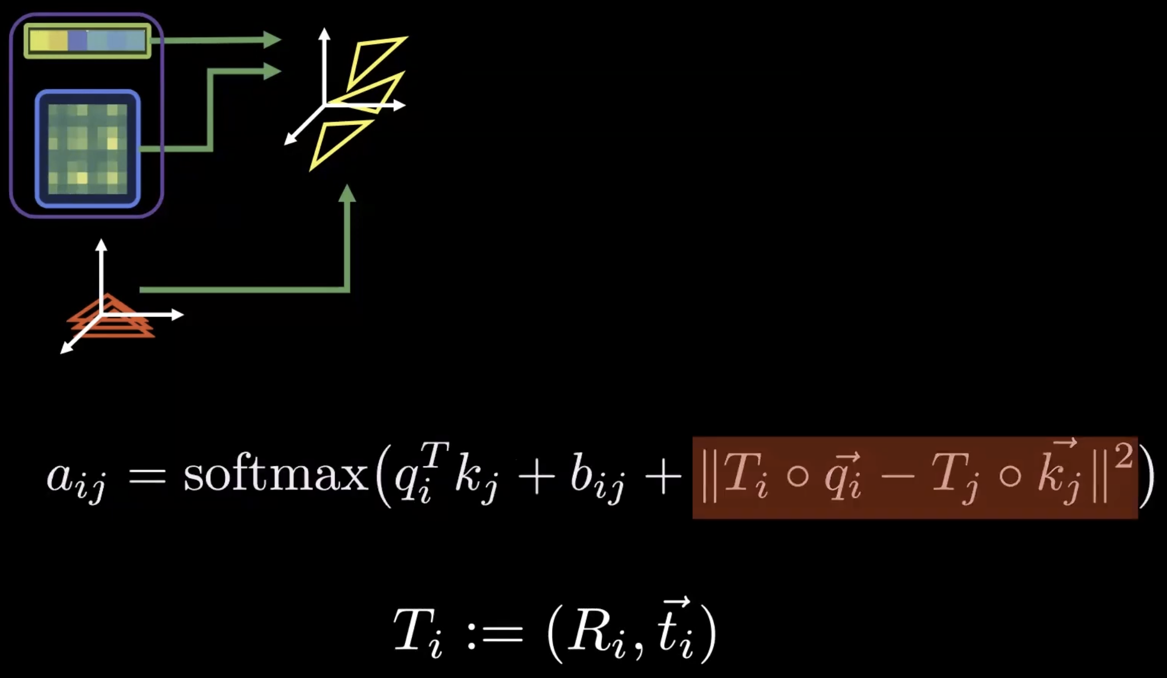
Invariant Point Attention Injects Geometry into Attention
The geometrically aware attention formula becomes
This attention is called the “Invariant Point Attention”. It was novel at the time.
We allow the queries and keys to live in the Euclidean space.
Notes:
https://youtu.be/ri39B0Voujc?si=T6uOQ5jmTC9yELUv&t=3347

Slide 35
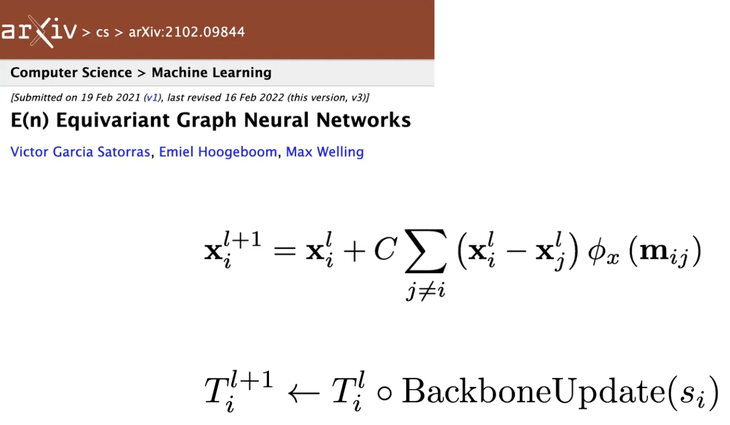
Invariant Point Attention Was Inspired by Equivariant Models
The type of equivariance we are using in AlphaFold 2 is approximate.
Note that we need not necessarily use sophisticated and mathematically principled techniques from group theory and differential geometry.
Notes:
https://youtu.be/ri39B0Voujc?si=mtCleM1-lpNZj3i5&t=3973

Slide 36
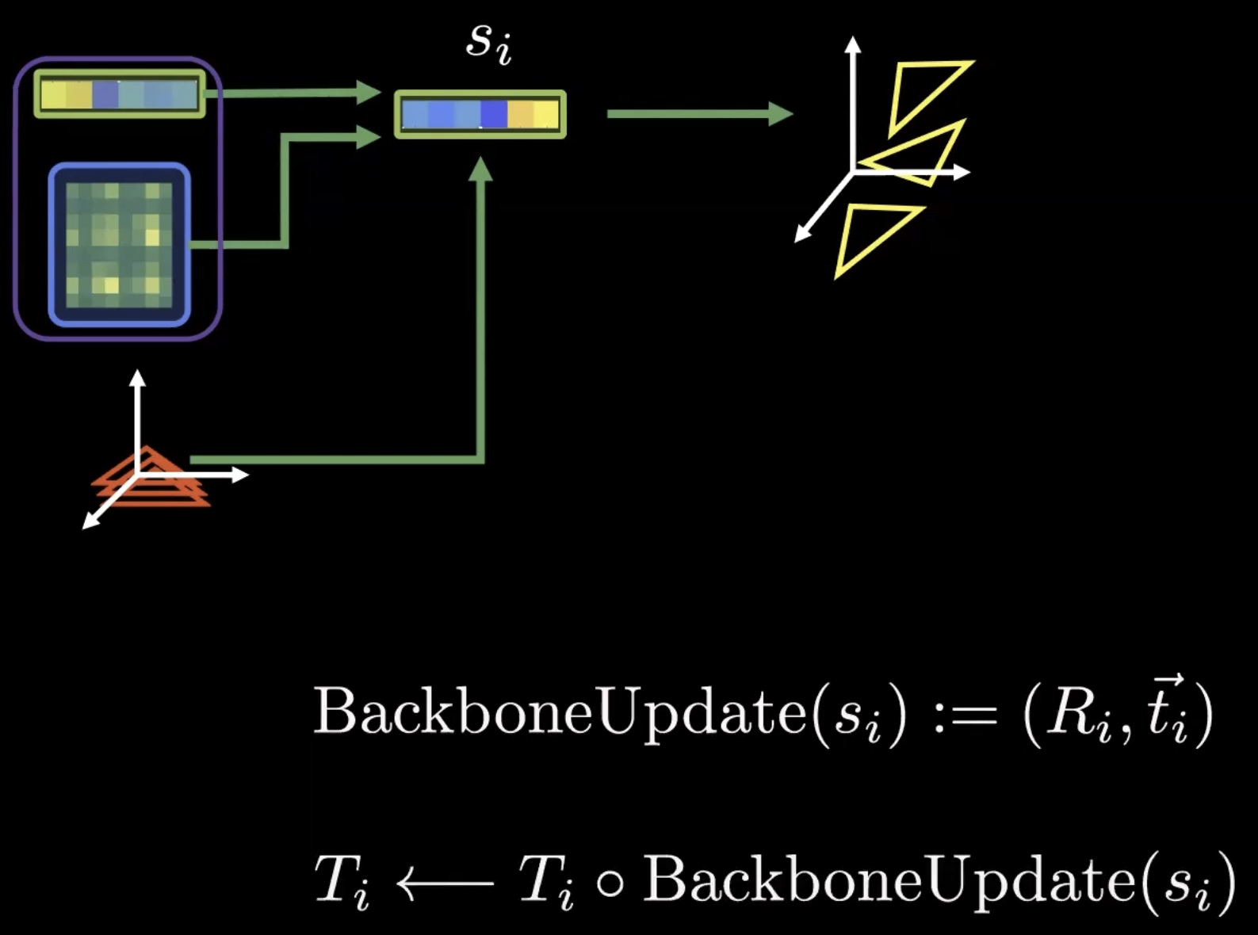
BackboneUpdate Predicts Local Frame Transformations
The updated single representation S_{i} is passed to BackboneUpdate(), which predicts the local rotation and translation for each residue frame.
Notes:
https://youtu.be/ri39B0Voujc?si=s5f1HJScCh5tmfmZ&t=3583

Slide 37
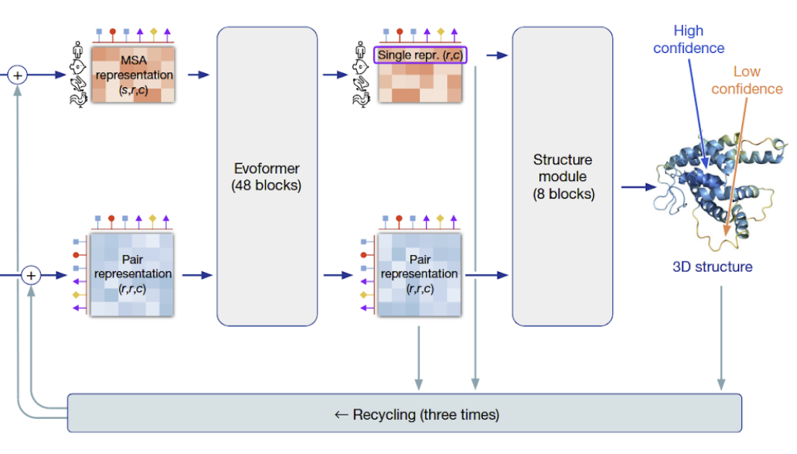
Recycling Iteratively Refines the Predicted Structure
There are 48 Evoformer blocks
Followed by 8 Structure module blocks
Loss is applied after each block
Recycling ≈ iterative refinement (3 cycles)
Notes:
https://youtu.be/ri39B0Voujc?si=cYcmsexiO7WHTPWS&t=4407
The loop works like this within each Evoformer block:
The MSA representation is updated by row attention (biased by the pair representation)
The MSA representation is updated by column attention
The pair representation receives an update from the MSA via outer product mean
The pair representation is refined by triangle updates
The updated pair representation will bias the row attention in the next block

Slide 38
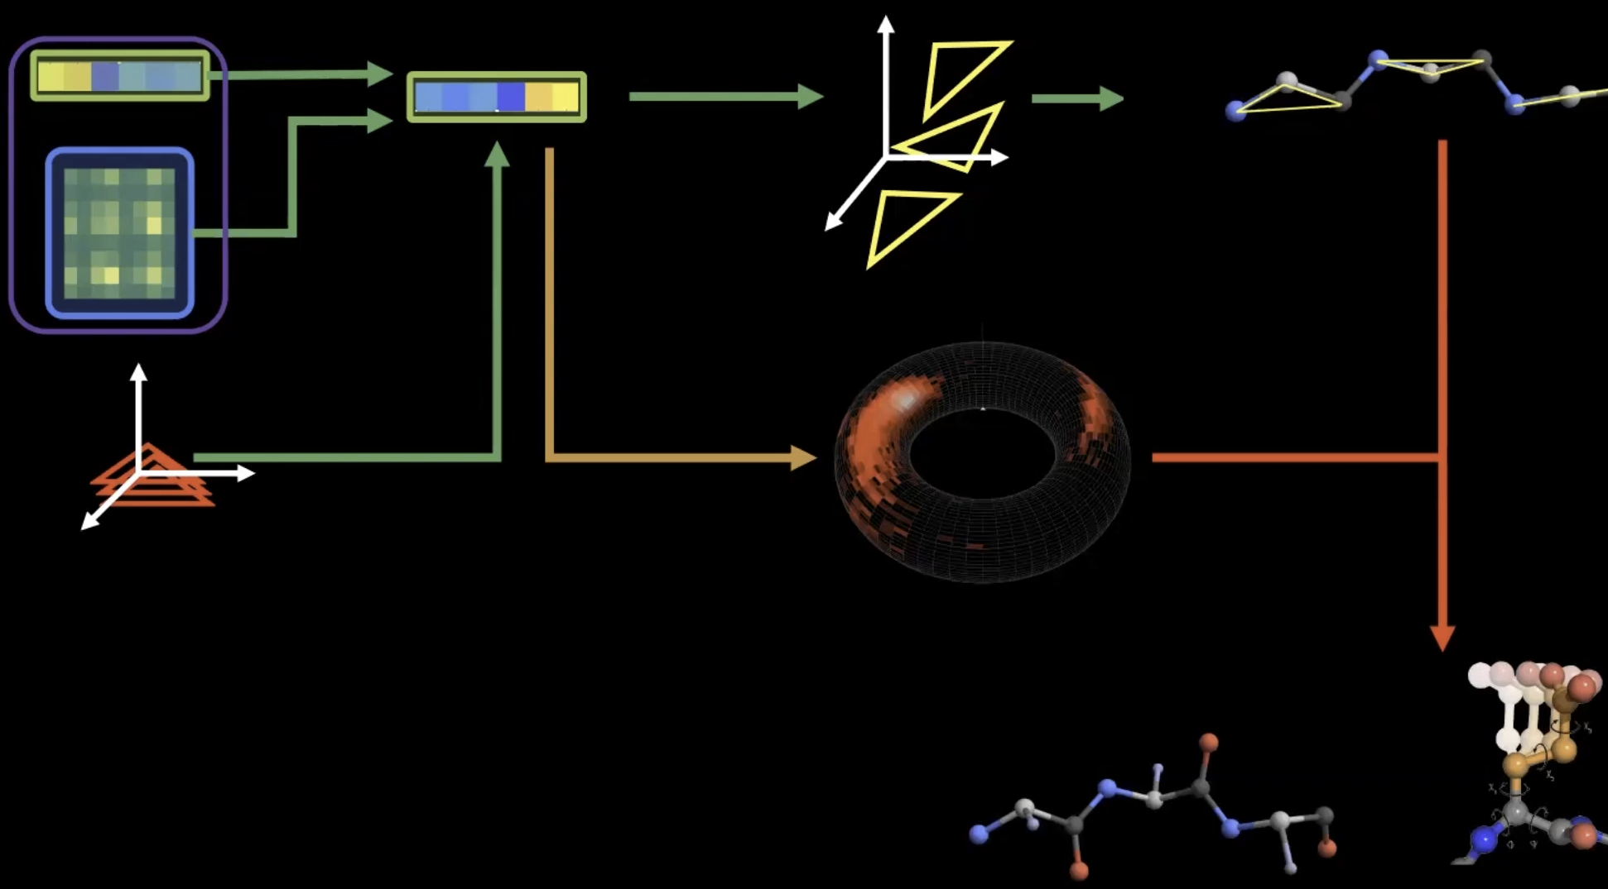
Side-chains Are Predicted from the Same Structural Representation
The same single representation S_{i} is used to predict side-chain torsion angles.
Because side-chain geometry is largely rigid, torsion prediction is sufficient.
The system is trained end-to-end.
Notes:
https://youtu.be/ri39B0Voujc?si=EhvG9TWsNUM108LL&t=3759

Slide 39
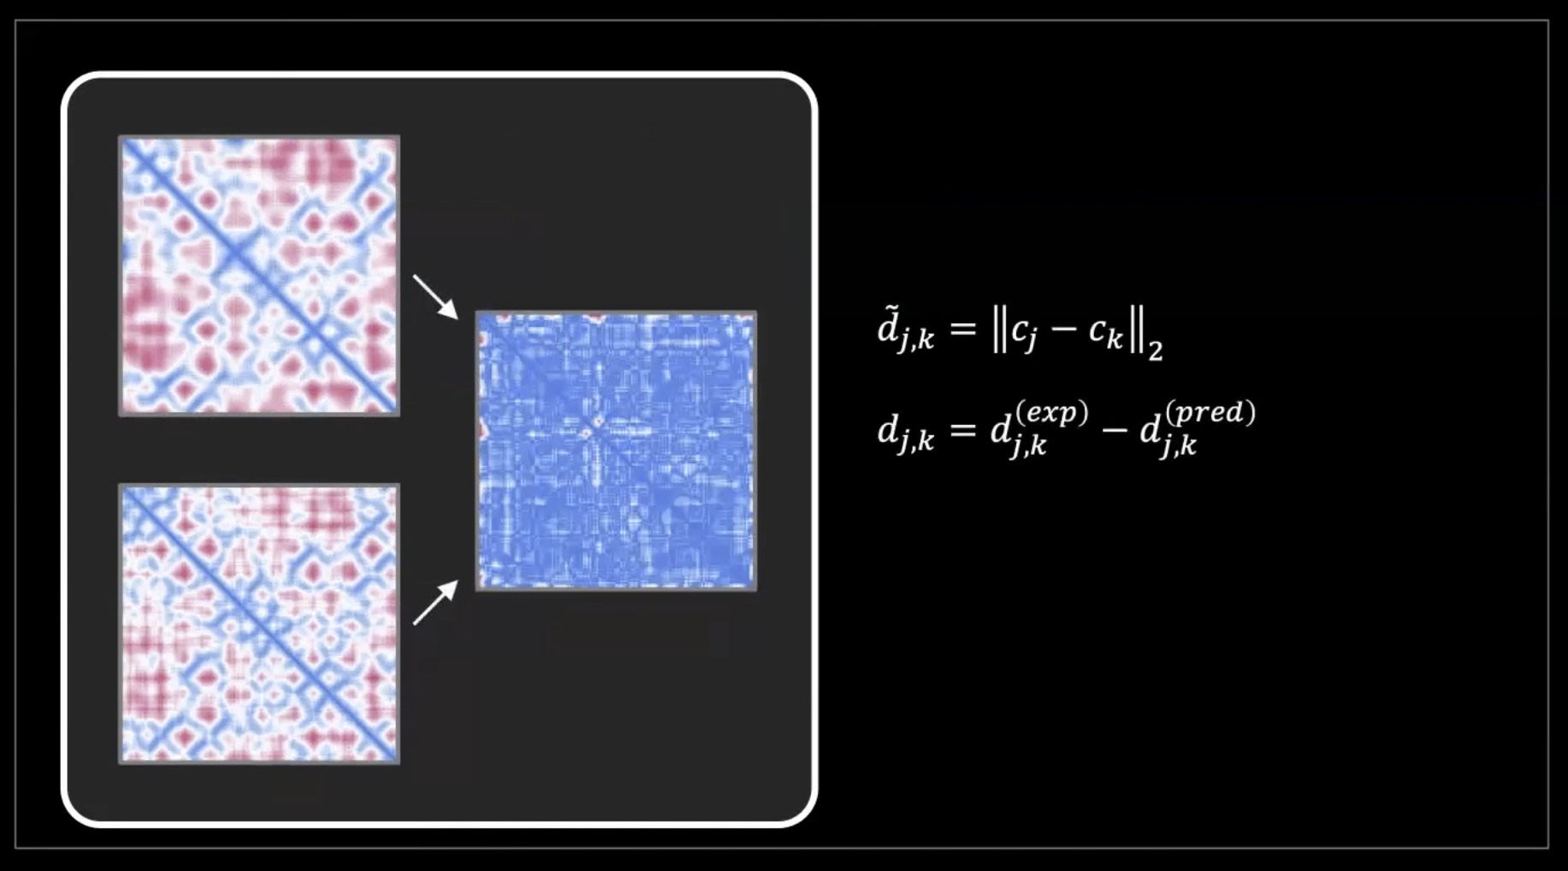
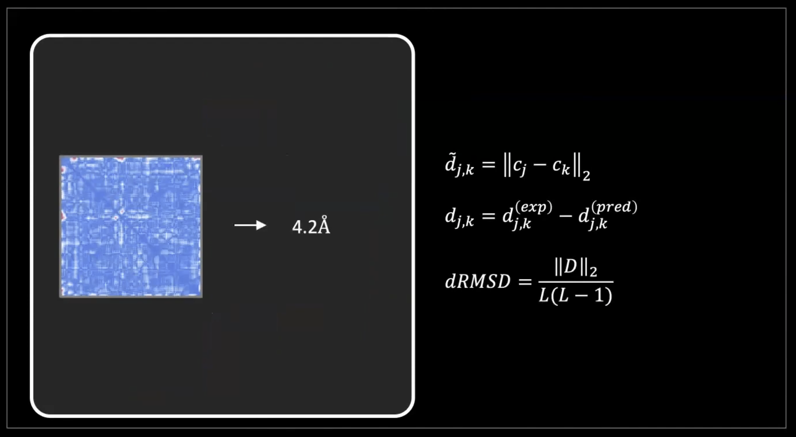
Structure Quality Can Be Measured Locally and Globally
dRMSD is a more global distance-based metric,
but not the same as GDT (Global Distance Test)
Local Structure Accuracy (lDDT / LDDT)
lDDT (i.e. Local Distance Difference Test) measures local structural accuracy.
GDT (i.e. Global Distance Test) measures global structural similarity.
Notes:
L is the protein length (number of residues), and it is used to normalize the sum so that the metric does not depend on how large the protein is. We average the error across the whole protein.
Here L denotes the protein length and is used to normalize the metric so that the error becomes comparable across proteins of different sizes.
https://youtu.be/ri39B0Voujc?si=dpUrNWuKP5LLEBku&t=4067
https://youtu.be/ri39B0Voujc?si=-ojbHUBxR6nZQbsy&t=4078

Slide 40
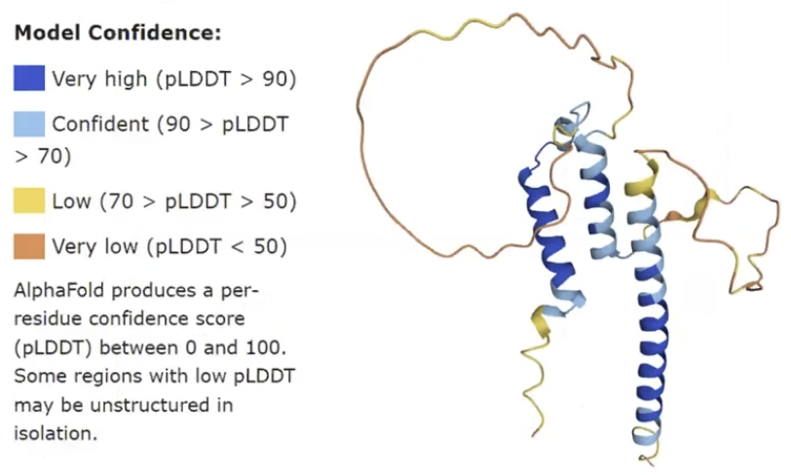
AlphaFold 2 Predicts Its Own Confidence via pLDDT
LDDT = the true (local) evaluation metric
pLDDT = the model’s predicted estimate of that metric
Notes:
https://youtu.be/kIkn5DGEJJw?si=TuXlaEg6B7JxKZpN&t=3835

Slide 41





The First Training Phase Combines Structural and Auxiliary Losses
FAPE loss → geometry-aware loss invariant to global rigid motions
Auxiliary loss → per-block supervision during iterative refinement
Distogram loss → supervision on the pair representation
Masked MSA loss → recovery of masked amino acids from evolutionary context
Confidence loss → supervision for confidence estimation
Notes:
https://youtu.be/ri39B0Voujc?si=1wTzqMyvCkI-1NUd&t=4257

Slide 42
The Second Training Phase Adds Experimental and Violation Losses
Experimentally resolved atom loss (L_{exp_resolved}):
Not every atom has experimentally determined coordinates. AlphaFold 2 includes an auxiliary prediction of whether each atom was experimentally resolved. This loss trains that prediction using resolved/unresolved labels. Missing coordinates are handled separately: structural losses ignore comparisons that require unavailable experimental coordinates.
Violation loss (L_{viol}):
A predicted protein can have the right overall shape but still contain unrealistic local geometry. This loss penalizes atoms coming too close together (steric clashes), incorrect bond lengths, and incorrect bond angles. During fine-tuning, it encourages chemically plausible structures, including in regions without experimental coordinates. These are soft penalties, so some violations can still remain.
Notes:
https://youtu.be/ri39B0Voujc?si=8k2zZTEYN1Xo9_aQ&t=4342

Slide 43
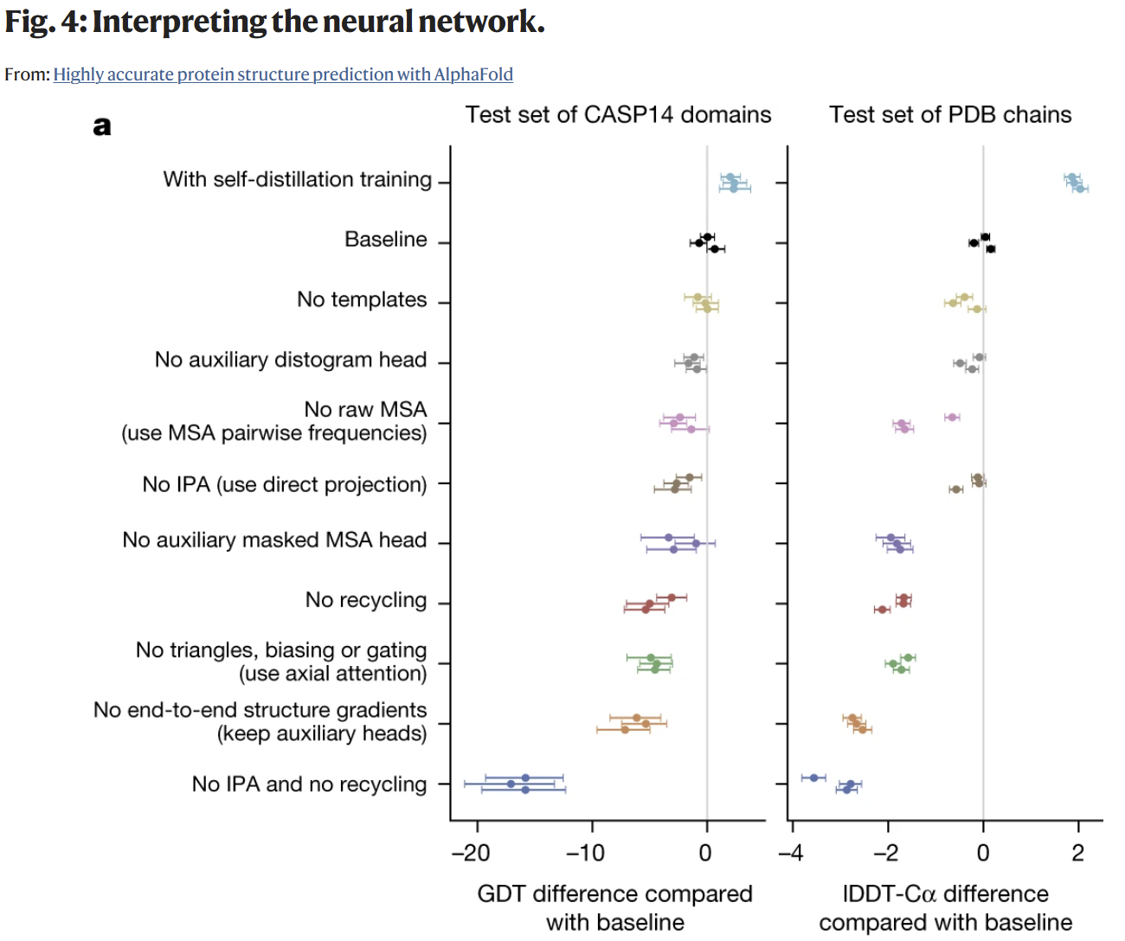
Ablation Studies Reveal Which Components Matter Most
“Highly accurate protein structure prediction with AlphaFold” by J. Jumper et al., Nature, 2021
Notes:
https://youtu.be/ri39B0Voujc?si=b9egWGtPdqRCNS1i&t=4465
https://www.nature.com/articles/s41586-021-03819-2/figures/4

Slide 44
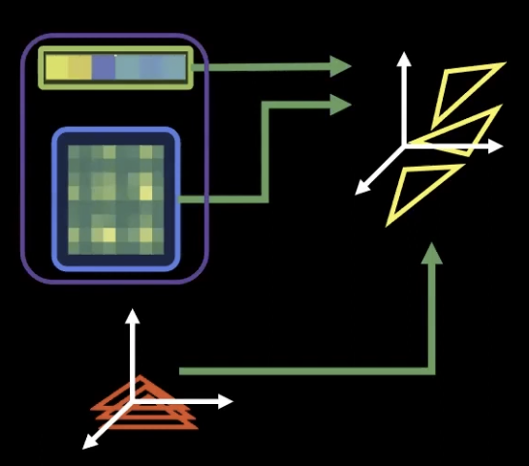
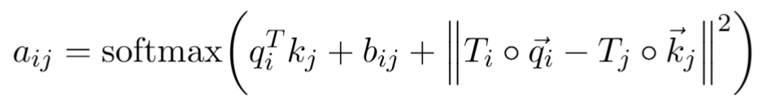
IPA and Recycling Are Critical for Performance
Remember → In AlphaFold 2, IPA stands for Invariant Point Attention. It’s one of the key architectural innovations that allows the model to reason directly in 3D space while remaining consistent under rotations and translations.
Notes:
https://youtu.be/ri39B0Voujc?si=YUaeSDyL42QkvOok&t=4627
https://www.nature.com/articles/s41586-021-03819-2/figures/4

Slide 45
OpenFold

Slide 46
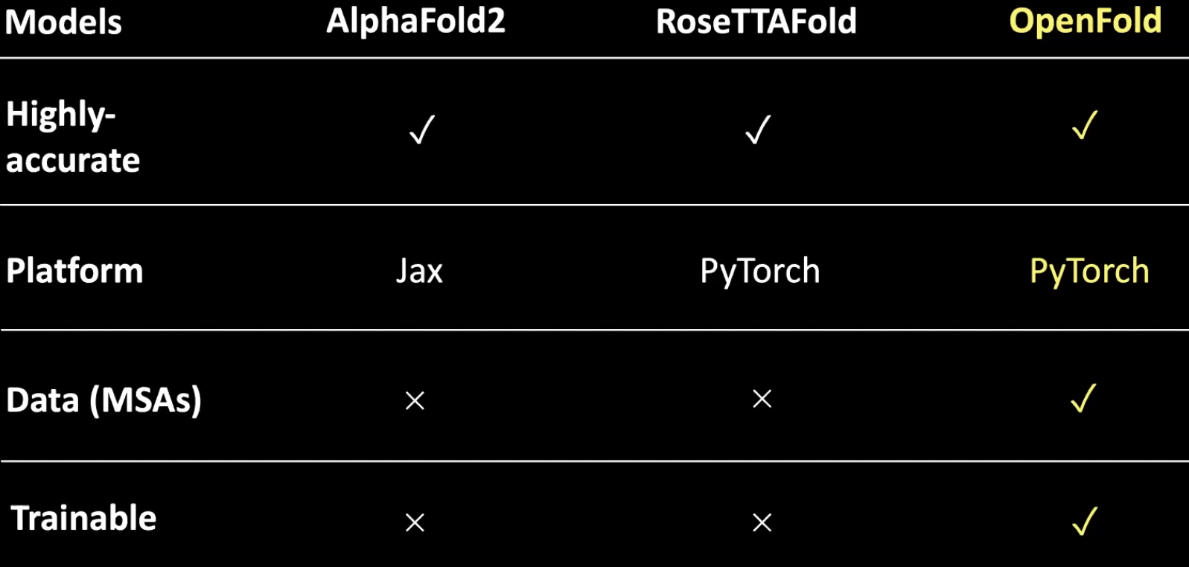

OpenFold Prioritized Reproducibility and Trainability
Notes:
https://youtu.be/kIkn5DGEJJw?si=QW09cm7wqplvUwNA&t=2441
https://github.com/aqlaboratory/openfold

Slide 47

Ask DeepWiki for concrete Details
Append github username and repository name to the deepwiki.com URL → https://deepwiki.com/aqlaboratory/openfold
Notes:
https://deepwiki.com/aqlaboratory/openfold

Slide 48
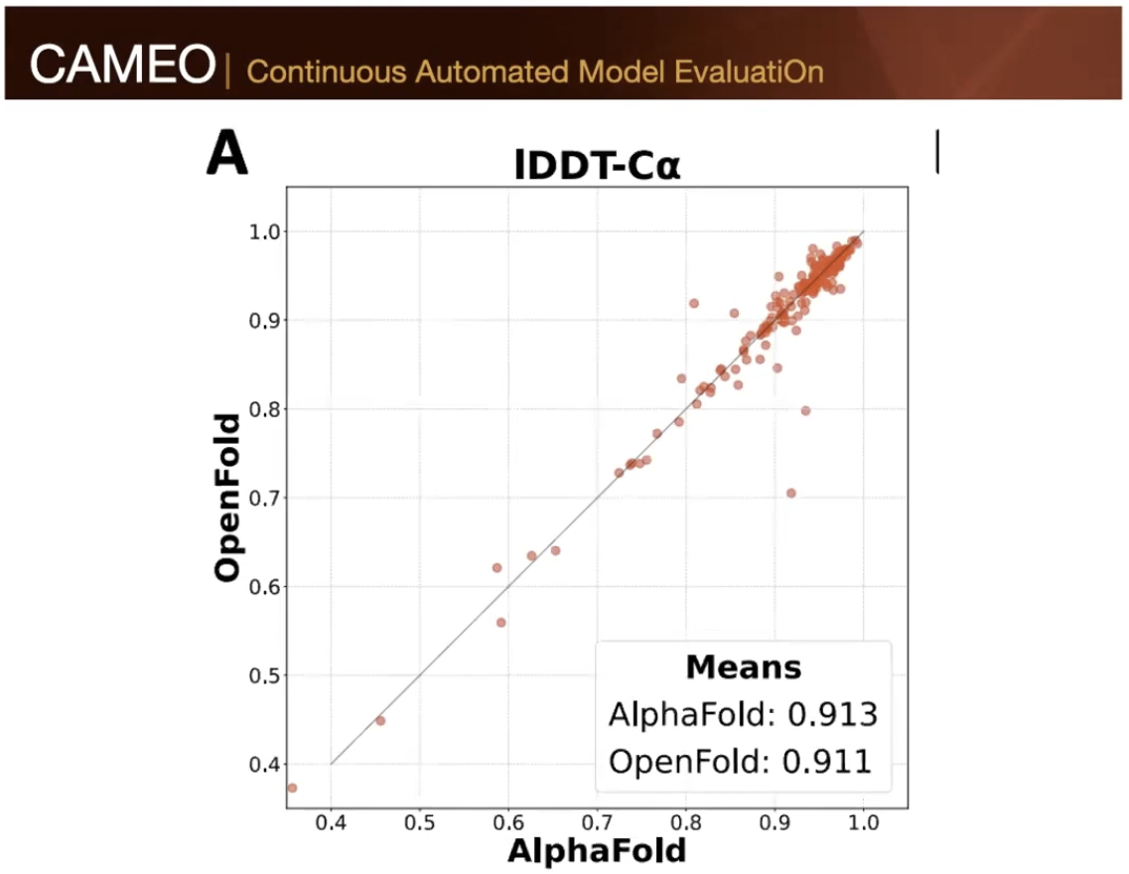
OpenFold Achieves Near-Parity with AlphaFold 2
Notes:
https://youtu.be/kIkn5DGEJJw?si=AjnPvVzpm9kVguyZ&t=3414

Slide 49
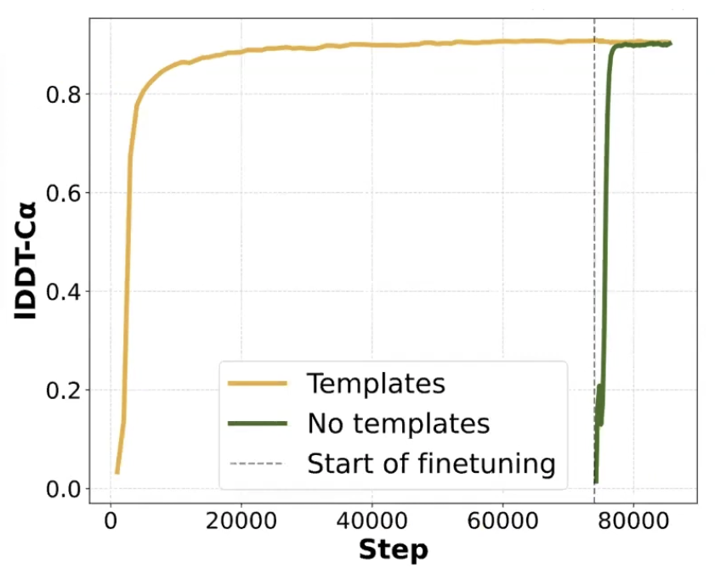
Most Performance Emerges Early in Training
The model achieves 90% of the final metric in only 3% of the training time.
Notes:
https://youtu.be/kIkn5DGEJJw?si=1GlLz3qdDAISEbUh&t=3737

Slide 50
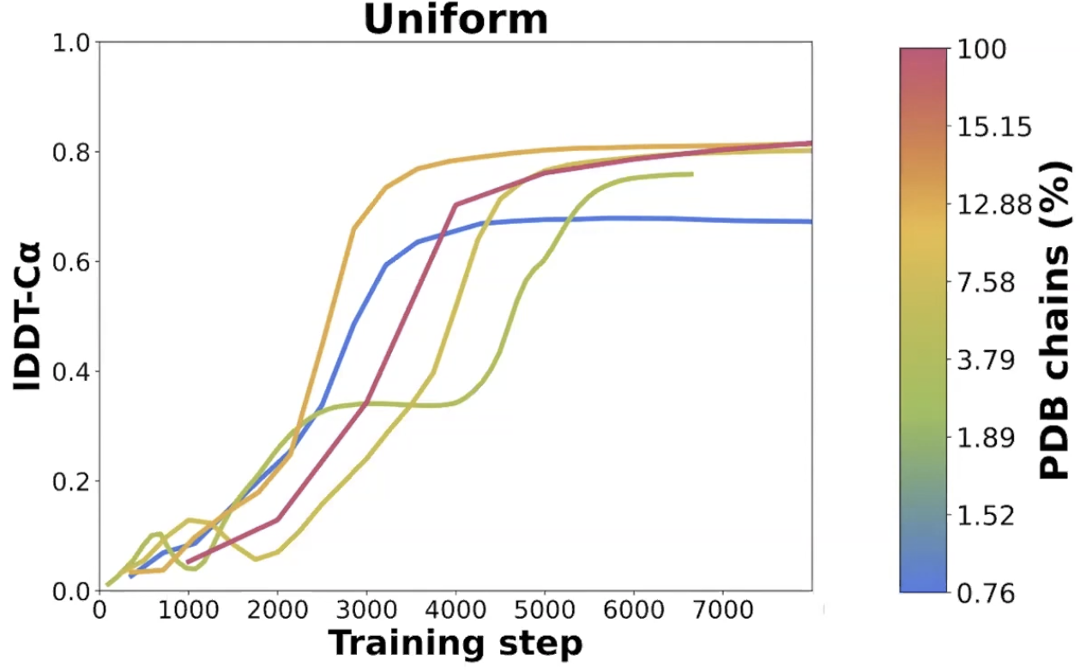
Performance with Deliberately Reduced Datasets
Notes:
https://youtu.be/kIkn5DGEJJw?si=iC8fAEu0mosTauXT&t=4374

Slide 51
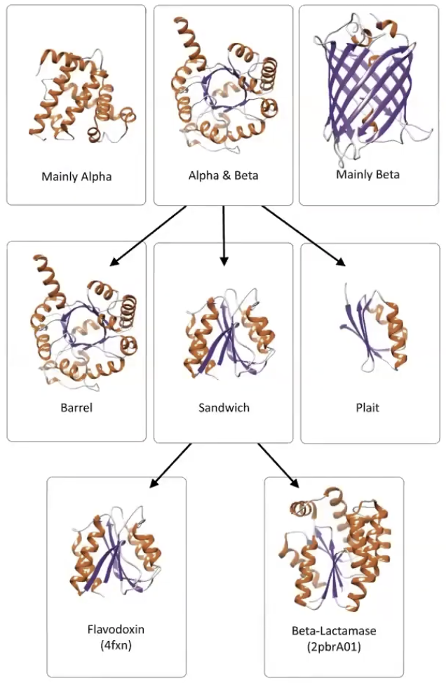
Protein Fold Space Is Rich but Still Constrained
Class
Nature is parsimonious in the structures it allows
Architecture
Topology or Fold
Notes:
https://youtu.be/kIkn5DGEJJw?si=5zw91nD9Ku4abAi1&t=4611

Slide 52
Take-Home Messages
AlphaFold 2 turned protein folding into a learnable geometric reasoning problem.
Its success came from combining co-evolution (1D), pairwise reasoning (2D), and triangle equivariant updates (3D).
The architecture works because its inductive biases match the biology and the geometry.
Confidence prediction (pLDDT) and reproducibility made the approach scientifically useful.

Slide 53
References
Theory material → https://nazimbouatta.scholars.harvard.edu/lectures
“Highly accurate protein structure prediction with AlphaFold” paper, by Jumper et al. → https://www.nature.com/articles/s41586-021-03819-2
Nobel Prize Talk → https://www.youtube.com/live/HnT1VWzdFWc
CASP challenge blog post → https://deepmind.google/blog/alphafold-a-solution-to-a-50-year-old-grand-challenge-in-biology/
OpenFold repository → https://github.com/aqlaboratory/openfold
“OpenFold: retraining AlphaFold2 yields new insights into its learning mechanisms and capacity for generalization”, by Ahdritz et al. → https://www.nature.com/articles/s41592-024-02272-z
DeepWiki → https://deepwiki.com/aqlaboratory/openfold
“MSA Transformer” by Rao et al. → https://www.biorxiv.org/content/10.1101/2021.02.12.430858v1.full
“E(n) Equivariant Graph Neural Networks”, by Satorras et al. → https://arxiv.org/abs/2102.09844
“Do Transformers Really Perform Bad for Graph Representation?”, by Ying et al. → https://arxiv.org/abs/2106.05234
“CCNet: Criss-Cross Attention for Semantic Segmentation”, by Huang et al. → https://arxiv.org/abs/1811.11721
“Protein Assembly and Building Blocks: Beyond the Limits of the LEGO Brick Metaphor”, by Y. Levy → https://www.semanticscholar.org/paper/Protein-Assembly-and-Building-Blocks%3A-Beyond-the-of-Levy/86a997321430edf8815f35d5e7254c1b9e7a1dd2

Slide 54


