Slide 1
Understanding
Diffusion
September 2026
Danu Caus

Slide 2




How to Read These Slides
Note that in presentation mode, not all content is necessarily visible. Please also check the hidden notes section in the PowerPoint format, to see if there are any additional URL references related to the visible content of any particular slide. The broader references are also available in the References slide at the very end. However, in the hidden notes you will see more concrete pointers, such as concrete PDF pages, exact Figure numbers within papers, etc.
Some of the slides are not mandatory for conceptual understanding, but very useful if you are more mathematically inclined or simply interested in a deeper understanding. They will be depicted using a cherry on top (-right) symbol or sometimes as a double-dose of cherry
for even deeper derivations.
If you find any mistakes on the slides, I would be very grateful 😇 if you could send me a note.
Enjoy!

Slide 3
Chapter 1
Defining Flow and Diffusion Models Through the Lens of Differential Equations

Slide 4
Flow Models

Slide 5


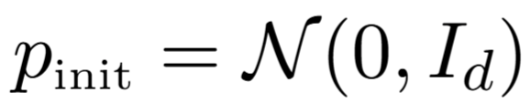
From Initial Distribution to Data Distribution
Generative
Model

Slide 6
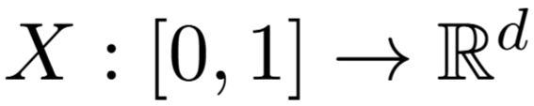





A Trajectory Maps Time to State
We assign each time a vector

Slide 7
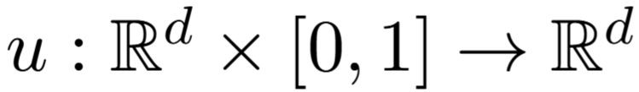
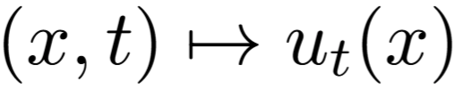
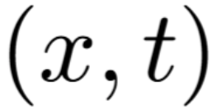
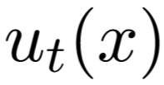
A Vector Field Assigns a Velocity
A vector field assigns each pair a direction .
In other words, you could think of as the speed vector.

Slide 8
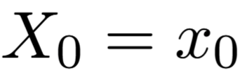
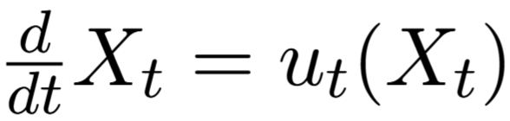
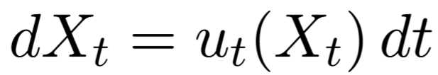
Ordinary Differential Equation (ODE)
Initial Condition:
i.e. where should the trajectory start
2) How does the trajectory evolve:
One thing to note is that in the future slides you will also encounter the equivalent formula after multiplying both sides by dt :
Side remark →The next state is dependent only on the current state => it is a Markov Process, i.e. with no memory.

Slide 9
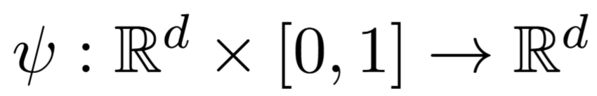
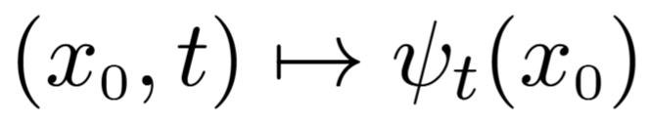
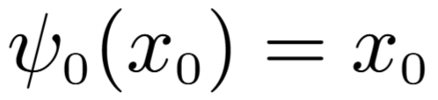
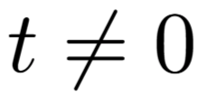
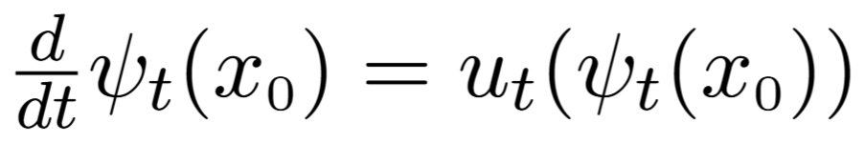
A Flow Collects All ODE Trajectories
The flow corresponds to the bundle of trajectories of the ODE for all initial conditions
Intuitively speaking, a flow warps space into a new form
The trajectory at time 0 is just:
2) At any other time step we have the evolution formula:
To gain intuition, check out this visualization tool → https://mariogemoll.com/flow-matching

Slide 10
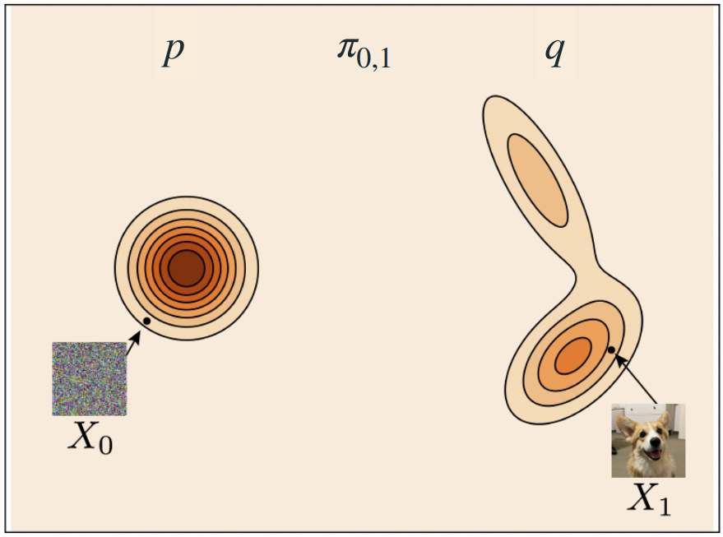
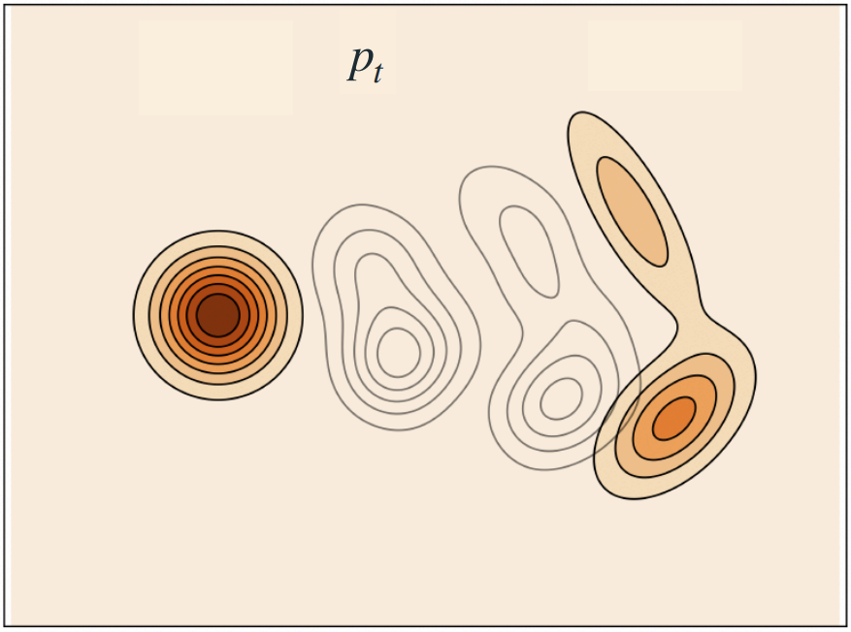
A Flow Transports Probability Density
A flow does not only move individual points. It moves an entire probability density over time: p → p_{t} → q . The vector field tells each point where to move. If all points follow this vector field, the whole distribution is continuously transformed from the initial distribution p into the target distribution q.
Notes:
Slide 172 from https://neurips.cc/media/neurips-2024/Slides/99531.pdf

Slide 11
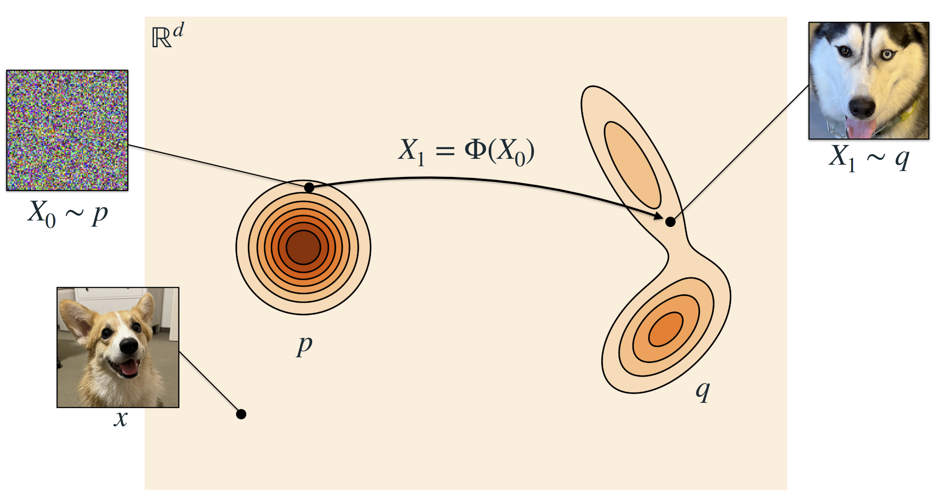
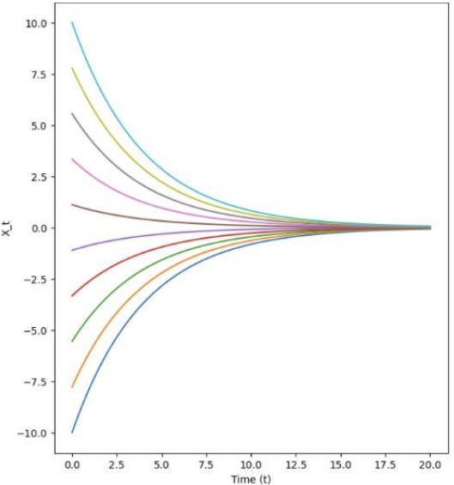
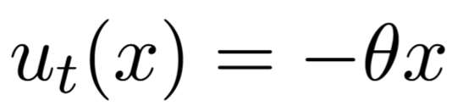
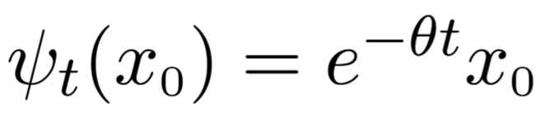
Example: A Linear Contracting Flow
Keeping in mind the intuition that a flow model changes a Probability Density Function (PDF) across time
let’s try to solve this simplified example below
Say we have a Linear ODE case:
We claim that the flow is given by:
Notes:
Slide 8 from https://neurips.cc/media/neurips-2024/Slides/99531.pdf
Slide 20 from https://diffusion.csail.mit.edu/2026/docs/20260120_Lecture_01.pdf

Slide 12
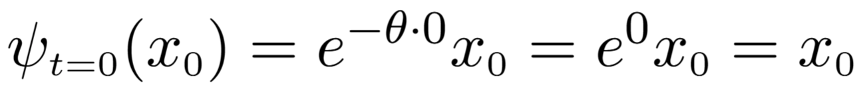
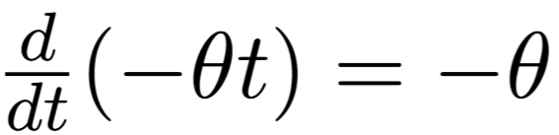

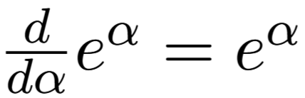
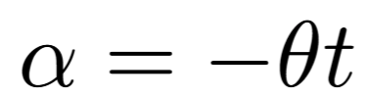


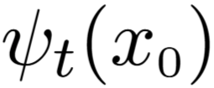
Verifying the Linear Flow Solution
Proof:
Initial condition:
ODE:
This is a composed function so we have to take the inner derivative with respect to time:
and then multiply with the outer derivative with respect to time:
, where
Does not depend on time t so we take it out of derivative operator
Continuation from bottom right:
This is just if we substitute the generic with

Slide 13
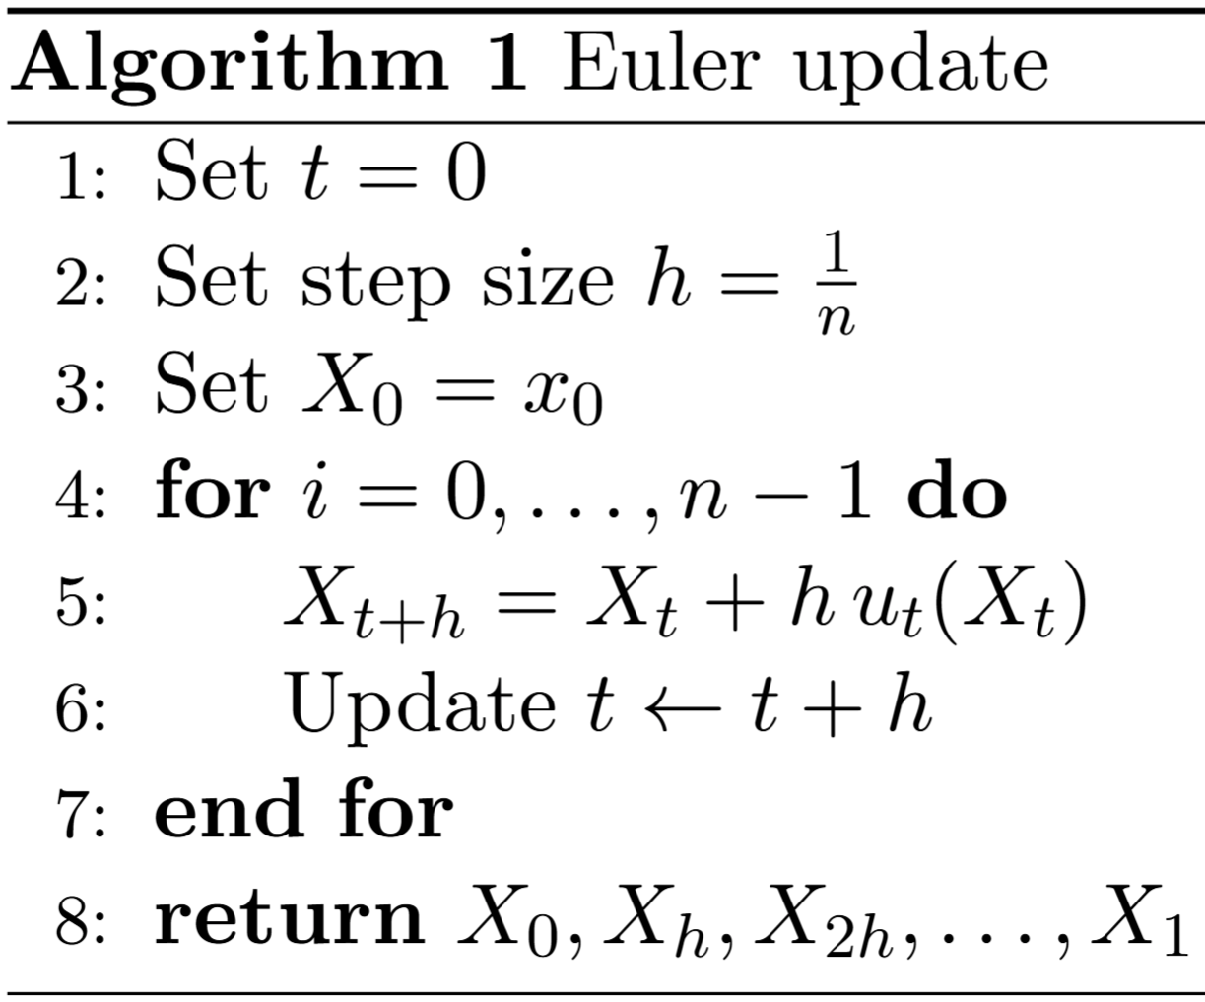


Euler Simulation of an ODE
We use the so called “Euler Update” method to simulate the ODE as follows:
We take a small step in the direction of the vector field
Return the full trajectory from time to time

Slide 14
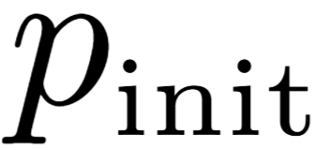
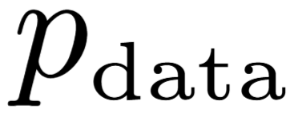


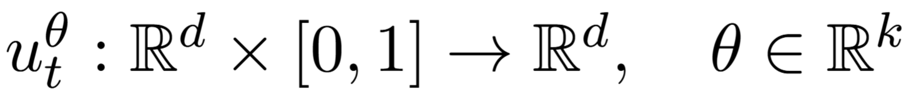
Neural Network as a Parameterized Vector Field
ODE
However, we model using a neural network , where are the parameters / weights of the neural network:
Hence, a neural network for our intents and purposes is literally just a
parameterized vector field.

Slide 15
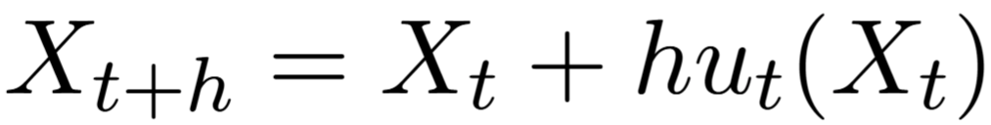
Vector Field vs. Flow
Intuitively, the neural network gives you the velocity vector, i.e. the change you need to do at a specific time and place:
where h is the small step in the direction of the vector field.
Note → the neural net itself is the Vector Field. The Flow on the other hand is the map that we implicitly get by simulating the ODE.

Slide 16
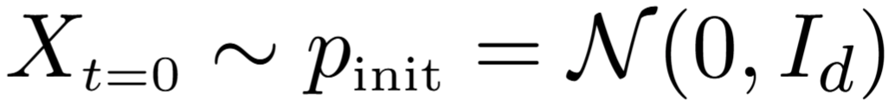
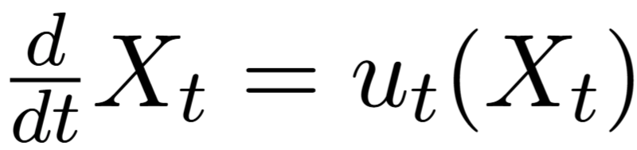
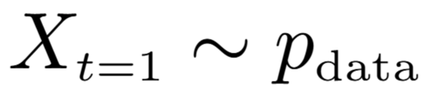
From Random Initialization to Data Distribution
We make the initial condition random:
Follow the vector field:
Until we reach our final goal:
Such that the end point has the data distribution we want to model.

Slide 17
Diffusion Models

Slide 18

Stochastic Process
A stochastic process is a collection of random variables { X_{t} } indexed by time. One realization is a trajectory or sample path.
The collection of these trajectories is the stochastic process, i.e. different realizations produce different sample paths.
Hence, we have a trajectory that maps time t to vector X_{t} as previously seen in the Flow case, however this time we add the aspect of stochasticity as seen in the plot above.

Slide 19
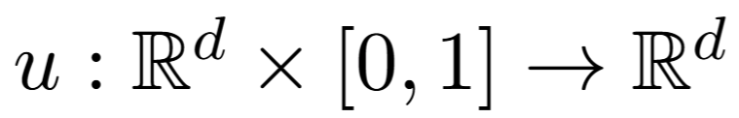

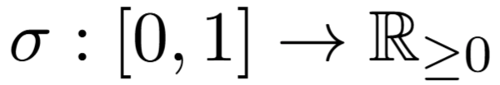

Drift and Diffusion Coefficient
The vector field u is similar to what it was before and can be thought of as deterministic drift:
but additionally we now add a so called diffusion coefficient that adds non-determinism and controls the stochasticity:

Slide 20
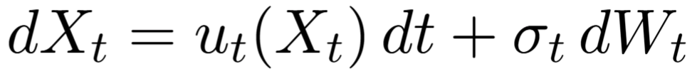
Stochastic Differential Equation (SDE)
Initial condition:
Brownian Motion /
Wiener Process, hence the
W notation
2) Evolution SDE:
ODE part
Added stochastic noise

Slide 21
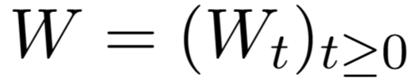
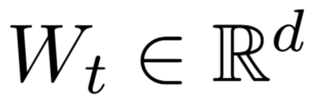



Brownian Motion
Brownian motion is a stochastic process denoted as W: ,
such that:
At time zero:
2)
It has Gaussian increments: , where
i.e., the variance increases linearly in time.
3)
It has independent increments, i.e.: are stochastically independent random variables ( ).
Side note: Brownian motion is a Gaussian Process with a specific type of kernel.

Slide 22
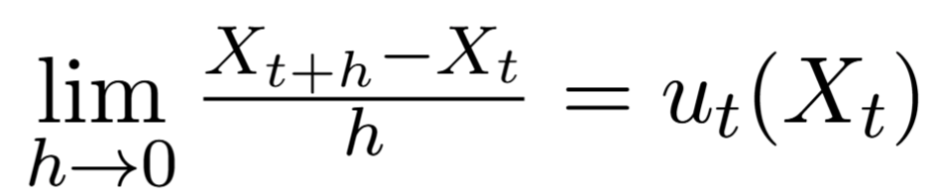
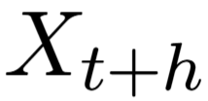
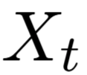


Why SDEs Use Increments
Note that the Brownian motion is continuous, but almost surely nowhere differentiable.
Hence, we need to describe the differential equations in a form that does not require derivatives.
For simplicity, let’s consider the ODE case again:
Mathematically this is equivalent to:
Position X
i.e., take the tangent at time t
Time t

Slide 23
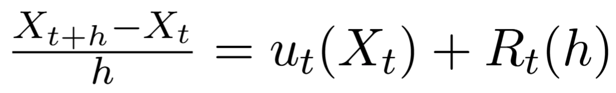


Finite-Difference Form of an ODE
For a finite step size h, we can write the finite-difference approximation with a remainder term R_{t}(h), where R_{t}(h) → 0 as h → 0. Hence, removing previous lim, we get the following equivalent equation:
error term
Multiply both sides by h →
Add to both sides →

Slide 24
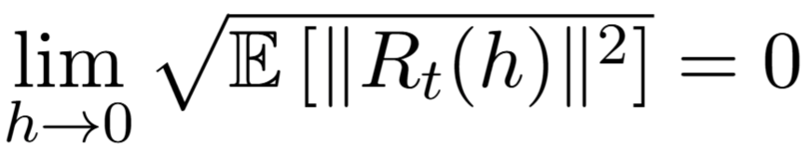
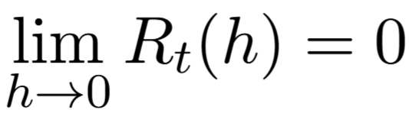
From ODE Increments to SDE Increments
Transitioning to the SDE case, the equation will be similar here, but we would have to add the stochastic increment coming from the brownian / diffusion noise.
same as
Because the Brownian increment is stochastic, convergence is commonly measured in mean square:
instead of simply: , as we had in the ODE case.

Slide 25
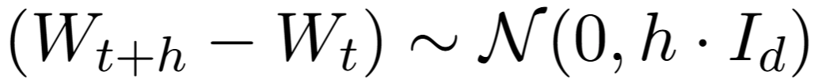
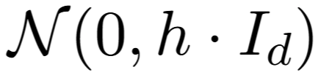
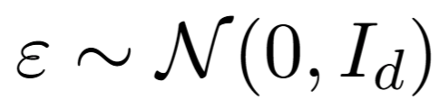
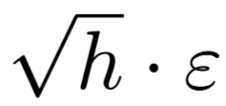


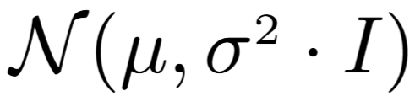

Reparameterization Trick
To sample from this is to sample from this
However, we make use of a trick in statistics where sampling from
is equivalent to sampling from a Standard Normal Distribution, i.e.
and then scaling epsilon to will ensure we’re following
So, if , then
More generally, if we want to follow , we can set it to
This is called the reparameterization trick and is also famously used in Variational Autoencoders / VAEs

Slide 26
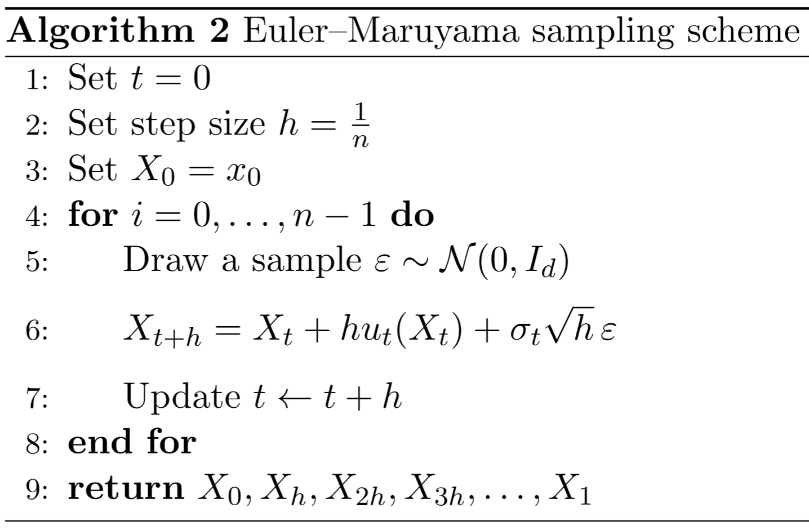


Euler–Maruyama Simulation of an SDE
Add additional noise with variance , using our reparameterization trick, and moreover → scale it by the diffusion coefficient as we’ve seen in the SDE equation.

Slide 27


Diffusion Model as an SDE
A diffusion model converts to via an SDE (instead of an ODE, like in the case of flow models)
SDE
As before, we will have a neural network acting like the vector field:
Unlike in the flow case, here we introduce the diffusion coefficient

Slide 28




Role of the Diffusion Coefficient
Most of the time is prescribed rather than learned. It may be constant or follow a time-dependent schedule.
1. As before, we initialize the model with
Note that if sigma is zero, we cancel this term completely and thus revert to the ODE / flow model case
2. And then follow
If sigma is on the larger side, then we will explore more. But if it’s too large, we might run into numerical instability issues.
3. Until we reach our goal →

Slide 29

Brownian Motion and Markov Processes
If you come from a Gaussian Process machine learning background, the Brownian motion can be viewed as a Gaussian Process (GP), as mentioned in an earlier slide. We just use a specific type of kernel function, namely the Wiener Kernel:
Similar to what Gaussian distributions are for continuous functions, the Brownian motion would be something equivalent, but for stochastic processes that are well behaved, i.e. they may not have derivatives, but they are still continuous.
All of this theory generally relates to Markov Processes, which is something more general, where we can also deal with “jump processes”, i.e. having jump discontinuities, which Brownian motion does not consider.

Slide 30
Chapter 2
From Conditional to Marginal:
Single Data Points to the Full Distribution

Slide 31
Conditional and Marginal Vector Fields

Slide 32

The Missing Training Target
Typically, we train the model by minimizing a squared-error loss:
In regression or classification, the training target is the label.
Here however we have no label => we have to derive a training target.

Slide 33
Terminology
Marginal Vector Field
Flow Matching
Marginal Score Function
Score Matching
Conditional < term >
Per single data point
Marginal < term >
Across a distribution of data points

Slide 34




The 6 Objects to Remember
Tractable
Intractable integral over entire data distribution => p_{t}(x) can’t be evaluated explicitly
Conditional Probability Path
Marginal Probability Path
Conditional Vector Field
Marginal Vector Field
Conditional Score Function
Marginal Score Function
Notes:
Slides 33, 34 and 35 at → https://diffusion.csail.mit.edu/2025/docs/slides_lecture_2.pdf

Slide 35




The Conditional Setup: Noise to a Single Data Point
Probability distribution over . We can draw samples from it.
Scattered / Blurry Gaussian
Focused dot / data point =>
can be viewed as a Dirac Distribution

Slide 36









Gaussian Conditional Probability Path
Where and are called noise schedulers, which are just functions that have the following properties:
Most common example:
and
1)
e.g.
2) and
2)

Slide 37









Gaussian Path from Noise to a Data Point
Variance goes down, step by step
Here we assume the dataset is a single point, hence the dirac function
is a Gaussian

Slide 38




Marginal Probability Path
Marginalizing means integrating over :
Density of z under the data distribution
We integrate over
Conditional Probability Path
z
Marginalize latent variable z (which in our case happens to be the data point) to obtain x
Every conditional path induces a marginal path. From a data distribution and a conditional path we get a marginal path .
x

Slide 39







A Conditional Vector Field Generates a Conditional Path
We denote the conditional vector field by:
ODE
If we sample and we simulate the ODE
=> the distribution of for any time between 0 and 1 is given by the conditional path:

Slide 40





Conditional Gaussian Vector Field
Where:
Scalar s₁
Scalar s₂
Since we pick and , at the end of the day we have just a scalar combination of z and x:

Slide 41
The Gaussian Vector Field Generates the Probability Path
So, if we simulate an ODE where we use the Gaussian Vector Field (i.e. the black arrows in the figure):
we end up following the Gaussian Probability Path (the concentric circles in the figure):

Slide 42


Marginalizing the Conditional Vector Fields
Posterior
Likelihood
Prior
Acts as a weighting term for the posterior
i.e. the ratio above is equal to the posterior over Z
Data
z
Note that marginalizing over the posterior here is referred to as the “Marginalization Trick”
Posterior
Likelihood
x
Noise

Slide 43


Marginal Vector Field as a Posterior Expectation
Posterior
Intuitively, we can say that the marginal vector field is the weighted average over all the data points z of the conditional vector fields where the weight is the posterior :
Data
z
Posterior
Likelihood
x
Noise

Slide 44
Posterior Interpretation
Data
Data
z
z
Given that we are at x, we go backwards
Posterior
Likelihood
Posterior
x
x
Noise
Noise
Given that we are at x, we’re taking the expected value (i.e. Integral means Expectation) of my conditional vector field . In other words, we’re going backwards from x to z and taking solutions that we’ve used before for single data points , and weigh them with the posterior . At every time, being at x, we’re basically going backwards to our latent variable, which happens to be a data point z and marginalizing over that.

Slide 45

Takeaway for the Practical Session
We are indirectly solving the collective problem of ending up with the data distribution, by focusing on generating single data points. In other words: generating single data points is a proxy tool of actually ending up with the overall data distribution
The core principle is that solving the problem per data point will be enough for training the model in practice.

Slide 46

The Many Roads from Noise to Data
Note that there are many ways of going from noise to data. There are infinitely many ways actually! At the beginning people were doing this without specifying intermediate paths
One key idea of diffusion models was to specify the way of going from noise to data using intermediate paths with scalable training.

Slide 47






Continuity Equation
Given a randomly initialized ODE: ,
Following the probability path , is equivalent to holding the
Continuity Equation :
for
Where by definition → ,

Slide 48


Probability Mass: Inflow and Outflow
Outflow
x
Inflow
Probability-flow intuition
Importantly,
this statement goes both ways
Change of probability mass at x
Net inflow of probability mass:
Inflow - Outflow

Slide 49



Going with the Flow
Let’s prove that by using the left part “<=” part of our equivalence relation “⇔” from before.
We will show that we can go from to and once this is done, we will make use of the “⇔” relation to conclude that
We end up following the probability path when we “go with the flow”

Slide 50

Proof: The Marginal Vector Field Generates the Marginal Path
Apply the marginalization formula
Move the time derivative inside the integral
Apply the continuity equation formula by using
the conditional probability, i.e. with “ | z” instead
Take the “div” operator outside and instantiate
the dots with x as shown by the arrows above
Multiply and divide by p_{t}(x) trick, so that we
reach the posterior formula p_{t}(z|x) in the red box
The integral is the Marginal Vector Field
formula that we’ve seen some slides ago

Slide 51
Conditional and Marginal Score Functions

Slide 52





The Score Is a Log-Density Gradient
Whenever you see in the diffusion context, think of “Score”.
Technically it’s but we will write for simplicity.
Similar as before, we can distinguish between the conditional score:
and the marginal score:

Slide 53






Marginal Score Function
Marginal score
Conditional score
To prove the formula for the marginal score function we will make use of the fact that: (assuming our log has base e, i.e. log == “natural logarithm” / ln)
If we have a composed function however, we would have instead, according to the chain-rule.
Therefore: , where is the vector of partial-derivative operators:

Slide 54


Proof: Marginal Score Identity
Apply the chain rule formula from last slide
Use the marginalization trick, i.e. integrate the conditionals to get the marginal
Take the integral outside of the gradient operator, because we integrate over z, but the gradient is with respect to x.
reduce
Apply the chain rule formula from last slide again, but for conditionals, i.e. “| z” case (as suggested by the 3 red arrows)
Therefore →

Slide 55


Marginal Score vs. Marginal Vector Field
Marginal Score Function formula:
Both are integrals over conditionals, which act like weighting terms for
the posterior p(z|x)
We have this p(z|x) posterior ratio in both cases
Marginal Vector Field formula:
Both formulas are posterior expectations. The same posterior weights either the conditional scores or the conditional vector fields.

Slide 56



Gaussian Conditional Score
We can design the conditional probability path ourselves, making its conditional score analytically available.
For example, if we use our beloved Gaussian Conditional Probability Path
then we can show analytically that the Gaussian Score is

Slide 57


From ODE to SDE
Use old vector field
This score is essentially the correction term that we have to apply to the old ODE vector field.
Noise injection
Different choices of are theoretically possible, provided the corresponding score correction is applied.

Slide 58
Injecting Noise: One Flow, Many SDEs
So a score function is essentially the correction term that we need to apply if we want to inject noise and convert an ODE to an SDE.
Training an ODE flow model will give us one solution. And by injecting noise on top, we can get a whole variety of different other models / solutions.
The anecdotal evidence is that a lot of the models in the literature are purely flow models, because that approach already does the job well. It’s a luxury to have a whole diversity of SDE models that all do the same thing, but empirically you might still be interested to explore these and find the optimal noise level to get the “best” results, best here meaning the most visually pleasing qualitative results to you.

Slide 59


From Continuity to Fokker–Planck
The continuity equation we saw in the ODE case:
becomes the Fokker-Planck equation in the SDE case:
Change of probability mass at x
Net inflow of probability mass:
Inflow - Outflow
Diffusion of probability mass
Compared with the continuity equation, the Fokker–Planck equation contains an additional diffusion term involving the Laplacian 𝚫. This is the same diffusion operator that appears in the heat equation.

Slide 60
Chapter 3
Practical Training Algorithms

Slide 61


Flow Matching vs. Score Matching
Flow matching is the training algorithm that uses the Marginal Vector Field concept:
⇒ Flow Matching
Score matching is the training algorithm that uses the Marginal Score Function concept:
⇒ Score Matching

Slide 62



Flow Matching: Learning the Marginal Vector Field
Goal: find a neural network with such parameters 𝚹 that would closely approximate u_{t}^{target} :
The Flow Matching Loss is an Expectation over squared differences:
Time t is uniform in range [0,1]
Draw a data point z, i.e. iterate over the data loader
Draw x from conditional path

Slide 63

Why the Flow Matching Loss Is Intractable
This loss function is the objective we want to minimize ideally. However, it is not tractable due to not being trivial to evaluate.
p_{t}(z|x)
This is a very high dimensional integral and basically intractable.
Why intractable? Well, we could technically loop over the entire dataset and for every datapoint evaluate the posterior ratio p_{t}(z|x) and then take an average over that. But let’s say our dataset has 100 million images => for every evaluation of the neural network we would need to do this. This is not realistic.

Slide 64

Conditional Flow Matching Loss
Since we have a formula for this, L_{CFM} will be tractable.
L_{CFM} is tractable, but does it even make sense to minimize this object? Because we don’t just want to generate single data points z. We want to generate distributions of data points, which is what is doing from the L_{FM} case.

Slide 65


Why Conditional Flow Matching Is a Valid Proxy
We will now show that we can indeed minimize L_{CFM} as a proxy for minimizing L_{FM}
Theorem: for
where C is a constant independent of 𝚹, and non-negative, i.e. L_{CFM} is shifted above L_{FM}
C
L_{FM​} can reach zero, whereas L_{CFM}​ generally does not. The two losses differ by a non-negative constant C.
C
C
C
𝚹*
𝚹
We don’t care about the value of L_{CFM} on the y-axis actually. We only care about 𝚹*. And 𝚹* is the same for both L_{FM} and L_{CFM}.

Slide 66


Consequences of the Constant Offset
There are 2 important properties that follow:
For minimizer 𝚹* of L_{CFM} :
So if we train perfectly, we will reach this equality => if we simulate our neural net model, we will have noise being converted into data, which was our overall goal.
Reduces to zero because the constant C does not depend on 𝚹
2)
Hence, both losses guide the model toward the same solution. The individual mini-batch updates may differ, but their average direction is the same.

Slide 67



General Flow Matching Training Procedure
By averaging over many samples drawn by the Data Loader, the empirical mean of the conditional terms approaches the corresponding marginal expectation .
The model has 2 inputs: the time t and location x. It then learns to regress towards each data point individually, and in the long run it will learn to create entire datasets.

Slide 68


CFM Loss for a Gaussian Conditional Path
Note –> we can pick the conditional probability path ourselves, and then we can pick the conditional vector field that does the job we want. This is essentially a design choice that is up to us. Hence, we can choose the Gaussian variants of p and u.
1) Choose Gaussian probability path:
2) Choose Gaussian conditional vector field:
If

Slide 69








Gaussian CFM Loss: Derivation I
for the Gaussian
Change of variable because
(See previous slide)

Slide 70





Gaussian CFM Loss: Derivation II
where and
We plug in some weighted average of the z data point and noise ε and are predicting
an average between the z data point and ε-noise, but using time derivative weights instead

Slide 71



Conditional OT Path
To make things even more concrete, let’s choose a specific
instance of 𝞪_{t} and 𝞫_{t} , say and
The corresponding derivatives with respect to time will be and , so:
Straight line between data z and noise ε
Difference between data and noise
z
ε
This is referred to as the Cond OT Path (i.e. Conditional Optimal Transport Path), i.e. an optimal transport path, essentially corresponding to a straight line between noise and data, which is tz + (1-t)ε and what we are predicting is the difference (z - ε)

Slide 72

Conditional OT Path Intuition
ε
z
We call this z
We call this ε
[ Slide 19 from https://neurips.cc/media/neurips-2024/Slides/99531.pdf ]
Notes:
Slide 19 from https://neurips.cc/media/neurips-2024/Slides/99531.pdf

Slide 73

Conditional OT Algorithm
Notice that we are learning to predict the same thing at all times t, namely (z-ε), but at inference phase we have to do it sequentially, since at t=0 we have access to no information at all, i.e. we have just ε-chaos, and at t = 1 we have access to full information. Hence, we have to gain this information step-by-step, for all t ∈ [0,1].
So over time we learn to predict the same thing (z-ε), but the amount of information grows, i.e. axis of information will still differ across time.

Slide 74


Physical Intuition
Cond OT special case
Changing velocity
Constant velocity
z
In general, with the Conditional Flow Matching Loss CFM we are essentially predicting velocities across our path of choice. And if we take the straight Cond OT path, our velocity becomes constant, i.e. (z-ε)
ε

Slide 75




Constant-Offset Identity Proof I
Because our loss functions resemble the structure (a-b)² we can make use of the binomial expansion formula, just treating a and b as vectors instead of scalars. We get the so-called Squared Euclidean Norm Expansion formula:
Let’s apply this to both losses

Slide 76

Constant-Offset Identity Proof II
(1) Appears in both cases
(3) Does not depend on 𝝧
(2)
Because first terms are the same (1), second terms are the same in expectation (2), and third terms will also differ in expectation by some constant C not depending on 𝝧 (3) =>

Slide 77

Flow Model Sampling
Now that we have trained the model, we will sample from it by using the algorithm we have seen before, where we plug in our newly trained vector field u_{t}^{𝜽}
Random initialization
One might wonder to what extent are flow models deterministic?
They are in fact deterministic once you sample the initial point. So, we have a random initialization indeed! But past that, the trajectory X₀ to X₁ is in fact deterministic, i.e. there is a one-to-one correspondence between the input and the output, which is given by the flow-map.
Return final point

Slide 78




Score Matching: Learning the Marginal Score
Remember: the SDE extension trick we learned before shows how the marginal score function allows to extend the ODE to an SDE with arbitrary diffusion coefficient:
,
=>
We have a Score Network: s_{t}^{𝞱} parametrized by 𝜽
The goal is to approximate the marginal score
As before, we will have a theoretical loss that is intractable because of the integral:

Slide 79


Denoising Score Matching Loss
We would then use the tractable version of the loss instead, just as we have done previously. This could be referred to as the “Conditional Score Matching Loss”, but the formal name in the literature is “Denoising Score Matching Loss”, i.e. L_{DSM}:
The L_{DSM} is tractable because we have an analytical formula for ,
namely :

Slide 80




Déjà vu
Just as before the following holds: ,
With the two similar properties:
1) For 𝚹* of L_{DSM} :
2) The gradients for the 2 losses are the same:

Slide 81

Score Matching Training Procedure
The loss here is generic, but we will get an elegant special case once we choose by design Gaussian Probability Paths.

Slide 82





Denoising Score Matching for a Gaussian Probability Path
Plug in
This is our design choice
Apply
, i.e. reparameterization trick.
Using this analytical formula, we get this final “Denoising Score Matching Loss”. We essentially predict the noise 𝝴 that was used to corrupt the data point, hence the term “denoising” in its name.

Slide 83

Denoising Score Matching Interpretation
We are taking some interpolated input between data point z and noise 𝝴
and learn to predict negatively scaled noise -𝝴 / 𝛃_{t}
Note that this loss can be numerically unstable for low 𝛃, i.e. if 𝛃 approaches zero, then the loss blows up towards infinity.

Slide 84

Score Matching Training Procedure for a Gaussian Probability Path
We get an elegant special case of our Score Matching Procedure if we choose by design Gaussian Probability Paths.

Slide 85





Learning the Drift and Score
Start with:
Exact result:
Plug in neural networks
Approximate:
End with:
After training => => and therefore

Slide 86

Denoising Diffusion Models (DDMs)
Denoising Diffusion Models = Diffusion Models with a Gaussian Probability Path:
Many people drop the word “denoising” and simply use the term “diffusion model”.
The DDMs have the special property that we can convert score matching to flow matching and vice-versa.
The first generation of diffusion models only did score matching, because they were implicitly relying on the Gaussian probability path.

Slide 87




Vector Field as a Linear Combination
We’ve already seen that:
which can be re-written as:

Slide 88


Score as a Linear Combination
Similarly, recall that:
Hence, the score is also of the form:

Slide 89



From Score Matching to Flow Matching: Conditional Case
Notice that 𝜆₁ and 𝜆₂ are not exactly the same in the 2 formulas we’ve seen, but this is not the important aspect. The main idea is that we get a linear relationship in both cases. Hence, we can say that both and are weighted combinations of x and z ⇒ we can convert them into each other!
Mathematically it can be proven that:
Train one, get the other for free!
So, we can compute only the score for example, and then get the vector field for free after training by using the analytical formula above.

Slide 90


From Score Matching to Flow Matching: Marginal Case
And if we marginalize over the variable z, a similar formula holds:
The approximate equivalent of this, using neural networks parametrized by 𝚹 will be:
Hence, we only need to train just one neural net instead of two
Note that we use the conditional formulas in the code, but the marginal object is what implicitly gets computed over large datasets.

Slide 91
Time Conventions and Extensions
We use the convention that noise resides at time t=0 and data is at t=1. But in the literature you can also find the convention that data is at t=0 and noise at t=1. This is called inverted time convention.
Historically, diffusion models were often introduced through discrete-time Markov noising and denoising chains. Here we use the continuous-time ODE/SDE and stochastic interpolant viewpoint.
Our framework also allows us to go from arbitrary p_{init} to arbitrary p_{data}
For example, we can go:
From video without audio to video with audio
From low resolution data to high resolution version of the same data
From partially occluded scenes in robotics, to fully visible scenes, i.e. unmasking

Slide 92
References
https://diffusion.csail.mit.edu/2026/index.html
https://diffusion.csail.mit.edu/2026/docs/lecture_notes.pdf
https://neurips.cc/media/neurips-2024/Slides/99531.pdf
https://github.com/facebookresearch/flow_matching
https://mariogemoll.com/flow-matching

Slide 93
Chapter 4
Conditional Generation /
Image generation based on prompts
Coming Soon

Slide 94
Classifier Guidance
Coming Soon

Slide 95
Classifier-Free Guidance
Coming Soon

