Slide 1
How Do Language Models See Text?
A Primer on Tokenization
October 2026
Danu Caus

Slide 2
Many LLM Quirks Start with Tokenization
Letter counting: a token can contain several letters, making character-level tasks less direct. For example, GPT-4 has incorrectly reported two “r”s in “strawberry” instead of three.
Arithmetic: a number such as 12345 may split into 123 and 45, rather than individual digits.
Languages: equivalent messages can require different numbers of tokens, affecting context usage.
Programming: whitespace tokenization affects how much code fits into the context window.

Slide 3
Where the Tokenizer Fits
Large Language Model
LLM
The Large Language Model (LLM) has its own training dataset, which is much larger than the dataset typically used to train the tokenizer.
Sequence of token IDs
Decode
En
c
ode
The tokenizer will have its own training set of documents which are used to train the vocabulary using the Byte Pair Encoding (BPE) algorithm as a one-time procedure. Once we have the vocabulary and the merges, we can do both encoding and decoding.
Tokenizer
Raw text strings

Slide 4
A Brief History of Byte Pair Encoding
Byte Pair Encoding (BPE) originated as a compression algorithm. It repeatedly replaces the most frequent pair of adjacent bytes with a single unused byte, producing a more compact representation (Gage, 1994).
Sennrich et al. adapted BPE for subword tokenization. Their version merges characters and character sequences into reusable pieces, helping neural machine translation models represent rare and unseen words (Sennrich, Haddow & Birch, 2016).
GPT-2 used byte-level BPE for language modeling. Starting from 256 possible byte values, its tokenizer learns larger pieces and can encode any UTF-8 text without an unknown-character token (Radford et al., 2019).
Notes:
Gage, P. (1994). A New Algorithm for Data Compression. C Users Journal, 12(2), 23–38.
https://jacobfilipp.com/DrDobbs/articles/CUJ/1994/9402/gage/gage.htm
Sennrich, R., Haddow, B., & Birch, A. (2016). Neural Machine Translation of Rare Words with Subword Units. ACL 2016.
https://aclanthology.org/P16-1162/
Radford, A., et al. (2019). Language Models are Unsupervised Multitask Learners. OpenAI.
https://cdn.openai.com/better-language-models/language_models_are_unsupervised_multitask_learners.pdf

Slide 5
How Does BPE Create New Tokens?
Example training text: hug hug hug pug pug
Step | “hug” × 3 | “pug” × 2 | New token added | ID
Start | [h] [u] [g] | [p] [u] [g] | None | [h] - 1, [u] - 2, [g] - 3, [p] - 4,
Merge u + g (5 occurrences) | [h] [ug] | [p] [ug] | [ug] | 5
Merge h + ug (3 occurrences) | [hug] | [p] [ug] | [hug] | 6
Merge p + ug (2 occurrences) | [hug] | [pug] | [pug] | 7
Each bracketed group is one token. In this example, we join pieces of the same word, but never across the spaces between words.
https://huggingface.co/learn/llm-course/en/chapter6/5

Slide 6
How Training Data Shapes Tokenization
Different training data. The tokenizer and LLM can use different datasets, with tokenizer training typically requiring much less text.
Frequent patterns get compact representations. The training mix shapes which pieces enter the vocabulary.
Language balance matters. English-heavy data can favour compact English representations over other languages.
Code and formatting matter too. The training mix influences whitespace encoding and can favour formats such as YAML over JSON, or vice versa.
Vocabulary choices have lasting effects. The vocabulary usually stays fixed during LLM training. Fewer tokens leave more room in the context window.

Slide 7
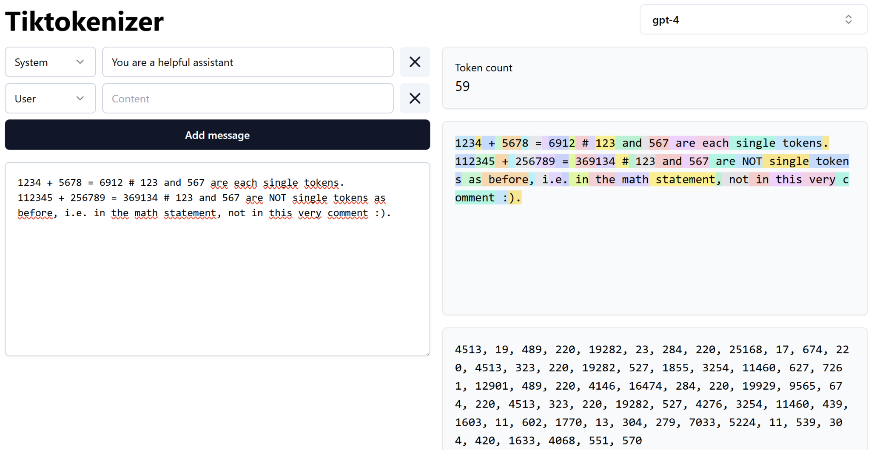
Numbers Split into Tokens of Variable Length
https://tiktokenizer.vercel.app/

Slide 8
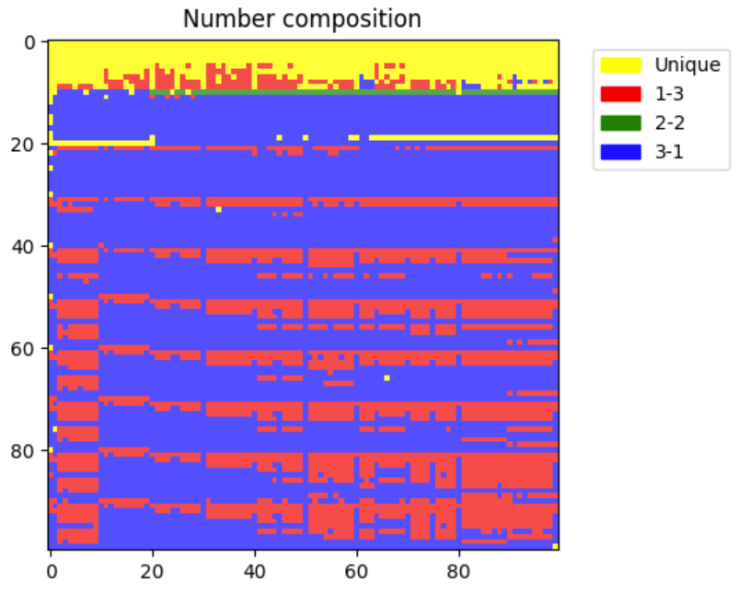
Number Tokenization in GPT-2 / GPT-3
X-axis: position within a row of 100 consecutive integers.
Y-axis: which block of 100 integers you are looking at. It increases downwards.
Moving one cell right advances by 1.
Moving one row down advances by 100.
Colour | Meaning | Example
Yellow: Unique | The entire number is one token | [number]
Red: 1–3 | One digit, then three digits | 2249 → [2][249]
Green: 2–2 | Two digits, then two digits | 2250 → [22][50]
Blue: 3–1 | Three digits, then one digit | 2251 → [225][1]
Check the full blog post at → https://www.beren.io/2023-02-04-Integer-tokenization-is-insane/

Slide 9
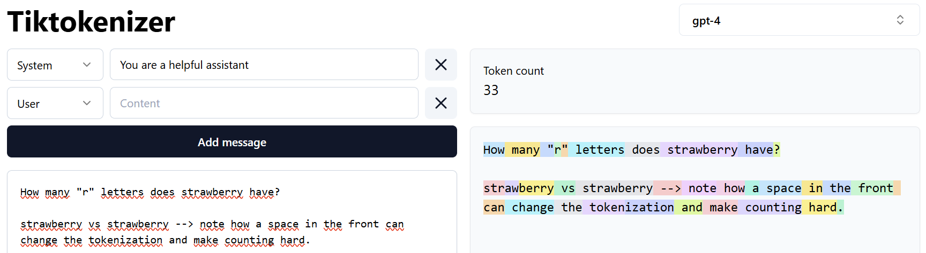
LLM Dyslexia
[str][aw][berry] → 3 tokens
[ strawberry] → 1 token
Same word, different IDs: the model sees token IDs, not letters.
For such a question, an agentic LLM can write and run a short piece of code that splits the word into letters and counts them.
It's important to develop an intuition about when to ask the LLM to do things via code and when to trust its outputs without additional tools.

Slide 10
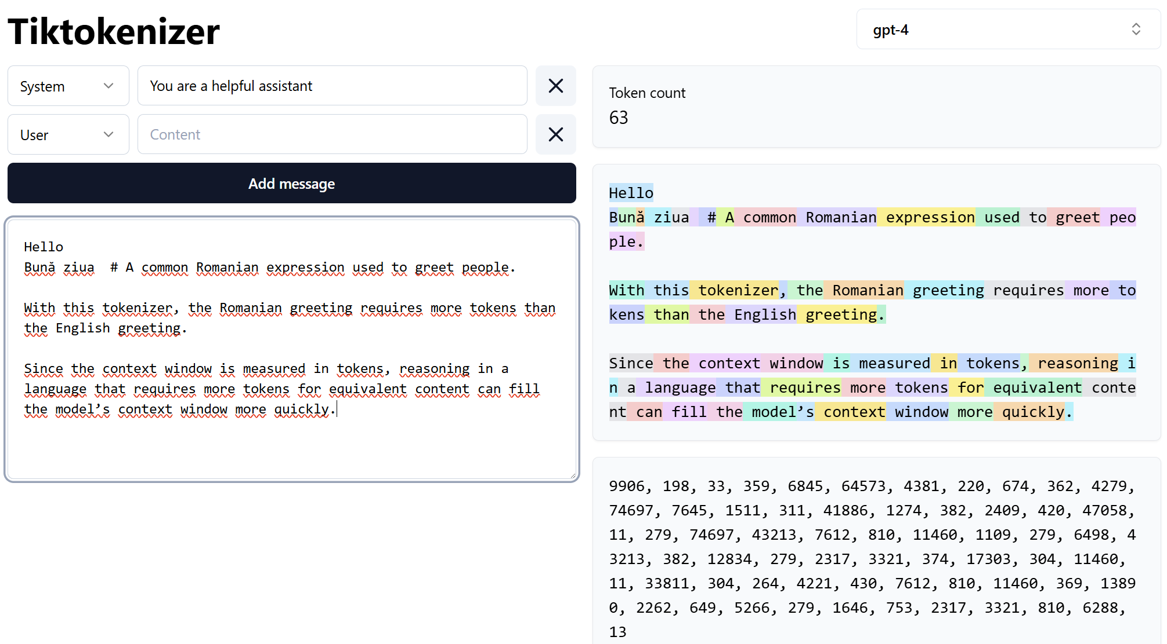
Not All Languages Are Tokenized Equally
https://tiktokenizer.vercel.app/
English dominates online text, so both the LLM and its tokenizer see more of it, and English can end up being tokenized more compactly.

Slide 11
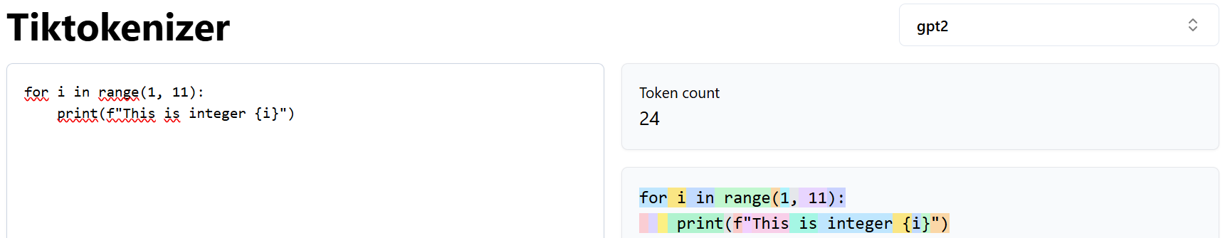
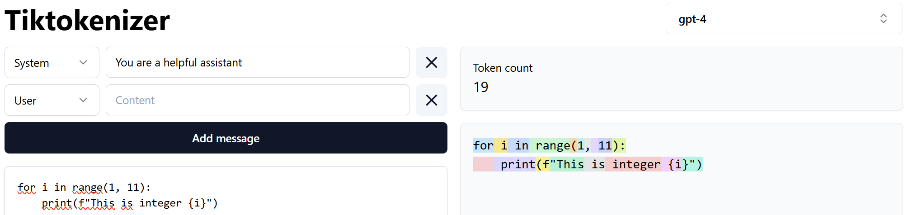
Tokenizing Source Code
In this example, the GPT-4 tokenizer groups consecutive spaces into fewer tokens than GPT-2’s, allowing more code to fit within the same token budget.
Each space is encoded separately, resulting in longer token sequences
Several spaces are merged together and treated as a single token.

Slide 12
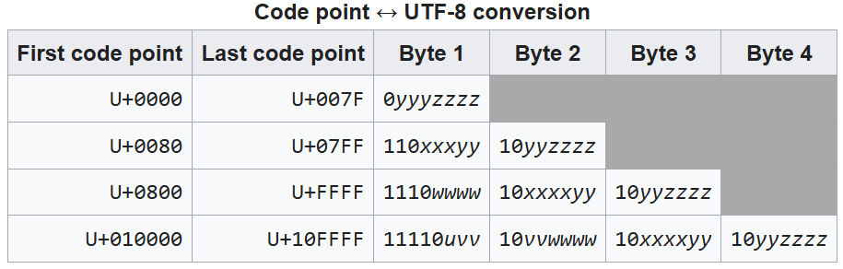
UTF-8 Encoding
[ https://en.wikipedia.org/wiki/UTF-8 ]
There are other encoding schemes like UTF-16 and UTF-32. UTF-32, for example, is fixed length, whereas UTF-8 is variable-length, which can result in shorter byte sequences. One of the major advantages of UTF-8 is that it is backwards compatible with ASCII, which is a much simpler encoding of text.
Check also → https://www.reedbeta.com/blog/programmers-intro-to-unicode/

Slide 13
Not All Byte Sequences Are Valid UTF-8
Example:
The character é (U+00E9) is encoded as two bytes: 11000011 10101001 → decimal values 195, 169
110 indicates the start of a two-byte sequence.
10 identifies the continuation byte.
By contrast, the byte 128 (10000000 in binary) cannot be decoded on its own: its 10 prefix marks it as a continuation byte, so a preceding start byte is required.
Hence, when you see lots of Unicode Replacement Characters like , the LLM post-processing pipeline cannot decode the bytes correctly for the browser to render. When decoding with errors="replace", invalid UTF-8 sequences are replaced with
def decode(token_ids):
# Join the bytes first: a UTF-8 character may span several tokens.
tokens = b"".join(vocab[token_id] for token_id in token_ids)
text = tokens.decode("utf-8", errors="replace") # In case of decoding issues use Unicode Replacement Characters
return text
https://github.com/ducspe/UnderstandingTokenization/blob/main/BPE_Tokenizer_Notebook.ipynb

Slide 14
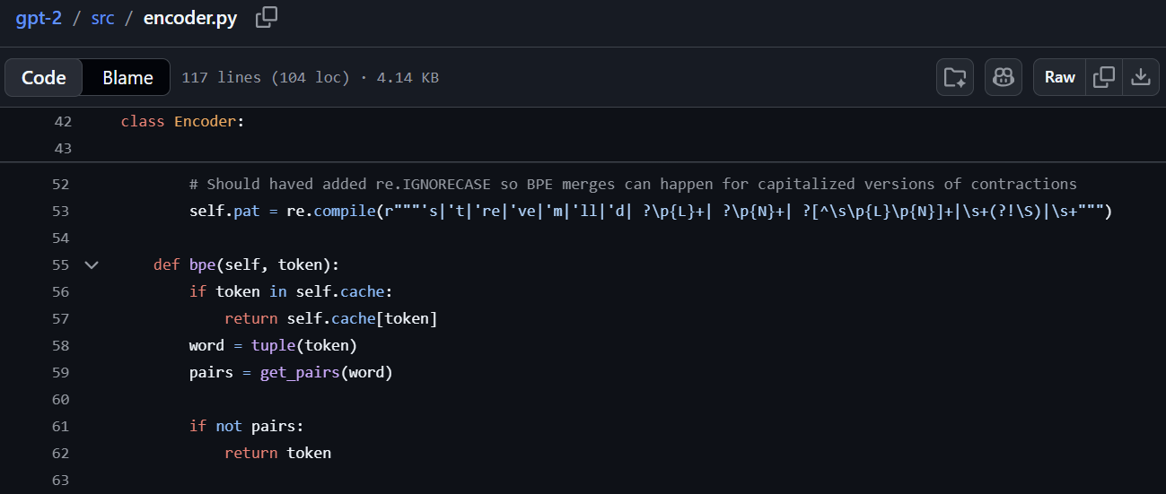
Preventing Merges with Regex Pre-tokenization
Some merges should never take place. For example, we might want to keep a word separate from the punctuation after it. Regular expressions let us specify which parts of the text should stay separate.
The regex splits text into smaller chunks before BPE is applied. It recognizes:
English contractions: 's, 't, 're, 've, 'm, 'll, 'd.
Groups of letters: such as hello.
Groups of numbers: such as 123.
Punctuation and symbols: such as !!!.
Whitespace: spaces, tabs and line breaks.
For example, “I'm buying 12 apples!” becomes: ["I", "'m", " buying", " 12", " apples", "!"]
BPE then processes each chunk separately and cannot merge across these boundaries.
https://github.com/openai/gpt-2/blob/master/src/encoder.py

Slide 15
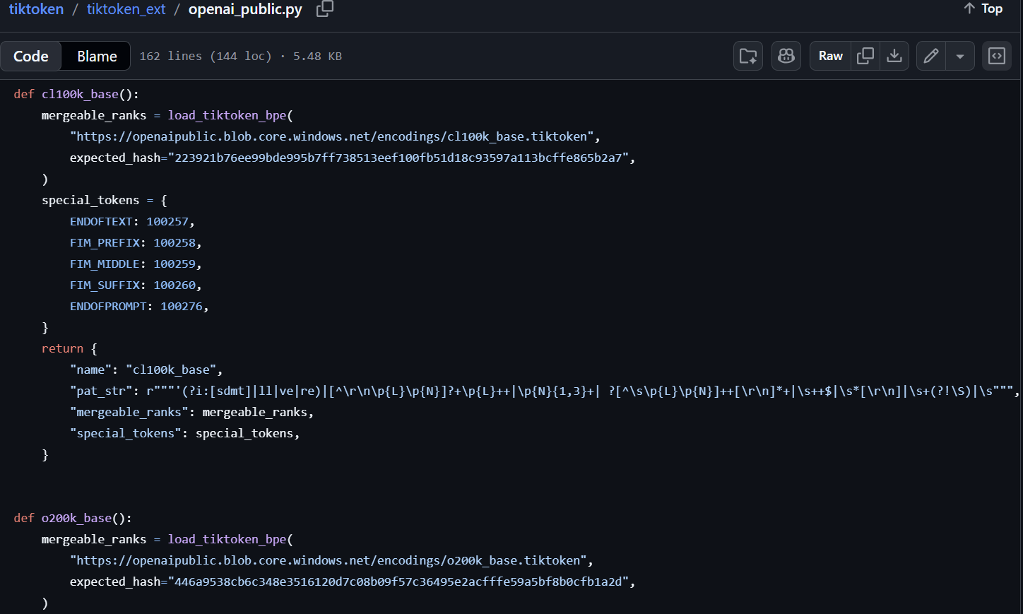
GPT-2 vs GPT-4 Pre-tokenization
cl100k_base is the tokenizer used by the original GPT-4, GPT-4 Turbo, and GPT-3.5 Turbo
Example text: “_hello I’M reading 12345!\n” where, “\n” represents a new line / line break.
GPT-2: ["_", "hello", " I", "’", "M", " reading", " 12345", "!", "\n"]
New regex: ["_hello", " I", "’M", " reading", " ", "123", "45", "!\n"]
The new regex keeps “_hello”, “'M”, and “!\n” together, but separates the space before the number and splits the digits into groups of up to three.
English contractions are now case-insensitive: both ’m and ’M are recognized
Numbers are split into groups of 1–3 digits: 12345 becomes "123" and "45", instead of one chunk
Spaces before numbers are separated: " 42" becomes " " and "42"
Words can include a preceding symbol: "_hello" can stay together, whereas GPT-2 separates "_" and "hello"
Previously, only a preceding space could attach to a group of letters.
Punctuation can include following line breaks: "!\n" can stay together, whereas GPT-2 separates "!" and "\n"
https://github.com/openai/tiktoken/blob/main/tiktoken_ext/openai_public.py

Slide 16
GPT-4 Special Tokens
special_tokens = {
ENDOFTEXT: 100257,
FIM_PREFIX: 100258,
FIM_MIDDLE: 100259,
FIM_SUFFIX: 100260,
ENDOFPROMPT: 100276,
}
Marks the end of a document or text sequence.
Ex: “Here is the text before the gap: The cat”
The cat sat on the mat.
Ex: “Now generate the missing text.”
fim_prefix
fim_middle
fim_suffix
Ex: “Here is the text after the gap: on the mat.”
Marks the end of the supplied prompt, after which the model generates its completion.
Example:
The model receives: <|fim_prefix|>The cat<|fim_suffix|> on the mat.<|fim_middle|>
And then generates the missing middle: “ sat”
Bavarian, Mohammad, et al. "Efficient training of language models to fill in the middle."
Notes:
Paper link → https://arxiv.org/pdf/2207.14255

Slide 17
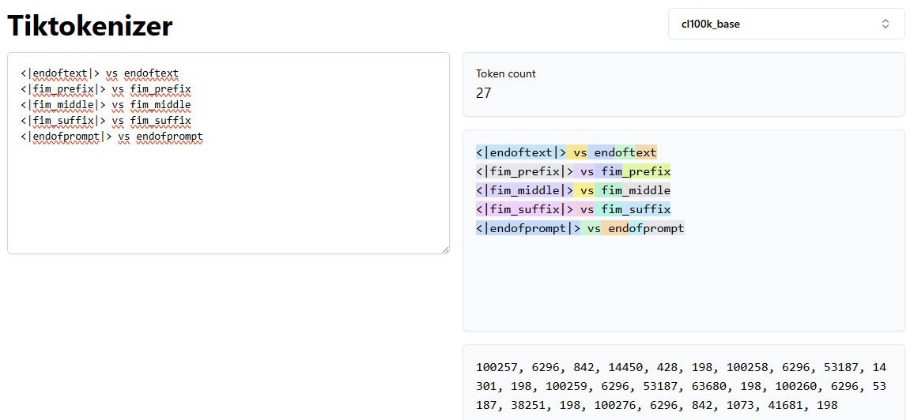
Special Tokens Enable Tool Use
Note how the special tokens are a single block.
Special tokens are indivisible markers that structure messages and tool calls, e.g. <message> and <call> (illustrative names). Tool names, arguments, and content typically use ordinary tokens. The model learns the format during training, while external software executes tool calls.
Search “special_tokens” → https://github.com/openai/tiktoken/blob/main/src/lib.rs

Slide 18
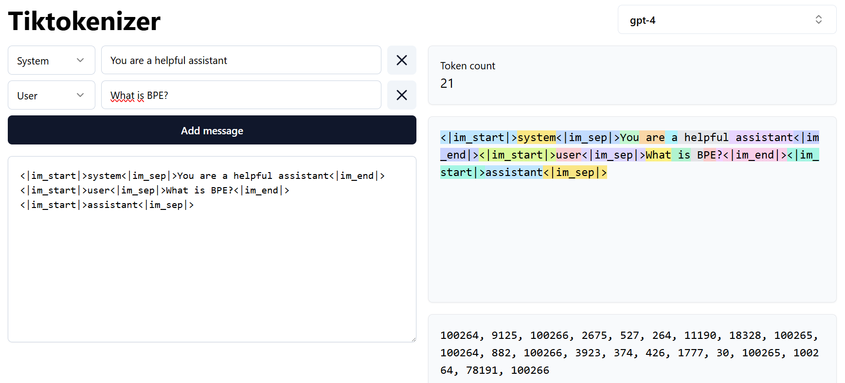
Structuring Conversations with Special Tokens
Role labels such as system, user, and assistant identify who is speaking. In this example, these labels are ordinary text enclosed by special tokens, so the model learns to interpret them as roles when they appear in that position.
Special tokens mark the boundaries between messages and separate message headers from their content.
<|im_start|> marks the beginning of a message.
<|im_sep|> separates the message header from its content.
<|im_end|> marks the end of a message.

Slide 19
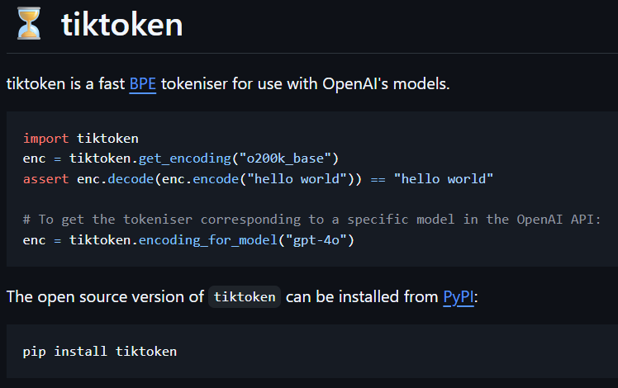
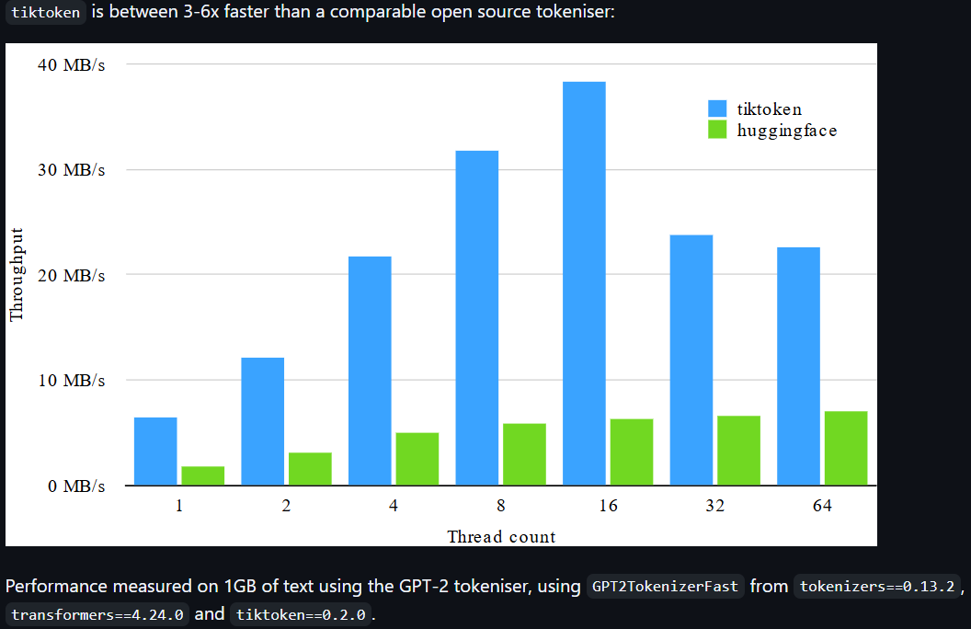
The tiktoken Library
https://github.com/openai/tiktoken

Slide 20
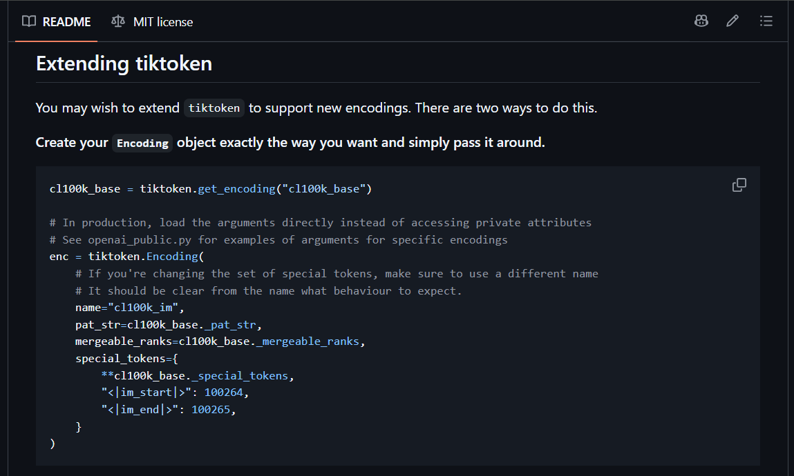
Extending tiktoken
You can add more special tokens with a new ID afterwards.
https://github.com/openai/tiktoken#extending-tiktoken

Slide 21
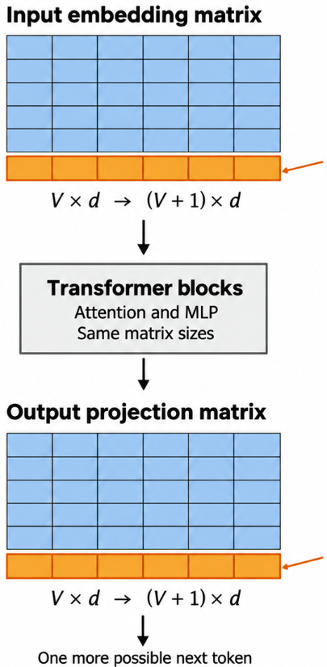
Adding New Tokens to a Pretrained Model
Add the new token to the tokenizer.
Expand the input embedding matrix and output vocabulary projection.
Initialize the new parameters.
Fine-tune on examples containing the new token.
A vector for new token
We initialize the new rows and then fine-tune.
Weights for predicting the new token. Note that V is the vocabulary size and d is the vector size.
Adding special tokens can support adapting a base model for chat or introducing tool-use formats in chat and coding models. Fine-tuning teaches the model to interpret and generate these formats.

Slide 22
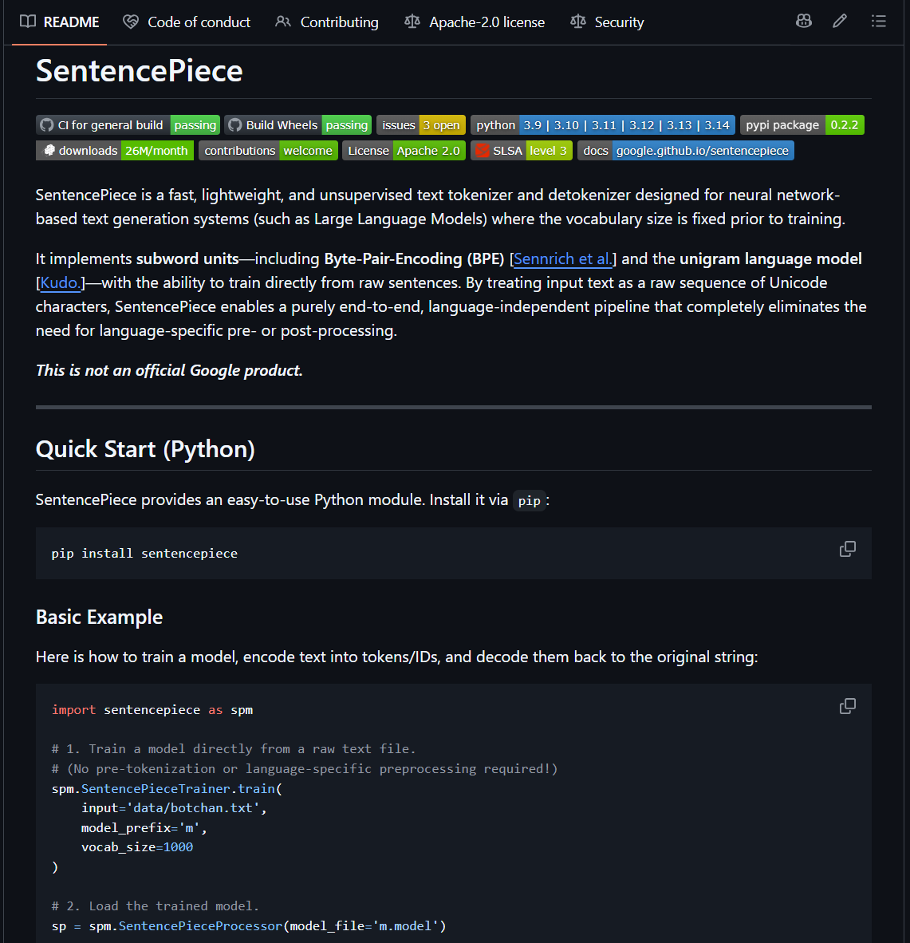
The SentencePiece Library
SentencePiece supports both tokenizer training and inference, whereas tiktoken focuses primarily on inference with an already trained tokenizer.
SentencePiece supports multiple algorithms, including BPE and Unigram, whereas tiktoken focuses on BPE.
SentencePiece is used by models such as Llama 2, Mistral 7B, and Mixtral 8×7B. (Llama 3 moved from SentencePiece to a tiktoken-based tokenizer)
https://github.com/google/sentencepiece

Slide 23
What Is in a SentencePiece BPE Vocabulary?
Special Tokens → Reserved tokens with predefined functions, e.g. <unk> for unknown tokens, <s> for start of sentence, </s> for end of sentence, and optionally <pad> for padding.
Byte Tokens → Tokens representing individual bytes, used as a fallback for characters not covered by the normal vocabulary when byte_fallback = True
Merge Tokens → Subword tokens learned by repeatedly merging frequently occurring neighboring symbols during BPE training.
Single-character tokens → Tokens representing individual Unicode characters retained according to the specified character_coverage. If a codepoint is too rare to fall within the cumulative character coverage specified by character_coverage, it is not added to the vocabulary, e.g. character_coverage = 0.995
Notes:
https://youtu.be/zduSFxRajkE?si=jDlY1Ou2tCbawSuL&t=5821

Slide 24
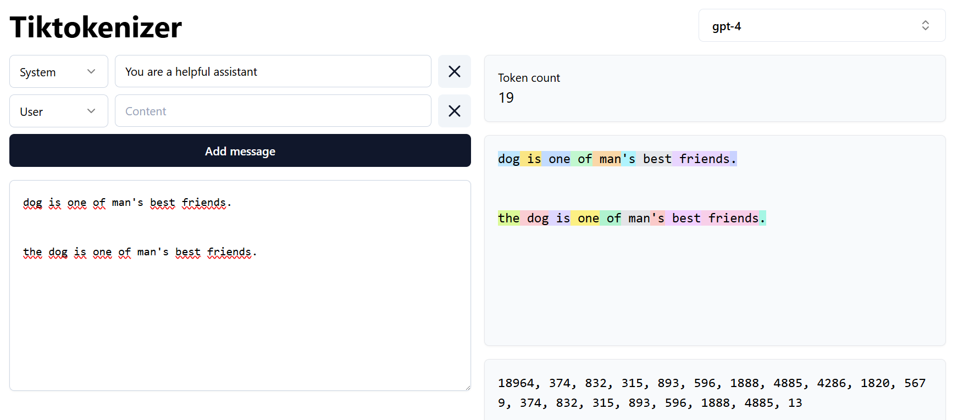
Whitespace Handling in SentencePiece
spm.SentencePieceTrainer.train(
input="token_training_text.txt",
model_prefix="model",
vocab_size=8000,
add_dummy_prefix=True
)
If add_dummy_prefix is True, a whitespace marker (▁) will be added at the start of the input. This treats the first word like a word preceded by a space, reducing the need to learn separate token variants for the same word with and without a preceding space.

Slide 25
tiktoken vs SentencePiece
 | tiktoken | SentencePiece
Basic representation | UTF-8 bytes | Unicode text / pieces
Tokenization methods | BPE | BPE, Unigram, character-level, word-level
Pre-tokenization | regex constraints | SentencePiece normalization / whitespace scheme
Training | primarily prebuilt encodings; educational trainer exists | full tokenizer-training toolkit
Whitespace | regex/BPE-dependent | explicit “▁” representation
Unknown characters | byte-based representation | “<unk>” or optional byte fallback

Slide 26
Takeaways
Tokens are the model’s units of text. The tokenizer converts text into a sequence of numerical IDs.
BPE builds tokens by merging frequent pairs. Its training data shapes which patterns get compact representations.
Fewer tokens mean more room in the context window. Different languages and formats use that space differently.
The tokenizer can split words in unexpected places. Splits don’t always follow syllables or familiar word parts. A token can also include the space before a word, so “hello” and “ hello” may use different tokens depending on the tokenizer.
Special tokens provide structure. The model learns the format during training, while external software executes tool calls.

Slide 27
References
Papers
Gage (1994), A New Algorithm for Data Compression https://jacobfilipp.com/DrDobbs/articles/CUJ/1994/9402/gage/gage.htm [Slide 4, Speaker Notes Section]
Sennrich, Haddow & Birch (2016). Neural Machine Translation of Rare Words with Subword Units. https://arxiv.org/abs/1508.07909 [Slide 4, Speaker Notes Section]
Radford et al. (2019). Language Models are Unsupervised Multitask Learners (GPT-2). https://cdn.openai.com/better-language-models/language_models_are_unsupervised_multitask_learners.pdf [Slide 4, Speaker Notes Section]
Bavarian et al. (2022). Efficient Training of Language Models to Fill in the Middle. https://arxiv.org/abs/2207.14255 [Slide 16, Speaker Notes Section]
Video
Andrej Karpathy. Let's build the GPT Tokenizer. https://www.youtube.com/watch?v=zduSFxRajkE [Slide 23, Speaker Notes Section]
Code and libraries
OpenAI GPT-2 encoder: https://github.com/openai/gpt-2/blob/master/src/encoder.py [Slide 14]
tiktoken: https://github.com/openai/tiktoken [Slide 19]
tiktoken encodings (cl100k_base regex): https://github.com/openai/tiktoken/blob/main/tiktoken_ext/openai_public.py [Slides 15, 16]
tiktoken special tokens (lib.rs): https://github.com/openai/tiktoken/blob/main/src/lib.rs [Slide 17]
Extending tiktoken: https://github.com/openai/tiktoken#extending-tiktoken [Slide 20]
SentencePiece: https://github.com/google/sentencepiece [Slides 22, 23, 24, 25]
Jupyter notebook: https://github.com/ducspe/UnderstandingTokenization/blob/main/BPE_Tokenizer_Notebook.ipynb [Slide 13]
Tools, courses and articles
Tiktokenizer: https://tiktokenizer.vercel.app/ [Slides 7, 9, 10, 11, 17, 18, 24]
Hugging Face LLM Course, BPE chapter: https://huggingface.co/learn/llm-course/en/chapter6/5 [Slide 5]
Beren Millidge. Integer tokenization is insane. https://www.beren.io/2023-02-04-Integer-tokenization-is-insane/ [Slide 8]
Nathan Reed. A Programmer's Introduction to Unicode. https://www.reedbeta.com/blog/programmers-intro-to-unicode/ [Slide 12]
Wikipedia: UTF-8. https://en.wikipedia.org/wiki/UTF-8 [Slide 12]

