Slide 1

Understanding Transformers
Overview, Internals and Insights
November 2025
Caus Danu

Slide 2
Background notes / Prologue
This resource is intended to introduce neural networks, generative AI at a high abstract level and subsequently focus on explaining Transformers in more depth to a scientific audience.
Transformers will be presented in the broader context of AI, building the stage from zero, step by step.
We will act therefore as a synthesizer of many resources created by the broader AI community.
Hence, many thanks! to all the creators of the helper material. All credits and references are visible on the last slide.
Same references are also given in the footnotes section of each individual slide, which is not visible in presentation mode, but will be useful for referencing at home for extra study, if need be.
Slide content
(visible in presentation mode)
Footnotes / URLs / References
(not visible during presentation)

Slide 3
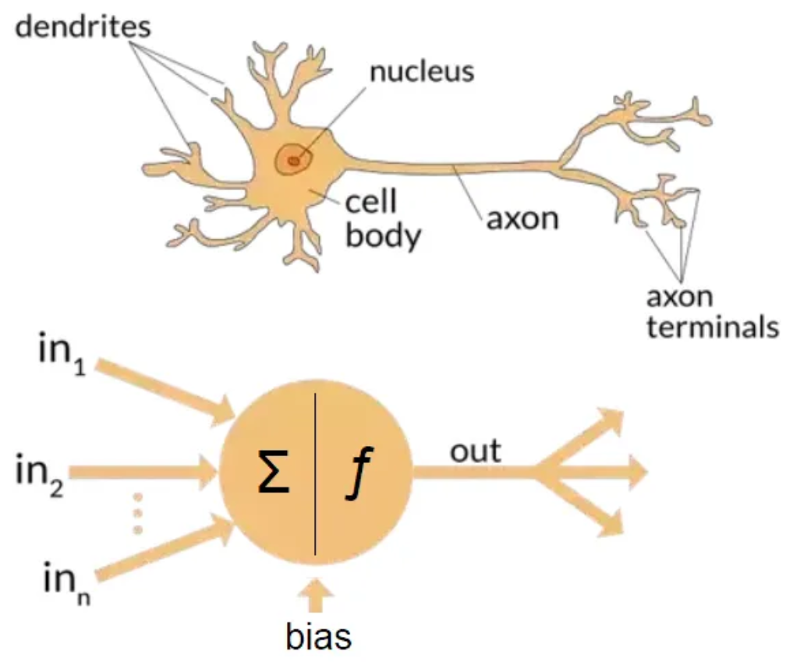
Artificial Neural Nets and Brain Parallels
Notes:
https://medium.com/data-science/the-differences-between-artificial-and-biological-neural-networks-a8b46db828b7

Slide 4
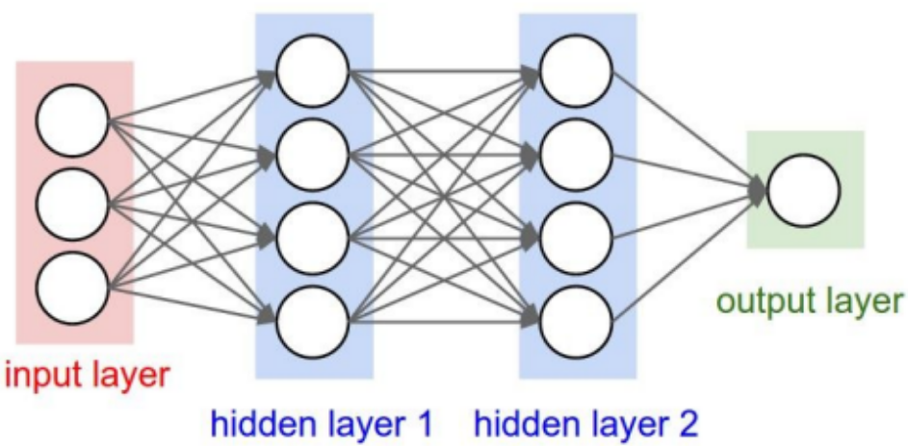
Artificial Neural Networks (ANNs)
This is a Multi-Layer Perceptron / MLP and it is used as one of the building blocks of the Transformer.
CS231n course from Stanford University
Notes:
https://cs231n.stanford.edu/slides/2019/cs231n_2019_lecture04.pdf

Slide 5
Backpropagation
Feed-forward / Inference
Training using Backpropagation
CS231n course from Stanford University
Notes:
https://cs231n.stanford.edu/slides/2019/cs231n_2019_lecture04.pdf

Slide 6
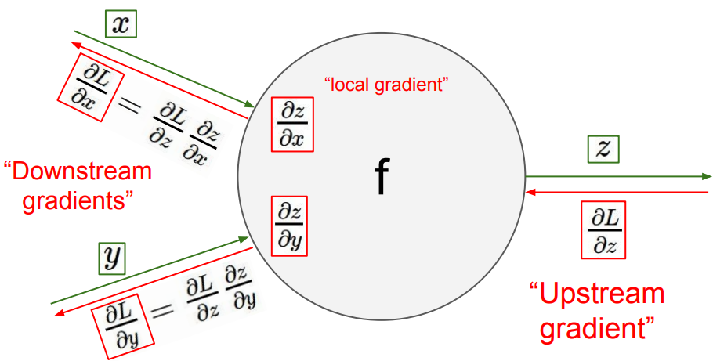
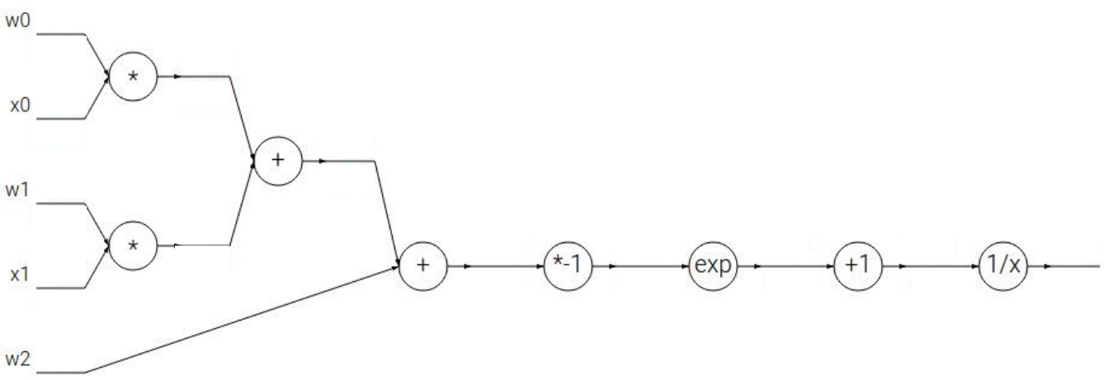
Backpropagation using Local Gradients and the Chain Rule
The Chain Rule is implemented with the help of local gradients.
We recursively multiply the local derivatives.
Backpropagation is a recursive application of the chain rule, backwards through the computational graph.
CS231n course from Stanford University
Notes:
https://cs231n.stanford.edu/slides/2019/cs231n_2019_lecture04.pdf

Slide 7
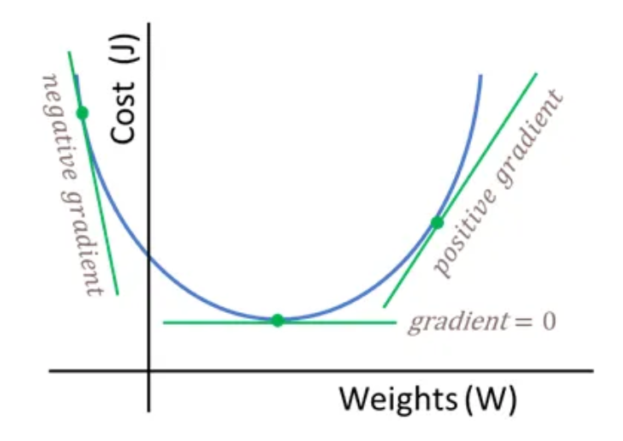
Cost function
Naming conventions in the literature: Cost / Loss / Error function
The task is to find a global minimum, or good enough suboptimal minima points via the gradient descent optimization procedure, i.e. parameter search.
Notes:
https://towardsdatascience.com/neural-networks-backpropagation-by-dr-lihi-gur-arie-27be67d8fdce

Slide 8
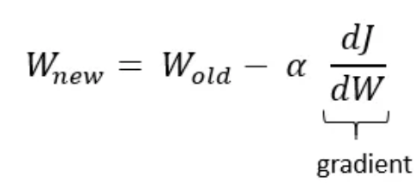
Weights update
J and L are usual notations for the Loss / Error / Cost function, i.e. the difference between what the model predicts and what it should predict according to the ground truth.
The weights are updated in the direction of negative gradient, so that the cost function is minimized as much as possible.
Notes:
https://towardsdatascience.com/neural-networks-backpropagation-by-dr-lihi-gur-arie-27be67d8fdce

Slide 9
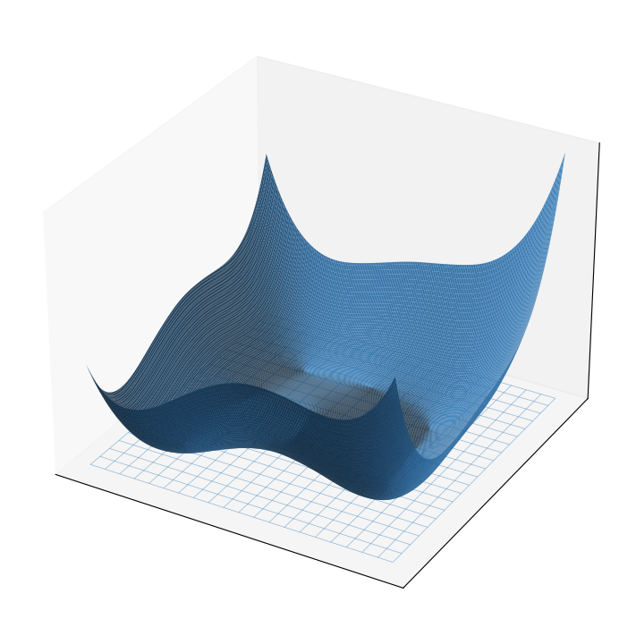
Scaling to Hyperspaces
L(W_{1,}W₂)
W₂
W₁
The cost function is much more complex for a typical neural net => Millions and even billions of weights!
Neural Network gradients have the ability to navigate the many dimensions skillfully though.
And actually, having many dimensions helps the gradient not to get stuck in bad suboptimal points.

Slide 10
Modeling Spectrum in the current AI era
Discriminative models
[older established approach]
Generative models
[newer trend]
Best of both worlds would be to use an Inductive bias + Data
Use a lot of training data / throw a lot of data at the problem task and let the network “figure it out”.
Predictions are limited to the training data domain, i.e. tied to the train dataset statistics, hence poor out of distribution predictions.
Are capable of out of domain generalization.
Lots of inductive bias, a priori knowledge is injected / enforced as a guide during training.
More creative than discriminative models.

Slide 11
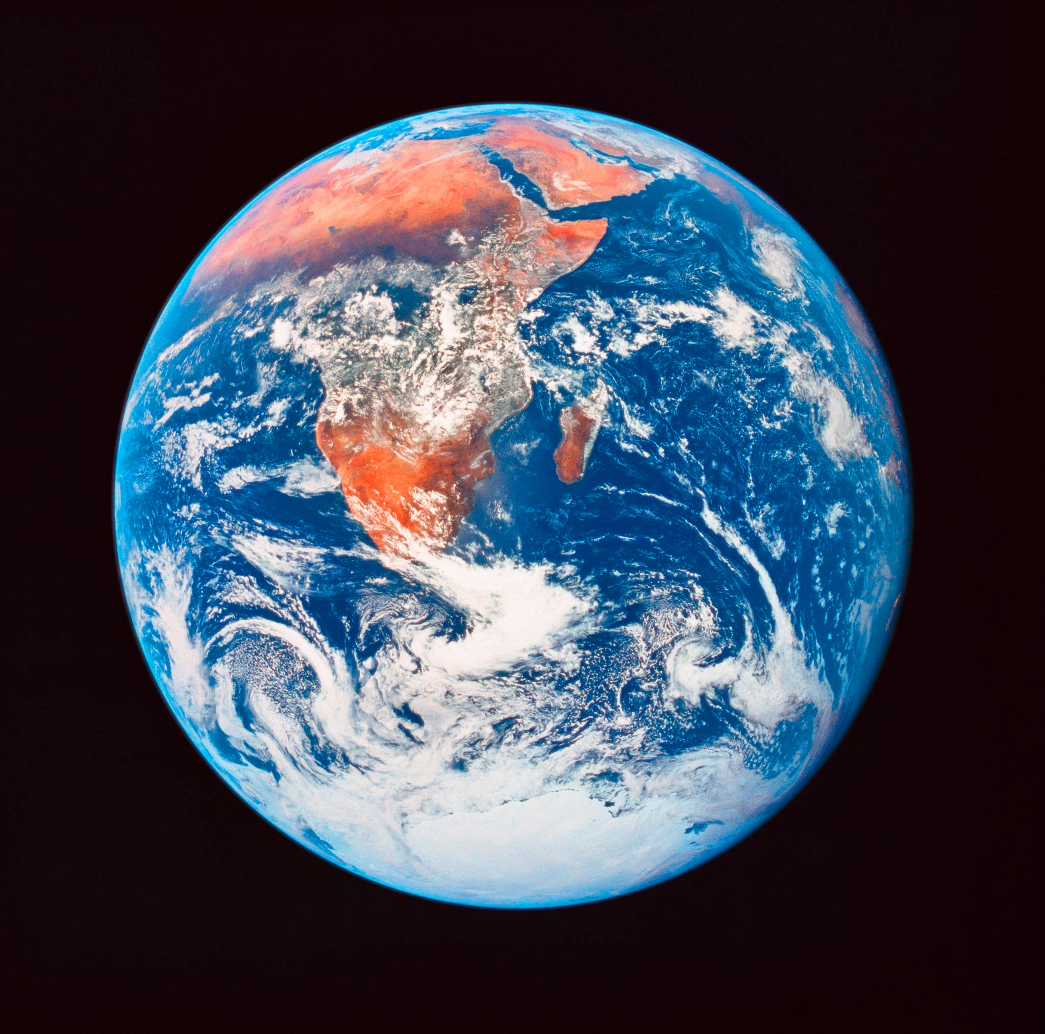
Generative AI
Encode a “world model” in the form of a very-high-dimensional / complex probability distribution.
P(A)
Internet
Books
Images
Videos
Audio
Robotic-Arm configurations
Etc.
User prompts will statistically “sample Answers” from the learned model.

Slide 12
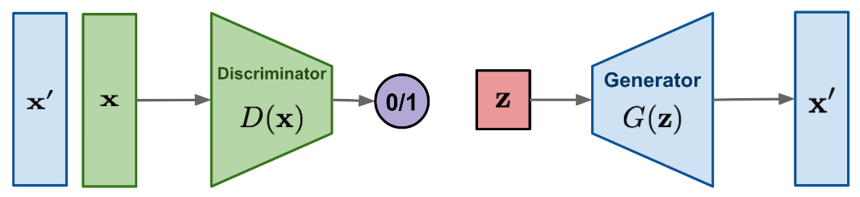
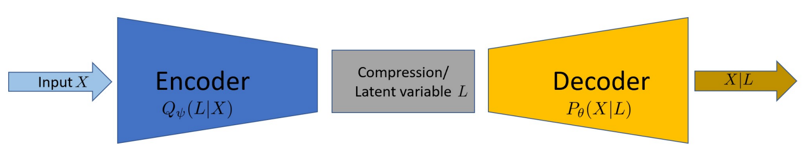
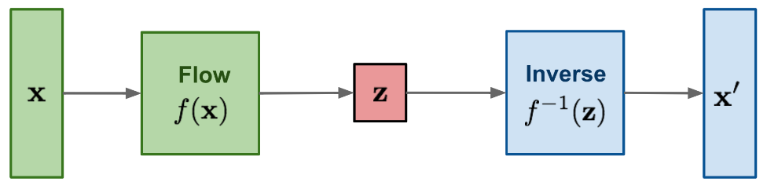
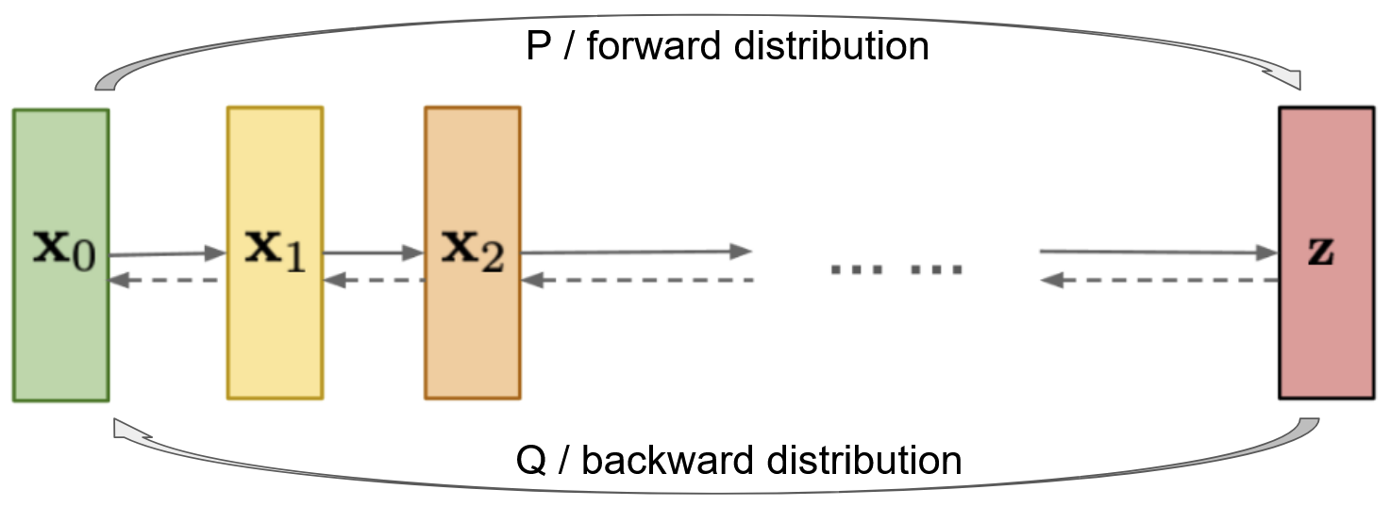
Mainstream Generative AI models
Generative Adversarial Networks / GANs -> Adversarial training / Arms race
Variational Autoencoders / VAEs -> Autoencoders, but with latent space
Flow-based models -> Invertible mapping between distributions
Diffusion models -> Markov chain for denoising intermediate states
Transformers -> we will focus our attention on them
Coming Soon
Notes:
https://lilianweng.github.io/posts/2018-10-13-flow-models/
https://lilianweng.github.io/posts/2021-07-11-diffusion-models/
https://ducspe.github.io/masterthesis_danucaus/ -> page 18

Slide 13
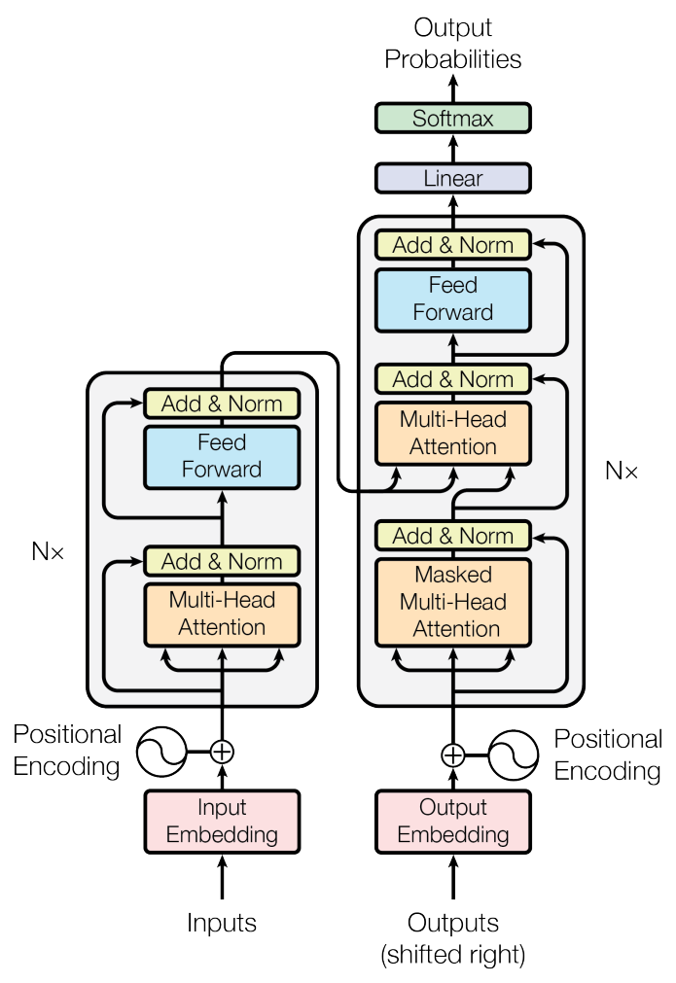
Transformers
“Attention is all you need” paper from 2017 by Vaswani et al.
Notes:
Figure 1 taken from the paper “Attention is all you need” by Vaswani et al. -> https://arxiv.org/pdf/1706.03762.pdf

Slide 14
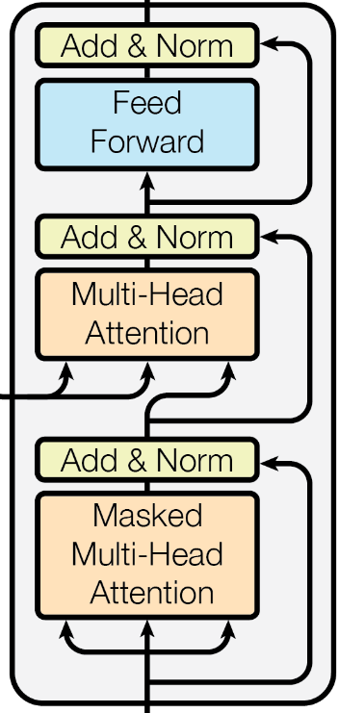
Conceptual Transformer Block
Secondly, a Multilayer Perceptron (MLP) crunches the data that was communicated among tokens in the previous self-attention phase.
First, the tokens communicate between themselves / they attend to each other (self-attention).

Slide 15
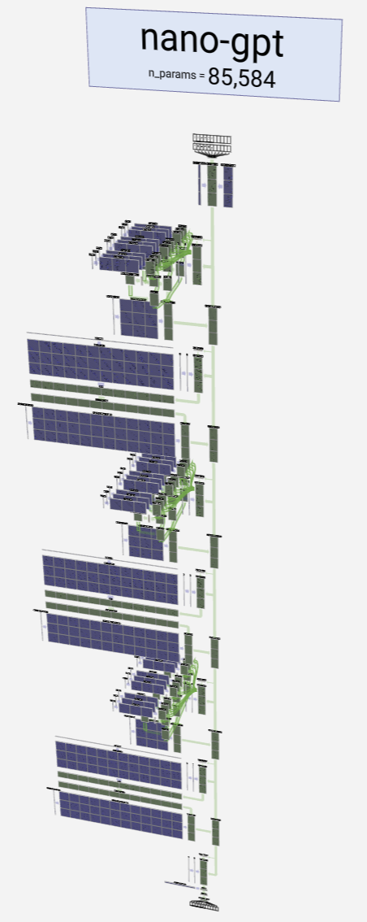
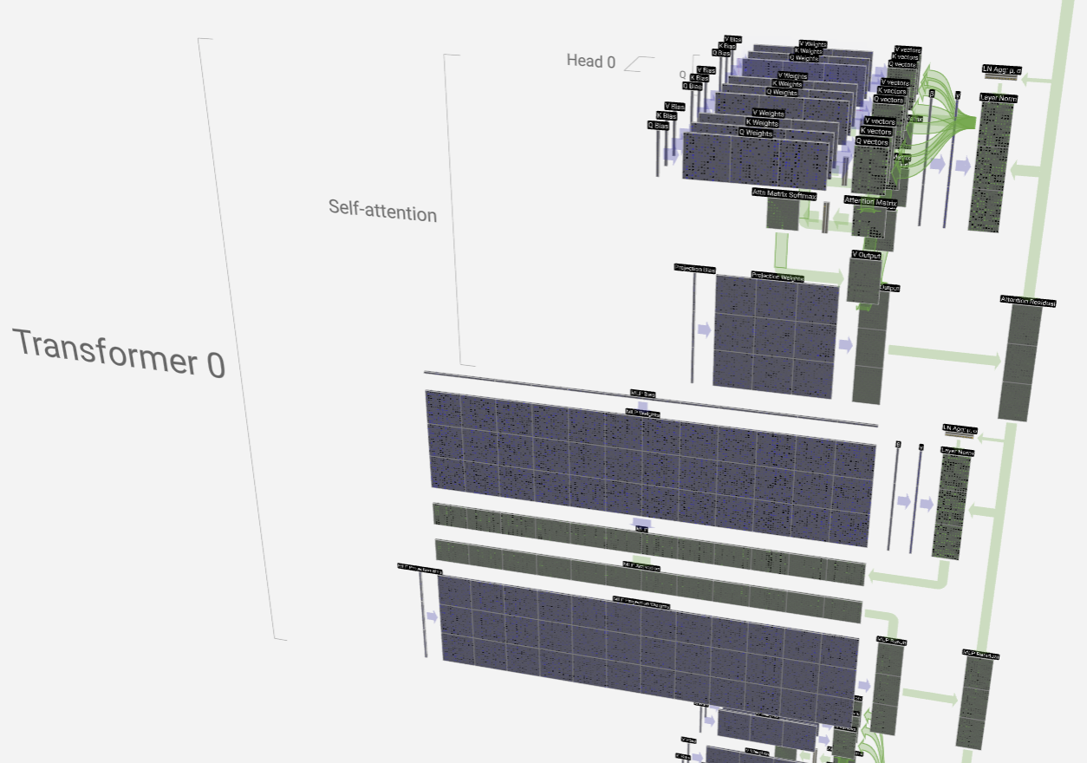
Realistic GPT Block
MLP
Visualize the physical structure of an LLM interactively at -> https://bbycroft.net/llm
Notes:
Images were snipped from an interactive LLM visualization tool available at -> https://bbycroft.net/llm

Slide 16
Self-Attention
Context-length
. . .
Token 1
Token 2
Token 3
Token N
All tokens communicate with one another.
This is computationally expensive [i.e. O(N²) complexity] because each token has to look at every other token to compute an attention score / attention weight.

Slide 17
Increasing the Context Length
Sparse Attention Mechanisms
Linformer
Reformer
Longformer
Blockwise Attention
Ring Attention
Reducing attention complexity is a very hot topic today🔥. This would allow for more context memory to be used when tackling problems. More memory means longer chains of thinking => thinking is computationally distributed over more tokens, which generally helps producing more accurate answers and can reduce hallucinations .

Slide 18
Key, Query and Value Embeddings
Key -> “What do I contain”.
Token
Value ->
“If you find me interesting, this is what I will communicate to you”.
Query ->
“What am I looking for”.

Slide 19
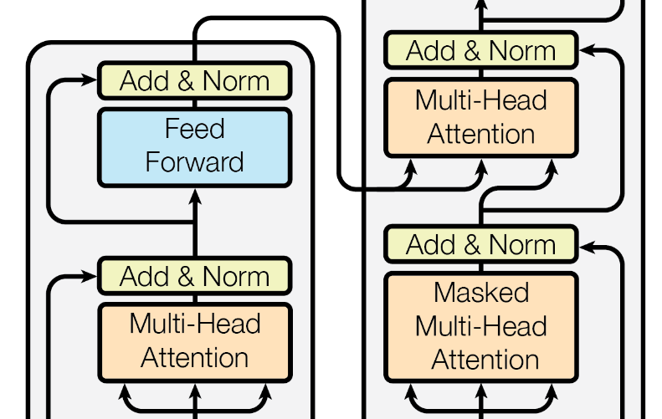
Self-Attention vs Cross-Attention
Cross-Attention -> the queries come from the decoder, whereas the keys and values are from the encoder side.
Self-attention -> the key, query and value vectors are related to the same entity, either the encoder, or the decoder.

Slide 20
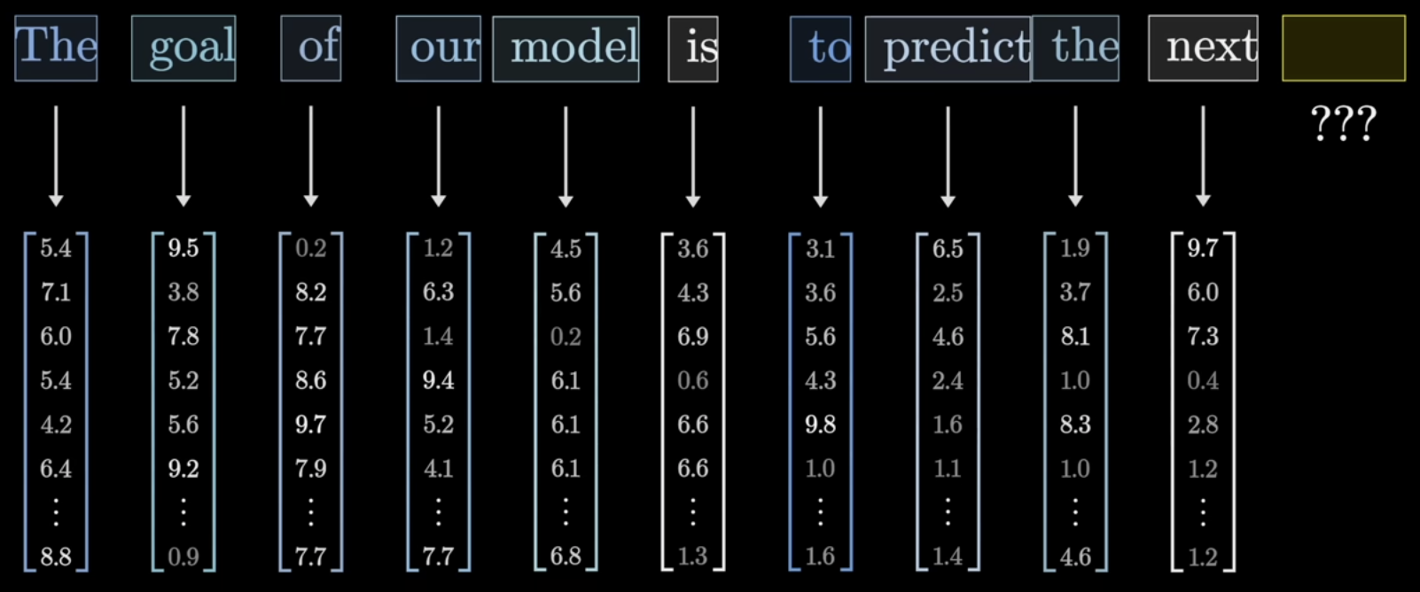
Token Embeddings
Tokens become positional vectors in a semantic space and are stored in an “Embedding Matrix”. Our task will be to predict the next token, i.e. the embedding vector of the next token.
3Blue1Brown
Notes:
https://youtu.be/wjZofJX0v4M?si=6bOMVOZ1FK0Ya8-O&t=790

Slide 21
Transformation Pipelines
Key Transform
k
Key
✖
E
Query Transform
q
✖
Query
✖
Token Embedding
Value Transform
v
Value

Slide 22
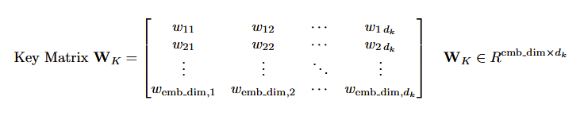
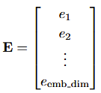
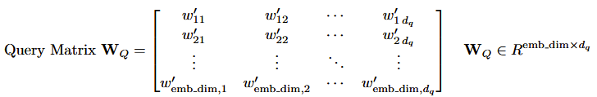
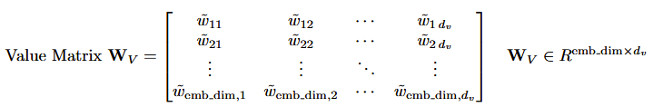
Transformation Matrices
An embedding transform is a multiplication with a specialized matrix, the parameters of which the transformer needs to learn.

Slide 23
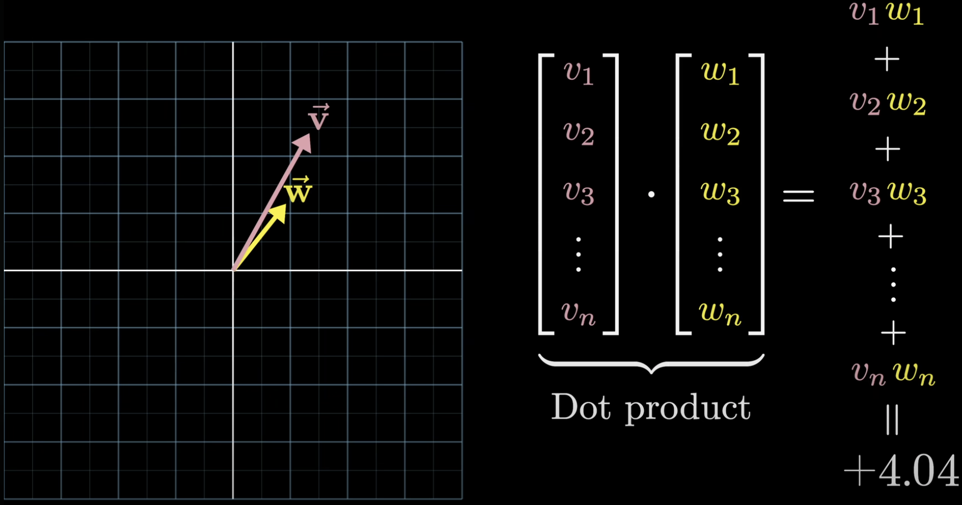
Mathematically Expressing Self-Attention
The dot product Query ・ Key is the attention score, where Query and Key are embedding vectors derived from the token embedding via matrix transformations.
Dot product measures similarity between vectors => Attention can be interpreted as the alignment between the Key and the Query vectors (i.e. two tokens find each other interesting).
Instead of the dot product, other measures can be used, like the cosine similarity for example (see Swin Transformer Version 2 paper).
3Blue1Brown
Notes:
https://youtu.be/wjZofJX0v4M?si=OtqYas1oYNpoEvKM&t=1018

Slide 24
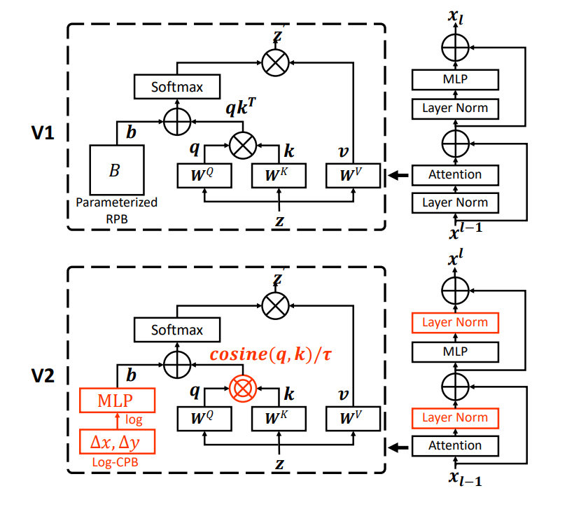
Cosine similarity
Notice the pre-Layer Norm
vs
post-Layer Norm
switch.
“Swin Transformer V2: Scaling Up Capacity and Resolution” by Liu et al.
Notes:
Figure 1 from “Swin Transformer V2: Scaling Up Capacity and Resolution” paper by Liu et al. -> https://arxiv.org/abs/2111.09883

Slide 25
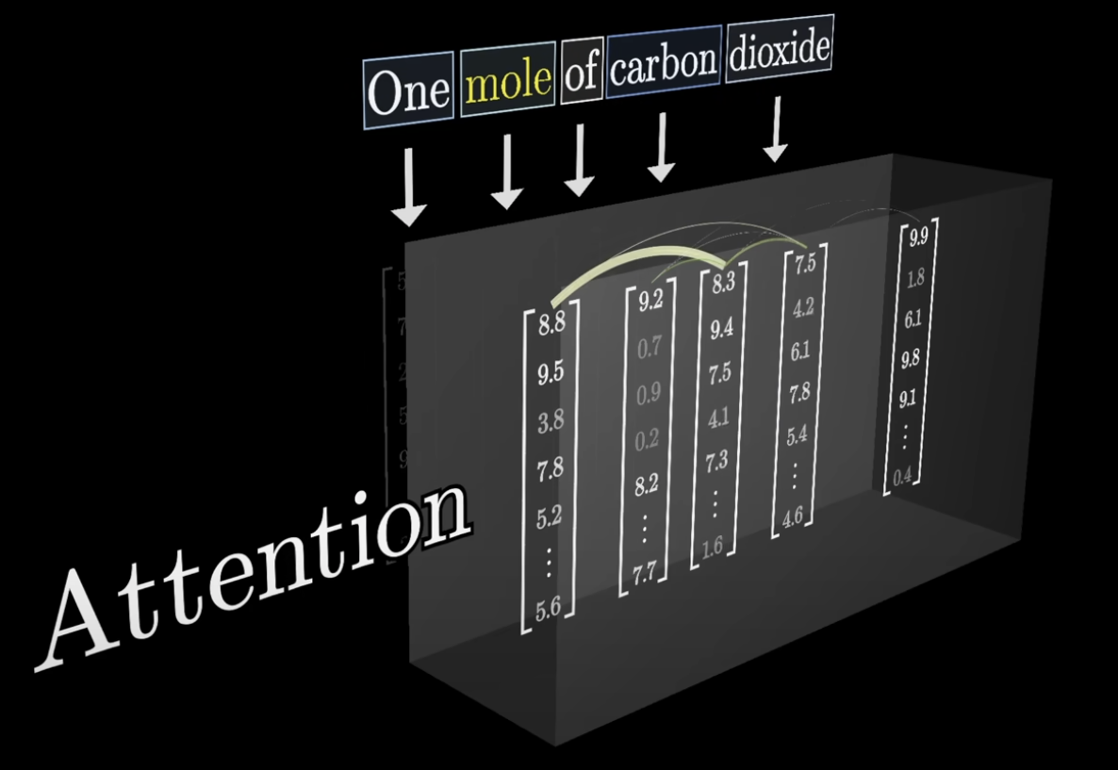
Discerning meaning among different contexts
3Blue1Brown
Arc thickness
encodes attention level
between tokens
The mole on his face was benign.
The mole lives underground.
Attention will capture the meaning of a word from the surrounding context, using weighted averages of neighboring embeddings.
Notes:
https://youtu.be/eMlx5fFNoYc?si=3HHAKgY1_bGv_cP9&t=153

Slide 26
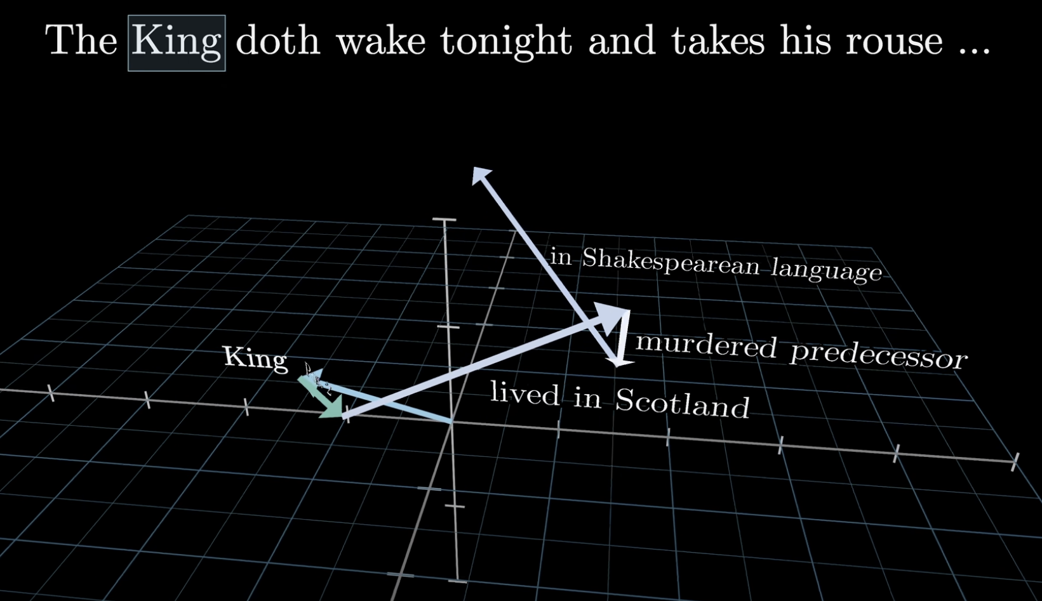
Navigating the Semantic Space via Attention
3Blue1Brown
The embedding of the word “King” absorbs via attention the embeddings from the other words in Shakespeare's work, as well as of the questions and statements that the users make in their conversation with the Transformer model.
Notes:
https://www.youtube.com/watch?v=eMlx5fFNoYc&t=95s

Slide 27
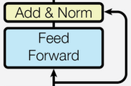
Computation Phase / Feed-Forward MLP
After the communication between tokens is finished, an MLP has to “think on what was said” during the self-attention phase.
This basically means that new features are derived after the communication phase using a database of facts encoded by the MLP.
Skip connections can be viewed as enriching the embedding, but also helping the learning process from a technical perspective.
Normalization is also very important for stabilizing learning and fostering convergence.
Let’s fast forward back to what we have already seen, and notice! the additional skip connection.

Slide 28
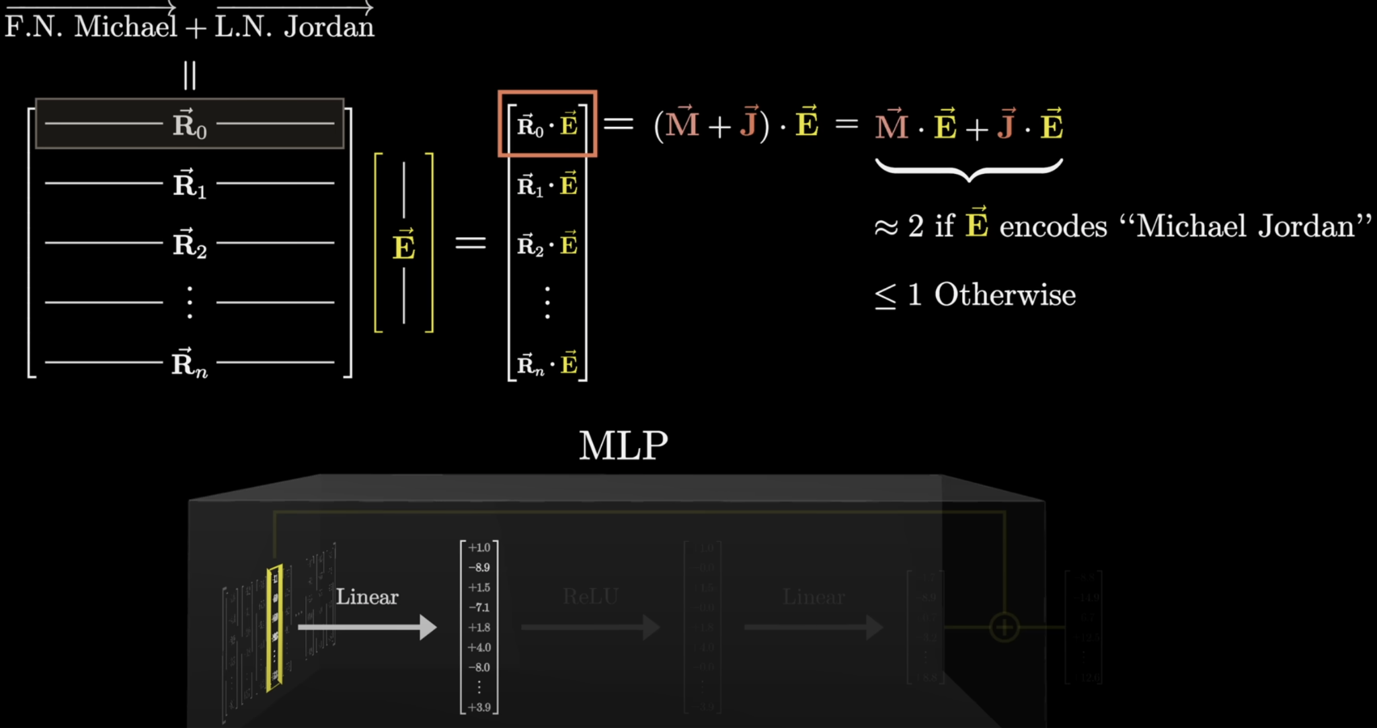
MLP Database of Facts
Note that we can correct the output “2” and “1” to be “1” and “0” for convenience, using the so called “Bias” term, and the “ReLU” / “GeLU” non-linearity.
3Blue1Brown
Notes:
https://youtu.be/9-Jl0dxWQs8?si=C_2pg-d_T5EGMOkZ&t=524

Slide 29
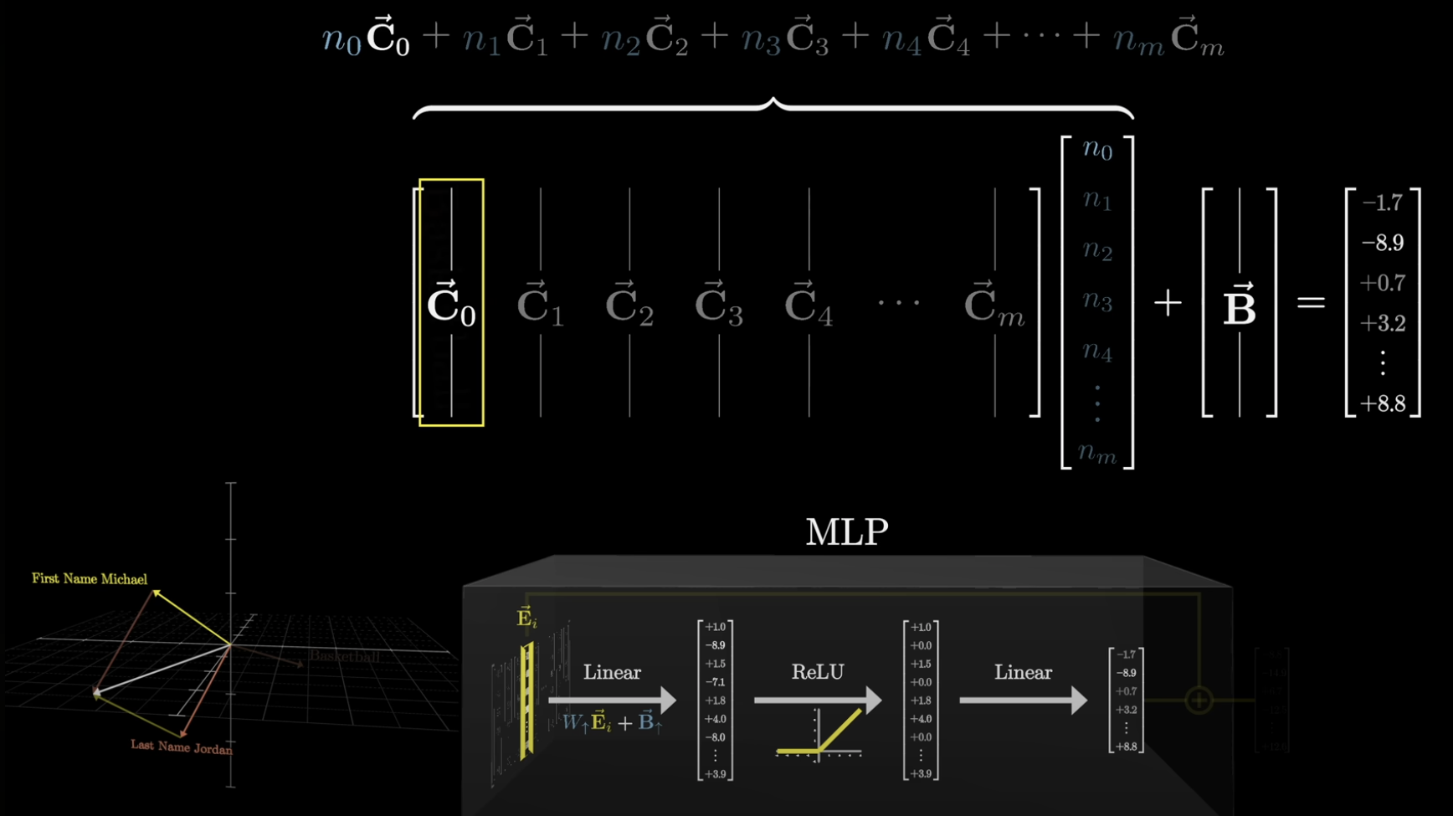
MLP Database of Facts, Layer 2
3Blue1Brown
C₀ might encode facts like: “Basketball” as a separate dimension in the space below
n₀ = 1 is like a flag being set when “Michael Jordan” is the input.
Basketball
Notes:
https://youtu.be/9-Jl0dxWQs8?si=uWsjpG98l0AP09rN&t=775

Slide 30
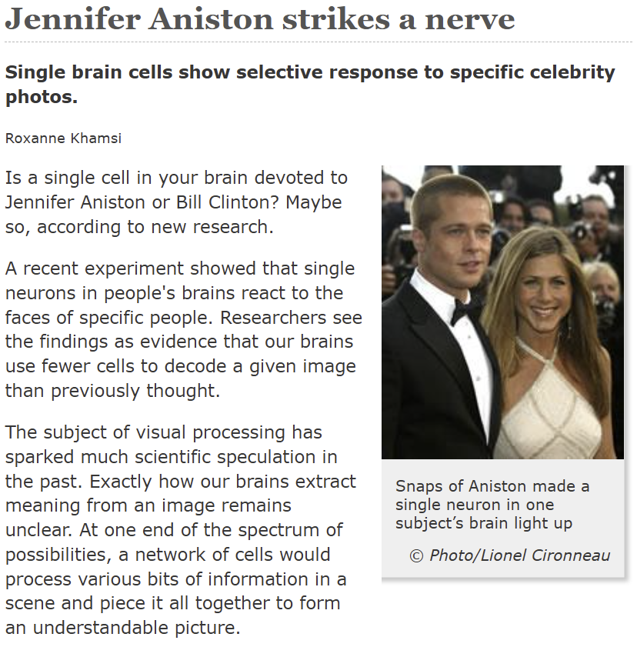
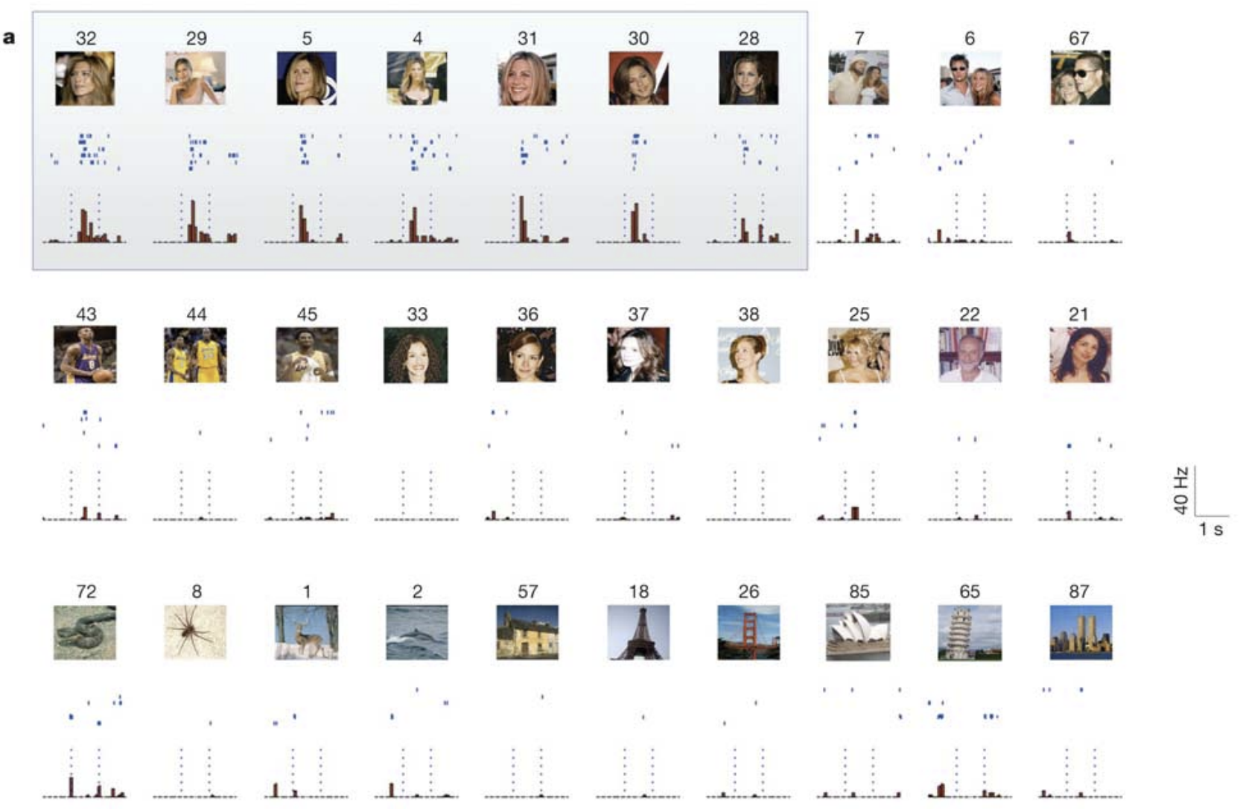
“Grandmother cells” analogy in Neuroscience
nature.com/news
“Invariant visual representation by single neurons in the human brain” R. Quian Quiroga et al., Nature 2005
“This unit was selectively activated by pictures of the actress Halle Berry as well as by a drawing of her” “Notably, the unit was selectively activated by the letter string ‘Halle Berry’ ”
Notes:
https://www.nature.com/news/2005/050620/full/news050620-7.html
https://www.nature.com/articles/nature03687
https://www.researchgate.net/publication/7770938_Invariant_Visual_Representation_by_Single_Neurons_in_the_Human_Brain

Slide 31
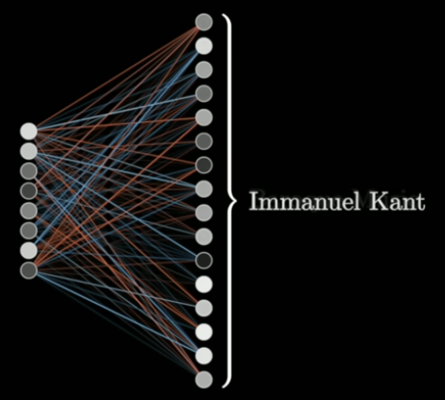
Superposition
A much more usual scenario is that an ensemble of neurons encodes a concept, rather than a single “grandmother cell”. This leads to the principle of superposition, in which a lot of the same neurons will be involved in encoding several concepts. It’s a combinatorics game for semantics that becomes very expressive when we have very high dimensional spaces like the 12,288 embedding size in the case of GPT-3 175B (Davinci) for example.
3Blue1Brown
An ensemble of neurons encode a single concept
Hence, same neurons can be involved in encoding different concepts
N-dimensions
Concept 1
Concept exp(εᐧN)
Notes:
https://youtu.be/9-Jl0dxWQs8?si=9x46MVg-sdmskaQ4&t=1025
https://youtu.be/9-Jl0dxWQs8?si=_UCmtd9Utvu7WeAL&t=1280

Slide 32
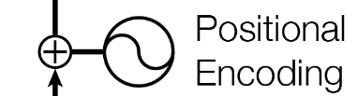
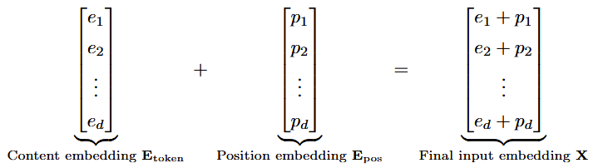
Positional encoding
The transformer treats the tokens as a Bag of Words (BoW).
We need to give each token a label that specifies its position in the form of a counter ID, for instance.
It’s noteworthy that the positional encoding information is literally added by a “+”/ plus operation.
There are various encoding schemes out there, such as absolute encoding or relative encoding for example. These seemingly small details can have a significant impact on how the transformer ends up performing. Check out the Swin Transformer paper for some empirical evidence.

Slide 33
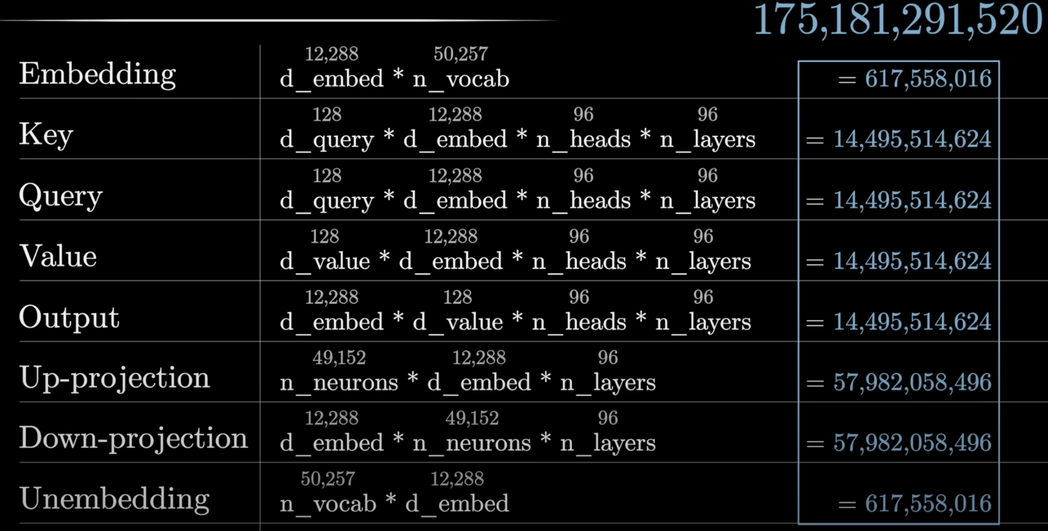
GPT-3 Tensors and the overall Number of Parameters
3Blue1Brown
Notes:
https://youtu.be/9-Jl0dxWQs8?si=zSgl6gb8fTfdniZV&t=1009

Slide 34
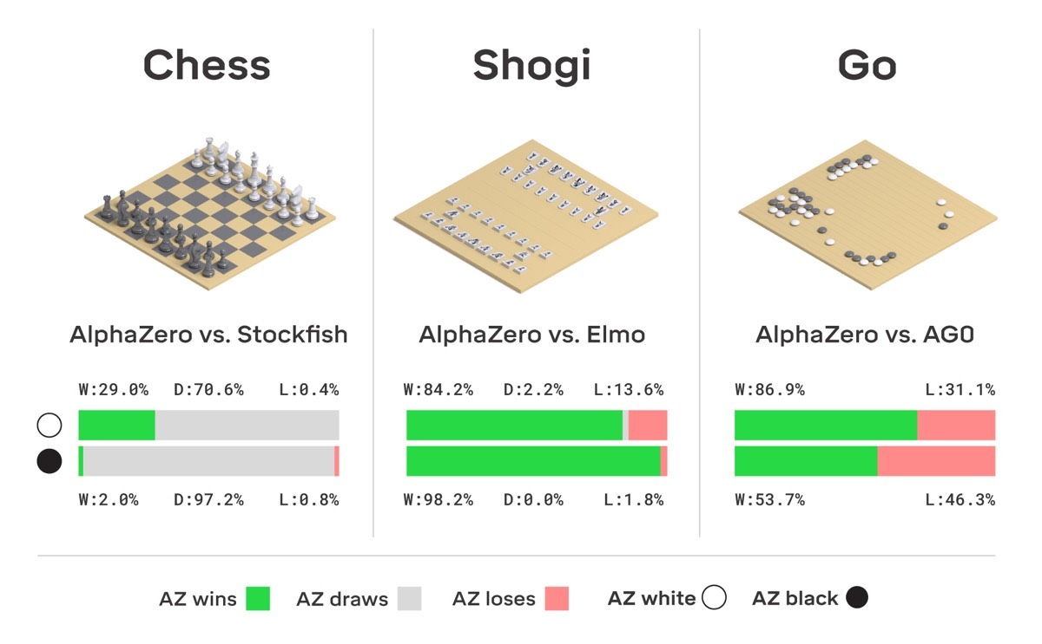
ChatGPT Pipeline
Pretraining the base model.
Supervised Fine-Tuning (SFT).
Reward Modeling / RM.
Reinforcement Learning / RL (with human in the loop / human feedback).
Additional Chain-of-Thought (CoT) Reinforcement Learning.
DeepMind subsequently created AlphaStar AlphaFold, AlphaEvolve using similar principles.
Conjecture: ChatGPT works so well, because it borrowed many insights from the AlphaZero games playing engine from back in 2016. Words seem to be the new chess pieces that have to be smartly arranged.
Notes:
https://arstechnica.com/science/2018/12/move-over-alphago-alphazero-taught-itself-to-play-three-different-games/

Slide 35
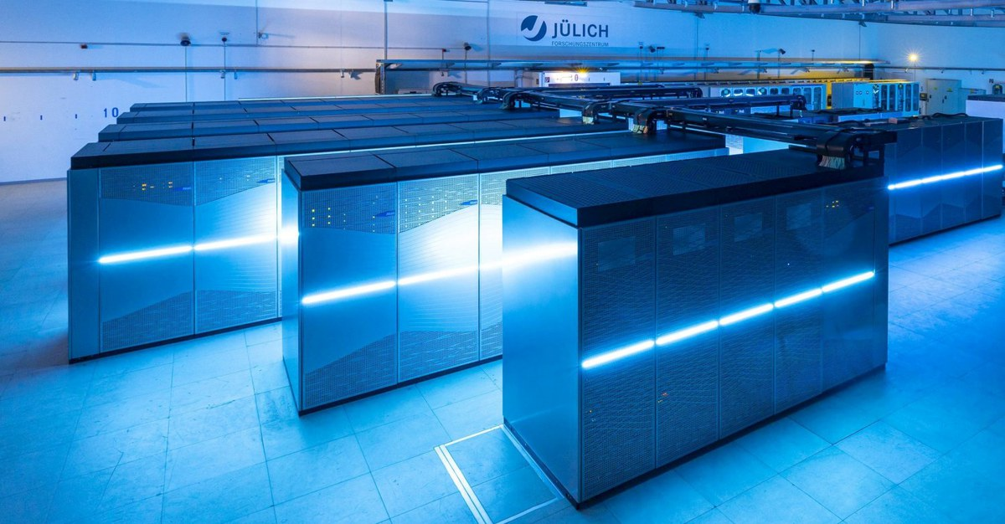
Pretraining the Foundational Model
Use raw data to train a Base Model.
The dataset is huge => potentially low quality in some places, but very large quantity
(ex: from roughly 1 to 45 TB / Terabytes of text, and beyond!).
We obtain a document completer in the end, i.e. a very well informed “auto-complete”.
Thousands of GPUs work in parallel (ex: 1000-2000 A100 GPUs).
Germany's fastest supercomputer JUWELS at Forschungszentrum Jülich
https://www.fz-juelich.de/en/ias/jsc/systems/supercomputers/apply-for-computing-time
Notes:
https://www.fz-juelich.de/en/news/archive/press-release/2022/first-european-exascale-supercomputer-coming-to-julich

Slide 36




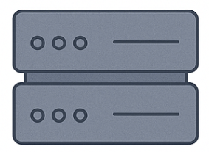
Supervised Fine Tuning (SFT stage)
Low quantity, but very high quality data: ~ 100K (prompt, response) tuples.
Domain Specialists / Contractors have to scrutinize the dataset so that close to ideal (prompt, response) tuples are assembled.
Less GPUs are required than in step 1 (ex: 1-100).
The outcome is the so-called SFT model.
[The figure sub-components were generated using the OpenAI diffusion model]

Slide 37
Reward Modeling
Ask the SFT model to produce multiple answers per prompt.
Ask human contractors to carefully rank these answers.
Train a reward model on these rankings.
Requires on the order of 1 to 100 GPUs for training.
The outcome is the so-called Reward Model / RM => Evaluates token trajectories.
Token 11 | Token 12 | Reward 1
Token trajectory 1
Token 21 | Token 22 | Token 23
Token 24 | Token 25 | Reward 2
Token trajectory 2
Token 31 | Token 32 | Token 33
Token 34 | Token 35 | Token 36
Token 37 | Token 38 | Reward 3
Token trajectory 3

Slide 38
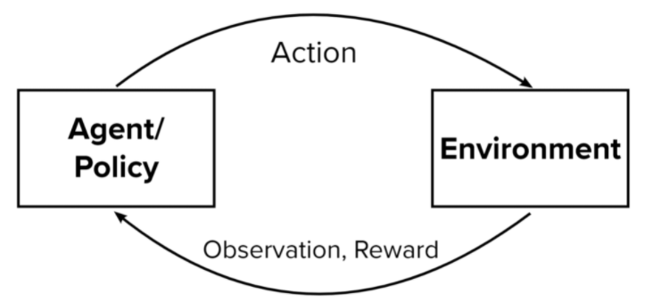
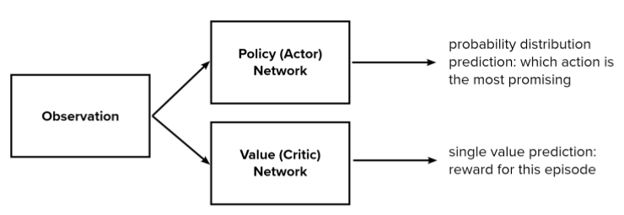
RLHF Reinforcement Learning
Train a Proximal Policy Optimization (PPO) algorithm.
Use the previously trained reward model to evaluate the reward.
PPO will have the task of generating token “trajectories” that will have a very good overall score.
Requires on the order of 1 to 100 GPUs for training.
The outcome is the so called RLHF model (reinforcement learning with human feedback).
Notes:
https://odsc.com/blog/reinforcement-learning-with-ppo/

Slide 39

Chain-Of-Thought Reasoning
To generate the recent chain-of-thought reasoning systems, we need even more Reinforcement Learning, i.e. something more and different than RLHF.
Problem Statement
Many, many, many! times
Model tries different token trajectories on its own and stores the ones that lead to the correct answer. Then, it trains on the successful token trajectories to improve its reasoning abilities, such that on future problems, it will prefer more reasonable chains-of-thought, i.e. more “correct thinking and planning” to solve problems. One interesting aspect is that training on coding tasks seems to generally improve logic ability across other areas such as math and sciences.
Answer Known Apriori

Slide 40
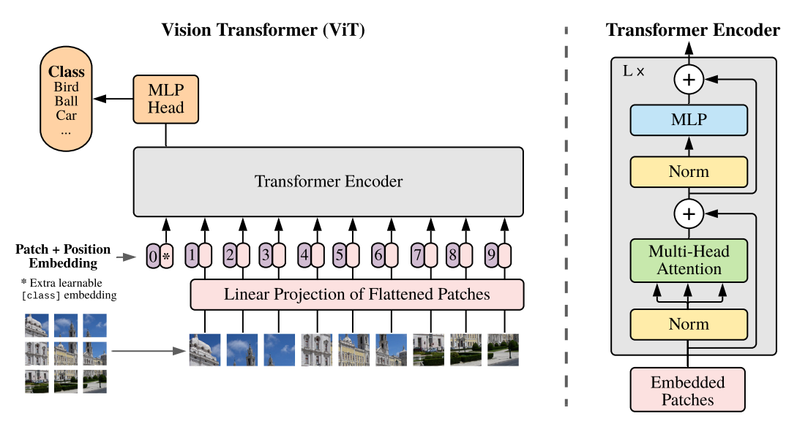
Vision Transformer / ViT
“An Image is Worth 16x16 Words: Transformers for Image Recognition at Scale” by A. Dosovitskiy et al. (2021)
Notes:
Figure 1 from the paper “An image is worth 16x16 words: Transformers for image recognition at scale” by A. Dosovitskiy et al. -> https://arxiv.org/pdf/2010.11929v2.pdf

Slide 41
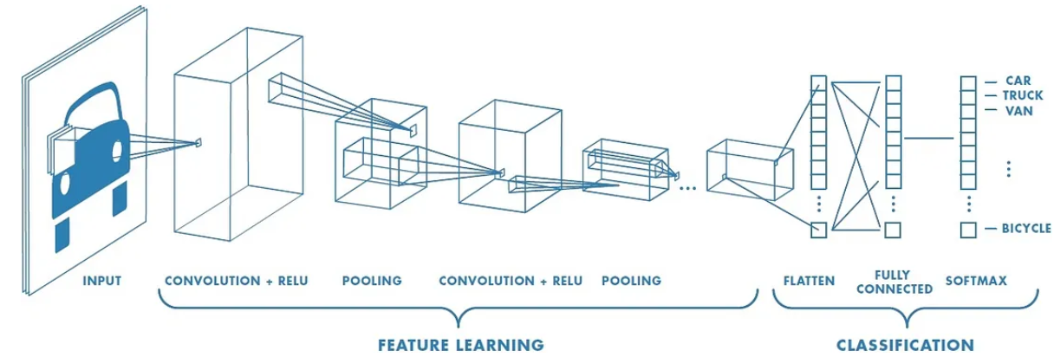
Convolutional Neural Networks (CNNs)
Generally applied in computer vision tasks, to extract visual features such as horizontal edges, vertical edges, edges of different angles, as well as more complex shapes like squares, circles, etc.
CNNs are very amenable to parallelism, so they don’t slow down the overall Transformer pipeline.
Several Convolutional Layers are used at the input stage of a vision transformer as an interface that converts 2D-Maps to 1D-Tokens, projecting the task to something very similar to the natural language processing scenario.
Visualize interactive demo at -> https://cs231n.github.io/convolutional-networks
Notes:
https://medium.com/@RaghavPrabhu/understanding-of-convolutional-neural-network-cnn-deep-learning-99760835f148
https://cs231n.github.io/convolutional-networks

Slide 42
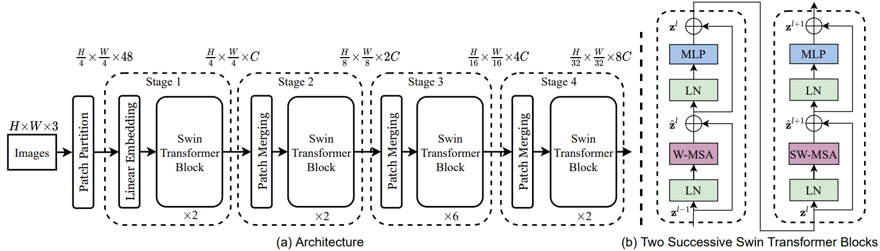
Swin Transformer
“Swin Transformer: Hierarchical Vision Transformer using Shifted Windows” by Liu et al. (2021)
Notes:
Figure 3 from the paper “Swin Transformer: Hierarchical Vision Transformer using Shifted Windows” by Liu et al. -> https://arxiv.org/pdf/2103.14030.pdf

Slide 43
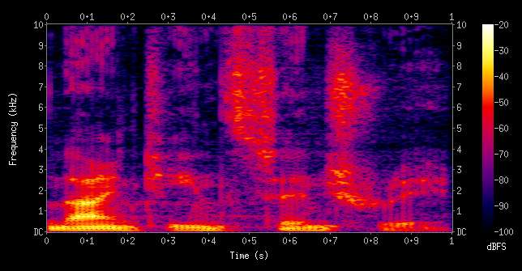
Audio Transformer
Raw sound waves can be mapped to a different space using STFT (Short-time Fourier Transform).
Here, time series become images => problem adapted to be tackled by a ViT / Swin Transformer.
Notes:
https://en.wikipedia.org/wiki/Short-time_Fourier_transform#/media/File:Spectrogram-19thC.png

Slide 44
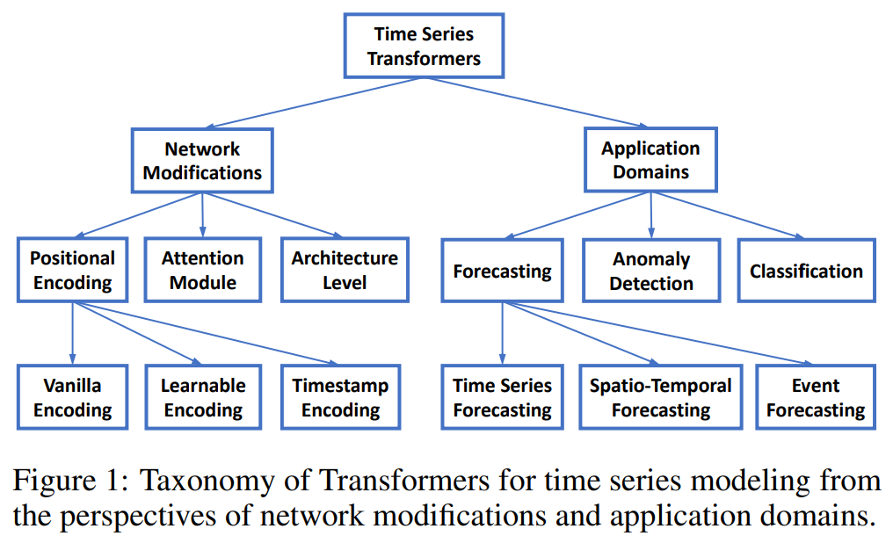
Time Series Transformer (TST)
Continuous data is sampled and quantized into discrete tokens.
Implementations available at -> https://huggingface.co/docs/transformers/model_doc/time_series_transformer
“Transformers in Time Series: A Survey” paper, by Wen et al. (2023)
Notes:
Figure 1 from the “Transformers in Time Series: A Survey” paper, by Wen et al. -> https://arxiv.org/pdf/2202.07125.pdf
https://github.com/qingsongedu/time-series-transformers-review

Slide 45
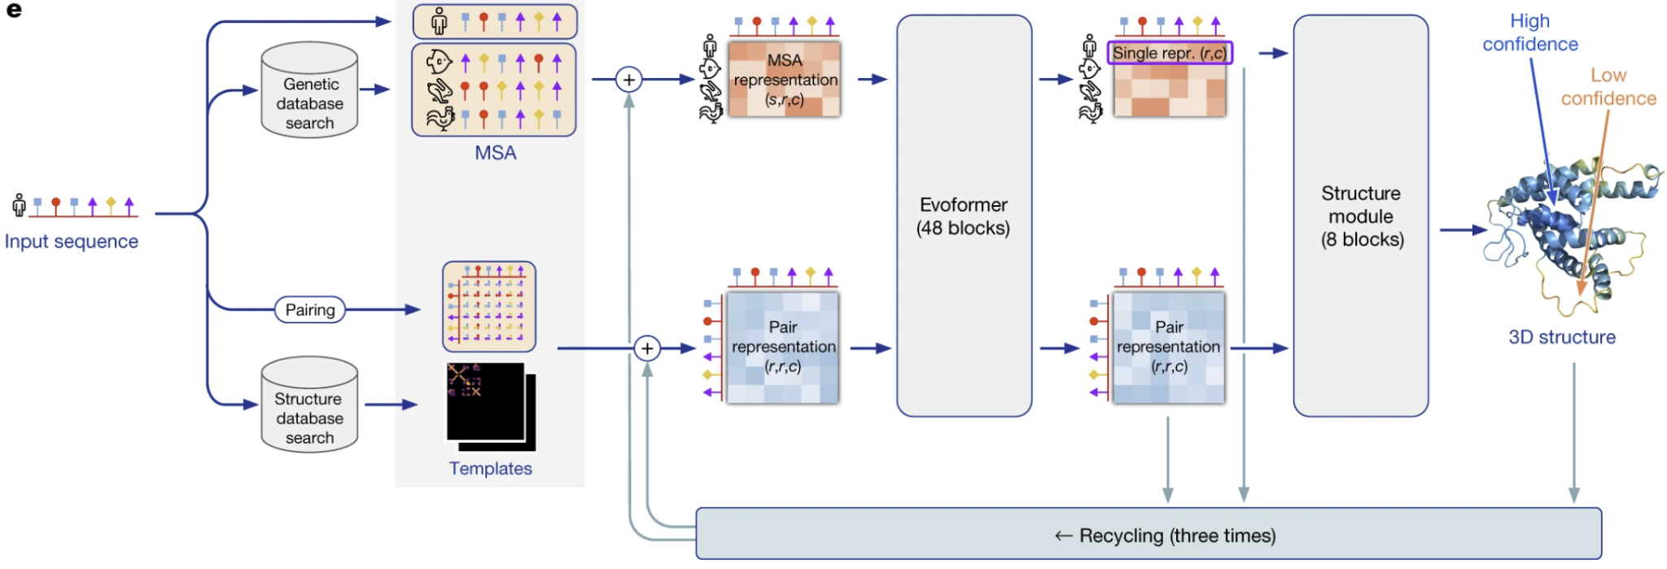
Computational Biology
“Highly accurate protein structure prediction with AlphaFold” by John Jumper et al. (Nature, 2021)
AlphaFold2 offers many insights on using Transformers in relatively data-scarce regimes.
It is also very insightful for cases were you need to handle 1D, 2D and 3D data formats within a single pipeline.
It’s not just a transformer, it’s a hybrid system in conjunction with a combination of many subtle training tricks to make protein structure prediction very accurate in the end, acceptable enough for real-world laboratory experiments.
Notes:
Subpart of Figure 1 from the AlphaFold2 paper by John Jumper et al., available at -> https://www.nature.com/articles/s41586-021-03819-2

Slide 46
Code example: Self-Attention Snippet Version 1
torch.Size([4, 8, 2])
tensor([[ 1.9269, 1.4873],
[ 0.9007, -2.1055],
[ 0.6784, -1.2345],
[-0.0431, -1.6047],
[-0.7521, 1.6487],
[-0.3925, -1.4036],
[-0.7279, -0.5594],
[-0.7688, 0.7624]])
tensor([[ 1.9269, 1.4873],
[ 1.4138, -0.3091],
[ 1.1687, -0.6176],
[ 0.8657, -0.8644],
[ 0.5422, -0.3617],
[ 0.3864, -0.5354],
[ 0.2272, -0.5388],
[ 0.1027, -0.3762]])
# Version 1:
# We want x[b,t] = mean_{i<=t} x[b,i]
xbow = torch.zeros((B,T,C))
for b in range(B):
for t in range(T):
xprev = x[b,:t+1] # (t,C)
xbow[b,t] = torch.mean(xprev, 0)
print(x[0])
print(xbow[0])

Slide 47
Code example: Self-Attention Snippet Version 2
torch.Size([4, 8, 2])
tensor([[ 1.9269, 1.4873],
[ 0.9007, -2.1055],
[ 0.6784, -1.2345],
[-0.0431, -1.6047],
[-0.7521, 1.6487],
[-0.3925, -1.4036],
[-0.7279, -0.5594],
[-0.7688, 0.7624]])
tensor([[ 1.9269, 1.4873],
[ 1.4138, -0.3091],
[ 1.1687, -0.6176],
[ 0.8657, -0.8644],
[ 0.5422, -0.3617],
[ 0.3864, -0.5354],
[ 0.2272, -0.5388],
[ 0.1027, -0.3762]])
Are xbow and xbow2 the same? -> True
# Version 1
# We want x[b,t] = mean_{i<=t} x[b,i]
xbow = torch.zeros((B,T,C))
for b in range(B):
for t in range(T):
xprev = x[b,:t+1] # (t,C)
xbow[b,t] = torch.mean(xprev, 0)
print(x[0])
print(xbow[0])
# Version 2
wei = torch.tril(torch.ones(T, T))
wei = wei / wei.sum(1, keepdim=True)
xbow2 = wei @ x # (B, T, T) @ (B, T, C) ---> (B, T, C)
print("Are xbow and xbow2 the same? -> ", torch.allclose(xbow, xbow2))

Slide 48
Code example: Self-Attention Snippet Version 3
torch.Size([4, 8, 2])
tensor([[ 1.9269, 1.4873],
[ 0.9007, -2.1055],
[ 0.6784, -1.2345],
[-0.0431, -1.6047],
[-0.7521, 1.6487],
[-0.3925, -1.4036],
[-0.7279, -0.5594],
[-0.7688, 0.7624]])
tensor([[ 1.9269, 1.4873],
[ 1.4138, -0.3091],
[ 1.1687, -0.6176],
[ 0.8657, -0.8644],
[ 0.5422, -0.3617],
[ 0.3864, -0.5354],
[ 0.2272, -0.5388],
[ 0.1027, -0.3762]])
Are xbow/xbow2 equal to xbow3? -> True
# Version 2
wei = torch.tril(torch.ones(T, T))
wei = wei / wei.sum(1, keepdim=True)
xbow2 = wei @ x # (B, T, T) @ (B, T, C) ---> (B, T, C)
print("Are xbow and xbow2 the same? -> ",
# Version 3: using Softmax
tril = torch.tril(torch.ones(T,T))
wei = torch.zeros((T,T))
wei = wei.masked_fill(tril == 0, float('-inf'))
wei = F.softmax(wei, dim=-1)
xbow3 = wei @ x
print("Are xbow/xbow2 equal to xbow3? -> ", torch.allclose(xbow, xbow3))

Slide 49
Takeaways
Generative AI is the art of encoding complex real world distributions, such that we can generate creative results later via sampling from the learned distribution.
Transformers are powerful neural networks that borrow the best ideas from prior models in the AI ecosystem and combine them together for a synergistic effect.
Self-attention and Feed-Forward MLP are the major conceptual components of a Transformer block.
Self-attention is essentially a communication graph where tokens exchange information stored in channels among themselves.
The Feed-Forward MLP is the memory database of the transformer, used to enrich the input embeddings with new facts.
Residual additive connections and pre- / post-normalization are important details / attributes, that contribute towards a more successful training and faster convergence.

Slide 50
Bonus slides and helper material next...

Slide 51
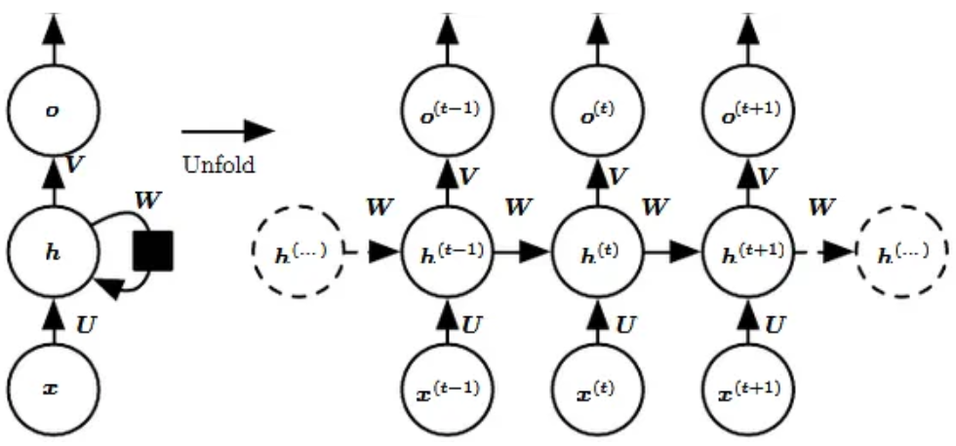
Sequential nature of Recurrent Neural Networks (RNNs)
By unfolding the feedback loop in time, we see the actual complexity of these networks. It is as if we train a very deep network and that may be very well why they’re significantly harder to train.
With RNNs things happen sequentially => deep graph structure.
With Transformers things happen in parallel => broad graph structure.
Transformers might simply be easier to train stably, and maybe that’s why they have better overall results.
Notes:
https://medium.com/data-science/recurrent-neural-networks-rnns-3f06d7653a85

Slide 52
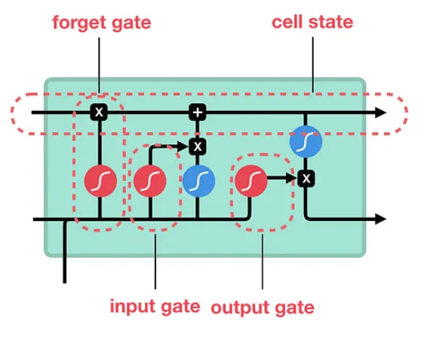
Long short-term memory (LSTMs)
Contains special gates that address the problem of vanishing gradients.
Addresses the problem of exploding gradients.
Notes:
https://medium.com/data-science/illustrated-guide-to-lstms-and-gru-s-a-step-by-step-explanation-44e9eb85bf21

Slide 53
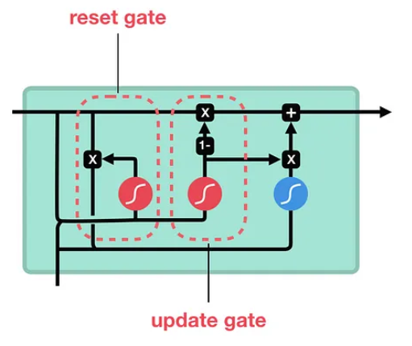
Gated Recurrent Units (GRUs)
Generally considered faster than LSTMs.
In practice => similar outcomes to what LSTM models provide.
Notes:
https://medium.com/data-science/illustrated-guide-to-lstms-and-gru-s-a-step-by-step-explanation-44e9eb85bf21

Slide 54
Generative Adversarial Networks / GANs
Two networks: Generator and Discriminator play a min-max game
Generator aims at producing realistic outputs to trick the Discriminator
Discriminator strives to improve its ability to discern true from fake data
Notes:
https://lilianweng.github.io/posts/2018-10-13-flow-models/

Slide 55
Variational Autoencoders / VAEs
Note -> Re-parametrization trick
Inspired from traditional autoencoders that compress data into vector codes
Variational autoencoders will learn a latent distribution function instead
The latent distribution can be sampled, resulting in variable latent samples
The samples are decoded, resulting in a variety of realistic reconstructions
Notes:
https://ducspe.github.io/masterthesis_danucaus/ -> page 18

Slide 56
Flow-based models
Use invertible neural networks to learn the data distribution
Enable exact log-likelihood directly thanks to one-to-one invertibility
More computationally expensive than VAEs, due to invertibility requirements
Notes:
https://lilianweng.github.io/posts/2018-10-13-flow-models/

Slide 57
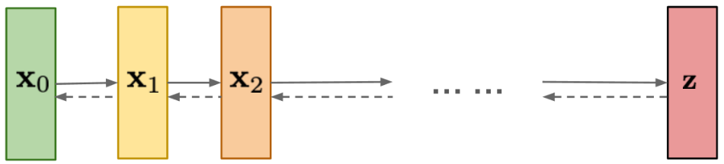
Diffusion models
P / forward distribution
Q / backward distribution
Markov chain of states, where each state is a noisy version of the other
The original input X₀ is diffused into pure noise Z over several steps
The model learns the noise that needs to be removed from a state at time t, to get to an earlier state
Notes:
https://lilianweng.github.io/posts/2021-07-11-diffusion-models/

Slide 58
References
https://medium.com/data-science/the-differences-between-artificial-and-biological-neural-networks-a8b46db828b7
https://cs231n.stanford.edu/slides/2019/cs231n_2019_lecture04.pdf
https://towardsdatascience.com/neural-networks-backpropagation-by-dr-lihi-gur-arie-27be67d8fdce
https://lilianweng.github.io/posts/2018-10-13-flow-models/
https://lilianweng.github.io/posts/2021-07-11-diffusion-models/
https://ducspe.github.io/masterthesis_danucaus/ -> page 18
“Attention is all you need” by Vaswani et al. -> https://arxiv.org/pdf/1706.03762.pdf
LLM visualization tool -> https://bbycroft.net/llm
3Blue1Brown channel / playlist -> https://www.youtube.com/playlist?list=PLZHQObOWTQDNU6R1_67000Dx_ZCJB-3pi
“Swin Transformer V2: Scaling Up Capacity and Resolution” paper by Liu et al. -> https://arxiv.org/abs/2111.09883
https://www.nature.com/news/2005/050620/full/news050620-7.html
Grandmother cells paper -> https://www.nature.com/articles/nature03687
https://www.researchgate.net/publication/7770938_Invariant_Visual_Representation_by_Single_Neurons_in_the_Human_Brain
https://arstechnica.com/science/2018/12/move-over-alphago-alphazero-taught-itself-to-play-three-different-games/
https://www.fz-juelich.de/en/news/archive/press-release/2022/first-european-exascale-supercomputer-coming-to-julich
https://odsc.com/blog/reinforcement-learning-with-ppo/
“An image is worth 16x16 words: Transformers for image recognition at scale” by A. Dosovitskiy et al. -> https://arxiv.org/pdf/2010.11929v2.pdf
https://medium.com/@RaghavPrabhu/understanding-of-convolutional-neural-network-cnn-deep-learning-99760835f148
https://cs231n.github.io/convolutional-networks
“Swin Transformer: Hierarchical Vision Transformer using Shifted Windows” by Liu et al. -> https://arxiv.org/pdf/2103.14030.pdf
https://en.wikipedia.org/wiki/Short-time_Fourier_transform#/media/File:Spectrogram-19thC.png
“Transformers in Time Series: A Survey” paper, by Wen et al. -> https://arxiv.org/pdf/2202.07125.pdf
https://github.com/qingsongedu/time-series-transformers-review
AlphaFold2 paper -> https://www.nature.com/articles/s41586-021-03819-2
https://medium.com/data-science/recurrent-neural-networks-rnns-3f06d7653a85
https://medium.com/data-science/illustrated-guide-to-lstms-and-gru-s-a-step-by-step-explanation-44e9eb85bf21

