Slide 1
Dynamic Routing Protocols I RIP
Relates to Lab 4.
The first module on dynamic routing protocols. This module provides an overview of routing, introduces terminology (interdomain, intradomain, autonomous system),

Slide 2
Routing
Recall: There are two parts to routing IP packets:
1. How to pass a packet from an input interface to the output interface of a router (packet forwarding) ?
2. How to find and setup a route ?
We already discussed the packet forwarding part
There are two approaches for calculating the routing tables:
Static Routing
Dynamic Routing: Routes are calculated by a routing protocol

Slide 3
Autonomous Systems
An autonomous system is a region of the Internet that is administered by a single entity.
Examples of autonomous regions are:
UVA’s campus network
MCI’s backbone network
Regional Internet Service Provider
Routing is done differently within an autonomous system (intradomain routing) and between autonomous system (interdomain routing).

Slide 4
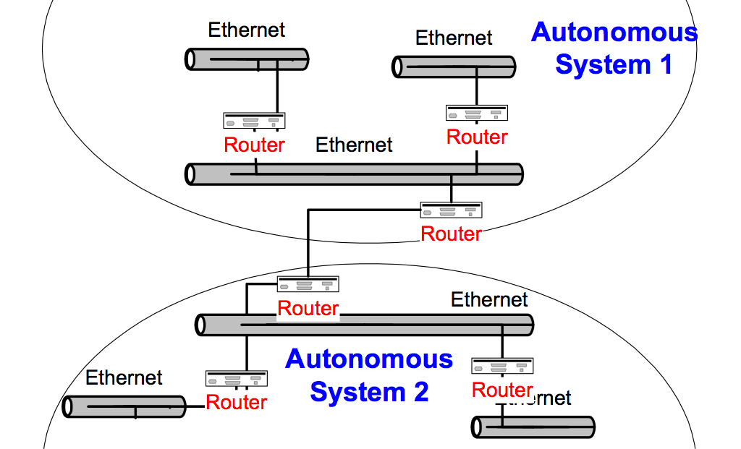
Autonomous Systems (AS)

Slide 5
Interdomain and Intradomain Routing
Intradomain Routing
Routing within an AS
Ignores the Internet outside the AS
Protocols for Intradomain routing are also called Interior Gateway Protocols or IGP’s.
Popular protocols are
RIP (simple, old)
OSPF (better)
Interdomain Routing
Routing between AS’s
Assumes that the Internet consists of a collection of interconnected AS’s
Normally, there is one dedicated router in each AS that handles interdomain traffic.
Protocols for interdomain routing are also called Exterior Gateway Protocols or EGP’s.
Routing protocols:
EGP
BGP (more recent)

Slide 6
Components of a Routing Algorithm
A procedure for sending and receiving reachability information about network to other routers
A procedure for calculating optimal routes
Routes are calculated using a shortest path algorithm:
Goal: Given a network were each link is assigned a cost. Find the path with the least cost between two networks with minimum cost.
A procedures for reacting to and advertising topology changes

Slide 7
Approaches to Shortest Path Routing
There are two basic routing algorithms found on the Internet.
1. Distance Vector Routing
Each node knows the distance (=cost) to its directly connected neighbors
A node sends periodically a list of routing updates to its neighbors.
If all nodes update their distances, the routing tables eventually converge
New nodes advertise themselves to their neighbors
2. Link State Routing
Each node knows the distance to its neighbors
The distance information (=link state) is broadcast to all nodes in the network
Each node calculates the routing tables independently

Slide 8
Routing Algorithms in the Internet
Distance Vector
Routing Information Protocol (RIP)
Gateway-to-Gateway Protocol (GGP)
Exterior Gateway Protocol (EGP)
Interior Gateway Routing Protocol (IGRP)
Link State
Intermediate System - Intermediate System (IS-IS)
Open Shortest Path First (OSPF)

Slide 9
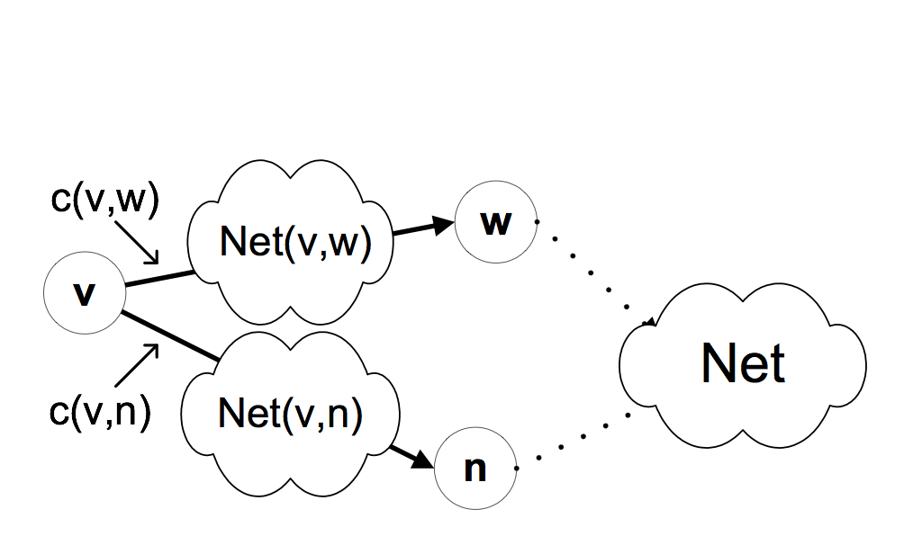
A network as a graph
In the following, networks are represented as a network graph:
nodes are connected by networks
network can be a link or a LAN
network interface has cost
networks are destinations
Net(v,w) is an IP address of a network
For ease of notation, we often replace the clouds between nodes by simple links.

Slide 10
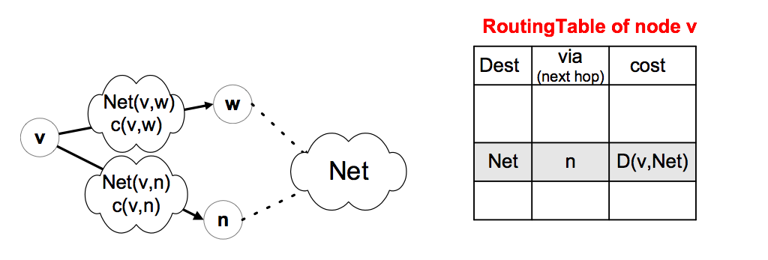
Distance Vector Algorithm: Routing Table
c(v,w): cost to transmit on the interface to network Net(v,w)
Net(v,w): Network address of the network between v and w The network can be a link, but could also be a LAN

Slide 11
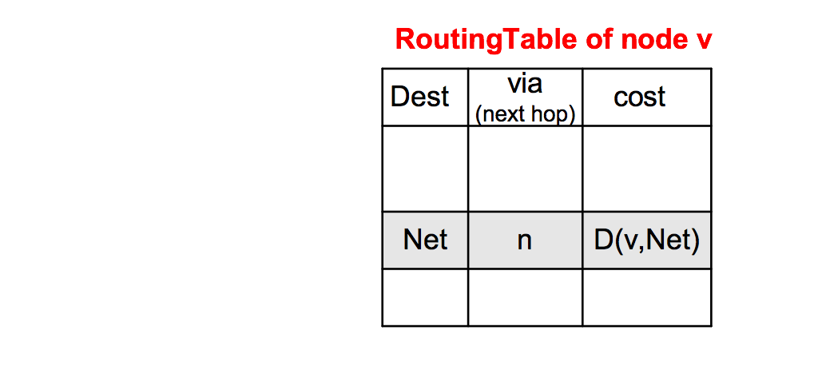
Distance Vector Algorithm: Messages
Nodes send messages to their neighbors which contain routing table entries
A message has the format: [Net , D(v,Net)] means“My cost to go to Net is D (v,Net)”
[Net , D(v,Net)]
v
n

Slide 12
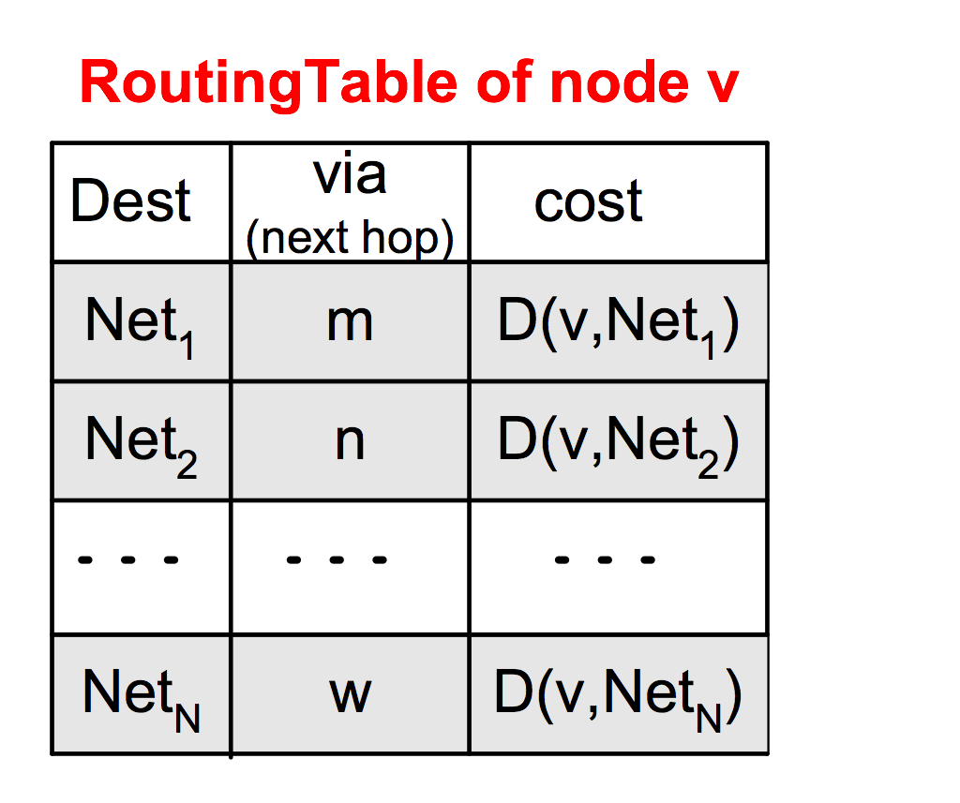
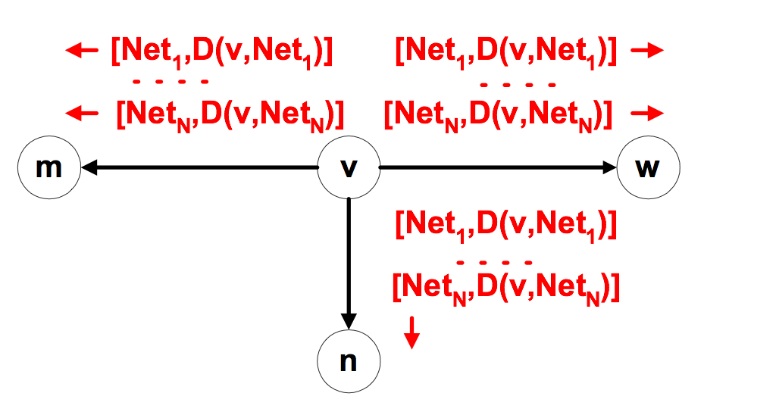
Distance Vector Algorithm: Sending Updates
Periodically, each node v sends the content of its routing table to its neighbors:

Slide 13
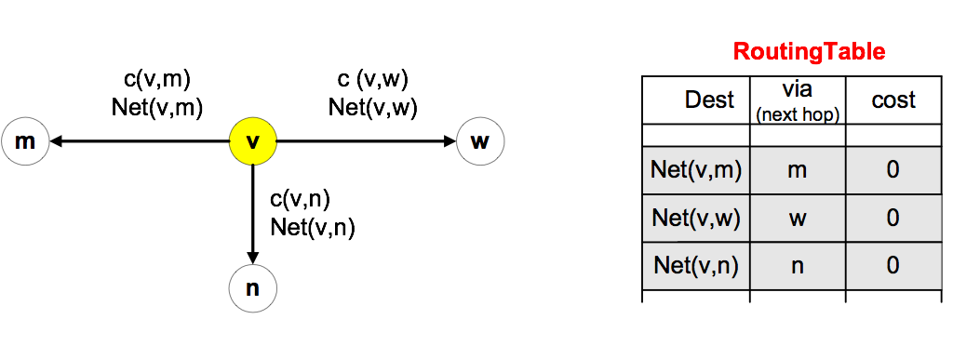
Initiating Routing Table I
Suppose a new node v becomes active.
The cost to access directly connected networks is zero:
D (v, Net(v,m)) = 0
D (v, Net(v,w)) = 0
D (v, Net(v,n)) = 0

Slide 14
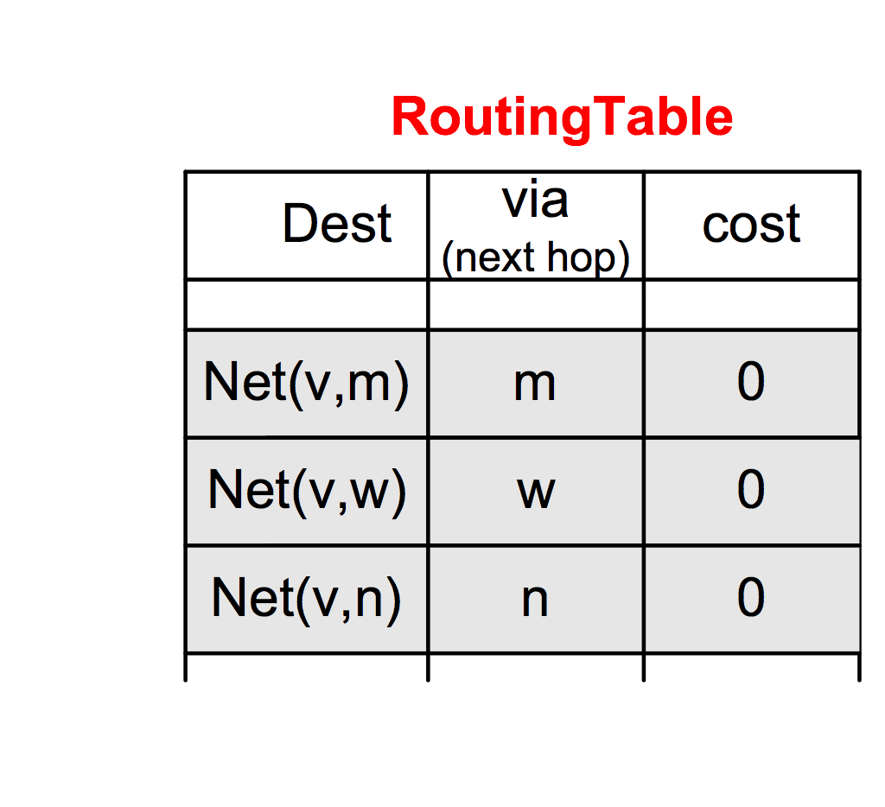
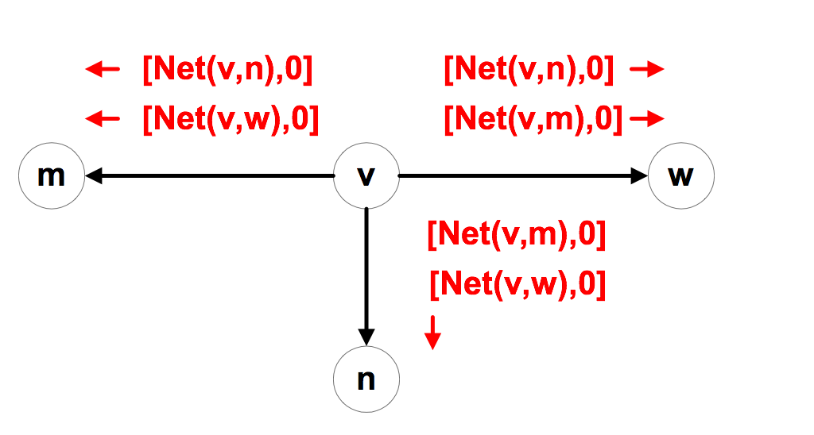
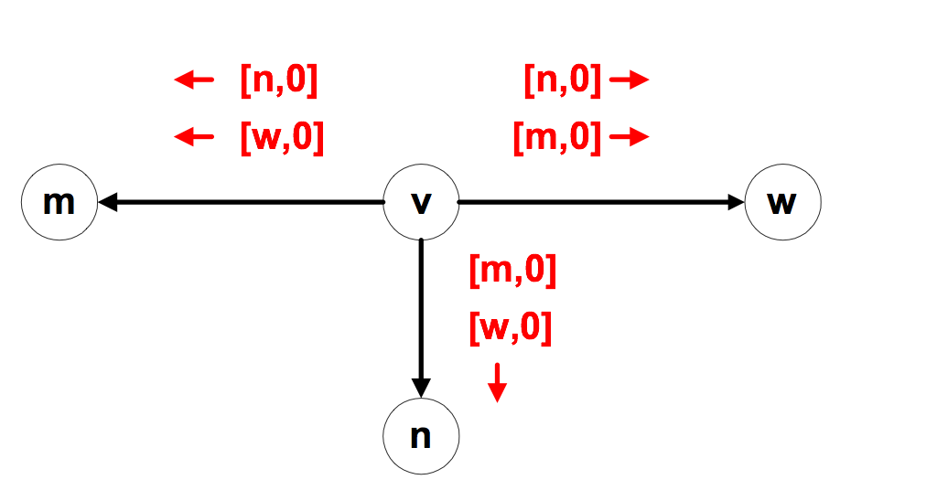
Initiating Routing Table II
New node v sends the routing table entry to all its neighbors:

Slide 15
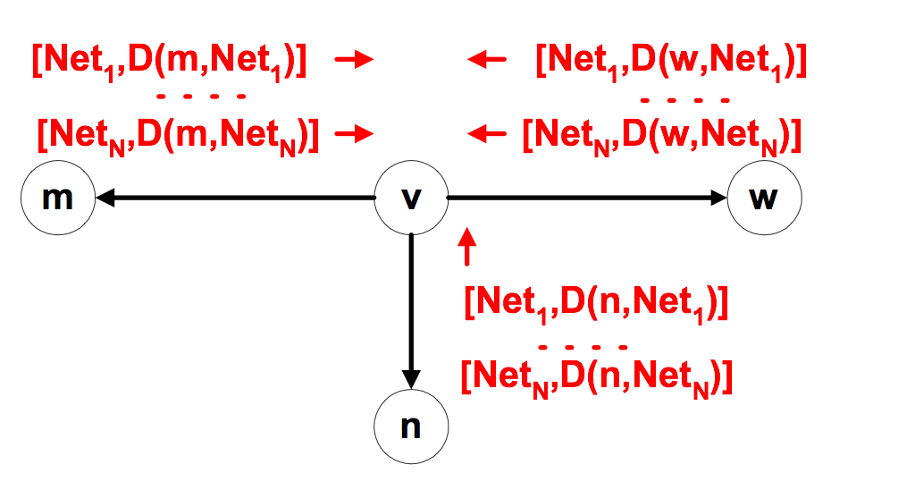
Initiating Routing Table III
Node v receives the routing tables from other nodes and builds up its routing table

Slide 16
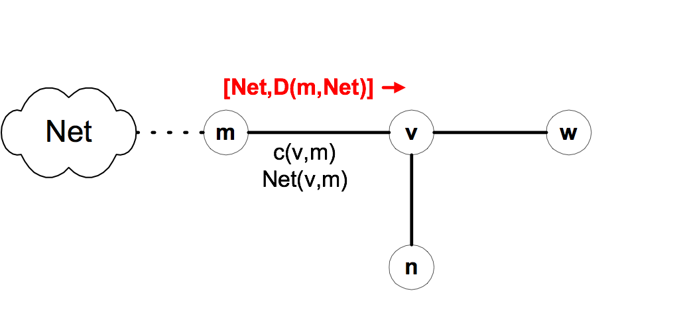
Updating Routing Tables I
Suppose node v receives a message from node m: [Net,D(m,Net)]
Node v updates its routing table and sends out further messages if the message reduces the cost of a route:
if ( D(m,Net) + c (v,m) < D (v,Net) ) {
D^{new} (v,Net) := D (m,Net) + c (v,m); Update routing table;
send message [Net, D^{new} (v,Net)] to all neighbors
}

Slide 17
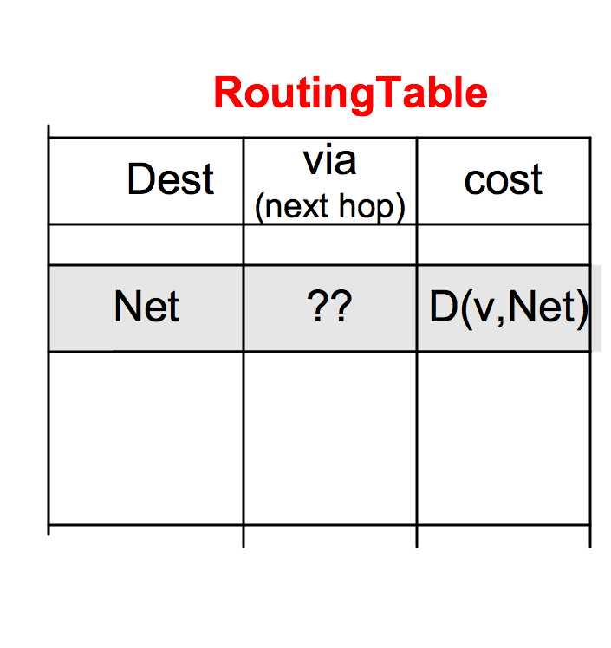
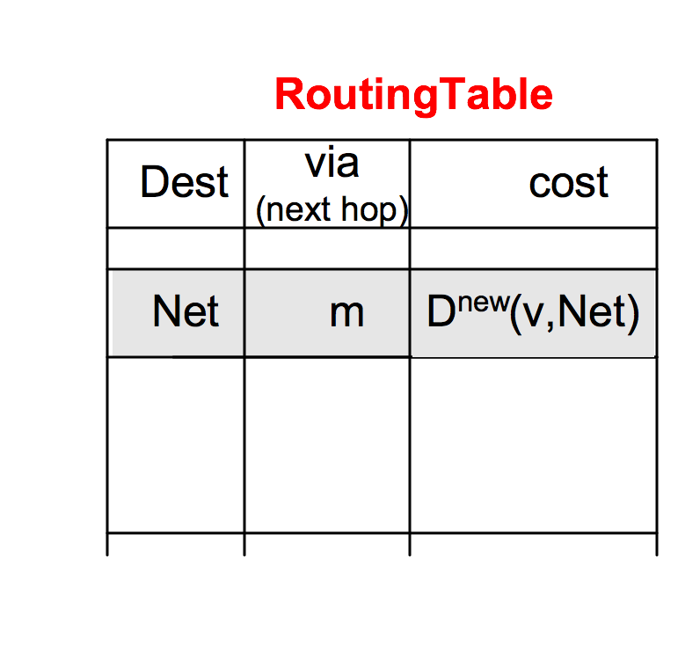
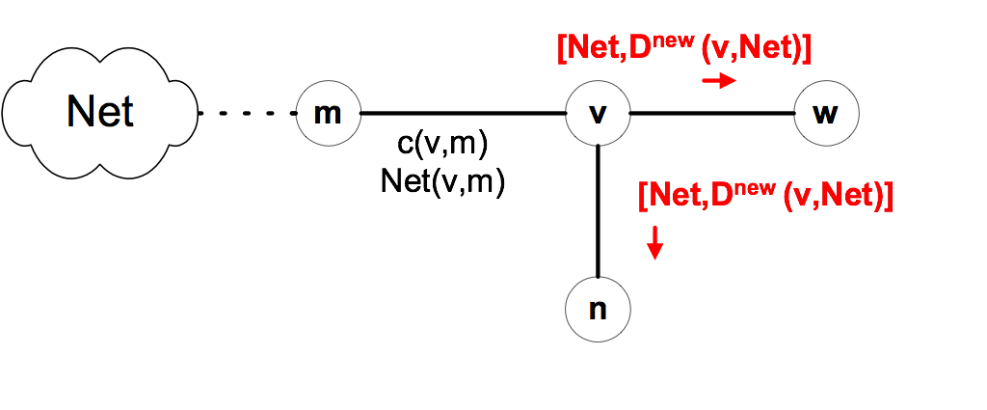
Updating Routing Tables II
Before receiving the message:
Suppose D (m,Net) + c (v,m) < D (v,Net):

Slide 18
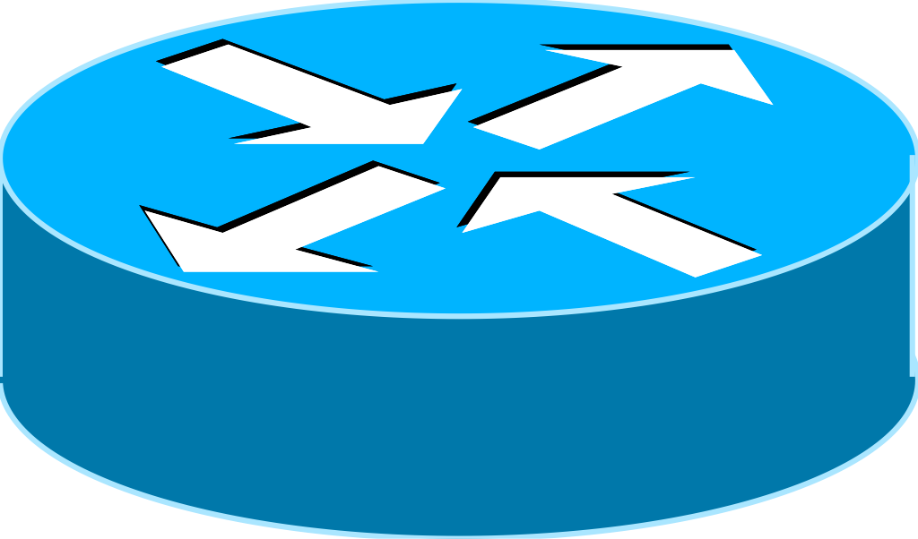
Example
Assume: - link cost is 1, i.e., c(v,w) = 1 - all updates, updates occur simultaneously - Initially, each router only knows the cost of connected interfaces
10.0.1.0/24
10.0.2.0/24
10.0.3.0/24
10.0.4.0/24
10.0.5.0/24
.2
.1
.2
.1
.2
.1
.2
.1
Router A
Router B
Router C
Router D
Net via
cost
Net via
cost
Net via
cost
Net via
cost
t=0: 10.0.1.0 - 0 10.0.2.0 - 0
t=0: 10.0.2.0 - 0 10.0.3.0 - 0
t=0: 10.0.3.0 - 0 10.0.4.0 - 0
t=0: 10.0.4.0 - 0 10.0.5.0 - 0
t=1: 10.0.1.0 - 0 10.0.2.0 - 0 10.0.3.0 10.0.2.2 1
t=1: 10.0.1.0 10.0.2.1 1 10.0.2.0 - 0 10.0.3.0 - 0 10.0.4.0 10.0.3.2 1
t=1: 10.0.2.0 10.0.3.1 1 10.0.3.0 - 0 10.0.4.0 - 0 10.0.5.0 10.0.4.2 1
t=1: 10.0.3.0 10.0.4.1 1 10.0.4.0 - 0 10.0.5.0 - 0
t=2: 10.0.1.0 - 0 10.0.2.0 - 0 10.0.3.0 10.0.2.2 1 10.0.4.0 10.0.2.2 2
t=2: 10.0.1.0 10.0.2.1 1 10.0.2.0 - 0 10.0.3.0 - 0 10.0.4.0 10.0.3.2 1 10.0.5.0 10.0.3.2 2
t=2: 10.0.1.0 10.0.3.1 2
10.0.2.0 10.0.3.1 1 10.0.3.0 - 0 10.0.4.0 - 0 10.0.5.0 10.0.4.2 1
t=2: 10.0.2.0 10.0.4.1 2 10.0.3.0 10.0.4.1 1 10.0.4.0 - 0 10.0.5.0 - 0

Slide 19
Example
10.0.1.0/24
10.0.2.0/24
10.0.3.0/24
10.0.4.0/24
10.0.5.0/24
.2
.1
.2
.1
.2
.1
.2
.1
Router A
Router B
Router C
Router D
Net via
cost
Net via
cost
Net via
cost
Net via
cost
t=2: 10.0.1.0 - 0 10.0.2.0 - 0 10.0.3.0 10.0.2.2 1 10.0.4.0 10.0.2.2 2
t=2: 10.0.1.0 10.0.2.1 1 10.0.2.0 - 0 10.0.3.0 - 0 10.0.4.0 10.0.3.2 1 10.0.5.0 10.0.3.2 2
t=2: 10.0.1.0 10.0.3.1 2
10.0.2.0 10.0.3.1 1 10.0.3.0 - 0 10.0.4.0 - 0 10.0.5.0 10.0.4.2 1
t=2: 10.0.2.0 10.0.4.1 2 10.0.3.0 10.0.4.1 1 10.0.4.0 - 0 10.0.5.0 - 0
t=3: 10.0.1.0 - 0 10.0.2.0 - 0 10.0.3.0 10.0.2.2 1 10.0.4.0 10.0.2.2 2 10.0.5.0 10.0.2.2 3
t=3: 10.0.1.0 10.0.2.1 1 10.0.2.0 - 0 10.0.3.0 - 0 10.0.4.0 10.0.3.2 1 10.0.5.0 10.0.3.2 2
t=3: 10.0.1.0 10.0.3.1 2
10.0.2.0 10.0.3.1 1 10.0.3.0 - 0 10.0.4.0 - 0 10.0.5.0 10.0.4.2 1
t=3: 10.0.1.0 10.0.4.1 3 10.0.2.0 10.0.4.1 2 10.0.3.0 10.0.4.1 1 10.0.4.0 - 0 10.0.5.0 - 0
Now, routing tables have converged !

Slide 20
Characteristics of Distance Vector Routing
Periodic Updates: Updates to the routing tables are sent at the end of a certain time period. A typical value is 90 seconds.
Triggered Updates: If a metric changes on a link, a router immediately sends out an update without waiting for the end of the update period.
Full Routing Table Update: Most distance vector routing protocol send their neighbors the entire routing table (not only entries which change).
Route invalidation timers: Routing table entries are invalid if they are not refreshed. A typical value is to invalidate an entry if no update is received after 3-6 update periods.

Slide 21
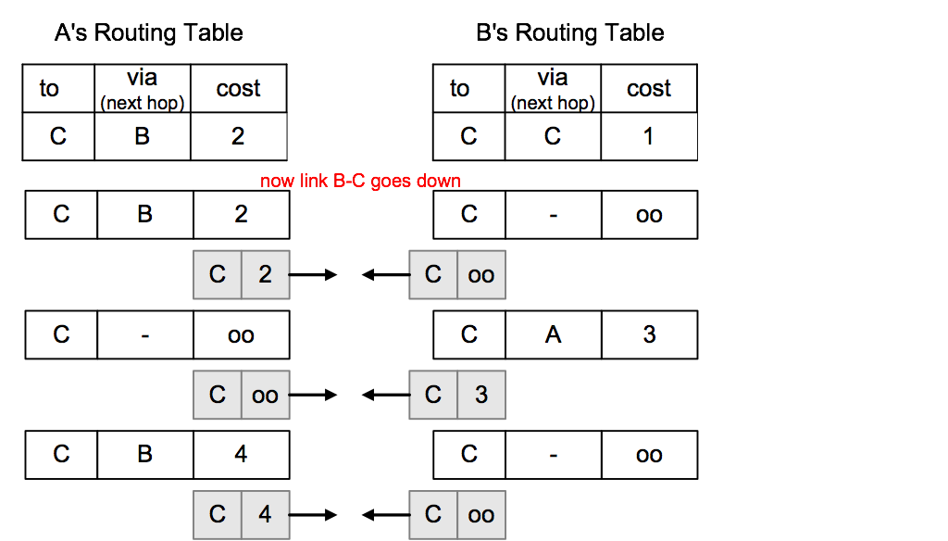
The Count-to-Infinity Problem
A
1
B
1
C

Slide 22
Count-to-Infinity
The reason for the count-to-infinity problem is that each node only has a “next-hop-view”
For example, in the first step, A did not realize that its route (with cost 2) to C went through node B
How can the Count-to-Infinity problem be solved?

Slide 23
Count-to-Infinity
The reason for the count-to-infinity problem is that each node only has a “next-hop-view”
For example, in the first step, A did not realize that its route (with cost 2) to C went through node B
How can the Count-to-Infinity problem be solved?
Solution 1: Always advertise the entire path in an update message (Path vectors)
If routing tables are large, the routing messages require substantial bandwidth
BGP uses this solution

Slide 24
Count-to-Infinity
The reason for the count-to-infinity problem is that each node only has a “next-hop-view”
For example, in the first step, A did not realize that its route (with cost 2) to C went through node B
How can the Count-to-Infinity problem be solved?
Solution 2: Never advertise the cost to a neighbor if this neighbor is the next hop on the current path (Split Horizon)
Example: A would not send the first routing update to B, since B is the next hop on A’s current route to C
Split Horizon does not solve count-to-infinity in all cases!

Slide 25
RIP - Routing Information Protocol
A simple intradomain protocol
Straightforward implementation of Distance Vector Routing
Each router advertises its distance vector every 30 seconds (or whenever its routing table changes) to all of its neighbors
RIP always uses 1 as link metric
Maximum hop count is 15, with “16” equal to “∞”
Routes are timeout (set to 16) after 3 minutes if they are not updated

Slide 26
RIP - History
Late 1960s : Distance Vector protocols were used in the ARPANET
Mid-1970s: XNS (Xerox Network system) routing protocol is the precursor of RIP in IP (and Novell’s IPX RIP and Apple’s routing protocol)
1982 Release of routed for BSD Unix
1988 RIPv1 (RFC 1058) - classful routing
1993 RIPv2 (RFC 1388) - adds subnet masks with each route entry - allows classless routing
1998 Current version of RIPv2 (RFC 2453)

Slide 27
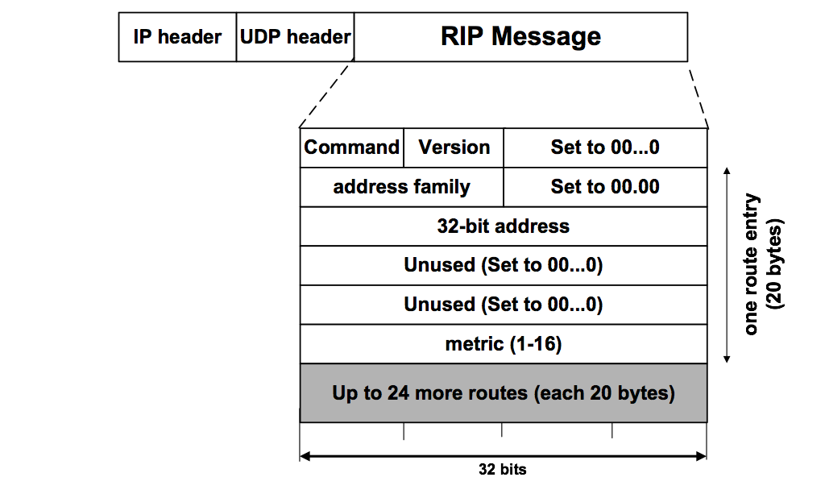
RIPv1 Packet Format
1: RIPv1
1: request 2: response
2: for IP
0…0: request full rou-ting table
Address of destination
Cost (measured in hops)
One RIP message can have up to 25 route entries

Slide 28
RIPv2
RIPv2 is an extends RIPv1:
Subnet masks are carried in the route information
Authentication of routing messages
Route information carries next-hop address
Exploites IP multicasting
Extensions of RIPv2 are carried in unused fields of RIPv1 messages

Slide 29

RIPv2 Packet Format
2: RIPv2
1: request 2: response
2: for IP
0…0: request full rou-ting table
Address of destination
Cost (measured in hops)
One RIP message can have up to 25 route entries

Slide 30
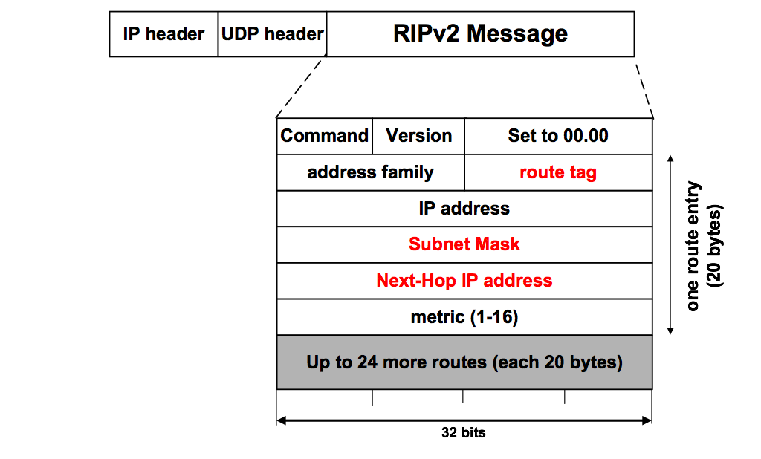
RIPv2 Packet Format
2: RIPv2
Used to carry information from other routing protocols (e.g., autonomous system number)
Subnet mask for IP address
Identifies a better next-hop address on the same subnet than the advertising router, if one exists (otherwise 0….0)

Slide 31
RIP Messages
This is the operation of RIP in routed. Dedicated port for RIP is UDP port 520.
Two types of messages:
Request messages
used to ask neighboring nodes for an update
Response messages
contains an update

Slide 32
Routing with RIP
Initialization: Send a request packet (command = 1, address family=0..0) on all interfaces:
RIPv1 uses broadcast if possible,
RIPv2 uses multicast address 224.0.0.9, if possible
requesting routing tables from neighboring routers
Request received: Routers that receive above request send their entire routing table
Response received: Update the routing table
Regular routing updates: Every 30 seconds, send all or part of the routing tables to every neighbor in an response message
Triggered Updates: Whenever the metric for a route change, send entire routing table.

Slide 33
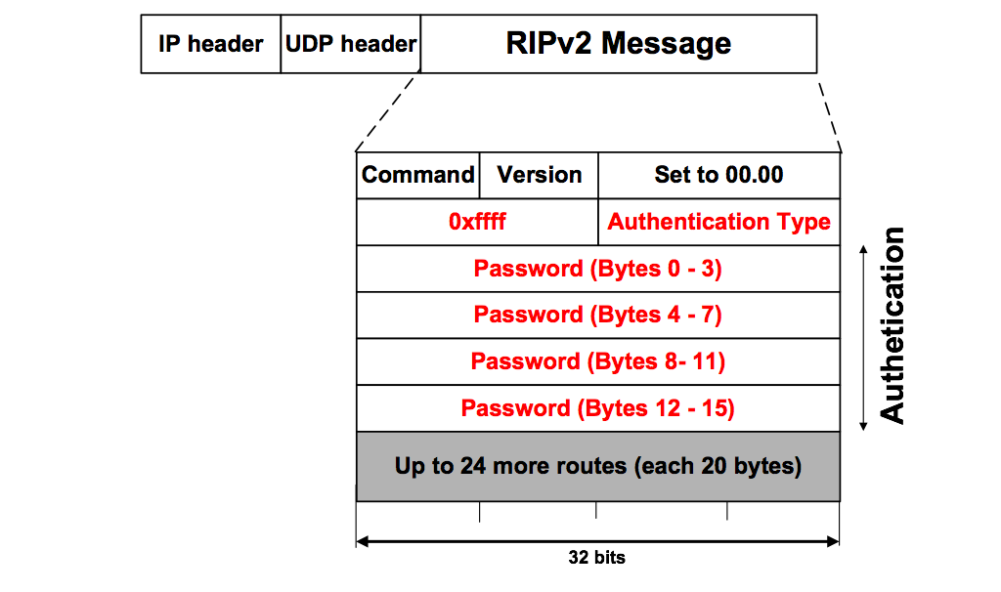
RIP Security
Issue: Sending bogus routing updates to a router
RIPv1: No protection
RIPv2: Simple authentication scheme
2: plaintext password

Slide 34
RIP Problems
RIP takes a long time to stabilize
Even for a small network, it takes several minutes until the routing tables have settled after a change
RIP has all the problems of distance vector algorithms, e.g., count-to-Infinity
RIP uses split horizon to avoid count-to-infinity
The maximum path in RIP is 15 hops

