Slide 1
Clustering

Slide 2
What is Clustering?
Attach label to each observation or data points in a set
You can say this “unsupervised classification”
Clustering is alternatively called as “grouping”
Intuitively, if you would want to assign same label to a data points that are “close” to each other
Thus, clustering algorithms rely on a distance metric between data points
Sometimes, it is said that the for clustering, the distance metric is more important than the clustering algorithm

Slide 3
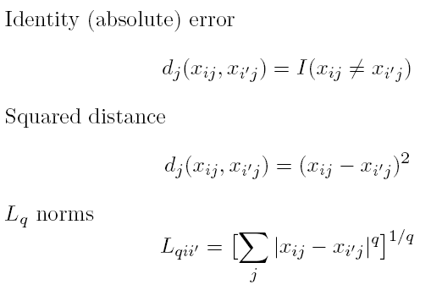

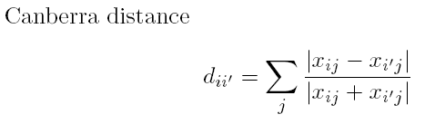
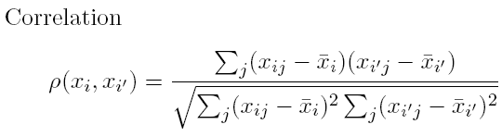
Distances: Quantitative Variables
Data point:
Some examples

Slide 4
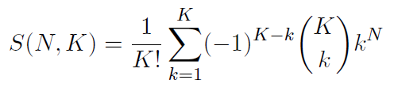
Combinatorial Approach
In how many ways can we assign K labels to N observations?
For each such possibility, we can compute a cost. Pick up the assignment with best cost.
Formidable number of possible assignments:

Slide 5
K-means Overview
An unsupervised clustering algorithm
“K” stands for number of clusters, it is typically a user input to the algorithm; some criteria can be used to automatically estimate K
It is an approximation to an NP-hard combinatorial optimization problem
K-means algorithm is iterative in nature
It converges, however only a local minimum is obtained
Works only for numerical data
Easy to implement

Slide 6
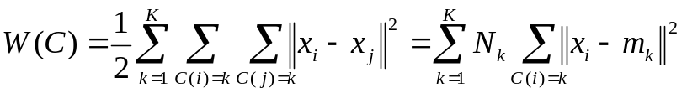
K-means: Setup
x₁,…, x_{N} are data points or vectors of observations
Each observation (vector x_{i}) will be assigned to one and only one cluster
C(i) denotes cluster number for the i^{th} observation
Dissimilarity measure: Euclidean distance metric
K-means minimizes within-cluster point scatter:
(Exercise)
where
m_{k} is the mean vector of the k^{th} cluster
N_{k} is the number of observations in k^{th} cluster

Slide 7
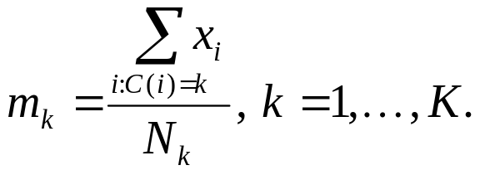
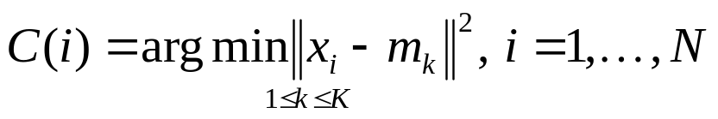
K-means Algorithm
For a given cluster assignment C of the data points, compute the cluster means m_{k}:
For a current set of cluster means, assign each observation as:
Iterate above two steps until convergence

Slide 8
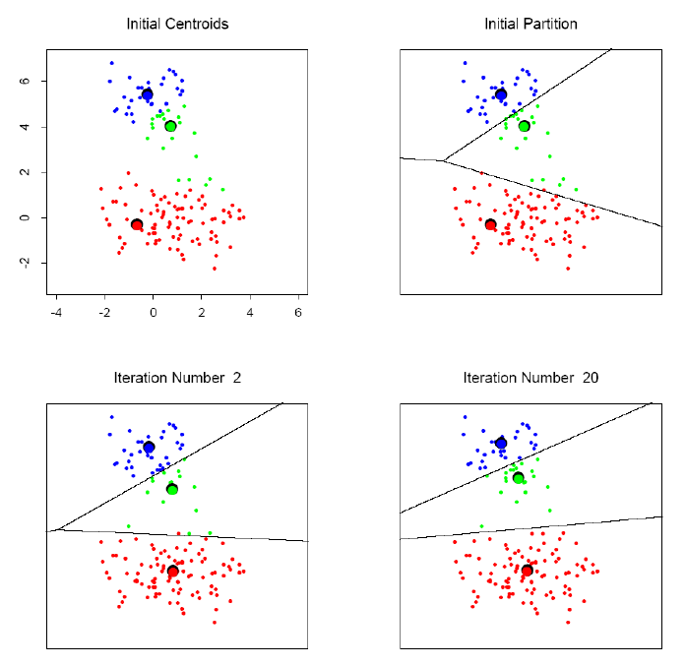
K-means clustering example

Slide 9
K-means application: community detection

Slide 10
K-means: summary
Algorithmically, very simple to implement
K-means converges, but it finds a local minimum of the cost function
Works only for numerical observations
K is a user input; alternatively BIC (Bayesian information criterion) or MDL (minimum description length) can be used to estimate K
Outliers can considerable trouble to K-means

