Slide 1
Adventure Work

Slide 2
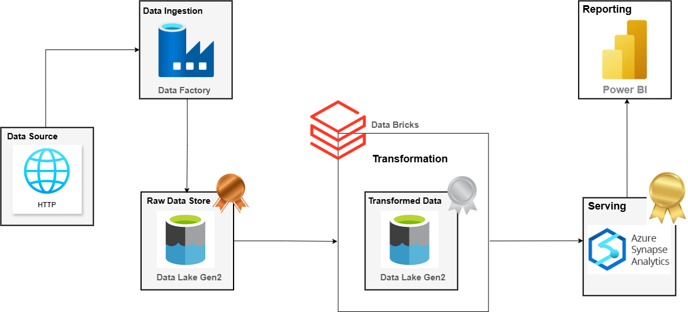
Data Architecture
Notes:
AdventureWork | Azure (Data Lake, Data Factory, Synapse Analytics), Databricks, Power BI
Implemented automated pipelines using Azure Data Factory to ingest 75,000+ records from GitHub into Bronze layer via HTTP connector
Performed data transformation using Databricks (PySpark) to load cleaned data into Silver layer and designed a Fact Constellation Schema (2 Facts, 4 Dims) on Synapse
Built a Power BI dashboard to present sales performance, return trends, and territory distribution by connecting to Gold layer

Slide 3
Table of contents
Phase 1: Pulling data from data source to bronze source
Phase 2: Data transformation with Data Bricks
Phase 3: Data Warehouse with Synapse
Phase 4: Connect Synapse to Power BI

Slide 4
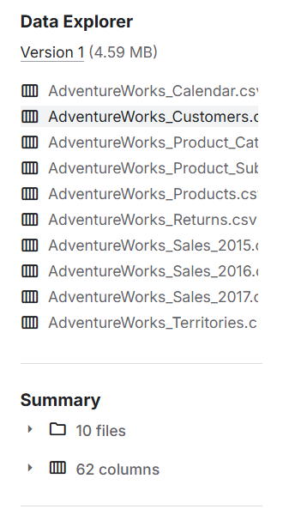
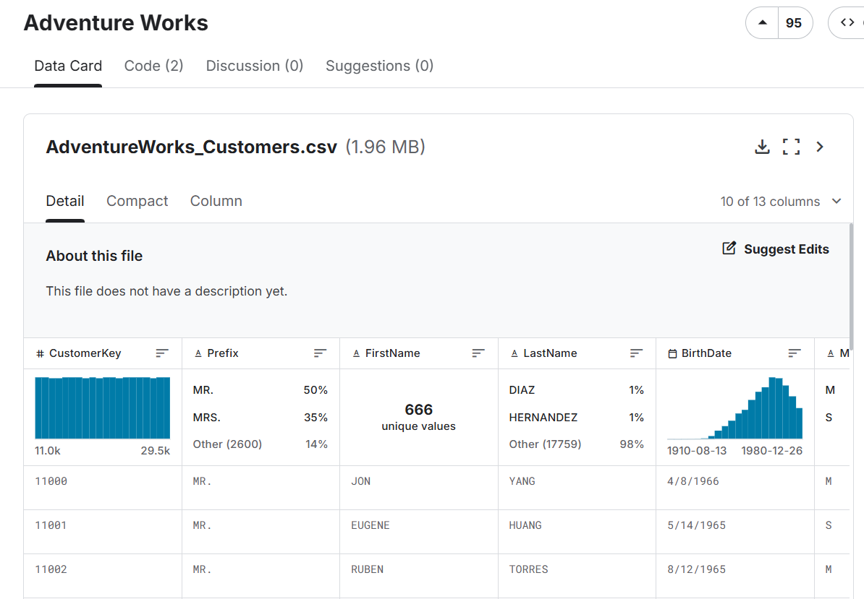
Data Understanding (API)
Notes:
We will upload all files data into GitHub and then use azure data factory to move it to destination which is bronze layer

Slide 5
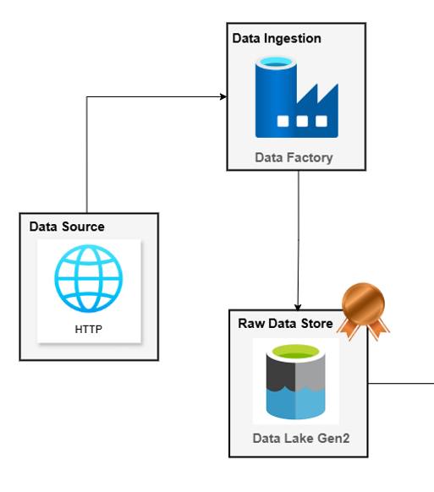
Phase 1: Pulling data from data source to bronze source

Slide 6
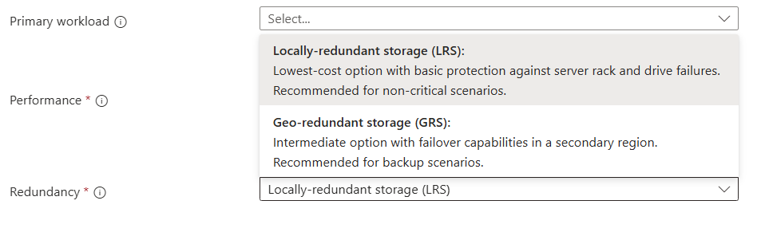
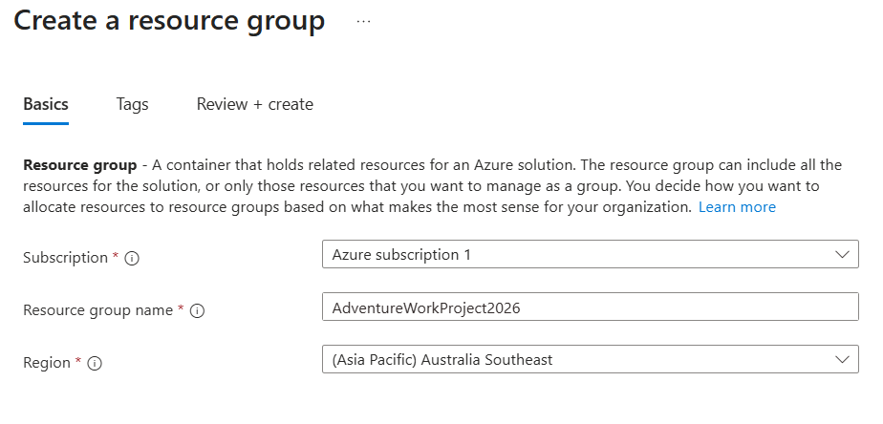
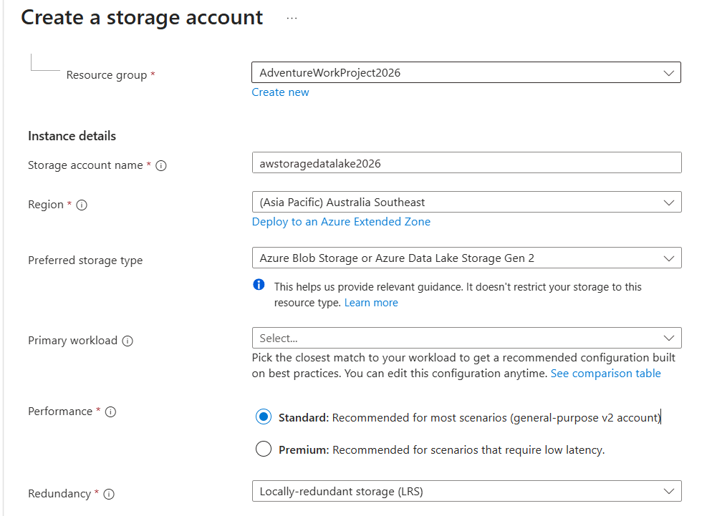
Phase 1: Pulling data from data source to bronze source
1.1 Create resource group
1.2 Create Data Lake (Storage account)
LRS – Locally-redundant storage:
Store 3 replicate in 1 data center (1 region)
Lower cost
GRS – Geo-redundant storage
Store 3 replicate in main region, 3 replicate in secondary region
Higher cost, protect data from disaster

Slide 7
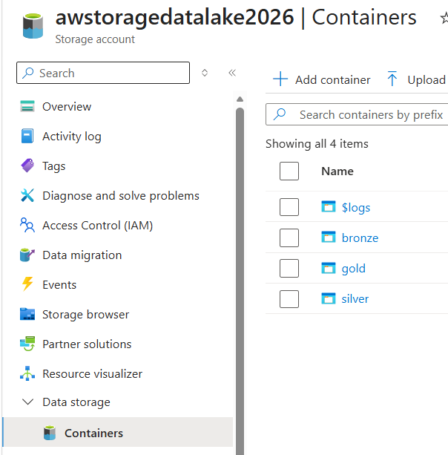
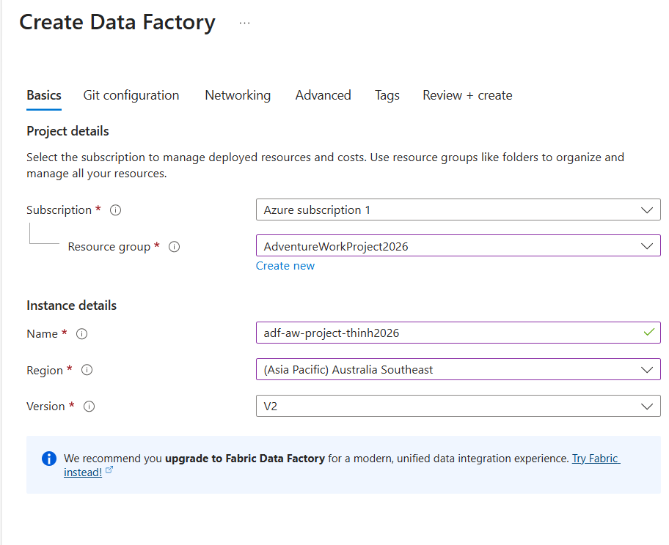
Phase 1: Pulling data from data source to bronze source
1.3 Create Data Factory
1.4 Create container in Data Lake

Slide 8
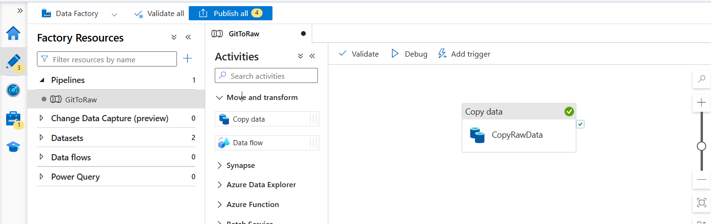
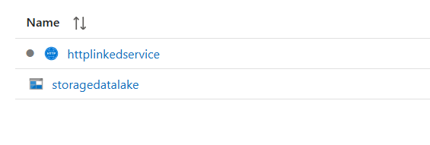
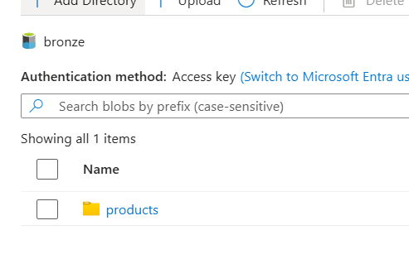

Phase 1: Pulling data from data source to bronze source
1.5 We want to pull data from GitHub to our Azure Data Factory
1.5.1 Create an activity ‘Copy Data’
1.5.2 Create 2 linked services
Httplinkedservice: url where data is located
Storagedatalake: destination of data
→ Link to source and sink for data streaming
In ‘Copy Data’ we have 2 main things
Source: where data is located
Sink: where data destination
Results in bronze layer we have products folder
Notes:
We have just pull 1 folder products into our bronze (static), but we have 8 9 folders left to pull, → need to build a dynamic pipeline

Slide 9

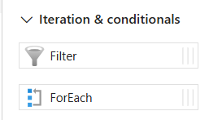
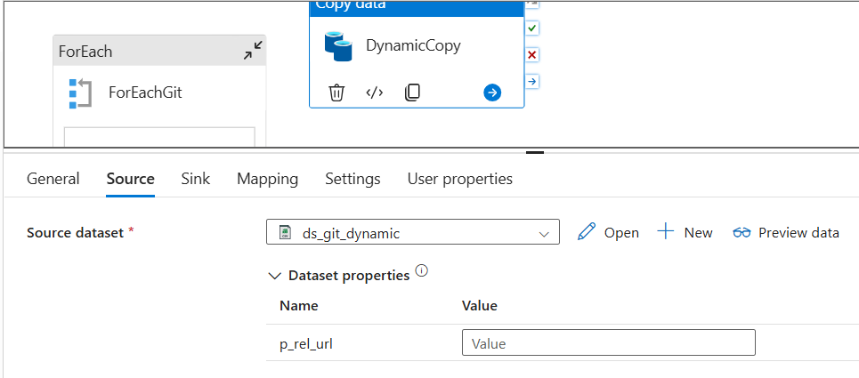
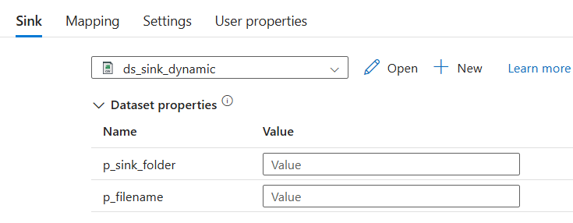
Phase 1: Pulling data from data source to bronze source
We just have create a static copy data which copy product file into our bronze layer, we have 9 files left to pull out to bronze layer. So do we need to create 9 copy activity for each file ?
We have to use an activity call ‘For Each’
Solution
To iterate through our file and then
create a folder for each file
There are 3 parameters we have to pass out:
Relative url of dataset location
Sink folder
Sink File
Notes:
We have just pull 1 folder products into our bronze (static), but we have 8 9 folders left to pull, → need to build a dynamic pipeline

Slide 10
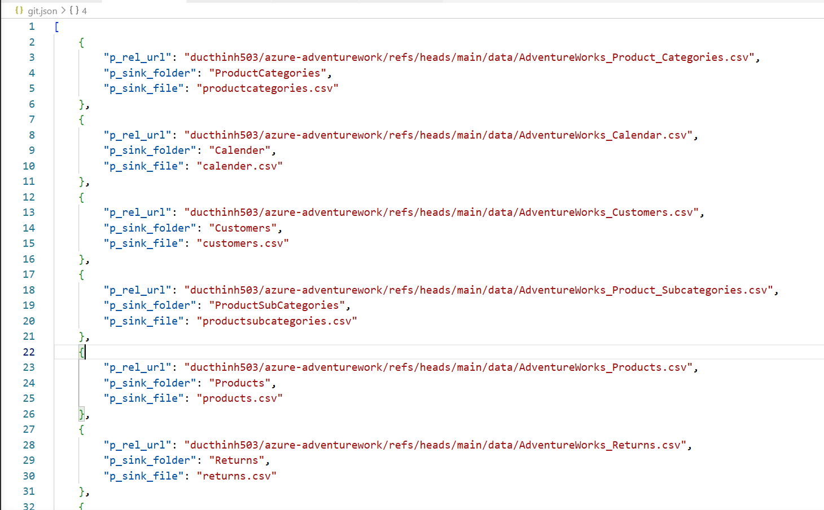
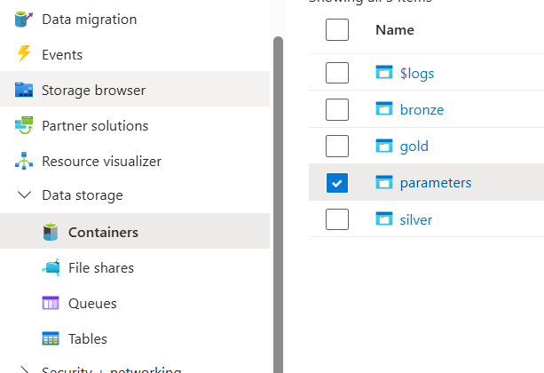
Phase 1: Pulling data from data source to bronze source
We then have to create a json file that will store all the parameters we need and upload it to storage accounts

Slide 11
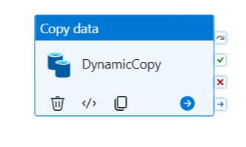
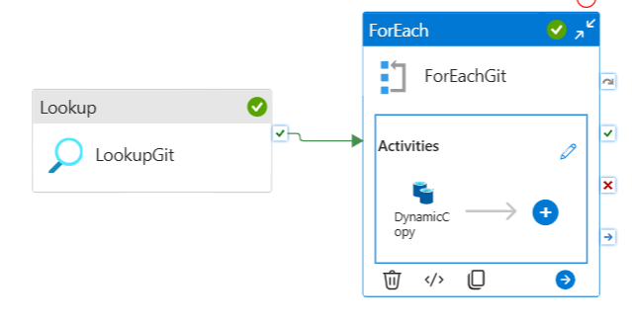
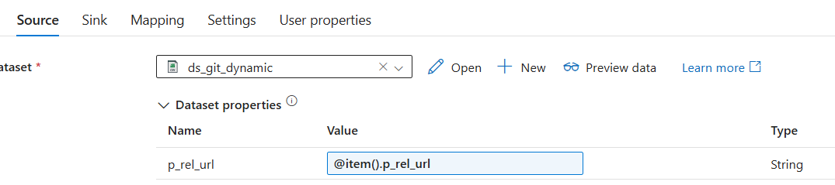
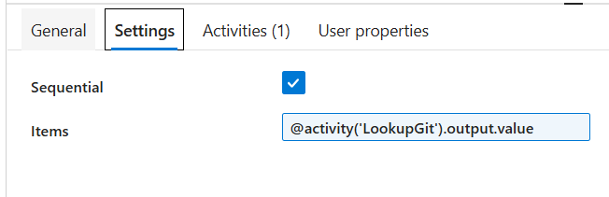
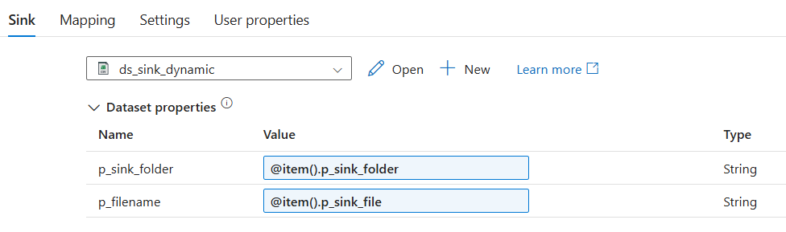
Phase 1: Pulling data from data source to bronze source
In our pipeline, we use an activity call ‘Look Up’ to read data from a source and output in JSON format
In for each, we have copy data activity
Setting for each received the data from lookup

Slide 12
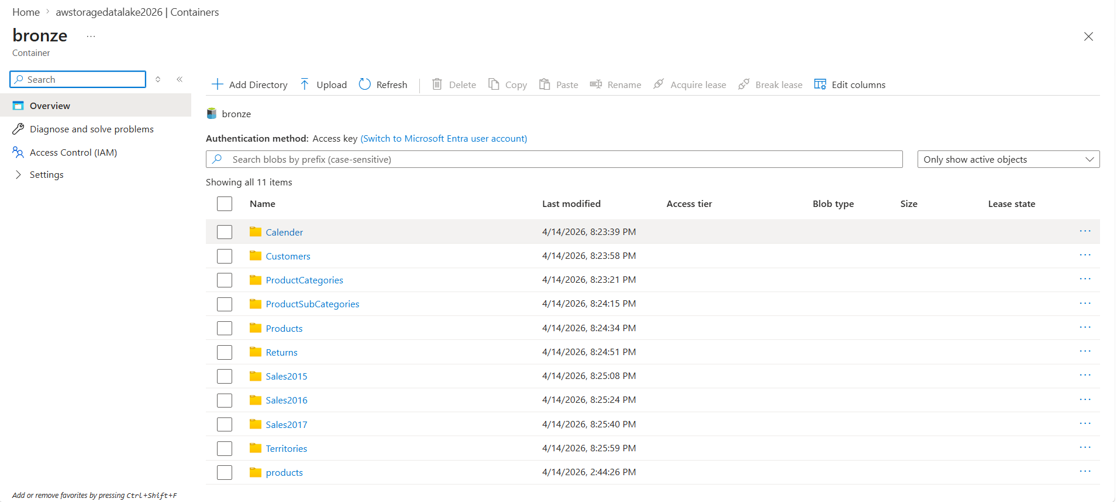
Phase 1: Pulling data from data source to bronze source
Phase 1 Done when we have pulled our data dynamically from Git to our Bronze layer

Slide 13
Phase 2: Data transformation with Data Bricks

Slide 14
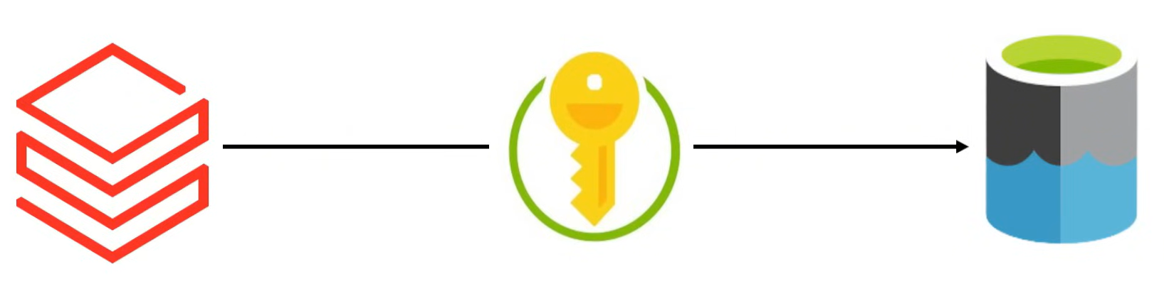
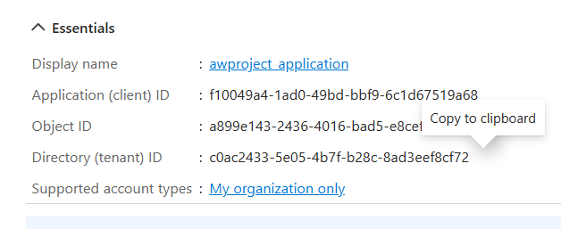
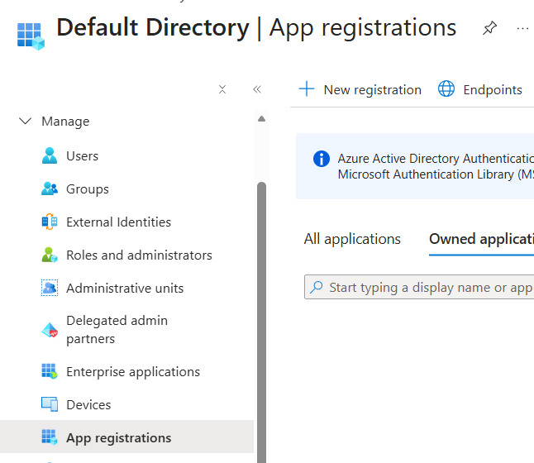
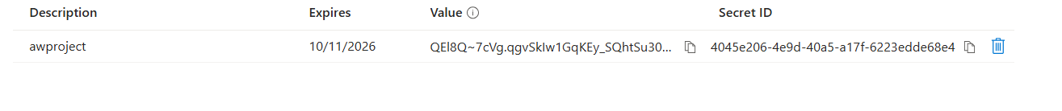



Phase 2: Data transformation with Data Bricks
2.1 Create DataBricks resource in our resource group and then make connection between DataLake and DataBricks
Data Access Key
Create app registration
Microsoft Entra ID
Create certificates & secrets
Notes:
Our resource which is Data Lake is not linked which Data Bricks → how we use Data Bricks to access Data Lake. We need permission
Application ID:
Object ID:
Directory ID:
Secret ID:
Value:
ID:

Slide 15
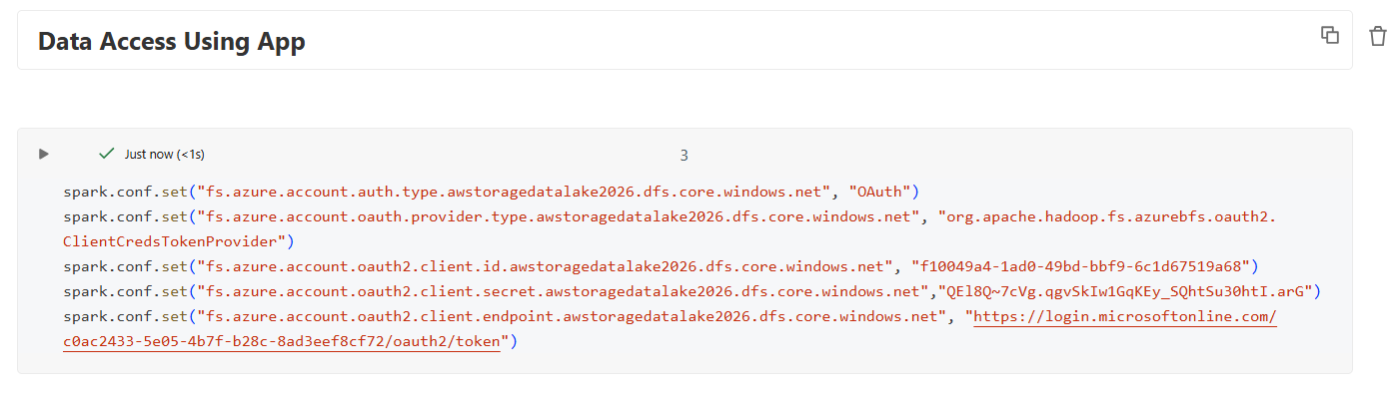
Phase 2: Data transformation with Data Bricks
2.2 Data transformation with DataBricks
Allow DataBricks to Access Data Lake (Storage Account)
Notes:
Keywords to search: Access Data Lake using Data Bricks

Slide 16
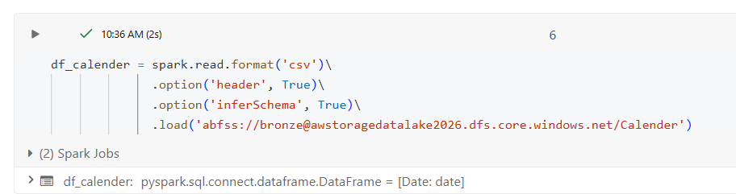
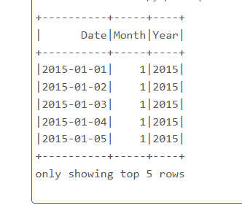
Phase 2: Data transformation with Data Bricks
2.3 Read data from bronze, perform transformation and load into silver layer
2.3.1 Transformation on df_calender
# Split date column into (day, month, year)
df_calender = df_calender.withColumn('Month',month(col('Date')))\
.withColumn('Year', year(col('Date')))
df_calender.show(5)
Notes:
Keywords to search: Access Data Lake using Data Bricks

Slide 17
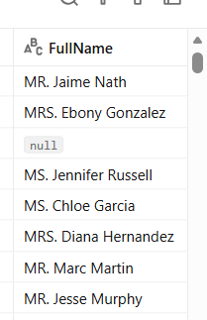
Phase 2: Data transformation with Data Bricks
2.3 Read data from bronze, perform transformation and load into silver layer
2.3.2 Transformation on df_customer
# Merge Prefix + LastName + FirstName -> FullName
# Capitalize first letter of each word
df_customer = df_customer.withColumn('FirstName', initcap(col('FirstName')))\
.withColumn('LastName', initcap(col('LastName')))\
.withColumn('FullName', concat(col('Prefix'), lit(' '), col('FirstName'), lit(' '), col('LastName')))
df_customer.display()
Notes:
Keywords to search: Access Data Lake using Data Bricks

Slide 18
Phase 2: Data transformation with Data Bricks
2.3 Read data from bronze, perform transformation and load into silver layer
2.3.3 Transformation on df_sales
# Convert StockDate to timestamp
df_sales = df_sales.withColumn('StockDate', to_timestamp('StockDate'))
# Replace all occurrences of character 'S' with 'T' in OrderNumber column
df_sales = df_sales.withColumn('OrderNumber', regexp_replace(col("OrderNumber"), 'S', 'T'))
# Create new column 'multiply' by multiplying OrderLineItem with OrderQuantity
df_sales = df_sales.withColumn('multiply', col('OrderLineItem') * col('OrderQuantity'))
Notes:
Keywords to search: Access Data Lake using Data Bricks

Slide 19
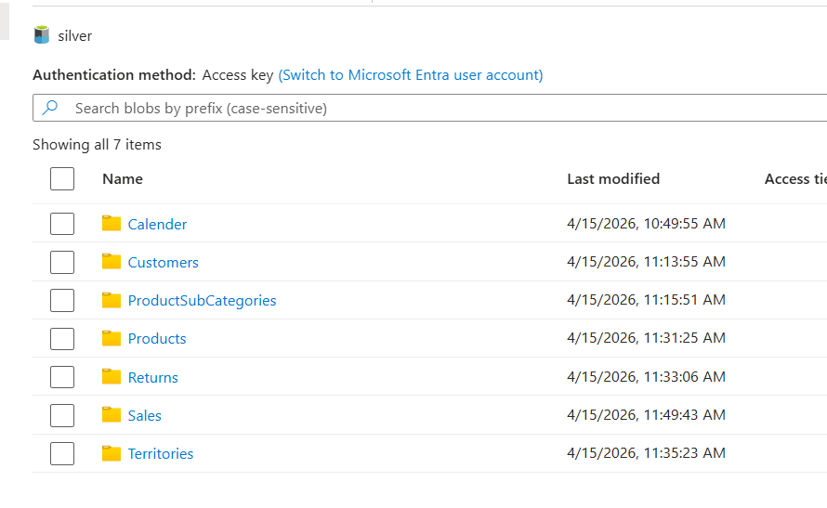
Phase 2: Data transformation with Data Bricks
2.3 Read data from bronze, perform transformation and load into silver layer
2.3.4 Load all dataframe into silver layer
# Push data to silver layer
df_sales.write.format('parquet')\
.mode('append')\
.option('path', 'abfss://silver@awstoragedatalake2026.dfs.core.windows.net/Sales')\
.save()
Phase 2 Done when we all have data in silver layer
Notes:
Keywords to search: Access Data Lake using Data Bricks

Slide 20
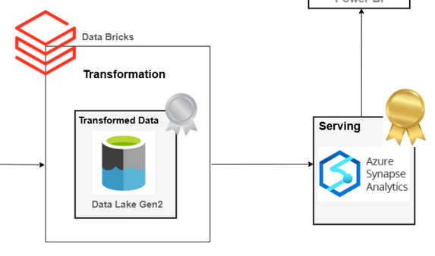
Phase 3: Data Warehouse with Synapse
Notes:
Keywords to search: Access Data Lake using Data Bricks

Slide 21
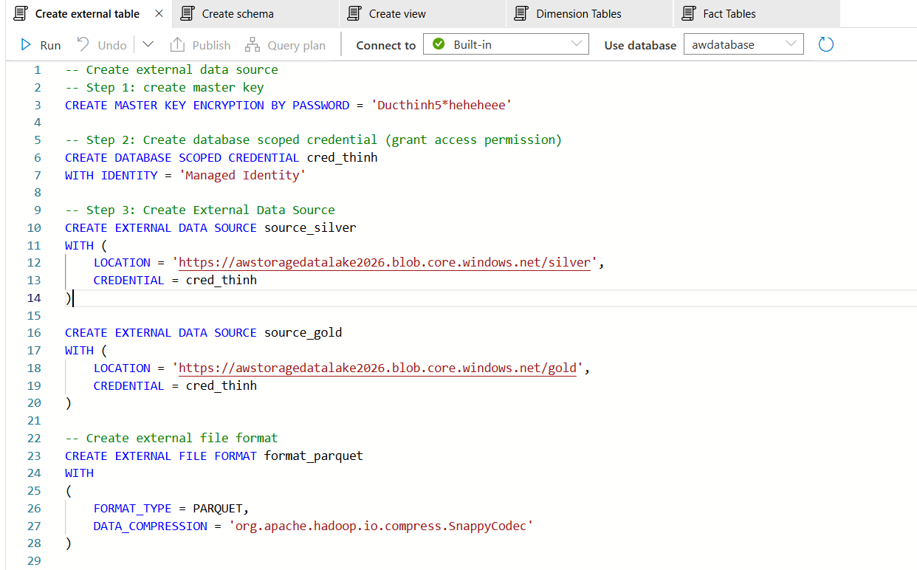
Phase 3: Data Warehouse with Synapse
3.1 Create External data source
Notes:
Keywords to search: Access Data Lake using Data Bricks

Slide 22
Phase 3: Data Warehouse with Synapse
3.2 Create View on table for query
-- Create calander view
CREATE VIEW gold.calander
AS
SELECT *
FROM OPENROWSET(
BULK 'https://awstoragedatalake2026.blob.core.windows.net/silver/Calender/',
FORMAT = 'PARQUET'
) AS query1
-- Create customer view
CREATE VIEW gold.customer
AS
SELECT *
FROM OPENROWSET(
BULK 'https://awstoragedatalake2026.blob.core.windows.net/silver/Customers/',
FORMAT = 'PARQUET'
) AS query1
Notes:
Keywords to search: Access Data Lake using Data Bricks

Slide 23
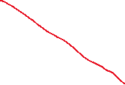

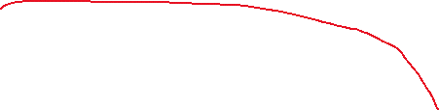
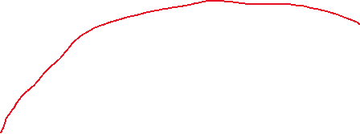
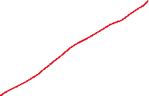


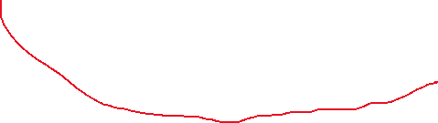
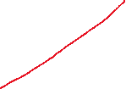


Phase 3: Data Warehouse with Synapse
3.3 Data Model → Star Schema
Dim Territories
DimCalender
FactSales
Fact Returns
Dim Product
DimCustomer
Notes:
Keywords to search: Access Data Lake using Data Bricks

Slide 24
Phase 4: Connect Synapse to Power BI
Notes:
Keywords to search: Access Data Lake using Data Bricks

Slide 25
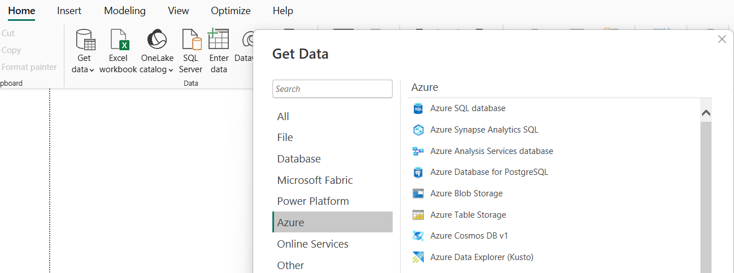


Phase 4: Connect Synapse to Power BI
Get Data -> Azure -> Azure Synapse Analytics SQL
Notes:
Keywords to search: Access Data Lake using Data Bricks

Slide 26
AdventureWork |
Notes:
Keywords to search: Access Data Lake using Data Bricks

Slide 27
