Slide 1
Project Chat App
Author: Bui Duc Thinh
Interview with Saigon Ventures company

Slide 2
About application
It is realtime chat application using socket.io and webrtc
Users send and receive messages, files
Users can make video conference with each other

Slide 3
Technologies
Express.js as backend
MongoDB as database
Socket.io as realtime server and Socket.io.client as react client
React.js and vite to bundle web app
Simple-peer as wrapper of webRTC to create peer connection for video conference

Slide 4
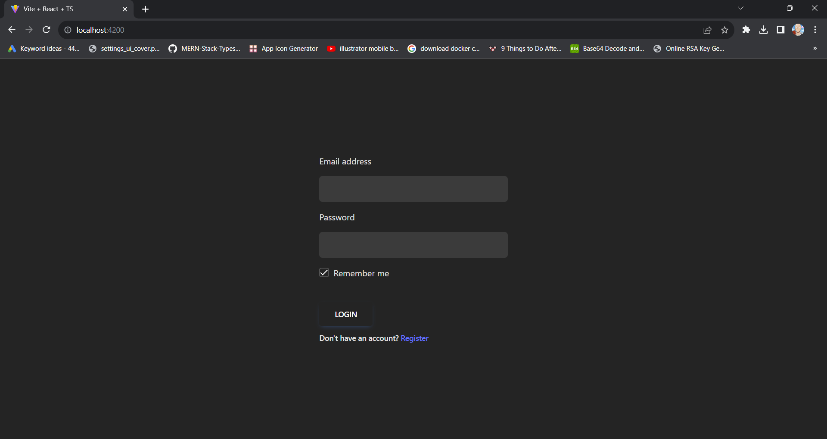
Login Screen

Slide 5
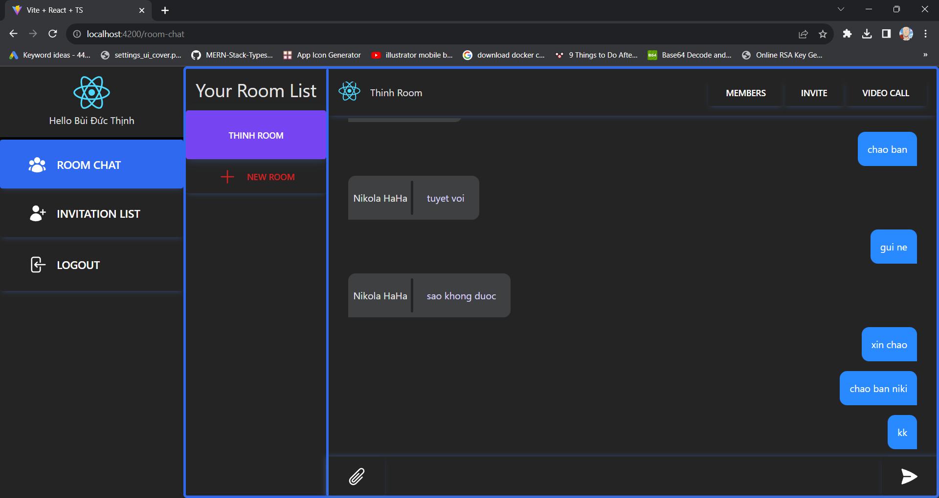
Chat Room Screen

Slide 6
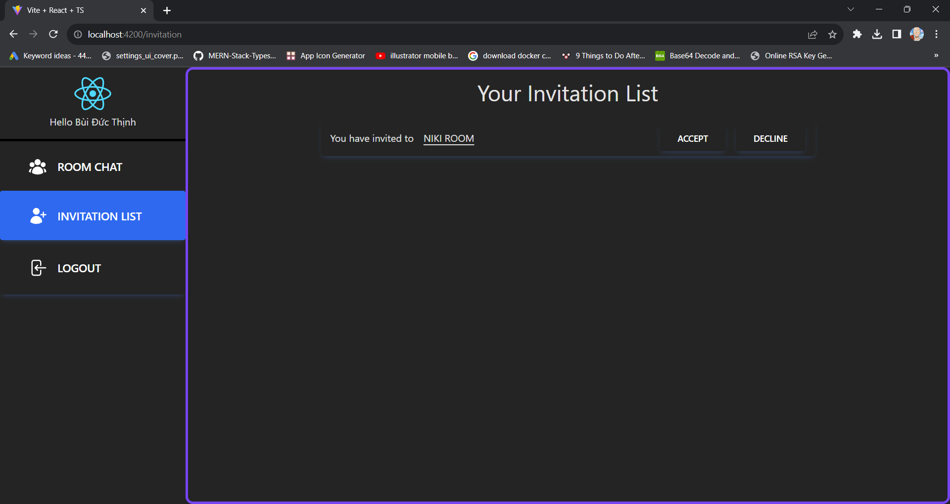
Invitation List Screen

Slide 7
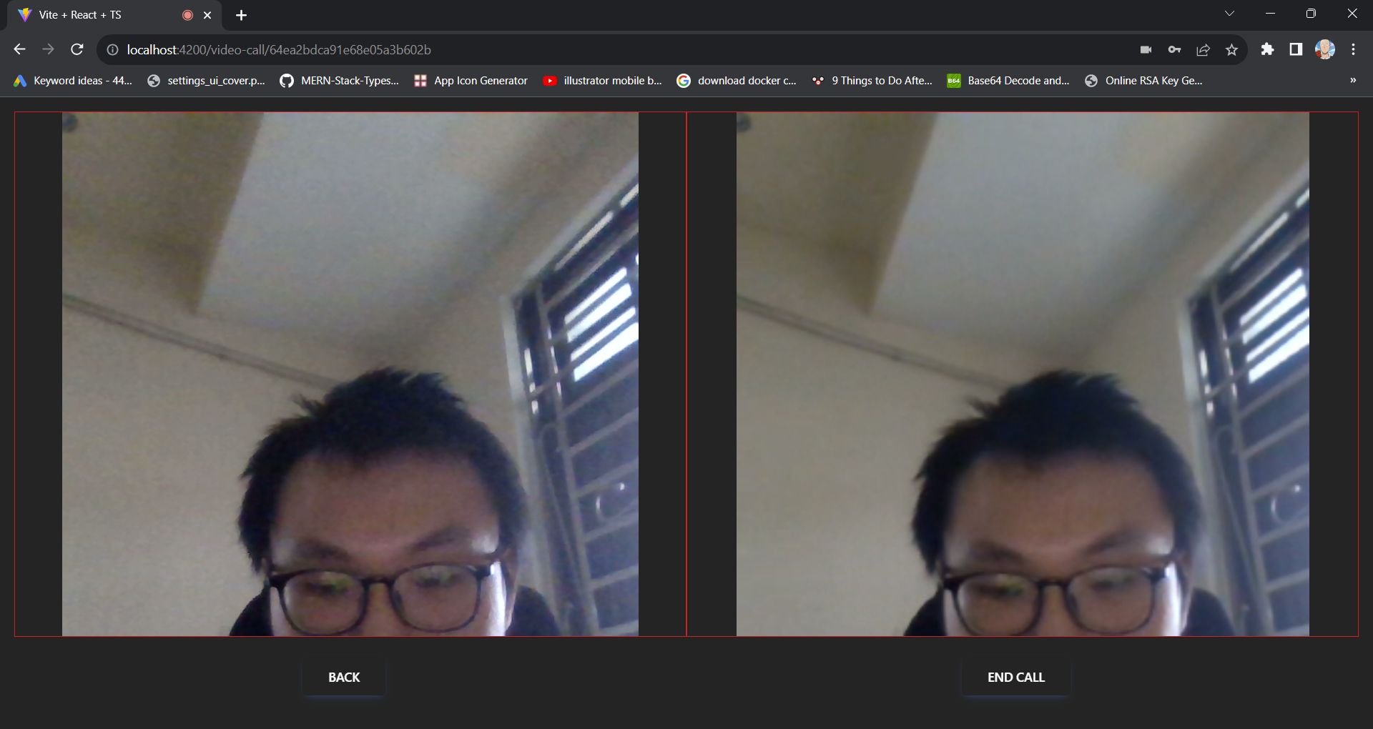
Video Conference Screen

Slide 8
Thank you, now demo

