Slide 1
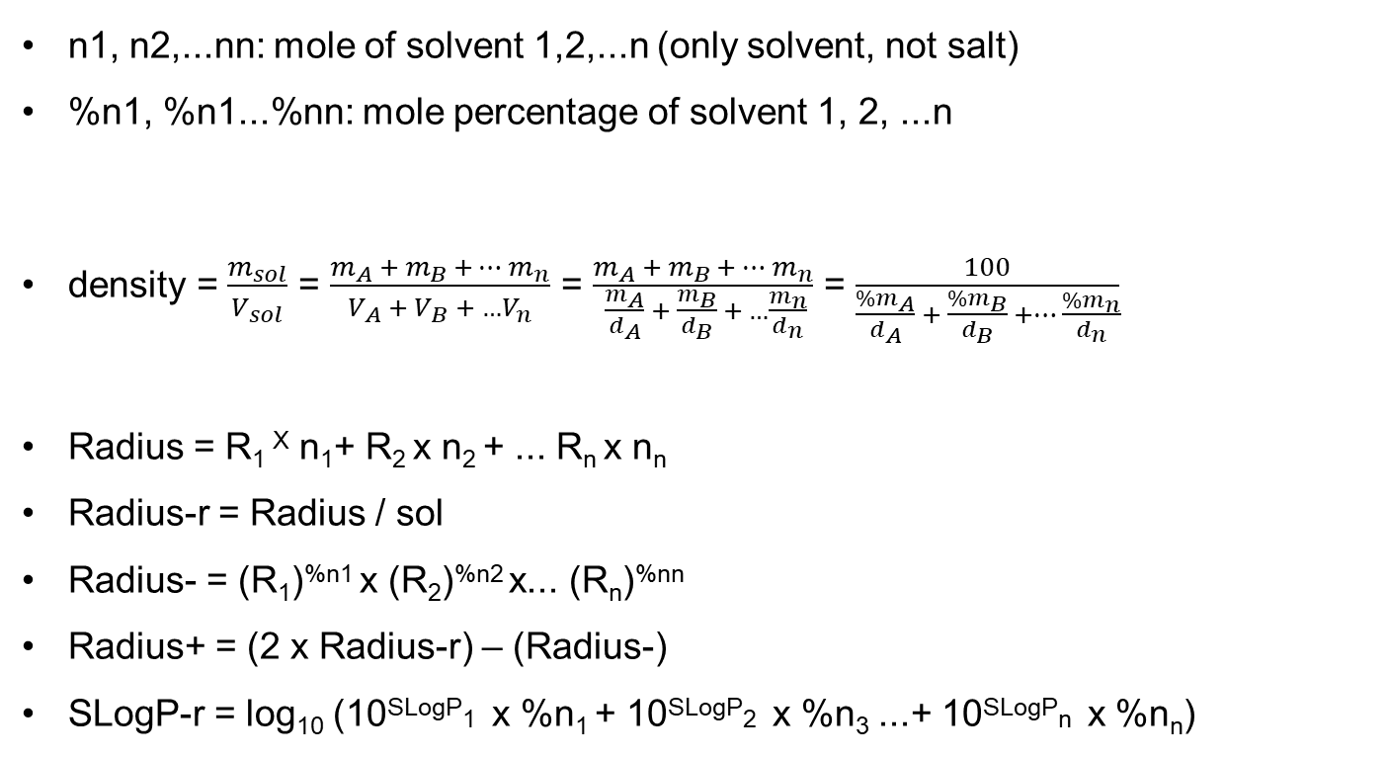
n1, n2,...nn: mole of solvent 1,2,...n (only solvent, not salt)
%n1, %n1...%nn: mole percentage of solvent 1, 2, ...n
density = $\frac{m_{sol}}{V_{sol}}$ = $\frac{m_{A} +{ m}_{B} +…{ m}_{n}}{V_{A} + V_{B} +{ …V}_{n}}$ = $\frac{m_{A} +{ m}_{B} +…{ m}_{n}}{ \frac{m_{A}}{d_{A}} + \frac{m_{B}}{d_{B}} + …\frac{m_{n}}{d_{n}}}$ = $\frac{100}{\frac{{\%m}_{A}}{d_{A}} + \frac{\%m_{B}}{d_{B}} +… \frac{\%m_{n}}{d_{n}}}$
Radius = R₁ ^{X} n₁+ R₂ x n₂ + ... R_{n} x n_{n}
Radius-r = Radius / sol
Radius- = (R₁)^{%n1} x (R₂)^{%n2} x... (R_{n})^{%nn}
Radius+ = (2 x Radius-r) – (Radius-)
SLogP-r = log₁₀ (10^{SLogP}1 x %n₁ + 10^{SLogP}2 x %n₃ ...+ 10^{SLogP}n x %n_{n})

