Slide 1
Training and optimizing model project
Estimate: ~2-3 weeks

Slide 2
Dataset 1 (49,762)
# of outputs: 3 (mps_pred, bps_pred, fps_pred)
# of inputs: 55
Outputs are independent

Slide 3
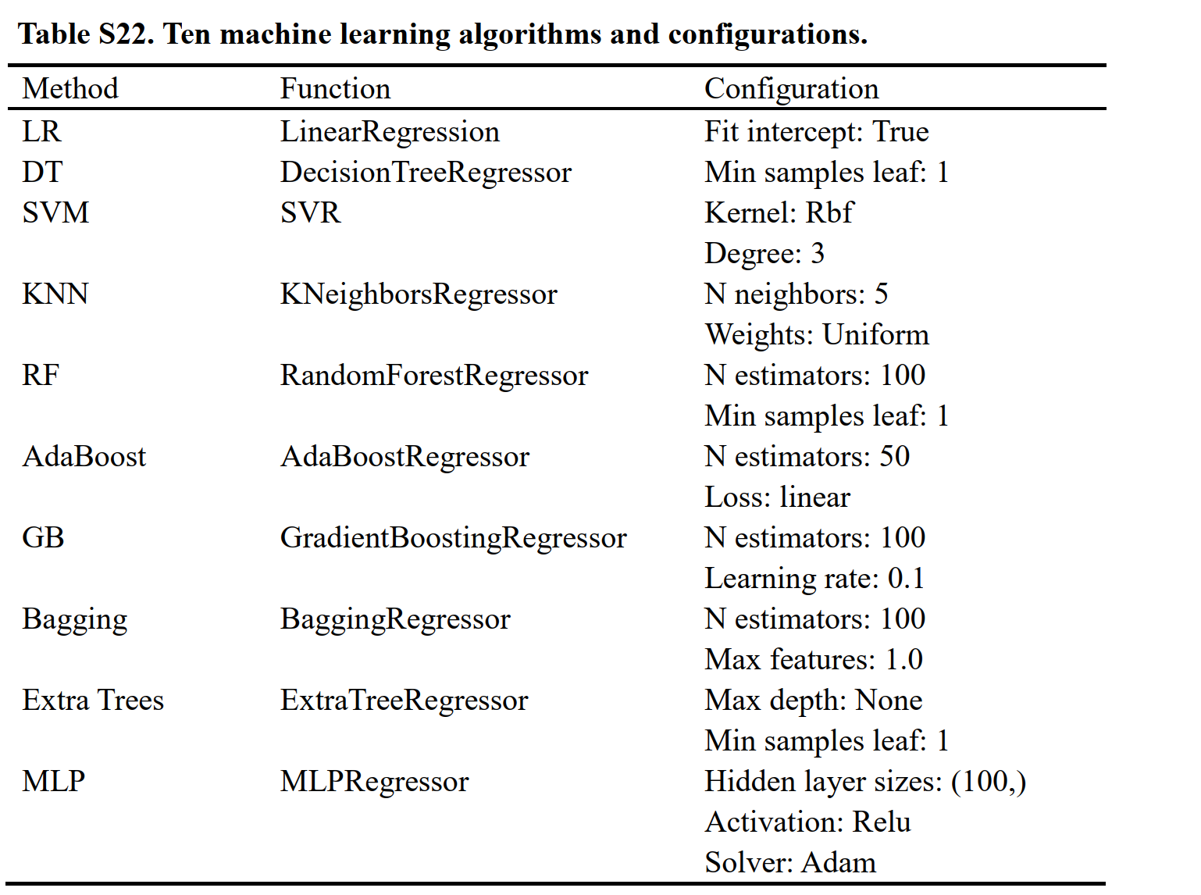
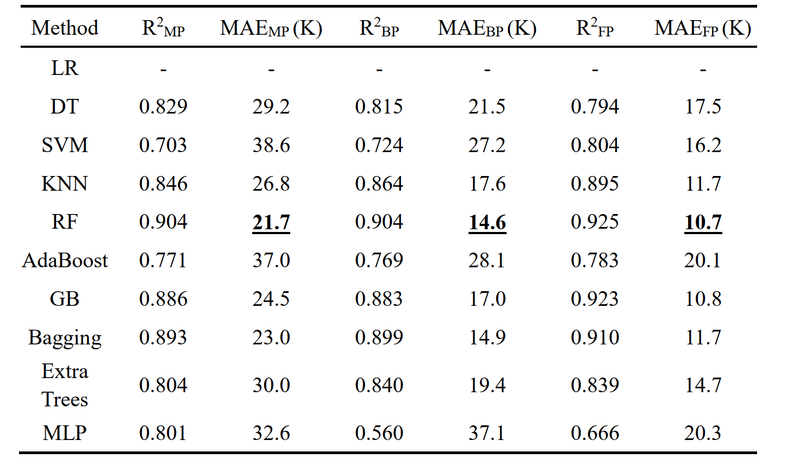
SOTA model

Slide 4
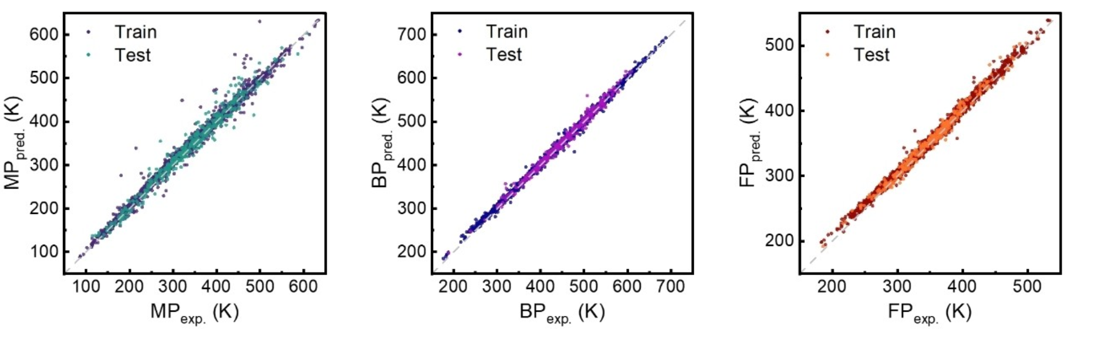
SOTA model

Slide 5
Dataset 2 (129,440)
# of outputs: 4 (mu, HOMO_eV, LUMO_eV, c_v)
# of inputs: 55
Outputs are independent

Slide 6
Discuss
Use separate model for training each output. Training inputs can be different among models
Expected 7 models for 7 outputs
Feature selection: Not all inputs need to be used for training -> avoid overfitting
Model selection: Use ML or deep learning model?
Create a unique script containing all 7 models
Running on Google Collab?
Support paying for Claude or ChatGPT
Create a repository on Github
Salary + bonus
Estimated time: ~2.5 weeks, 4 weeks max
*The end goal is to predict properties of unknown compounds accurately (>1 million compounds)

