Slide 1
Find A location for my new Restaurant

Slide 2
Introduction
The restaurant service is an attractive business in Paris
However, the competition is very High
Where could I open my future Vietnamese restaurant

Slide 3
strategy
Target to students and young working people
Find a location near to universities or co-working spaces (interesting points)
Prefer the low completion zone

Slide 4
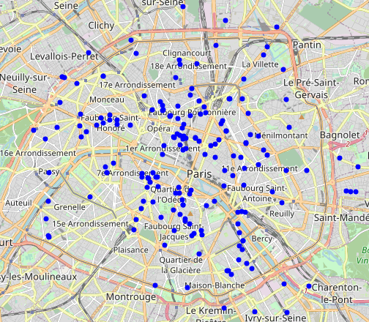
Data
Get name, location of all universities and co-working space in Paris (6km from the city center) from FourSquare

Slide 5
Data
Determine number of Vietnamese restaurants with in 800m and 200m from the interesting points

Slide 6
Methodology and results
Step 1: Remove all interesting point close to other Vietnamese restaurants:
- More than 3 Vietnamese restaurant within 800m
- a Vietnamese restaurant within 200m

Slide 7
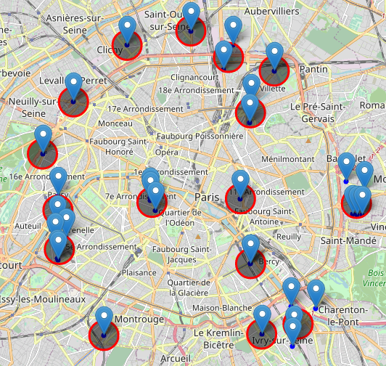
Methodology and results
Step 2: Cluster the remaining interesting points into 16 candidate zones with a radius of 800m

Slide 8
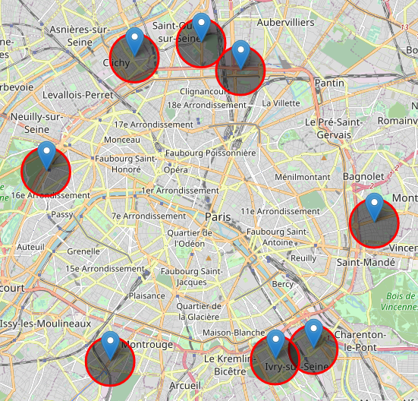
Methodology and results
Step 3: Remove candidate zones with more than 57 restaurants inside (all kinds of restaurants)
→ 8 zones

Slide 9
Methodology and results
Step 4: Identify addresses of the centers of candidate zone:
1. 56-74 Avenue Michelet, 93400 Saint-Ouen, France
2. 44 Rue Jean Jacques Rousseau, 94200, Ivry-sur-Seine
3. 4 Rue Paul Eluard, 93100 Montreuil
4. 187 Avenue Pierre Brossolette, 92120 Montrouge
5. 18 Impasse Dumur, 92110 Clichy
6. 54 Boulevard Ney, 75018 Paris
7. 16 Boulevard Lannes, 75116 Paris
8. 74 bis Avenue Maurice Thorez, 94200 Ivry-sur-Seine

Slide 10
Conclusion
8 zones are identified
quite far the city center
Low competition (from Vietnamese restaurants and other restaurants)
Close to universities or co-working spaces
Pay attention to the identified zone in the west and east of the Paris → affluent zones

