Slide 1
My Collection Website
The final project for JScript 310B Class
From 1-20-2022 to 3-24-2022
Author: Joseph Tran

Slide 2
My Collection contains
“Quote Collection” collects all my favorite quotes. For example:
“The best and most beautiful things in this world cannot be seen or even heard, but must be felt with the heart.”
Helen Keller
“Life teaches you a new lesson every day, if you are attentive enough in the class of life.”
Invajy

Slide 3


My Collection contains
“Book Collection” collects all my favorite books:
Quo Vadis – Author: Henryk Sienkiewicz
The story of the love that develops between a young Christian woman and a Roman officer who, after meeting her fellow Christians, converts to her religion.
Sans Famille – Author: Hector Malot
The story tells about an adventurous adventure of Rémi - a boy with no parents, no relatives who live with his adoptive mother in a remote countryside.

Slide 4
Project Specification
Input data from DOM will be stored in the local storage
The info from the local storage will be displayed in DOM
DOM
Local Storage
Input data from DOM
Data retrieving from local storage

Slide 5
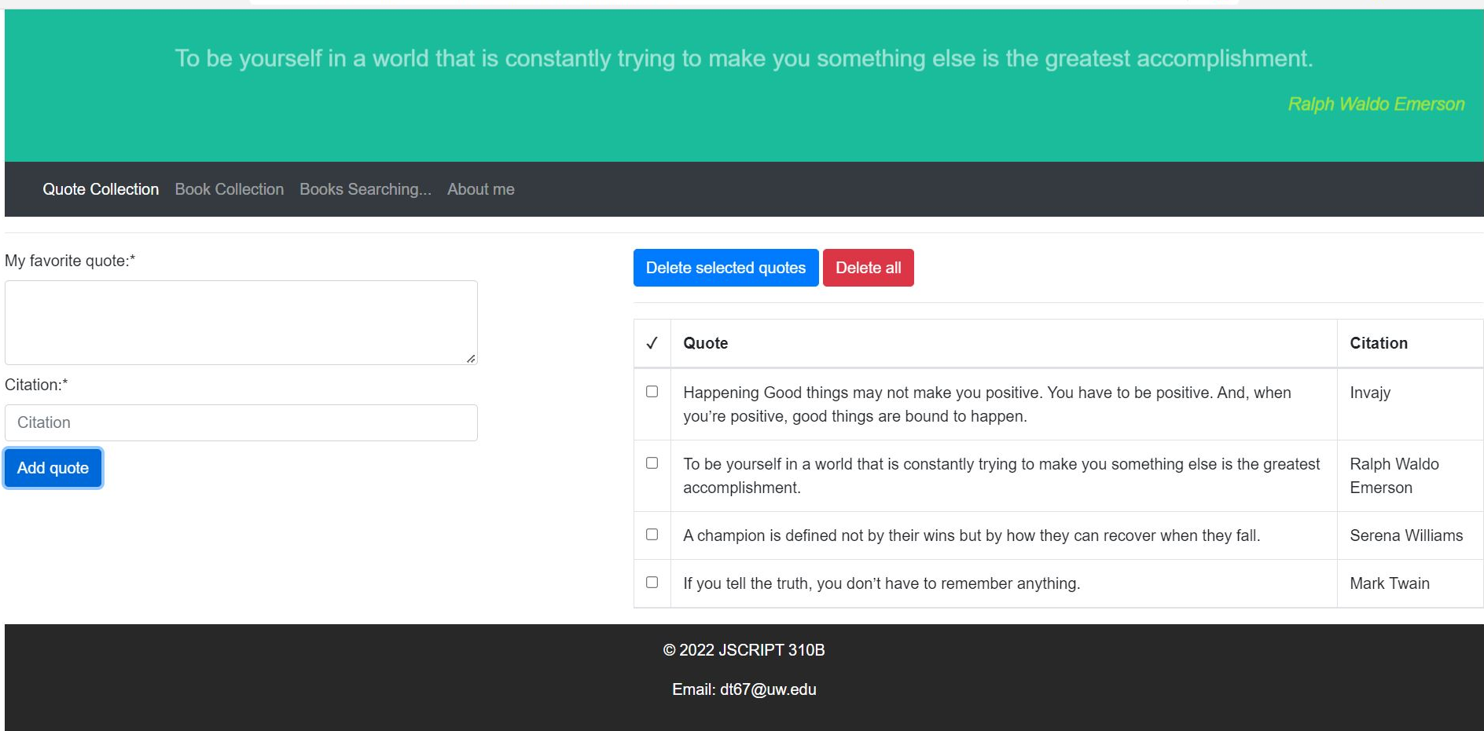
Quote Collection page

Slide 6
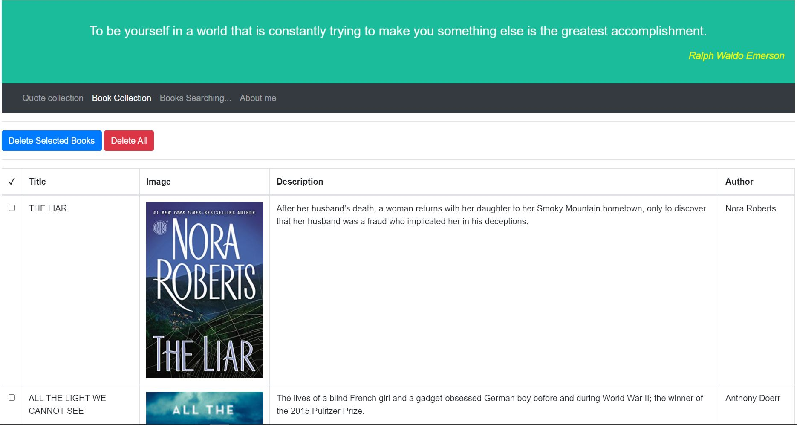
Book Collection page
The books in Book Collection page are selected from the New York Times Best Sellers Lists and stored in the local storage and showed on the HTML page.

Slide 7
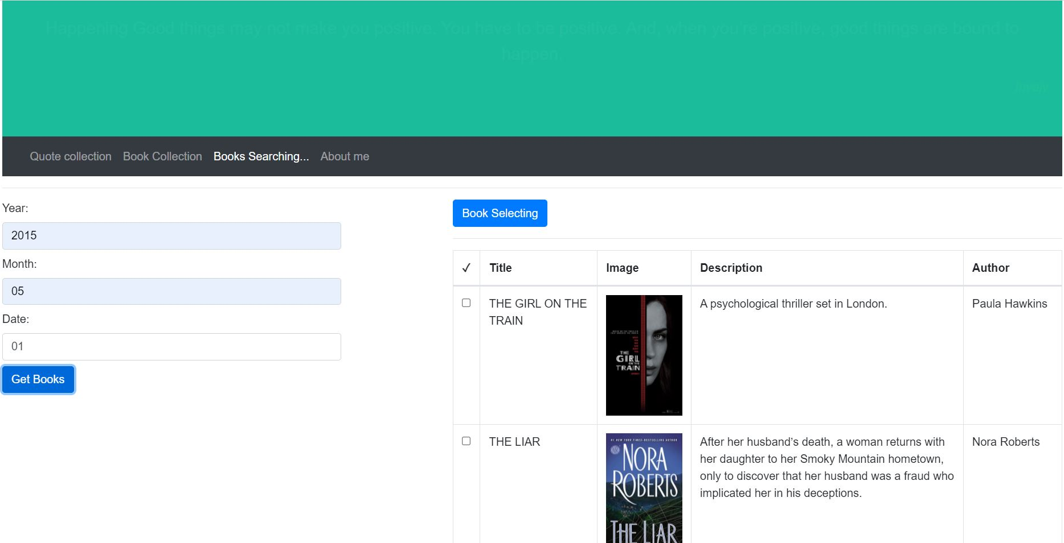
Books Searching page
Using the NYT API to retrieve the list of best sellers books. You can choose which ones you love.
After selecting, your selected books will be stored in the local storage and showed on the Book Collection page immediately.

Slide 8
My Collection website
Using:
JavaScript, HTML, CSS
Bootstrap 5 CSS
New York Times Books API
Source code at https://github.com/ductran67/jscript310B-final
Demo the real website!

Slide 9
Next Step for My Collection website
Using database (MySQL, SQL Server, MongoDB, etc.) instead of local storage to store data.
Redesign for both PCs and mobile devices

Slide 10
Thank you.

