Slide 1
My Collection Website
The final project for JScript 310B Class
From 1-20-2022 to 3-24-2022
Author: Joseph Tran

Slide 2
My Collection contains
“Quote Collection” collects all my favorite quotes. For example:
“The best and most beautiful things in this world cannot be seen or even heard, but must be felt with the heart.”
Helen Keller
“Life teaches you a new lesson every day, if you are attentive enough in the class of life.”
Invajy

Slide 3


My Collection contains
“Book Collection” collects all my favorite books:
Quo Vadis – Author: Henryk Sienkiewicz
(a famous Polish writer in the turn of the 20th century)
Sans Famille – Author: Hector Malot
(a popular French writer in the 19th century)

Slide 4
Project Specification
Input data from DOM will be stored in the local storage
The info from the local storage will be displayed in DOM
DOM
Local Storage
Input data from DOM
Data retrieving from local storage

Slide 5
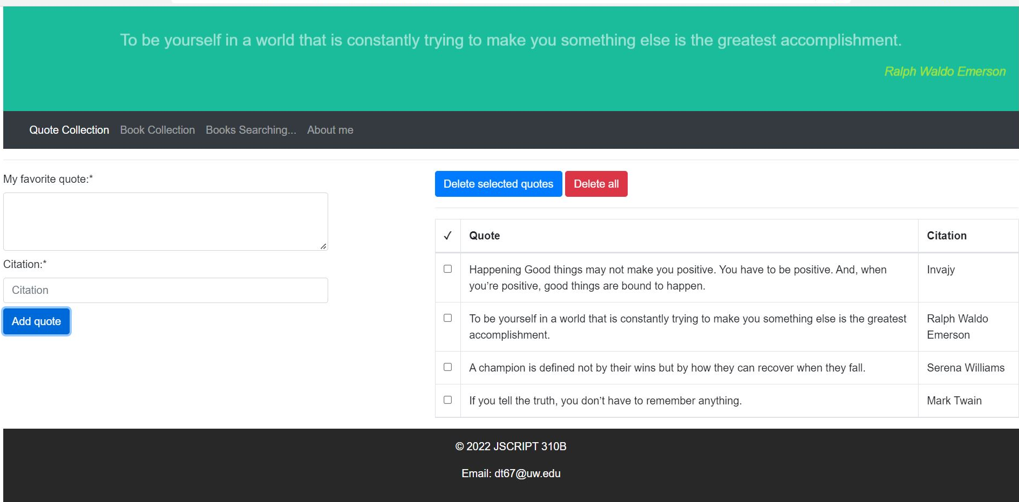
Quote Collection page

Slide 6
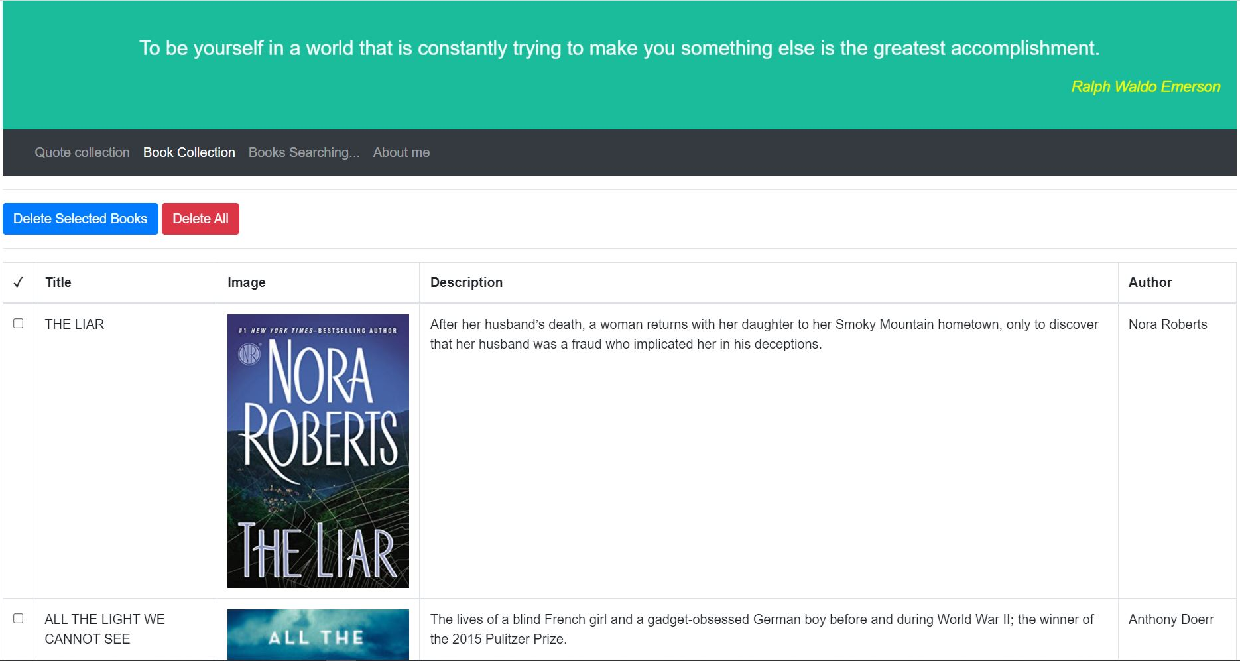
Book Collection page
The books in Book Collection page are selected from the New York Times Best Sellers Lists and stored in the local storage and showed on the HTML page.

Slide 7
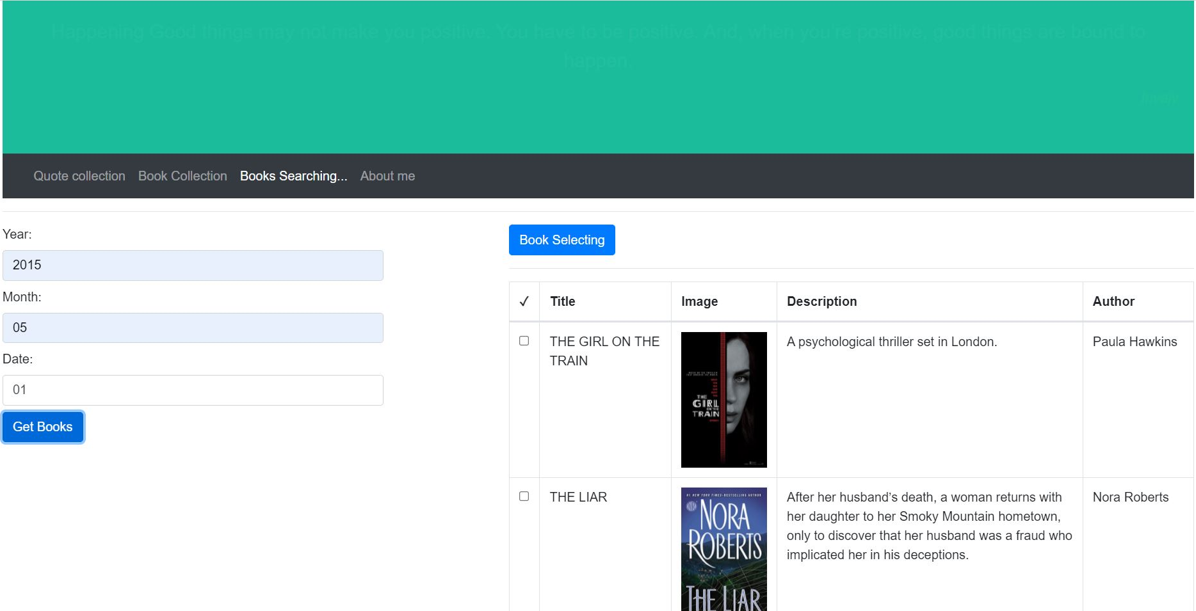
Books Searching page
Using the NYT API to retrieve the list of best sellers books from their data and choosing which ones you love.
After selecting, your selected books will be stored in the local storage and showed on the Book Collection page immediately.

Slide 8
My Collection website
Using:
JavaScript, HTML, CSS
Bootstrap 5 CSS
New York Times Books API
Source code in https://github.com/ductran67/jscript310B-final.git
Demo the real website!

Slide 9
Thank you.

