Slide 1
RADIAL BASIS FUNCTION
Instructor: Dr. Cao Hoang Tru
Member: Nguyen Duc Tri
Nguyen Dang Trang

Slide 2
OUTLINE
Idea of Radia Basis Function (RBF) Network
Architecture of RBF Network
Training
Other aspects

Slide 3

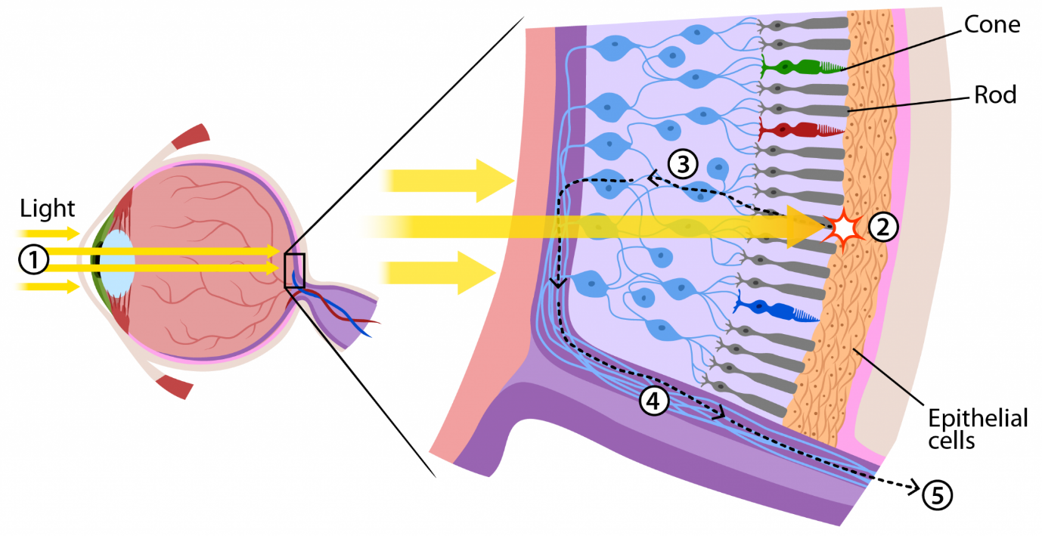

IDEA: HOW WE SEE

Slide 4
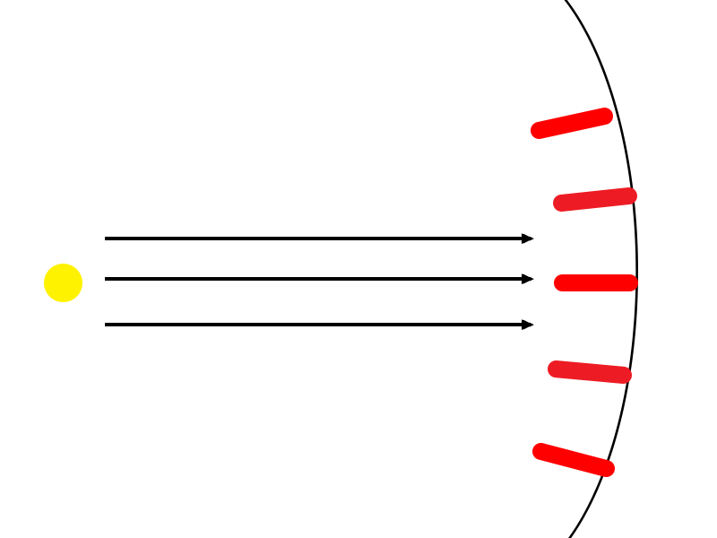
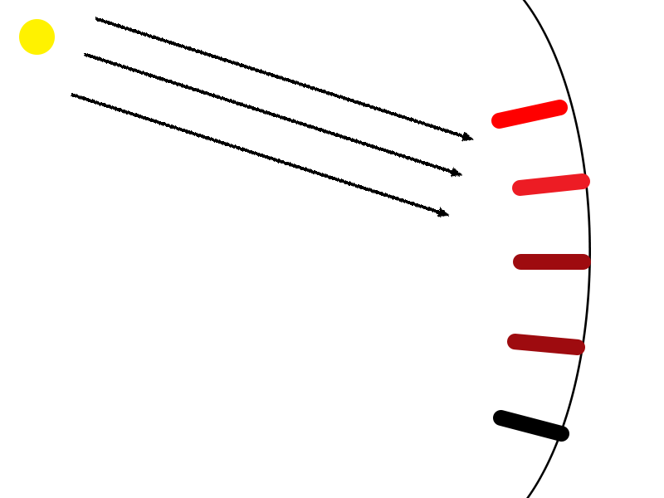
IDEA: HOW WE SEE
Bulb, cell and distance between them
The Activation of cells are NOT the same
All signals are processed at brain
Notes:
Nói quy ước: tế bào nón, que gọi chung là tế bào thị giác, gọi tắt là tế bào
Quá trình gồm 3 giai đoạn:
tia sang chiếu tới tế bào,
tế bào kích thích -> Click
tổng hợp tín hiệu tại não

Slide 5
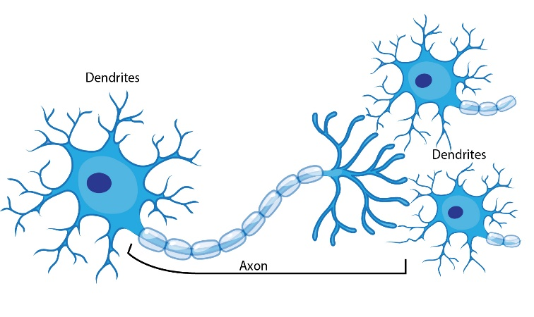

Radial Basis Function Architecture (Overview)
MLP network
RBF network
Notes:
3 lớp, giống mlp
Click ->

Slide 6
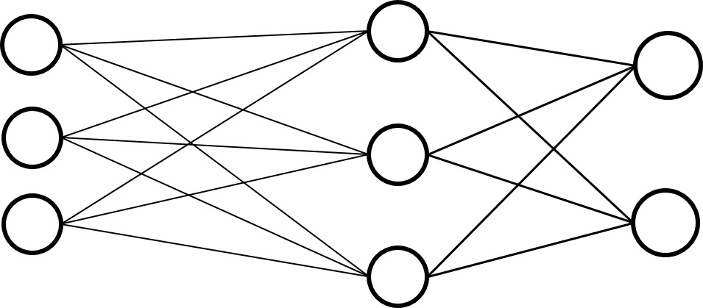
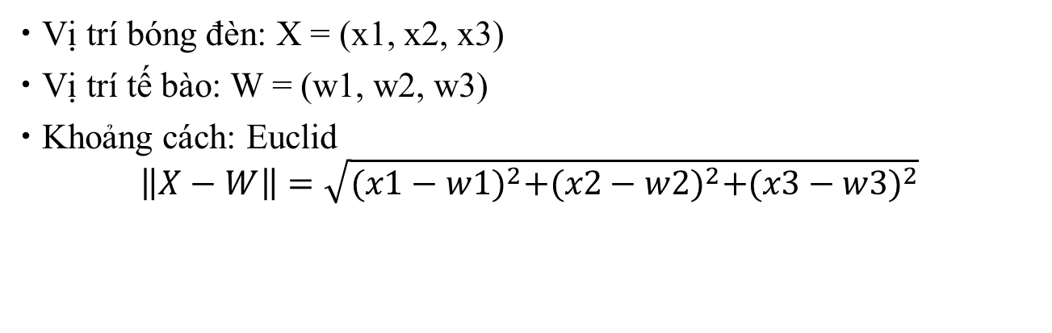
MODELING NETWORK
1. Distance between the bulb and a cell: Weight space
x1
w1
x2
w2
x3
w3
Vị trí bóng đèn: X = (x1, x2, x3)
Vị trí tế bào: W = (w1, w2, w3)
Khoảng cách: Euclid
$$\left\|X−W\right\|=\sqrt{{(x1−w1)}^{2}+{(x2−w2)}^{2}+{(x3−w3)}^{2}}$$

Slide 7
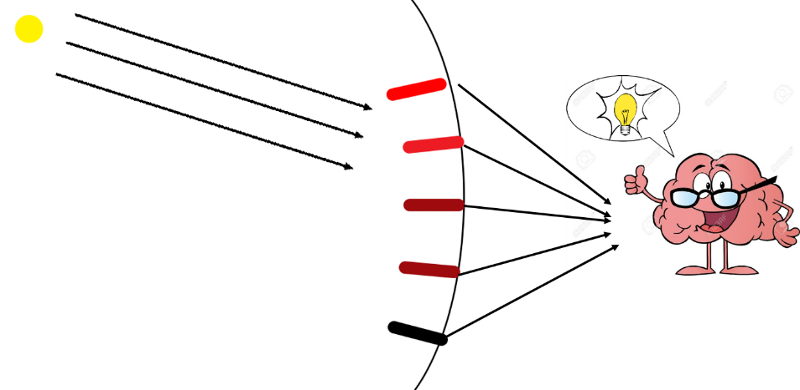
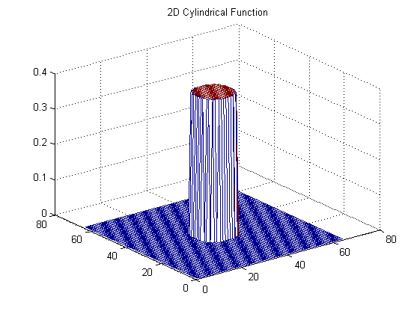
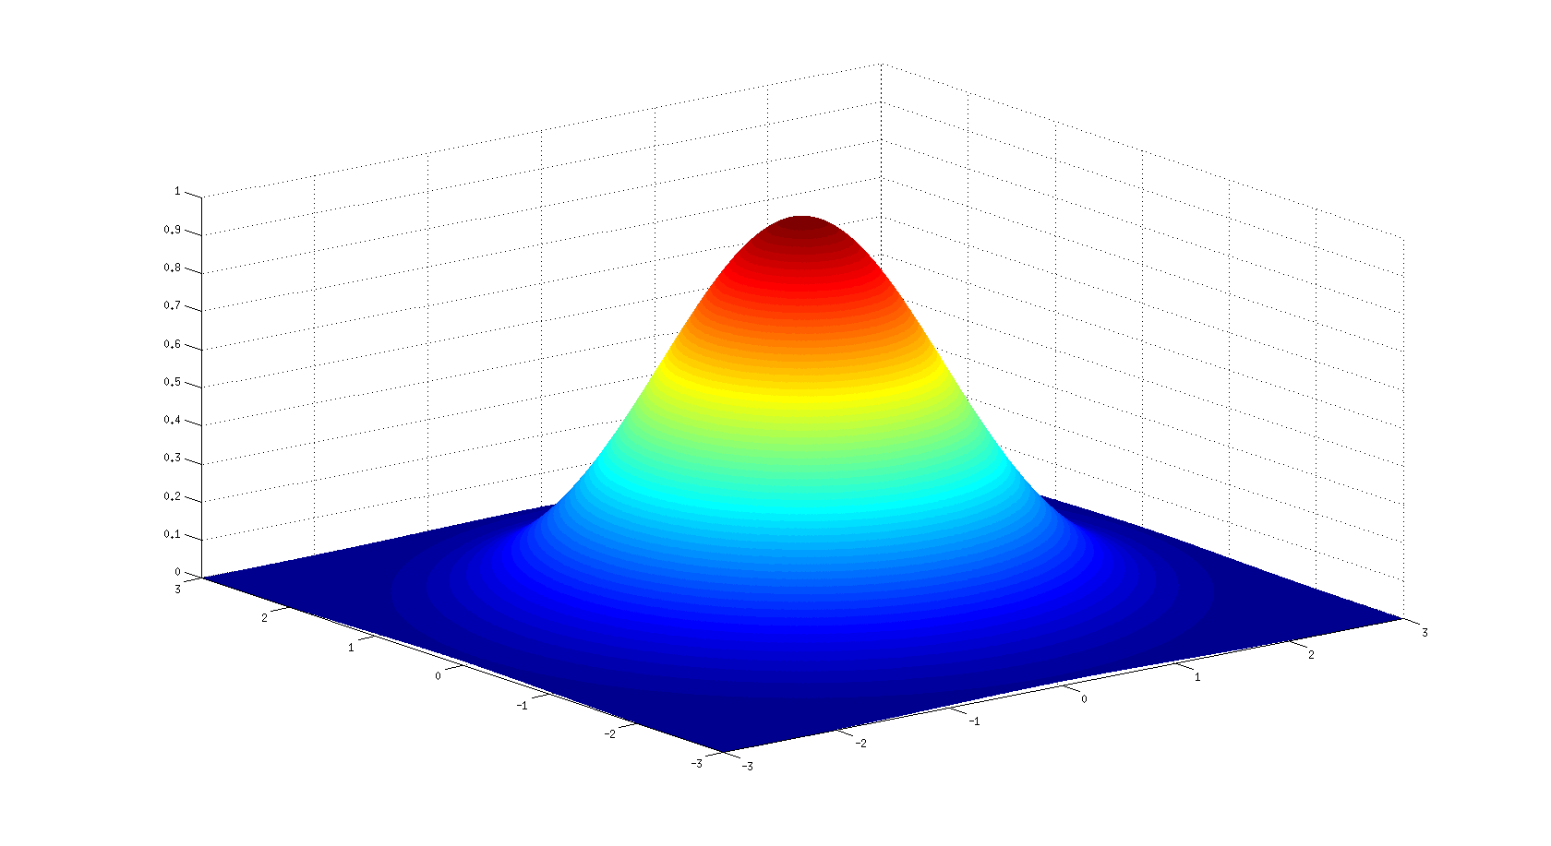
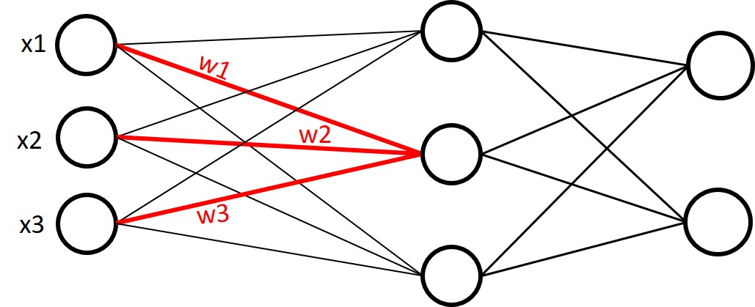
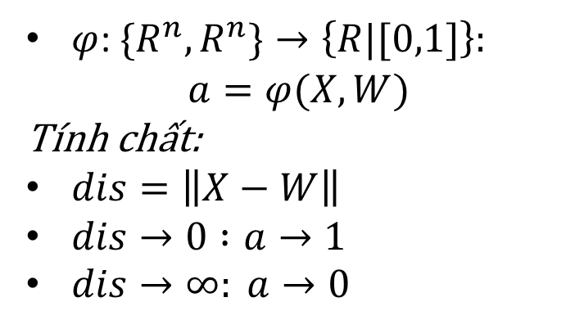
MODELING NETWORK
2. The Activation of cells are NOT the same
Cần tìm:
$φ$: $\{R^{n}, R^{n}\}→\left\{R|[0,1]\right\}:$
$$a=φ(X, W)$$
Tính chất:
$dis=\left\|X−W\right\|$
$dis→0 :a→1$
$dis→∞: a→0$
???
Notes:
Mô tả lại mô hình (hình bên phải trên)
Nêu vấn đề: Xem xét với 1 node in hidden, đã có input, tìm output của hidden (hình bên phải dưới). OUTPUT có 2 đường ra, nhưng cùng 1 giá trị
Diễn tả 3 dòng tính chất
Độ activation là số thực, chỉ scale trong khoảng (0,1)

Slide 8
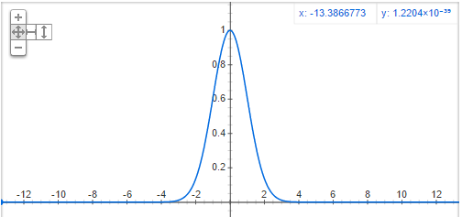
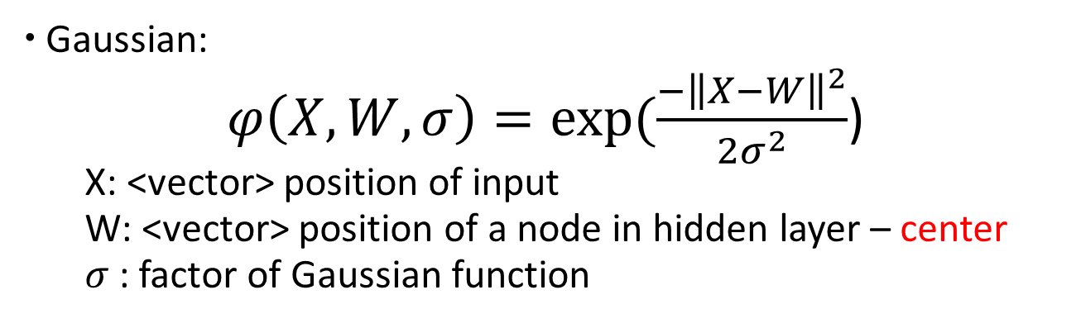

MODELING NETWORK
2. The Activation of cells are NOT the same
a
a
$σ$=1
0.05
x₂
w
x₁
Radius
Gaussian:
$φ\left(X,W,σ\right)=exp⁡(\frac{−{\left\|X−W\right\|}^{2}}{2σ^{2}}$)
X: <vector> position of input
W: <vector> position of a node in hidden layer – center
$σ$: factor of Gaussian function
Notes:
Nhấn mạnh: Chọn hàm Gaussian là hàm kích
Giải thích các axis đồ thị: tung là a, hoành là tọa độ X, W (giả sử 1 chiều)

Slide 9
MODELING NETWORK
2. The Activation of cells are NOT the same
Gaussian:
$φ\left(X,W,σ\right)=exp⁡(\frac{−{\left\|X−W\right\|}^{2}}{2σ^{2}}$)
X: <vector> position of input
W: <vector> position of a node in hidden layer – center
$σ$: factor of Gaussian function
Notes:
Bán kính to thì dễ kích thích hơn bán kính nhỏ
Cái gì điều chỉnh bán kính

Slide 10
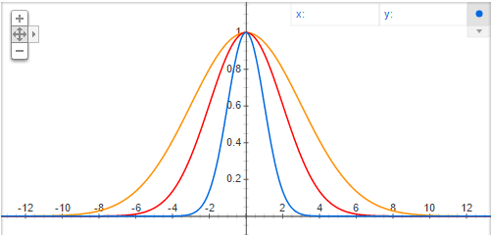



MODELING NETWORK
2. The Activation of cells are NOT the same
$σ$=3
$σ$=2
$σ$=1
Gaussian:
$φ\left(X,W,σ\right)=exp⁡(\frac{−{\left\|X−W\right\|}^{2}}{2σ^{2}}$)
X: <vector> position of input
W: <vector> position of a node in hidden layer – center
$σ$: factor of Gaussian function
Notes:
Giải thích các axis đồ thị: a và dis
w còn gọi là center, nói lại về axis x: xem như đặt w tại 0,0
xichma -> bật hình thứ 2 lên

Slide 11
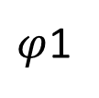
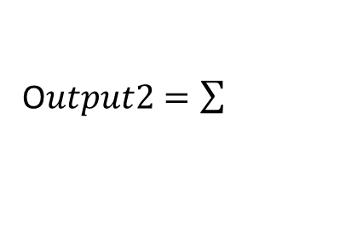
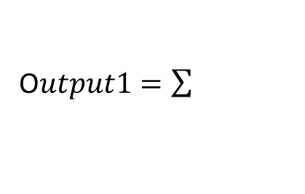


MODELING NETWORK
3. All signals are processed at brain
$φ$1
x1
k1
O$utput1=\sum{}$
k2
$$φ2$$
x2
k3
O$utput2=\sum{}$
x3
$$φ3$$
$$Output1=φ1∗k1+φ2∗k2+φ3∗k3$$

Slide 12
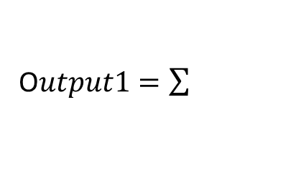

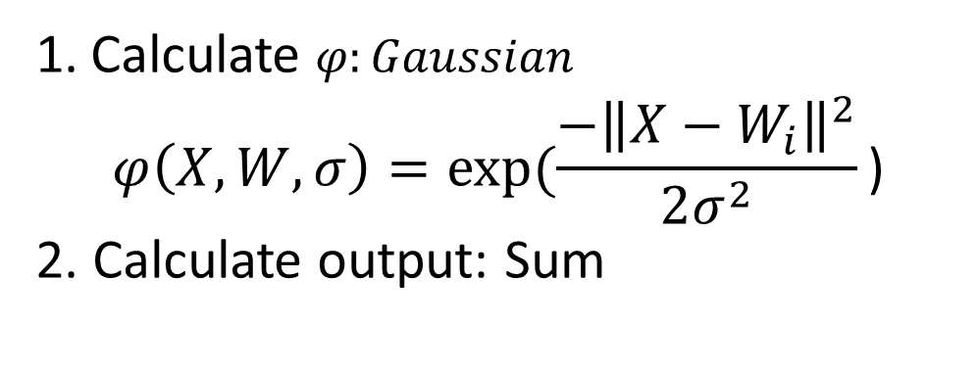
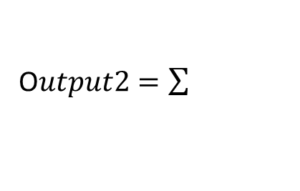




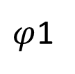
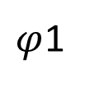
Radial Basis Function Network Architecture
$φ$1
x1
O$utput1=\sum{}$
$$φ2$$
x2
O$utput2=\sum{}$
x3
$$φ3$$
$φ$1
x1
k1
Calculate $φ:Gaussian$
$$φ\left(X,W,σ\right)=exp⁡(\frac{−{\left\|X−W_{i}\right\|}^{2}}{2σ^{2}}\text{)}$$
2. Calculate output: Sum
$$φ2$$
k2
x2
k3
x3
$$φ3$$
Notes:
Sửa, theme node output

Slide 13
Example: XOR
XOR function
x₁ | x₂
0 | 0
0 | 1
1 | 0
1 | 1

Slide 14



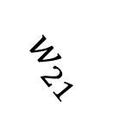






Example: XOR
-1
$$w_{11}$$
$$φ_{1}$$
x₁
$$w_{12}$$
$${θ=k}_{3}$$
$$k_{1}$$
$$y$$
$$w_{21}$$
$$k_{2}$$
x₂
$$φ_{2}$$
$$w_{22}$$
Input layer
Hidden layer
Output layer
$$W_{1}\left(w_{11},w_{12}\right)=(0,0)$$
$$W_{2}\left(w_{21},w_{22}\right)=(1,1)$$
$$φ_{i}=e^{−\frac{{\left\|X−W_{i}\right\|}^{2}}{2σ^{2}}}$$
$$Chọn σ=1/{\sqrt{2}}→φ_{i}=e^{−{\left\|X−W_{i}\right\|}^{2}}$$
$$K(k_{1}=−2.5018,k_{2}=−2.5018,k_{3}=−2.8404)$$

Slide 15



Example: XOR
-1
$$w_{11}$$
$$φ_{1}$$
$$0→$$
x₁
$$w_{12}$$
$${θ=k}_{3}$$
$$k_{1}$$
$$y$$
$$w_{21}$$
$$k_{2}$$
$$1→$$
x₂
$$φ_{2}$$
$$w_{22}$$
Input layer
Hidden layer
Output layer
$$X\left(x_{1},x_{2}\right)=(0,1)$$

Slide 16





Example: XOR
-1
$$w_{11}$$
$$φ_{1}$$
$$0→$$
x₁
$$w_{12}$$
$${θ=k}_{3}$$
$$k_{1}$$
$$y$$
$$w_{21}$$
$$k_{2}$$
$$1→$$
x₂
$$φ_{2}$$
$$w_{22}$$
Input layer
Hidden layer
Output layer
$$X\left(x_{1},x_{2}\right)=(0,1)$$
$$W_{1}\left(w_{11},w_{12}\right)=(0,0)$$
$$φ_{i}=e^{−{\left\|X−W_{i}\right\|}^{2}}$$

Slide 17
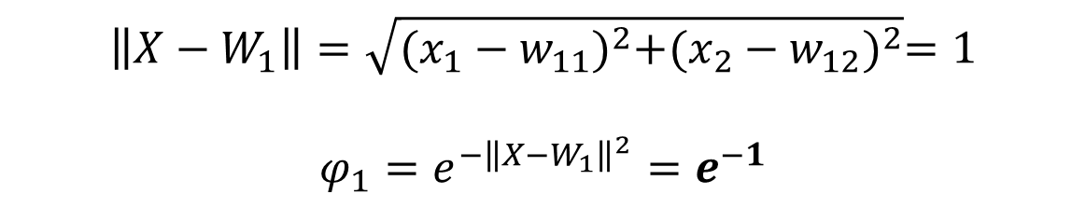
Example: XOR
-1
$$w_{11}$$
$$φ_{1}$$
$$0→$$
x₁
$$w_{12}$$
$${θ=k}_{3}$$
$$k_{1}$$
$$y$$
$$w_{21}$$
$$k_{2}$$
$$1→$$
x₂
$$φ_{2}$$
$$w_{22}$$
Input layer
Hidden layer
Output layer
$$\left\|X−W_{1}\right\|=\sqrt{{(x_{1}−w_{11})}^{2}+{(x_{2}−w_{12})}^{2}}=1$$
$$φ_{1}=e^{−{\left\|X−W_{1}\right\|}^{2}}=e^{−1}$$

Slide 18


Example: XOR
-1
$$w_{11}$$
$$φ_{1}$$
$$0→$$
x₁
$$w_{12}$$
$${θ=k}_{3}$$
$$k_{1}$$
$$y$$
$$w_{21}$$
$$k_{2}$$
$$1→$$
x₂
$$φ_{2}$$
$$w_{22}$$
Input layer
Hidden layer
Output layer
$$φ_{1}=e^{−1}$$
$$φ_{2}=e^{−1}$$

Slide 19





Example: XOR
-1
$$w_{11}$$
$$φ_{1}$$
$$0→$$
x₁
$$w_{12}$$
$${θ=k}_{3}$$
$$k_{1}$$
$$y$$
$$w_{21}$$
$$k_{2}$$
$$1→$$
x₂
$$φ_{2}$$
$$w_{22}$$
Input layer
Hidden layer
Output layer
$$φ_{1}=e^{−1}$$
$$φ_{2}=e^{−1}$$
$$K\left(k_{1},k_{2},k_{3}\right)=(−2.5018,−2.5018,−2.8404)$$

Slide 20
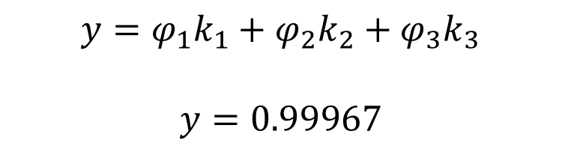
Example: XOR
-1
$$w_{11}$$
$$φ_{1}$$
$$0→$$
x₁
$$w_{12}$$
$${θ=k}_{3}$$
$$k_{1}$$
$$y$$
$$w_{21}$$
$$k_{2}$$
$$1→$$
x₂
$$φ_{2}$$
$$w_{22}$$
Input layer
Hidden layer
Output layer
$$y=φ_{1}k_{1}+φ_{2}k_{2}+φ_{3}k_{3}$$
$$y=0.99967$$

Slide 21
RBF: Training Algorithm
What will we have to learn for RBF NN with a given architecture ?
1. The centers of hidden nodes
2. The weights from the hidden to the output layer
….
….

Slide 22
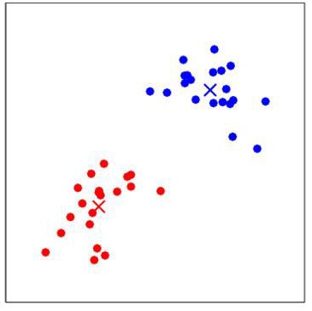
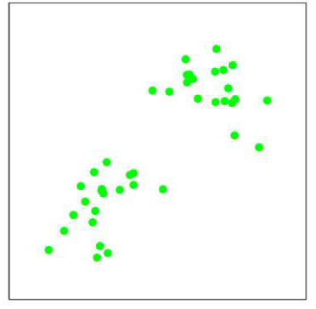
RBF: Training Algorithm
The centers of hidden nodes
Centers:
centers are chosen randomly from the training set OR
use clustering algorithm for finding the centers: k-means algorithm
…
...

Slide 23







RBF: Training Algorithm
The weights from the hidden to the output layer
Weights: are computed by means of the pseudo-inverse method.
- For an input $(x_{i},y_{i})$
$$φ_{1}$$
$$w_{1}$$
$$x_{i}$$
$$d_{i}$$
….
….
$$w_{M}$$
$$φ_{M}$$
$${w_{1}φ_{1}+…+w_{M}φ_{M}=d}_{i}=y_{i}$$

Slide 24
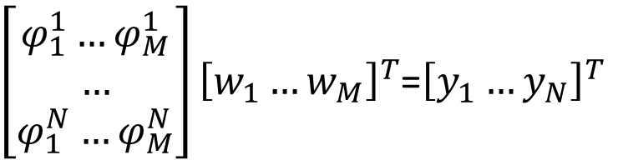


RBF: Training Algorithm
The weights from the hidden to the output layer
$${w_{1}φ_{1}+…+w_{M}φ_{M}=y}_{i}$$
This can be re-written in matrix form for one input:
$$\left[φ_{1}…φ_{M}\right]{\left[w_{1}…w_{M}\right]}^{T}=y_{i}$$
and for all N inputs at the same time
$\left[\begin{aligned}φ_{1}^{1}…φ_{M}^{1} \\ … \\ φ_{1}^{N}…φ_{M}^{N}\end{aligned}\right]{\left[w_{1}…w_{M}\right]}^{T}$=${\left[y_{1}…y_{N}\right]}^{T}$

Slide 25



RBF: Training Algorithm
The weights from the hidden to the output layer
Let:
$$G=\left[\begin{aligned}φ_{1}^{1}…φ_{M}^{1} \\ … \\ φ_{1}^{N}…φ_{M}^{N}\end{aligned}\right]$$
then we can rewrite:
$$G\left[\begin{aligned}w_{1} \\ … \\ w_{M}\end{aligned}\right]=\left[\begin{aligned}y_{1} \\ … \\ y_{N}\end{aligned}\right]$$
$${W=\left[w_{1}…w_{M}\right]}^{T}=G^{−1}{\left[y_{1}…y_{N}\right]}^{T}$$

Slide 26
RBF: Training Algorithm
The weights from the hidden to the output layer
G⁺ is the pseudo-inverse of the matrix G
We can obtain the weights using the following formula:
$${W=\left[w_{1}…w_{M}\right]}^{T}=G^{+}{\left[y_{1}…y_{N}\right]}^{T}$$

Slide 27
RBF: Training Algorithm
Summary
Choose centers randomly from the training set OR use k-means algorithm.
2. Finding the weights using the pseudo-inverse method.
→ Unsupervised learning
→ Supervised learning
→ Hybrid learning

Slide 28
Example: XOR Training
Unsupervised learning
Output of hidden layer
Supervised learning

Slide 29
Example: XOR Training
1. Unsupervised learning
x₂
p | x₁ | x₂ | Y
1 | 0 | 0 | 0
2 | 0 | 1 | 1
3 | 1 | 0 | 1
4 | 1 | 1 | 0
(2)
(4)
(1)
(3)
O
x₁

Slide 30


Example: XOR Training
1. Unsupervised learning
x₂
* Hidden layer:
(2)
(4)
$$μ_{2}$$
$$μ_{1}$$
(1)
(3)
O
x₁

Slide 31
Example: XOR Training
1. Unsupervised learning
x₂
* Hidden layer:
(2)
(4)
x₁
0
$$μ_{2}$$
0
$$μ_{1}$$
(1)
(3)
1
O
x₁
x₂
1

Slide 32
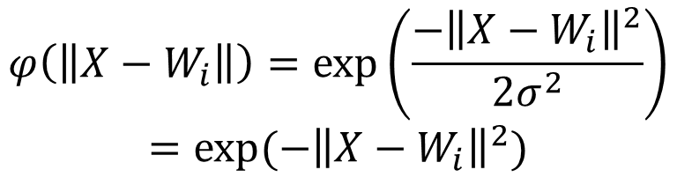
Example: XOR Training
2. Output of hidden layer
* Gaussian function:
x₂
(2)
(4)
$$φ\left(\left\|X−W_{i}\right\|\right)=\exp\left(\frac{−{\left\|X−W_{i}\right\|}^{2}}{2σ^{2}}\right)$$
$$=exp⁡(−{\left\|X−W_{i}\right\|}^{2})$$
(1)
(3)
O
x₁

Slide 33

Example: XOR Training
3. Unsupervised learning
0
x₁
?
0
1
?
x₂
1
Gaussian function:
$$φ_{i}\left(\left\|X−W_{i}\right\|\right)=exp⁡(−{\left\|X−W_{i}\right\|}^{2})$$

Slide 34



Example: XOR Training
3. Supervised learning
-1
x₁
0
$${θ=w}_{3}$$
0
$$w_{1}$$
1
x₂
$$w_{2}$$
1

Slide 35
Example: XOR Training
3. Supervised learning
p | x₁ | x₂ | y | ɸ₁ | ɸ₂ | bias
1 | 0 | 0 | 0 | 1.0000 | 0.1353 | -1
2 | 0 | 1 | 1 | 0.3678 | 0.3678 | -1
3 | 1 | 0 | 1 | 0.3678 | 0.3678 | -1
4 | 1 | 1 | 0 | 0.1353 | 1.0000 | -1

Slide 36
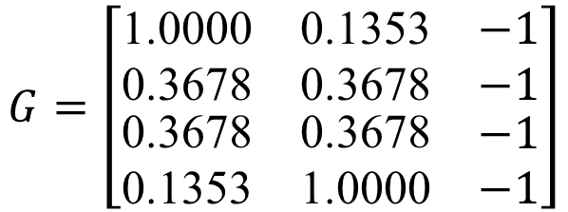
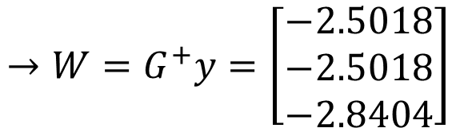
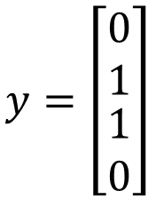
Example: XOR Training
3. Supervised learning
p | x₁ | x₂ | y | ɸ₁ | ɸ₂ | bias
1 | 0 | 0 | 0 | 1.0000 | 0.1353 | -1
2 | 0 | 1 | 1 | 0.3678 | 0.3678 | -1
3 | 1 | 0 | 1 | 0.3678 | 0.3678 | -1
4 | 1 | 1 | 0 | 0.1353 | 1.0000 | -1
$$G=\left[\begin{matrix}\text{1.0000} & \text{0.1353} & −1 \\ \text{0.3678} & \text{0.3678} & −1 \\ \begin{aligned}\text{0.3678} \\ \text{0.1353}\end{aligned} & \begin{aligned}\text{0.3678} \\ \text{1.0000}\end{aligned} & \begin{aligned}−1 \\ −1\end{aligned}\end{matrix}\right]$$
$$y=\left[\begin{matrix}\begin{aligned}0 \\ 1\end{aligned} \\ 1 \\ 0\end{matrix}\right]$$
Result:
$$→W=G^{+}y=\left[\begin{matrix}−2.5018 \\ −2.5018 \\ −2.8404\end{matrix}\right]$$

Slide 37


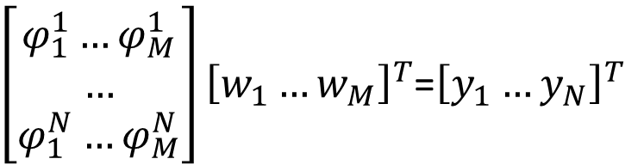
OTHER ASPECTS
Number neuron in hidden layer
Hidden layer has M neurons
M should be less than number of N input datas
$\left[\begin{aligned}φ_{1}^{1}…φ_{M}^{1} \\ … \\ φ_{1}^{N}…φ_{M}^{N}\end{aligned}\right]{\left[w_{1}…w_{M}\right]}^{T}$=${\left[y_{1}…y_{N}\right]}^{T}$
$$\left\{\begin{aligned}{w_{1}φ_{1}^{1}+…+w_{M}φ_{M}^{1}=y}_{1} \\ {w_{1}φ_{1}^{2}+…+w_{M}φ_{M}^{2}=y}_{2} \\ … \\ {w_{1}φ_{1}^{N}+…+w_{M}φ_{M}^{N}=y}_{N}\end{aligned}\right.$$

Slide 38
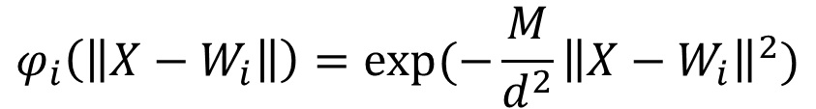
RBF: Other aspects
Gaussian functions
Spreads: are chosen by normalization
$$σ=\frac{Maximum distance between any 2 centers}{\sqrt{number of centers}}=\frac{d}{\sqrt{M}}$$
Then the activation function of hidden neuron i become:
$$φ_{i}\left(\left\|X−W_{i}\right\|\right)=exp⁡(−\frac{M}{d^{2}}{\left\|X−W_{i}\right\|}^{2})$$

