Slide 1
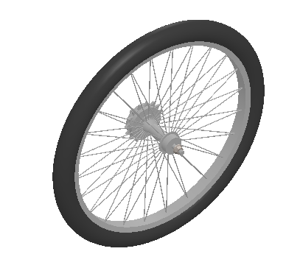
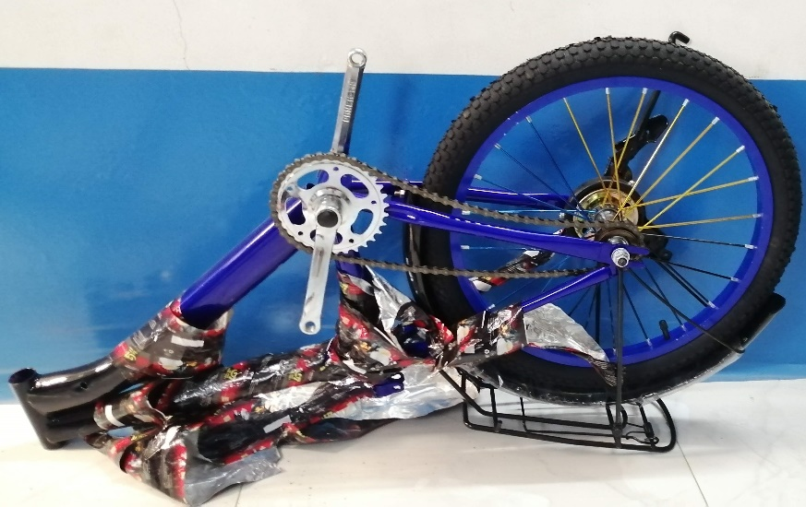
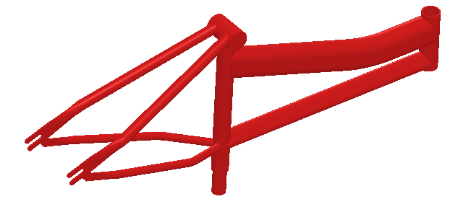
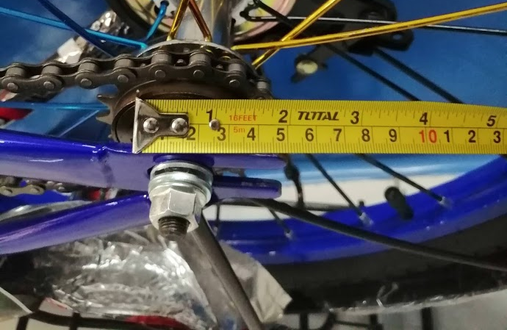
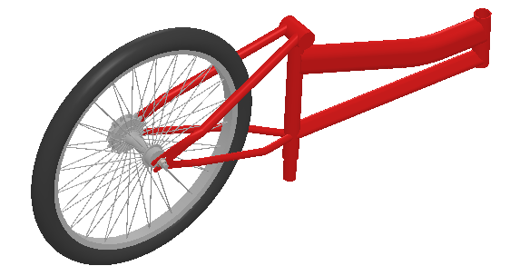
System
Motivation
+
Assembling and tightening the bicycle bolts

Slide 2
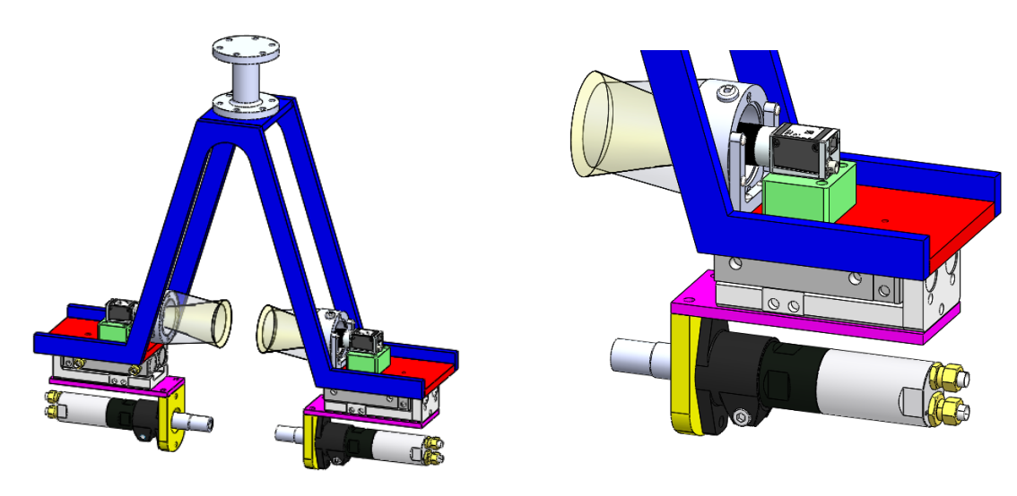
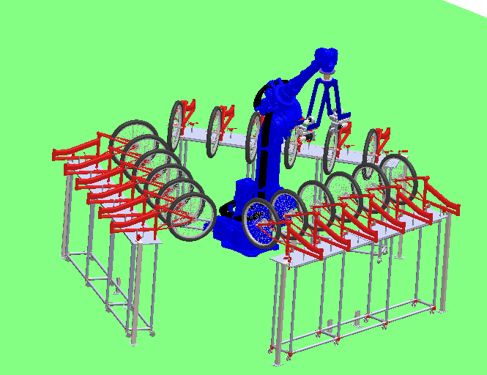
System Design
Workspace
Robot’s Tool

Slide 3
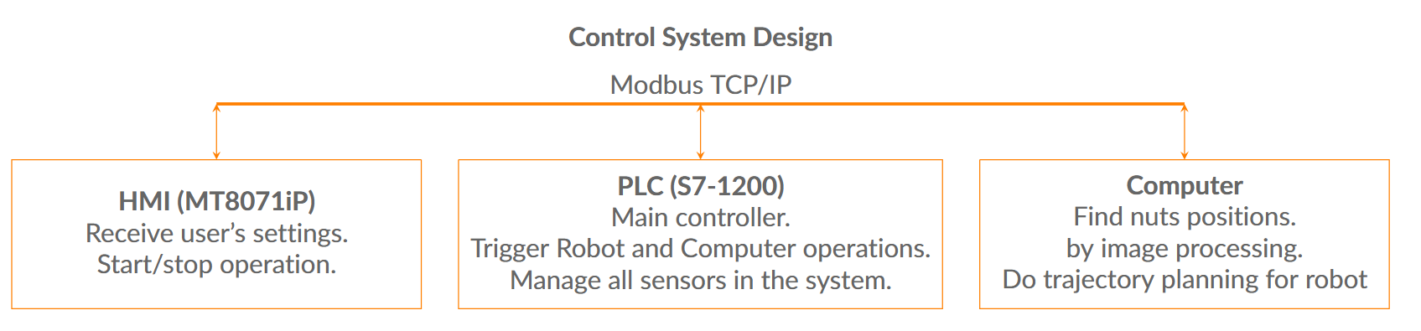
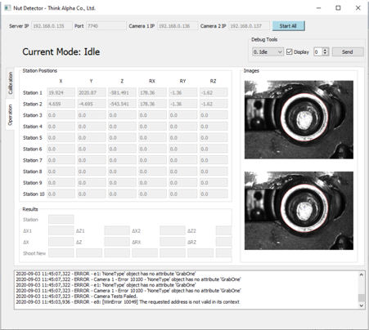
Control System Design
Control System Design

Slide 4
The Workflow
System Design
My golden star !!!

Slide 5

Capture, Run and Ref. Positions
System Design
The capture position at station $i$ is given by
$$P_{capture−i}=P_{ref−i}+ΔP_{capture−X}$$
The nut running position at station $i$ is given by
$$P_{run−i}=P_{ref−i}+ΔP_{run−X}$$

Slide 6
Image Processing Technique
Image Processing

Slide 7
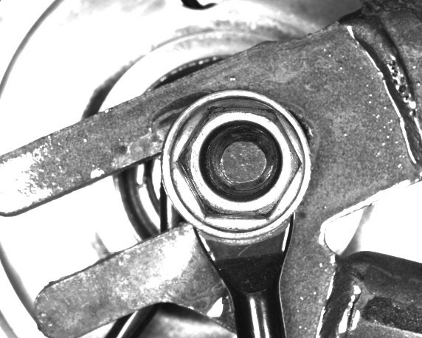

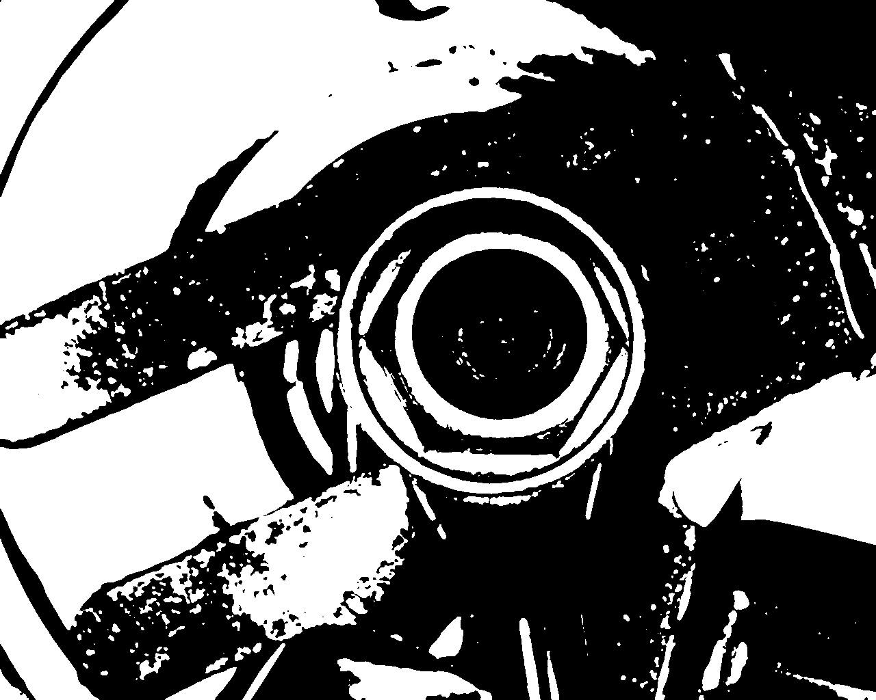

Detect the Nut in the Image (1/2)
Image Processing
(a) Origin Image
(b) Undistorted
(c) Gaussian blurred
(d) Otsu Thresholed
(e) Closing Transformed
(Inverted Image)
(Dilation followed by Erosion)

Slide 8
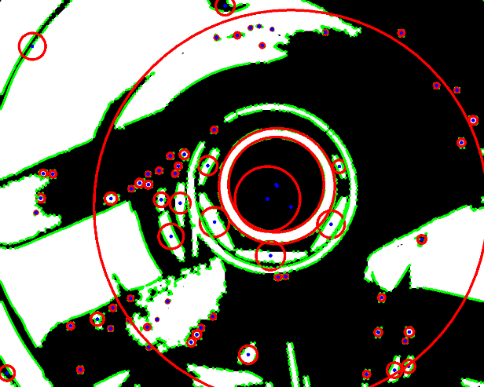
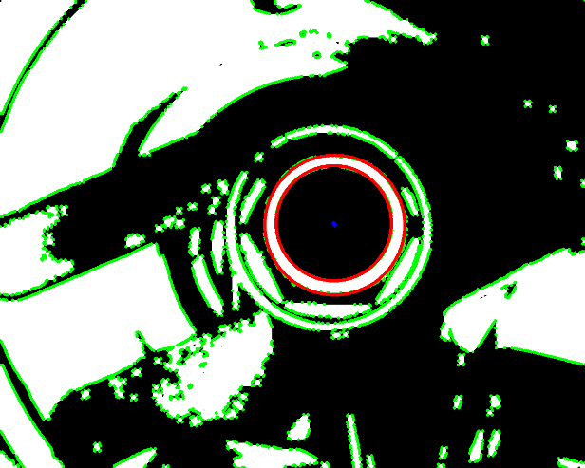

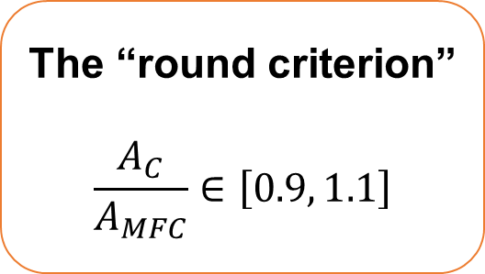
Detect the Nut in the Image (2/2)
Image Processing
(a) All contours and their min-fitting-circles
(b) Filter out the
“not round” contours.
(c) Final contour (using dimensional comparision)
The “round criterion”
$$\frac{A_{C}}{A_{MFC}}∈\left[0.9, 1.1\right]$$
Min Fitting Circle

