Slide 1

Noise-robust Automatic Speaker Verification
Presented by
Truong Duc Tuan
Supervisor
Assoc. Prof. Chng Eng Siong
7th August 2024

Slide 2
About me
Name: Truong Duc Tuan
Matriculated date: 10-Jan-2023
Supervisor: Assoc. Prof. Chng Eng Siong
CGPA: 4.83
Research Topic:
Noise-Robust Automatic Speaker Verification
Publication: 1. Duc-Tuan Truong, Ruijie Tao, Jia Qi Yip, Kong Aik Lee, and Eng Siong Chng. Emphasized Non-Target Speaker Knowledge in Knowledge Distillation for Automatic Speaker Verification. In ICASSP 2024 - 2024 IEEE International Conference on Acoustics, Speech and Signal Processing (ICASSP). IEEE, 10336–10340.
2. Duc-Tuan Truong, Ruijie Tao, Tuan Nguyen, Hieu-Thi Luong, Kong Aik Lee, and Eng Siong Chng. Temporal-Channel Modeling in Multi-head Self-Attention for Synthetic Speech Detection. to appear at INTERSPEECH 2024 - Annual Conference of the International Speech Communication Association.

Slide 3
Outline
Introduction
What is Automatic Speaker Verification (ASV)?
Challenge for ASV system?
Literature Review
Overview of ASV system
Current approaches of noise-robust ASV models
Method
Emphasized Non-target Speakers In Knowledge Distillation for ASV
Conclusion and Future Works

Slide 4
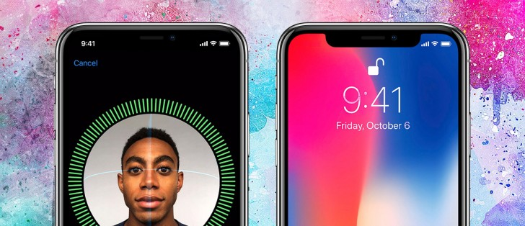
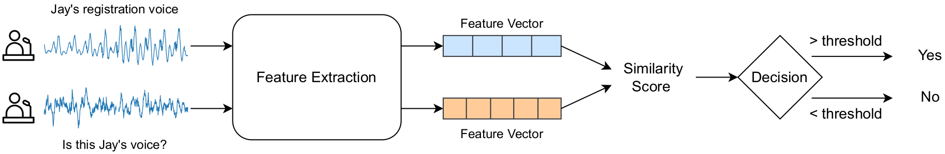
1. Introduction
What is Identity Verification?
What is Automatic Speaker Verification (ASV)?
is the process of verifying two voices are from the same person
Where can ASV be applied for?
Authentication: phone banking, voice assistant (Siri), etc
Surveillance: identifying evidence voiceprint (ransom call), etc

Slide 5
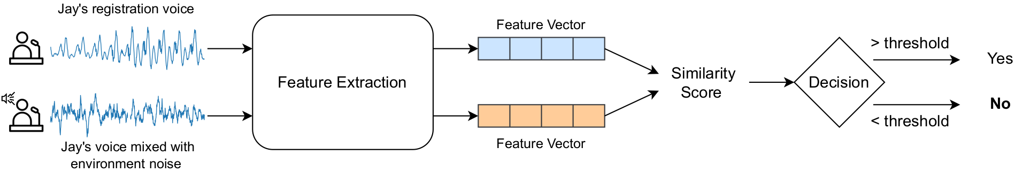
1. Introduction: Challenge for ASV system
1. Environment Noise:
Exist everywhere in real-world scenarios (e.g. car engines, wind blow, dog barking, etc.)
Can degrade the audio quality → reduce ASV performance
→Research Topic: Noise-robust ASV

Slide 6
Outline
Introduction
What is Automatic Speaker Verification (ASV)?
Challenge for ASV system?
Literature Review
1. Overview of ASV system
2. Current approaches of noise-robust ASV models
Method
Emphasized Non-target Speakers In Knowledge Distillation
Conclusion and Future Works

Slide 7
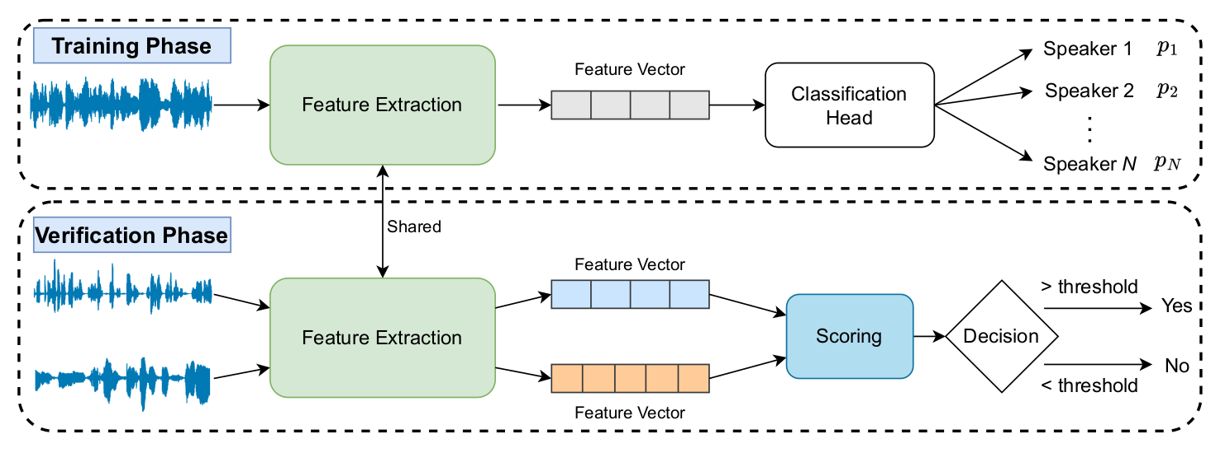
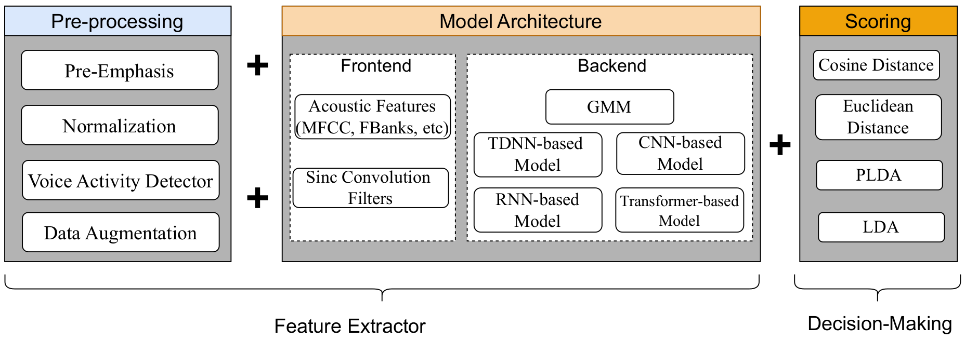
2.1. Literature Review: Overview of ASV model
System pipeline:
Feature Extraction Structure:
[1] Kabir, Md, M., Ph. D., Jungpil, Shin, Israt, Jahan, and Abu, Ohi. "A Survey of Speaker Recognition: Fundamental Theories, Recognition Methods and Opportunities".IEEE Access (2021)
[2]Shome, N., Sarkar , A., Ghosh, A. K., Laskar, R. H., Kashyap, R. “Speaker Recognition through Deep Learning Techniques: A Comprehensive Review and Research Challenges”, Periodica Polytechnica Electrical Engineering and Computer Science (2023)

Slide 8
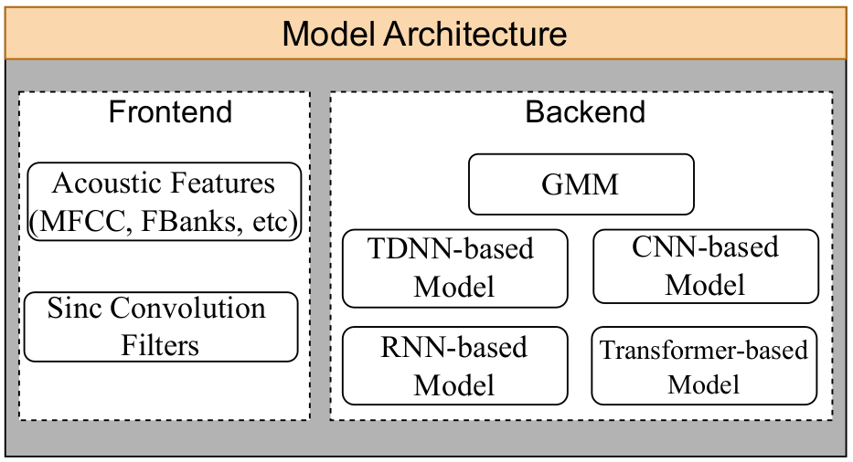
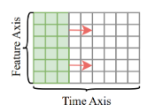
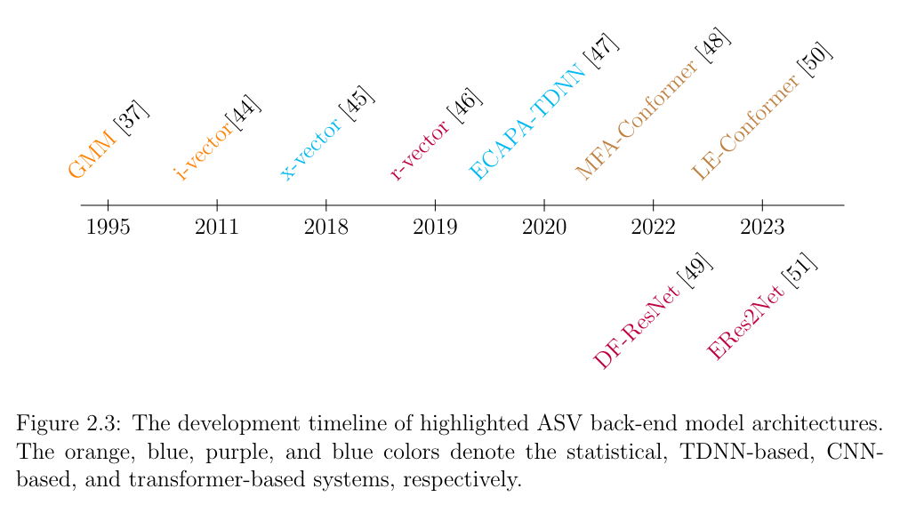
2.1. Literature Review: Overview of ASV model
Frequency Axis
[1] Mirco Ravanelli, & Yoshua Bengio. (2019). Speaker Recognition from Raw Waveform with SincNet.
[2] E. Variani, X. Lei, E. McDermott, I. L. Moreno, and J. Gonzalez-Dominguez “Deep neural networks for small footprint text-dependent speaker verification,” in 2014 IEEE International Conference on Acoustics, Speech and Signal Processing (ICASSP), 2014, pp. 4052–4056.
[3] Maros Jakubec, Roman Jarina, Eva Lieskovska, and Peter Kasak. 2024. Deep speaker embeddings for Speaker Verification: Review and experimental comparison. Eng. Appl. Artif. Intell. 127, PA (Jan 2024). https://doi.org/10.1016/j.engappai.2023.107232

Slide 9
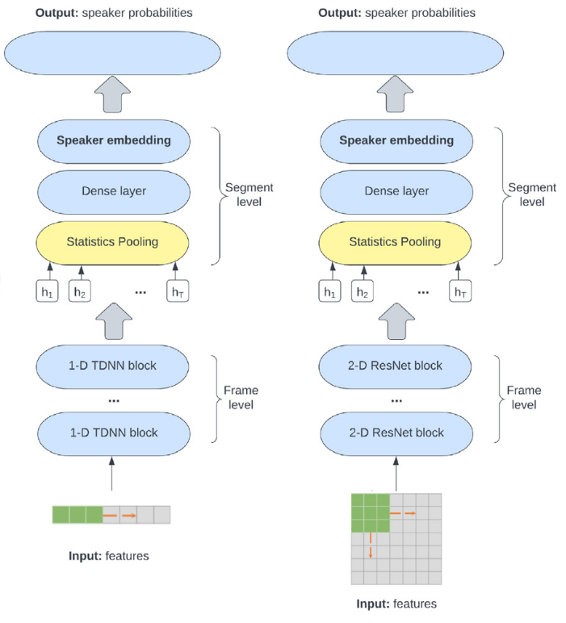
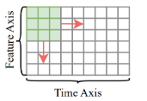
2.1. Literature Review: Overview of ASV model
F
T
TDNN-based (Time delay NN)
CNN-based
[1] E. Variani, X. Lei, E. McDermott, I. L. Moreno, and J. Gonzalez-Dominguez “Deep neural networks for small footprint text-dependent speaker verification,” in 2014 IEEE International Conference on Acoustics, Speech and Signal Processing (ICASSP), 2014, pp. 4052–4056.
[2] Maros Jakubec, Roman Jarina, Eva Lieskovska, and Peter Kasak. 2024. Deep speaker embeddings for Speaker Verification: Review and experimental comparison. Eng. Appl. Artif. Intell. 127, PA (Jan 2024). https://doi.org/10.1016/j.engappai.2023.107232

Slide 10
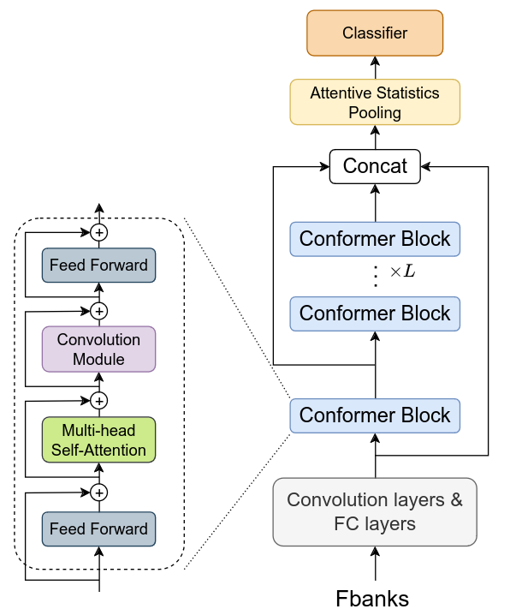

2.1. Literature Review: Overview of ASV model
Transformer-based
[1] E. Variani, X. Lei, E. McDermott, I. L. Moreno, and J. Gonzalez-Dominguez “Deep neural networks for small footprint text-dependent speaker verification,” in 2014 IEEE International Conference on Acoustics, Speech and Signal Processing (ICASSP), 2014, pp. 4052–4056.
[2]Y. Zhang et al., “MFA-Conformer: Multi-scale Feature Aggregation Conformer for Automatic Speaker Verification,” in Proc. Interspeech 2022, 2022, pp. 306–310.

Slide 11
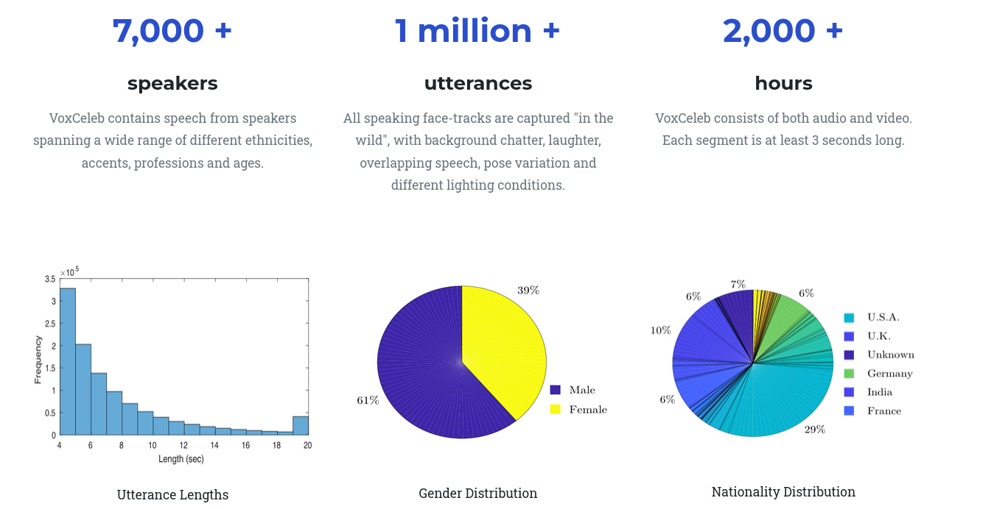
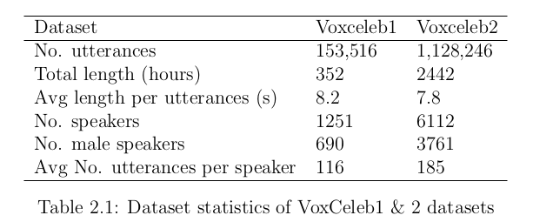
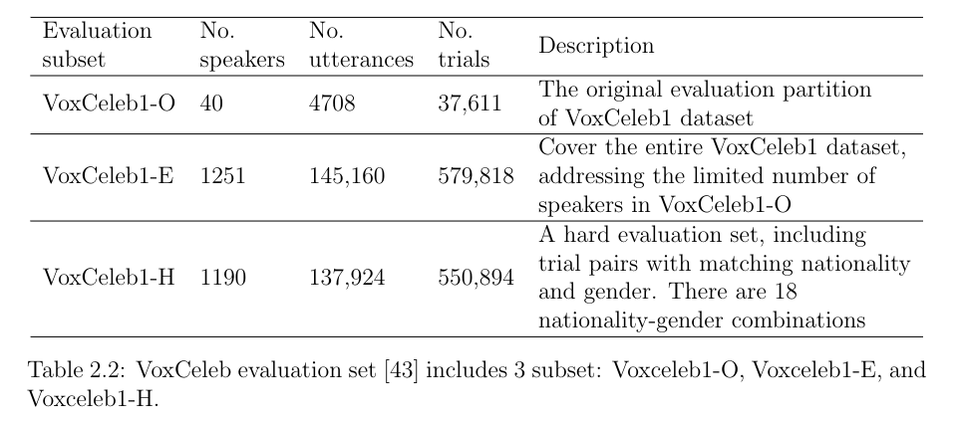
2.1. Literature Review: Overview of ASV model
Corpus: VoxCeleb is a large dataset consisting of short clips extracted from interview YouTube videos
Original VoxCeleb1 test set
Extend the test set to entire VoxCeleb1
Hard test set include pairs with matching nationality and genders
[1]Shome, N., Sarkar , A., Ghosh, A. K., Laskar, R. H., Kashyap, R. “Speaker Recognition through Deep Learning Techniques: A Comprehensive Review and Research Challenges”, Periodica Polytechnica Electrical Engineering and Computer Science (2023)
[2] Arsha Nagrani, , Joon~Son Chung, Weidi Xie, and Andrew Zisserman. "Voxceleb: Large-scale speaker verification in the wild".Computer Science and Language (2019).

Slide 12
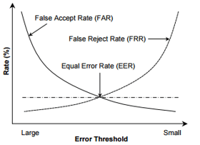

2.1. Literature Review: Overview of ASV model
Metrics (lower is better):
Equal Error Rate (EER) (%) decide the threshold where FAR = FRR
Ex: EER=1% means the model has 1% FAR and 1% FRR
minimum Detection Cost Function (minDCF): using the detection thresholds that minimize the detection cost (DCT).
[1]Shome, N., Sarkar , A., Ghosh, A. K., Laskar, R. H., Kashyap, R. “Speaker Recognition through Deep Learning Techniques: A Comprehensive Review and Research Challenges”, Periodica Polytechnica Electrical Engineering and Computer Science (2023)

Slide 13
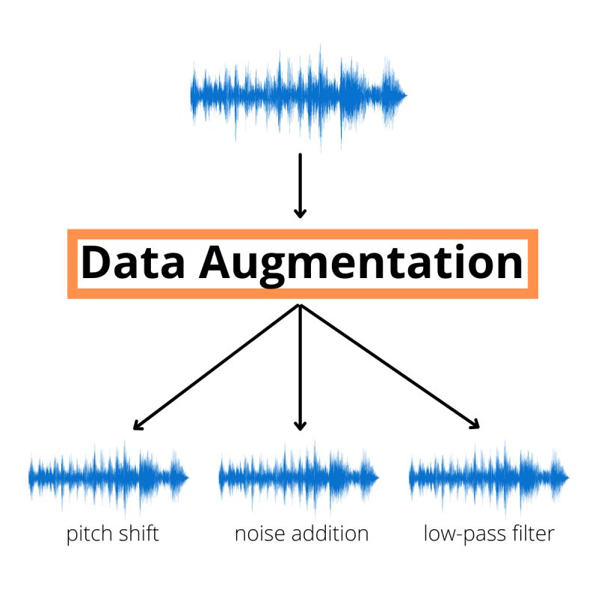
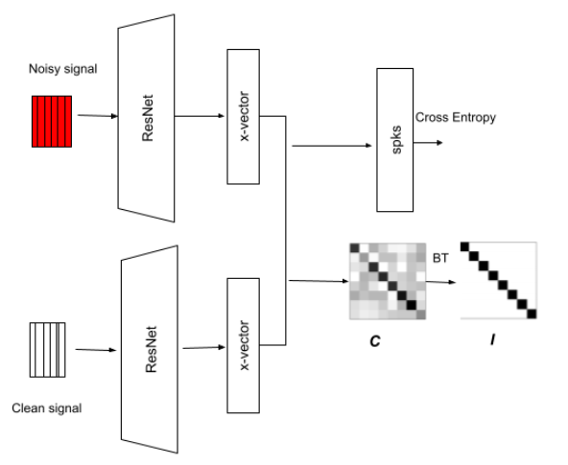
2.2. Literature Review: Noise-robust ASV
Noise-robust ASV methods
Feature Compensation
Model Compensation
Data Augmentation
Feature-Domain Adaptation
pitch shift
noise addition
room impulse response
[1] Ming, Ji & Hazen, Timothy & Glass, James & Reynolds, Douglas. (2007). Robust speaker recognition in noisy conditions. IEEE Trans Speech Audio Process. Audio, Speech, and Language Processing,
[2] Zhongxin Bai, , and Xiao-Lei Zhang. "Speaker recognition based on deep learning: An overview".Neural Networks (2021)
[3] K. Sreenivasa Rao, Sourjya Sarkar. “Robust Speaker Recognition in Noisy Environments”. Springer Cham (2014)

Slide 14
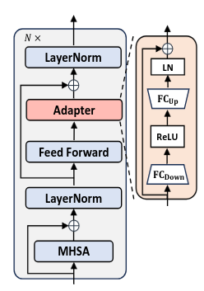
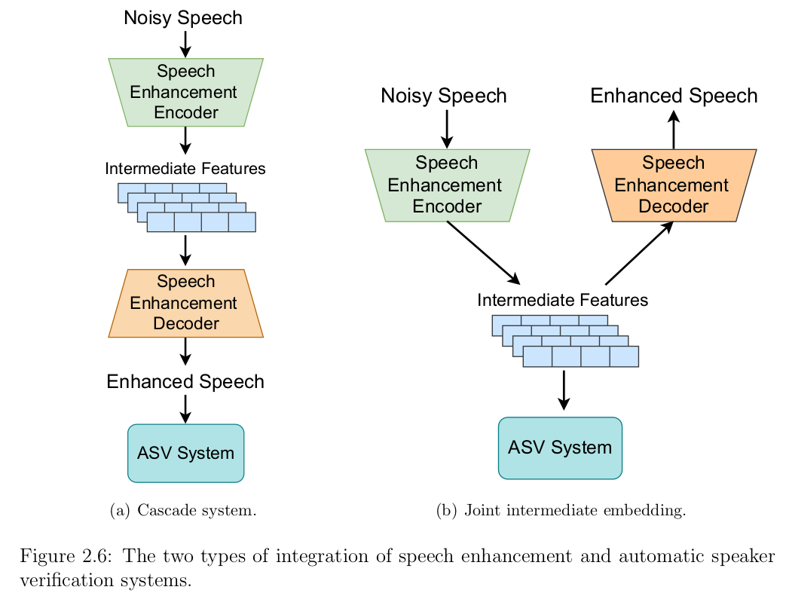
2.2. Literature Review: Noise-robust ASV
Noise-robust ASV methods
Feature Compensation
Model Compensation
Data Augmentation
Feature-Domain Adaptation
Model-Domain Adaptation
Speech Enhancement
[1] Ming, Ji & Hazen, Timothy & Glass, James & Reynolds, Douglas. (2007). Robust speaker recognition in noisy conditions. IEEE Trans Speech Audio Process. Audio, Speech, and Language Processing,
[2] W. Huang, B. Han, S. Wang, Z. Chen, and Y. Qian, “Robust cross-domain speaker verification with multi-level domain adapters,” in ICASSP 2024 - 2024 IEEE International Conference on Acoustics, Speech and Signal Processing (ICASSP), 2024, pp. 11 781–11 785.

Slide 15
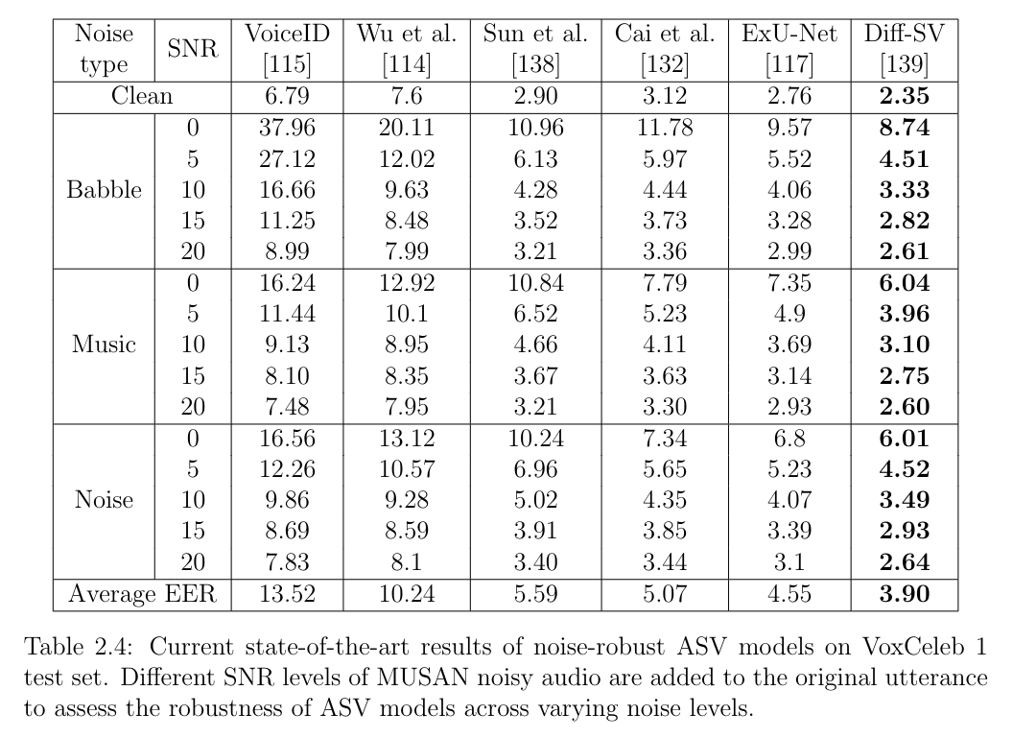
2.2. Literature Review: Baseline results
Train set: VoxCeleb 1 dev set Eval set: VoxCeleb 1 test set
Speech Enhancement
Model adaptation
Feature adaptation
Current state-of-the-art results in EER of noise-robust ASV models on VoxCeleb 1 test set. Different SNR levels of MUSAN noisy audio are added to the original utterance to assess the robustness of ASV models across varying noise levels.
[115] S. Shon, H. Tang, and J. R. Glass, “Voiceid loss: Speech enhancement for speaker verification,” in Interspeech, 2019.
[114] Y. Wu, L. Wang, K. A. Lee, M. Liu, and J. Dang, “Joint Feature Enhancement and Speaker Recognition with Multi-Objective Task-Oriented Network,” in Proc. Interspeech 2021, 2021, pp. 1089–1093.
[138] Y. Sun, H. Zhang, L. Wang, K. A. Lee, M. Liu, and J. Dang, “Noise-disentanglement metric learning for robust speaker verification,” CASSP 2023
[132] D. Cai, W. Cai, and M. Li, “Within-sample variability-invariant loss for robust speaker recognition under noisy environments, ICASSP 2020
[117] Ju-Ho Kim, Jungwoo Heo, Hye-jin Shim, & Ha-Jin Yu (2022). Extended U-Net for Speaker Verification in Noisy Environments. In Proc. Interspeech 2022
[139] J.-H. Kim, J. Heo, H.-S. Shin, C.-Y. Lim, and H.-J. Yu, “Diff-sv: A unified hierarchical framework for noise-robust speaker verification using score-based diffusion
probabilistic models,” ICASSP 2024

Slide 16
2.2. Literature Review: Baseline results
Train set: VoxCeleb 2 dev set Eval set: VoxCeleb 1
# | Model type | Model name | Params | EER (%)
 |  |  |  | VoxCeleb1-O | VoxCeleb1-E | VoxCeleb1-H
1 | Transformer | MFA-Conformer | 20.9M | 0.99 | 1.22 | 1.22
2 | 2D-CNN | ResNet34 | 6.34M | 1.05 | 1.11 | 1.99
2 | TDNN | ECAPA-TDNN | 20.7M | 0.86 | 0.97 | 1.90
3 | 2D-CNN | ERes2Net | 6.61M | 0.84 | 0.96 | 0.96
4 | TDNN | CAM++ | 7.18M | 0.77 | 0.87 | 1.70
5 | 2D-CNN | DF-ResNet | 6.98M | 0.75 | 0.88 | 1.64
Current state-of-the-art results in EER (%) of noise-robust ASV models on VoxCeleb 1 dataset
[1] Yafeng Chen, undefined., et al, "3D-Speaker-Toolkit: An Open Source Toolkit for Multi-modal Speaker Verification and Diarization," 2024.
[2] Xiyuan Wang, undefined., et al, "P-vectors: A Parallel-coupled TDNN/Transformer Network for Speaker Verification," in Proc. INTERSPEECH 2023, 2023, pp. 3182–3186.

Slide 17
Outline
Introduction
What is Automatic Speaker Verification (ASV)?
Challenge for ASV system?
Literature Review
Overview of ASV system
Current approaches of noise-robust ASV models
Method
Emphasized Non-target Speakers In Knowledge Distillation
Conclusion and Future Works

Slide 18
3. Method: Knowledge Distillation for Robust ASV: Emphasized Non-target Speakers In Knowledge Distillation
Motivation
Proposed Method
Experiment results
Included Publication:
Emphasized Non-Target Speaker Knowledge in Knowledge Distillation for Automatic Speaker Verification
Truong, D.T., Tao, R., Yip, J., Aik Lee, K., and Chng, E, published at ICASSP 2024

Slide 19



3.1. Motivation: Self-supervised learning
Self-supervised learning (SSL) is trained by:
Training data without manual label annotation
Labels are extracted by using one part of the input or the other input
With the huge amount of unlabeled data, SSL models can learn robust data representation
Recent SSL WavLM [1] can extract noise-robust speech representation
Pseudo-label
z1
z2
z3
(5)
Mask prediction loss
Hidden embeddings
h1
h2
h3
(4)
WavLM Encoder layers
K-Means
Mixing audio
(3) Masking
(1)
(2)
Add noise | Utterance mixing
Clean audio
[1] Chen, Sanyuan et al. “WavLM: Large-Scale Self-Supervised Pre-Training for Full Stack Speech Processing.” IEEE Journal of Selected Topics in Signal Processing 16 (2021)

Slide 20
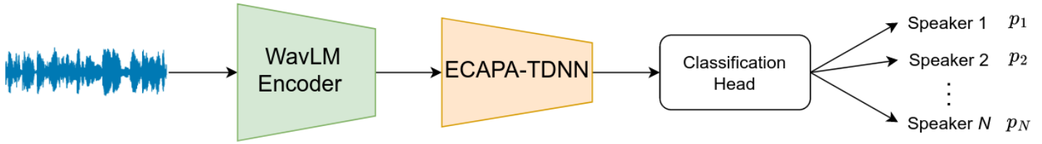
3.1. Motivation: Robust Large SSL model
By finetuning WavLM with downstream ASV model ECAPA-TDNN with the ASV task, WavLM+ECAPA-TDNN achieve SOTA results
Model type | Model name | Params | EER (%)
 |  |  | VoxCeleb1-O | VoxCeleb1-E | VoxCeleb1-H
2D-CNN | ResNet34 | 6.34M | 1.05 | 1.11 | 1.99
1D-CNN | ECAPA-TDNN | 20.7M | 0.86 | 0.97 | 1.90
2D-CNN | ERes2Net | 6.61M | 0.84 | 0.96 | 0.96
1D-CNN | CAM++ | 7.18M | 0.77 | 0.87 | 1.70
1D-CNN | DF-ResNet | 6.98M | 0.75 | 0.88 | 1.64
 | WavLM-ECAPA-TDNN | 316M | 0.38 | 0.48 | 0.98
However, WavLM is large-scale model with total number of parameter up to 320 millions.
[1] Chen, Sanyuan et al. “WavLM: Large-Scale Self-Supervised Pre-Training for Full Stack Speech Processing.” IEEE Journal of Selected Topics in Signal Processing 16 (2021).

Slide 21
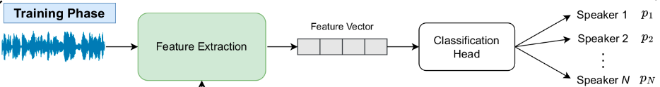
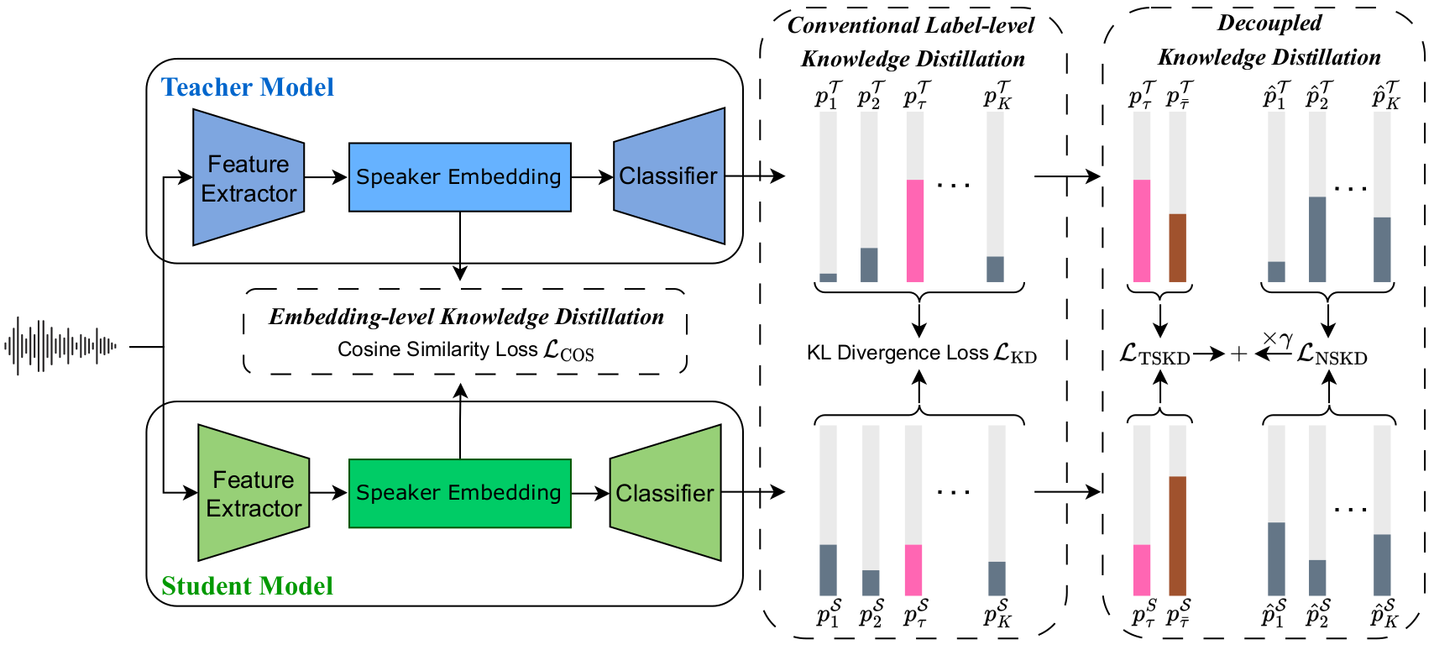

3.1. Motivation: Knowledge Distillation
K
K
Knowledge Distillation (KD) is to train compact student models with the supervision of large and strong teacher models.
The output probability of a speaker i among K speakers
a utterance of
speaker t
K: the number of training speakers

Slide 22
3.1. Motivation: Problem with label-level KD
K: the number of training speakers
Target speaker t
(positive class)
a utterance of
speaker t
Conventional label-level knowledge distillation overlooks the significant knowledge from non-target speakers due to the high value of the probability of target speaker

Slide 23
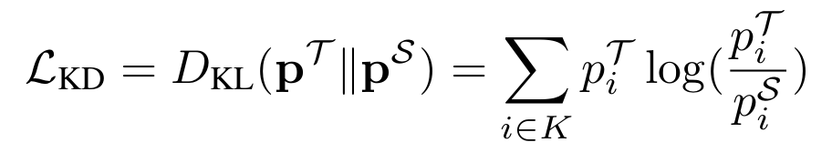

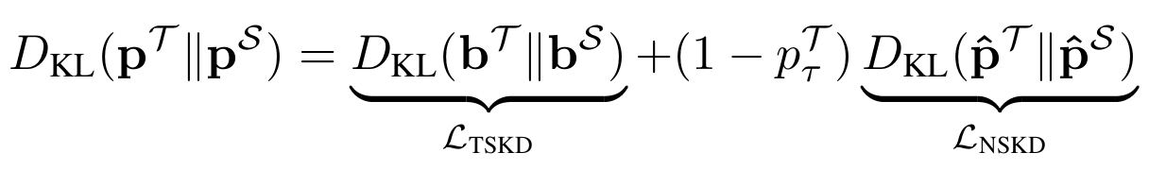
3.1. Motivation: Problem with label-level KD
K: the number of training speakers
Target Speaker
Knowledge Distillation (TSKD)
a utterance of
speaker t
Non-target Speaker
Knowledge Distillation (NSKD)
Label-level knowledge distillation is minimizing the Kullback-Leibler Divergence (KLD) between the student (S) and teacher (T )
where denote the output probabilities of the teacher and student networks, respectively
After split the target and non-target speakers and reformulating the previous Eq, we can view KLD as:
The knowledge from non-target speakers is suppressed
[1] Borui Zhao, Quan Cui, Renjie Song, Yiyu Qiu, and Jiajun Liang, “Decoupled knowledge distillation,” in IEEE/CVF CVPR, 2022

Slide 24
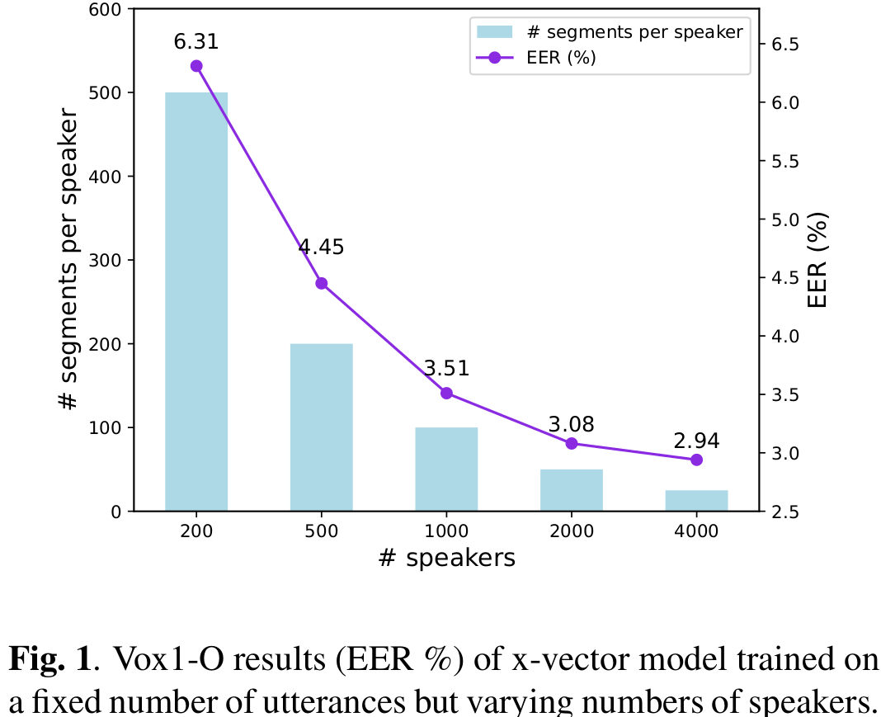
3.2. Proposed Method: Our preliminary result
To verify the importance of non-target speakers, a toy experiment is conducted
We trained different x-vector models:
a fixed number of training utterances (audio samples)
an increasing number of speakers in the training set ( but a lower number of utterances per speakers)
The data statistic of each training experiment (Total training utterances = 100,000)
# | No. speakers | No. audio samples per speaker
1 | 200 | 500
2 | 500 | 200
3 | 1000 | 100
4 | 2000 | 50
5 | 4000 | 25
The performance of the x-vector model consistently improves with an increasing number of non-target speakers in the training set.
→ This indicates the impact of non-target speakers

Slide 25
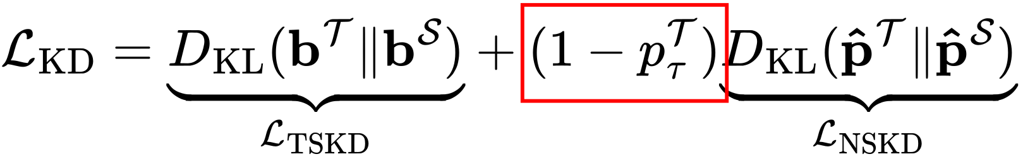
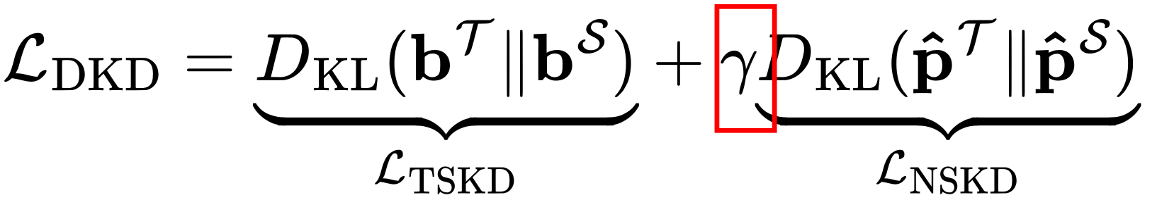
3.2. Proposed Method: Emphasized Non-target Speakers In Knowledge Distillation
Modified the label-level KD loss:
by emphasizing non-target speaker knowledge with a predefined weight as follows:
[1] Borui Zhao, Quan Cui, Renjie Song, Yiyu Qiu, and Jiajun Liang, “Decoupled knowledge distillation,” in IEEE/CVF CVPR, 2022

Slide 26
3.3. Experiments and results
Corpus
Train set: Voxceleb 2 dev set
5994 speakers, 1 092 009 utterances
Test set: Voxceleb 1 eval sets
Model
Teacher model: WavLM-Large + ECAPA-TDNN
Student models: X-vector (TDNN), ResNet34 (CNN), CAM++ (D-TDNN)
Training settings:
Input length: 2 seconds
Additive noise augmentation is applied randomly (p=0.6) with:
Environment noise
Room impulse response
Loss functions:
Additive angular margin loss (classification loss)
Knowledge distillation loss
[1] David Snyder, Daniel Garcia-Romero, Gregory Sell, Daniel Povey, and Sanjeev Khudanpur, “X-vectors: Robust dnn embeddings for speaker recognition,” in IEEE ICASSP, 2018
[2] Hossein Zeinali, Shuai Wang, Anna Silnova, Pavel Matějka, and Oldřich Plchot, “BUT system description to VoxCeleb speaker recognition challenge 2019,” in arXiv preprint arXiv:1910.12592, 2019.
[3] Hui Wang, Siqi Zheng, Yafeng Chen, Luyao Cheng, and Qian Chen, “CAM++: A Fast and Efficient Network for Speaker Verification Using Context-Aware Masking,” in Proc. INTERSPEECH, 2023

Slide 27
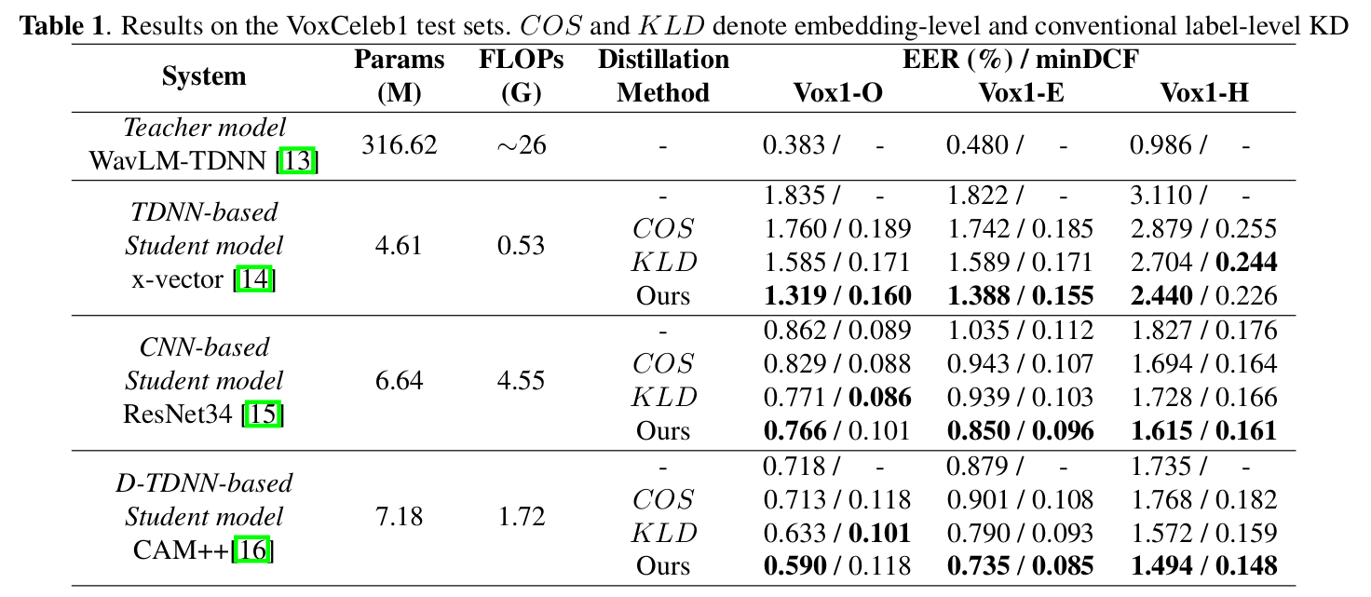
3.3. Experiments and results
[1] David Snyder, Daniel Garcia-Romero, Gregory Sell, Daniel Povey, and Sanjeev Khudanpur, “X-vectors: Robust dnn embeddings for speaker recognition,” in IEEE ICASSP, 2018
[2] Hossein Zeinali, Shuai Wang, Anna Silnova, Pavel Matějka, and Oldřich Plchot, “BUT system description to VoxCeleb speaker recognition challenge 2019,” in arXiv preprint arXiv:1910.12592, 2019.
[3] Hui Wang, Siqi Zheng, Yafeng Chen, Luyao Cheng, and Qian Chen, “CAM++: A Fast and Efficient Network for Speaker Verification Using Context-Aware Masking,” in Proc. INTERSPEECH, 2023

Slide 28
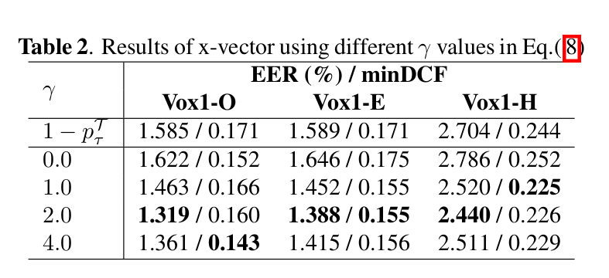
3.3. Experiments and results
The experiment shows the importance of non-target knowledge distillation:
by changing the value of gamma:

Slide 29
Outline
Introduction
What is Automatic Speaker Verification (ASV)?
Challenge for ASV system?
Literature Review
Overview of ASV system
Current approaches of noise-robust ASV models
Method
Emphasized Non-target Speakers In Knowledge Distillation
Conclusion and Future Works

Slide 30
4. Conclusion
We propose a method to improve the robustness of speaker verification model
Emphasized Non-target Speakers In Knowledge Distillation
To train smaller student models from a robust teacher model
Improve the knowledge distillation ability by focusing on non-target speaker information

Slide 31
4. Future works
Self-supervised learning for speaker verification
Pseudo-label
z1
z2
z3
(5)
Mask prediction loss
Hidden embeddings
h1
h2
h3
(4)
WavLM Encoder layers
K-Means
Mixing audio
(3) Masking
(1)
(2)
Add noise | Utterance mixing
Clean audio
[1] Chen, Sanyuan et al. “WavLM: Large-Scale Self-Supervised Pre-Training for Full Stack Speech Processing.” IEEE Journal of Selected Topics in Signal Processing 16 (2021.

Slide 32
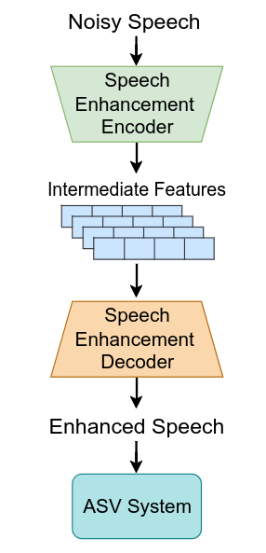
4. Future works
2. Speaker-aware speech enhancement for speaker verification
Distorting speaker information in the speech input

Slide 33
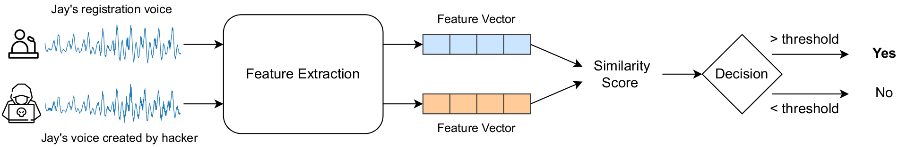
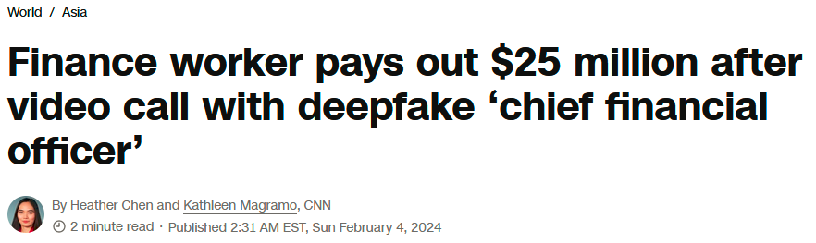

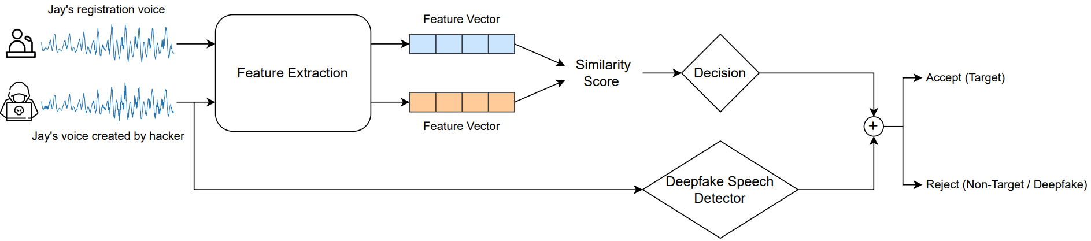
4. Future works
3. Speech Anti-spoofing

Slide 34
Thank you for your attention!
Feel free to ask questions.

Slide 35
Questions from committee members
Prof. Luu
Why Transformer does not perform well on ASV task?
is WavLM still the SOTA for ASV?
Question about the motivation: WavLM is not very big why don't use WavLM directly for the task?
Prof. Wang
Is the underperformance of transformer because of the training scheme is not suitable for transformer training?
Long tail problem of speaker verification when increase the number of speakers? Is there a problem when adding new speaker to the system?
Prof. Madhukumar
Can replace the K-Mean with more advanced clustering algorithm?
Can replace the KL-divergence with more advanced distance measurement like density distance?

Slide 36
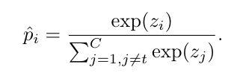
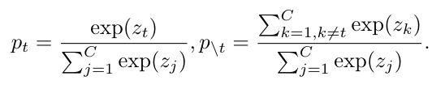
Appendix
The logit of a non-target i over all non-target classes
The logit of a class i
overall classes
The logit of a target class t
over all classes
The logit of non-target classes
over all classes
K: the number of training speakers
Target Speaker
Knowledge Distillation (TSKD)
Non-target Speaker
Knowledge Distillation (NSKD)
[1] Borui Zhao, Quan Cui, Renjie Song, Yiyu Qiu, and Jiajun Liang, “Decoupled knowledge distillation,” in IEEE/CVF CVPR, 2022
Notes:
‹#›

Slide 37
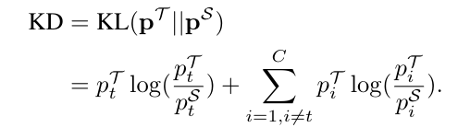
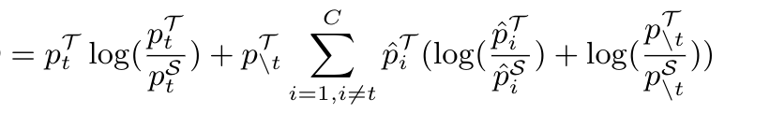

Appendix
The logit of a non-target i over all non-target classes
The logit of a class i
overall classes
The logit of a target class t
over all classes
The logit of all non-target classes
over all classes
(KL-Divergence between teacher & student logit distribution)
Re-formulating KL-Divergence
(Seperate the target & non-target class logit)
( )
[1] Borui Zhao, Quan Cui, Renjie Song, Yiyu Qiu, and Jiajun Liang, “Decoupled knowledge distillation,” in IEEE/CVF CVPR, 2022
Notes:
‹#›

Slide 38
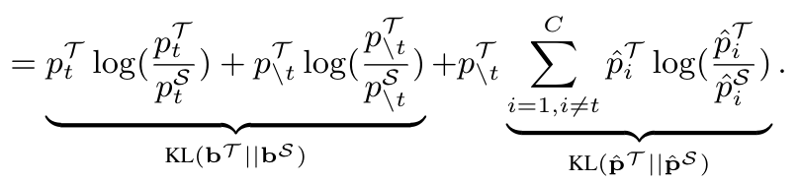
Appendix
(KL-Divergence between teacher & student logit distribution)
Re-formulating KL-Divergence
(Seperate the target & non-target class logit)
( bz )
Binary logits (target vs non-target class)
logits between all non-target classes
[1] Borui Zhao, Quan Cui, Renjie Song, Yiyu Qiu, and Jiajun Liang, “Decoupled knowledge distillation,” in IEEE/CVF CVPR, 2022
Notes:
‹#›

Slide 39
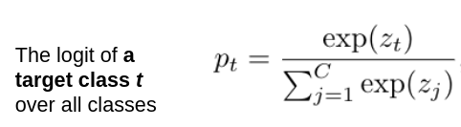

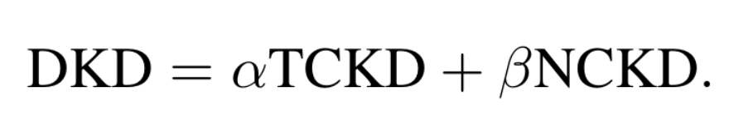
Appendix
When the model well predict the target class
High logit of the target class p_t ~= 1
p_t ~= 1
Vanishing
Final Re-formulating KL-Divergence
Decoupled KL-Divergence
[1] Borui Zhao, Quan Cui, Renjie Song, Yiyu Qiu, and Jiajun Liang, “Decoupled knowledge distillation,” in IEEE/CVF CVPR, 2022
Notes:
‹#›

