Slide 1
Data Structures and Algorithms
Dynamic Algorithms
PLSD210

Slide 2

Collision Frequency
Birthdays or the von Mises paradox
  There are 365 days in a normal year
    Birthdays on the same day unlikely?
  How many people do I need
  before “it’s an even bet”
  (ie the probability is > 50%)
  that two have the same birthday?
  View
    the days of the yearas the slots in a hash table
    the “birthday function” as mapping people to slots
  Answering von Mises’ question answers the question about the probability of collisions in a hash table

Slide 3
Distinct Birthdays
Let Q(n) = probability that n people have distinct birthdays
Q(1) = 1
With two people, the 2nd has only 364 “free” birthdays
The 3rd has only 363, and so on:
364
Q(2) = Q(1) *
365
364
364
365-n+1
Q(n) = Q(1) *
*
* … *
365
365
365

Slide 4
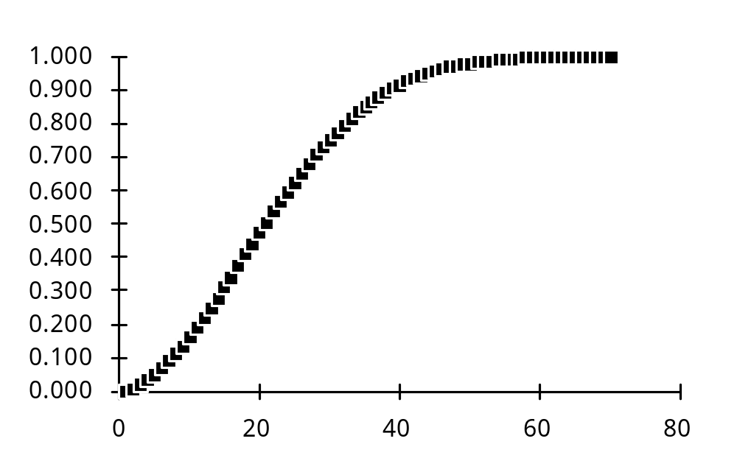
Coincident Birthdays
Probability of having two identical birthdays
P(n) = 1 - Q(n)
P(23) = 0.507
With 23 entries,
table is only
23/365 = 6.3%
full!

Slide 5
Hash Tables - Load factor
Collisions are very probable!
Table load factor
must be kept low
Detailed analyses of the average chain length
(or number of comparisons/search) are available
Separate chaining
  linked lists attached to each slot
gives best performance
  but uses more space!
n
n = number of items
α =
m
m = number of slots

Slide 6
Classes of Algorithms
Classes of Algorithms
  Polynomial
    Efficient O(n^{k})
  Intractable
    O(k^{n}) or O(n^{n}) or O(n!)
Efficient Algorithms
  Divide and Conquer
    Quick Sort; Binary Search; ....
  Dynamic Algorithms
    Where a divide phase doesn’t work!
    Doesn’t divide original problem into sufficiently small sub-problems

Slide 7
Dynamic Algorithms - Fibonacci numbers
Example
  Calculate Fibonacci numbers
  Simple, elegant!
  But .... Let’s analyze it’s performance!
int fib( int n ) {
if ( n < 2 ) return n;
else
return fib(n-1) + fib(n-2);
}

Slide 8
Fibonacci Numbers - Time complexity
int fib( int n ) {
if ( n < 2 ) return n;
else
return fib(n-1) + fib(n-2);
}
Analysis
  If time to calculate
  f_{n} is t_{n}
  then
    t_{n} = t_{n-1} + t_{n-2}
  Now
    t₁ = t₂ = c
  So
    t_{n} = c’f_{n-2}

Slide 9
Fibonacci Numbers & Fibonacci Time!
int fib( int n ) {
if ( n < 2 ) return n;
else
return fib(n-1) + fib(n-2);
}
Analysis
  So
    t_{n} = c’f_{n-2}
  but
  therefore
  and this is definitely not an efficient algorithm!!
f_{n+1}
√5 + 1
lim
=
= 1.618 ....
n→∞
f_{n}
2
f_{n+1}
= O( 1.618^{n} )

Slide 10
Fibonacci Numbers - Iterative solution
We all know how to calculate Fibonacci numbers
int fib( int n ) {
int f1, f2, f;
if ( n < 2 ) return n;
else {
f1 = f2 = 1;
for( k = 2; k < n; k++ ) {
f = f1 + f2;
f2 = f1;
f1 = f;
}
return f;
}

Slide 11
Fibonacci Numbers - Iterative solution
We all know how to calculate Fibonacci numbers
int fib( int n ) {
int f1, f2, f;
if ( n < 2 ) return n;
else {
f1 = f2 = 1;
for( k = 2; k < n; k++ ) {
f = f1 + f2;
f2 = f1;
f1 = f;
}
return f;
}
Note the f1, f2 here
We start by solving the
smallest problems
Then use those solutions
to solve bigger and bigger
problems

Slide 12
Saving the Small Problem Solutions
We all know how to calculate Fibonacci numbers
int fib( int n ) {
int f1, f2, f;
if ( n < 2 ) return n;
else {
f1 = f2 = 1;
for( k = 2; k < n; k++ ) {
f = f1 + f2;
f2 = f1;
f1 = f;
}
return f;
}
Note the f1, f2 here
Then use those solutions
to solve bigger and bigger
problems
At every stage,
we retain the solutions
to the previous two problems
in f1 and f2

Slide 13
Dynamic Approach
Dynamic Approach
  Solve the small problems
  Store the solutions
  Use those solutions
  to solve larger problems
Iterative Fibonacci
  O( n )
  vs O( n^{n} ) for the recursive case!
Dynamic algorithms
use space
No free lunch!

Slide 14
Dynamic Approach
Dynamic Approach
  Solve the small problems
  Store the solutions
  Use those solutions for larger problems
Iterative Fibonacci
  O( n )
  vs O( n^{n} ) for the recursive case!
Another case where not knowing your algorithms
could lead to
extreme professional embarrassment!

Slide 15
Binomial Coefficients
Recursive definition
As for Fibonacci numbers,
time is O( ) which grows exponentially
eg you can show
(
n
)
(
n
)
= 1
= 1
0
n
(
n
)
(
n-1
)
(
n-1
)
=
+
m
m-1
m
(
n
)
m
(
n
)
>=
2^{n}
n/2
n

Slide 16
Binomial Coefficients
1
Pascal’s Triangle
Each entry O(1) time
O(n²) entries
O(n²) time to calculate
all the binomial coefficients
Dynamic algorithms
  Solve small problems first,
  Use solutions for larger problems
  Requires space to store previous row of the triangle
  Speed for space trade-off typical of dynamic algorithms
1
1
1
2
1
1
3
3
1
1
4
6
4
1
1
5
10
10
5
1

Slide 17
Lecture 18 - Key Points
Hash Tables
  Using the birthday problem
    Discovered that collisions are frequent!
  Load factor
    Keep low to reduce collision frequency
  Hash Tables do work!
    Easily (most of the time)
      Especially if you can test the data beforehand!
    Find acceptable hash function and table size empirically

Slide 18
Lecture 18 - Key Points
Dynamic Algorithms
  Solve small problems
  Store answers to these small problems
  Use the small problem results to answer larger problems
  Use space to obtain speed-up
  Examples
    Fibonacci numbers
      Recursive: O(n^{n}) Iterative (dynamic): O(n)
    Binomial coefficients
      Recursive: O(n^{n}) Iterative (dynamic): O(n²)

Slide 19
Optimal Binary Search Trees
Balanced trees
  Always the most efficient search trees?

Slide 20
Optimal Binary Search Trees
Balanced trees
  Always the most efficient search trees?
  Yes, if every key is equally probable
Spelling check dictionary
  Entry at root of a balanced tree ... miasma?
  Occurrence in ordinary text ... 0.01%, 0.0001%, .. ?
  99.99+% of searches waste at least one comparison!
  Common words (‘a’, ‘and’, ‘the’, ...) in leaves?
  If key, k, has relative frequency, r_{k} ,
  then in an optimal tree, we minimise
Σd_{k}r_{k}
d_{k}
is the depth of key k

Slide 21
Optimal Binary Search Trees
Finding the optimal tree
Try each “candidate” key as the root
  Divides the keys into left and right groups
  Try each key in the left group as root of the left sub-tree
  ...
Number of candidate keys: O(n)
Number of candidates for roots of sub-trees: 2O(n)
O(n^{n}) algorithm

Slide 22
Optimal Binary Search Trees
Lemma
  Sub-trees of optimal trees are themselves optimal trees
Proof
  If a sub-tree of an optimal tree is not optimal,
  then a better search tree will be produced if the sub-tree is replaced by an optimal tree.

Slide 23
Optimal Binary Search Trees
Key Table
  Keys (in order) + frequency
Key Problem
  Which key should be placed at the root?
    If we can determine this, we can ask the same question for the left and right subtrees.
A
B
C
D
E
F
G
H
I
J
K
L
M
N
O
P
..
23
10
8
12
30
5
14
18
20
2
4
11
7
22
22
10
..

Slide 24
Optimal Binary Search Tree
Divide and conquer?
  Choose a key for the root n choices
  Repeat the process for the sub-trees 2 O(n)
  O(n^{n})
Smaller problems are not small enough!
  One k, one n-k-1

Slide 25
Optimal Binary Search Tree
Start with the small problems
Look at pairs of adjacent keys
Two possible
arrangements
A
B
C
D
E
F
G
H
I
J
K
L
M
N
O
P
..
23
10
8
12
30
5
14
18
20
2
4
11
7
22
22
10
..
C
D
Min
D
C
Cost
8x1 + 12x2 = 32
8x2 + 12x1 = 28

Slide 26
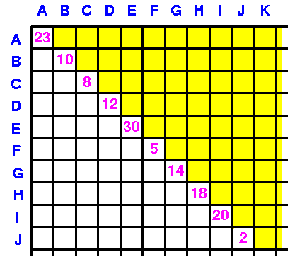
Optimal Binary Search Tree - Cost matrix
Initialise
Diagonal
  C[j,j]
  Costs of
  one-element ‘trees’
Below diagonal
  C[j,k]
  Costs of best tree
  j to k
C_{jj}
Zero
x
Cost of best tree C-G

Slide 27
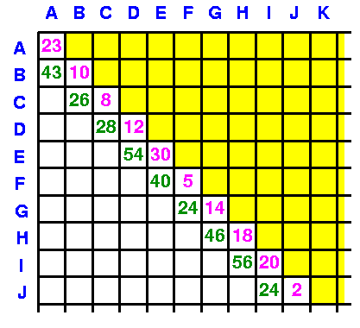
Optimal Binary Search Tree - Cost matrix
Store the costs of the best two element trees
Diagonal
  C[j,j]
  Costs of
  one-element ‘trees’
Below diagonal
  C[j-1,j]
  Costs of best
  2-element trees
  j-1 to j
C_{j-1,j}

Slide 28
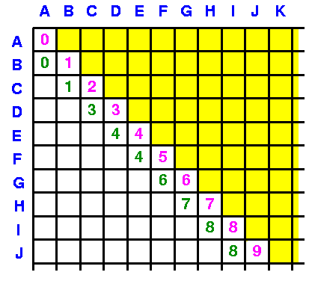
Optimal Binary Search Tree - Root matrix
Store the roots of the best two element trees
Diagonal
  Roots of 1-element trees
Below diagonal
  best[j-1,j]
  Root of best
  2-element trees
  j-1 to j

Slide 29
Optimal Binary Search Tree - 3-element trees
Now examine the 3-element trees
Choose each in turn as the root
  B with (C,D) to the right
  C with B and D as children
  D with (B,C) to the left
Find best, store cost in C[B,D]
Store root in best[B,D]
A
B
C
D
E
F
G
H
I
J
K
L
M
N
O
P
..
23
10
8
12
30
5
14
18
20
2
4
11
7
22
22
10
..
Next slide

Slide 30
Optimal Binary Search Tree - 3-element trees
3-element trees
Find best, store cost in C[B,D]
Store root in best[B,D]
Root = B
Root = C
Root = D
B
We already
know this is
best for C,D
and stored
its cost
D
C
D
B
B
D
C
C
Best B,C

Slide 31
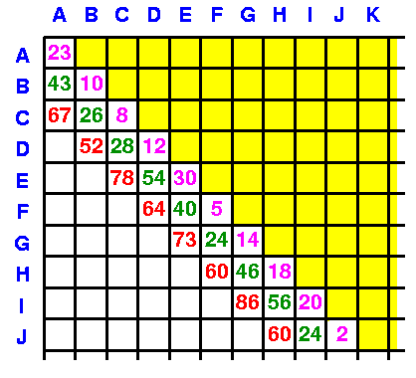
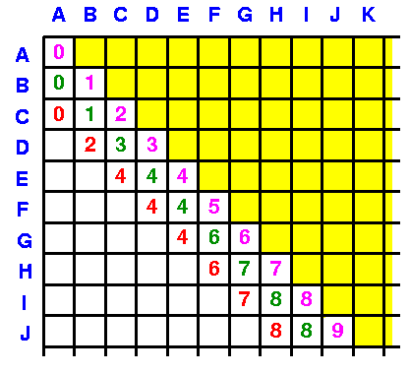
Optimal Binary Search Tree - 3-element trees
Similarly, update all C[j-2,j] and best[j-2,j]
Costs
Roots

Slide 32
Optimal Binary Search Trees - 4-trees
Now the 4-element trees
eg A-D
  Choose A as root
  Choose B as root
  Choose C as root
  Choose D as root
Use 0 for left
Best B-D is known
A-A is in C[0,0]
Best C-D is known
A-B is in C[0,1]
D is in C[3,3]
A-C is in C[0,2]
Use 0 in C[4,3] for right

Slide 33
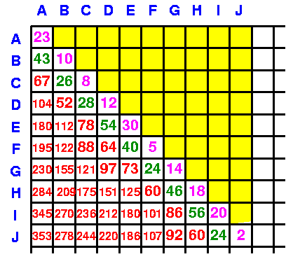
Optimal Binary Search Trees
Final cost will be in C[0,n-1]
Final
cost

Slide 34
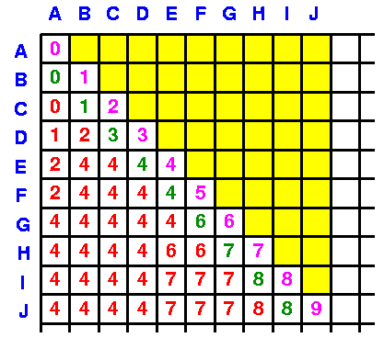
Optimal Binary Search Trees
Construct the search tree
Root will be in
best[0,n-1]
If r0 = best[0,n-1],
Left subtree root is
best[0,r0-1],
Right subtree root is
best[r0+1,n-1]
Root = ‘E’

Slide 35
Optimal Binary Search Trees
Construct the search tree
E
B
H
A
D
G
I
C
F
J

Slide 36
Optimal Binary Search Trees - Analysis
k -element trees require k operations
  One for each candidate root
There are k of them O(k²)
There are n levels
Constructing the tree is O(n)
  Average ~ logn
Total O(n³)
n
Σ k² = O(n³)
k =1

Slide 37
Optimal Binary Search Trees - Notes
A good example of a dynamic algorithm
  Solves all the small problems
  Builds solutions to larger problems from them
  Requires space to store small problem results
Code in notes
  A Java version has more explicit variable names!
    Attached to the Web notes
  See the animation coming soon!

Slide 38
Other Dynamic Algorithms
Matrix Chain Multiplication
  We have to compute a product of n matrices:
  Matrix multiplication is associative
    We can compute this in many ways
  Aside
    time complexity for multiplying two nxn matrices?
  What is the optimal parenthesisation?
A₁A₂A₃...A_{n}
(A₁A₂) (A₃...A_{n})
A₁(A₂ A₃) (...A_{n})
etc

Slide 39
Matrix Chain Multiplication
Example
  A₁ - 10x100 A₂ - 100x5 A₃ - 5x50
A₁A₂A₃
(A₁A₂)A₃
A₁A₂ 10x100x5 = 5000 => A₁A₂ (10x5)
(A₁A₂)A₃ 10x5x50 = 2500
Σ 7500
A₁(A₂A₃)
A₂A₃ 100x5x50 = 25000 => A₂A₃ (100x50)
A₁(A₂A₃) 10x100x50 = 5000
Σ 75000

Slide 40
Matrix Chain Multiplication
Optimal sub-structure
  Subchains of optimal parenthesisations must be optimal parenthesisations
  Otherwise we could replace them with cheaper parenthesisations
    As with the optimal binary search tree
  This is a hallmark of dynamic algorithms
Finding the optimal chain
  Compute the costs of A₁A₂, A₂A₃, ...
  Use them to compute the optimal A₁A₂A₃, A₂A₃A₄, ..
  O(n³) algorithm requiring O(n²) space!!

Slide 41
Matrix Chain Multiplication
Optimal sub-structure
  Subchains of optimal parenthesisations must be optimal parenthesisations
  Otherwise we could replace them with cheaper parenthesisations
    As with the optimal binary search tree
  This is a hallmark of dynamic algorithms
Finding the optimal chain
  Compute the costs of A₁A₂, A₂A₃, ...
  Use them to compute the optimal A₁A₂A₃, A₂A₃A₄, ..
  O(n³) algorithm requiring O(n²) space!!
Note that we can measure space requirements
using the O(..) notation also!

Slide 42
Other Dynamic Problems
Longest common sub-sequence
  Two sequences of symbols
    X = x₁x₂x₃ ... x_{n}
    Y = y₁y₂y₃ ... y_{m}
  What’s the longest sequence
    Z = z₁z₂z₃ ... z_{p}
  found in both X and Y?

Slide 43
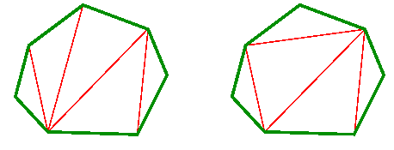
Other Dynamic Problems
Optimal polygon triangulation
  A polygon can be divided intro triangles in a number of ways
  If there is a weight
  associated with
  each triangle,
  Find the triangulation
  of
  minimum (maximum) weight
  Any weight, eg length of perimeter, will do!
This problem maps to matrix chain multiplication

Slide 44
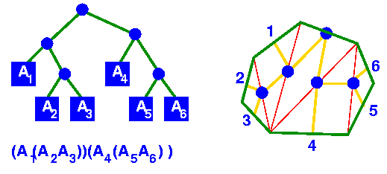
Mapping Problems to Related Ones
Polygon triangulation / matrix chain multiplication
  Key Capability:
    Identify different problems with the same solution
    Map one problem to another

