Slide 1
Data Structures and Algorithms
Searching
Hash Tables
PLSD210

Slide 2
Hash Tables
All search structures so far
  Relied on a comparison operation
  Performance O(n) or O( log n)
Assume I have a function
  f ( key ) → integer
  ie one that maps a key to an integer
What performance might I expect now?

Slide 3
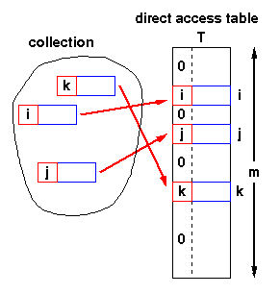
Hash Tables - Structure
Simplest case:
  Assume items have integer keys in the range 1 .. m
  Use the value of the key itself
  to select a slot in a
  direct access table
  in which to store the item
  To search for an item with key, k,
  just look in slot k
    If there’s an item there,
    you’ve found it
    If the tag is 0, it’s missing.
  Constant time, O(1)

Slide 4
Hash Tables - Constraints
Constraints
  Keys must be unique
  Keys must lie in a small range
  For storage efficiency,
  keys must be dense in the range
  If they’re sparse (lots of gaps between values),
  a lot of space is used to obtain speed
    Space for speed trade-off

Slide 5
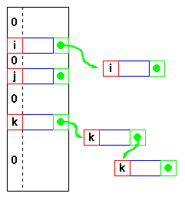
Hash Tables - Relaxing the constraints
Keys must be unique
  Construct a linked list of duplicates
  “attached” to each slot
  If a search can be satisfied
  by any item with key, k,
  performance is still O(1)
  but
  If the item has some
  other distinguishing feature
  which must be matched,
  we get O(n^{max})
  where n^{max} is the largest number
  of duplicates - or length of the longest chain

Slide 6
Hash Tables - Relaxing the constraints
Keys are integers
  Need a hash function
  h( key ) → integer
  ie one that maps a key to
  an integer
  Applying this function to the
  key produces an address
  If h maps each key to a unique
  integer in the range 0 .. m-1
  then search is O(1)

Slide 7
Hash Tables - Hash functions
Form of the hash function
  Example - using an n-character key
  int hash( char *s, int n ) {
  int sum = 0;
  while( n-- ) sum = sum + *s++;
  return sum % 256;
  }
  returns a value in 0 .. 255
  xor function is also commonly used
  sum = sum ^ *s++;
  But any function that generates integers in 0..m-1 for some suitable (not too large) m will do
  As long as the hash function itself is O(1) !

Slide 8
Hash Tables - Collisions
Hash function
  With this hash function
  int hash( char *s, int n ) {
  int sum = 0;
  while( n-- ) sum = sum + *s++;
  return sum % 256;
  }
  hash( “AB”, 2 ) and
  hash( “BA”, 2 )
  return the same value!
  This is called a collision
  A variety of techniques are used for resolving collisions

Slide 9
Hash Tables - Collision handling
Collisions
  Occur when the hash function maps
  two different keys to the same address
  The table must be able to recognise and resolve this
  Recognise
    Store the actual key with the item in the hash table
    Compute the address
      k = h( key )
    Check for a hit
      if ( table[k].key == key ) then hit
      else try next entry
  Resolution
    Variety of techniques
We’ll look at various
“try next entry” schemes

Slide 10
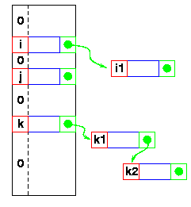
Hash Tables - Linked lists
Collisions - Resolution
  Linked list attached
  to each primary table slot
    h(i) == h(i1)
    h(k) == h(k1) == h(k2)
  Searching for i1
    Calculate h(i1)
    Item in table, i,
    doesn’t match
    Follow linked list to i1
  If NULL found,
  key isn’t in table

Slide 11
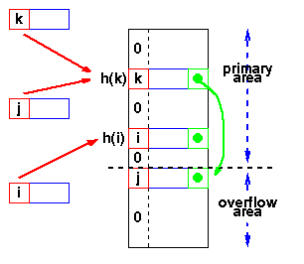
Hash Tables - Overflow area
  Overflow area
    Linked list constructed
    in special area of table
    called overflow area
  h(k) == h(j)
  k stored first
  Adding j
    Calculate h(j)
    Find k
    Get first slot in overflow area
    Put j in it
    k’s pointer points to this slot
  Searching - same as linked list

Slide 12
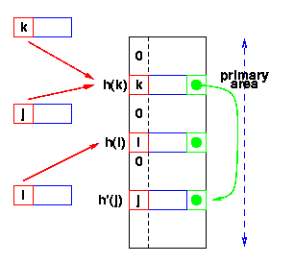
Hash Tables - Re-hashing
  Use a second hash function
    Many variations
    General term: re-hashing
  h(k) == h(j)
  k stored first
  Adding j
    Calculate h(j)
    Find k
    Repeat until we find an empty slot
      Calculate h’(j)
    Put j in it
  Searching - Use h(x), then h’(x)
h’(x) -
second hash function

Slide 13
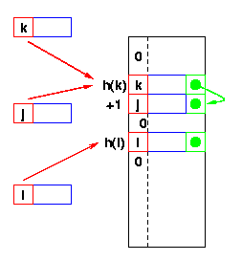
Hash Tables - Re-hash functions
  The re-hash function
    Many variations
  Linear probing
    h’(x) is +1
    Go to the next slot
    until you find one empty
  Can lead to bad clustering
  Re-hash keys fill in gaps
  between other keys and exacerbate
  the collision problem

Slide 14
Hash Tables - Re-hash functions
  The re-hash function
    Many variations
  Quadratic probing
    h’(x) is c i² on the i^{th} probe
    Avoids primary clustering
    Secondary clustering occurs
      All keys which collide on h(x) follow the same sequence
      First
        a = h(j) = h(k)
      Then a + c, a + 4c, a + 9c, ....
      Secondary clustering generally less of a problem

Slide 15
Hash Tables - Collision Resolution Summary
Chaining
  Unlimited number of elements
  Unlimited number of collisions
  Overhead of multiple linked lists
Re-hashing
  Fast re-hashing
  Fast access through use of main table space
  Maximum number of elements must be known
  Multiple collisions become probable
Overflow area
  Fast access
  Collisions don't use primary table space
  Two parameters which govern performance need to be estimated

Slide 16
Hash Tables - Collision Resolution Summary
Re-hashing
  Fast re-hashing
  Fast access through use of main table space
  Maximum number of elements must be known
  Multiple collisions become probable
Overflow area
  Fast access
  Collisions don't use primary table space
  Two parameters which govern performance need to be estimated

Slide 17
Hash Tables - Summary so far ...
Potential O(1) search time
  If a suitable function h(key) → integer can be found
Space for speed trade-off
  “Full” hash tables don’t work (more later!)
Collisions
  Inevitable
    Hash function reduces amount of information in key
  Various resolution strategies
    Linked lists
    Overflow areas
    Re-hash functions
      Linear probing h’ is +1
      Quadratic probing h’ is +ci²
      Any other hash function!
        or even sequence of functions!

Slide 18
Hash Tables - Choosing the Hash Function
“Almost any function will do”
  But some functions are definitely better than others!
Key criterion
  Minimum number of collisions
    Keeps chains short
    Maintains O(1) average

Slide 19
Hash Tables - Choosing the Hash Function
Uniform hashing
  Ideal hash function
    P(k) = probability that a key, k, occurs
    If there are m slots in our hash table,
    a uniform hashing function, h(k), would ensure:
    or, in plain English,
    the number of keys that map to each slot is equal
Σ P(k) =
Σ P(k) = ....
Σ P(k) =
1
m
k | h(k) = 0
k | h(k) = 1
k | h(k) = m-1
Read as sum over all k such that h(k) = 0

Slide 20
Hash Tables - A Uniform Hash Function
If the keys are integers
randomly distributed in [ 0 , r ),
then
is a uniform hash function
Most hashing functions can be made to map the keys
to [ 0 , r ) for some r
  eg adding the ASCII codes for characters mod 255
  will give values in [ 0, 256 ) or [ 0, 255 ]
  Replace + by xor
    same range without the mod operation
Read as 0 ≤ k < r
mk
h(k) =
r

Slide 21
Hash Tables - Reducing the range to [ 0, m )
We’ve mapped the keys to a range of integers
0 ≤ k < r
Now we must reduce this range to [ 0, m )
where m is a reasonable size for the hash table
Strategies
  Division - use a mod function
  Multiplication
  Universal hashing

Slide 22
Hash Tables - Reducing the range to [ 0, m )
Division
  Use a mod function
    h(k) = k mod m
  Choice of m?
    Powers of 2 are generally not good!
    h(k) = k mod 2^{n}
    selects last n bits of k
      All combinations are not generally equally likely
  Prime numbers close to 2^{n} seem to be good choices
    eg want ~4000 entry table, choose m = 4093
k mod 2⁸ selects these bits
0110010111000011010

Slide 23
Hash Tables - Reducing the range to [ 0, m )
Multiplication method
  Multiply the key by constant, A, 0 < A < 1
  Extract the fractional part of the product
    ( kA - ⎣kA⎦ )
  Multiply this by m
    h(k) = ⎣m * ( kA - ⎣kA⎦ )⎦
  Now m is not critical and a power of 2 can be chosen
  So this procedure is fast on a typical digital computer
    Set m = 2^{p}
    Multiply k (w bits) by ⎣A•2^{w}⎦ ⬅ 2w bit product
    Extract p most significant bits of lower half
    A = ½(√5 -1) seems to be a good choice (see Knuth)

Slide 24
Hash Tables - Reducing the range to [ 0, m )
Universal Hashing
  A determined “adversary” can always find a set of data that will defeat any hash function
    Hash all keys to same slot ⬅ O(n) search
  Select the hash function randomly (at run time)
  from a set of hash functions
  Reduced probability of poor performance
  Set of functions, H, which map keys to [ 0, m )
  H, is universal, if for each pair of keys, x and y,
  the number of functions, h ⊂ H,
  for which h(x) = h(y) is |H |/m

Slide 25
Hash Tables - Reducing the range to ( 0, m ]
Universal Hashing
  A determined “adversary” can always find a set of data that will defeat any hash function
    Hash all keys to same slot ⬅ O(n) search
  Select the hash function randomly (at run time)
  from a set of hash functions
  ---------
  Functions are selected at run time
    Each run can give different results
    Even with the same data
    Good average performance obtainable

Slide 26
Hash Tables - Reducing the range to ( 0, m ]
Universal Hashing
  Can we design a set of universal hash functions?
  Quite easily
  Key, x = x₀, x₁, x₂, ...., x_{r}
  Choose a = <a₀, a₁, a₂, ...., a_{r}>
  a is a sequence of elements
  chosen randomly from { 0, m-1 }
  h_{a}(x) = Σ a_{i}x_{i} mod m
  There are m^{r+1} sequences a,
  so there are m^{r+1} functions, h_{a}(x)
  Theorem
    The h_{a} form a set of universal hash functions
x₀ x₁ x₂ .... x_{r}
n-bit “bytes” of x
Proof:
See Cormen

Slide 27

Collision Frequency
Birthdays or the von Mises paradox
  There are 365 days in a normal year
    Birthdays on the same day unlikely?
  How many people do I need
  before “it’s an even bet”
  (ie the probability is > 50%)
  that two have the same birthday?
  View
    the days of the year as the slots in a hash table
    the “birthday function” as mapping people to slots
  Answering von Mises’ question answers the question about the probability of collisions in a hash table

Slide 28
Distinct Birthdays
Let Q(n) = probability that n people have distinct birthdays
Q(1) = 1
With two people, the 2nd has only 364 “free” birthdays
The 3rd has only 363, and so on:
364
Q(2) = Q(1) *
365
364
364
365-n+1
Q(n) = Q(1) *
*
* … *
365
365
365

Slide 29
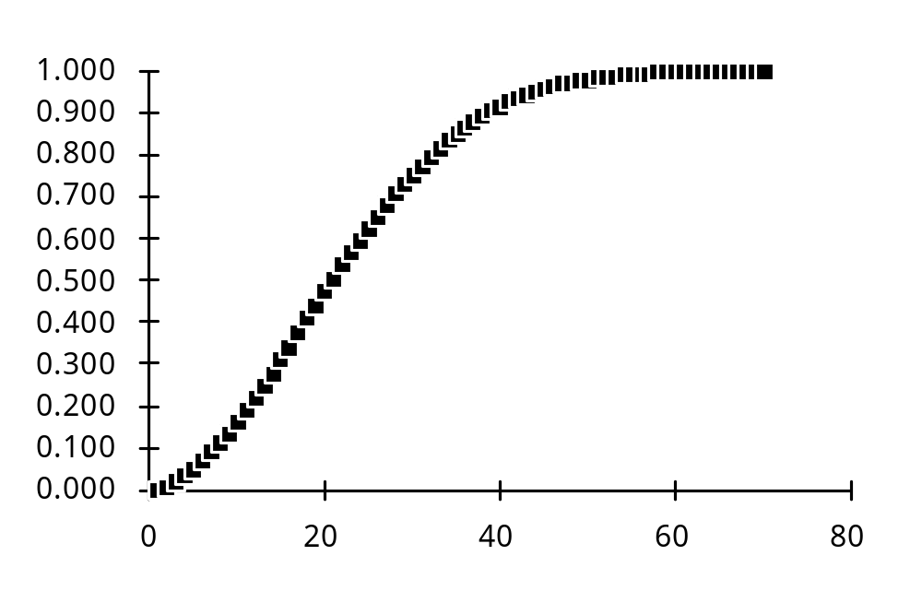
Coincident Birthdays
Probability of having two identical birthdays
P(n) = 1 - Q(n)
P(23) = 0.507
With 23 entries,
table is only
23/365 = 6.3%
full!

Slide 30
Hash Tables - Load factor
Collisions are very probable!
Table load factor
must be kept low
Detailed analyses of the average chain length
(or number of comparisons/search) are available
Separate chaining
  linked lists attached to each slot
gives best performance
  but uses more space!
n
n = number of items
α =
m
m = number of slots

Slide 31
Hash Tables - General Design
Choose the table size
  Large tables reduce the probability of collisions!
  Table size, m
  n items
  Collision probability α = n / m
Choose a table organisation
  Does the collection keep growing?
    Linked lists (....... but consider a tree!)
  Size relatively static?
    Overflow area or
    Re-hash
Choose a hash function
....

Slide 32
Hash Tables - General Design
Choose a hash function
  A simple (and fast) one may well be fine ...
  Read your text for some ideas!
Check the hash function against your data
  Fixed data
    Try various h, m
    until the maximum collision chain is acceptable
    Known performance
  Changing data
    Choose some representative data
    Try various h, m until collision chain is OK
    Usually predictable performance

Slide 33
Hash Tables - Review
If you can meet the constraints
Hash Tables will generally give good performance
O(1) search
  Like radix sort,
  they rely on calculating an address from a key
  But, unlike radix sort,
  relatively easy to get good performance
    with a little experimentation
      not advisable for unknown data
    collection size relatively static
    memory management is actually simpler
      All memory is pre-allocated!

