Slide 1
Data Structures and Algorithms
PLSD210(ii)
Searching

Slide 2
Searching
Sequential Searches
  Time is proportional to n
  We call this time complexity O(n)
  Pronounce this “big oh” of n
  Both arrays (unsorted) and linked lists
Binary search
  Sorted array
  Time proportional to log₂ n
  Time complexity O(log n)

Slide 3
Searching - Binary search
Creating the sorted array
  AddToCollection
    adds each item in correct place
    Find position c₁ log₂ n
    Shuffle down c₂ n
    Overall c₁ log₂ n + c₂ n
    or c₂ n
  Each add to the sorted array is O(n)
Can we maintain a sorted array
with cheaper insertions?
Dominant
term

Slide 4
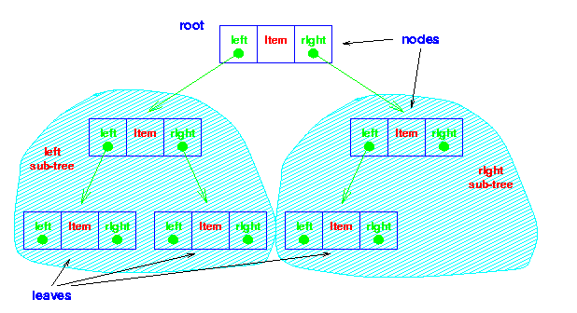
Trees
Binary Tree
  Consists of
    Node
    Left and Right sub-trees
    Both sub-trees are binary trees

Slide 5
Trees
Binary Tree
  Consists of
    Node
    Left and Right sub-trees
    Both sub-trees are binary trees
Note the
recursive
definition!
Each sub-tree
is itself
a binary tree

Slide 6
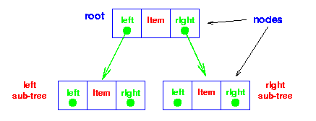
Trees - Implementation
Data structure
struct t_node {
void *item;
struct t_node *left;
struct t_node *right;
};
typedef struct t_node *Node;
struct t_collection {
Node root;
……
};

Slide 7
Trees - Implementation
Find
extern int KeyCmp( void *a, void *b );
/* Returns -1, 0, 1 for a < b, a == b, a > b */
void *FindInTree( Node t, void *key ) {
if ( t == (Node)0 ) return NULL;
switch( KeyCmp( key, ItemKey(t->item) ) ) {
case -1 : return FindInTree( t->left, key );
case 0: return t->item;
case +1 : return FindInTree( t->right, key );
}
}
void *FindInCollection( collection c, void *key ) {
return FindInTree( c->root, key );
}
Less,
search
left
Greater,
search right

Slide 8
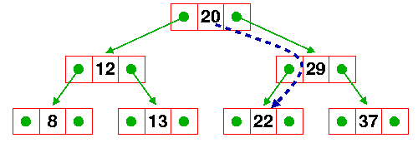
Trees - Implementation
Find
  key = 22;
  if ( FindInCollection( c , &key ) ) ….
n = c->root;
FindInTree( n, &key );
FindInTree(n->right,&key );
FindInTree(n->left,&key );
return n->item;

Slide 9
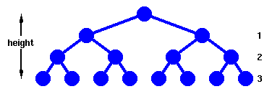
Trees - Performance
Find
  Complete Tree
  Height, h
    Nodes traversed in a path from the root to a leaf
  Number of nodes, h
    n = 1 + 2¹ + 2² + … + 2^{h} = 2^{h+1} - 1
    h = floor( log₂ n )

Slide 10
Trees - Performance
Find
  Complete Tree
  Since we need at most h+1 comparisons,
  find in O(h+1) or O(log n)
  Same as binary search

Slide 11
Lecture 2 & 3 - Summary
Add
Delete
Find
Arrays
Simple, fast
Inflexible
O(1)
O(n) inc sort
O(n)
O(n)
O(logn)
binary search
Linked List
Simple
Flexible
O(1)
sort -> no adv
O(1) - any
O(n) - specific
O(n)
(no bin search)
Trees
Still Simple
Flexible
O(log n)

Slide 12
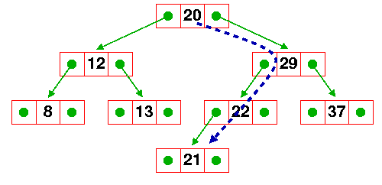
Trees - Addition
Add 21 to the tree
  We need at most h+1 comparisons
  Create a new node (constant time)
  add takes c₁(h+1)+c₂ or c log n
  So addition to a tree takes
  time proportional to log n
  also
Ignoring
low order
terms

Slide 13
Trees - Addition - implementation
static void AddToTree( Node *t, Node new ) {
Node base = *t;
/* If it's a null tree, just add it here */
if ( base == NULL ) {
*t = new; return; }
else
if( KeyLess(ItemKey(new->item),ItemKey(base->item)) )
AddToTree( &(base->left), new );
else
AddToTree( &(base->right), new );
}
void AddToCollection( collection c, void *item ) {
Node new, node_p;
new = (Node)malloc(sizeof(struct t_node));
/* Attach the item to the node */
new->item = item;
new->left = new->right = (Node)0;
AddToTree( &(c->node), new );
}

Slide 14
Trees - Addition
Find c log n
Add c log n
Delete c log n
Apparently efficient in every respect!
But there’s a catch ………..

Slide 15
Trees - Addition
Take this list of characters and form a tree
A B C D E F
??

Slide 16
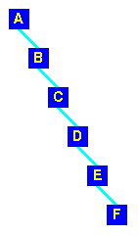
Trees - Addition
Take this list of characters and form a tree
A B C D E F
In this case
  Find
  Add
  Delete

