Slide 1
Data Structures and Algorithms
PLSD210(ii)
Stacks

Slide 2
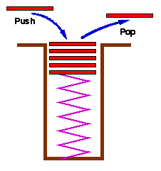
Stacks
Stacks are a special form of collection
with LIFO semantics
Two methods
  int push( Stack s, void *item );
  - add item to the top of the stack
  void *pop( Stack s );
  - remove an item from the top of the stack
Like a plate stacker
Other methods
  int IsEmpty( Stack s );
  /* Return TRUE if empty */
  void *Top( Stack s );
  /* Return the item at the top,
  without deleting it */

Slide 3
Stacks - Implementation
Arrays
  Provide a stack capacity to the constructor
  Flexibility limited but matches many real uses
    Capacity limited by some constraint
      Memory in your computer
      Size of the plate stacker, etc
push, pop methods
  Variants of AddToC…, DeleteFromC…
Linked list also possible
Stack:
  basically a Collection with special semantics!

Slide 4
Stacks - Relevance
Stacks appear in computer programs
  Key to call / return in functions & procedures
  Stack frame allows recursive calls
  Call: push stack frame
  Return: pop stack frame
Stack frame
  Function arguments
  Return address
  Local variables

Slide 5
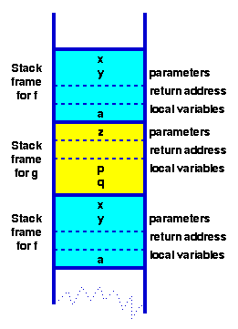
Stack Frames - Functions in HLL
Program
function f( int x, int y) {
int a;
if ( term_cond ) return …;
a = ….;
return g( a );
}
function g( int z ) {
int p, q;
p = …. ; q = …. ;
return f(p,q);
}
Context
for execution of f

Slide 6
Recursion
Very useful technique
  Definition of mathematical functions
  Definition of data structures
    Recursive structures are naturally processed by recursive functions!

Slide 7
Recursion
Very useful technique
  Definition of mathematical functions
  Definition of data structures
    Recursive structures are naturally processed by recursive functions!
Recursively defined functions
  factorial
  Fibonacci
  GCD by Euclid’s algorithm
  Fourier Transform
  Games
    Towers of Hanoi
    Chess

Slide 8
Recursion - Example
Fibonacci Numbers
Pseudo-code
fib( n ) = if ( n = 0 ) then 1
else if ( n = 1 ) then 1
else fib(n-1) + fib(n-2)
C
int fib( n ) {
if ( n < 2 ) return 1;
else return fib(n-1) + fib(n-2);
}
Simple, elegant solution!

Slide 9
Recursion - Example
Fibonacci Numbers
C
int fib( n ) {
if ( n < 2 ) return 1;
else return fib(n-1) + fib(n-2);
}
But, in the Fibonacci case, a run-time disaster!!!!
However, many recursive functions,
eg binary search, are simple, elegant and efficient!

