Slide 1
Ranging Measure Report
Ngày/tháng/năm
GVHD:
Tên SV1: MSSV:
Tên SV1: MSSV:
Copyrights 2016 UIT-Khoa KTMT . All Rights Reserved.

Slide 2
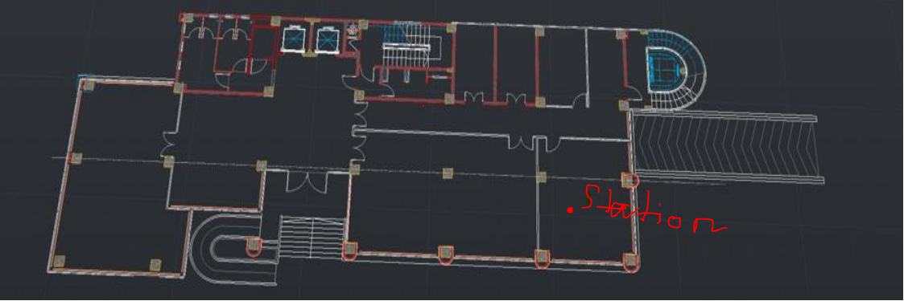
Stations Position
The stations is located at 6.8
Copyrights 2016 UIT-Khoa KTMT . All Rights Reserved.

Slide 3
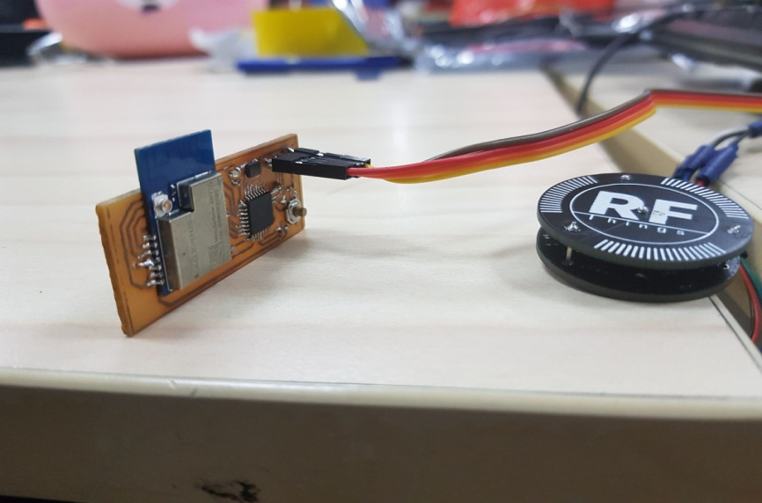
Antenna position
Antenna placement
Copyrights 2016 UIT-Khoa KTMT . All Rights Reserved.

Slide 4
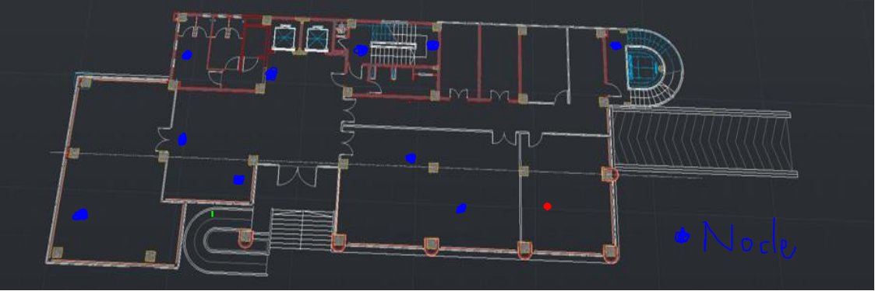
Node positions
Node positions
Copyrights 2016 UIT-Khoa KTMT . All Rights Reserved.

Slide 5
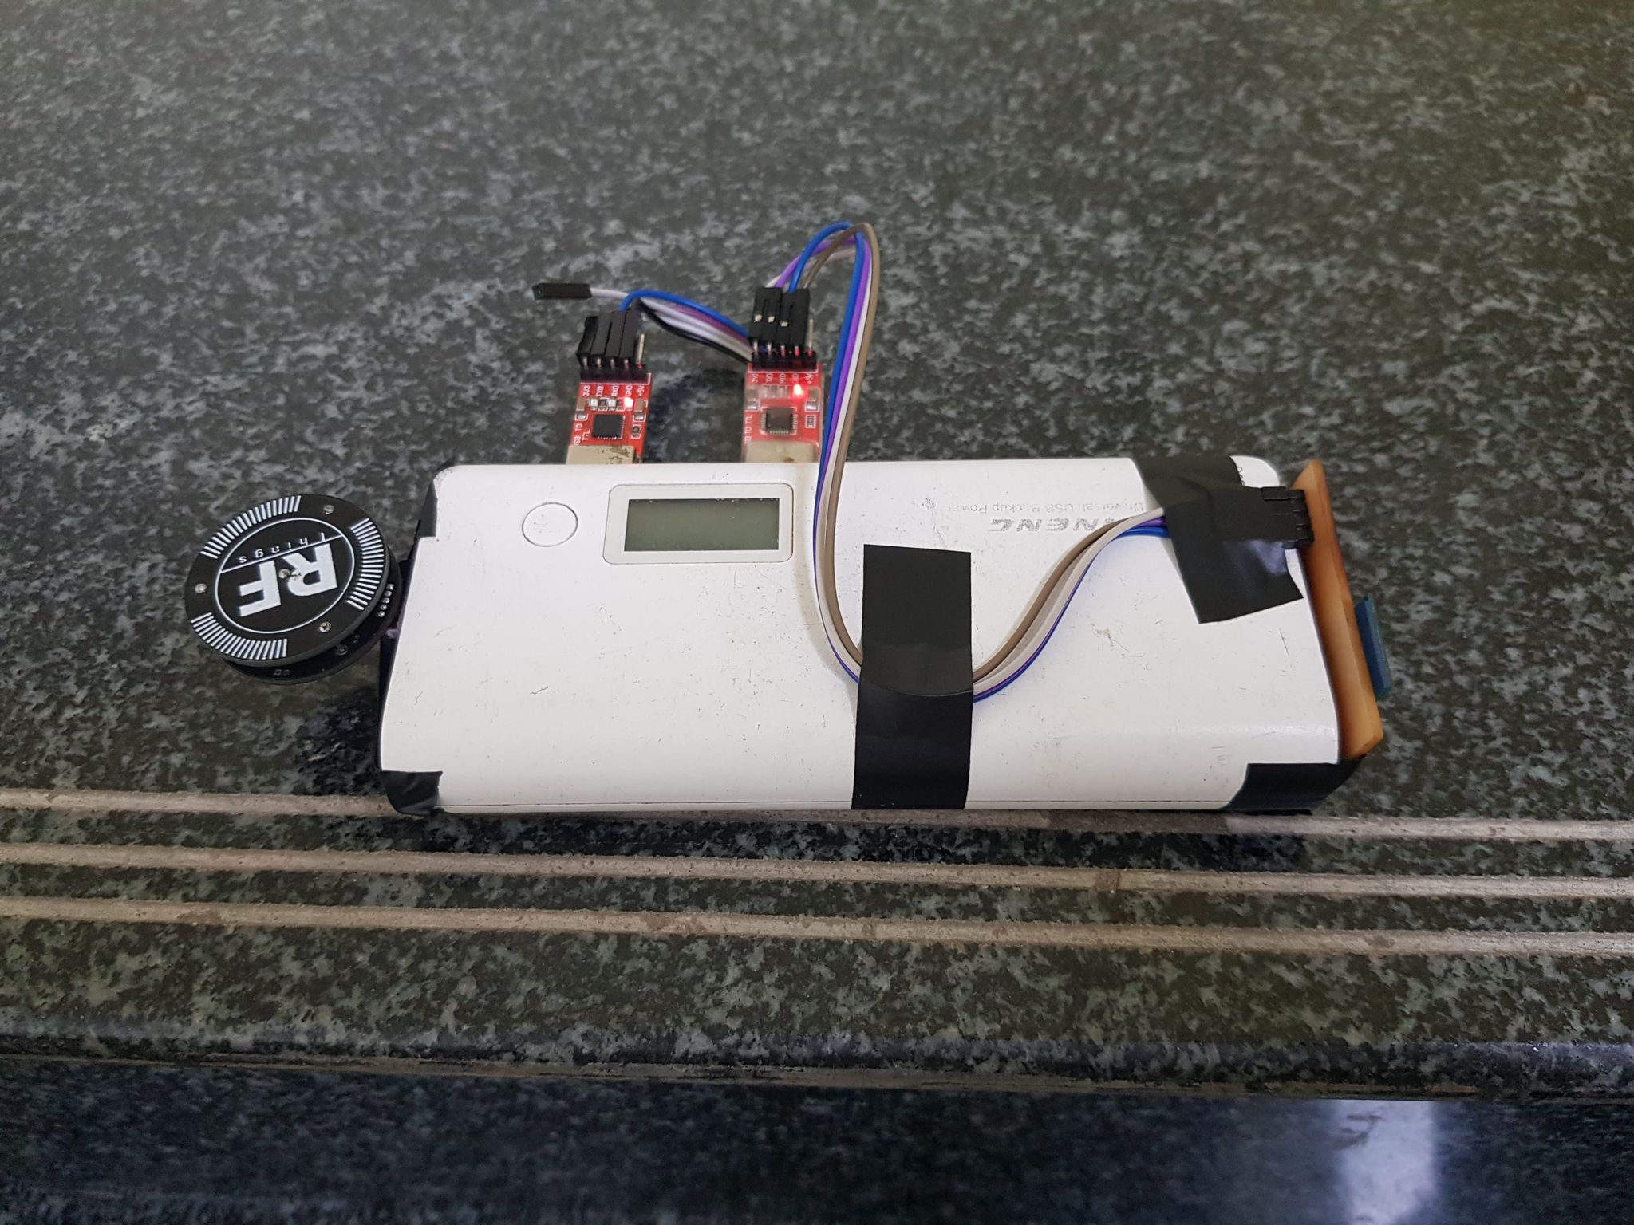
Node
LoRa test node
CP : 2.476GHz
Ebyte : 2.402GHz
Copyrights 2016 UIT-Khoa KTMT . All Rights Reserved.

Slide 6
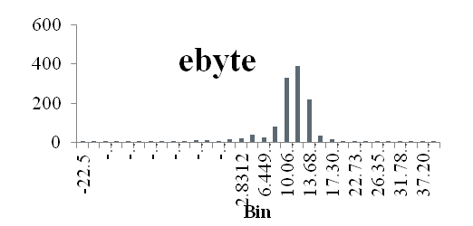
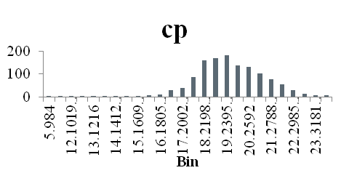
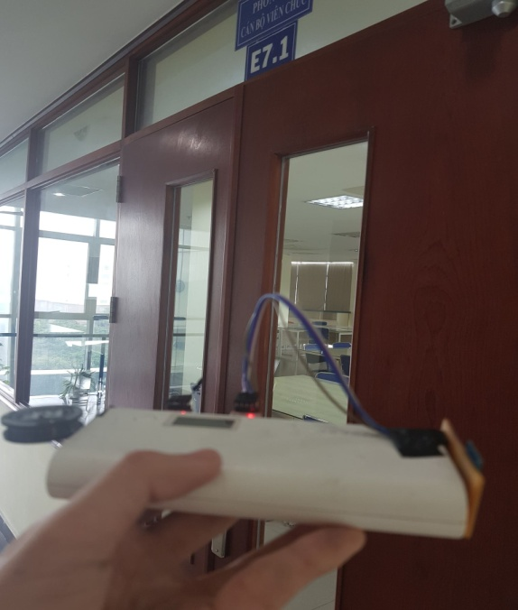
In front of 6.1 room
Mean |  |  | 9.232968
Standard Error |  |  | 0.166442
Median |  |  | 10.297
Mode |  |  | 11.609
Standard Deviation |  |  | 5.908092
Sample Variance |  |  | 34.90555
Kurtosis |  |  | 8.529761
Skewness |  |  | -1.81127
Range |  |  | 63.328
Minimum |  |  | -22.5
Maximum |  |  | 40.828
Sum |  |  | 11633.54
Count |  |  | 1260
Confidence Level(99.0%) |  |  | 0.429376
Mean |  |  | 19.1049
Standard Error |  |  | 0.047286
Median |  |  | 19.031
Mode |  |  | 18.984
Standard Deviation |  |  | 1.674471
Sample Variance |  |  | 2.803854
Kurtosis |  |  | 5.422885
Skewness |  |  | -0.90429
Range |  |  | 17.844
Minimum |  |  | 5.984
Maximum |  |  | 23.828
Sum |  |  | 23957.55
Count |  |  | 1254
Confidence Level(99.0%) |  |  | 0.121985
Scenario
Copyrights 2016 UIT-Khoa KTMT . All Rights Reserved.

Slide 7
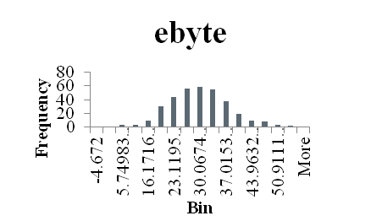
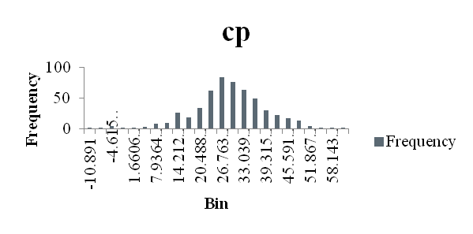
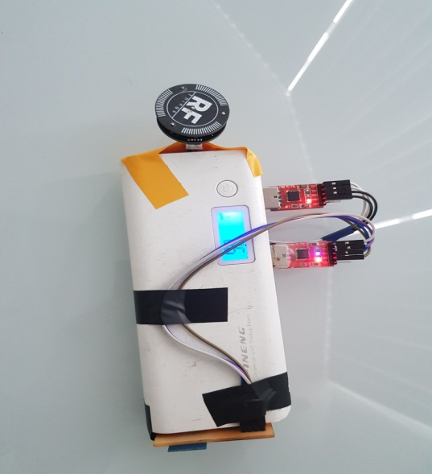
Inside 6.1 room
Column1
Mean |  |  | 27.97759
Standard Error |  |  | 0.451107
Median |  |  | 27.6875
Mode |  |  | 18.937
Standard Deviation |  |  | 8.366787
Sample Variance |  |  | 70.00313
Kurtosis |  |  | 1.137661
Skewness |  |  | 0.076273
Range |  |  | 62.531
Minimum |  |  | -4.672
Maximum |  |  | 57.859
Sum |  |  | 9624.292
Count |  |  | 344
Confidence Level(99.0%) |  |  | 1.168475
Column1
Mean |  |  | 27.18474
Standard Error |  |  | 0.455341
Median |  |  | 27.156
Mode |  |  | 26.437
Standard Deviation |  |  | 10.54191
Sample Variance |  |  | 111.1319
Kurtosis |  |  | 1.21679
Skewness |  |  | -0.34446
Range |  |  | 72.172
Minimum |  |  | -10.891
Maximum |  |  | 61.281
Sum |  |  | 14571.02
Count |  |  | 536
Confidence Level(99.0%) |  |  | 1.17708
Copyrights 2016 UIT-Khoa KTMT . All Rights Reserved.

Slide 8
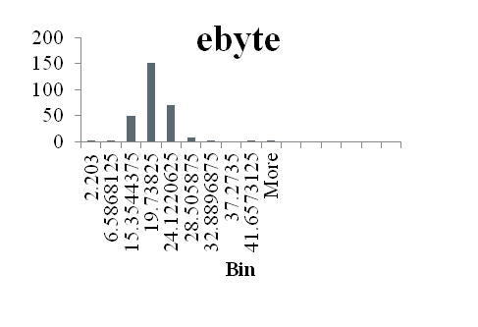
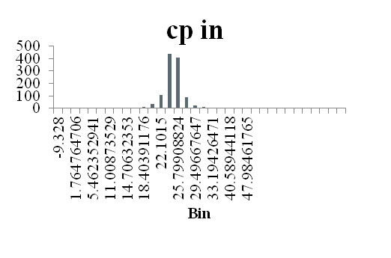
Inside WC
Column1
Mean |  |  | 18.31492
Standard Error |  |  | 0.278044
Median |  |  | 18.1795
Mode |  |  | 14.875
Standard Deviation |  |  | 4.685675
Sample Variance |  |  | 21.95555
Kurtosis |  |  | 63.19612
Skewness |  |  | 5.458417
Range |  |  | 70.141
Minimum |  |  | 2.203
Maximum |  |  | 72.344
Sum |  |  | 5201.437
Count |  |  | 284
Confidence Level(99.0%) |  |  | 0.721054
Column1
Mean |  |  | 23.63702
Standard Error |  |  | 0.098298
Median |  |  | 23.828
Mode |  |  | 24.094
Standard Deviation |  |  | 3.345008
Sample Variance |  |  | 11.18908
Kurtosis |  |  | 26.83482
Skewness |  |  | -1.50155
Range |  |  | 62.859
Minimum |  |  | -9.328
Maximum |  |  | 53.531
Sum |  |  | 27371.67
Count |  |  | 1158
Confidence Level(99.0%) |  |  | 0.253616
Copyrights 2016 UIT-Khoa KTMT . All Rights Reserved.

Slide 9
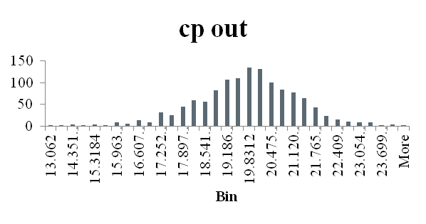
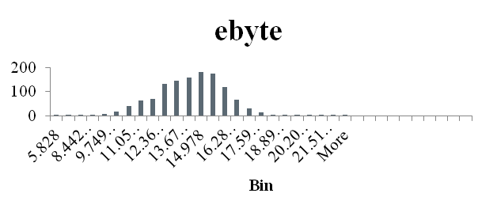
In front of WC
Column1
Mean |  |  | 14.10122
Standard Error |  |  | 0.054622
Median |  |  | 14.234
Mode |  |  | 14.984
Standard Deviation |  |  | 1.934251
Sample Variance |  |  | 3.741327
Kurtosis |  |  | 3.129095
Skewness |  |  | 0.160913
Range |  |  | 22.875
Minimum |  |  | 5.828
Maximum |  |  | 28.703
Sum |  |  | 17682.93
Count |  |  | 1254
Confidence Level(99.0%) |  |  | 0.14091
Column1
Mean |  |  | 19.61175
Standard Error |  |  | 0.041657
Median |  |  | 19.687
Mode |  |  | 19.25
Standard Deviation |  |  | 1.486294
Sample Variance |  |  | 2.209069
Kurtosis |  |  | 1.054735
Skewness |  |  | -0.34372
Range |  |  | 11.282
Minimum |  |  | 13.062
Maximum |  |  | 24.344
Sum |  |  | 24965.76
Count |  |  | 1273
Confidence Level(99.0%) |  |  | 0.107463
Copyrights 2016 UIT-Khoa KTMT . All Rights Reserved.

Slide 10
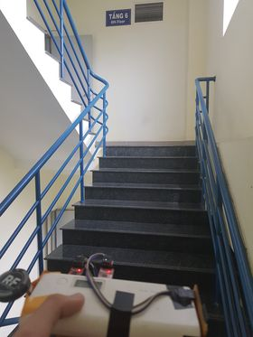
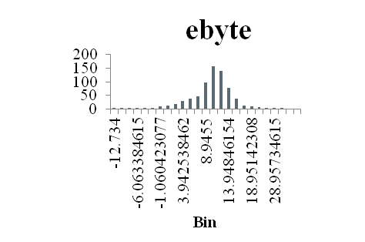
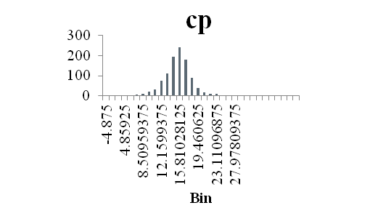
Mid Stairs 6-5
Column1
Mean |  |  | 9.327791
Standard Error |  |  | 0.17534
Median |  |  | 10.094
Mode |  |  | 10.531
Standard Deviation |  |  | 4.655599
Sample Variance |  |  | 21.6746
Kurtosis |  |  | 3.355338
Skewness |  |  | -0.86581
Range |  |  | 43.359
Minimum |  |  | -12.734
Maximum |  |  | 30.625
Sum |  |  | 6576.093
Count |  |  | 705
Confidence Level(99.0%) |  |  | 0.452874
Column1
Mean |  |  | 14.84191
Standard Error |  |  | 0.095532
Median |  |  | 14.937
Mode |  |  | 14.328
Standard Deviation |  |  | 3.101481
Sample Variance |  |  | 9.619182
Kurtosis |  |  | 5.781742
Skewness |  |  | -0.11977
Range |  |  | 38.937
Minimum |  |  | -4.875
Maximum |  |  | 34.062
Sum |  |  | 15643.37
Count |  |  | 1054
Confidence Level(99.0%) |  |  | 0.246521
Copyrights 2016 UIT-Khoa KTMT . All Rights Reserved.

Slide 11
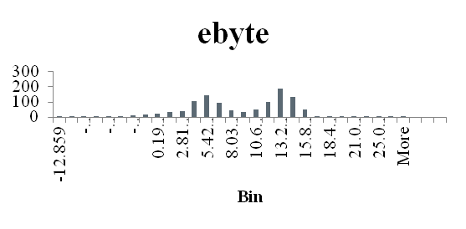
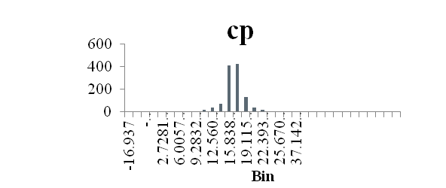
Stairs 6
Column1
Mean |  |  | 8.442945
Standard Error |  |  | 0.156489
Median |  |  | 9.2965
Mode |  |  | 12.844
Standard Deviation |  |  | 5.185435
Sample Variance |  |  | 26.88873
Kurtosis |  |  | 0.065886
Skewness |  |  | -0.26304
Range |  |  | 43.093
Minimum |  |  | -12.859
Maximum |  |  | 30.234
Sum |  |  | 9270.354
Count |  |  | 1098
Confidence Level(99.0%) |  |  | 0.403792
Column1
Mean |  |  | 15.75449
Standard Error |  |  | 0.089318
Median |  |  | 15.906
Mode |  |  | 15.422
Standard Deviation |  |  | 3.112055
Sample Variance |  |  | 9.684884
Kurtosis |  |  | 21.61814
Skewness |  |  | -1.38907
Range |  |  | 55.718
Minimum |  |  | -16.937
Maximum |  |  | 38.781
Sum |  |  | 19125.95
Count |  |  | 1214
Confidence Level(99.0%) |  |  | 0.23043
Copyrights 2016 UIT-Khoa KTMT . All Rights Reserved.

Slide 12
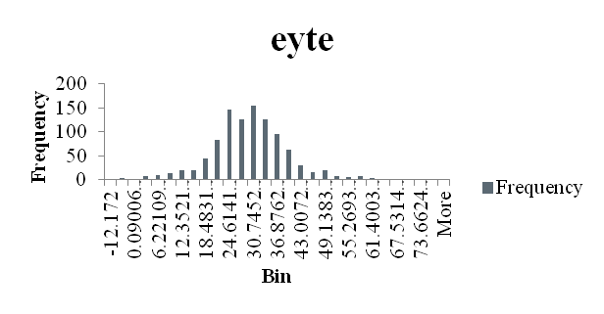
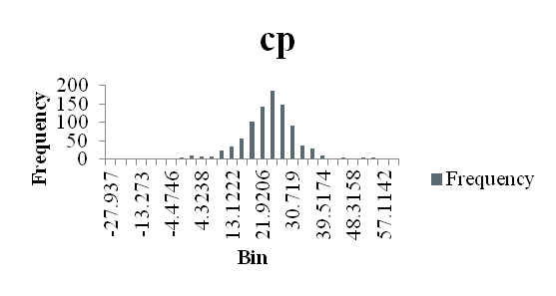
6.2
Mean |  |  | 28.31517
Standard Error |  |  | 0.325026
Median |  |  | 28.1405
Mode |  |  | 23.359
Standard Deviation |  |  | 10.3295
Sample Variance |  |  | 106.6985
Kurtosis |  |  | 2.723846
Skewness |  |  | 0.390391
Range |  |  | 95.031
Minimum |  |  | -12.172
Maximum |  |  | 82.859
Sum |  |  | 28598.33
Count |  |  | 1010
Confidence Level(99.0%) |  |  | 0.838799
Mean |  |  | 22.40289
Standard Error |  |  | 0.295057
Median |  |  | 22.906
Mode |  |  | 19.25
Standard Deviation |  |  | 8.91542
Sample Variance |  |  | 79.48471
Kurtosis |  |  | 4.801206
Skewness |  |  | -0.53066
Range |  |  | 87.984
Minimum |  |  | -27.937
Maximum |  |  | 60.047
Sum |  |  | 20453.84
Count |  |  | 913
Confidence Level(99.0%) |  |  | 0.761611
Copyrights 2016 UIT-Khoa KTMT . All Rights Reserved.

Slide 13
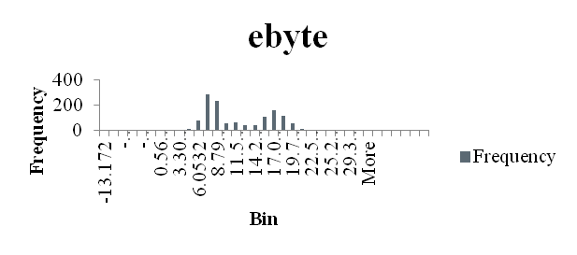
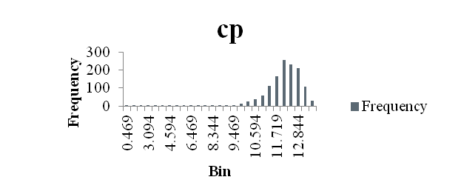
6.4
Column1
Mean |  |  | 11.05642
Standard Error |  |  | 0.141471
Median |  |  | 8.859
Mode |  |  | 6.578
Standard Deviation |  |  | 5.077225
Sample Variance |  |  | 25.77822
Kurtosis |  |  | 0.53609
Skewness |  |  | 0.150146
Range |  |  | 48.063
Minimum |  |  | -13.172
Maximum |  |  | 34.891
Sum |  |  | 14240.67
Count |  |  | 1288
Confidence Level(99.0%) |  |  | 0.364947
Mean |  |  | 11.79259
Standard Error |  |  | 0.036249
Median |  |  | 11.984
Mode |  |  | 11.953
Standard Deviation |  |  | 1.301432
Sample Variance |  |  | 1.693725
Kurtosis |  |  | 21.23448
Skewness |  |  | -3.7141
Range |  |  | 13.125
Minimum |  |  | 0.469
Maximum |  |  | 13.594
Sum |  |  | 15200.65
Count |  |  | 1289
Confidence Level(99.0%) |  |  | 0.09351
Copyrights 2016 UIT-Khoa KTMT . All Rights Reserved.

Slide 14
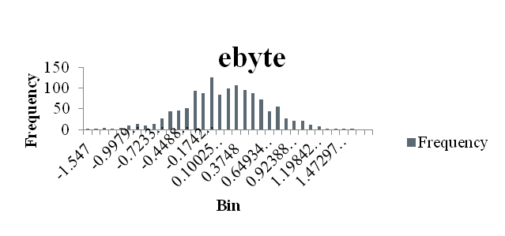
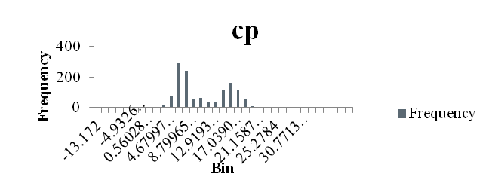
6.6
Mean |  |  |  | 0.207195
Standard Error |  |  |  | 0.012624
Median |  |  |  | 0.203
Mode |  |  |  | 0.141
Standard Deviation |  |  |  | 0.451491
Sample Variance |  |  |  | 0.203844
Kurtosis |  |  |  | 0.345921
Skewness |  |  |  | -0.12559
Range |  |  |  | 3.203
Minimum |  |  |  | -1.547
Maximum |  |  |  | 1.656
Sum |  |  |  | 265.003
Count |  |  |  | 1279
Confidence Level(99.0%) |  |  |  | 0.032567
Mean |  |  | 11.05642
Standard Error |  |  | 0.141471
Median |  |  | 8.859
Mode |  |  | 6.578
Standard Deviation |  |  | 5.077225
Sample Variance |  |  | 25.77822
Kurtosis |  |  | 0.53609
Skewness |  |  | 0.150146
Range |  |  | 48.063
Minimum |  |  | -13.172
Maximum |  |  | 34.891
Sum |  |  | 14240.67
Count |  |  | 1288
Confidence Level(99.0%) |  |  | 0.364947
Copyrights 2016 UIT-Khoa KTMT . All Rights Reserved.

Slide 15
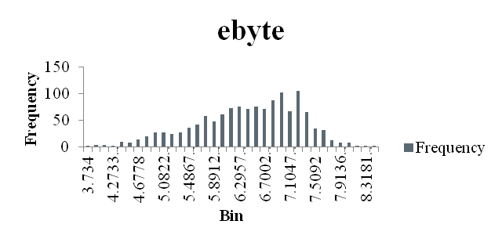
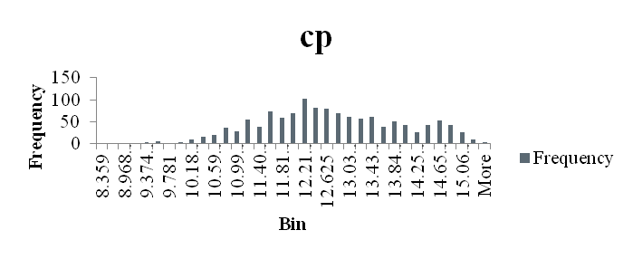
Emergency exit
Column1
Mean |  |  | 6.369175
Standard Error |  |  | 0.02272
Median |  |  | 6.484
Mode |  |  | 6.844
Standard Deviation |  |  | 0.816982
Sample Variance |  |  | 0.667459
Kurtosis |  |  | -0.22606
Skewness |  |  | -0.50182
Range |  |  | 4.719
Minimum |  |  | 3.734
Maximum |  |  | 8.453
Sum |  |  | 8235.343
Count |  |  | 1293
Confidence Level(99.0%) |  |  | 0.05861
Column1
Mean |  |  | 12.59494
Standard Error |  |  | 0.036208
Median |  |  | 12.5
Mode |  |  | 11.953
Standard Deviation |  |  | 1.29237
Sample Variance |  |  | 1.670219
Kurtosis |  |  | -0.45507
Skewness |  |  | -0.01304
Range |  |  | 7.11
Minimum |  |  | 8.359
Maximum |  |  | 15.469
Sum |  |  | 16045.96
Count |  |  | 1274
Confidence Level(99.0%) |  |  | 0.093405
Copyrights 2016 UIT-Khoa KTMT . All Rights Reserved.

Slide 16
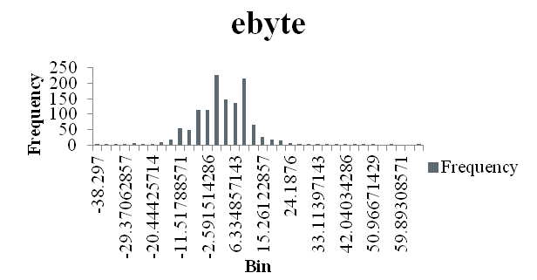
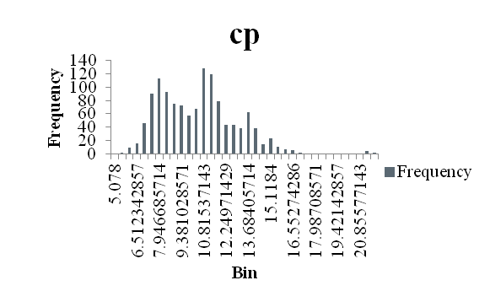
6.3
Mean |  |  | 1.17883
Standard Error |  |  | 0.276713
Median |  |  | 0.641
Mode |  |  | 0.016
Standard Deviation |  |  | 9.826248
Sample Variance |  |  | 96.55516
Kurtosis |  |  | 4.767378
Skewness |  |  | 0.560223
Range |  |  | 104.141
Minimum |  |  | -38.297
Maximum |  |  | 65.844
Sum |  |  | 1486.504
Count |  |  | 1261
Confidence Level(99.0%) |  |  | 0.713848
Mean |  |  | 10.23331
Standard Error |  |  | 0.069854
Median |  |  | 10.2815
Mode |  |  | 10.797
Standard Deviation |  |  | 2.491358
Sample Variance |  |  | 6.206864
Kurtosis |  |  | 0.996301
Skewness |  |  | 0.715996
Range |  |  | 16.734
Minimum |  |  | 5.078
Maximum |  |  | 21.812
Sum |  |  | 13016.77
Count |  |  | 1272
Confidence Level(99.0%) |  |  | 0.180203
Copyrights 2016 UIT-Khoa KTMT . All Rights Reserved.

