Slide 1
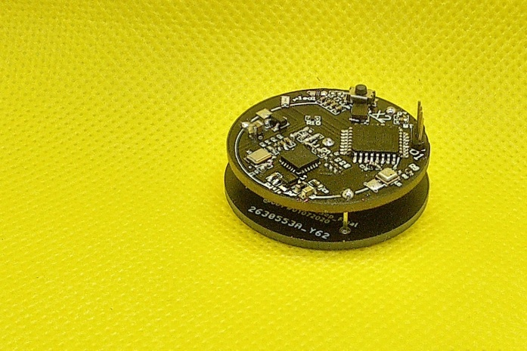
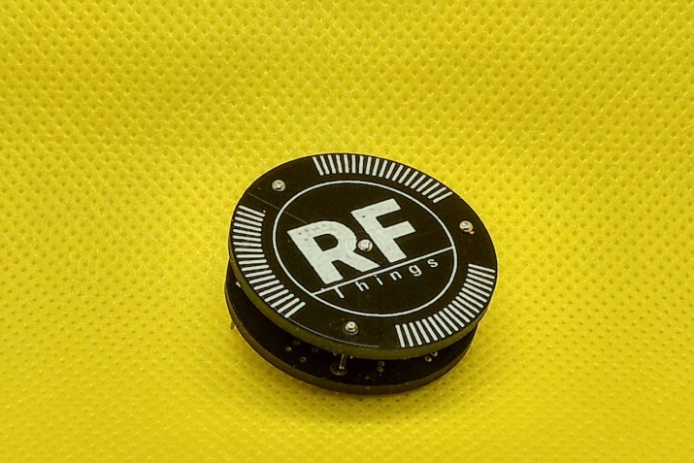
LoRa Tracking 2.4GHz module tutorial
Bottom module
Top module

Slide 2
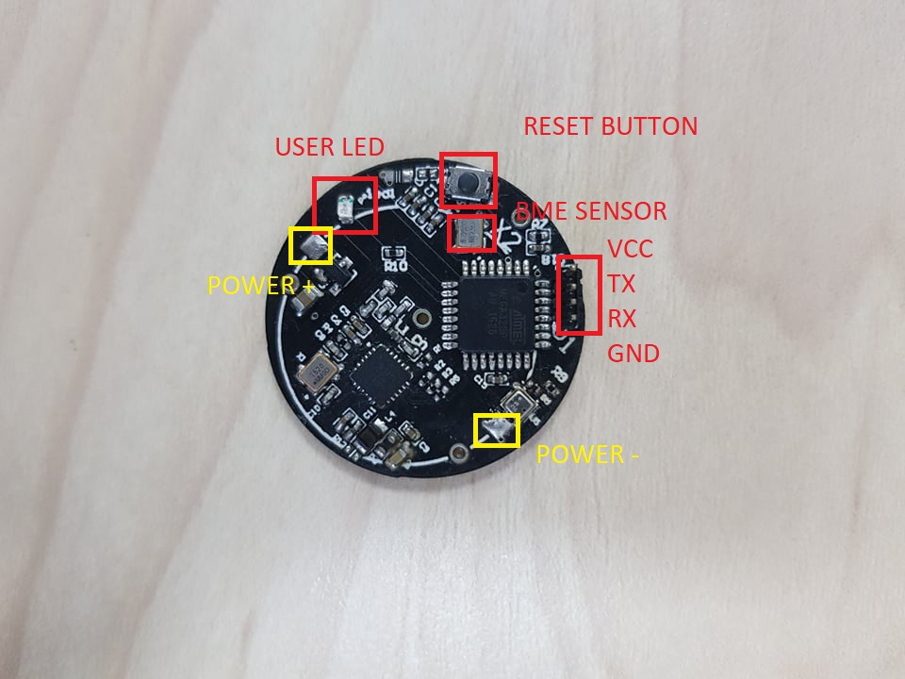
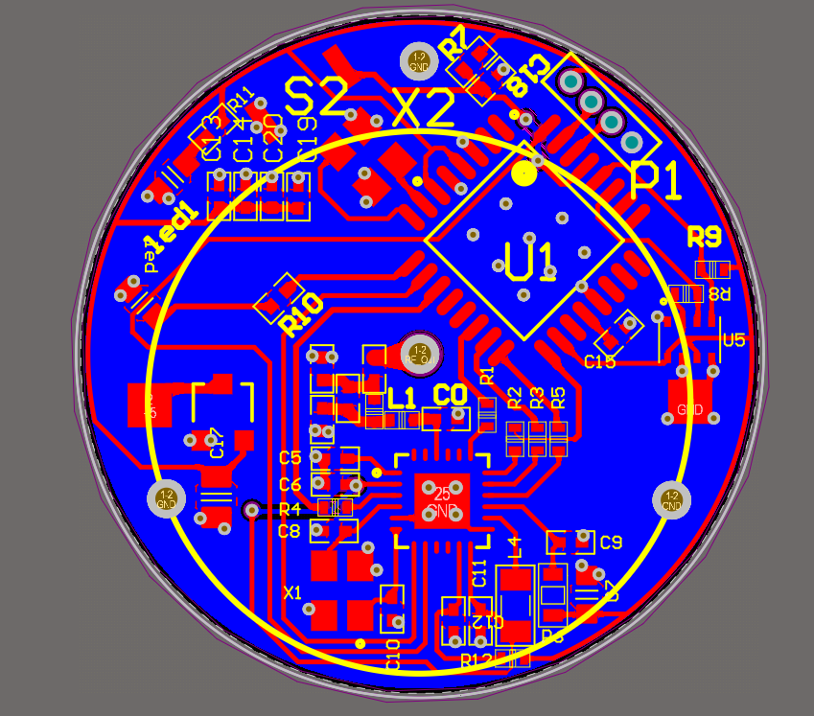
Hardware
Hardware design
PCB design

Slide 3
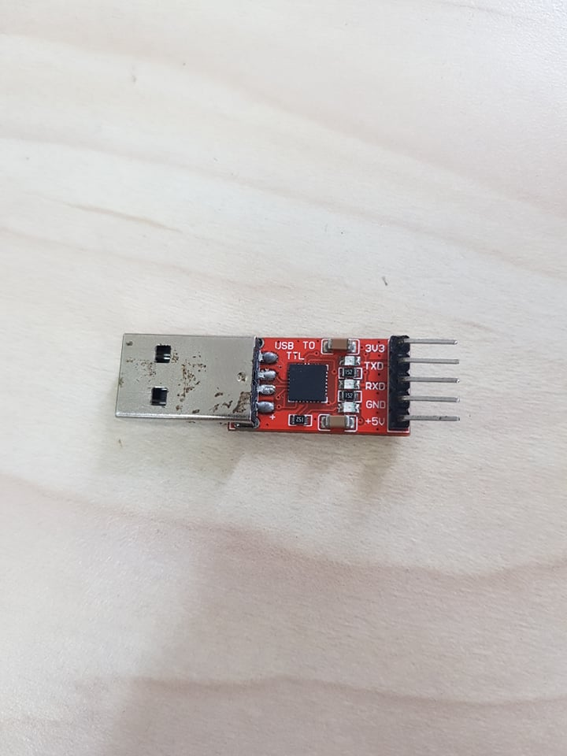
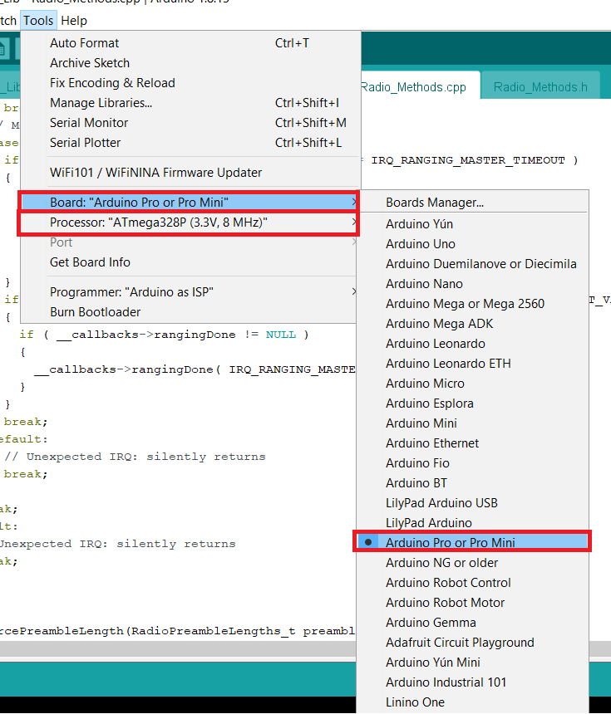
Load Program to board
Use USB to TTL or other USB UART are suitable
Configure Arduino IDE as below
Press reset button once when IDE change status “Uploading”

Slide 4
Software
Ranging with Kalman filter
Simple test LoRa connections
This tutorial use Arduino IDE compiler for all source code

Slide 5
RANGING APPLICATION

Slide 6
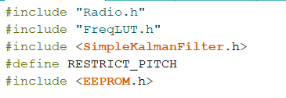
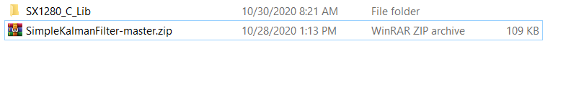
Ranging Filter add library
Include necessary library
Due to having a Kalman library, you should import zip file I have attach in folder
“KalmanFilterRanging”

Slide 7


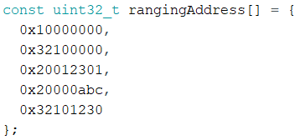
Ranging Filter configure address
Select role for node (in SX12080_C_Lib.ino file), need at least 2 node (1 master and 1 slave) to perform ranging.
Define debug label (if not print label debug please comment this line)
Array of ranging address (The master node and the slave node must be the same)

Slide 8
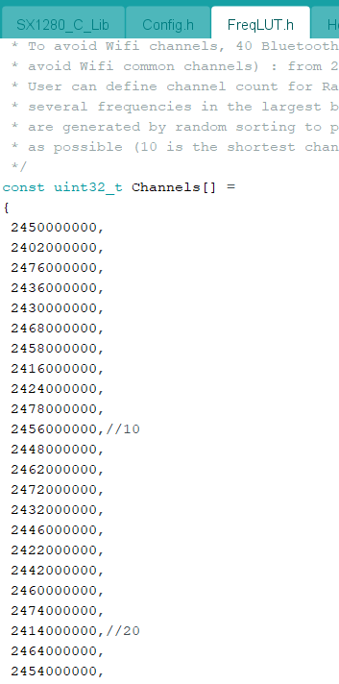
Ranging Filter chanel
Not only use the same address but also the LoRa node Master and Slave must be use the same channel frequency
List of channel frequency in file “FreqLUT.h “

Slide 9
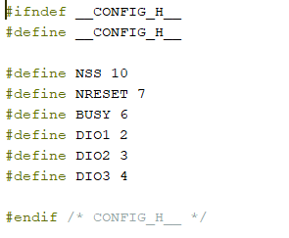
Ranging Filter configure Pin
“Config.h” use to mapping SX1280 with digital pin in Arduino
In this design use only DIO1

Slide 10
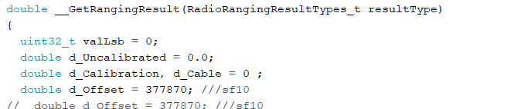

Ranging Filter calibration
Calibrate data from raw data in __getRangingResult function in Radio_Method.cpp file
You should choose the value “d_Offset” to calibrate ranging’s result
The value of “d_Offset” will be different for each device
__ProcessIrqs function in “Radio_Method.cpp” file use debug DIO communicate with SX1280
Use callback function to get register value debug if can not ranging(fail)

Slide 11

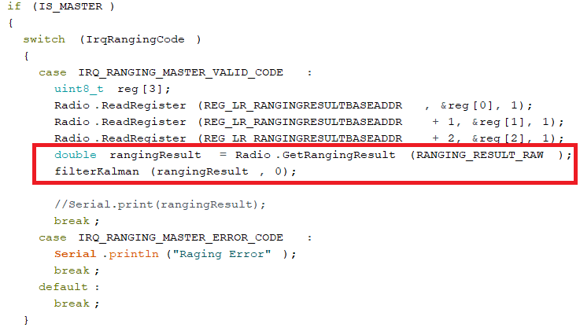
Ranging continuous use the average value
Master and slave ranging continuous
Raw data will be passed through the Kalman filter
The average distance will be printed after every 100 packages ranging success

Slide 12

Ranging continuous use median value
Ranging value will be store into EEPROM and after every 100 packages will print the 50th value of array
    EEPROM Atmega328p 512byte
    Double size 4bytes
    Store about 128 value
You can change “average value” to “median value” by set 2nd parameter of “filterKalmanfunction”
Option 1 : median value
Option 0 : mean value( average value)

Slide 13


Ranging normal
Ranging get raw data with noFilterKalman() function
Result of ranging not pass through Kalman filter
The same to ranging with filter, average value will be printed after every 100 packages ranging success
You can print each ranging value in the ways replace “ Serial.print(‘ . ’)” to “ Serial.println(rangingResult)”
It can also be used for ranging with filter above

Slide 14
PingPong Application

Slide 15



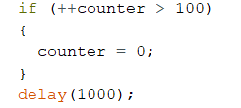
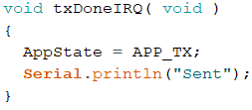
PingPong TX
Configure IO and load program same the Ranging applications
Select role
Send data if node’s role master
Set up counter value to PingPong
Reset counter value
In case ranging success print out serial screen “Sent”

Slide 16
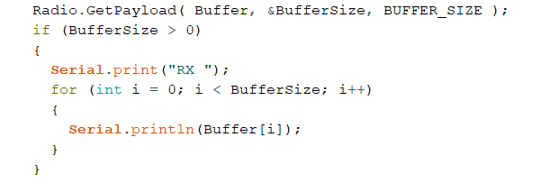
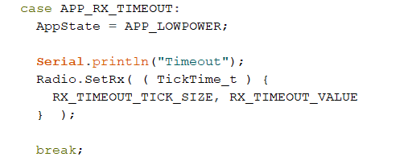
PingPong RX
Read and print out serial screen receive buffer if role is slave
In case PingPong failure print out the string “Time out”

