Slide 1




PREDICTING FINANCIAL DISTRESS IN US RETAILERS FROM SEC XBRL DISCLOSURES
TEAM 18
  Project Supervisor: M.Sc. Cap Dinh La Thang
  Student: Nguyen Duc Y (ID: 25730094)

Slide 2

INPUT & OUTPUT SPECIFICATIONS
INPUT SPECIFICATION
OUTPUT SPECIFICATION
  16 Raw SEC XBRL Financial Items: Quarterly 10-K & 10-Q balance sheets and income statements across 8 retail chains, enforcing strict point-in-time timestamping (available_on ≤ as_of).
  47 Multi-Window Engineered Ratios: Derived across rolling windows (≤ 8 quarters): solvency, liquidity, profit margins, capital leverage, YoY changes, and historical min/max values.
  Strict Out-of-Scope Boundaries: Excludes contemporaneous market stock prices, macroeconomic indices, and credit agency ratings; strictly prohibits one-hot ticker encoding shortcuts.
  Binary Risk Classification: Supervised label Y ∈ {0, 1}: 0 = Sound / Healthy; 1 = Impairment / Financial Distress in the subsequent forward quarter.
  Calibrated Probability & Audit Priority: Continuous posterior P(distress) ∈ [0, 1] mapped to operational threshold t = 0.7879 (C(FN) = 5 · C(FP)) for audit escalation.
  Local Profile Explainability (SHAP): Instance-level KernelSHAP feature attributions quantifying exact marginal contributions of liquidity, leverage, and cash burn toward each risk alert.

Slide 3


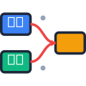





Corpus Architecture & Purged Time-Split
SEC Filings Universe
Observation Matrix
Audited Cell Matrix
332 Quarters
324 Samples
4,609 Data Cells
DG, DKS, FIVE, HD, LOW, ORLY, ROST, WMT
8-quarter temporal sliding windows
0 SHA-256 discrepancies
TRAINING SET
PURGED BUFFER
VALIDATION
LOCKED TEST
212
16
32
64
  62.3% Distress Positive
  In-sample parameter tuning
  90-Day Quarantine
  IFiling latency buffer
  65.6% Distress Positive
  Threshold selection
  59.38% Distress Positive
  Strict out-of-time test

Slide 4




DUAL-LEVEL IMBALANCE PARADOX
LEVEL 1 • SAMPLE OBSERVATIONS
LEVEL 2 • ENTITY CONCENTRATION
MODERATE SAMPLE IMBALANCE
EXTREME ENTITY DISTORTION
Reduces human error
AI systems process complex data with high precision, minimizing mistakes that can lead to costly financial losses.
Aggregate observation splits appear benign across standard class balance diagnostics.
Individual retail chains exhibit deterministic, single-class regime persistence.
Improves decision-making
Imbalance Ratio: 1.66
By analyzing patterns and predicting outcomes, AI supports financial professionals in making more informed and strategic decisions.
Distress Ratio: 62.35%
Shannon Entropy: 0.9556 bit
Automates repetitive tasks
Routine processes such as document verification, data entry, and compliance checks are handled quickly, saving time and resources.
41.0% of total corpus originates from purely single-class firms, creating an entity memorization vulnerability.
High Shannon entropy falsely suggests a balanced learning problem to naive estimators.

Slide 5


Feature Signals & Multicollinearity
TOP PREDICTIVE FEATURE
MULTICOLLINEARITY AUDIT
current_ratio_min_window
Extreme Feature Redundancy
Inverse Ranking: Raw AUC = 0.048 indicates strong separation where lower liquidity scores monotonically predict imminent distress events.
Dimensionality Collapse: 47 nominal accounting metrics span less than 13 independent linear coordinates.

Slide 6

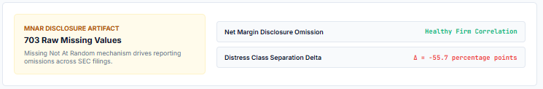
Data Preprocessing & MNAR Mechanism
1
SEC XBRL
2
Filing Audit
3
Rolling Window
4
MNAR Audit
4
Model Matrix
Raw 10-K / 10-Q
SHA-256 validation
8-quarter spans
703 missing cells
47 scaled features

Slide 7
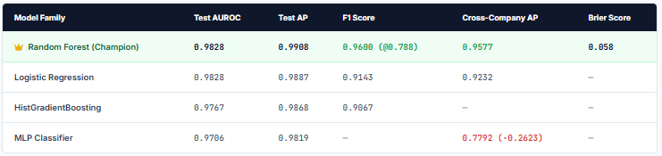
FOUR FAMILY MODEL BENCHMARKING
Selection Rationale: Random Forest selected as production champion with superior cross-company AP (0.9577), good calibration (Brier 0.058), and robust resistance to MLP cross-company collapse (−0.2623).

Slide 8


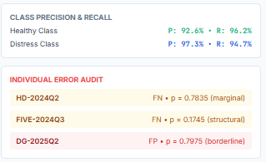
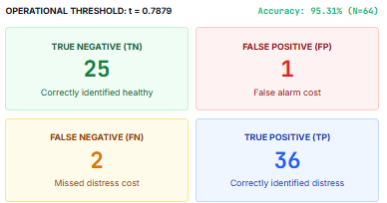

Confusion Matrix & Error Audit
Error Audit Finding: 2 of 3 test errors (HD-2024Q2 & DG-2025Q2) occurred within 0.01 of the decision boundary, confirming razor-sharp classification margin across the locked period.

Slide 9


COST & CALIBRATION OPTIMIZATION
PANEL A • ASYMMETRIC LOSS
PANEL B • CALIBRATION ADJUSTMENT
Reduces human error
OPERATIONAL THRESHOLDING
BAYES DECISION CRITERION
AI systems process complex data with high precision, minimizing mistakes that can lead to costly financial losses.
Improves decision-making
By analyzing patterns and predicting outcomes, AI supports financial professionals in making more informed and strategic decisions.
Bayes Risk Minimization: Theoretical threshold p* = C(FP) / [C(FP) + C(FN)] = 1.0 / 6.0 = 0.1667.
Operational Prudence: Empirical threshold t = 0.7879 trading off 2 FNs + 1 FP ⇒ cost of 11 ⇒ not Bayes-optimal because RF's p̂ is uncalibrated (ECE 0.109)
Automates repetitive tasks

Slide 10

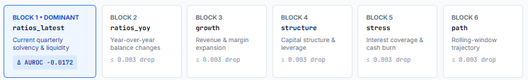




47-Feature Taxonomy & Ablation
KEY ABLATION INSIGHT
PRACTICAL CONCLUSION
a decrease of −0.0172 AUROC (the largest among the 6 folds, but within the uncertainty of the 64 test samples)
Latest-quarter solvency metrics carry virtually all actionable predictive information; historical multi-quarter trajectory features provide minimal marginal utility.

Slide 11


Entity Shortcut Leakage
TICKER MEMORIZATION
LEAVE-ONE-COMPANY-OUT
0.9858
0.6280
Naive Ticker AUROC
Unseen Retailers AUROC
DeLong test: p = 0.7546 vs Random Forest, proving headline AUROC can be matched via ticker memorization alone
Severe degradation reveals that high in-sample test scores conceal an entity-identity shortcut rather than cross-firm mechanics.

Slide 12



The future of finance is intelligent, adaptive, and human-centered. AI is not replacing finance, it is redefining it.
Email
THANK YOU
FOR YOUR ATTENTION
25730094@ms.uit.edu.vn

