Slide 1
Clustering travel destinations
Áron Dudás
11 May, 2018

Slide 2
Why?
Clustering cities is useful for:
  Tourists to find their next holiday destination
  Travel agencies offer better packages
  Destinations to understand their vistiors

Slide 3
What?
Data gathered from two sources:
  List of cities by international visitors (Wikipedia)
  Venue data (Foursquare)

Slide 4
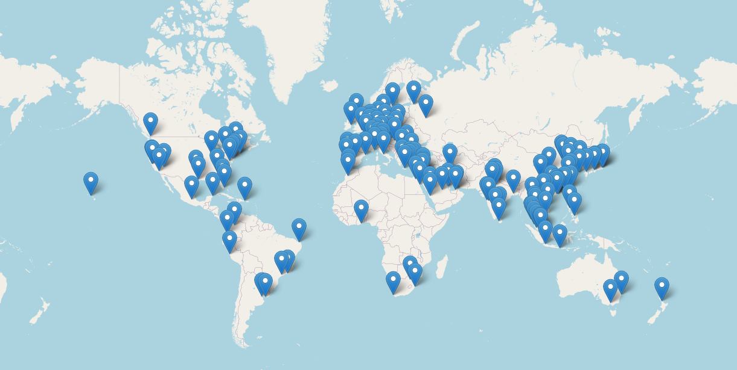
The cities

Slide 5
The venues
Raw data: 26924 entries
After cleaning:
  20477 venues
  In 381 categories
  For 137 cities

Slide 6
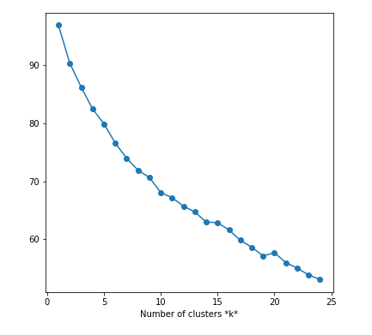
How?
Clustering using K-Means
K = 10

Slide 7
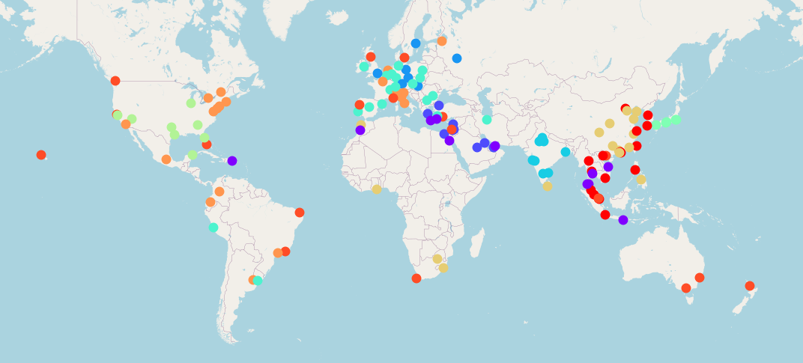
The results

Slide 8
Future improvements
Adding more diverse data
  Temperature data
  Economic data
Different clustering algorithms
  DBSCAN
  SpectralClustering

