Slide 1
Project: Energy Consumption Analysis
Analyzation of energy usage and greenhouse gas (GHG) emissions of Ontario's Broader Public Sector (BPS) organizations

Slide 2
Approaches
The approach involved a comprehensive analysis of energy usage and GHG emissions, evaluating conservation effectiveness through key criteria.
I have employed a combination of quantitative and qualitative methods to identify trends, allowing for a holistic understanding of the BPS organizations' environmental impact through the Interactive Visualizations which have been created.

Slide 3
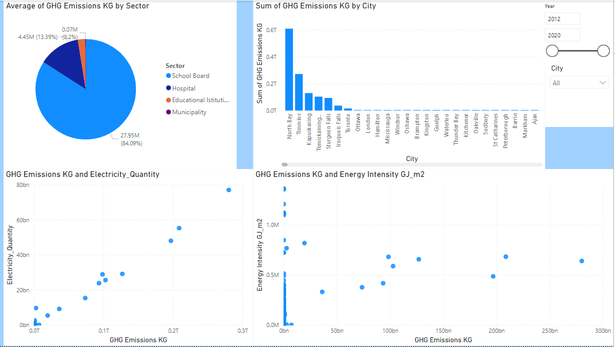
Exploratory Data Analysis The below mentioned dashboard tells about the how Green house gas affecting across all the sectors. We aalso look at its relationship with electricity and energy.

Slide 4
Conclusion
Through the Analysis, It identified successful conservation measures in certain BPS organizations while pinpointing areas for improvement. The data-driven suggestions include implementing targeted energy efficiency initiatives, investing in renewable energy sources, and fostering sustainable practices to achieve ambitious climate change mitigation goals within the Broader Public Sector."

