Slide 1
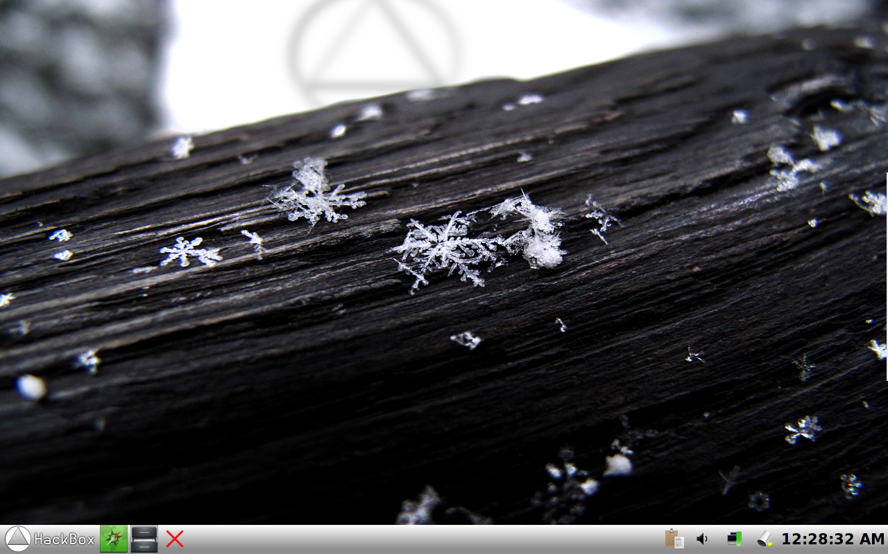
The Desktop Explained

Slide 2
This is the start menu, click here to launch an application.

Slide 3
Here are your web browser and your file browser to allow quick access to them from the start menu.
This is a list of categories for your applications, move the mouse over these to view more applications.
Here is where you logout, shutdown, or reboot your computer.
Click here to proceed...

