Slide 1
INDEPENDENT PRODUCT MANAGEMENT CASE
Netflix
After Hours
Evidence aligned late night viewing concept and deployment ready interactive prototype
Final release · November 2026
Not affiliated with, endorsed by, or produced for Netflix
CHIDUMEBI NKWO · AI PRODUCT MANAGER
Notes:
Source: Final case study and repository decision log. All claims retain their evidence classification.

Slide 2
02
Executive decision
The case is complete. A positive financial case remains unproven.
Proceed only as a small, instrumented learning pilot if an authorized organization sponsors further validation.
Decision area | Final position
Viewer need | Directionally supported by independent secondary evidence
Pilot experience | Manual timer, cancellable stop, local checkpoint, and resume choice
Customer validation | Not completed
Economic result | Positive case not demonstrated
Portfolio outcome | Completed independent concept to decision case
INDEPENDENT PORTFOLIO CASE · CHIDUMEBI NKWO
Notes:
Sources: phase-4/03-gate-4-decision.md; PROJECT_STATUS.md; phase-1/00-decision-log.md.

Slide 3
03
Evidence changed the scope
The original suite exceeded the available evidence, so the pilot became smaller and user controlled.
Original assumption | Evidence decision
Wearables infer sleep reliably | Deferred to a separate feasibility track
Advanced audio improves sleep | Removed with all therapeutic claims
Premium prompts create conversion | Removed from pilot; contribution held at zero
Unattended playback creates savings | Retained only as a measurable operational hypothesis
One late night window fits everyone | Replaced with user initiated controls
INDEPENDENT PORTFOLIO CASE · CHIDUMEBI NKWO
Notes:
Sources: phase-2/02-baseline-validation-matrix.md; phase-2/03-revised-baselines-and-recommendations.md.

Slide 4
04
Research outcome
Secondary evidence established context and interaction precedent. It did not validate product specific outcomes.
Baseline | Disposition | Product implication
Bedtime viewing context | Supported | Continue problem track
Manual timer pattern | Supported | Use a familiar interaction
Problem frequency | Unresolved | Do not claim incidence
Recovery value | Unresolved | Test correction and desirability
Retention or conversion | Unsupported | Hold contribution at zero
Delivery savings | Unresolved | Require internal marginal value
INDEPENDENT PORTFOLIO CASE · CHIDUMEBI NKWO
Notes:
Sources: phase-2/01-deep-research-findings.md; phase-2/02-baseline-validation-matrix.md.

Slide 5
05
Pilot experience
One release promise connects timer setup, a controlled stop, and transparent recovery.
01
02
03
Set timer
Stop gently
Resume clearly
15, 30, 45 minutes, or episode end
Dim, show countdown, cancel on input
Choose checkpoint or latest position
Release boundary
Manual controls, local state, no wearable or commercial claim
INDEPENDENT PORTFOLIO CASE · CHIDUMEBI NKWO
Notes:
Sources: phase-1/09-pilot-scope-v0.1.md; phase-3/01-prototype-alignment-assessment.md.

Slide 6
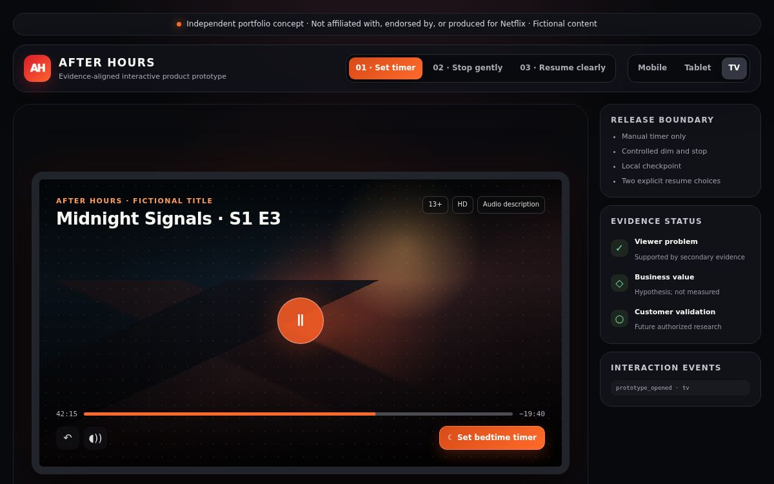
06
Deployment ready prototype
The self contained release runs without external scripts, fonts, images, APIs, analytics, or storage calls.
Verified journeys
Timer selection
Cancellable stop
Local checkpoint resume
TV and mobile layouts
Keyboard and dialog states
Sandbox deployed
Repository host ready
INDEPENDENT PORTFOLIO CASE · CHIDUMEBI NKWO
Notes:
Source: deployed prototype screenshot and release verification completed 2026-11-09.

Slide 7
07
Measurement framework
Targets guide decisions. They do not represent measured results.
Question | Primary measure | Decision use
Do viewers activate it? | Activation rate | Desirability
Does the timer complete? | Controlled stop completion | Core value
Is the stop unwanted? | Cancel and immediate restart | Trust guardrail
Does recovery help? | Checkpoint choice and correction | Resume value
Does behaviour change? | Avoided continuation minutes | Operational input
Does retention change? | Experiment retention delta | Future evidence only
INDEPENDENT PORTFOLIO CASE · CHIDUMEBI NKWO
Notes:
Sources: phase-3/04-measurement-event-dictionary.md; phase-1/07-analysis-framework.md.

Slide 8
08
Gate 4 conclusion
The model can calculate stream hours under assumptions. Missing internal inputs prevent a positive financial conclusion.
Value pathway | Conservative treatment | Reason
Retention | Zero | No causal evidence
Premium conversion | Zero | No observed conversion
Avoided stream hours | Computable | Requires behavioural assumptions
Marginal delivery value | Unavailable | Not public evidence
Build and operating cost | Unavailable | Requires authorized estimates
Gate 4 closed as not demonstrated, rather than failed.
Approval closes the evidence review. It does not approve an investment case.
INDEPENDENT PORTFOLIO CASE · CHIDUMEBI NKWO
Notes:
Sources: phase-4/01-value-case-methodology.md; phase-4/02-normalized-scenario-results.md; phase-4/03-gate-4-decision.md.

Slide 9
09
Future evidence roadmap
Each stage must produce the evidence needed for the next decision.
1
Authorized discovery
Frequency, severity, desirability
2
Usability pilot
Task success and correction
3
Instrumented experiment
Activation, completion, avoided minutes
4
Economic review
Marginal value and build and run costs
5
Feasibility tracks
Privacy, sync, certification, reliability
INDEPENDENT PORTFOLIO CASE · CHIDUMEBI NKWO
Notes:
Source: final case study roadmap and future evidence backlog.

Slide 10
10
Final portfolio position
A complete concept to decision case with a bounded pilot and an honest investment conclusion.
Viewer problem
Pilot
Economics
Credible context
Bounded and deployable
Not demonstrated
The original concept remains archived for traceability. The active release reflects the evidence.
github.com/dudedumebi-gif/netflix-after-hours-product-case
INDEPENDENT PORTFOLIO CASE · CHIDUMEBI NKWO
Notes:
Source: PROJECT_STATUS.md and final repository release.

