Slide 1

Pre Game Win Prediction

Slide 2
Agenda
Introduction
Objective
Data
Modeling
Conclusion
Challenges
Next Steps

Slide 3
Introduction
5 vs 5 strategy game
Each player controls a ‘champion’
Game progression: Earn gold > purchase items > destroy enemy defense structures
Key factors affecting outcome: Reflex, Strategy, Teamwork, Luck, Mental state

Slide 4
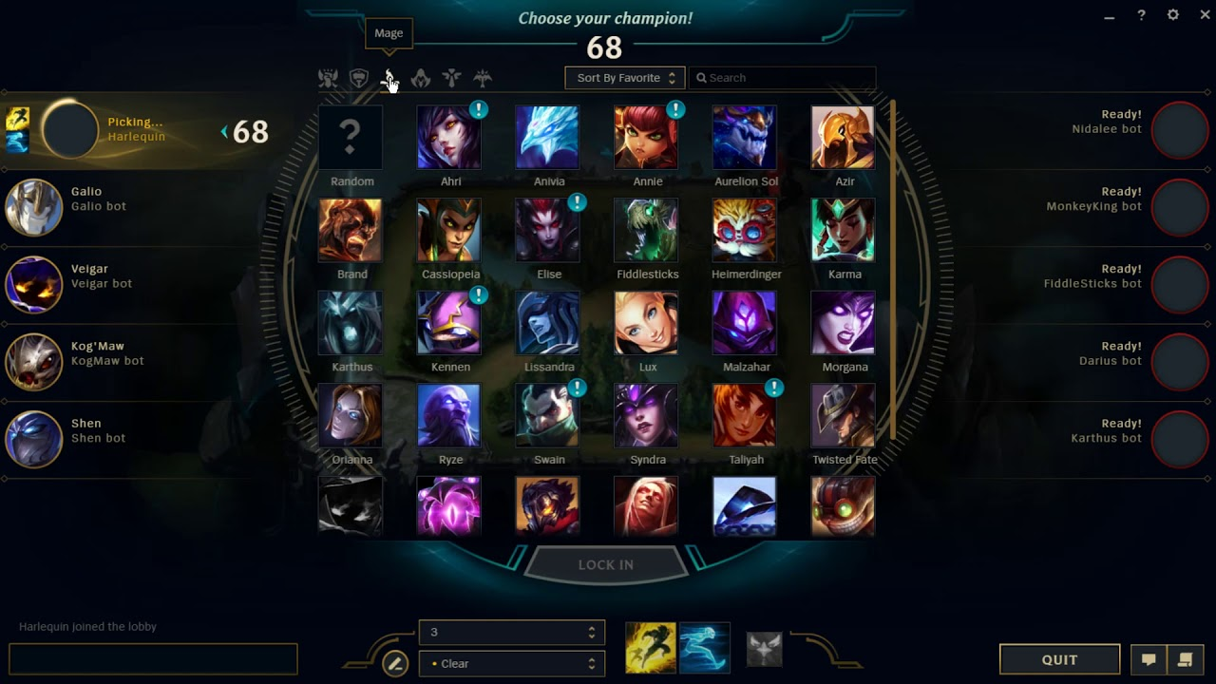
Objective
Win prediction before game start
Known Factors (Ally match history)
Unknown Factors (Opponent info)
Champion Selection Screen

Slide 5
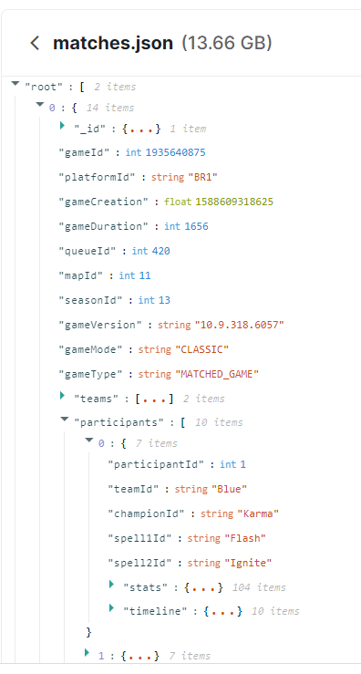
Data
Data Source: https://www.kaggle.com/d4sein/league-of-legends-patch-109
Data Dictionary: https://developer.riotgames.com/apis#match-v4/GET_getMatch
Ranked game data from Season 10 (2020)
Load matches.json into mongoDB
Filter NA region and remove duplicate GameID
Flatten the nested JSON (1 Game with 10 players) to 10 Games for 10 Players
32k games performance stats

Slide 6
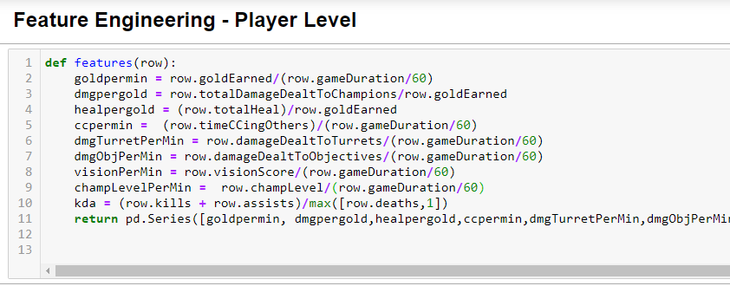
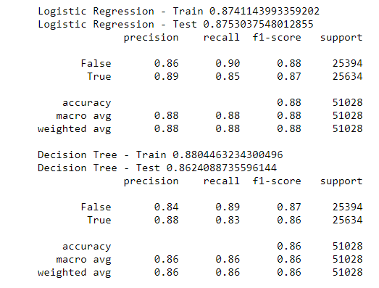
Post Game Analysis

Slide 7
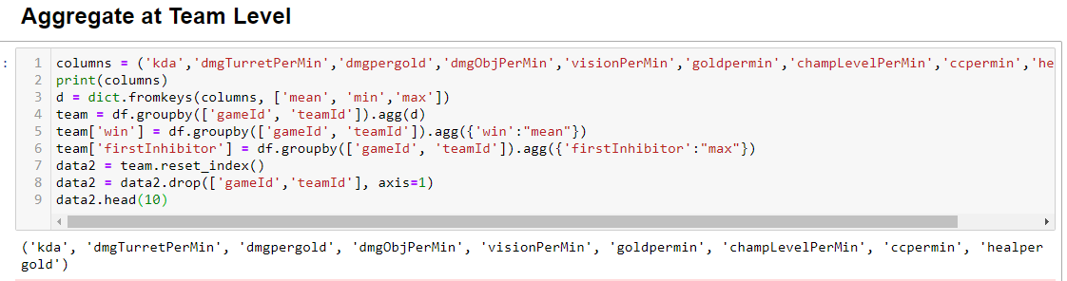
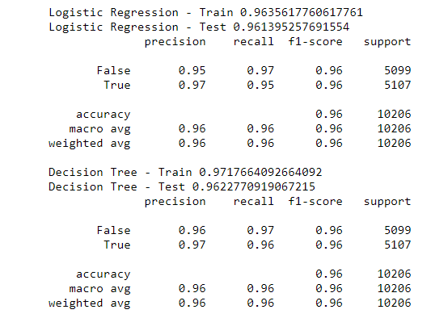
Post Game Analysis

Slide 8
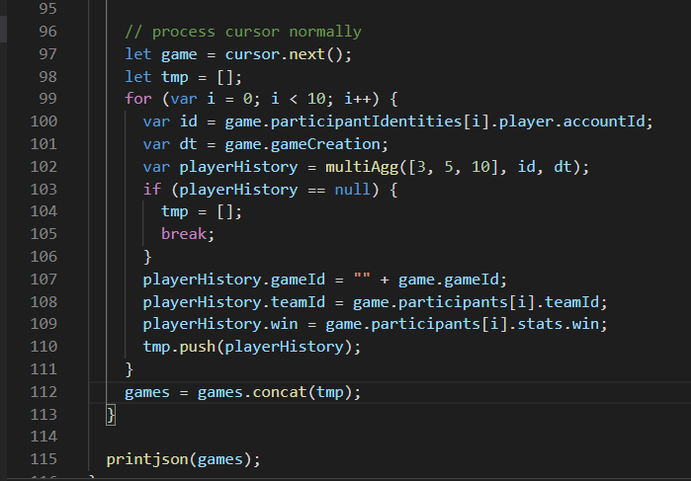
Pre Game Analysis History Aggregation
Frequency: Short/Medium/Long (3/5/10)
Features from Post Game Analysis
Find past X games prior to the sample per player and aggregated at Player level in JS
Discard sample if 1 of the 10 players don’t have any match history

Slide 9
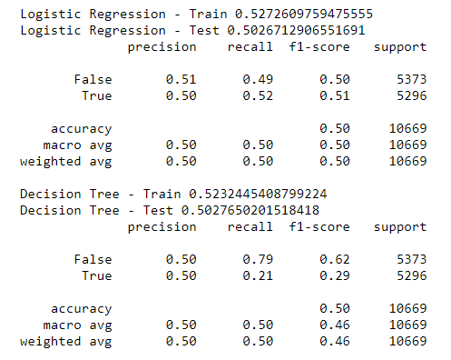
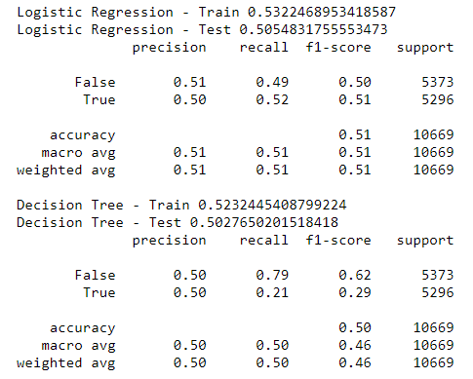
Pre Game Analysis
Prediction on individual player
MinMaxScaler
StandardScaler

Slide 10
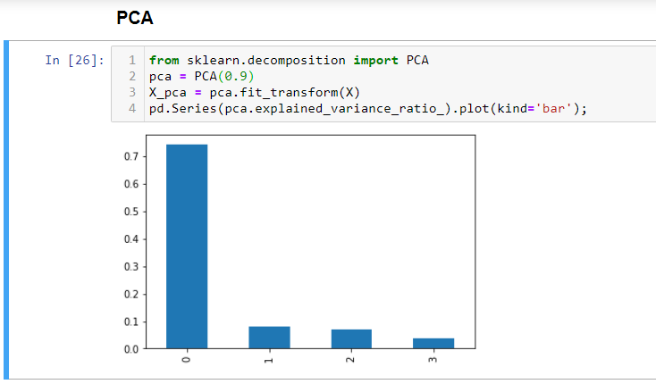
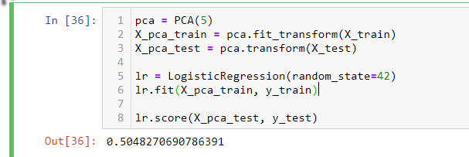
Pre Game Analysis
Prediction on individual player

Slide 11
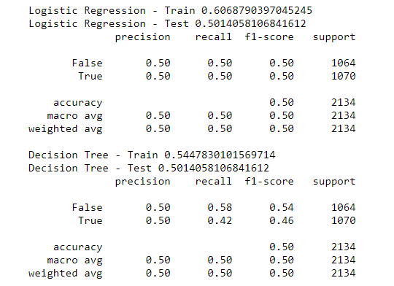
Pre Game Analysis
Prediction on team
Aggregate using min/avg/max - Baseline

Slide 12
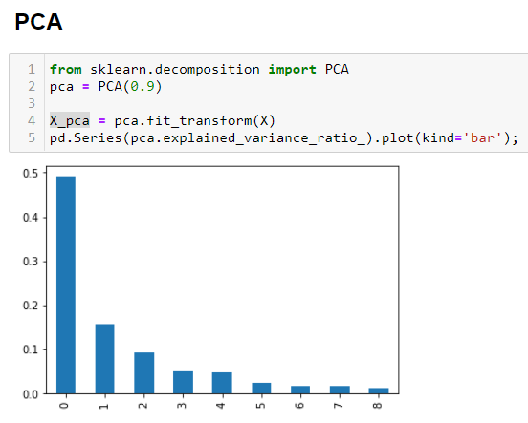
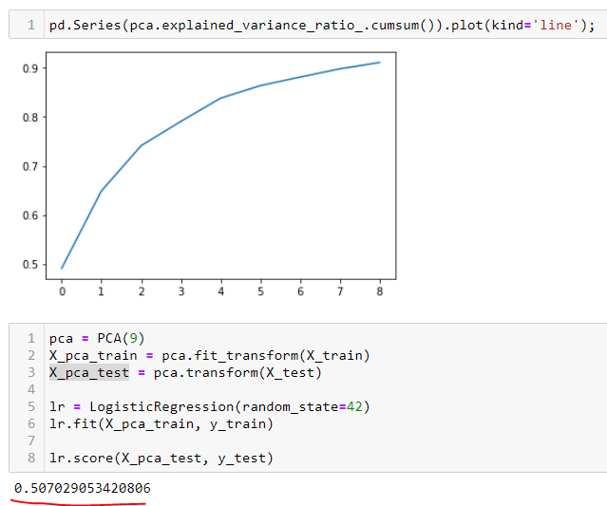
Pre Game Analysis
Prediction on team

Slide 13
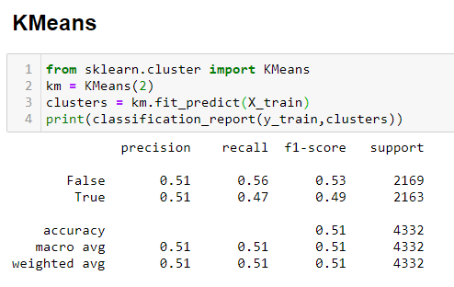
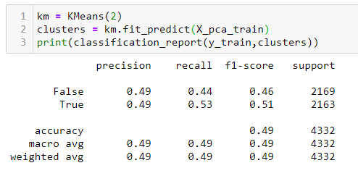
Pre Game Analysis
Prediction on team
Without PCA
With PCA

Slide 14
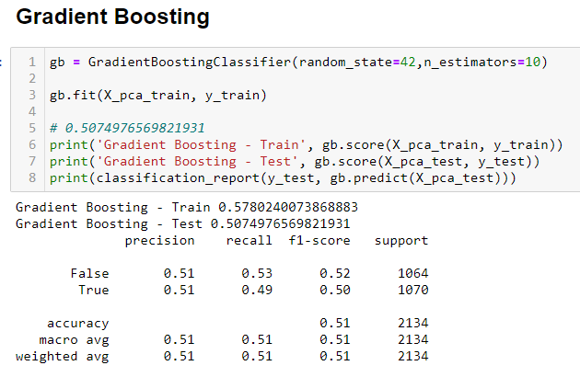
Pre Game Analysis
Prediction on team

Slide 15
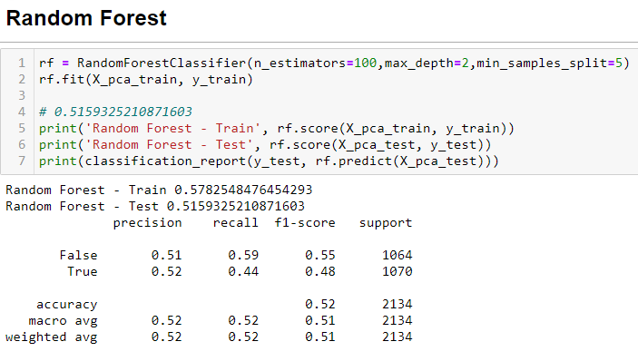
Pre Game Analysis
Prediction on team

Slide 16

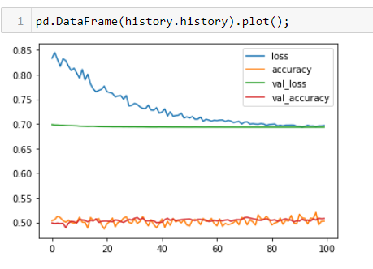
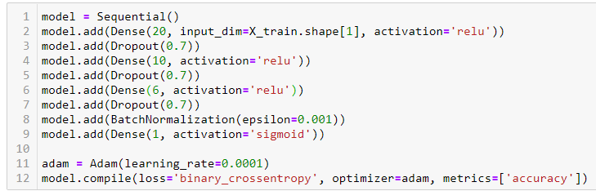
Pre Game Analysis
Prediction on team

Slide 17
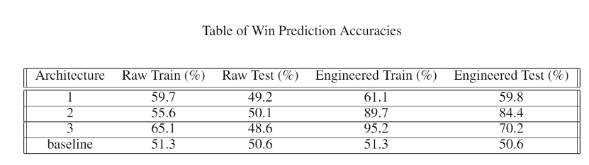
Conclusion
Each model achieved about 50-51% accuracy
Using only 1 team’s history data is not enough to predict outcome
Match making algorithm is very good at maintaining 50% win rate
Need more data to create a meaningful model
Research paper using both team’s history data
https://github.com/minihat/LoL-Match-Prediction/blob/master/FINAL%20REPORT.pdf

Slide 18
Challenges
Aggregating match history at player level
8h per run of my ETL script x 3 mistakes = 24h wasted
Lack of data/Riot Games API rate limit
Feature engineering

Slide 19
Next Steps
Train model based on 1 player specifically
Get player elo data to compare to avg stats of player of same skill level
Calculate player champion mastery vs avg champion stats
Build new model to identify outliers:
Player who bought their accounts (skill < elo)
Player who is paid to play on someone else account (skill > elo)

