Slide 1

Web Crawler Project
Python
Selenium
Beautiful soup

Slide 2
Content
Motivation
AmiAmi Website
Data collected
Data Analysis
Conclusion
Challenges
Next Steps

Slide 3
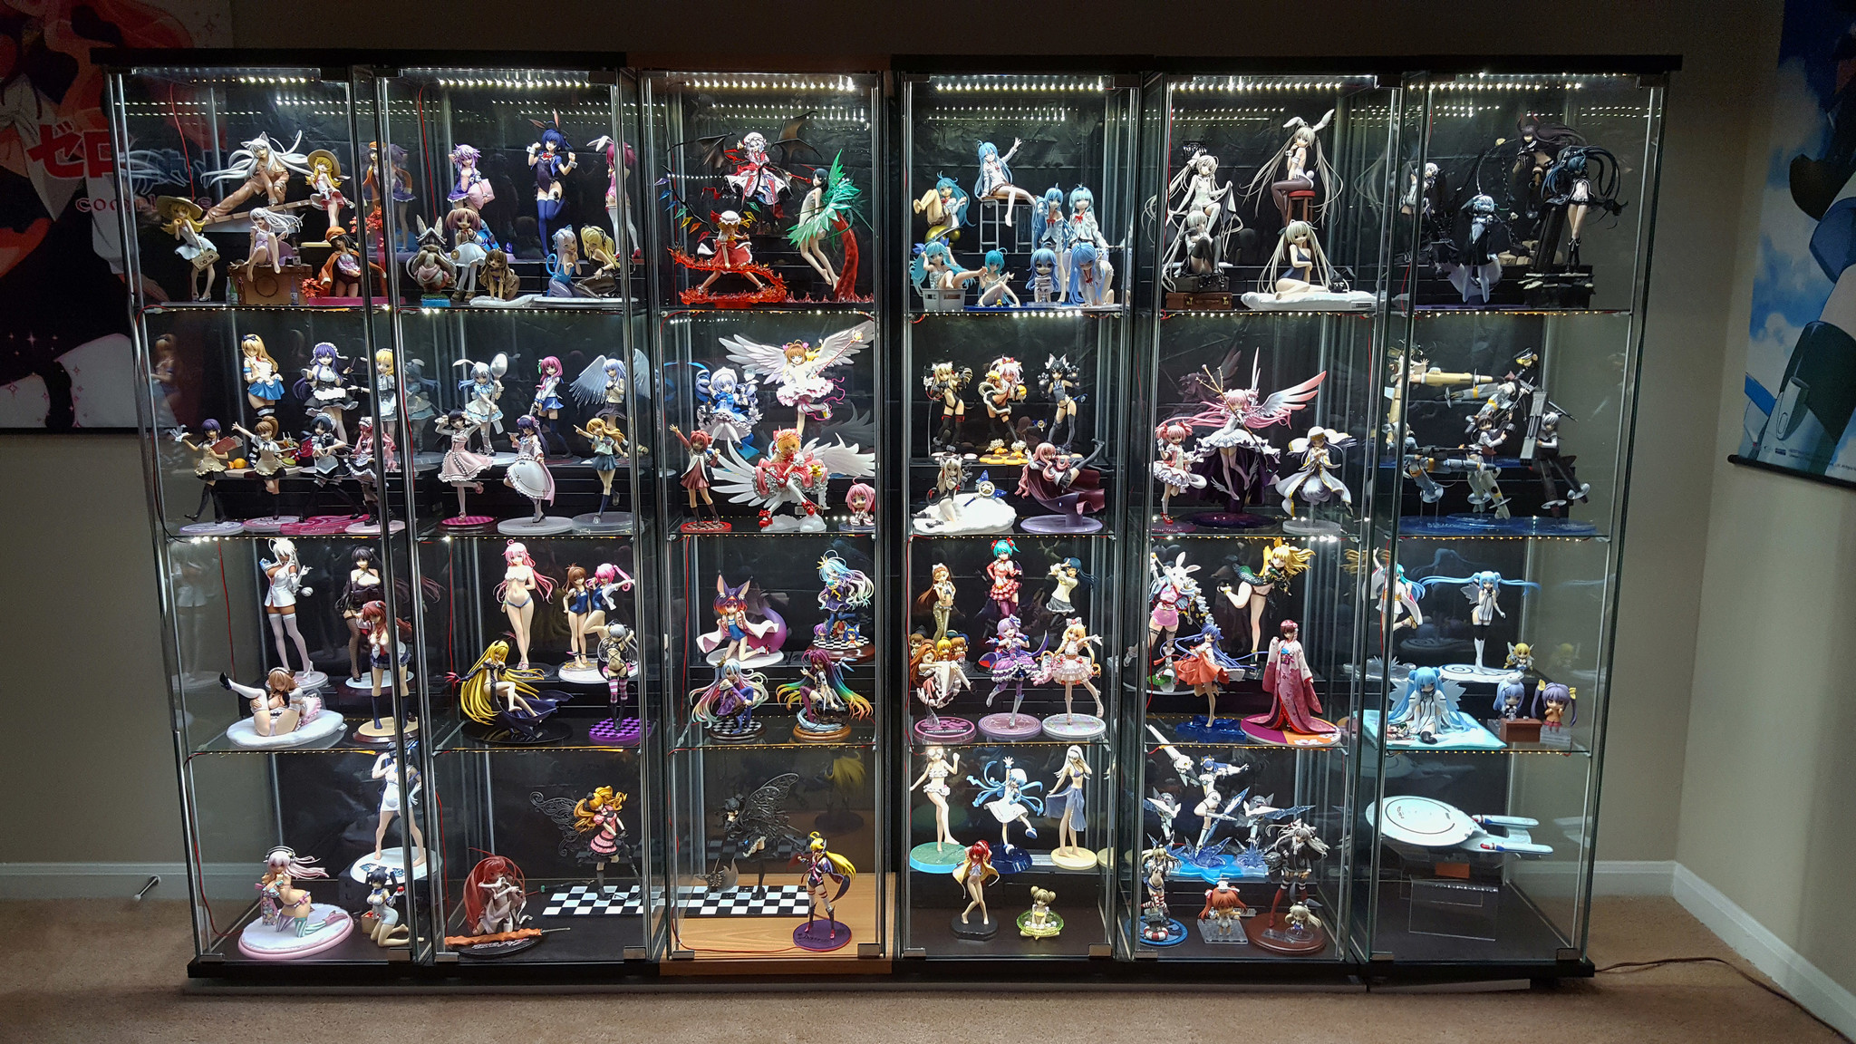
Motivation
See recent trend in figure prices

Slide 4
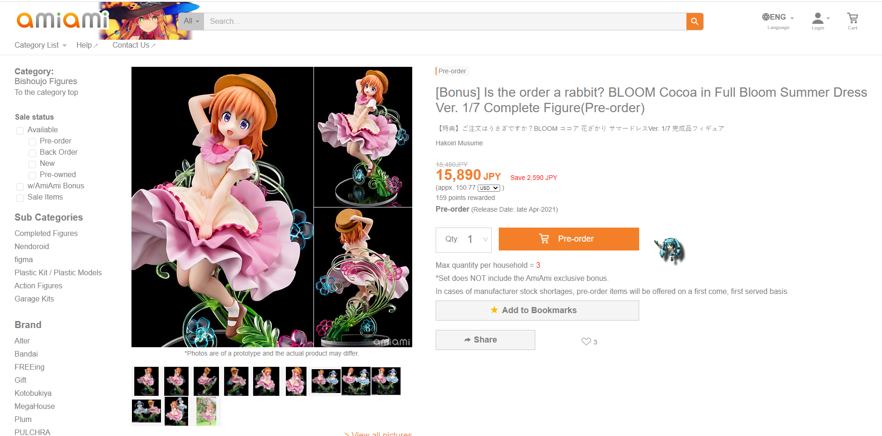
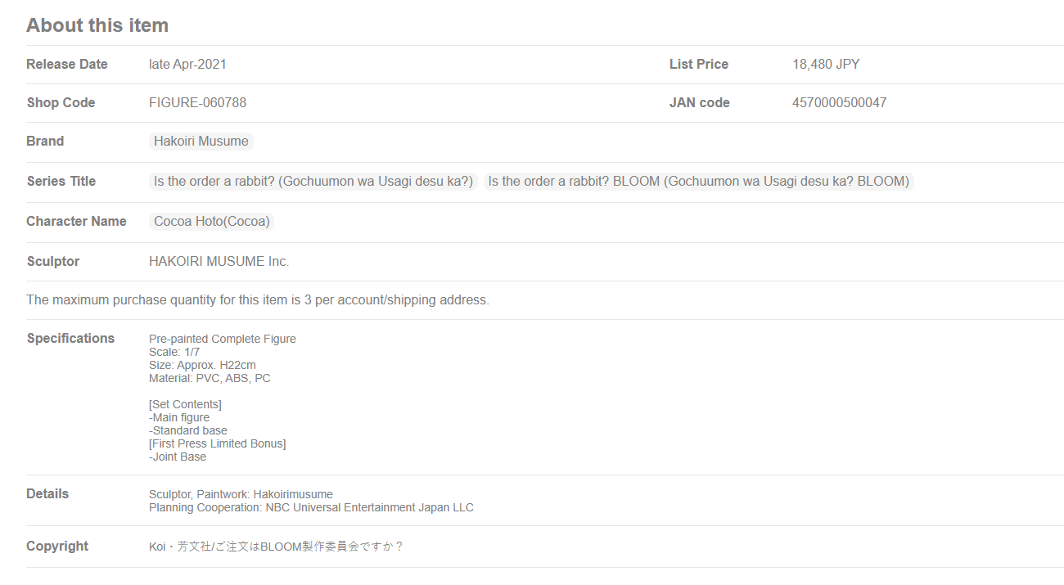
AmiAmi Website
Example page to scrap data from

Slide 5
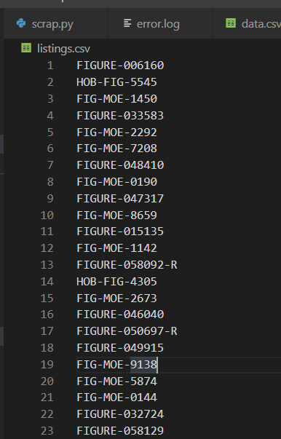
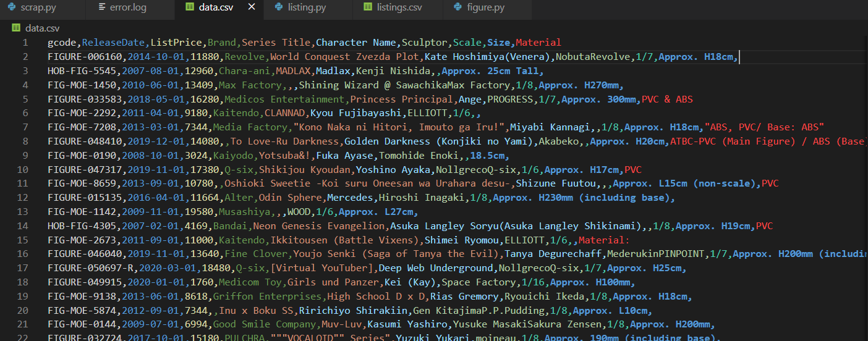
Output Data
Results of the scrapper is a csv file containing all the figure prices
Data points: 4.6k
Date range: 2002 - 2021

Slide 6
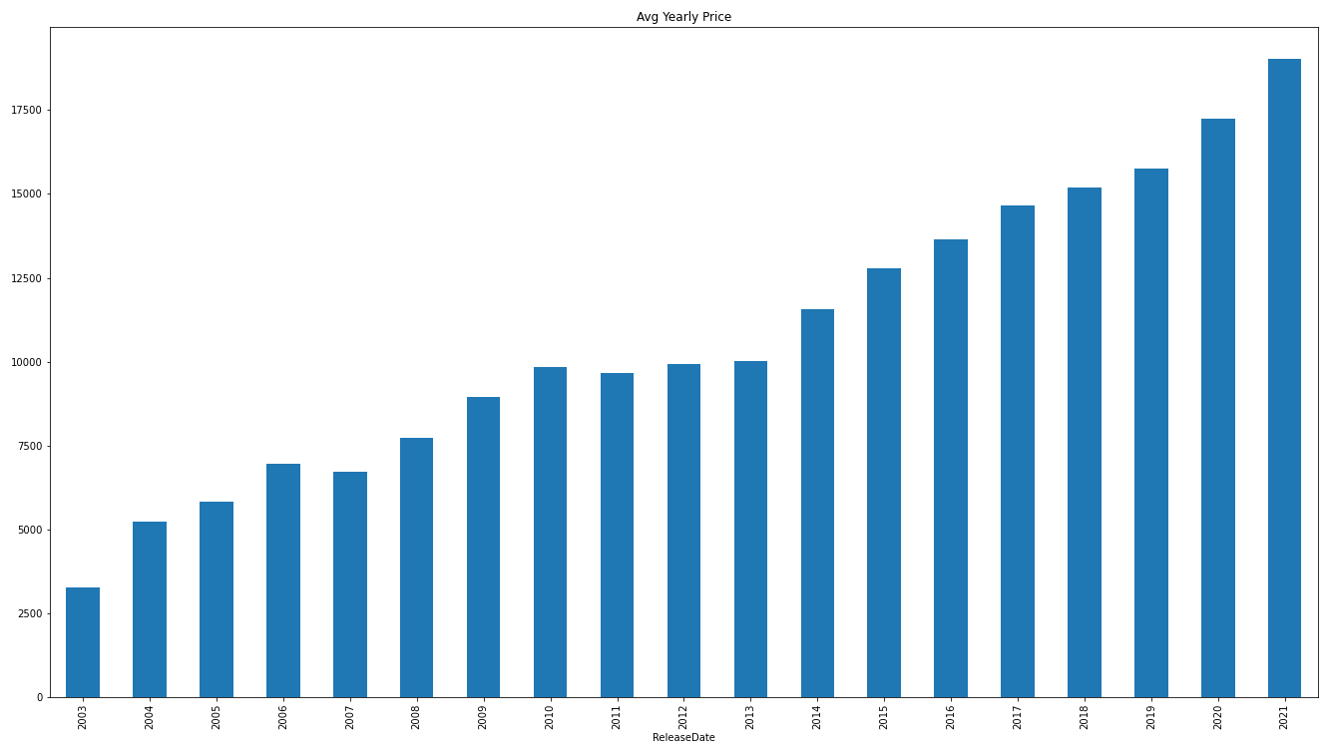
Data analysis
Average prices by year

Slide 7
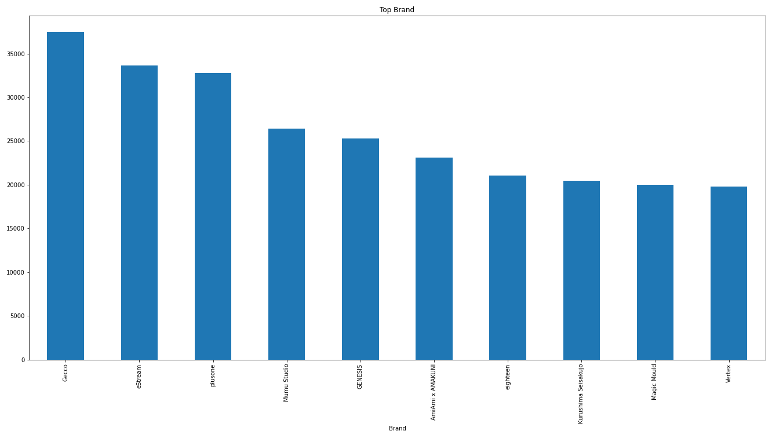
Data analysis
Most expansive Brands based on average unit price

Slide 8
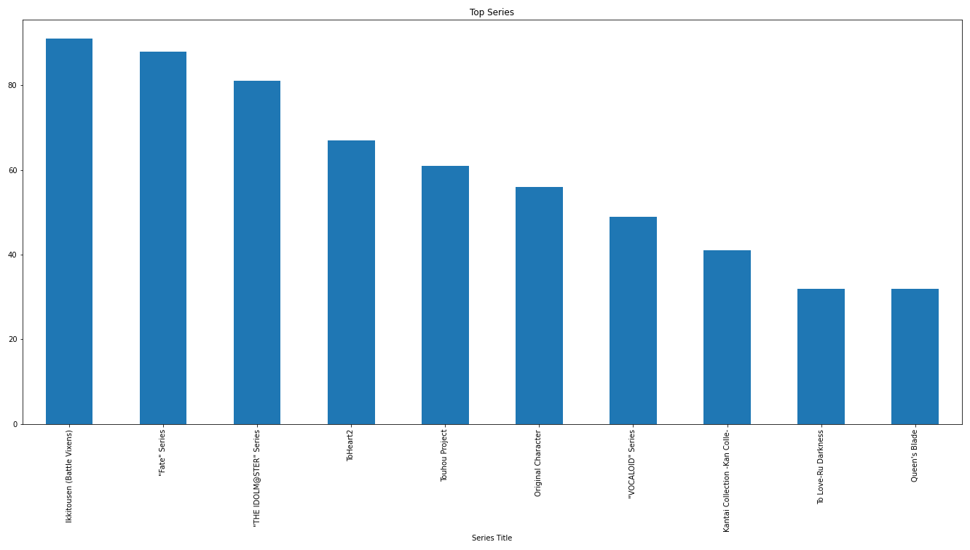
Data analysis
Series with most number of unique figures

Slide 9
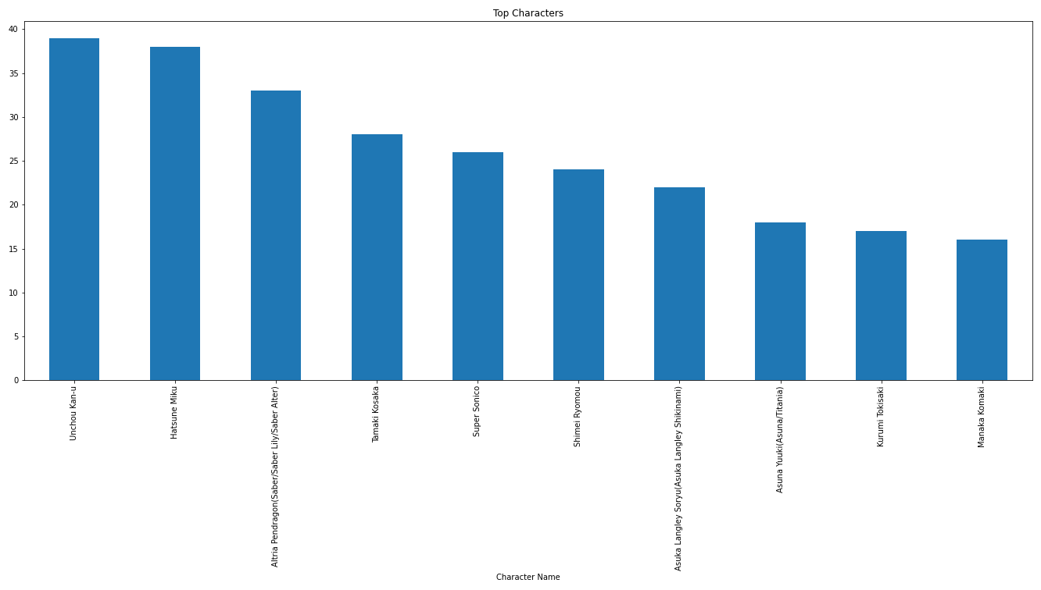
Data analysis
Most popular characters based on number of figures

Slide 10
Conclusion
Avg Price is almost double from 10 years ago
Action Figures (Gecco) is the most expansive
Ikkitousen (3 kingdoms) is most popular series/character

Slide 11
Challenges
Missing Data (price/404)
Server Maintenance
Error handling

Slide 12
Next Steps
2nd hand trading forum price analysis
Real Database and daily updates
Performance (10h total) -> Multi Threads

Slide 13
Project Code
https://github.com/dudehacker/amiami-analysis

