Slide 1


Natural Language Processing
Sentiment Analysis of a tweet
Mini Project
HRITHIK CHUGH
1

Slide 2
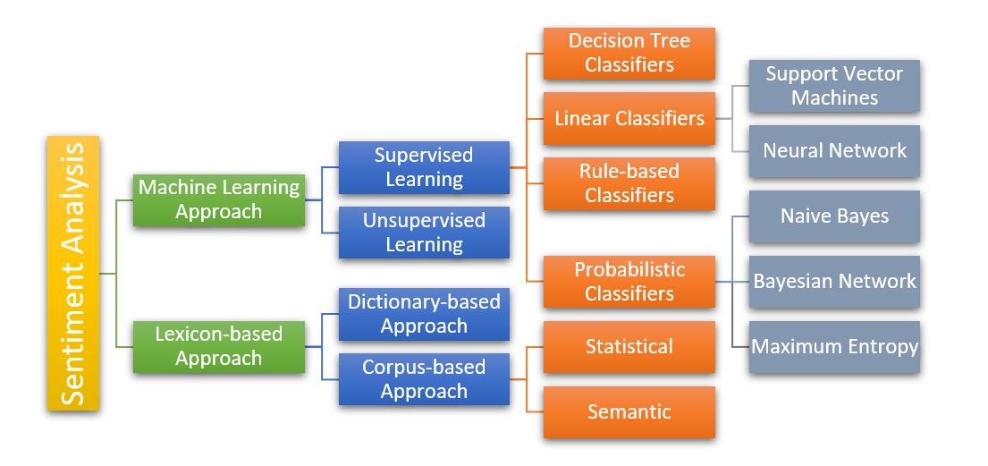
WHAT?
Sentiment Analysis
Preprocessing
Corpus
Tokenizing
Stop Words
Normalizing
Morphology
Wordnet
averaged_perceptron_tagger
pos_tag
modelling

Slide 3
An Example (How?):
[1] from nltk.corpus import twitter_samples
[2] twitter_samples.tokenized(‘.json’)
[3] cleaned_tokens_list.append(remove_noise(tokens, stop_words))
[4] pos_tag(tokenized_string)
[5] re.sub('http[s]?://(?:[a-zA-Z]|[0-9]|[$-_@.&+#]|[!*\(\),]|'\
'(?:%[0-9a-fA-F][0-9a-fA-F]))+','', token)
[6] lemmatizer = WordNetLemmatizer()
[7] token = lemmatizer.lemmatize(token, pos)
[8] classifier = NaiveBayesClassifier.train(train_data)
[9] classifier.classify(dict([token, True] for token in custom_tokens)
Input line:
#FollowFriday @France_Inte @PKuchly57 @Milipol_Paris for being top engaged members in my community this week :)
Tokenzied List:
['#FollowFriday',
'@France_Inte',
'@PKuchly57',
'@Milipol_Paris',
'for',
'being',
'top',
'engaged',
'members',
'in',
'my',
'community',
'this',
'week',
':)']
POS Tagged List:
[('#FollowFriday', 'JJ'),
('@France_Inte', 'NNP'),
('@PKuchly57', 'NNP'),
('@Milipol_Paris', 'NNP'),
('for', 'IN'),
('being', 'VBG'),
('top', 'JJ'),
('engaged', 'VBN'),
('members', 'NNS'),
('in', 'IN'),
('my', 'PRP$'),
('community', 'NN'),
('this', 'DT'),
('week', 'NN'),
(':)', 'NN')]
Normalized List:
[('FollowFriday', 'JJ'),
('France_Inte', 'NNP'),
('PKuchly57', 'NNP'),
('Milipol_Paris', 'NNP'),
('for', 'IN'),
('be', 'VBG'),
('top', 'JJ'),
('engage', 'VBN'),
('member', 'NNS'),
('in', 'IN'),
('my', 'PRP$'),
('community', 'NN'),
('this', 'DT'),
('week', 'NN'),
(':)', 'NN')]

Slide 4
That’s all, folks!
4

