Slide 1

Password Security
Kayla Dudek CSIT: 100-27

Slide 2
Presentation Overview
What are Passwords?
What are Security Breaches & Threats?
Types of Cyber Attacks
Phishing Scams
Malware
Significance of Password Strength
Password Protection Strategies
Future Technologies
Safety for Cybercrimes
Conclusion

Slide 3
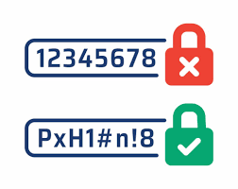
What are Passwords?
Passwords are a combination of numbers, letters, and special characters that people use to protect their accounts and information online.
Passwords are required to access different accounts, devices, and digital platforms and applications.
Image by ProWriters: Professional & Management Liability Insurance

Slide 4
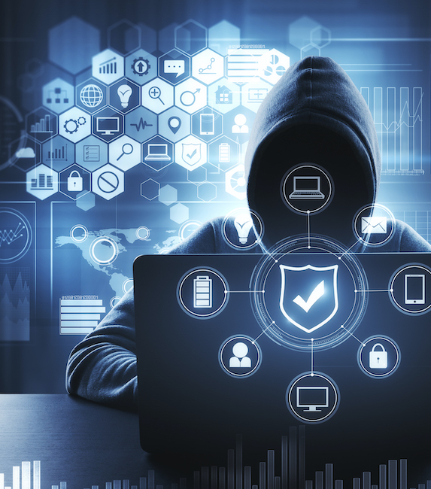
What are Security Breaches & Threats?
Data security breaches are events when access to protected information is accessed by unauthorized users.
The illegal access can lead to, theft, and misuse of personal, financial, or corporate information by malicious individuals.
All cybercrimes involve criminal activity that target computers using viruses and other types of malwares and or criminal activity using computers to commit other crimes.
With the increase in password usage causes a higher risk and vulnerability.
Image by FAU:FAU Research Reveals Internet Crime Becoming More Sophisticated

Slide 5

Types of Cyber Attacks
Some types of cyber attacks include:
Hacking
Phishing
Malware
Viruses
The people who conduct the breaches are called cybercriminals, hackers, and or scammers.

Slide 6
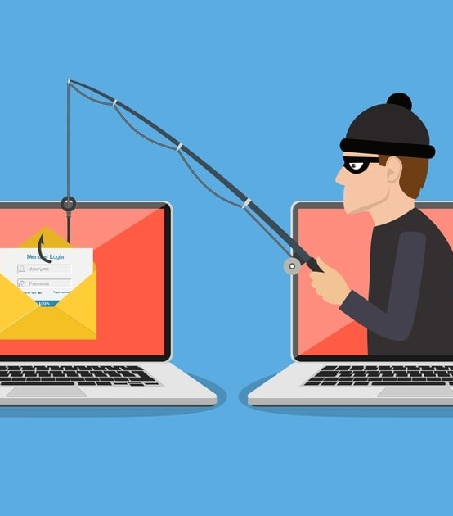
Phishing Scams
Phishing attempts (aka: scams) trick people into releasing information through fake emails, messages, and phone calls
Phishing scams tend to have a sense of emergency to distract vulnerable people into agreeing to share private and important information.
Phishing scammers often make the scam look like a legitimate link, social media posting, email, familiar branding, and artificial websites made to mimic official sites.
By falling into these scams, the person can unintendedly give out private information.
Image by MailGuard

Slide 7
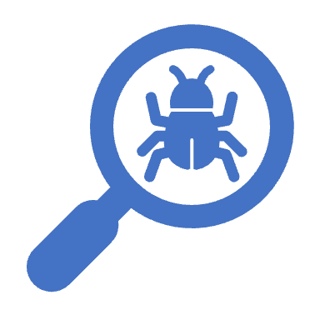
Malware
Malware is software that infiltrates systems.
Ransomware, Trojan horses, and spyware are types of malware
Cybercriminals can lock individuals from their accounts, spread viruses, gain illegal access to accounts, and act secretly to gain information.
Once inside a user’s system, malware can steal information, complicate operations, and compromise data access.
Malicious software can attack computer systems, networks, and devices.

Slide 8
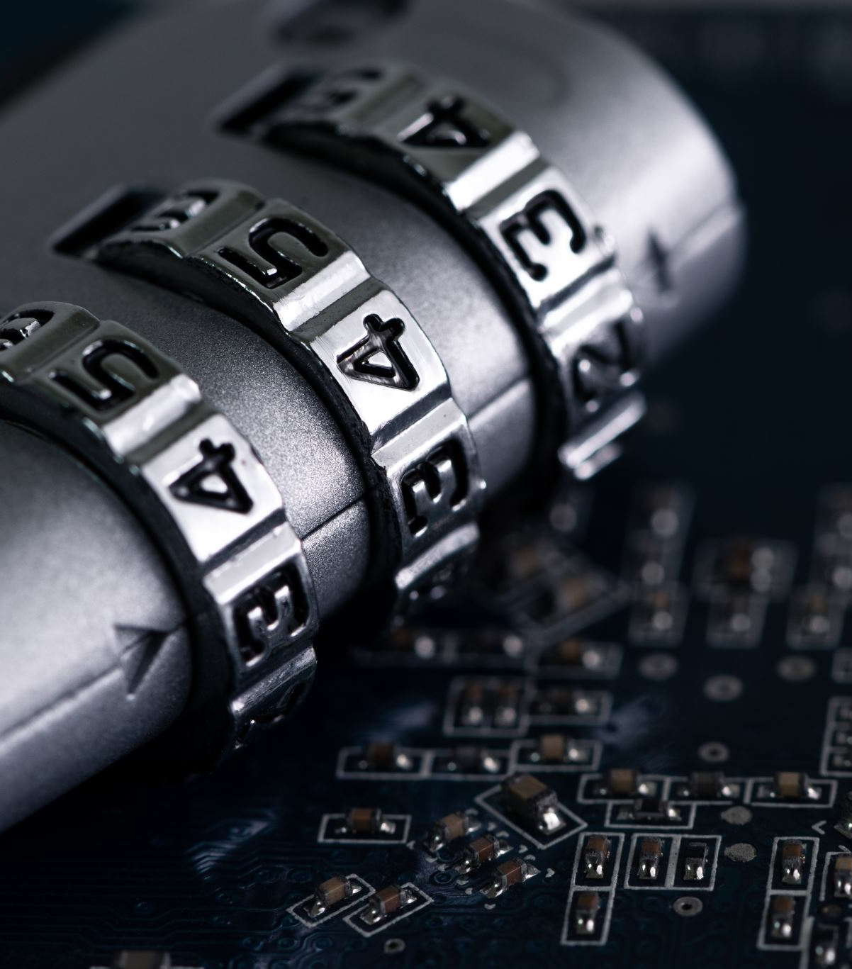
Significance of Password Strength
There are strategies to not be as vulnerable to attacks.
The best way to combat attacks are with strong passwords and password security such as two step verification systems.
It is encouraged to be educated about the dangers of weak passwords.
It is important to update passwords regularly, create unique passwords

Slide 9
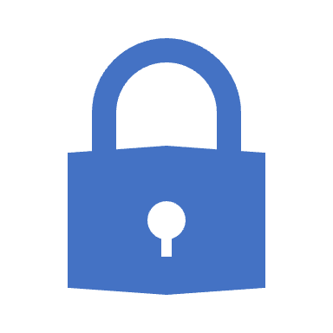
Password Protection Strategies
As technology continues to develop and advance cyber threats continue to grow and advance.
Technology prevention strategies:
Regular security assessments
Employee training
Data encryption
Creating a plan for responding when an attack occurs.
Keeping a close watch on accounts helps prevents situations from escalating or even happening at all.

Slide 10

Future Technology
Advancements in technologies are always continuing to grow progress, and improvements are consistently being made to update password security
There are already many types of authentication such as facial recognition, voice recognition, or movement patterns, two-step verification, and more.
Future technologies are expected to include fingerprints, facial features, and eye scans to secure identification. These systems would allow for a higher level of security.
Image by The Build Blog

Slide 11
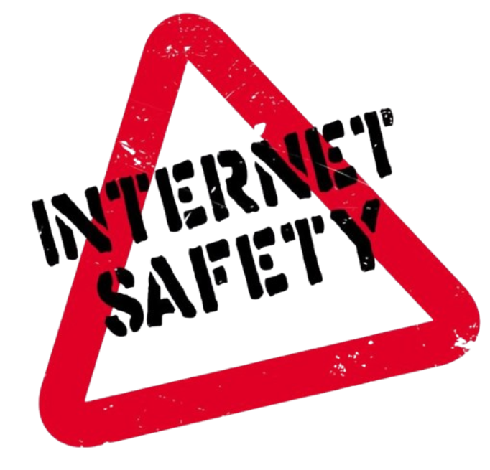
Safety for Cybercrimes
The United States Bureau of International Narcotics and Law Enforcement Affairs warns people about the risks of cybercrime.
People should always have high alerts and have a high guard against the attacks of cyber criminals and practice safe internet usage, including password security.
Individuals, and organizations should continue to develop online safety protocols to deal with data breaches and attacks.
Authentication developers must continue to work tirelessly at creating protection methods to keep up with safety against cybercrimes.
Image by Lewis & Clark County

Slide 12
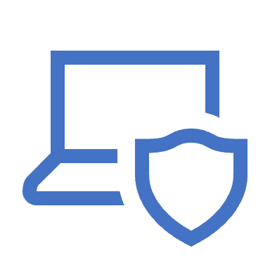
Conclusion
Password security is a critical component in safeguarding personal and organizational data in the ever-changing digital world.
It is important to change any weak passwords, and education yourself and other about the consequences of cyber attacks.
Practicing strong password policies, knowing risk exposures, and adopting multi-factor identification can help in protecting against cybercriminal access.
Password security strategies will continue to develop but also keep the the ease and enjoyment of using the internet.

