Slide 1
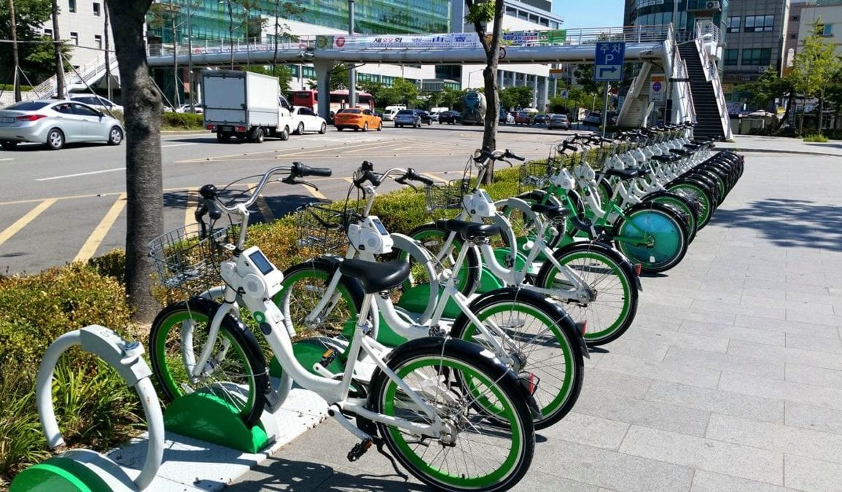
Group 7 Rental Bike share - SOAR
IST 718
Summer 2022
Dan Burke
Matt Dunlap
David No
Kushal Shah

Slide 2
Specification
Seoul Bike Sharing Demand
Questions
Kaggle, Seoul Bike Sharing Demand Prediction (Link)
Rows - 8760
Columns - 14
Day
Rented Bike Count
Hour of day
Temperature (°C)
Humidity (%)
Wind Speed (m/s)
Dew Point Temperature (10 m)
Solar Radiation (MJ/m2)
Rainfall (mm)
Snowfall (cm)
Season (Winter, Spring, Summer, Fall)
Functioning Day (Yes/No if hour of day is time for work)
Holiday (Yes/No)
Given environmental data, are we able to predict (with what accuracy and precision) bike rental sales.
What out of sample data may be used to forecast bike rental sales?
Is it possible to leverage the Seoul Bike Rental data in order to identify new markets/cities which the Bike sharing business may expand operations to?

Slide 3
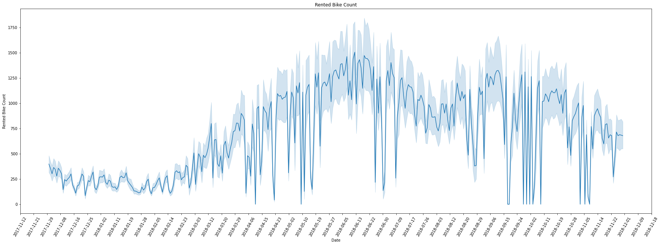
Observation- Time Series
Time series of rented bike counts averaged each day (dark line representing average)
Rented bike counts taken every hour
Rental bike demand grows from end of 2017 to the summer of 2018 and slowly decreases to end of 2018
May be due to season and weather

Slide 4
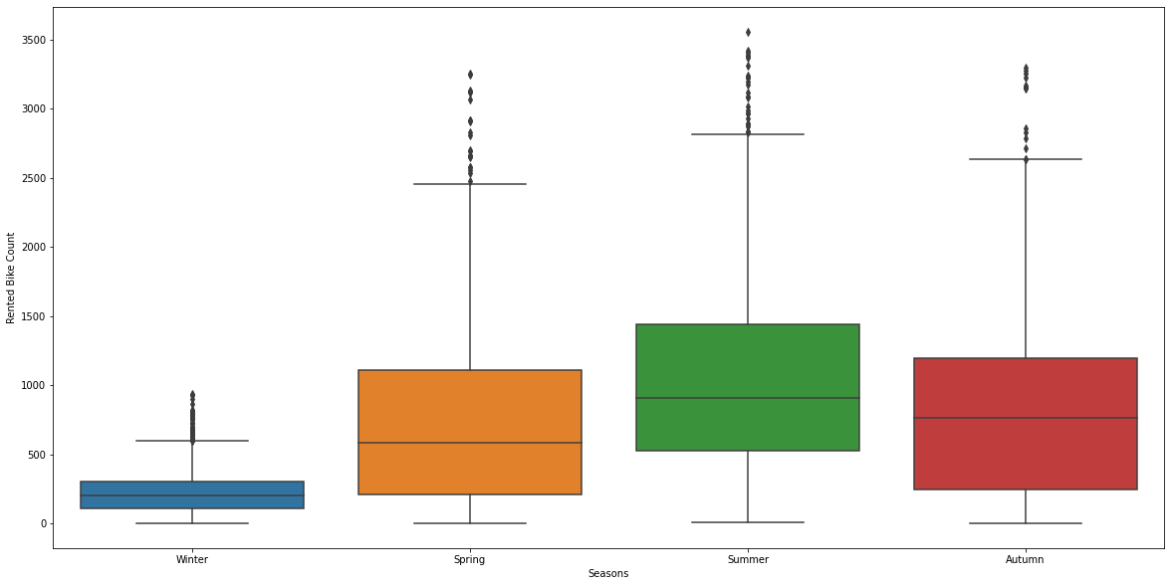
Observation - Season
Summer has the most rental bike usage, most likely to warmer weather and summer vacation for students

Slide 5
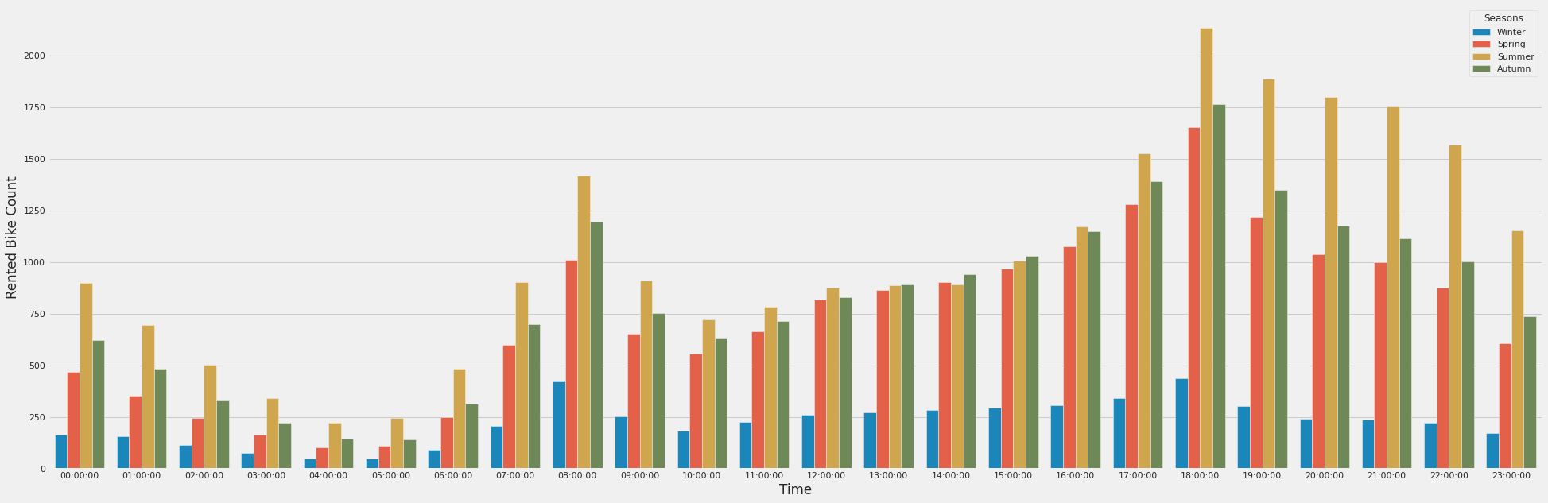
Observation – Hour with Seasons
High rented bike count in morning and night
Commuting to work and school

Slide 6
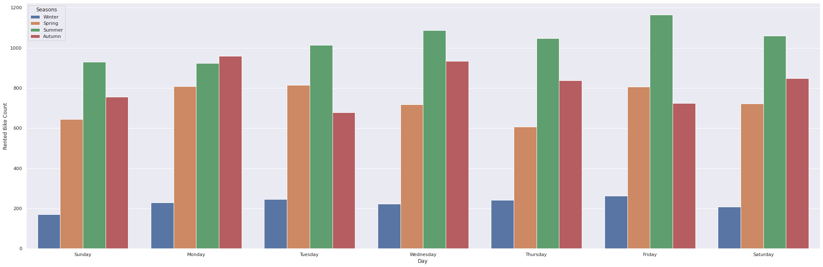
Observation – Day with Seasons
In winter, rental bike counts are low and stable throughout the week
In spring, rental bike counts peaks on Monday and then Friday
In summer, rental bike counts peak on Friday
In autumn, rental bike counts peak on Monday and Wednesday

Slide 7
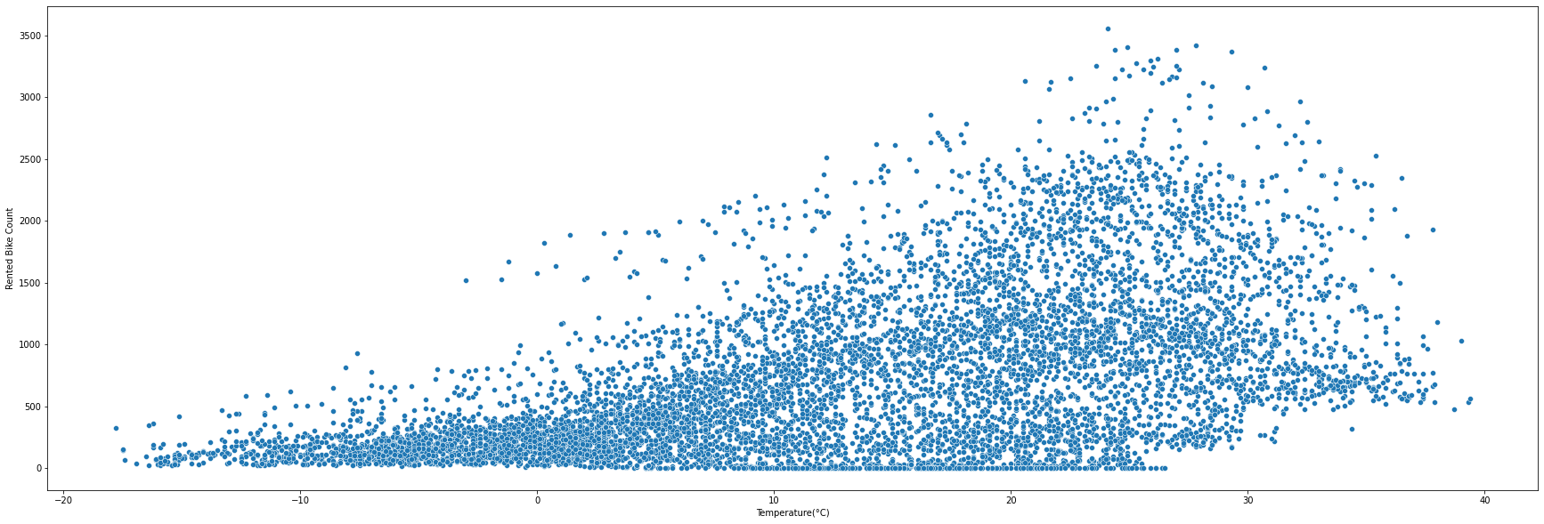
Observation - Temperature
As temperature increases, rented bike count seems to increase as well
Possible linear relationship

Slide 8
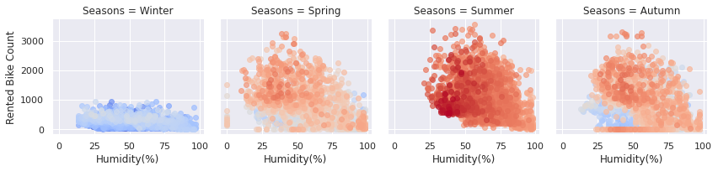
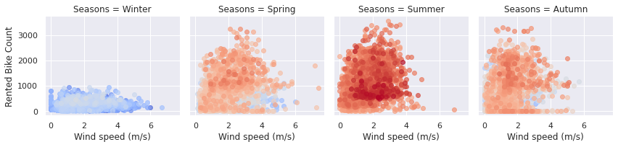
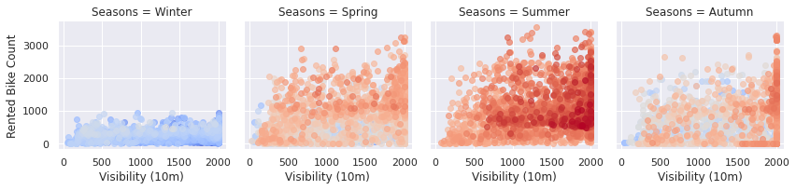
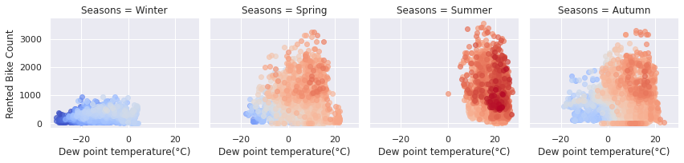
Observation - Weather
Humidity – Rental bike count seem to be highest at 50%
Wind speed – Rental bike count drops after 4 m/s
Visibility – Seem to not affect rental bike counts
Dew point temperature – Seem to not affect rental bike counts. Dew point also seems to be dependent on season.

Slide 9
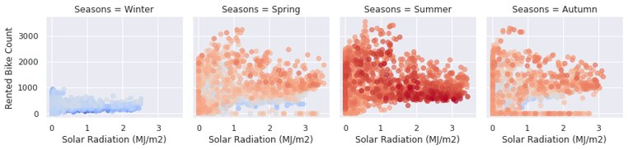
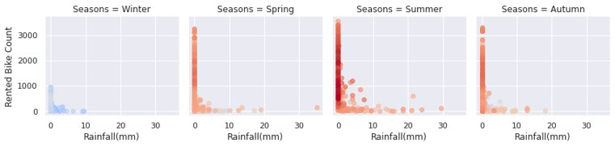
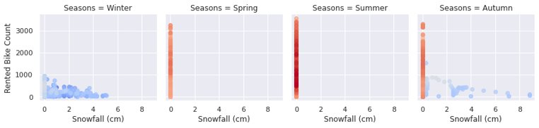
Observation – Weather continued
Solar radiation or measure of sunlight has most rented bike counts near 1 Mj/m2
Rainfall and snowfall have most rental bike counts at 0 mm

Slide 10
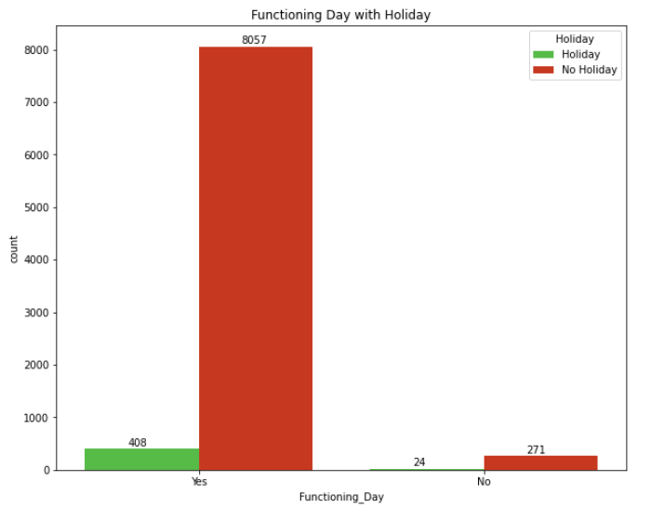
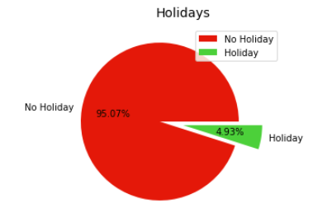
Observation - Holidays
5% of dates are holidays
Majority of rental bike counts are during working hours

Slide 11
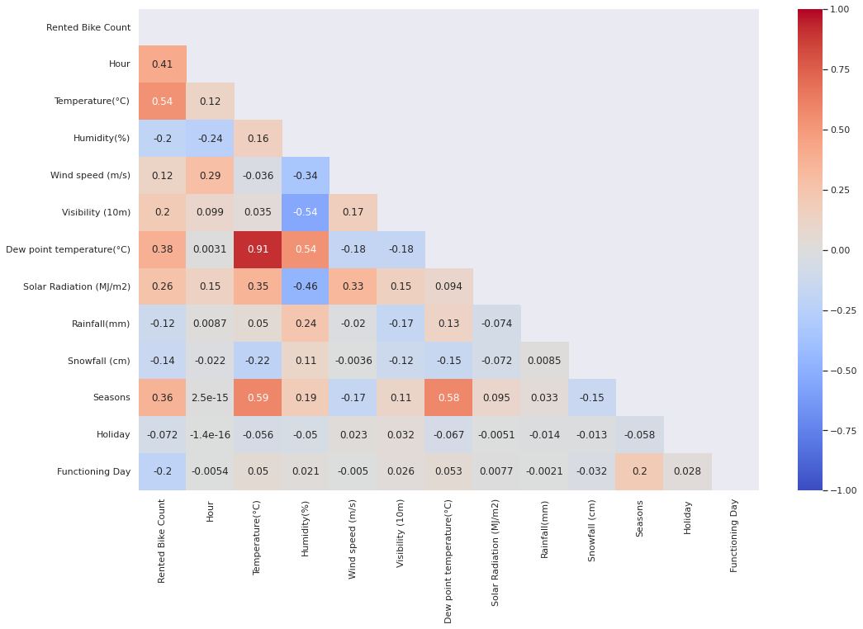
Observation - Correlation
Rented bike count has some correlation with temperature (0.54) and hour of day (0.41)

Slide 12
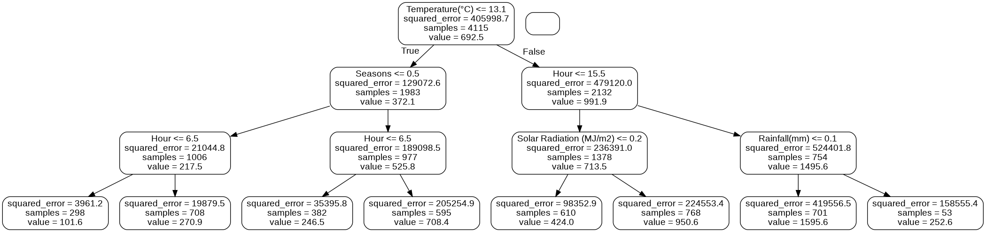
Analysis – Random Forest
Number of trees used: 1,000
Random Forest Tree, top 3 levels
Mean Absolute Error: 115.83 bikes
RMSE: 90%

Slide 13
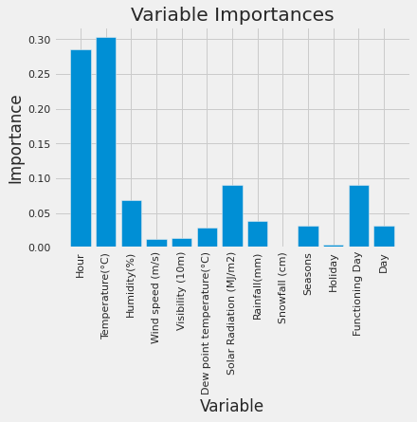
Analysis – Variables of Importance from Random Forest
Top two variables of importance are hour of day and temperature
The next three variables of importance are solar radiation, functioning day, and humidity

Slide 14
Analysis - Clustering
We also investigated clustering to help group similar days together
This could help us identify new locations for growth as clusters that tend to have a higher number of rentals would show us what features we should look for in a new location.
We utilized two types of clustering
Model Based Clustering
K Means Clustering

Slide 15
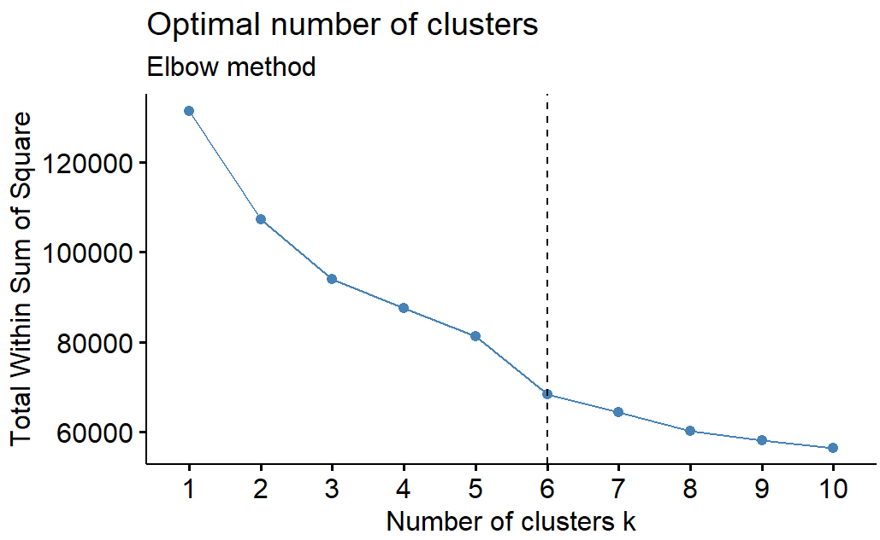
Analysis – Clustering
Utilizing the elbow method, we identified that clustering the data into 6 clusters was the most optimal method.
For Model Based Clustering, the algorithm automatically selects the optimal number of clusters. It selected 9 clusters

Slide 16
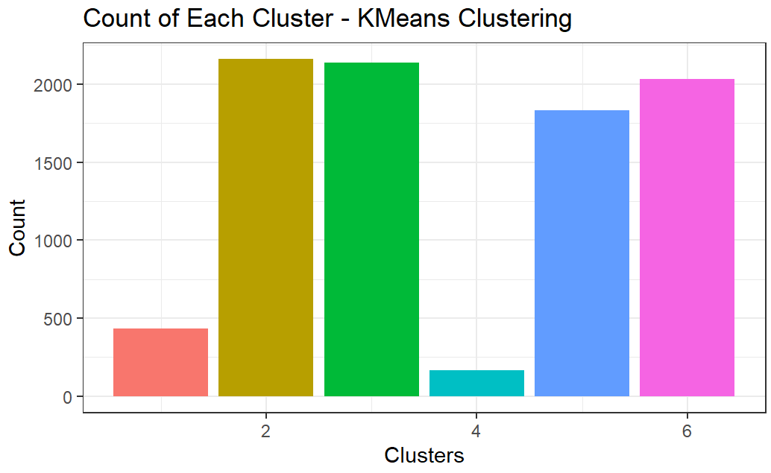
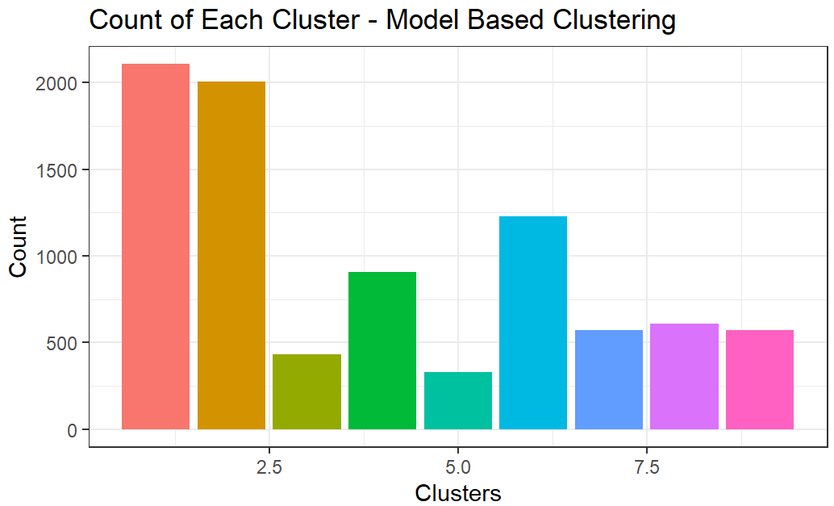
Analysis – Clustering
On the left we can see the distributions of each cluster for both clustering algorithms.
Cluster 2 and Cluster 1 for K Means Clustering and Model Based Clustering Respectively had the highest average rentals

Slide 17
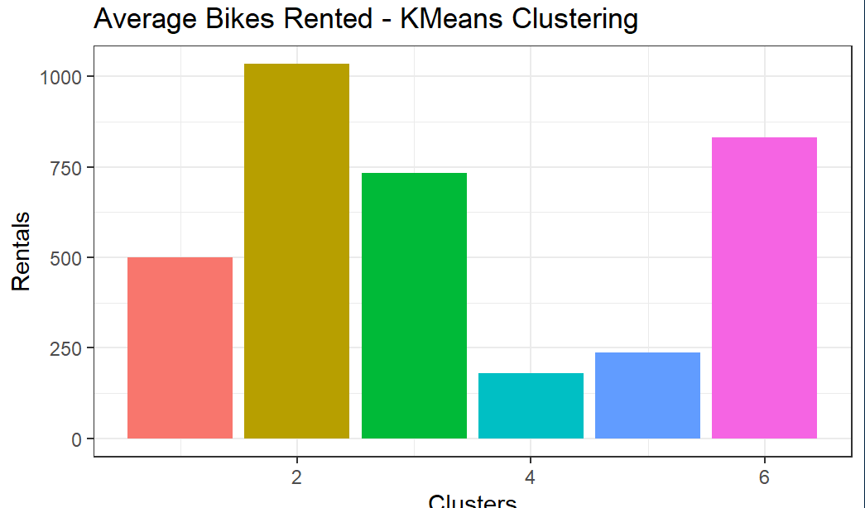
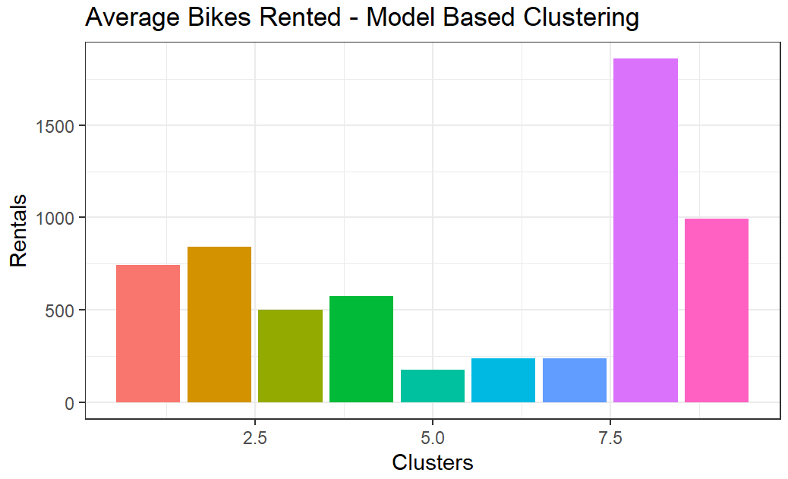
K Means Clustering (Left)
Cluster 2 on the Left Has the Highest Average Number of Rentals
Model Based Clustering (Right)
Cluster 8 on the Right Has the Highest Average Number of Rentals

Slide 18
Analysis – Clustering
K Means Cluster 2
Summer was the season for Majority of the Rentals
Humidity was slightly higher for this cluster compared to the data set
Wind Speed was also slightly higher
Model Based Clustering Cluster 8
Likewise, to above, summer was the main season for this cluster
Very similar to the above cluster, the clusters overlapped for the most part
A key difference was the hour, rentals were mostly towards evening time around 7 PM.
The model-based cluster 8 was more selective and had a higher average.

Slide 19
Remaining Work to Do
Compare different models of regression
Multiple Linear Regression
SVM
Tensor flow and/or XGBoost
Optimization of models
Identify Comparable Cities with Similar Weather
Construct Data Pipeline
Koeppen Geiger Climate Classification
Generate Geocoded list of Potential Cities
Position Stack
Climate Zone – Query Lat/Long Position of each city
Climate Zone API
City Weather Clustering Analysis
Derive Higher Fidelity City Data (Monthly Basis)
OpenWeatherAPI
Perform Cluster Analysis
Find comparable Bike Sharing Datasets to run models on
Potential Datasets
Washington D.C.
London, U.K.

