Slide 1

Group 7 Rental Bike Share Final Project
By: Dan Burke, Matt Dunlap, David No, and Kushal Shah

Slide 2
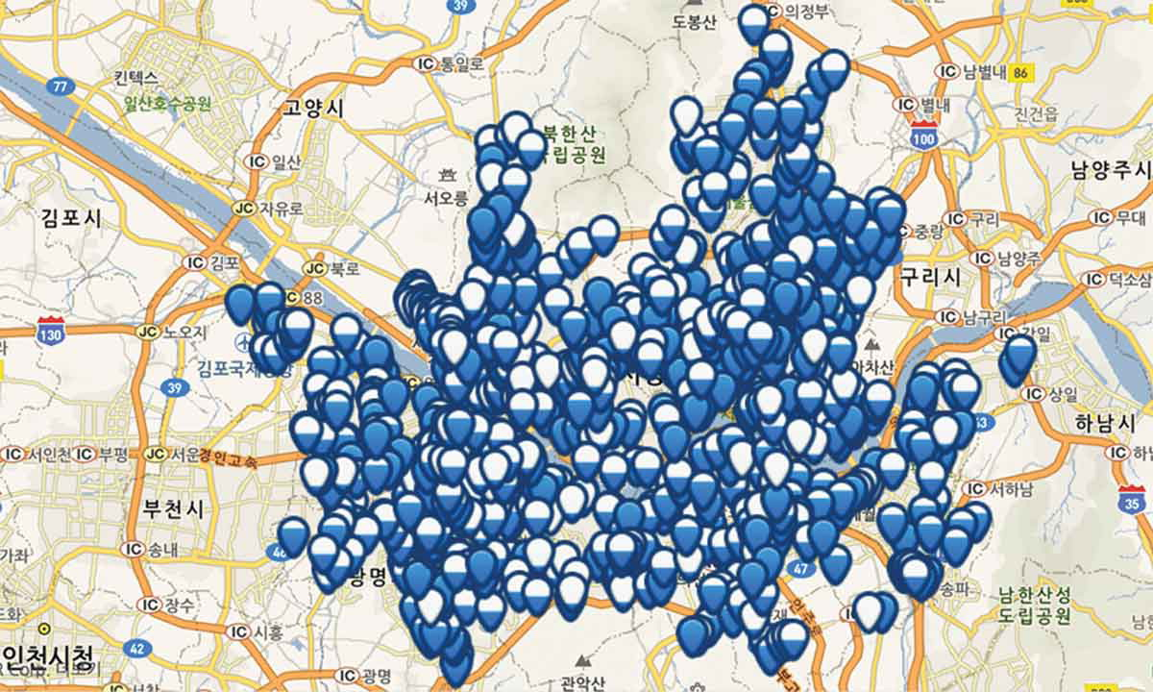
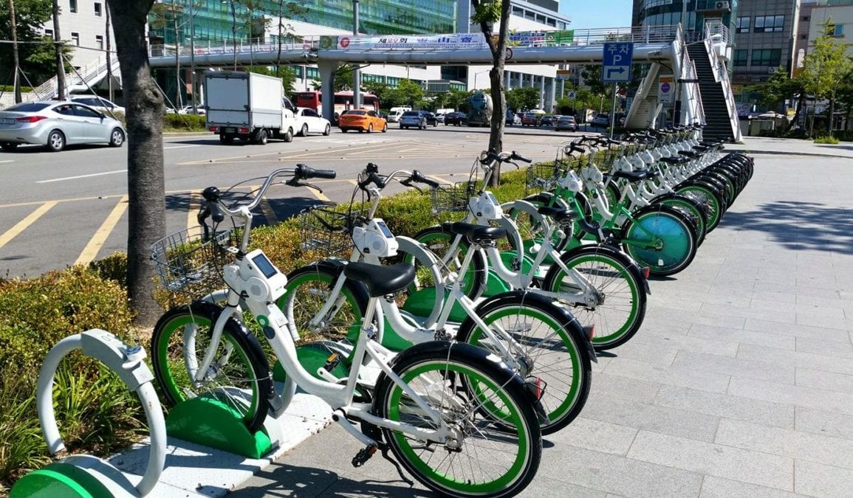
Introduction - Background
Seoul Bike started in 2015 near the Han River in Seoul, South Korea
In 2020, around 1,500 rental bike stations in Seoul operating 24 hours
Users sign up on internet and receive password to unlock rental bike from station
Website tracks distance, duration, and calories burned
Our goals is to find which features encourage rentals which will help with expansion and customer acquisition
Map of Rental Bike Location in Seoul, South Korea in 2020
Sathishkumar V E and Yongyun Cho. 'A rule-based model for Seoul Bike sharing demand prediction using weather data' European Journal of Remote Sensing, pp. 1-18, Feb, 2020

Slide 3
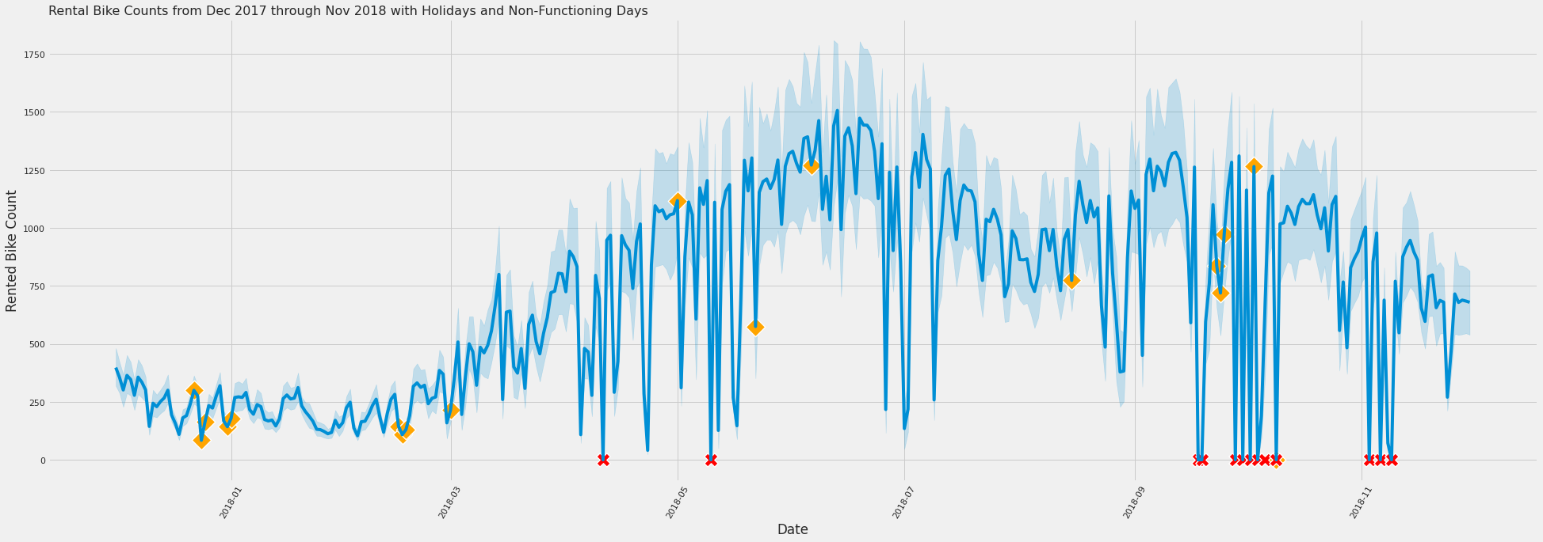
Early Data Analysis – Time Plot with Holidays and Non-Functional Days
Orange Diamond – Holidays
Red X – Non functioning
Orange diamonds are holidays, Red X are non-functional days (0 bike rentals)
October 9 is both holiday and non-functional
Holidays don't seem to increase rental bike usage

Slide 4
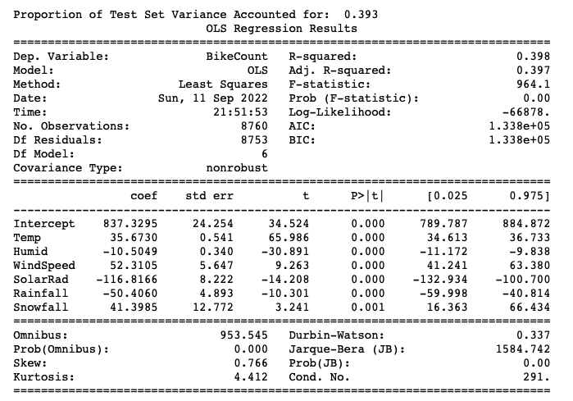

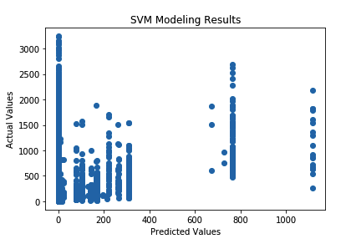
SVM and Linear Regression Modeling
Highest R-Squared: .398
Uses all numeric variables except Visibility and Dew Temp
Almost 40% of variance in bikes rented in a day related to weather
SVM model uses same variables as linear regression
Results poor
Many different parameters tried
Only 3% accurate on test data set
Predictions lower than many of test data set

Slide 5
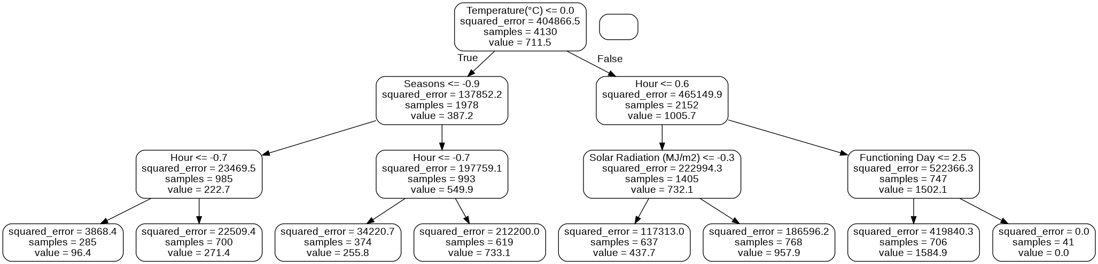
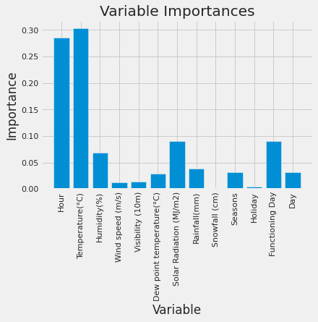
Random Forest
1,000 iterations
Mean Absolute Error (MAE) for Training Set: 41.14
MAE for Test Set: 115.91
R-Squared: 0.90

Slide 6
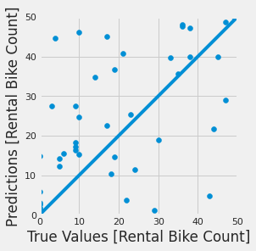
Keras with TensorFlow
Two hidden layers with 512 neurons each
Learning rate is 0.01
100 epochs
MAE for Training Set: 85.40
MAE for Test Set: 107.56
R-Squared: 0.91

Slide 7
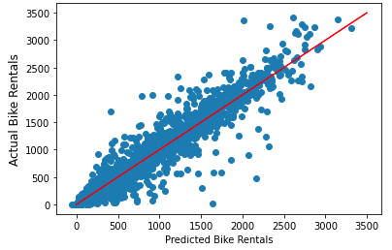
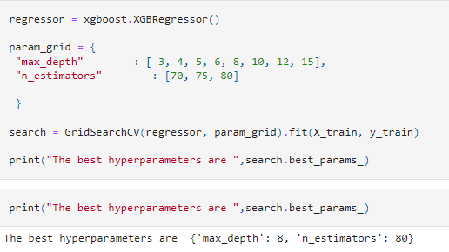
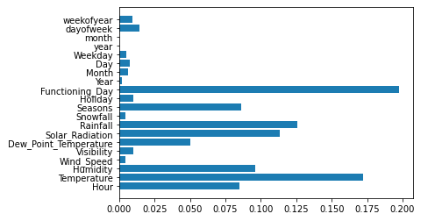
XGBoost – Extreme Gradient Boosting
XGBoost Estimator
GridSearchCV
Parmeter Grid
Max_depth: [ 3, 4, 5, 6, 8, 10, 12, 15]
N_estimators: : [70, 75, 80]
Feature Importance
Mean R2 – 0.92129
Hyper Parameters
N_estimators = 82
Max_depth = 12
Eta = 0.01
Subsample=0.7
Notes:
Why XG Boost?
Highly Flexible
Parallel Processing
Supports Regularization
Ideal for small to Medium Dataset
Able to run Cross Validation after each iteration
Availability of GPU Acceleration
Preprocessing included:
Converting string features to a "Category" data type
Addition of "Day of Year", "Week of Year" in order to add more granularity to our data.
We saw we possess "category" columns (specifically Holiday, Functioning Day, Seasons, Weekday. In order to successfully run and generator an gradient-boosted model we must convert these columns to a numerical value. We do this by instantiating the "Label Encoder" from the SKLearn library.
To "get our foot in the door" with hyper parameters, we utilize the "XGBoost" Estimator to try out every combination of the "max_depth" and "n_estimators" hyper parameters.
"n_estimators" refers to the number of gradient boosted trees or the number of boosted rounds.
"max_depth" refers to the maximum depth of a tree, increasing this value adds complexity to our model.
Model Generation:
Leveraged "make_pipeline()" to expediently generate models
4 models generated, first with no tuning parameters which resulted with a R2 value of 0.843
After tuning we were able to achieve a maximum R2 value of 0.92129

Slide 8
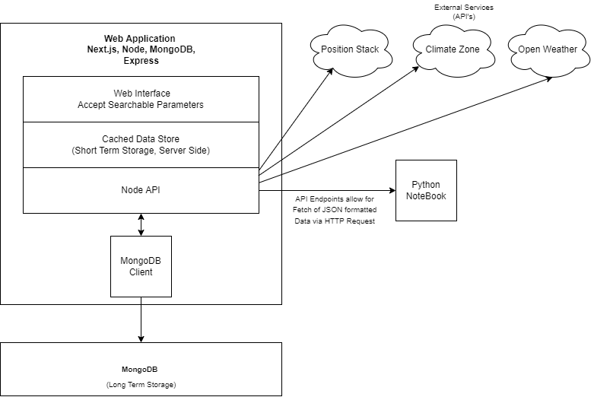
Sister City Identification – Sys Design
Next.js (React.js), Node, MongoDB
Streamlined Data Fetching
Organization and Aggregation of Data
Simplify
Short Term/Long Term Storage
MongoDB – NoSQL
Notes:
- It quickly became apparent with attempting to answer the "Sister City Identification" question that the problem is less identifying a city to expand to, but rather:
How do you enable a Data Science team to answer that question? -> Through a Data Engineering Pipeline
Data Engineering Questions:
- How do you link external services to your team?
Centralization of data fetching from external services – API (Application Programming Interface)
- How do you aggregate that data of multiple Schema designs? How do you store it while maintaining as much of the initial/intended shape of that data?
A NoSQL Database – MongoDB
- How do you make the available to your team and different teams across your organization?
MongoDB Endpoint for raw access to data at various scales

Slide 9
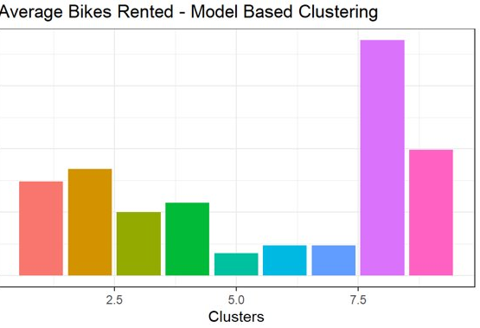
Clustering Analysis
We also investigated clustering to help group similar days together
This could help us identify new locations for growth as clusters that tend to have a higher number of rentals would show us what features we should look for in a new location.
Model Based Clustering Results on the Left
Cluster 8 to Clear Cut Best One
Some features for cluster 8:
Summer Months
Evening time around 7 PM
We also tried K Means Clustering that had similar results

Slide 10

Conclusions
One of the biggest takeaways from each model is the impact of weather.
It was a common feature among them all to see the different weather aspects to
Looking for populated areas with warm weather and low levels of rain would be our recommendation for expansion.
Spain
West Coast – United States

