Slide 1
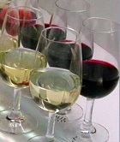
WINE QUALITY PREDICTION
IST 707 DATA ANALYSIS PROJECT
NATALI NEWMAN, MORGAN GERE, DAN BURKE, NICK TINSELY

Slide 2
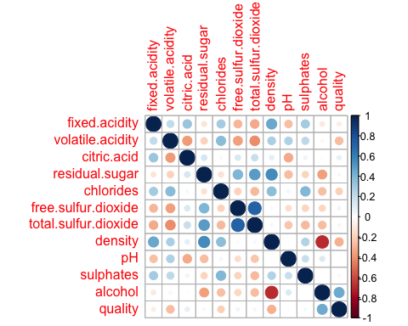
correlation
((Whoever wants to cover correlation- I know a couple of us ran this))
Highest correlations were between:
residual sugar & density (0.55251695)
total sulfur dioxide & free sulfur dioxide (0.72093408)

Slide 3
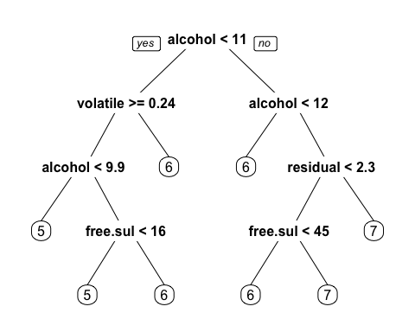
Decision tree
Alcohol and volatile acidity were the biggest factors in decision tree prediction of quality
However, only 54.06% accuracy

Slide 4
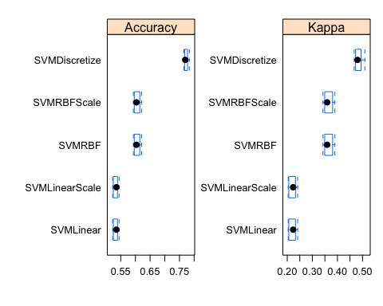
Support vector machine prediction
Using the given quality assignments (0-10)
SVM linear performed at ~52-53% accuracy depending on the training data
SVM non-linear with a radial kernel performed at ~61-63% accuracy
The quality variable was discretized into high (7-10), medium (4-6), and low(0-3)
SVM non-linear with a radial kernel achieved a ~77-78% accuracy with the discretized output variable

Slide 5
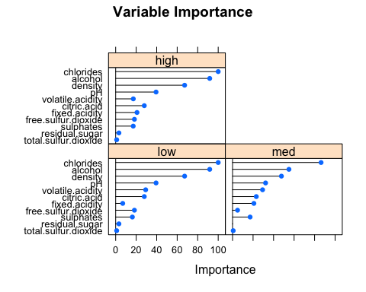
variable Importance in the svm model

Slide 6
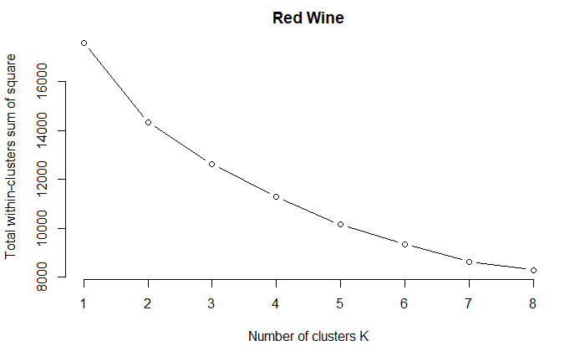
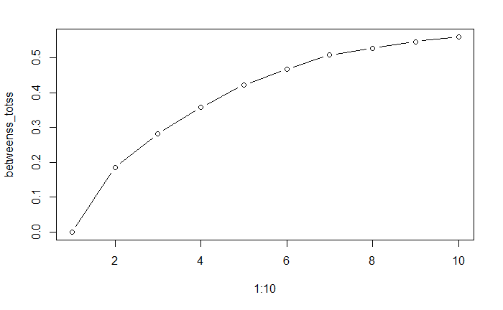
Elbow Method
Shoulder Method

Slide 7
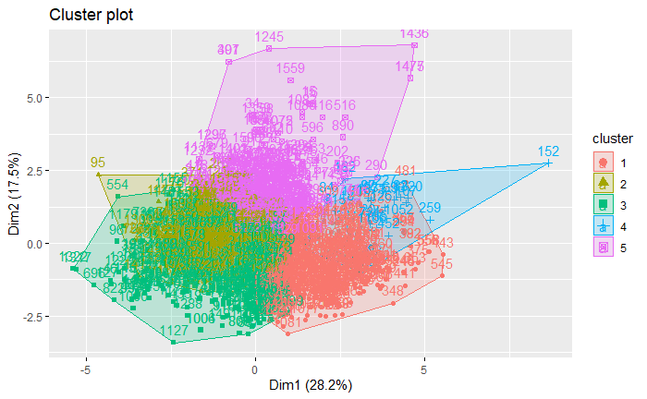
Full Red Wine Dataset 5 clusters
Quality Red Full
1 2 3 4 5
3 2 7 0 0 1
4 5 38 4 1 5
5 98 293 47 17 226
6 178 191 168 9 92
7 82 22 83 1 11
8 7 0 10 0 1

Slide 8
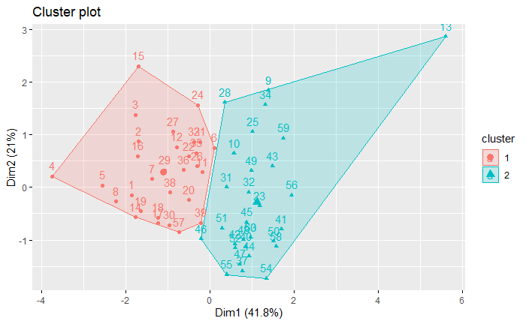
Equal number of each quality attributes.
Quality discretized in High and Low Quality
Correlated attributes removed
Low impact attributes removed
Quality_ Red_Equal
1 2
High 6 24
Low 24 6

Slide 9
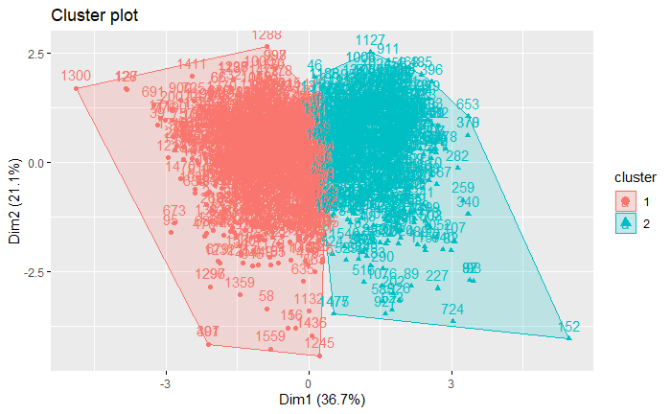
Quality_Red_F
1 2
High 377 478
Low 562 182
Accuracy 0.650
Precision 0.559
Recall 0.724
F-measure 0.631

Slide 10
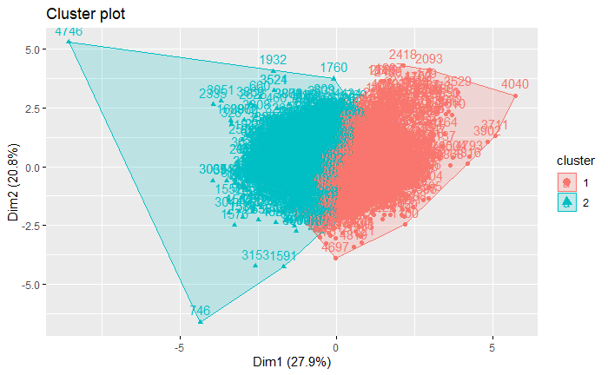
Lots of errors with just High and Low.
Placed quality 6 in “Mid”
Observed the clusters was splitting 6 into both low and high.
Quality White Full
1 2
High 723 337
Low 669 971
Mid 1049 1149

Slide 11
Confusion Matrix and Statistics
Reference
Prediction High_Quality Low_Quality
High_Quality 689 140
Low_Quality 133 336
Accuracy : 0.7897
95% CI : (0.7665, 0.8116)
No Information Rate : 0.6333
P-Value [Acc > NIR] : <2e-16
Kappa : 0.5458
Mcnemar's Test P-Value : 0.7165
Sensitivity : 0.8382
Specificity : 0.7059
Pos Pred Value : 0.8311
Neg Pred Value : 0.7164
Prevalence : 0.6333
Detection Rate : 0.5308
Detection Prevalence : 0.6387
Balanced Accuracy : 0.7720
'Positive' Class : High_Quality
k-Nearest Neighbors
5199 samples
12 predictor
2 classes: 'High_Quality', 'Low_Quality'
No pre-processing
Resampling: Cross-Validated (10 fold, repeated 3 times)
Summary of sample sizes: 4679, 4680, 4679, 4679, 4680, 4679, ...
Resampling results across tuning parameters:
k Accuracy Kappa
1 0.7825860 0.5290920
Accuracy was used to select the optimal model using the largest value.
The final value used for the model was k = 1.

Slide 12
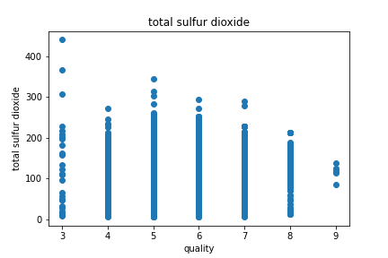
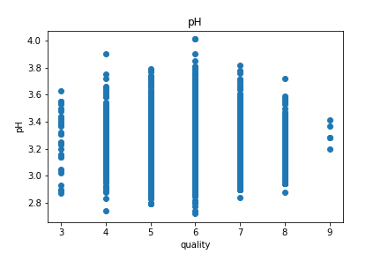
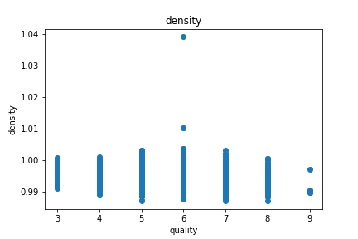
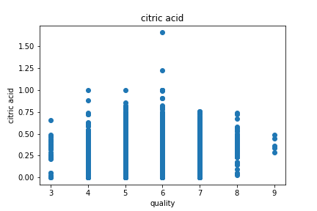
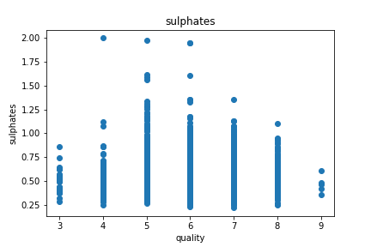
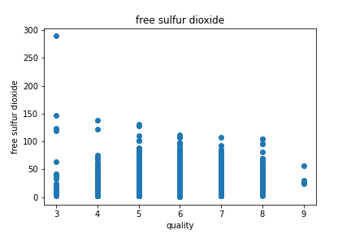
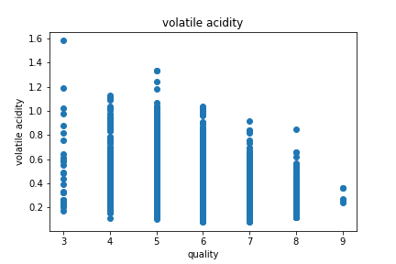
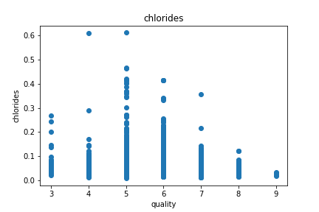
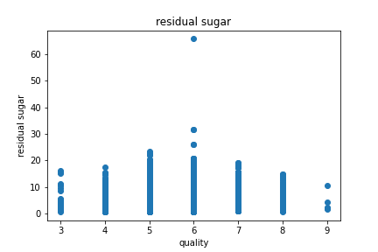
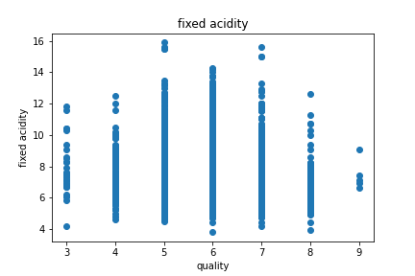
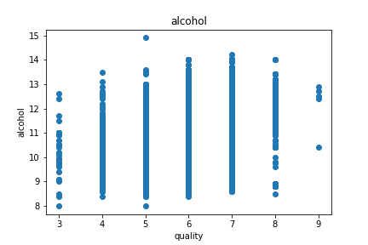
Naïve Bayes Classifier – Python “scikit-learn” Implementation

Slide 13
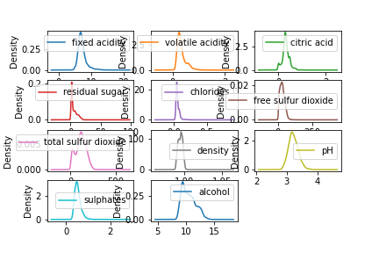
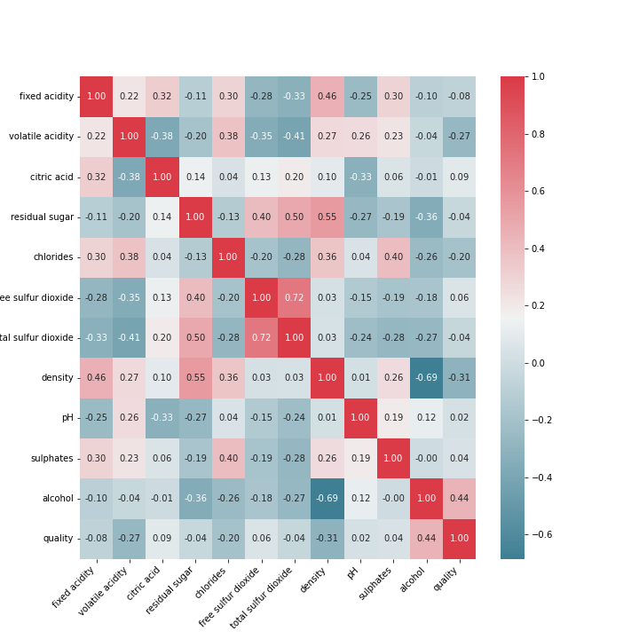
Naïve Bayes Classifier – Python “scikit-learn” Implementation
Explored Attributes by Wine Quality (Previous Slide)
Explored Attributes by Density (Seaborn lib)
Created Correlation Matrix (bottom Left)
Created Random Forest Model
Created Naïve Bayes Model (“GaussianNB”)
Repeated to explore Red and White separately, then concatenating

Slide 14
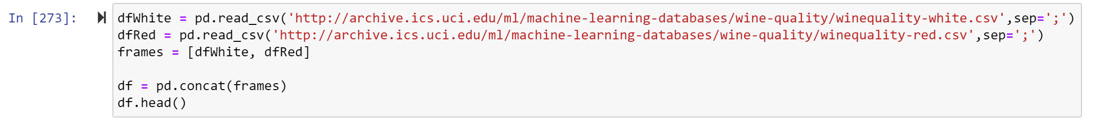
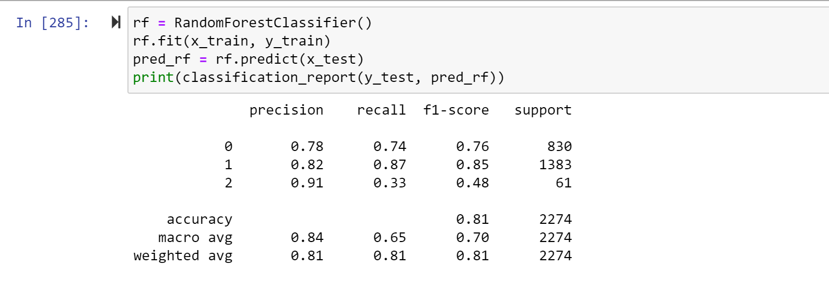
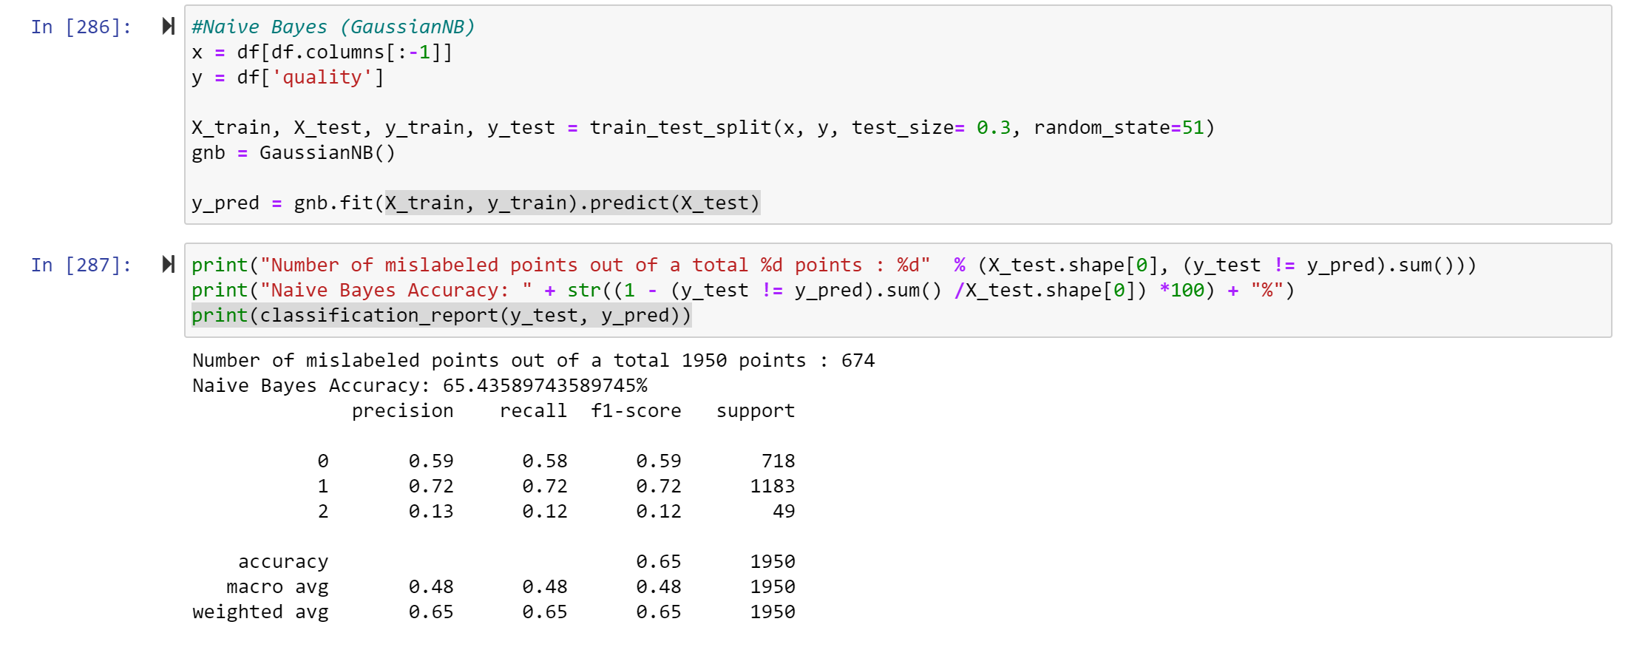
Naïve Bayes Classifier – Python “scikit-learn” Implementation

Slide 15
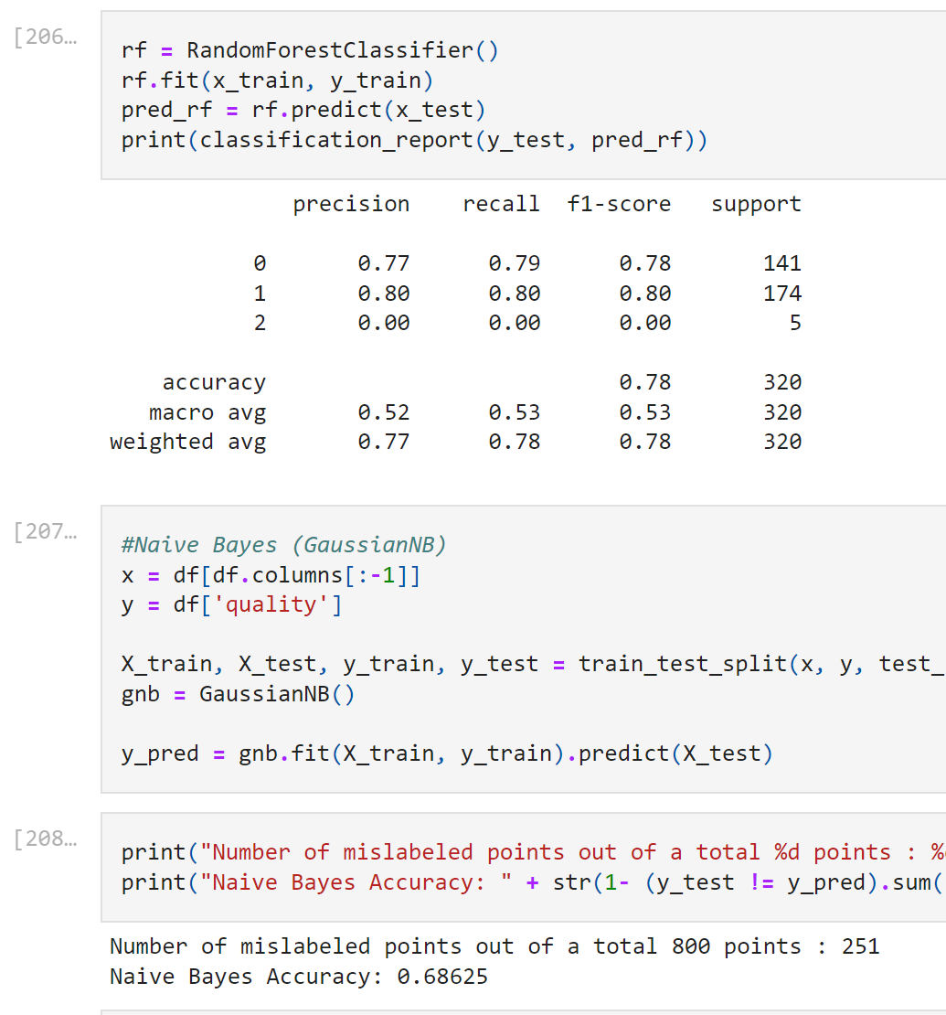
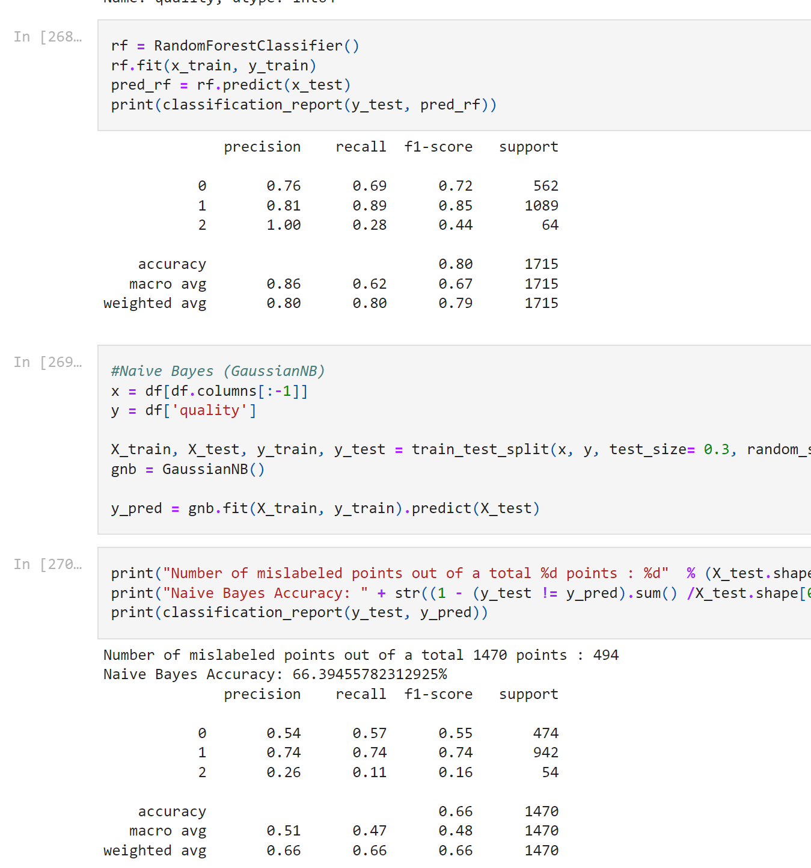
Red
White

