Slide 1

WINE QUALITY PREDICTION
IST 707 DATA ANALYSIS PROJECT
NATALI NEWMAN, MORGAN GERE, DAN BURKE, NICK TINSELY

Slide 2
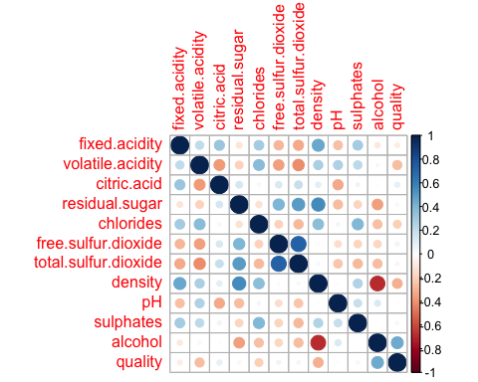
correlation
((Whoever wants to cover correlation- I know a couple of us ran this))
Highest correlations were between:
residual sugar & density (0.55251695)
total sulfur dioxide & free sulfur dioxide (0.72093408)

Slide 3
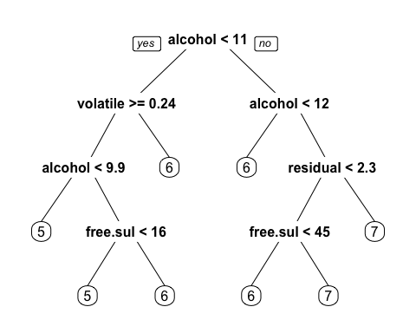
Decision tree
Alcohol and volatile acidity were the biggest factors in decision tree prediction of quality
However, only 54.06% accuracy

Slide 4
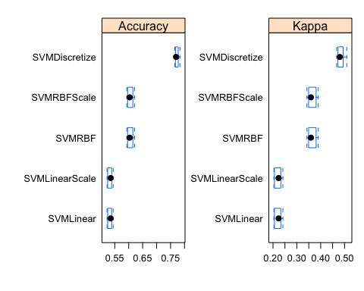
Support vector machine prediction
Using the given quality assignments (0-10)
SVM linear performed at ~52-53% accuracy depending on the training data
SVM non-linear with a radial kernel performed at ~61-63% accuracy
The quality variable was discretized into high (7-10), medium (4-6), and low(0-3)
SVM non-linear with a radial kernel achieved a ~77-78% accuracy with the discretized output variable

Slide 5
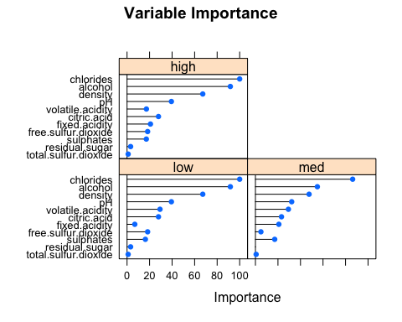
variable Importance in the svm model

Slide 6
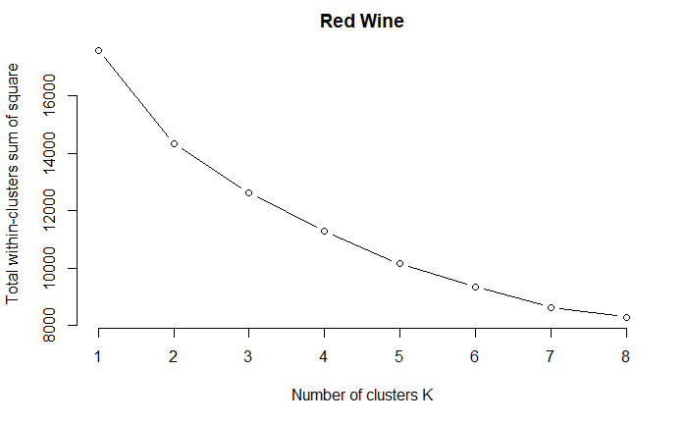
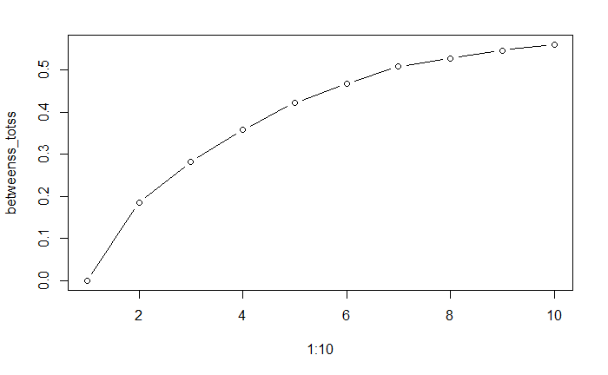
Elbow Method
Shoulder Method

Slide 7
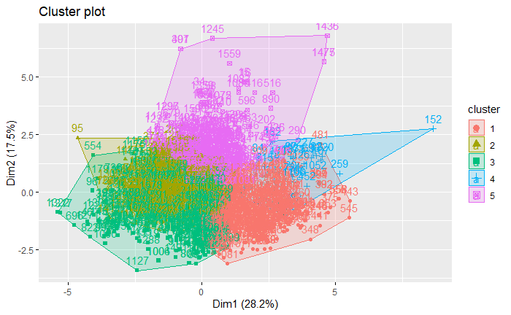
Full Red Wine Dataset 5 clusters
Quality Red Full
1 2 3 4 5
3 2 7 0 0 1
4 5 38 4 1 5
5 98 293 47 17 226
6 178 191 168 9 92
7 82 22 83 1 11
8 7 0 10 0 1

Slide 8
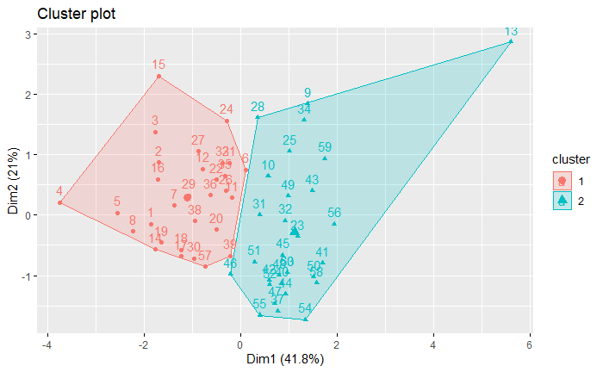
Equal number of each quality attributes.
Quality discretized in High and Low Quality
Correlated attributes removed
Low impact attributes removed
Quality_ Red_Equal
1 2
High 6 24
Low 24 6

Slide 9
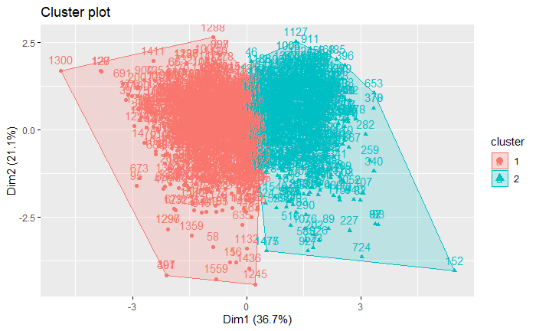
Quality_Red_F
1 2
High 377 478
Low 562 182
Accuracy 0.650
Precision 0.559
Recall 0.724
F-measure 0.631

Slide 10
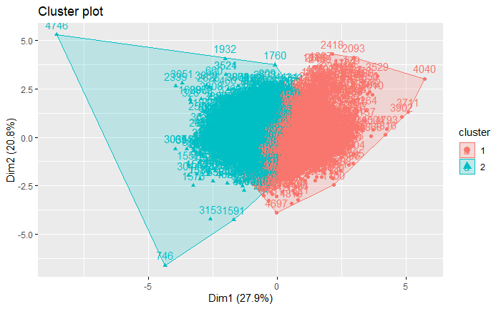
Lots of errors with just High and Low.
Placed quality 6 in “Mid”
Observed the clusters was splitting 6 into both low and high.
Quality White Full
1 2
High 723 337
Low 669 971
Mid 1049 1149

Slide 11
Confusion Matrix and Statistics
Reference
Prediction High_Quality Low_Quality
High_Quality 689 140
Low_Quality 133 336
Accuracy : 0.7897
95% CI : (0.7665, 0.8116)
No Information Rate : 0.6333
P-Value [Acc > NIR] : <2e-16
Kappa : 0.5458
Mcnemar's Test P-Value : 0.7165
Sensitivity : 0.8382
Specificity : 0.7059
Pos Pred Value : 0.8311
Neg Pred Value : 0.7164
Prevalence : 0.6333
Detection Rate : 0.5308
Detection Prevalence : 0.6387
Balanced Accuracy : 0.7720
'Positive' Class : High_Quality
k-Nearest Neighbors
5199 samples
12 predictor
2 classes: 'High_Quality', 'Low_Quality'
No pre-processing
Resampling: Cross-Validated (10 fold, repeated 3 times)
Summary of sample sizes: 4679, 4680, 4679, 4679, 4680, 4679, ...
Resampling results across tuning parameters:
k Accuracy Kappa
1 0.7825860 0.5290920
Accuracy was used to select the optimal model using the largest value.
The final value used for the model was k = 1.

