Slide 1
Swift Programming language

Slide 2
Instructor Information
Name : Javad Ameri
Email : javad.amerisianaki@hccs.edu
Teaching History:
1994 – 2004 AIU University - Full time faculty
2012 – Current Houston Community College - Full time faculty
2013 – Current Lone Star College – Adjunct faculty

Slide 3
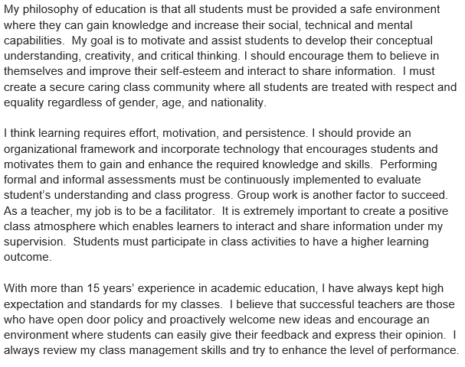
Teaching Philosophy

Slide 4
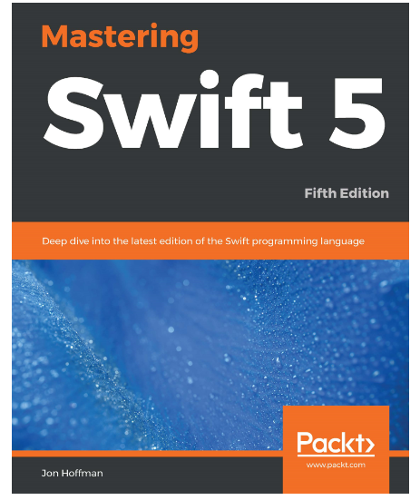
Book Title : Mastering Swift 5 Book Author : Jon Hoffman EDITION : Fifth edition

Slide 5
Other resources
Swift Programming Language Guide
Swift Programming Language Guide - Code with Chris

Slide 6
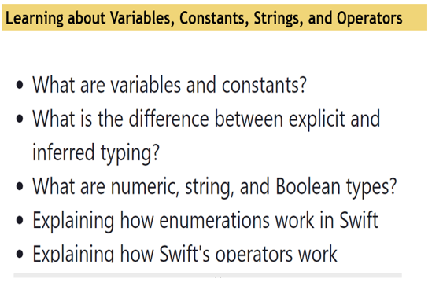
Module 1

Slide 7
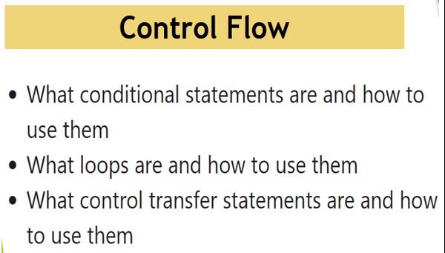
Module 2

Slide 8
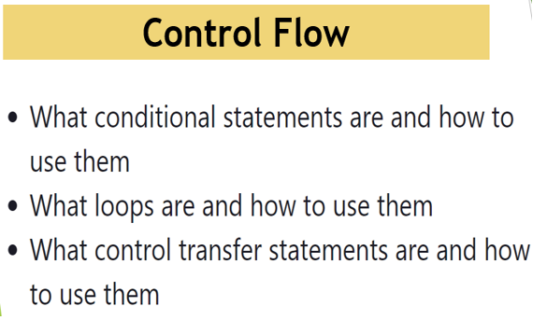
Module 3

Slide 9
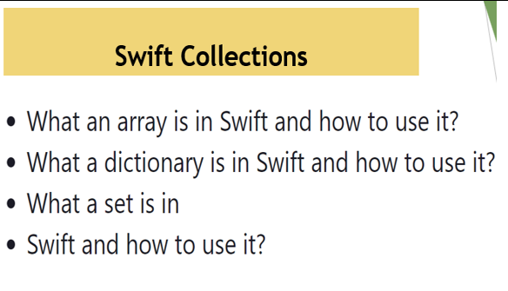
Module 4

Slide 10
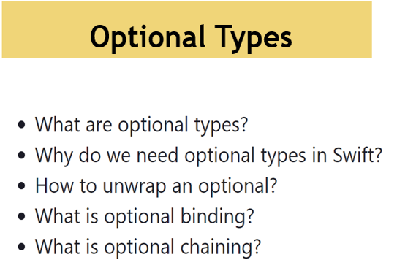
Module 5

Slide 11
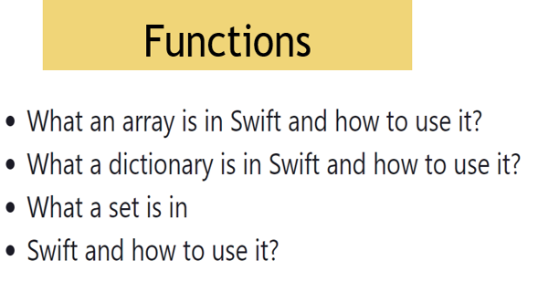
Module 6

Slide 12
BEST WISHES

