Slide 1
Computer Organization

Slide 2
Computer System
Hardware
Software

Slide 3
Computer Hardware
A typical computer system consists of the following major components:
The central processing unit (CPU)
Main memory
Secondary storage devices
Input devices
Output devices

Slide 4
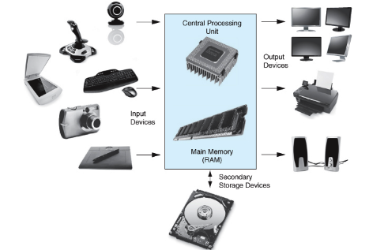
Computer Hardware

Slide 5
The organization of the CPU
Arithmetic & Logic unit (ALU)
ALU is designed to perform mathematical operations
Control
unit
COORDINATES ALL OF THE COMPUTER’S OPERATIONS

Slide 6
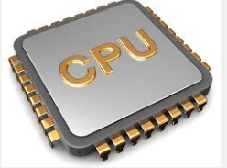
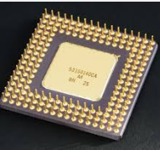
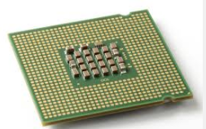
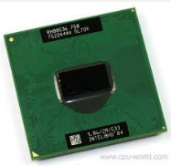
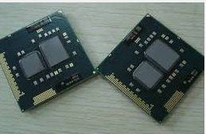
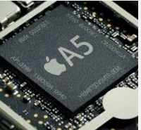
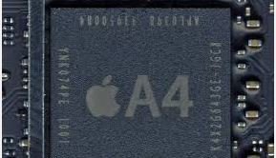
CPU images

Slide 7
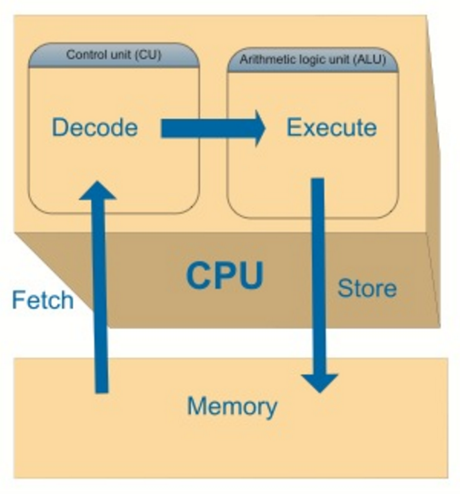
THE CPU’S JOB

Slide 8
THE CPU’S JOB
Fetch:
The CPU’s control unit fetches, from main memory, the next instruction in the sequence of program instructions
CPU
RAM

Slide 9
THE CPU’S JOB
Decode:
The instruction in encoded in the form of a number. The control unit decodes the instruction and generates an electronic signal

Slide 10
The job CPU
Execute:
The signal is routed to the appropriate component of the computer (such as the ALU, a disk drive, or some other device). The signal causes the component to perform an operation
DISK DRIVE
CPU
RAM

Slide 11
Computer internal memory
RAM (Random Access memory)
ROM (Read only memory)
Cache memory

Slide 12
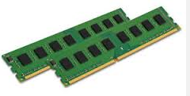
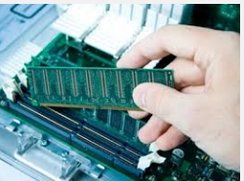
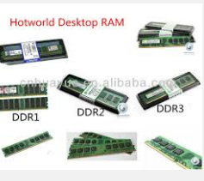
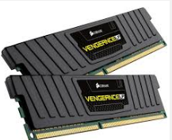
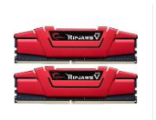
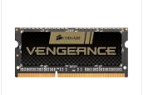
RAM

Slide 13
RAM
RAM (Random Access Memory) is a device that holds information
RAM holds the sequence of instructions in the programs that are running and the data those programs are using

Slide 14
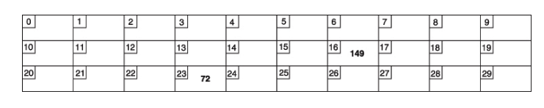
RAM
Main memory is an ordered sequence of cells, called memory cells
Each cell has a unique location in main memory, called the address of the cell
When the computer is turned off, RAM loses its data

Slide 15
Memory capacity
Prefix | Symbol | Exponential | Numeric | Binary | Decimal value
Kilo | K | 10^3 | 1,000 | 2^10 | 1024
Mega | M | 10^6 | 1,000,000 | 2^20 | 1,048,576
Giga | G | 10^9 | 1,000,000,000 | 2^30 | 1,073,741,824
Tera | T | 10^12 | 1,000,000,000,000 | 2^40 | 1,099,511,627,776
Peta | P | 10^15 | 1,000,000,000,000,000 | 2^50
Exa | E | 10^18 | 1,000,000,000,000,000,000 | 2^60
Zatta | Z | 10^21 | 1,000,000,000,000,000,000,000 | 2^70
Yotta | Y | 10^24 | 1,000,000,000,000,000,000,000,000 | 2^80

Slide 16
Binary Number System
Byte
7 | 6 | 5 | 4 | 3 | 2 | 1 | 0
2^7 | 2^6 | 2^5 | 2^4 | 2^3 | 2^2 | 2^1 | 2^0
128 | 64 | 32 | 16 | 8 | 4 | 2 | 1

Slide 17
Bit VS Byte
Bits are used to measure data transfer speed rate as Internet connection (Example: 25Mbps)
Bytes are used to measure file size and storage capacity (Example: 2GB)

Slide 18
DDR2 VS DDR3 VS DDR4 RAM
Feature | DDR2 | DDR3 | DDR4
TRANSFER RATE | 400 MB/S – 1066 MB/S | 800MB/S-2133MB/S | 1600MB/S-3200MB/S
MEMORY DENSITY |  | 512MB – 8GB | 2GB – 16GB
VOLTAGE | 1.8 VOLTS | 1.5 BOLTS

Slide 19
Secondary storage devices
Hard disk drive (HDD) (External & Internal)
Magnetic HDD
Solid State Drive (SSD)
Hybrid HDD
DVD
Blu Ray
Flash Memory

Slide 20
Magnetic HDD VS SSD
HDD VS SSD

Slide 21
USB PORTS

Slide 22
HDMI PORT

Slide 23
CELLULAR NETWORT
Type | Speed Rate
3G | 144 Kbps - 400 Kbps
4G | 5 Mbps - 12 Mbps

Slide 24
Character representations in memory
Character | ASCII (IN DECIMAL) | UNICODE (IN DECIMAL) | BINARY CODE
# | 35 | 35 | 00100011
$ | 36 | 36 | 00100100
0 | 48 | 48 | 00110000
1 | 49 | 49 | 00110001
A | 65 | 65 | 01000001
B | 66 | 66 | 01000010
a | 97 | 97 | 01100001
b | 98 | 98 | 01100010

Slide 25
SATA Explanation - Ports, Cables, Controllers, Motherboards
SATA and IDE cables

Slide 26
Numbering systems
Decimal (0 … 9)10
Binary (0 … 1)2
Hexadecimal (0 … 9, A, B, C, D, E, F)16
(0 … 9,10,11,12,13,14,15)16
Octal (0 … 7)8

Slide 27
Hexadecimal Number System
Byte
First digit | Second digit
7 | 6 | 5 | 4 | 3 | 2 | 1 | 0
8 | 4 | 2 | 1 | 8 | 4 | 2 | 1
2^3 | 2^2 | 2^1 | 2^0 | 2^3 | 2^2 | 2^1 | 2^0
3 |  |  |  | 3

Slide 28
Octal Number System
Byte
First digit | Second digit | Third digit
2 Bit | 3 Bit | 3 Bit
7 | 6 | 5 | 4 | 3 | 2 | 1 | 0
2 | 1 | 4 | 2 | 1 | 4 | 2 | 1
2^1 | 2^0 | 2^2 | 2^1 | 2^0 | 2^2 | 2^1 | 2^0
2 |  | 5 |  |  | 6
1 | 0 | 1 | 0 | 1 | 1 | 1 | 0

Slide 29
Computer Software
Operating System software
Application software

Slide 30
Operating System software
Windows
OS X operating system (MAC computers)
Linux
UNIX

Slide 31
Operating System software difference
Security
Stable
User friendly
Ease of use
Multimedia capabilities

