Slide 1
SWIFT LANGUAGE
Variables & Constants

Slide 2
Constants and Variables
Constants and variables associate a name
(such as maximumNumberOfLoginAttempts or welcomeMessage)
with a value of a particular type (such as the number 10 or the string "Hello").
The value of a constant can’t be changed once it’s set, whereas a variable can be set to a different value in the future

Slide 3
Floating-Point Numbers
To represent a number that has a decimal point, like 3.2, you use a floating-point number
Swift has two basic floating-point number types:
Float, which is a 32-bit floating-point number
Double, which is a 64-bit floating-point number
The default inferred type for floating-point numbers in Swift is Double

Slide 4
Declaring floating-point number constants
let d1 = 1.1 // Implicitly Double
let d2: Double = 1.1
let f1: Float = 100.3

Slide 5
Declaring floating-point number types
var gpa:Float
var salary:Double

Slide 6
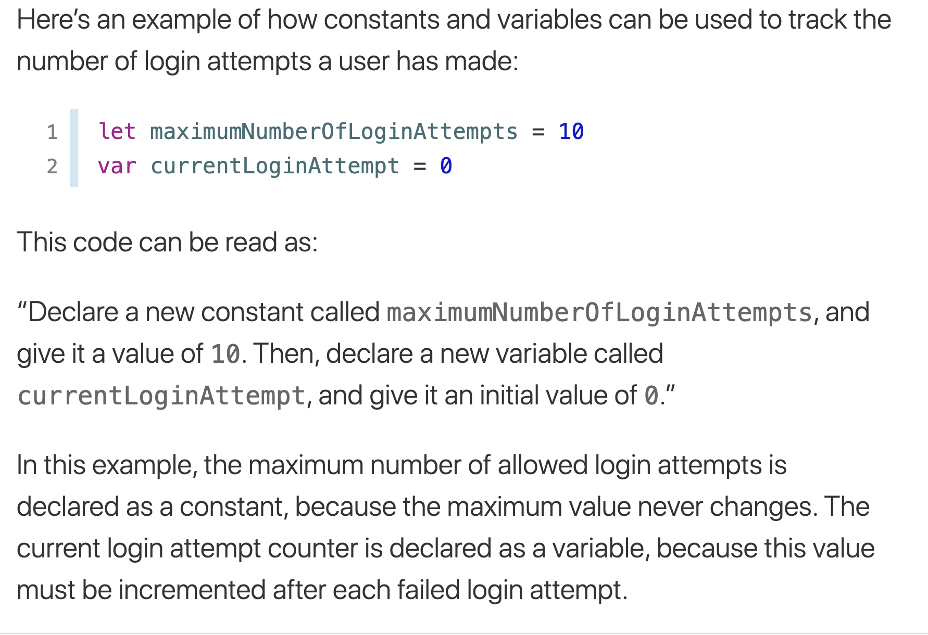
Declaring Constants and Variables
Constants and variables must be declared before they’re used.
You declare constants with the let keyword and variables with the var keyword.

Slide 7
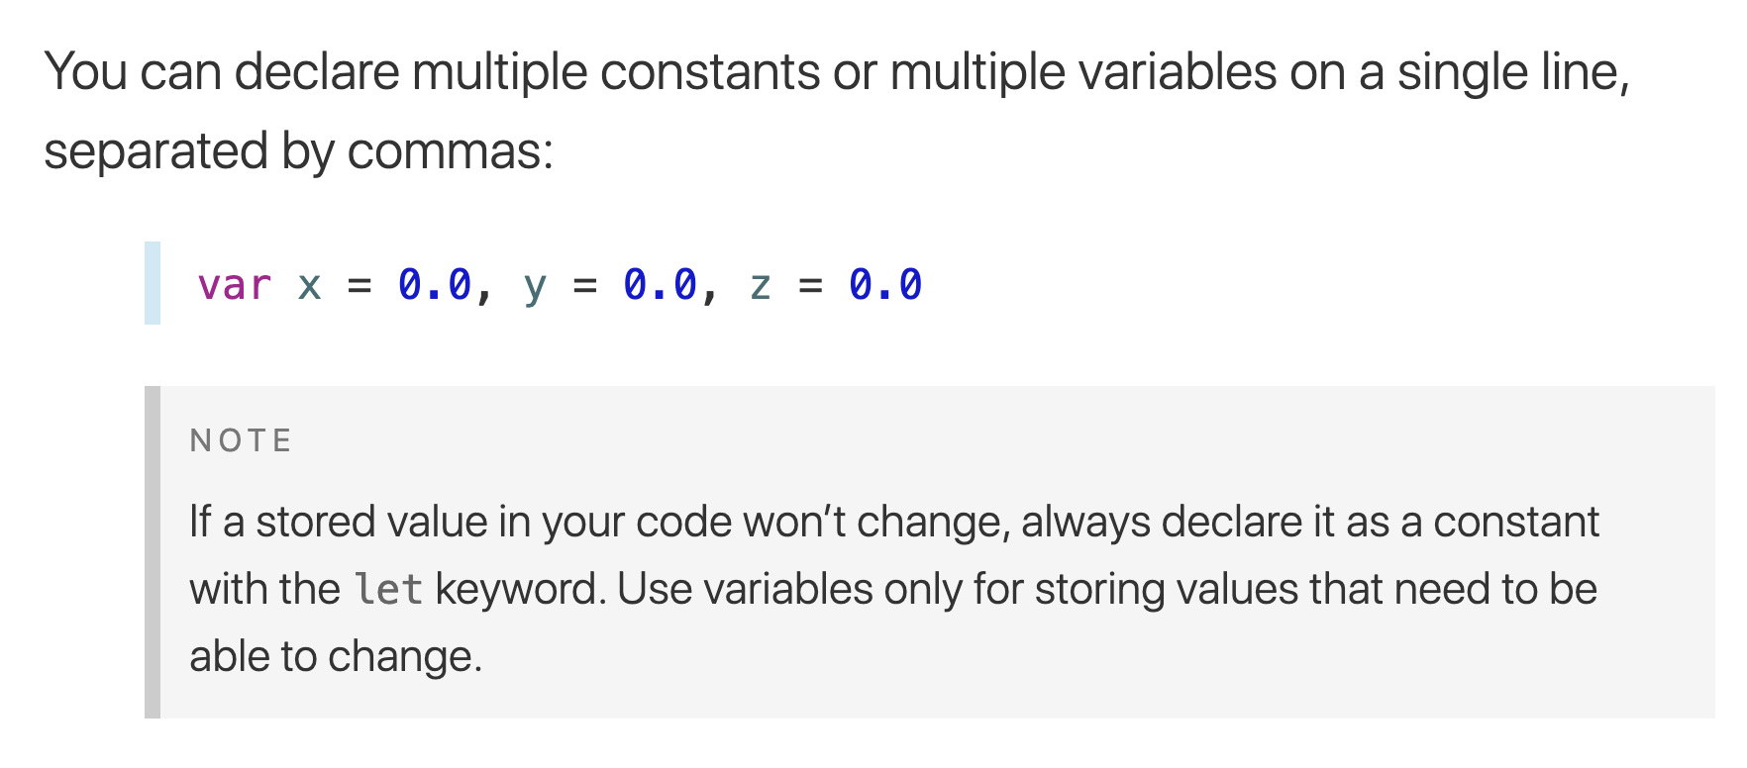
Declaring declare multiple constants or multiple variables on a single line

Slide 8
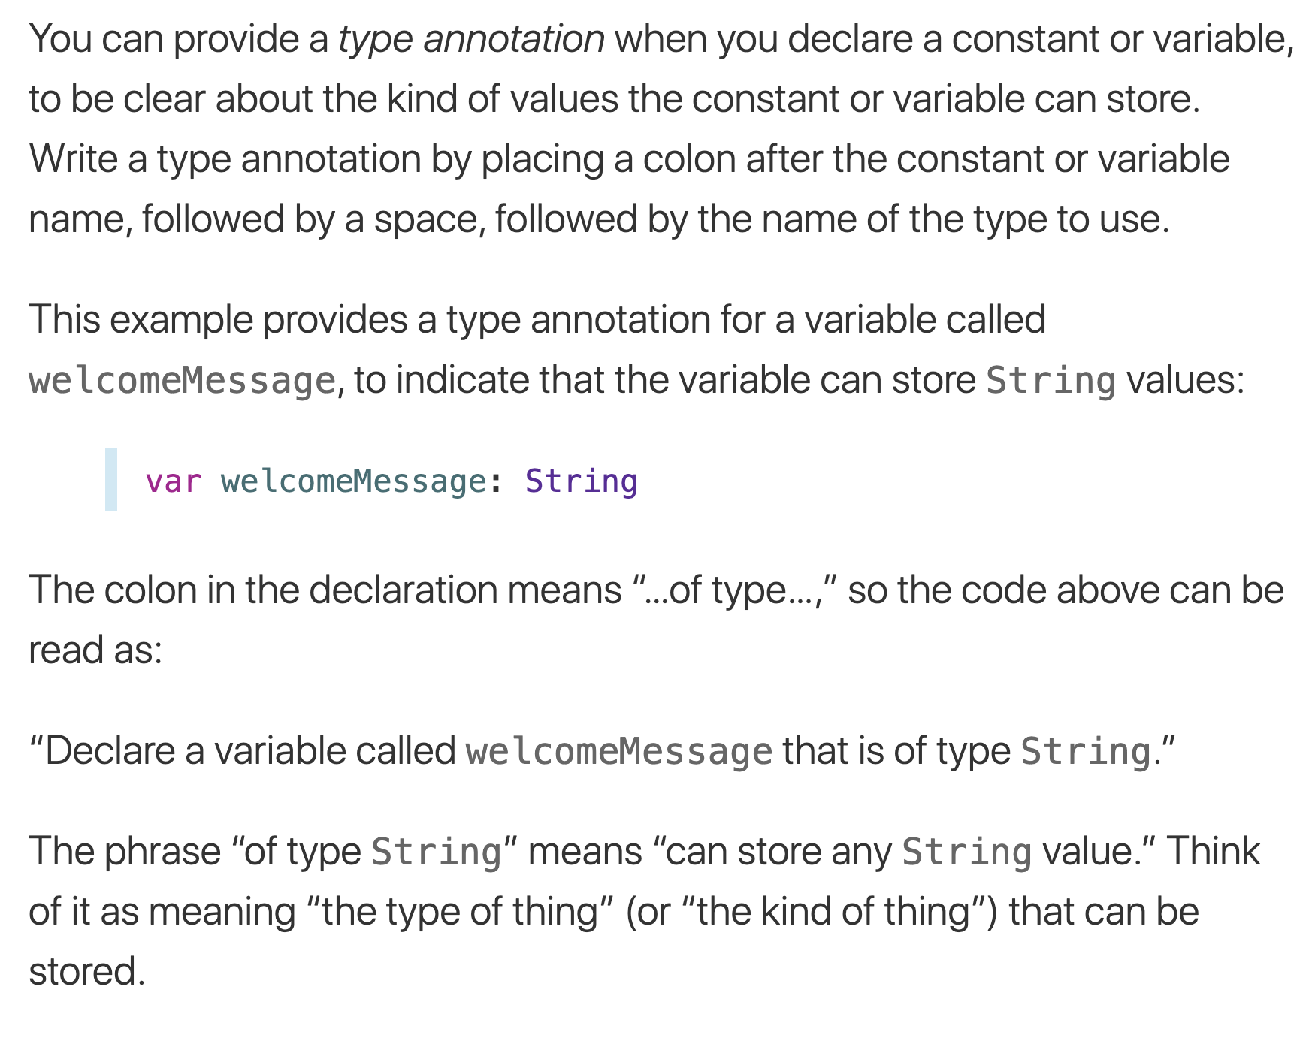
Type Annotations

Slide 9
Naming Constants and Variables
Constant and variable names can contain almost any character, including Unicode characters
Constant and variable names can’t contain whitespace characters, mathematical symbols, arrows, private-use Unicode scalar values, or line- and box-drawing characters.
Nor can they begin with a number, although numbers may be included elsewhere within the name

Slide 10
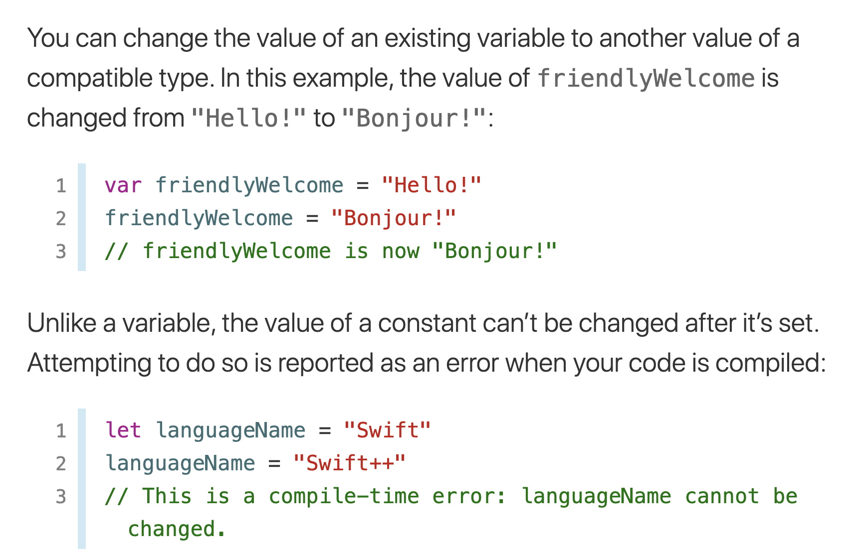
Naming Constants and Variables

Slide 11
Comments
Use comments to include nonexecutable text in your code, as a note or reminder to yourself.
Comments are ignored by the Swift compiler when your code is compiled
comments begin with two forward-slashes (//):
// This is a comment.
Multiline comments start with a forward-slash followed by an asterisk (/*) and end with an asterisk followed by a forward-slash (*/):
/*
This is also a comment
but is written over multiple lines.
*/

Slide 12
Numeric Literals
Integer literals can be written as:
A decimal number, with no prefix
A binary number, with a 0b prefix
An octal number, with a 0o prefix
A hexadecimal number, with a 0x prefix
All of these integer literals have a decimal value of 17:
let decimalInteger = 17
let binaryInteger = 0b10001 // 17 in binary notation
let octalInteger = 0o21 // 17 in octal notation
let hexadecimalInteger = 0x11 // 17 in hexadecimal notation

Slide 13
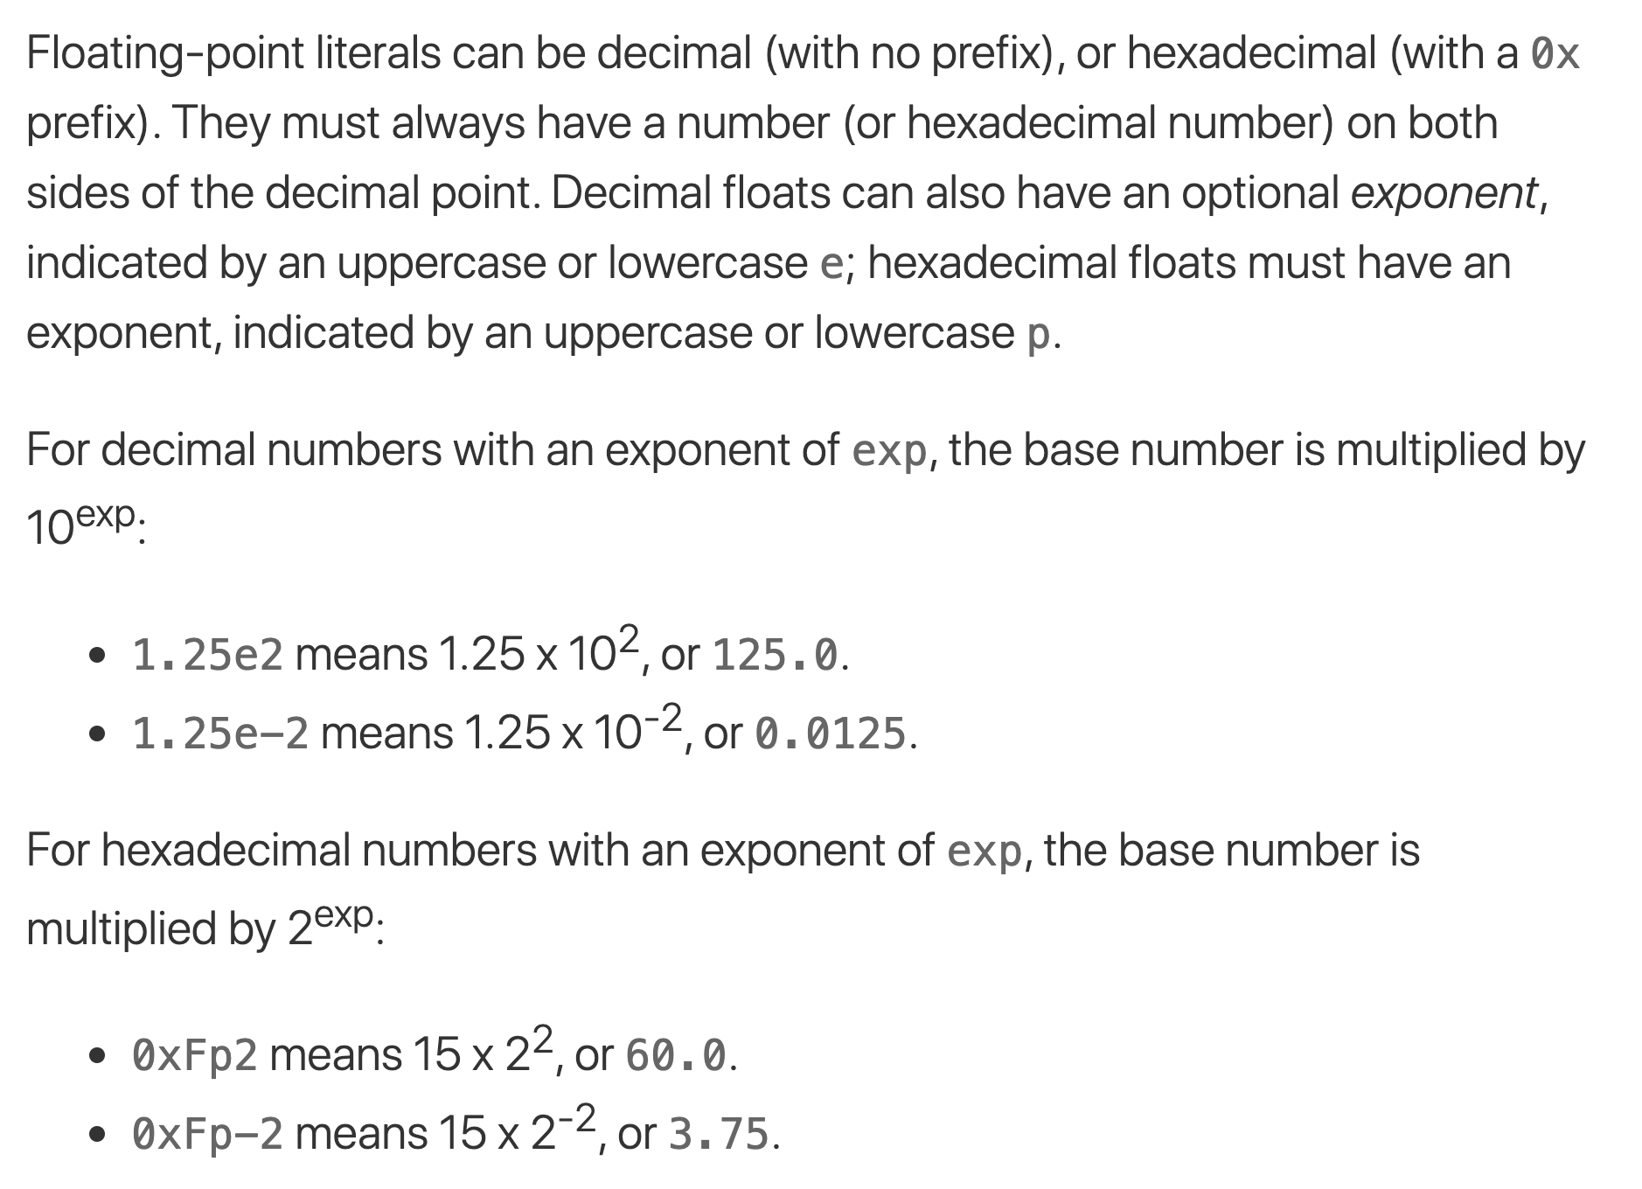
Floating-point literals

Slide 14
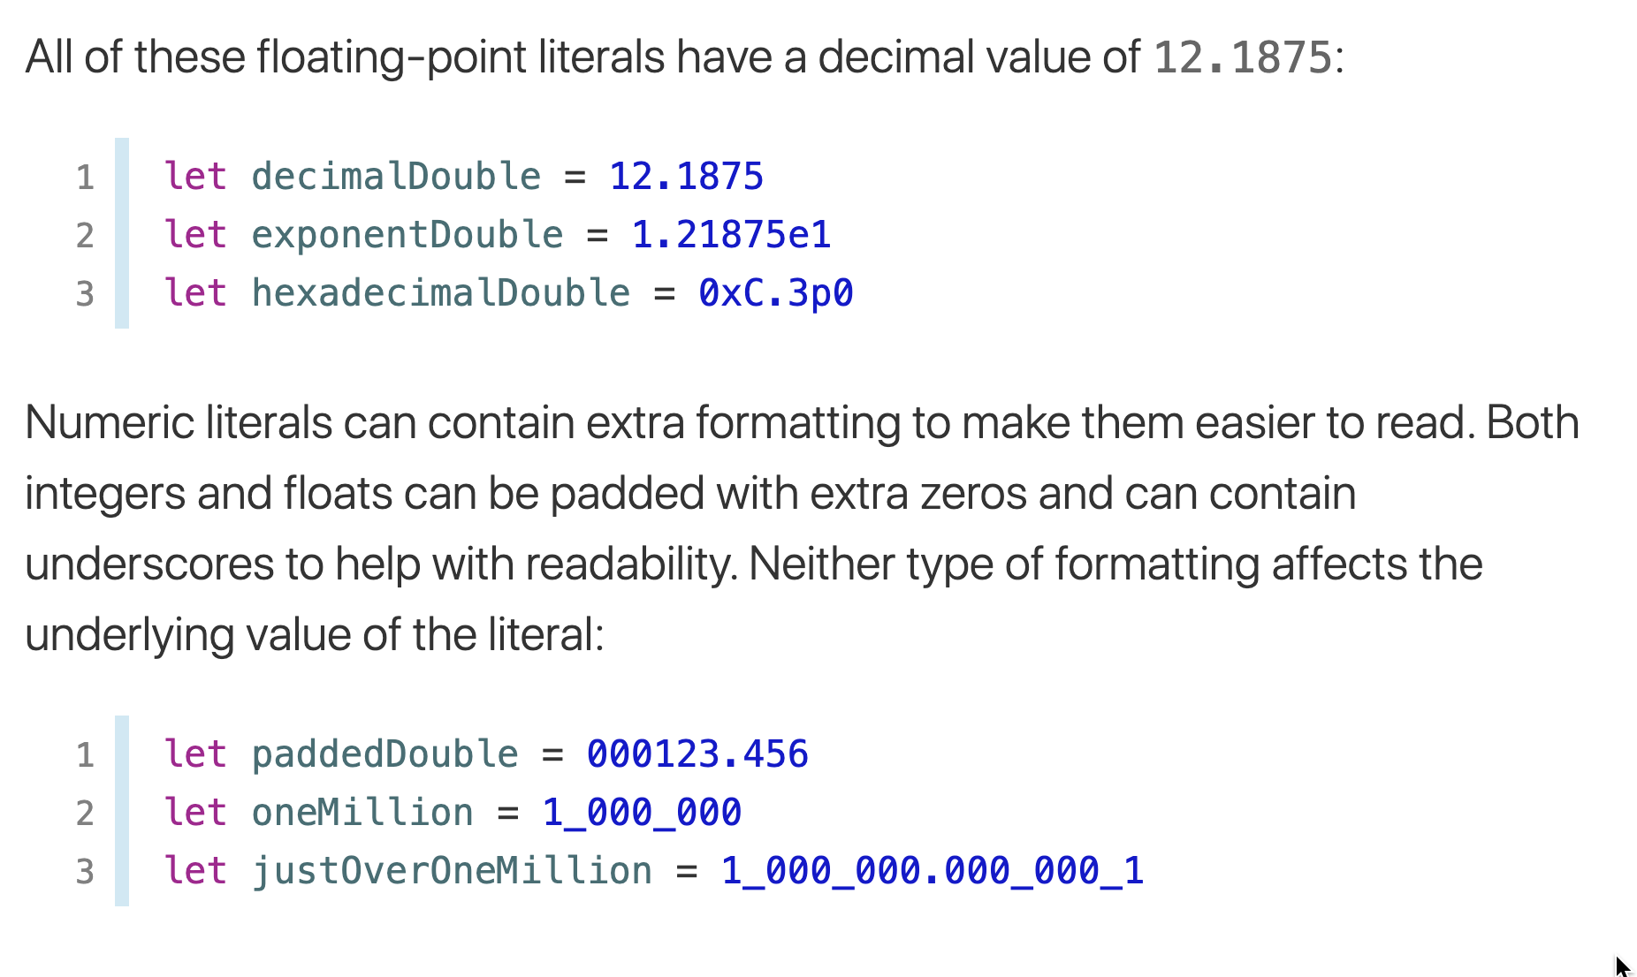
Floating-point literals

Slide 15
Booleans
Swift has a basic Boolean type, called Bool.
Boolean values are referred to as logical, because they can only ever be true or false.
Swift provides two Boolean constant values, true and false

Slide 16
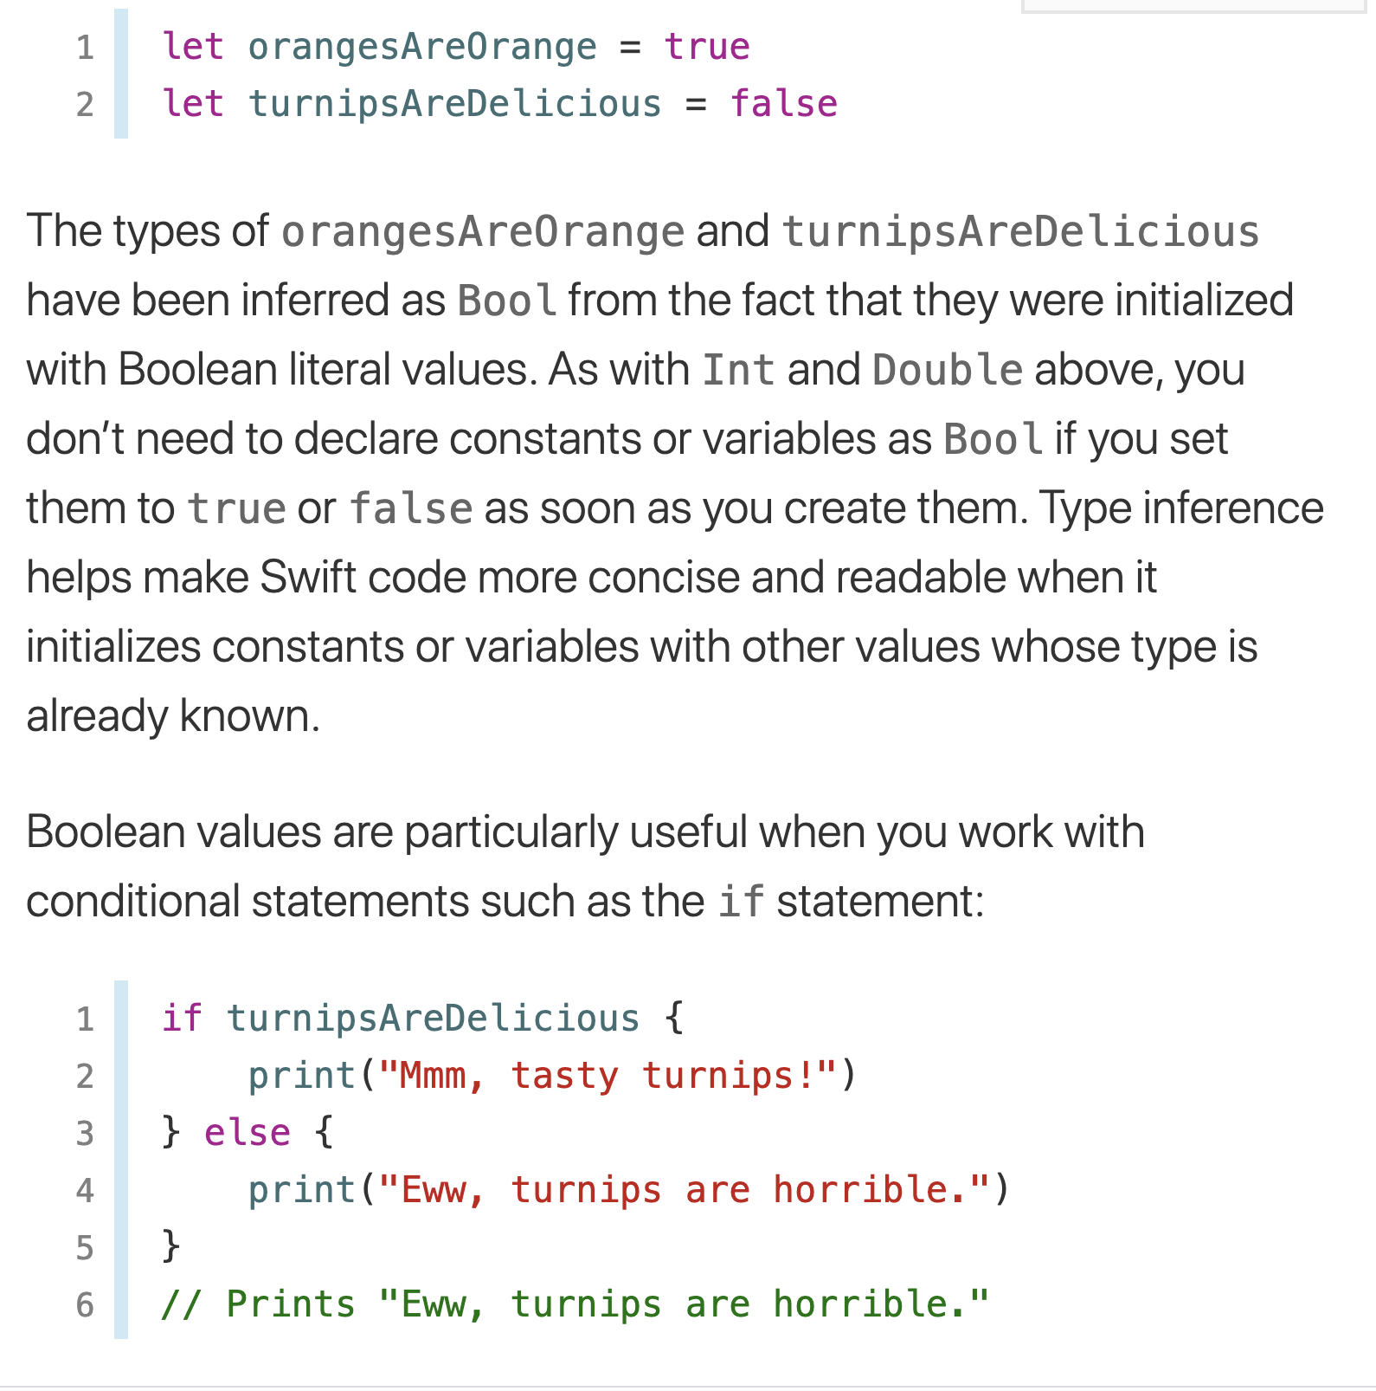
Booleans

Slide 17
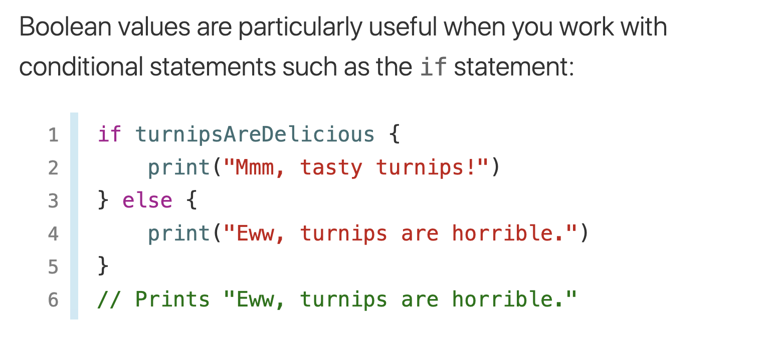
Booleans

